Slide 1
Graph based Image Segmentation
D.A. Forsyth,
University of Illinois at Urbana Champaign

Slide 2
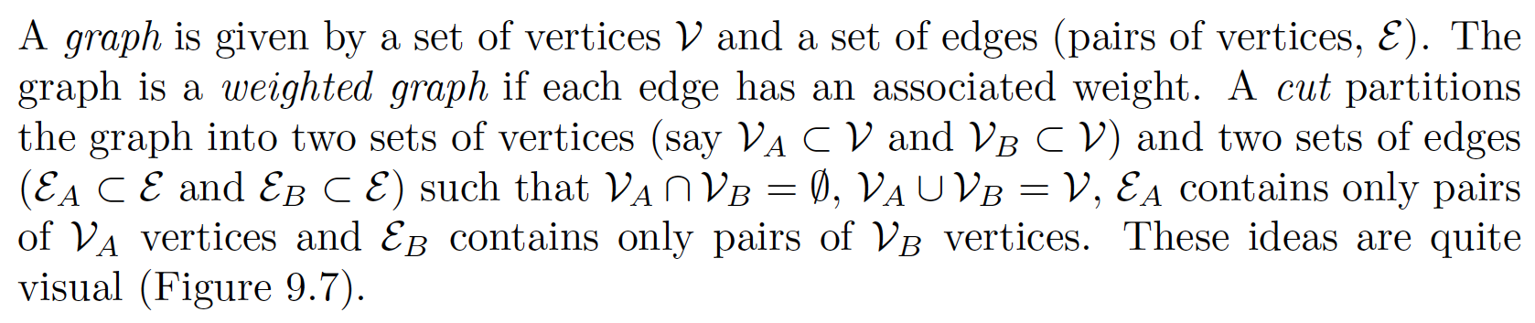
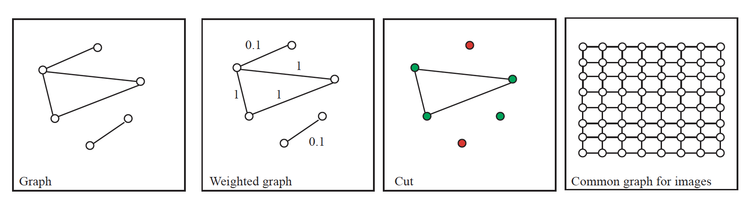
Graphs

Slide 3
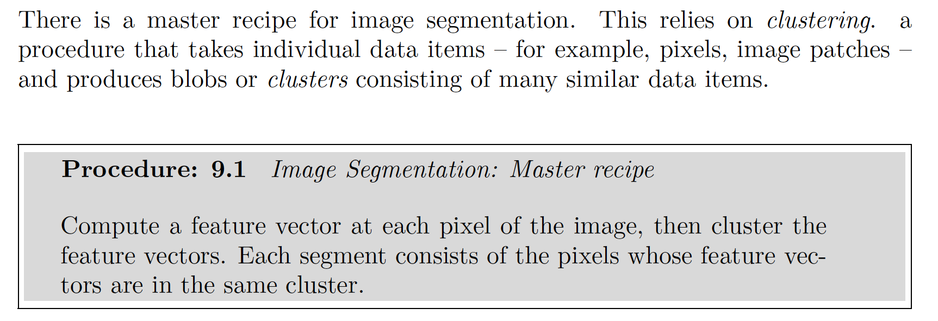
Key idea of segmentation
Break images/videos into large, useful pieces
internally coherent pieces
same color; same color and texture; etc
simplify
Identify key objects

Slide 4
Grabcut
Idea:
segment foreground from background
using rough model of appearance
ensure there are few/no isolated pixels
each pixel gets a binary variable
1 for foreground, 0 for background
build probability model of features for both
P(feats[i]|z_i=1) and P(feats[i]|z_i=0)
many methods; normal distribution is one possibility
use graph to force pixels to “be like their neighbors”

Slide 5

FG/BG only
Choose z_i to minimize:

Slide 6
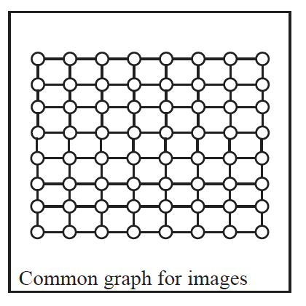
If there are edges...
z_i
z_j
Cases:
(z_i, z_j) are:
(0, 0), (1, 1) - agree, both background/foreground
(1, 0), (0, 1) - disagree

Slide 7
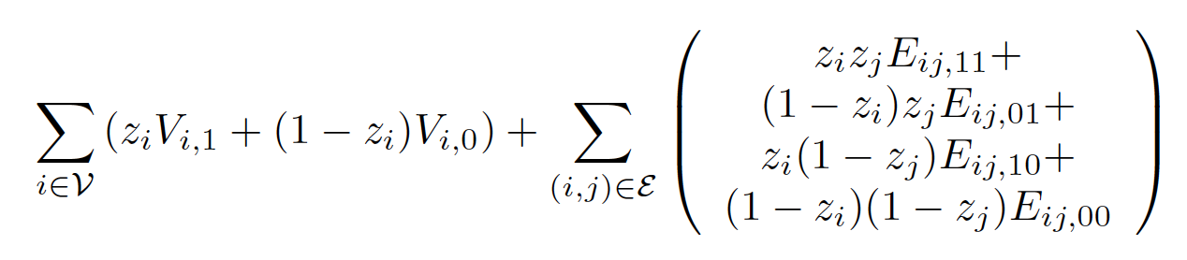
Minimize
by choice of z_i (V’s, E’s are known)
General case v. nasty
IF cheaper to agree than disagree
very fast algorithms are available (OOS)
this is the case we care about...

Slide 8
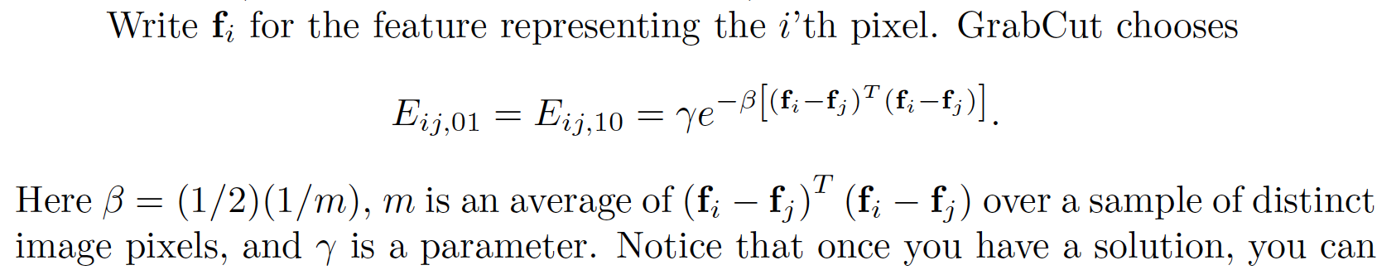
Setting up the cost function...
E_ij00=E_ij11=0
z_i neq z_j should be more expensive when their features are similar

Slide 9
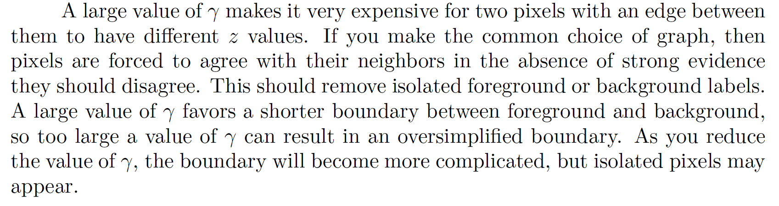
Parameter

Slide 10
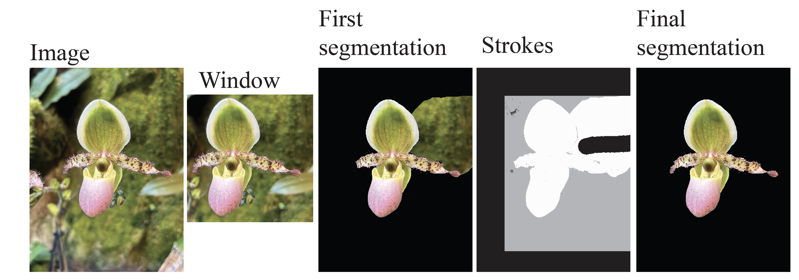
Interactive segmentation

Slide 11
More segments
GrabCut did two pieces
but needed foreground/background models
To cluster
Build an affinity matrix
represents affinity between vertices
Use this to cut graph
components should
be internally coherent (high internal affinity)
be different (low affinity across cut)

Slide 12
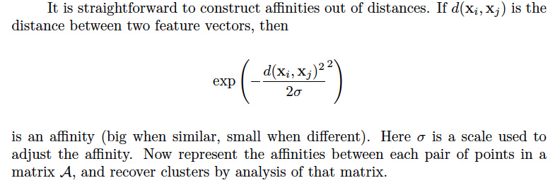
Affinity matrices
How similar is node i and node j?
typically each node is a pixel
large number – very similar
small number – very different
Common case:
use distances

Slide 13
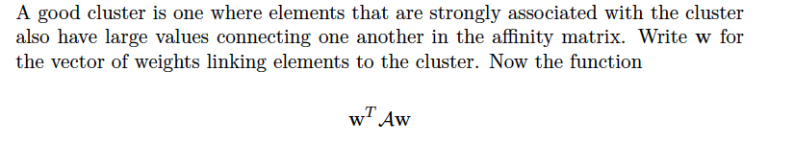
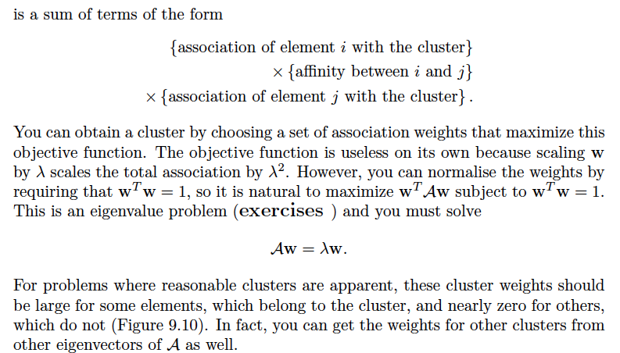
The simplest clustering...

Slide 14
Eigenvectors are natural
They’re permutation covariant

Slide 15
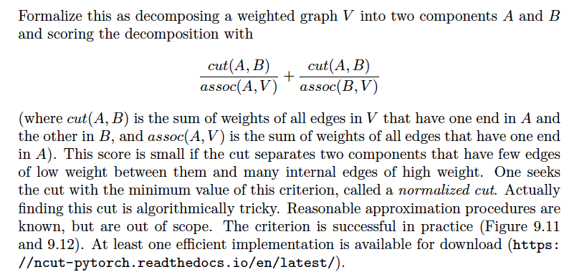
Normalized cuts

Slide 16
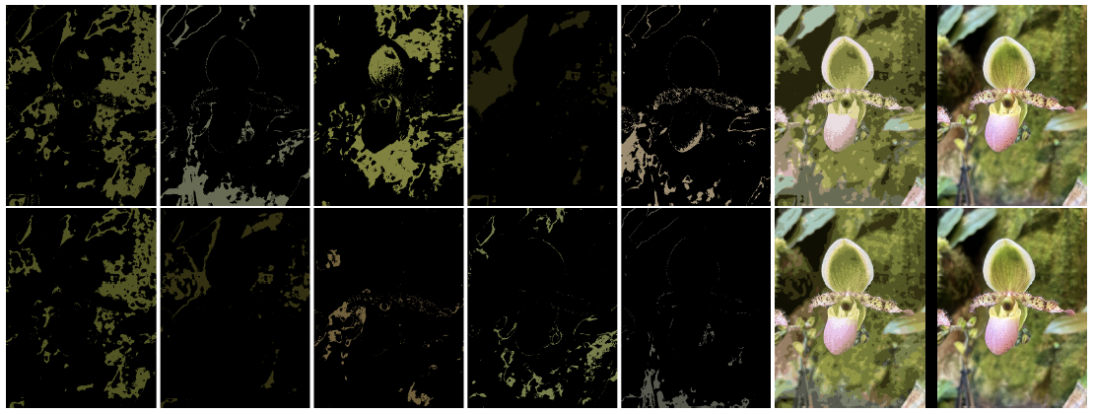
Normalized cut segmentations
k=10
k=30

Slide 17
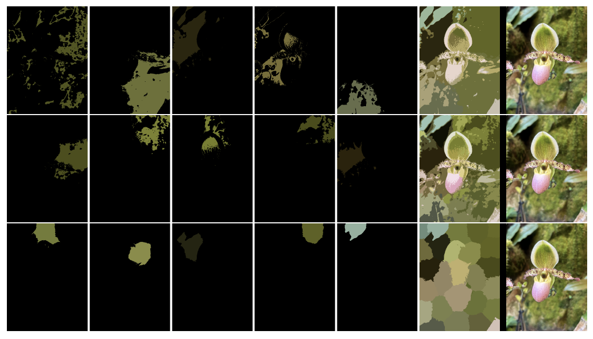
Normalized cut segmentations
k=10, height=1
k=30, height=1
k=30, height=10

Slide 18
Evaluating segmentations
Compare to human segmentations of scenes
Detailed comparison requires care
humans don’t always agree
boundaries may not be on exactly the right spot
There is now an established procedure (notes)

Slide 19
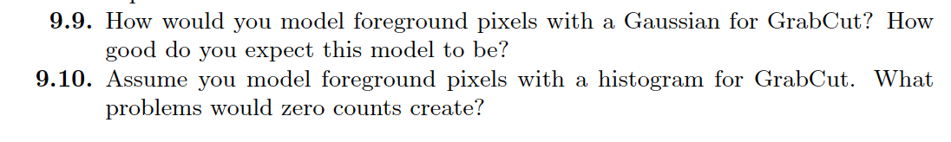

Things to think about

