Slide 1
Homogenous Coordinates
D.A. Forsyth
University of Illinois at Urbana Champaign

Slide 2

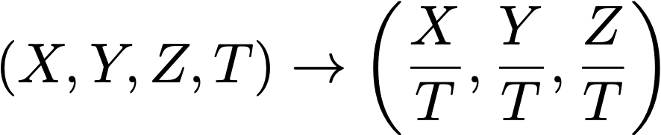
Homogeneous coordinates
Add an extra coordinate and use an equivalence relation
for 2D
  equivalence relation
  k*(X,Y,Z) is the same as (X,Y,Z)
for 3D
  equivalence relation
  k*(X,Y,Z,T) is the same as (X,Y,Z,T)
“Ordinary” or “non-homogeneous” coordinates
  properly called affine coordinates
  in 3D, affine -> homogeneous
  in 3D, homogeneous to affine

Slide 3


Homogeneous coordinates
Notice (0, 0, 0, 0) is meaningless (HC’s for 3D)
  also (0, 0, 0) in 2D
Basic notion
  Possible to represent points “at infinity” by careful use of zero
  Where parallel lines intersect
    eg
  Where parallel planes intersect (etc)
Can write the action of a perspective camera as a matrix
and
intersect at

Slide 4
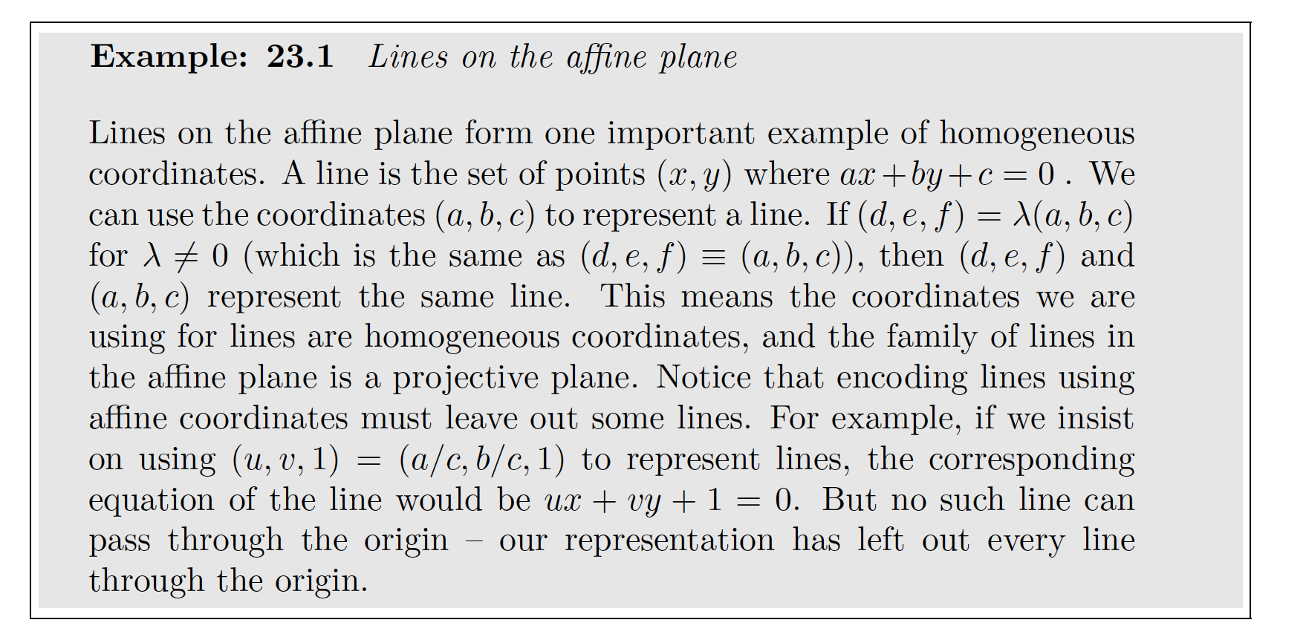
Homogeneous coordinates

Slide 5
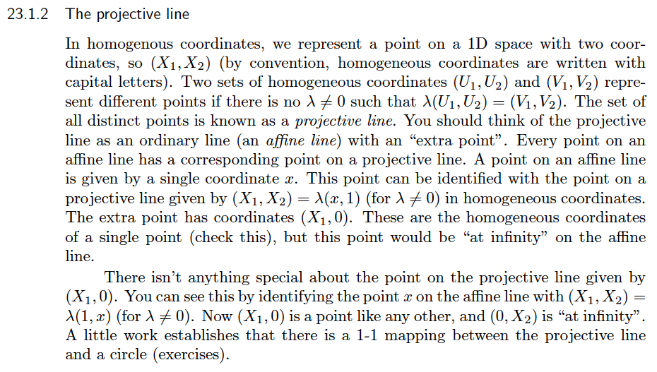
Homogeneous coordinates for a line

Slide 6
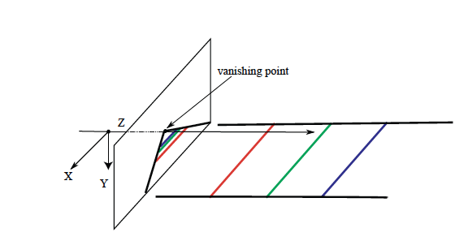
You can see the point at infinity

Slide 7
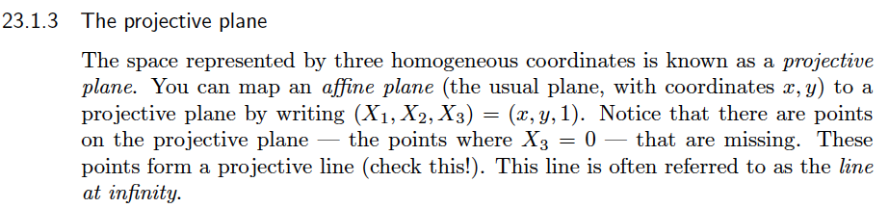
Homogeneous coordinates for the plane

Slide 8
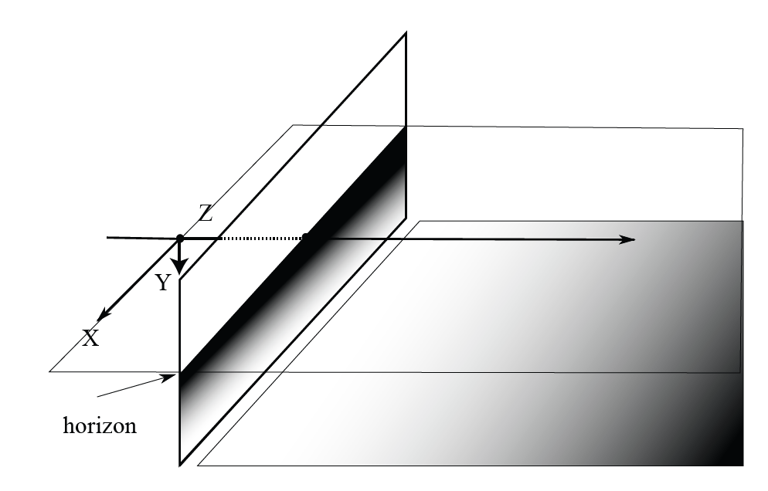
You can see the line at infinity, too!

Slide 9
Main issues
Keep track of coordinates you’re working in
  or else...
Transforming is easy
  in 3D, affine -> homogeneous
  in 3D, homogeneous to affine
HC’s account for observable phenomena
  point at infinity
  line at infinity, etc.
Remember dividing by zero annoys computers

