Slide 1
Image Classification
D.A. Forsyth
University of Illinois at Urbana Champaign

Slide 2
Core idea
Label image by:
  Insert image into encoder
  apply multiclass classifier
Variants:
  complexity and training process for encoder
  how encoder is trained
    using labels from your dataset is one of many options
  what kinds of label are predicted
Right now, one label for the image
  but the label might have quite complex structure...

Slide 3
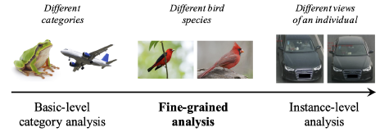
Types of label
Image credit: Figure 3 of Fine-Grained Image Analysis with Deep Learning: A Survey

Slide 4
Types of label: category
predict the category of the “main object”

Slide 5
Types of label: attribute
A.Farhadi, I. Endres, D. Hoiem, D.A. Forsyth, “Describing objects by their attributes”, CVPR 2009

Slide 6
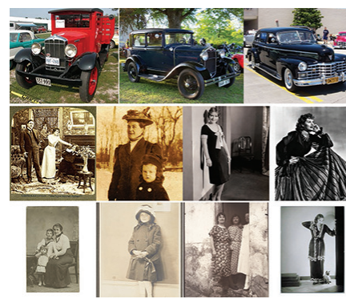
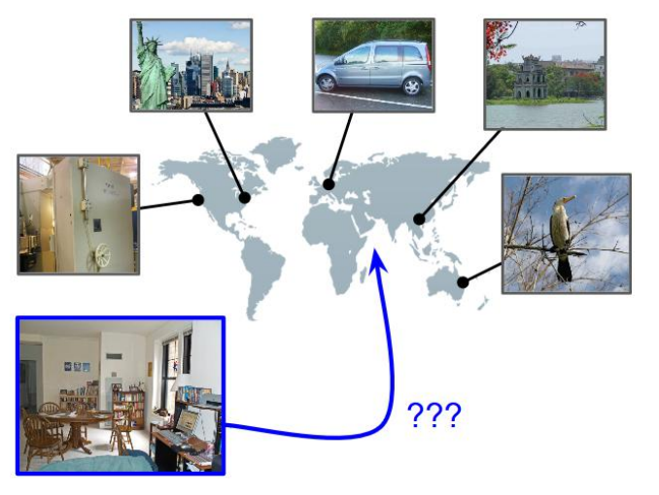
Other types of label...
Date prediction
Vo et al. (2017)
Vittayakorn et al. (2017)

Slide 7
The encoder
Architectures
  ResNet
  Transformer
  Something else
Training
  Labels only
  Pretrained and fine-tune

Slide 8
Recipes for cases
Cheap and cheerful
  obtain small encoder
    likely, small ResNet, possibly pre-trained on ImageNet
  Train this on your labels
    possibly fine-tuning encoder
      small learning rate for encoder, bigger for linear classifier
Luxury high performance
  obtain large encoder
    very likely transformer, heavily pretrained
  fine-tune on your labels
Large specialized
  eg fine-grained recognition
  architectures and processes quite varied

Slide 9
Pretraining with labels
Procedure:
  minimize loss by descent
    rich collection of training tricks, can’t do here
      multi-GPU training; managing batch sizes; learning rate schedules;etc, etc.
ImageNet
  the Big Beast
    1000 categories, millions of training images
  BUT
    categories might not line up with what you want
    there are always more unlabelled than labelled images
TinyImageNet
  200 classes, 100K images, smaller images

Slide 10
Pretraining without labels
Strategies:
  Predicting location
  Inpainting
  Contrastive learning

Slide 11
Predicting location
Idea:
  if you can predict relative location of two patches
    you must have a good image encoding
Procedure:
  pass reference, query patch through encoder
  predict location of query wrt reference using discriminator
    manage a number of effects that lead to trivial solutions
      chromatic aberration, etc.

Slide 12
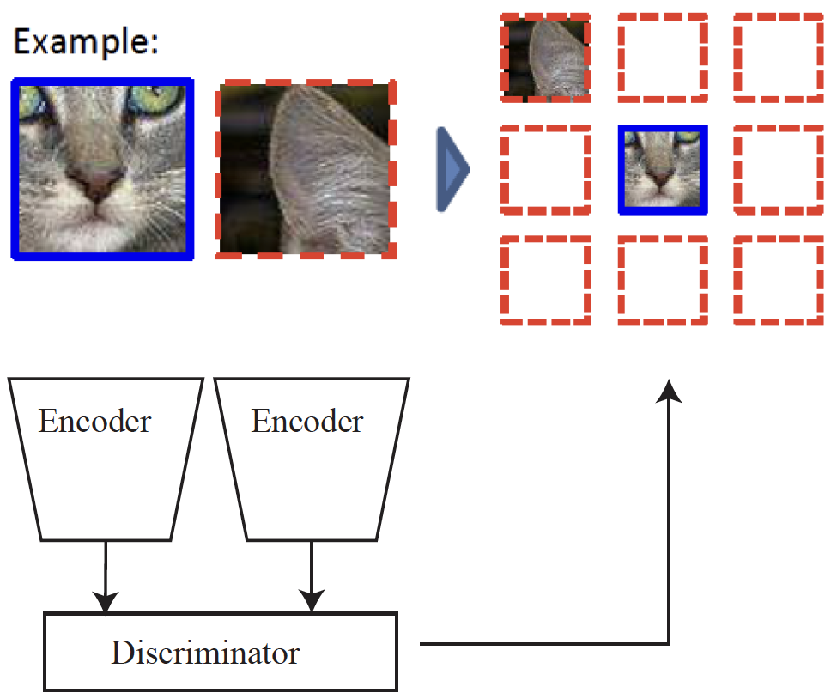
Predicting location
Part of Fig1 of Unsupervised Visual Representation Learning by Context Prediction

Slide 13
Masked autoencoder
Knock out high percentage of image patches
  masked image
train encoder/decoder to predict
  image from masked image
  drop decoder, keep encoder
This requires a strong (transformer) encoder

Slide 14
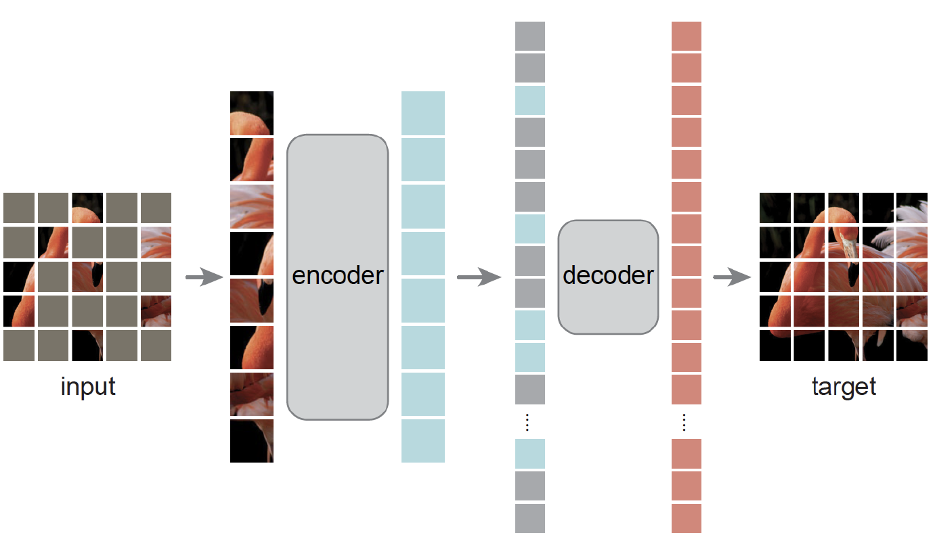
Masked autoencoder
Figure 1 from Masked Autoencoders Are Scalable Vision Learners

Slide 15
Pretraining: contrastive learning
An encoder yields an image embedding
  for this, use embeddings on to unit sphere
Contrastive learning
  (one of many variants!)
  Exploit data augmentation
    take image and
      crop+resize; adjust colormap; etc
    Adjust encoder so that
      encode(A) and encode( augment(A)) are close
      Images spread out
        encode(A) and encode(B) are far
        which is why we need the sphere

Slide 16
Fine-grained recognition
Applications:
  identify birds
  identify animals
  identify parts
  etc.
General issue:
  some categories are very similar
  may need to know where to look to find the difference

Slide 17
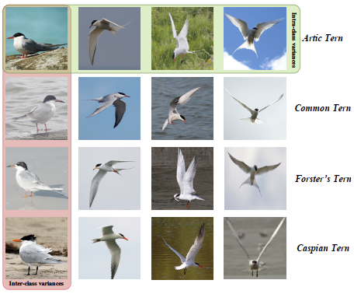
Fine grained category recognition
within class variation
between class variation
Image credit: Figure 4 of Fine-Grained Image Analysis with Deep Learning: A Survey

Slide 18
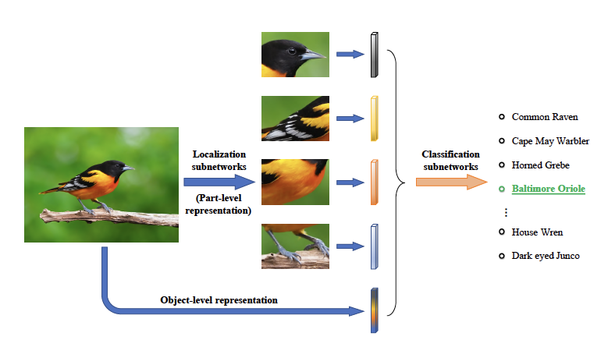
Strategy: localize then describe
Issue:
  fierce demands on labelled data
Image credit: Figure 8 of Fine-Grained Image Analysis with Deep Learning: A Survey

Slide 19
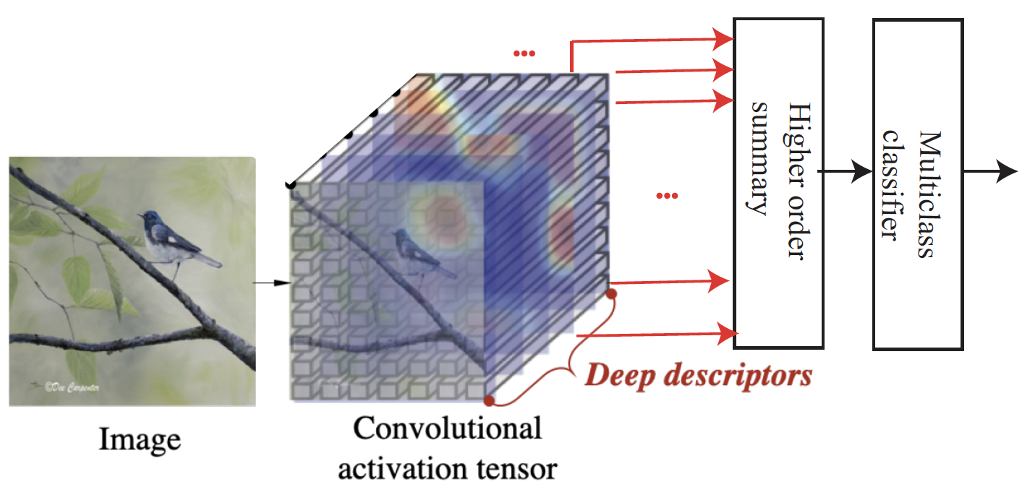
Strategy: higher order features
For example, covariance of deep feature vectors
Image credit: uses Fig 9 of Fine-Grained Image Analysis with Deep Learning: A Survey

Slide 20
SOTA - rough summary
Very high accuracy with 1000’s of classes
  Using
    very deep residual networks
    alternative feature construction methods
Challenges
  tough with little training data
    use a pretrained encoder and a classifier
    link to language (later)
  sufficient change in dataset presents problems

