Slide 1
Inpainting using patches
D.A. Forsyth
University of Illinois at Urbana Champaign

Slide 2
Another property of images
They’re built out of patches that tend to repeat
So there is often a patch some distance away that looks like the patch you’re looking at
even for quite big patches

Slide 3
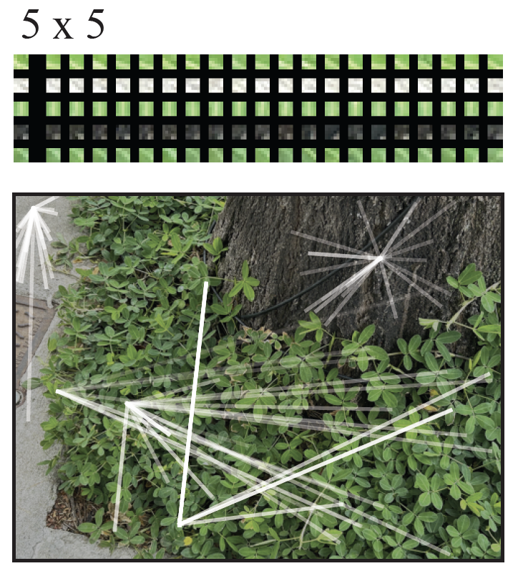
Denoising images using patches
Images tend to be made of repeating
patches

Slide 4
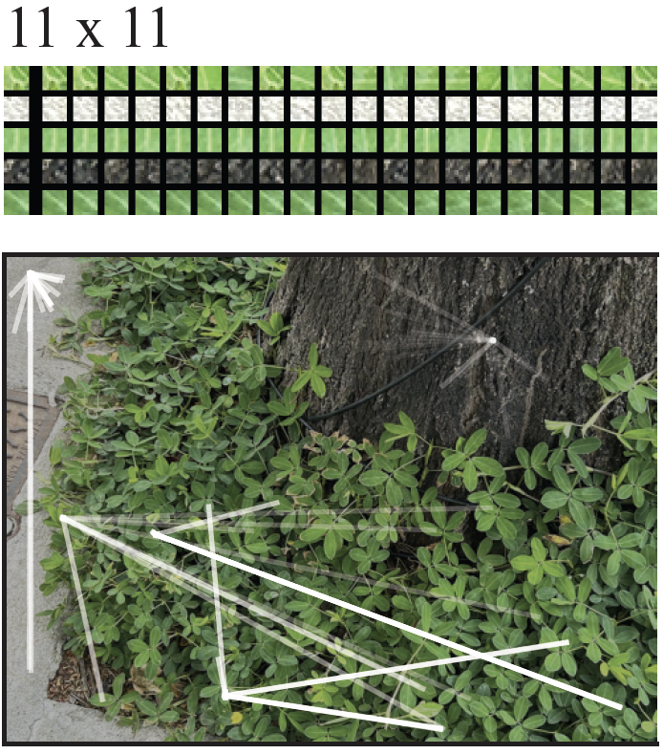
Denoising images using patches
Images tend to be made of repeating
patches
This is true even for quite big
(so quite distinctive)
patches

Slide 5
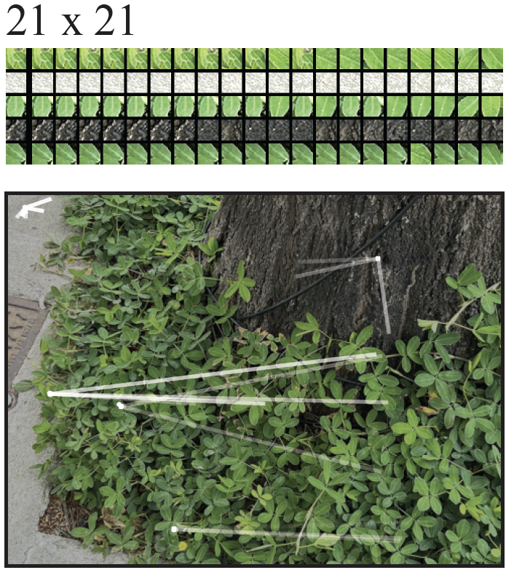
Denoising images using patches
Images tend to be made of repeating
patches
This is true even for quite big
(so quite distinctive)
patches

Slide 6
Inpainting
Simplest case:
some fraction of pixels has been “knocked out” at random
(perhaps set to zero)
and you know which pixels
Fix:
take window around knocked out pixel
find closest match in the image
take the center pixel from matching window

Slide 7
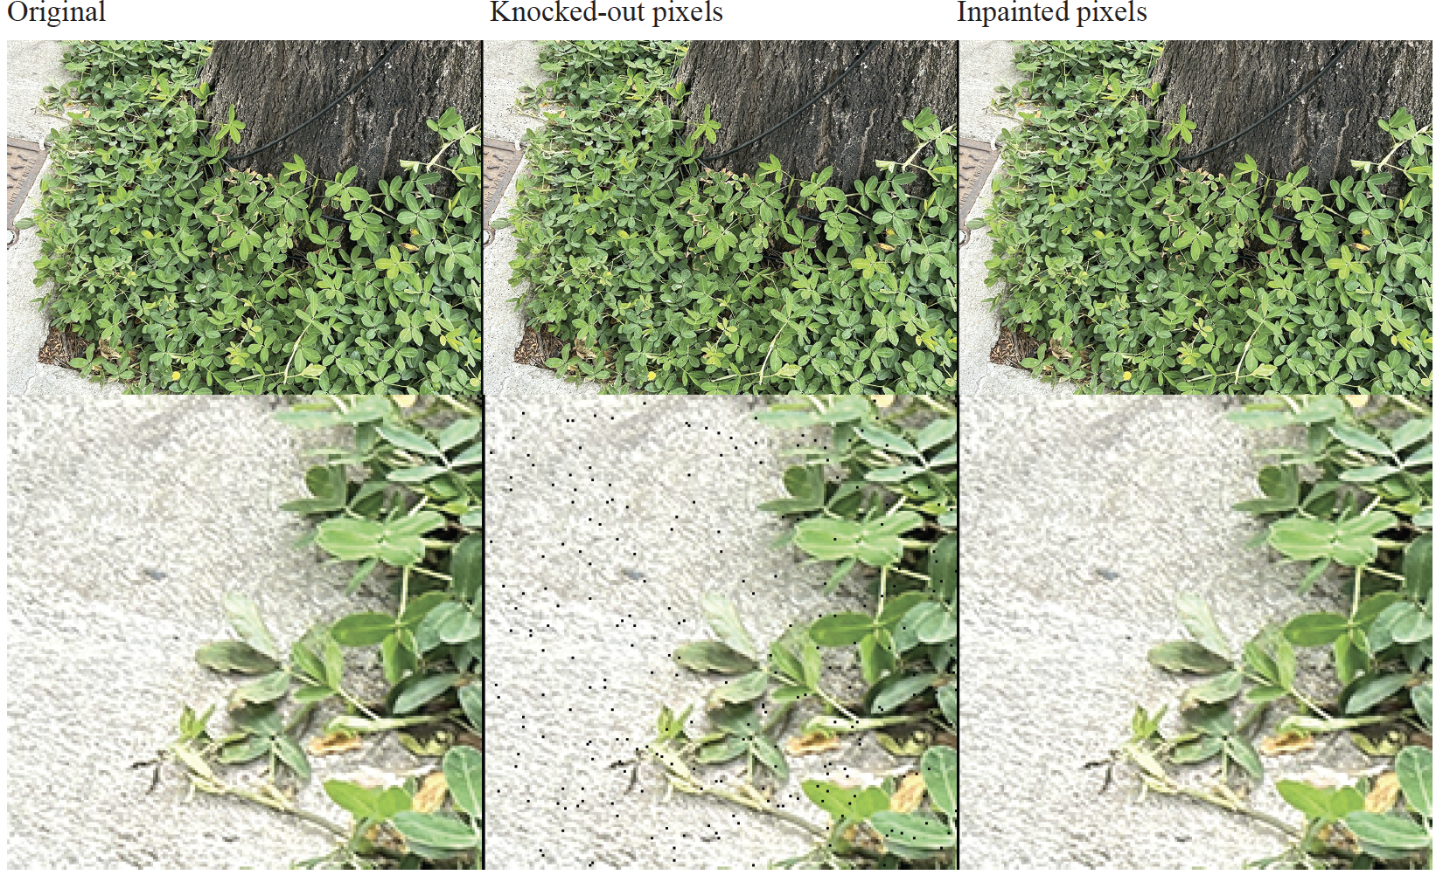

Slide 8
Inpainting for bigger knockouts
Assume a kxk window gets ”knocked out” (k small, but k>1)
Procedure works if you are careful about matching
- eg don’t match to windows that have knocked out pixels

Slide 9
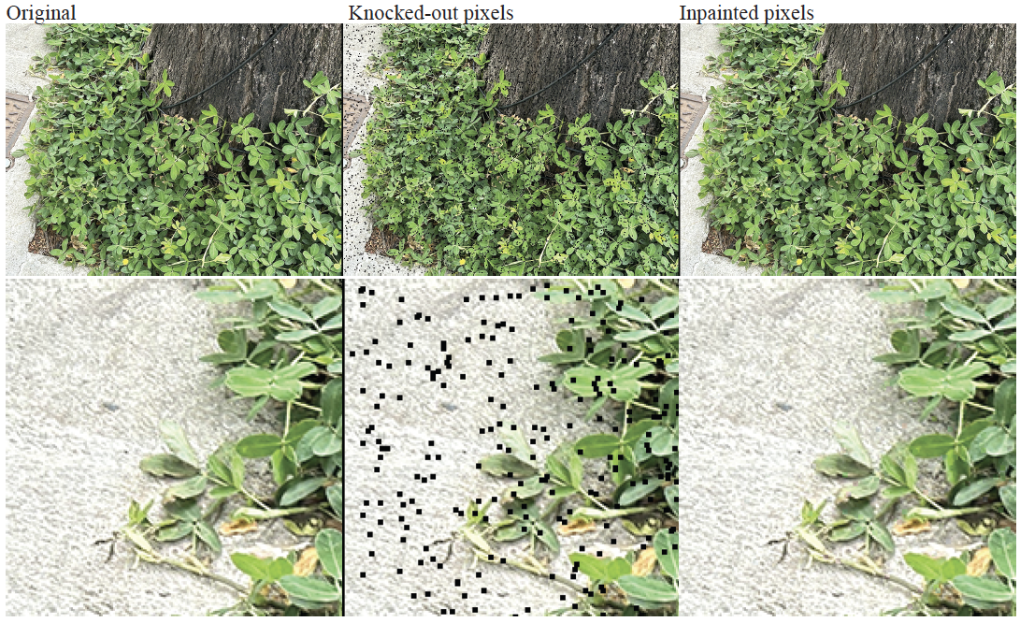

Slide 10
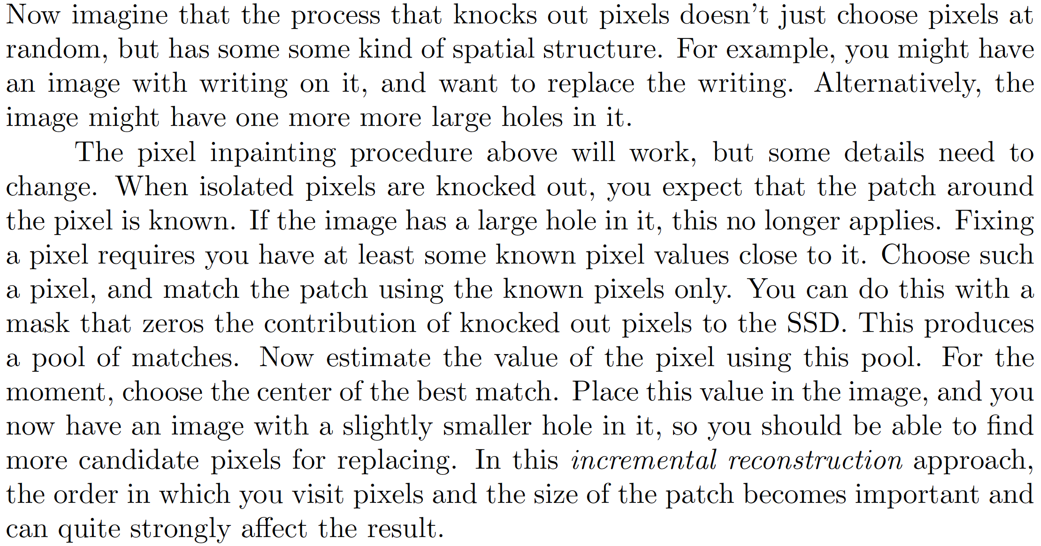
Incremental inpainting

Slide 11
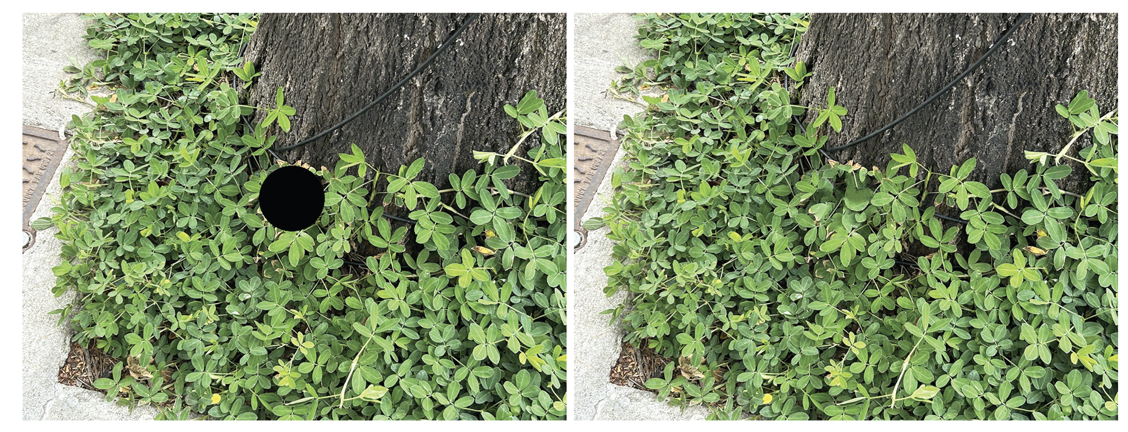

Slide 12
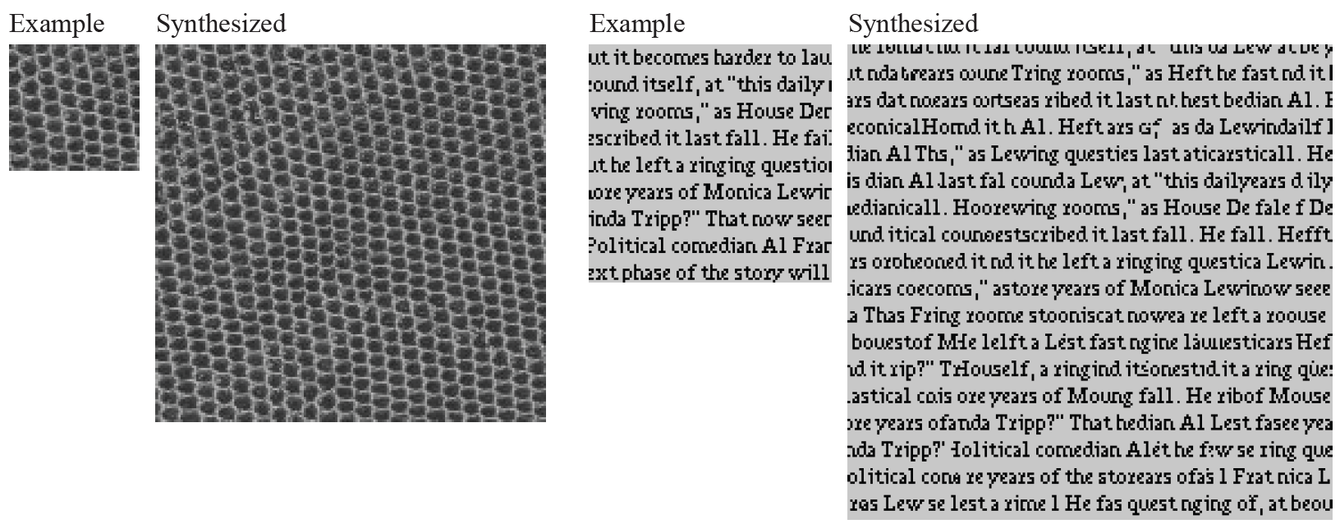
Incremental inpainting makes big images from small

Slide 13
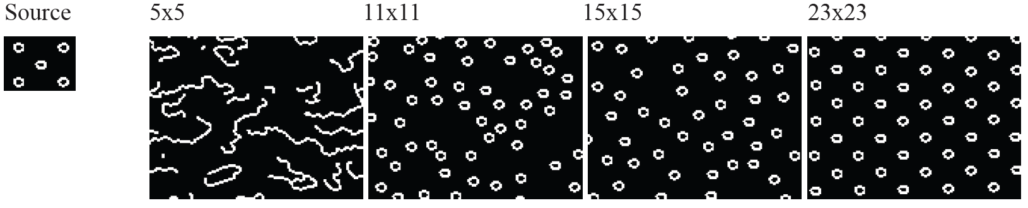
The size of the patch matters

Slide 14
But this is a weird noise model…
You *know* which pixels are wrong
What about additive gaussian noise?
The principle here is that there are other patches in the image that are “like” the patch you are interested in
Idea – estimate pixel value using
a weighted sum *over all patches* weighted by similarity
of patch to neighborhood around pixel

Slide 15
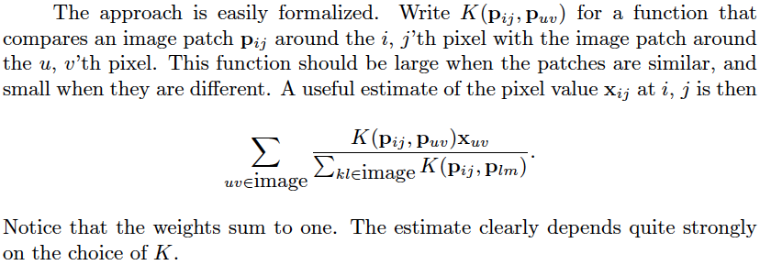
Non-local means

Slide 16
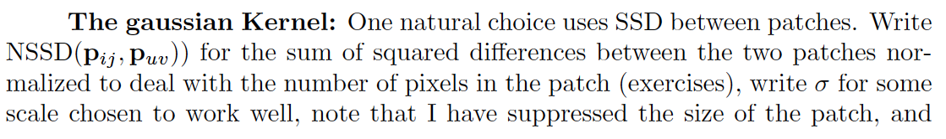
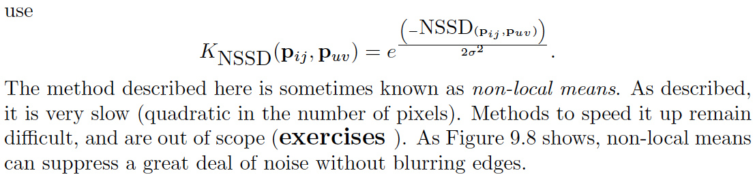

Slide 17
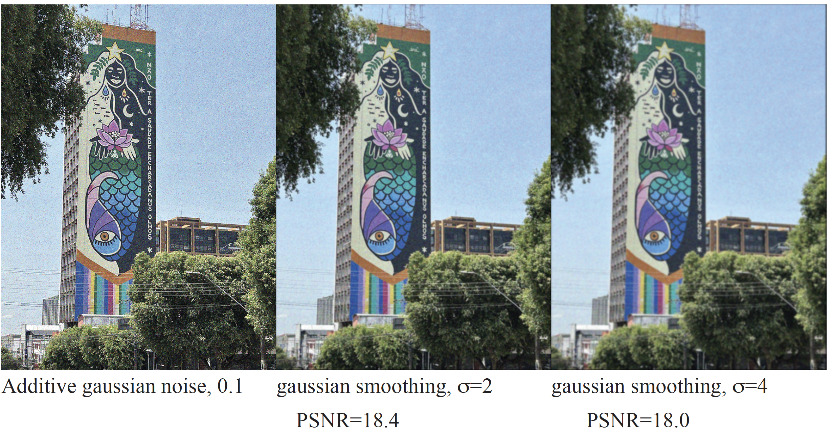

Slide 18
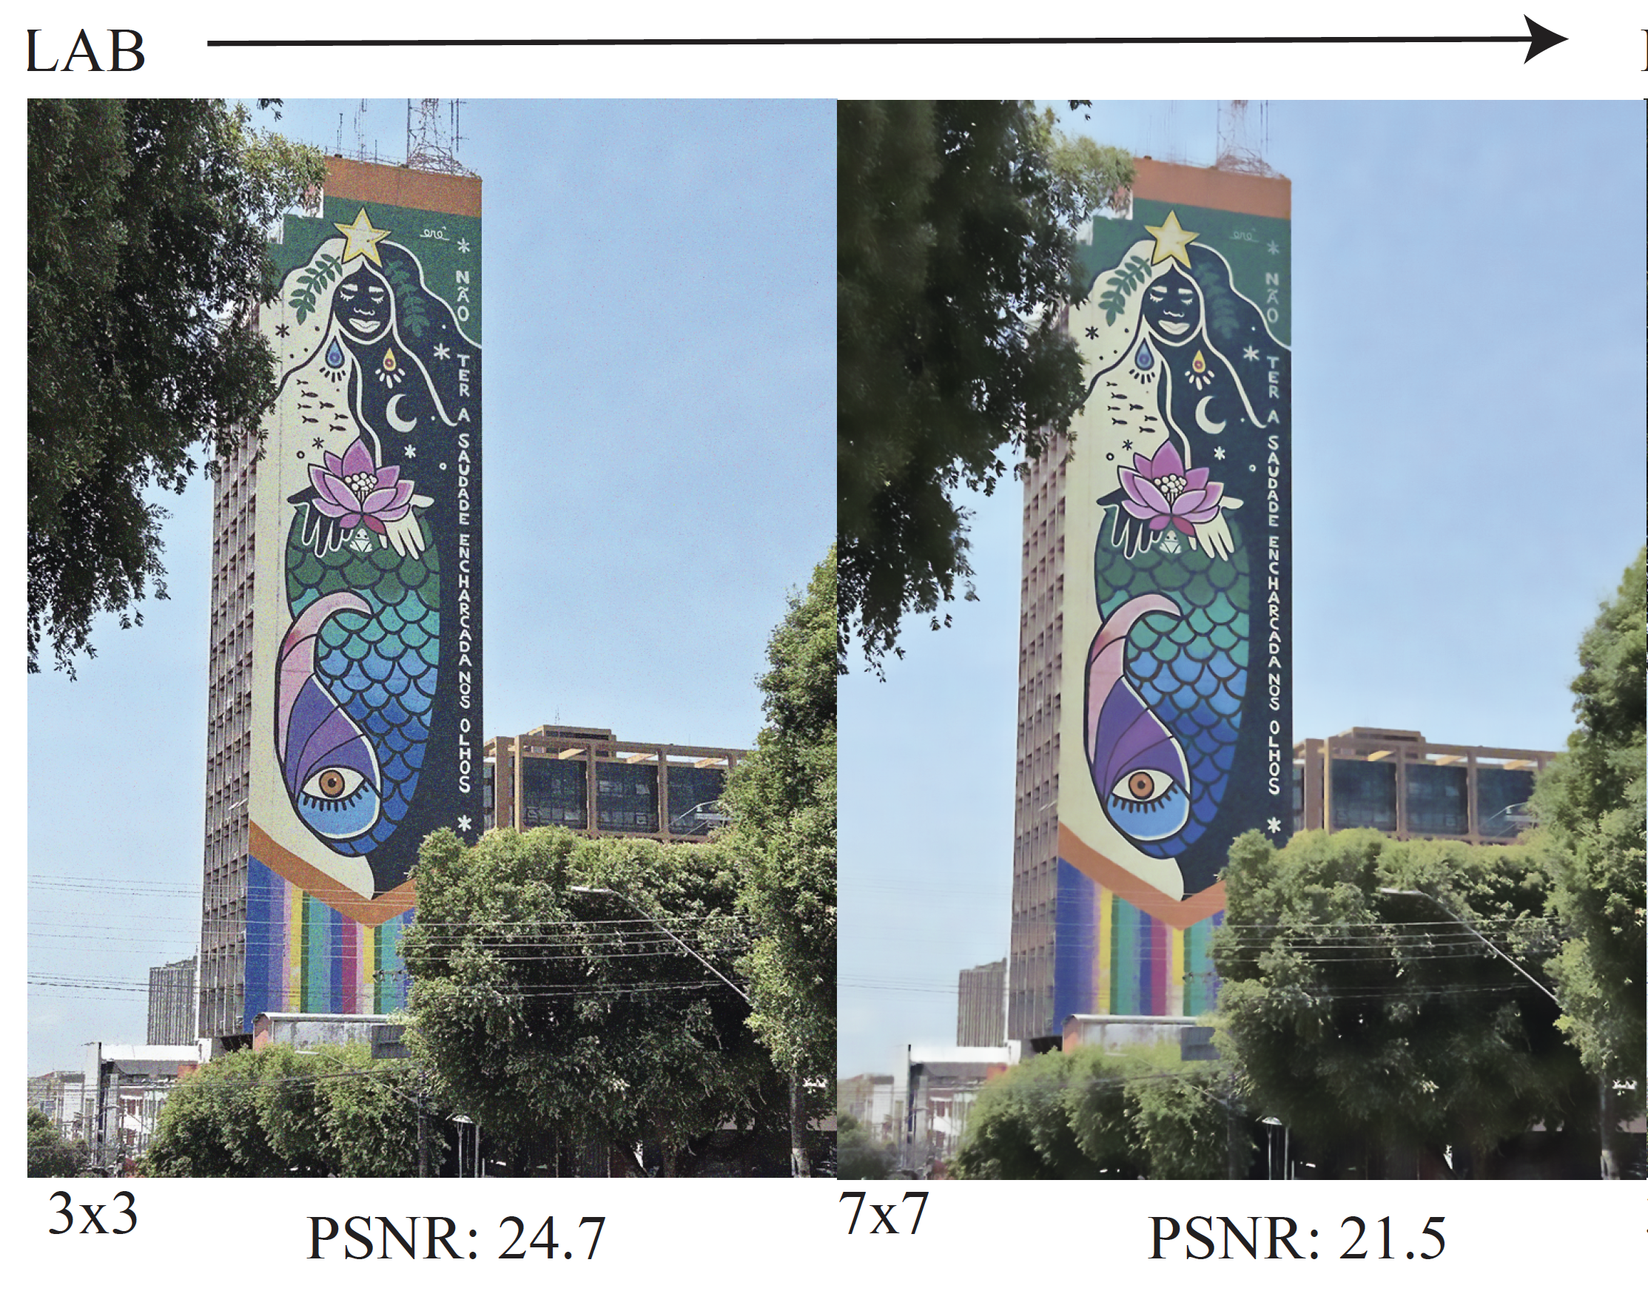

Slide 19
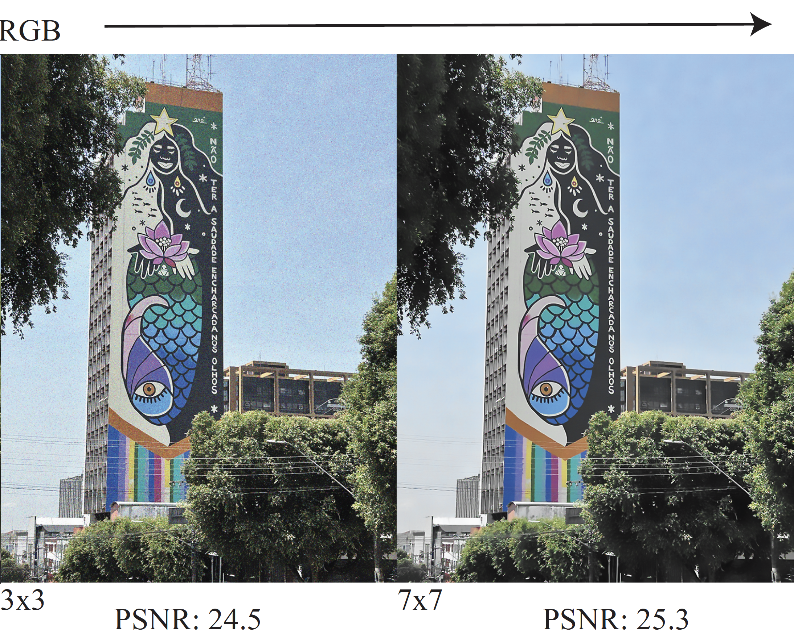

Slide 20
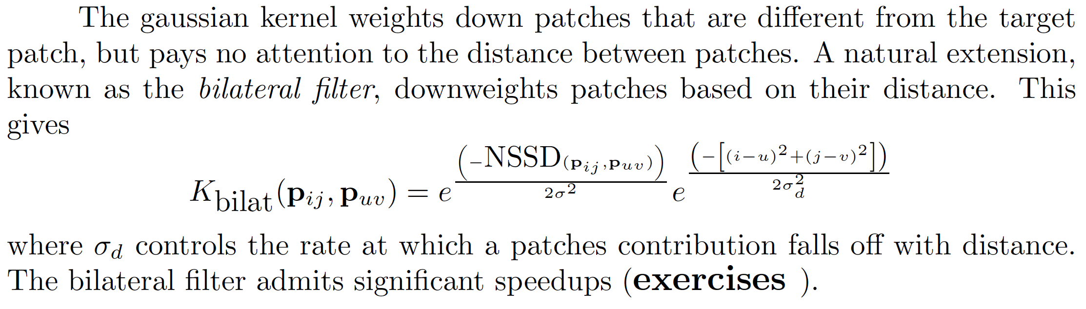
The Bilateral Filter

Slide 21
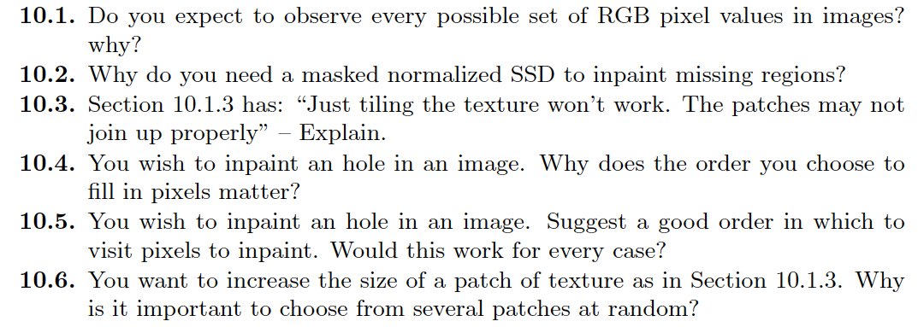
Things to think about

