Slide 1
Illumination: Inference
D.A. Forsyth,
University of Illinois at Urbana Champaign

Slide 2
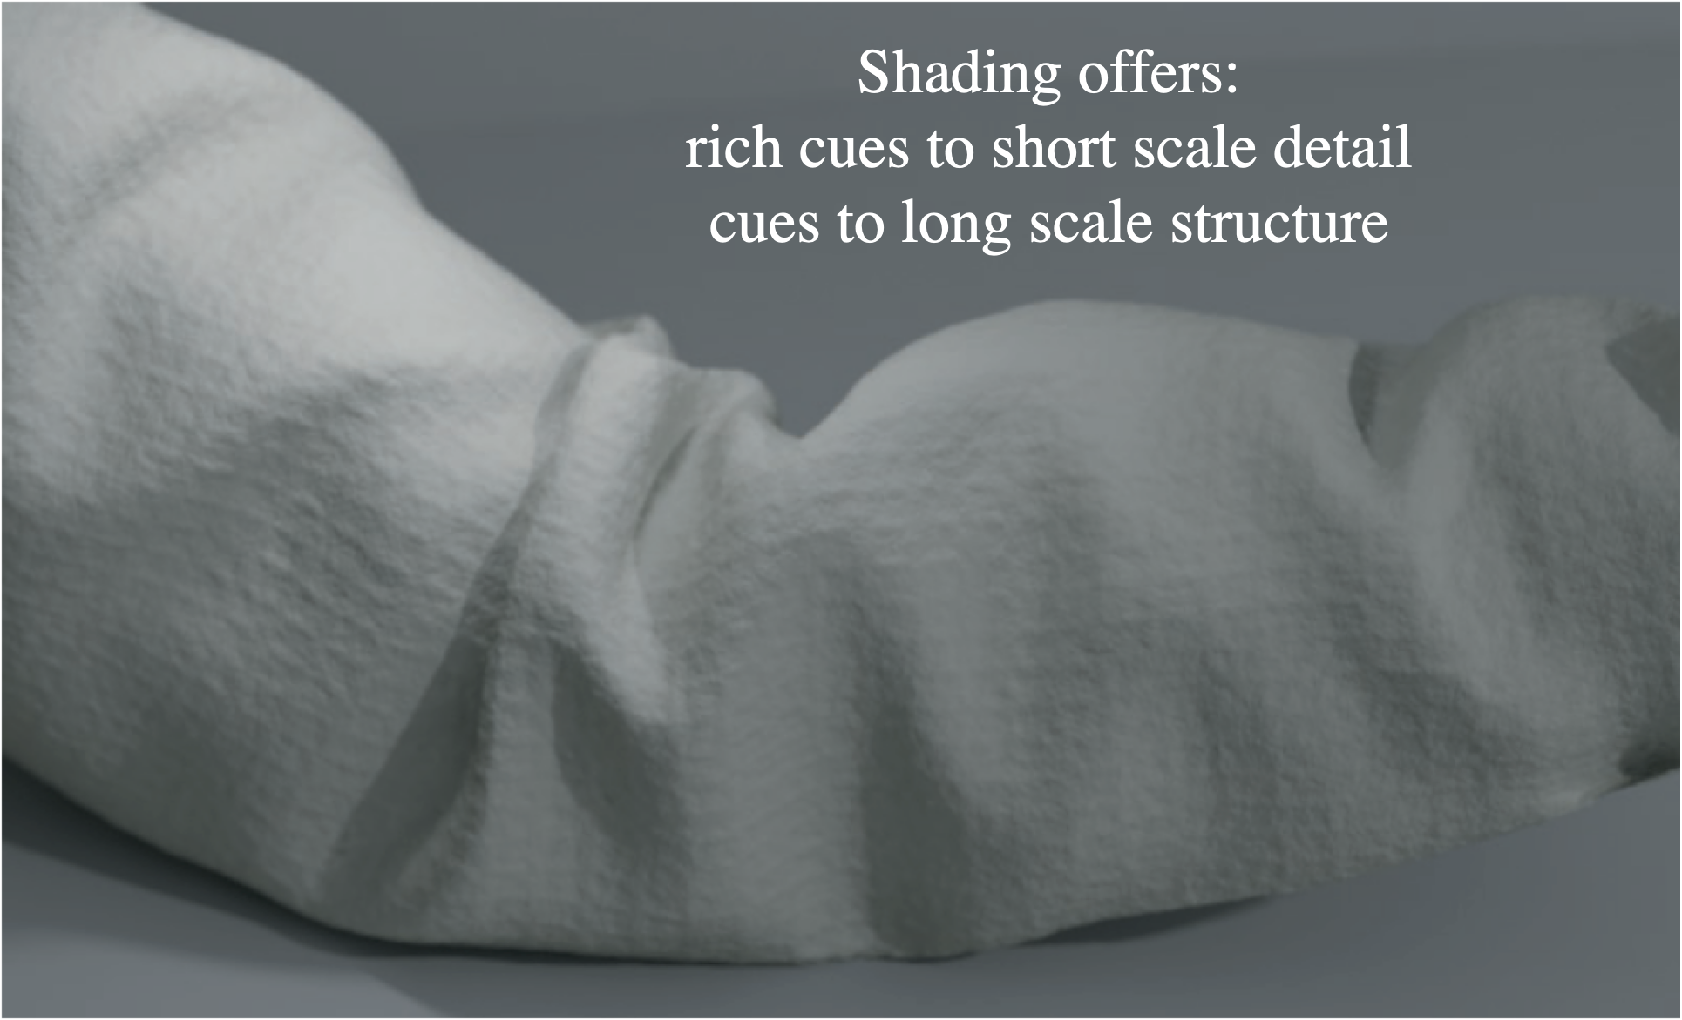
Shading is an amazingly detailed cue

Slide 3
Inferences
Lightness
  whether surface is dark or light, independent of shading
Shape
  photometric stereo
Camera response function
  from images

Slide 4
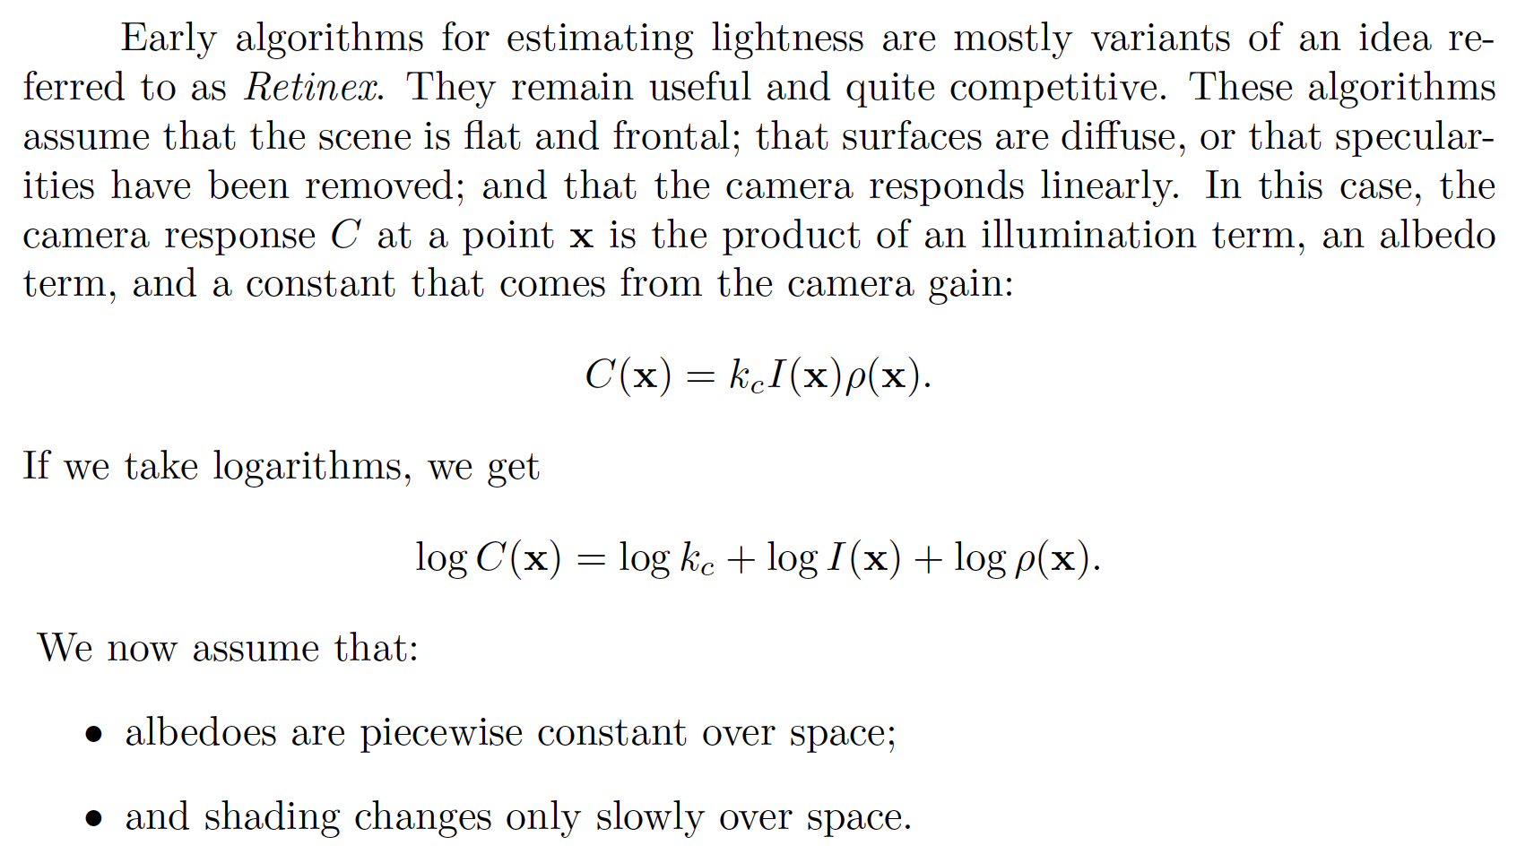
Lightness

Slide 5
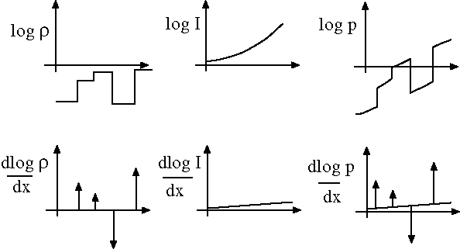

Slide 6
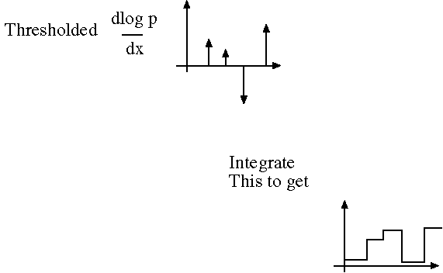

Slide 7
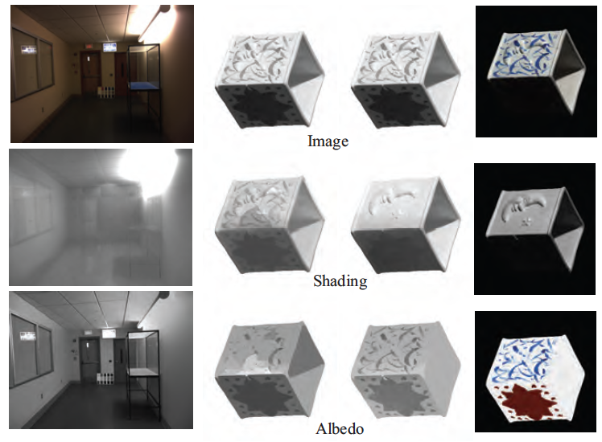

Slide 8
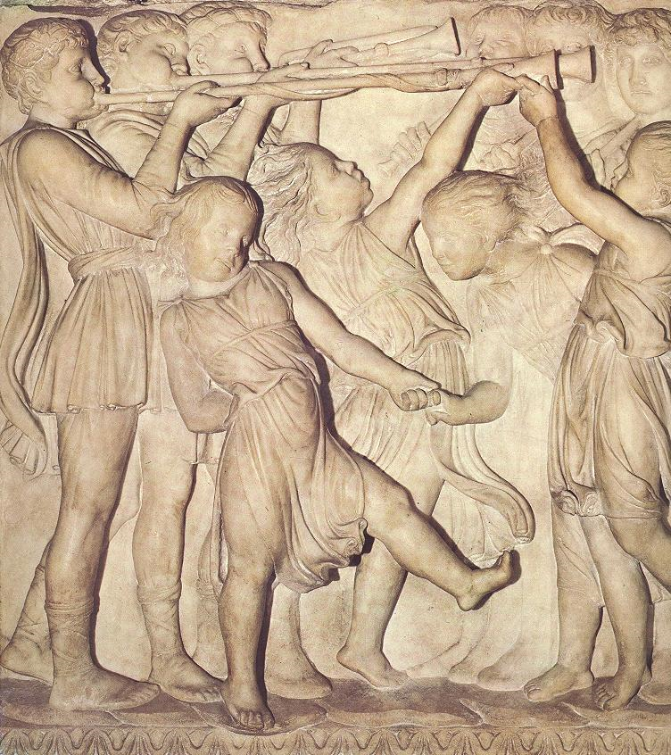
Photometric stereo, or shape from shading
Can we reconstruct the shape of an object based on shading cues?
Luca della Robbia,
Cantoria, 1438

Slide 9





Photometric stereo
Reconstruct object shape based on shading cues
Assuming a Lambertian object
  given the image intensity ($I$) and light source direction ($S$)
  recover the surface normal ($N$) from a single image
$$N$$
$$I=ρ \left(S⋅N\right)$$
$$=ρ\left\|S\right\|\cos{θ}$$
$$S$$
θ

Slide 10
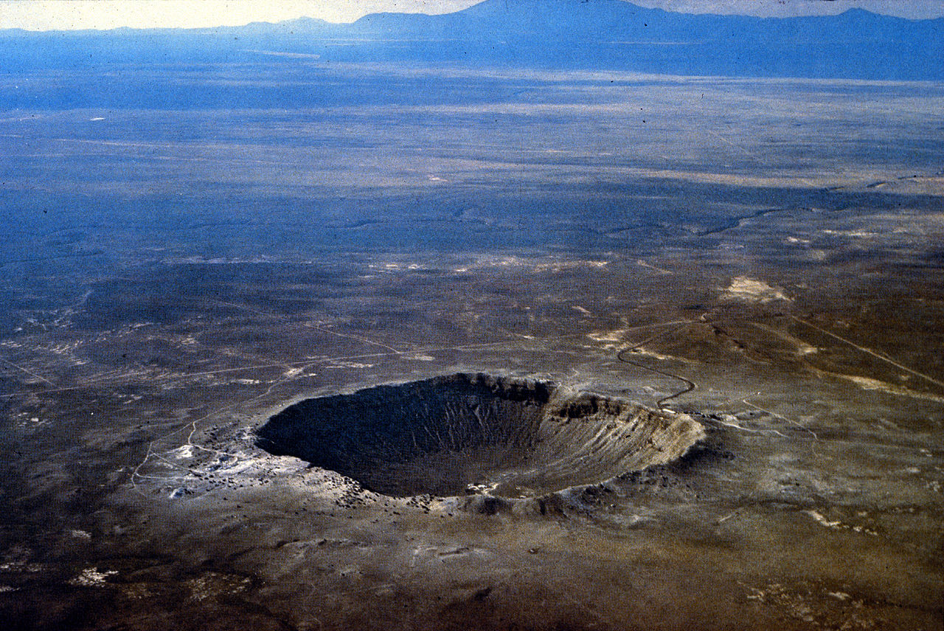
Shape from shading ambiguity
Source: J. Johnson and D. Fouhey
Image source

Slide 11
Shape from shading ambiguity
Humans assume light from above (and the blueness also tells you distance)
Source: J. Johnson and D. Fouhey
Image source

Slide 12



Photometric stereo
$$S1$$
$$S2$$
???
$$Sn$$
F&P 2nd ed., sec. 2.2.4

Slide 13
Photometric stereo
Assume:
  A Lambertian object
  A local shading model (each point on a surface receives light only from sources visible at that point)
  A set of known light source directions
  A set of pictures of an object, obtained in exactly the same camera/object configuration but using different sources
  Orthographic projection
Goal: reconstruct object shape and albedo

Slide 14
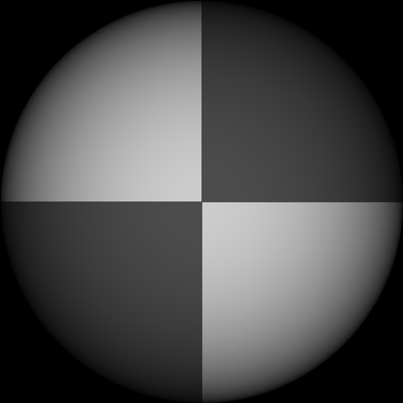
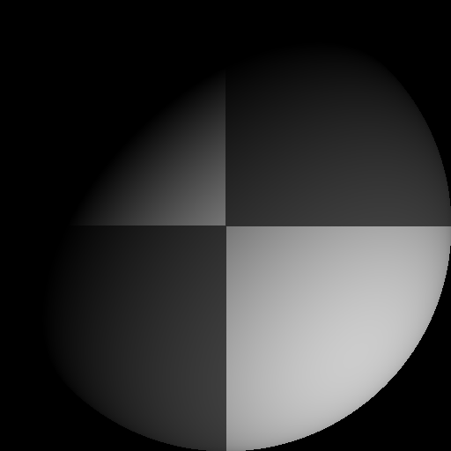
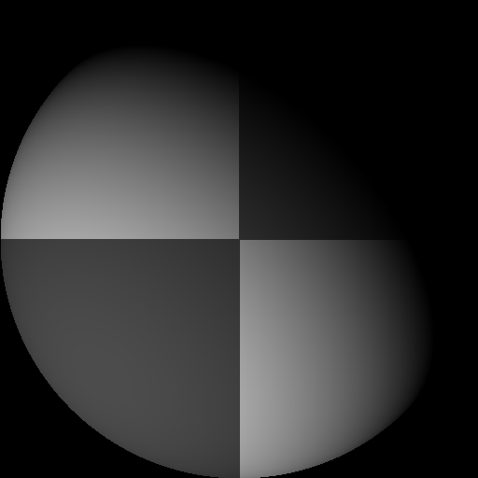
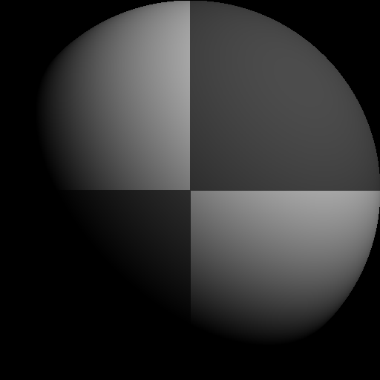
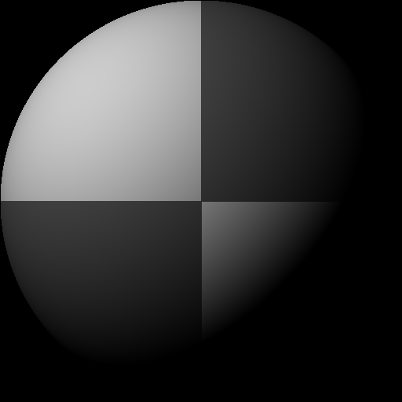

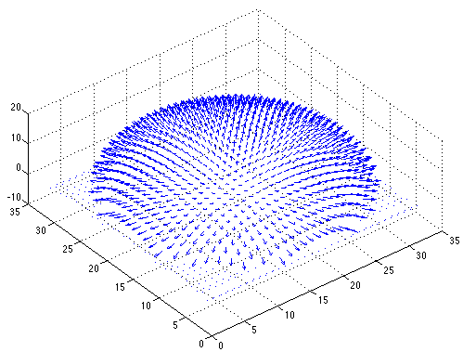
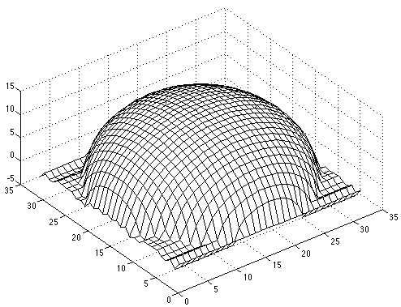
Example 1
Recovered albedo
Recovered normal field
Recovered surface model
F&P 2nd ed., sec. 2.2.4

Slide 15
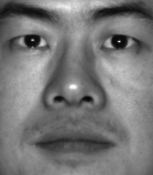
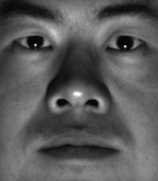
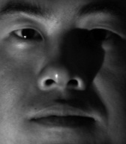
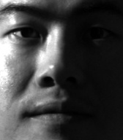
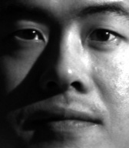
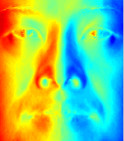
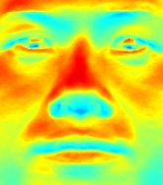
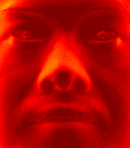

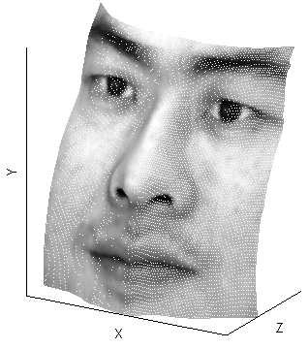
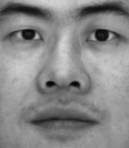



Example 2
Input
…
Recovered albedo
Recovered surface model
Recovered normal field
$$x$$
$$y$$
$$z$$

Slide 16
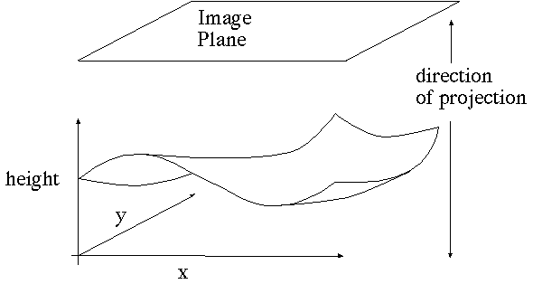

Image model
Known: source vectors $Sj$and pixel values $I_{j}(x,y)$
Unknown: surface normal $N(x,y)$ and albedo $ρ(x,y)$
F&P 2nd ed., sec. 2.2.4

Slide 17
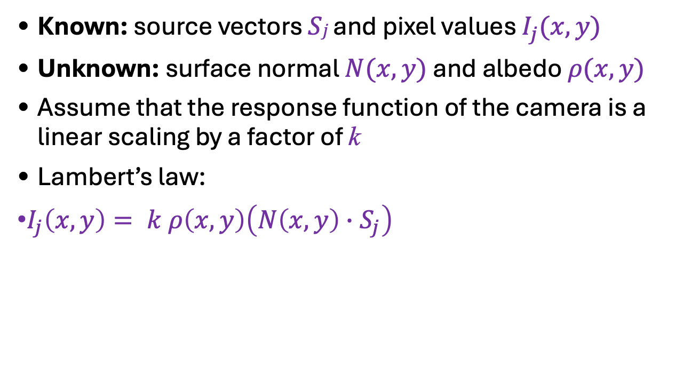


Image model
Known: source vectors $Sj$and pixel values $I_{j}(x,y)$
Unknown: surface normal $N(x,y)$ and albedo $ρ(x,y)$
Assume that the response function of the camera is a linear scaling by a factor of k
Lambert’s law:
$I_{j}\left(x,y\right)= k ρ\left(x,y\right)\left(N\left(x,y\right)∙S_{j}\right)$
$$=\left(ρ\left(x,y\right)N(x,y)\right)∙\left(k S_{j}\right)$$
$$=g(x,y)∙V_{j}$$
F&P 2nd ed., sec. 2.2.4

Slide 18
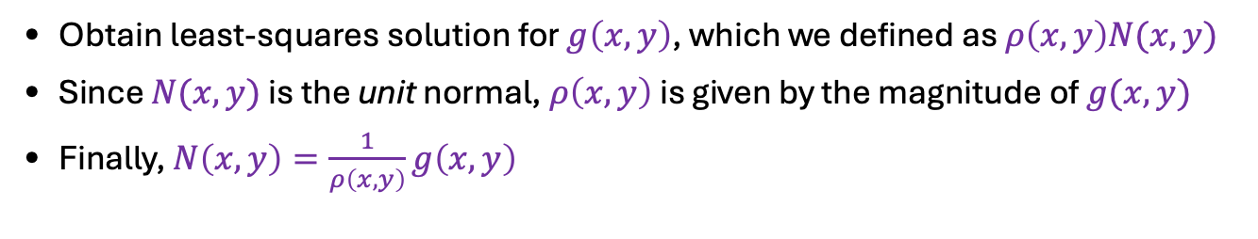
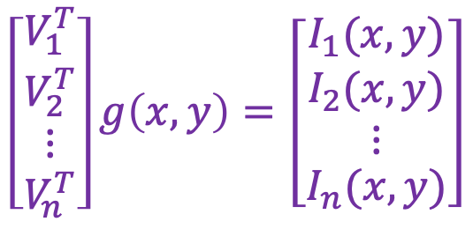



Least squares problem
For each pixel, set up a linear system:
$$\left[\begin{matrix}V_{1}^{T} \\ \begin{aligned}V_{2}^{T} \\ ⋮\end{aligned} \\ V_{n}^{T}\end{matrix}\right]g\left(x,y\right)=\left[\begin{matrix}I_{1}(x,y) \\ \begin{aligned}I_{2}(x,y) \\ ⋮\end{aligned} \\ I_{n}(x,y)\end{matrix}\right]$$
$$n × 3$$
$$3 × 1$$
$$n × 1$$
known
unknown
known
Obtain least-squares solution for $g\left(x,y\right)$, which we defined as $ρ\left(x,y\right)N(x,y)$
Since $N(x,y)$ is the unit normal, $ρ\left(x,y\right)$ is given by the magnitude of $g(x,y)$
Finally, $N\left(x,y\right)=\frac{1}{ρ\left(x,y\right)}g\left(x,y\right)$
F&P 2nd ed., sec. 2.2.4

Slide 19
Synthetic example
Recovered albedo
Recovered normal field
F&P 2nd ed., sec. 2.2.4

Slide 20
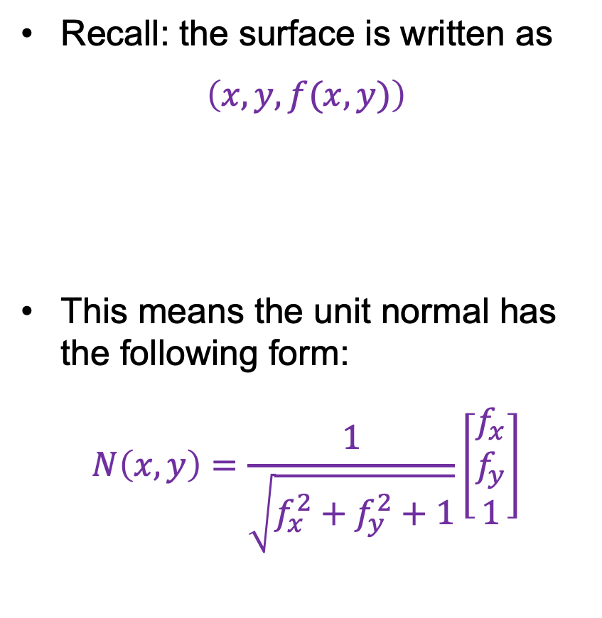
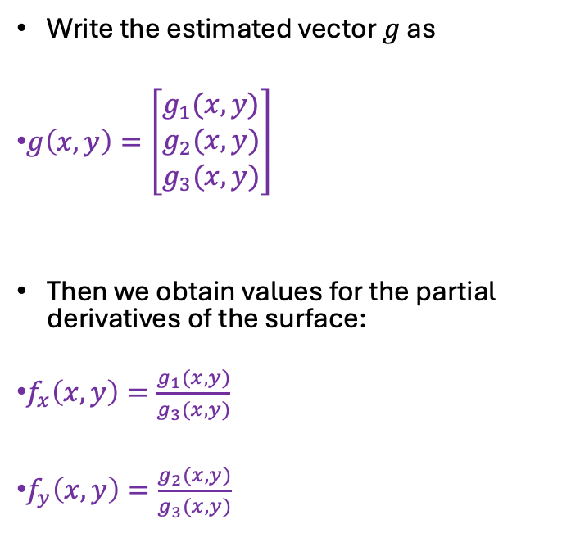
Recovering a surface from normals
Write the estimated vector $g$ as
$g\left(x,y\right)=\left[\begin{matrix}g_{1}(x,y) \\ g_{2}(x,y) \\ g_{3}(x,y)\end{matrix}\right]$
Then we obtain values for the partial derivatives of the surface:
$f_{x}\left(x,y\right)=\frac{g_{1}(x,y)}{g_{3}(x,y)}$
$f_{y}\left(x,y\right)=\frac{g_{2}(x,y)}{g_{3}(x,y)}$
Recall: the surface is written as
$\left(x,y,f(x,y)\right)$
This means the unit normal has the following form:
$N\left(x,y\right)=\frac{1}{\sqrt{f_{x}^{2}+f_{y}^{2}+1}}\left[\begin{matrix}f_{x} \\ f_{y} \\ 1\end{matrix}\right]$
F&P 2nd ed., sec. 2.2.4

Slide 21
Surface recovered by integration
F&P 2nd ed., sec. 2.2.4

Slide 22
Variants
With enough images, etc.
  you can do this if the illuminants aren’t known
You can do this with one image:
  if there are three illuminants, each of a different color
With enough images, etc.
  interreflections are not a major problem

Slide 23
Interreflections are a problem
but not a major one for photometric stereo – why?
From Koenderink slides on image texture and the flow of light

Slide 24
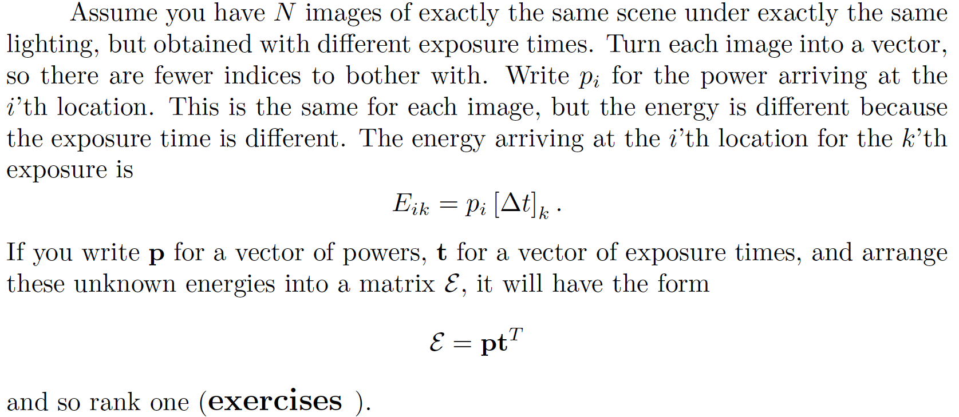
CRF Estimation

Slide 25
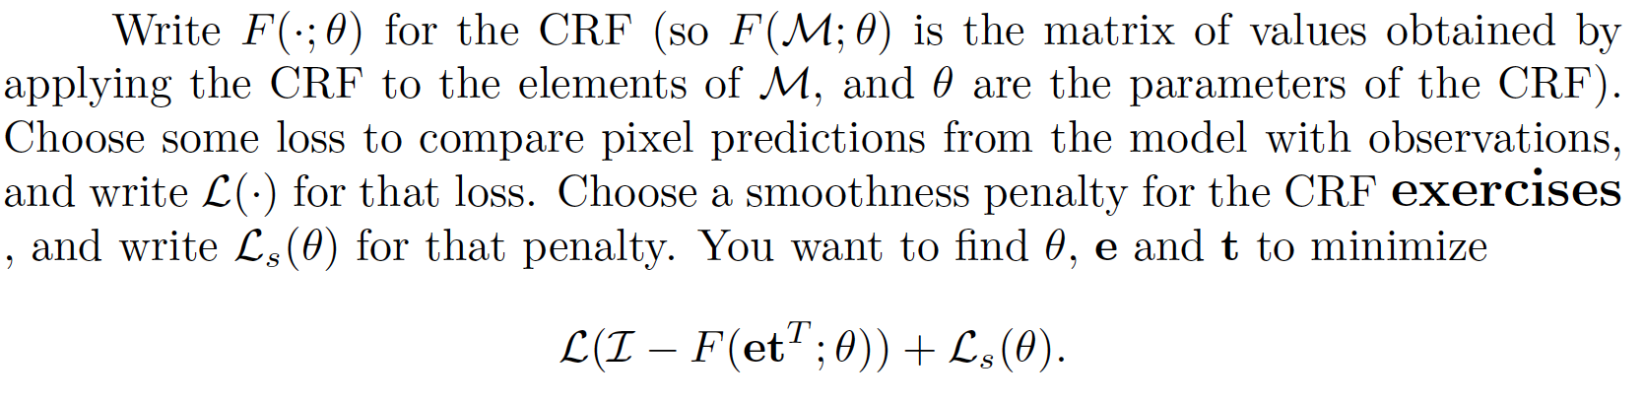
CRF Estimation

Slide 26
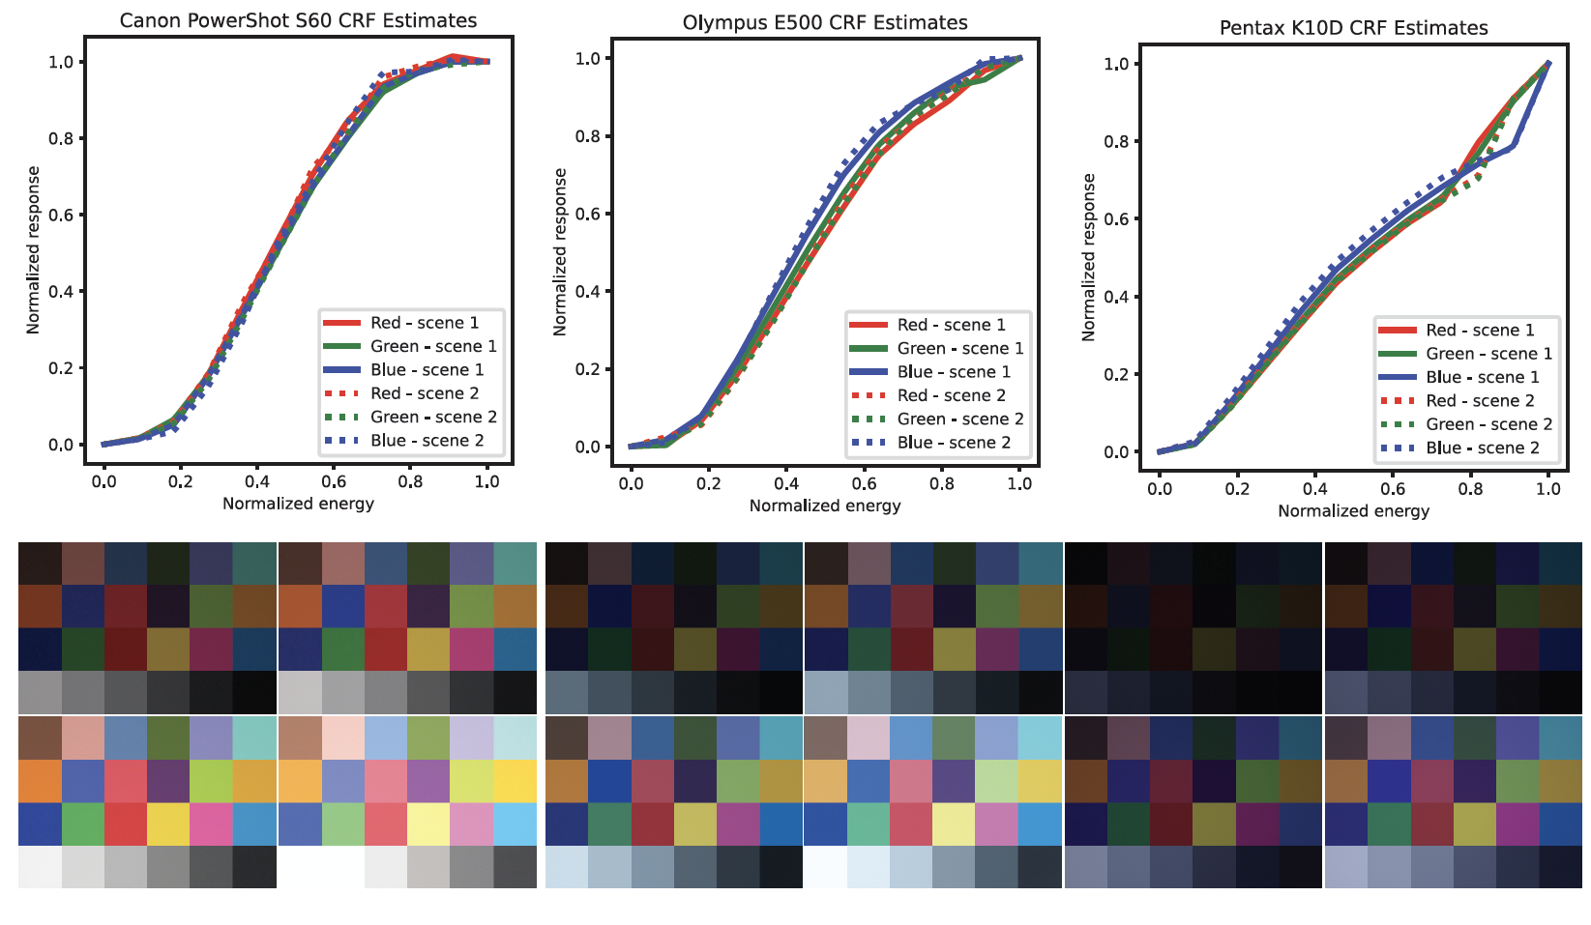
CRF estimation

