Slide 1
Image Intensity:
Simple Physics
D.A. Forsyth
University of Illinois at Urbana Champaign

Slide 2

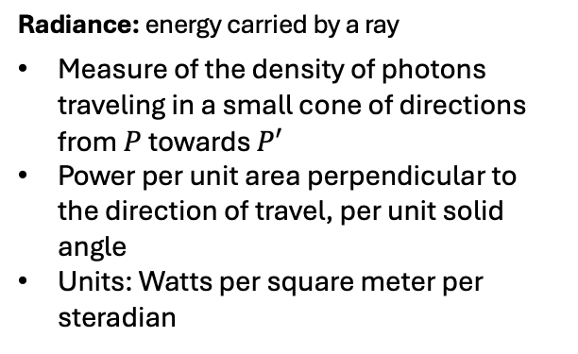



Radiometry of image formation
$$L$$
P
$$E$$
Radiance: energy carried by a ray
Measure of the density of photons traveling in a small cone of directions from $P$towards $P′$
Power per unit area perpendicular to the direction of travel, per unit solid angle
Units: Watts per square meter per steradian
$$P′$$
Irradiance: energy arriving at a surface
Incident power per unit area (not foreshortened)
Units: Watts per square meter
What is the relationship between $E$ and $L$?

Slide 3
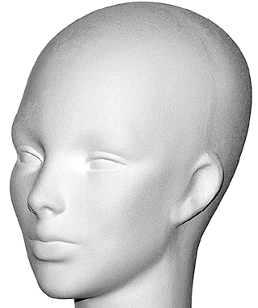
Basic models of reflection
Specular reflection: light is reflected
about the surface normal
Diffuse reflection: light scatters
equally in all directions
incoming light
incoming light
Slide from D. Hoiem

Slide 4
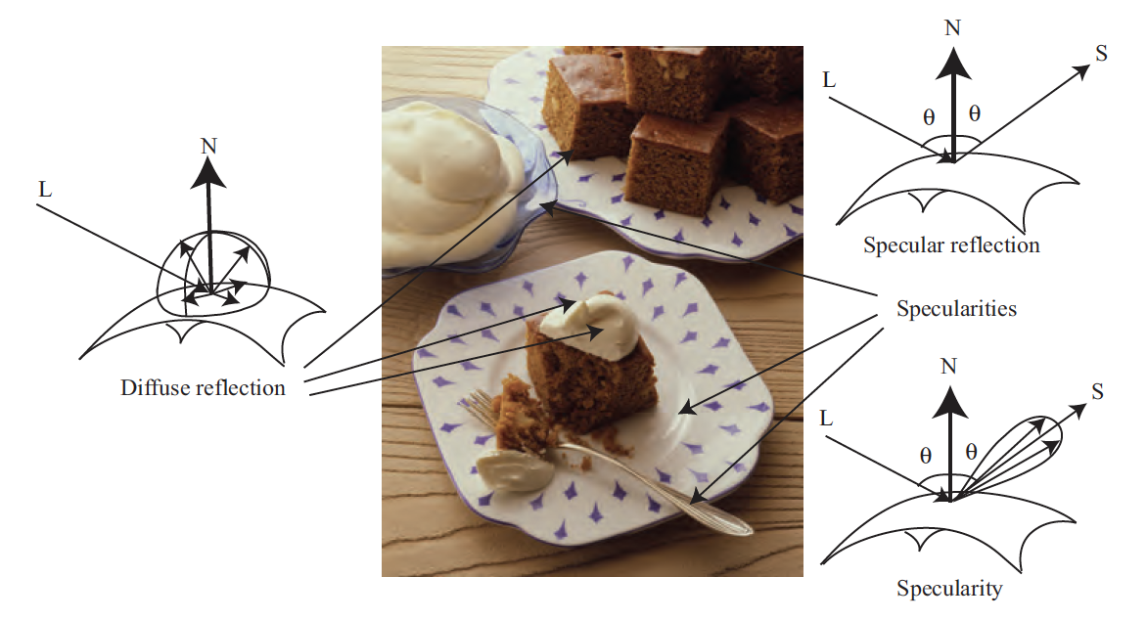
Diffuse and specular reflection

Slide 5
Specular reflection
Radiation arriving along a source direction leaves along the specular direction (source direction reflected about normal)
Classic case: Mirror
Diagnosis
  When you look at a specular surface from different directions, appearance changes
  True specular surfaces are “really like” mirrors
    Form a clear image
Q:
  Why do mirrors reverse left and right, but not up and down?

Slide 6
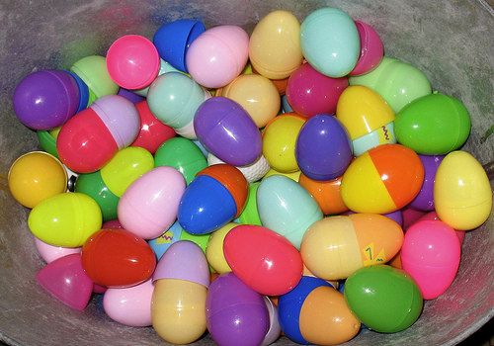
Specularities
On real surfaces, energy usually goes into a “lobe” of directions
  So image is blurred
  More usually, you see only the source
Specularities: narrow bright patches
  On metals: color of the metal
  Others: color of the light source

Slide 7
Diffuse reflection
Light scatters equally in all directions
  E.g., brick, matte plastic, rough wood
Diagnosis:
  Surface has the same brightness when looked at from different directions
    (under fixed illumination)
Extremely common
  Very often surfaces are “largely” diffuse
Image source

Slide 8
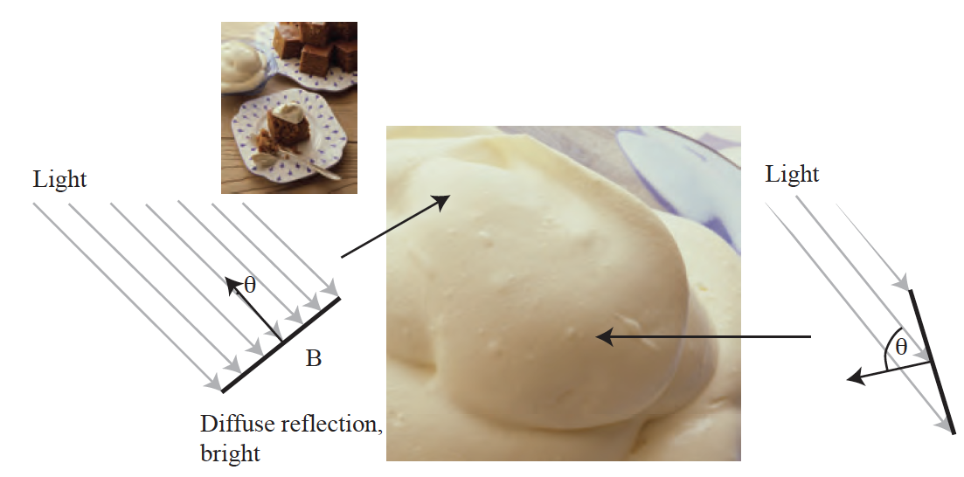
Orientation of diffuse surfaces

Slide 9
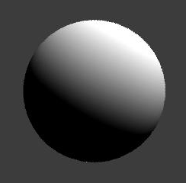




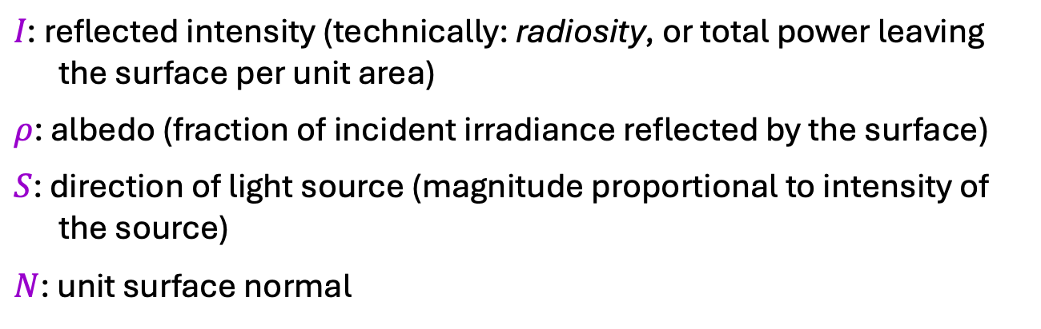
Diffuse reflection: Lambert’s law
$$N$$
$$I=ρ \left(S⋅N\right)$$
$$=ρ\left\|S\right\|\cos{θ}$$
θ
$$S$$
$I\text{: }\text{reflected} \text{intensity}$ (technically: radiosity, or total power leaving the surface per unit area)
$ρ$: albedo (fraction of incident irradiance reflected by the surface)
$S$: direction of light source (magnitude proportional to intensity of the source)
$N$: unit surface normal
Notes:
BRDF is constant
Albedo: fraction of incident irradiance reflected by the surface
Radiosity: total power leaving the surface per unit area (regardless of direction)

Slide 10
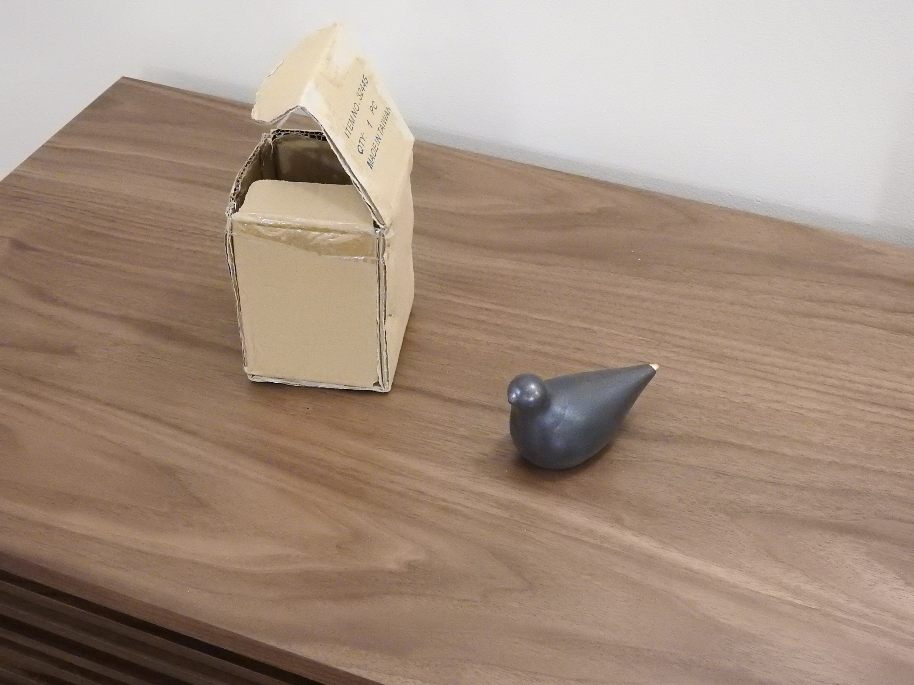

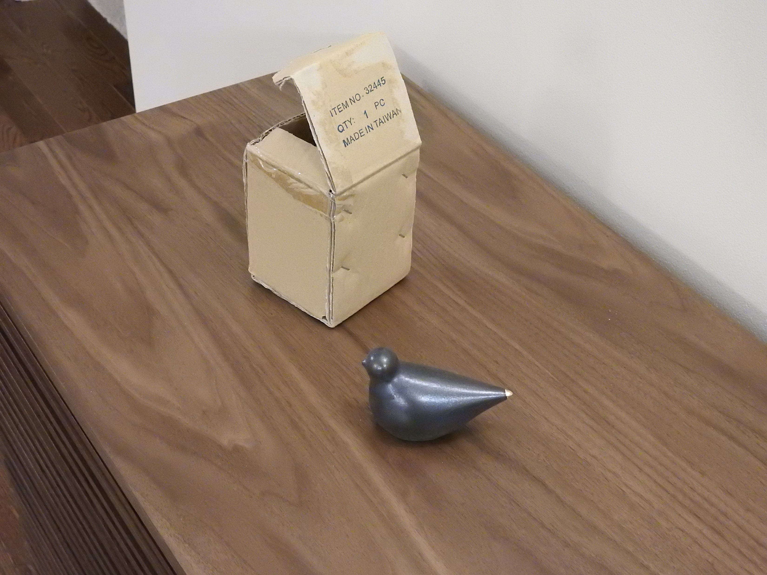
Diffuse vs. specular: Significance
Same lighting, as close as possible camera settings, but different camera position
Diffuse
Specular
Same appearance
Totally different appearance
Source: J. Johnson and D. Fouhey

Slide 11
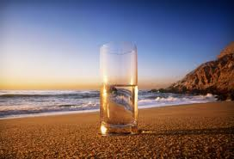
Light at surface – other effects
Transparency
Refraction
Slide from D. Hoiem

Slide 12
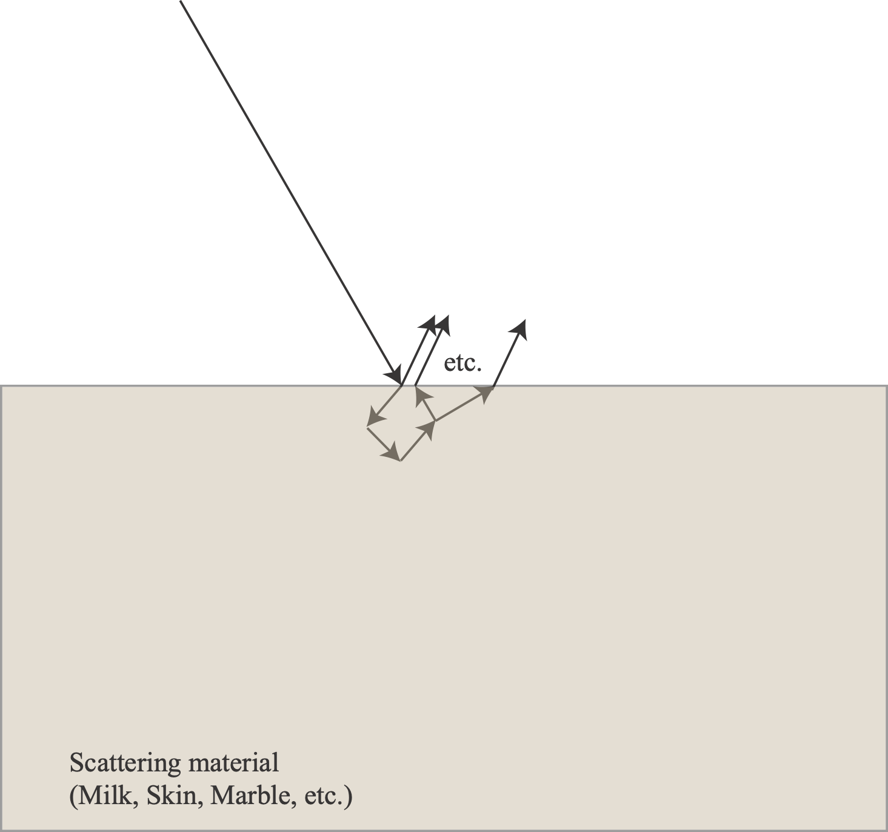
Light at surface – other effects
Subsurface scattering
Slide from D. Hoiem
Image source

Slide 13
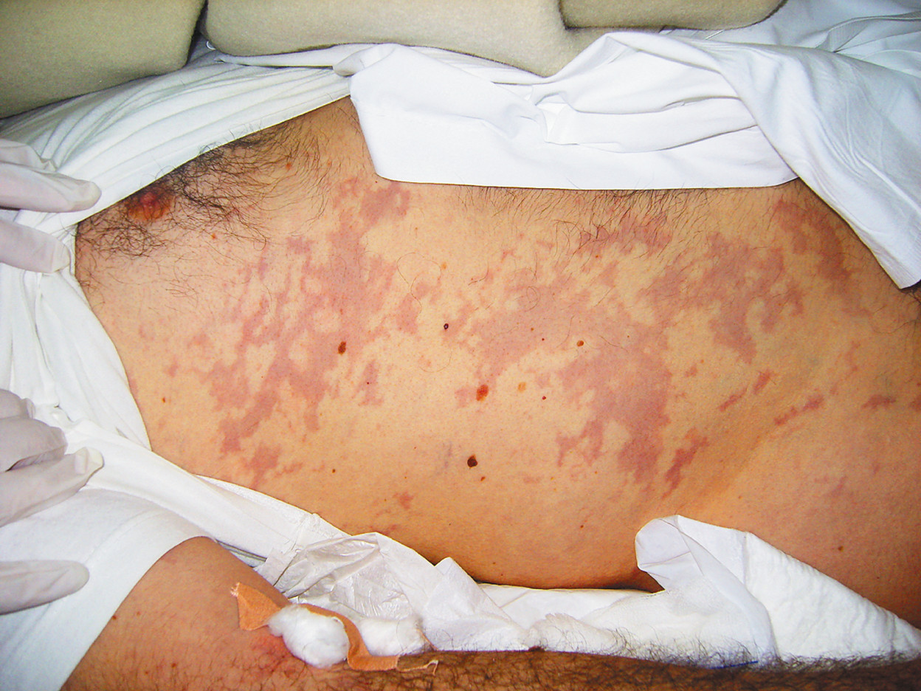
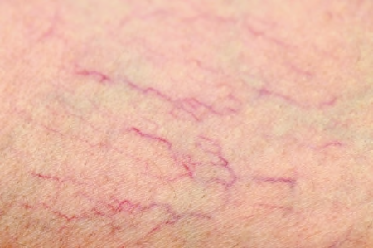
subsurface scattering in skin (not rendered!)

Slide 14




Light at surface – other effects
Fluorescence
Phosphorescence
$$λ1$$
$$λ2$$
$$t>1$$
$$t=1$$
Slide from D. Hoiem
Image source
Notes:
Fluorescence is light energy produced by a process where high-energy radiation (such as ultraviolet or X-ray) is absorbed by electrons surrounding an atom and is re-emitted as light energy. Unlike fluorescence, a phosphorescent material does not immediately re-emit the radiation it absorbs.
From https://www.pharmatutor.org/pharma-analysis/define-fluorescence-and-phosphorescence

Slide 15
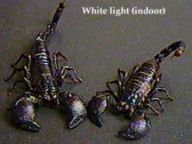
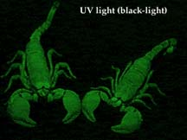
Fluorescence in nature
Many examples, mostly obscure:
scorpions, deep sea fish, teeth, nylon, chitons

Slide 16
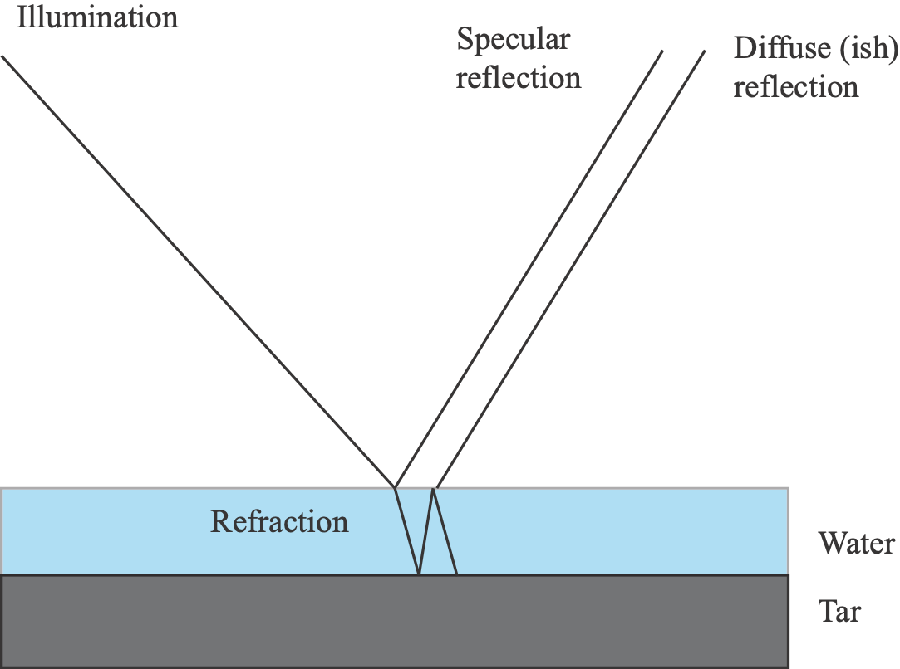
Films on surfaces
eg water
Assume:
  film is thin
You see:
  specular reflection+diffuse term

Slide 17
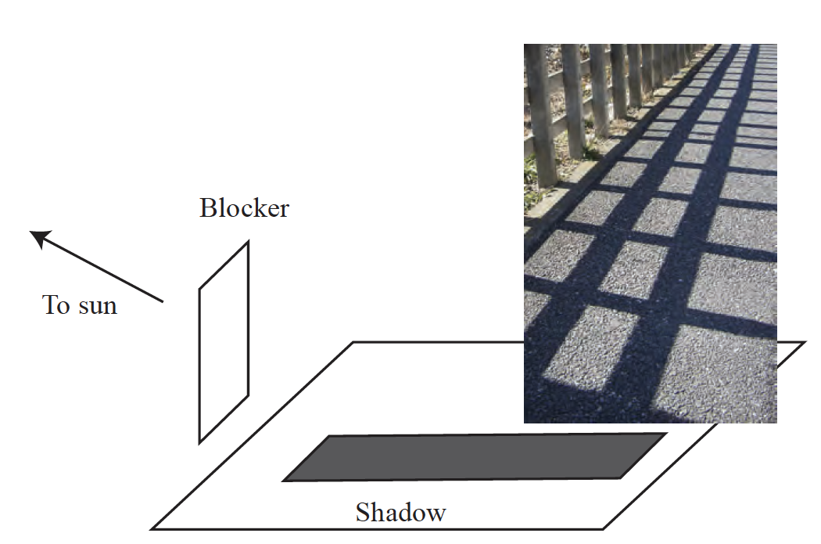
Shadows

Slide 18
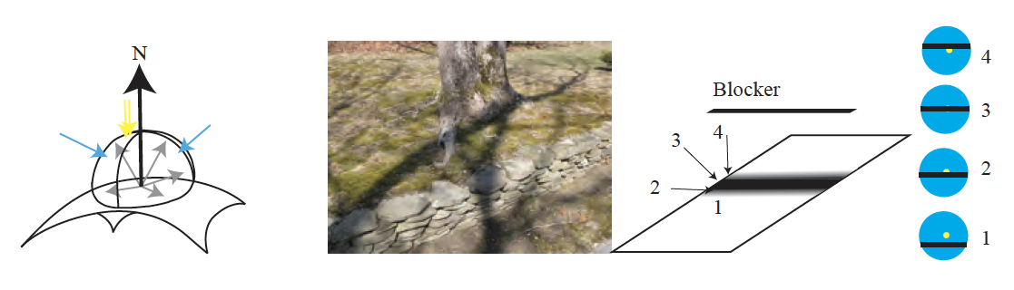
Blurred shadows

Slide 19
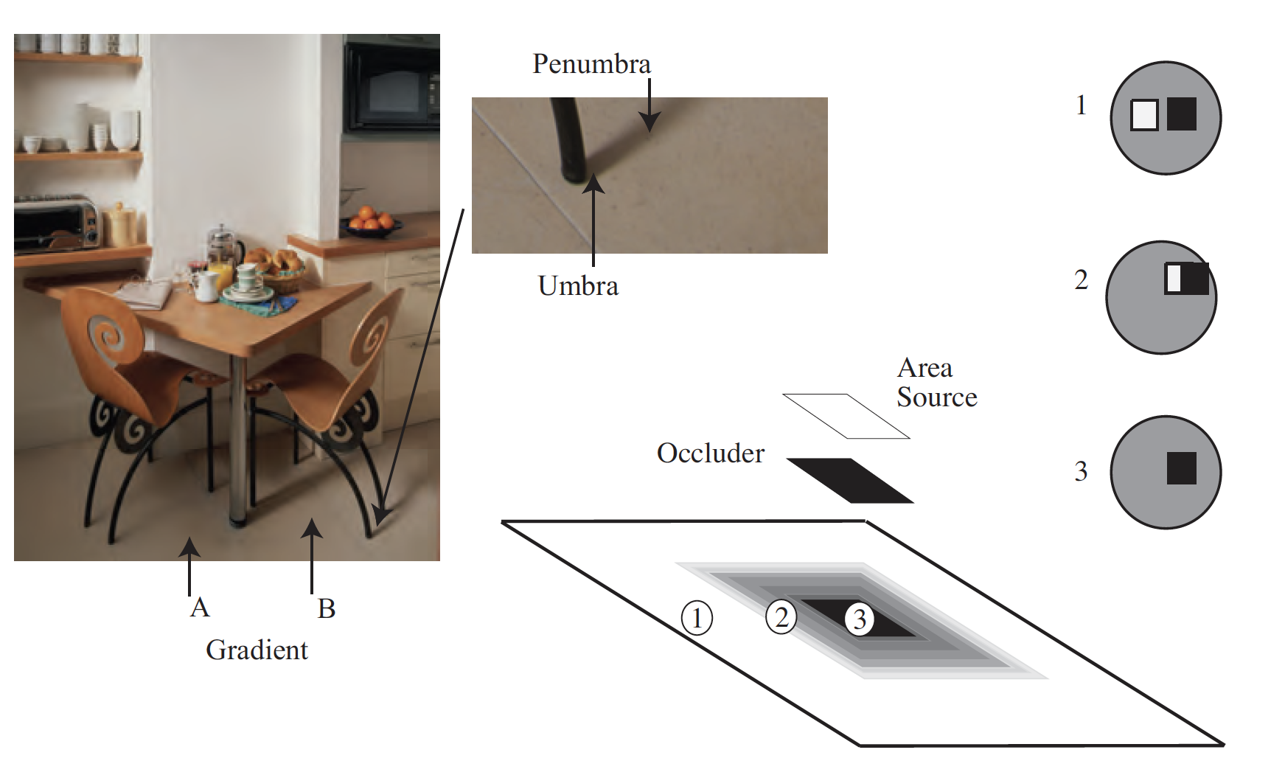
Area sources and their effects

Slide 20
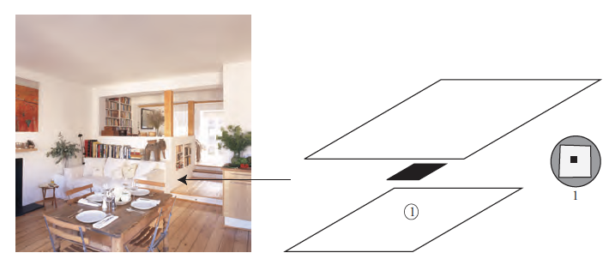
Dark shadows are rare indoors

Slide 21
Interreflections
local shading model is poor
    because surfaces reflect light onto one another
Major nuisance;
  the distribution of light (in principle) depends on the configuration of every radiator;
  big distant ones are as important as small nearby ones (solid angle)
The effects are easy to model
It appears to be hard to extract information from these models

Slide 22
Interreflections are a problem
but not a major one for photometric stereo – why?
From Koenderink slides on image texture and the flow of light

Slide 23
Things to think about
Most people aren’t aware of colored interreflections
  even when you describe the physics
  WHY?
Why is it hard to use shadows as a shape cue?

