Slide 1
Interest points by UNet
D.A. Forsyth
University of Illinois at Urbana Champaign

Slide 2
Interest points: Finding interest points
Superpoint:
  Break 8M X 8N image into 8x8 windows
  Classify each window into 65 classes:
  64 locations and one “no-interest point in this window”
  so decoder produces 65 X M X N block
  [This can be refined...]
Training:
  First, make a lot of synthetic images with known corner locations
  then train purely discriminatively (you know where the corners are!)

Slide 3
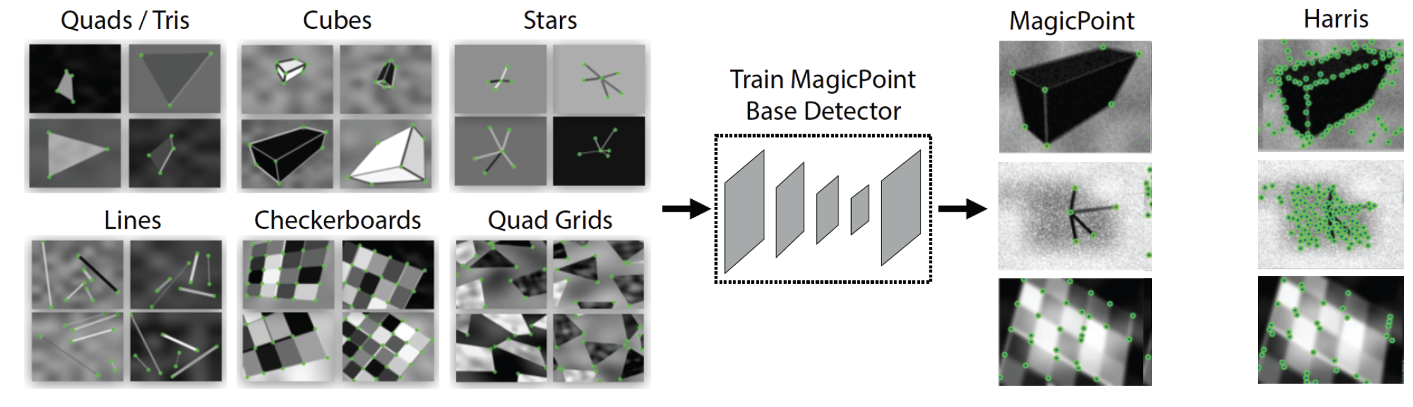
Yields MagicPoint
But you can do better...

Slide 4
Heatmaps
Take the 65 x M x N block, compute the probabilities,
  drop the “no interest point” score
  get a 64 x M x N block of scores
  don’t sum to one, cause one option is missing.
Turn this into a 1 x (8 M) x (8 N) “image”
  each pixel has a value that indicates the ”probability” of an interest point at that location
This is a heatmap

Slide 5
Training with heatmaps
Take a natural image
  form its heatmap
  Apply an affine transform A, to get A(I) and H(A(I))
  Now and should be the same
    where they overlap

Slide 6
Training with heatmaps, II
Idea:
  get a collection of random affine transformations A_n
  Now compute an average of
use this as a target distribution
  for training the unet that predicts the heatmap

Slide 7
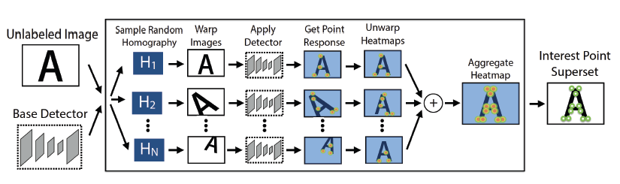
SuperPoint
Target heatmap

Slide 8
Locating the interest points
Threshold scores from the trained decoder
  interest points at locations where the score>threshold
These are on 8M x 8N grid

Slide 9
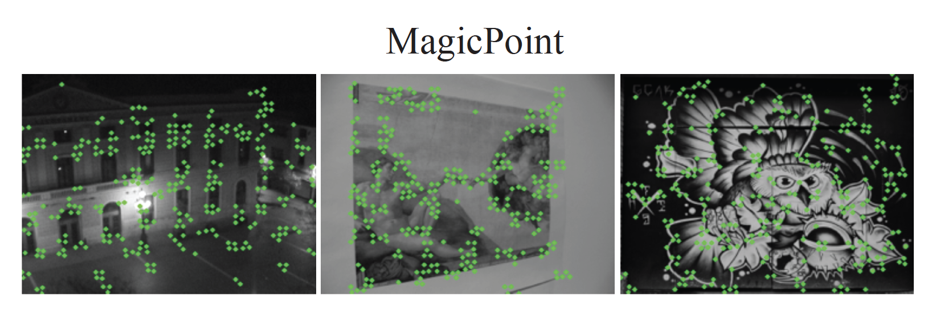
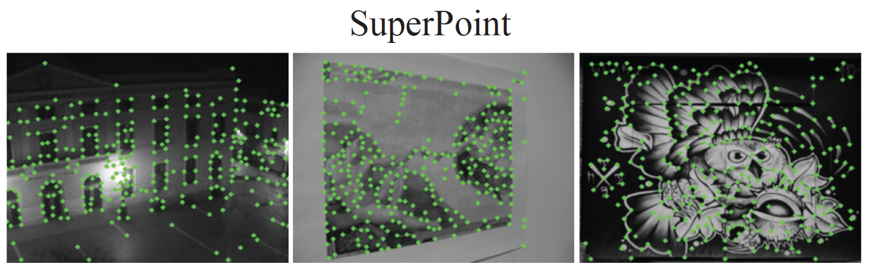
Real improvements from heatmap

Slide 10
Learning to describe the interest point
Add a second decoder.
  This decodes to a d x M x N block of descriptors
    (but the interest point locations are on (8M x8N) grid – upsample and interpolate)
Now use a version of the affine trick
  For image I and image A(I) you know which pairs of tiles correspond

Slide 11
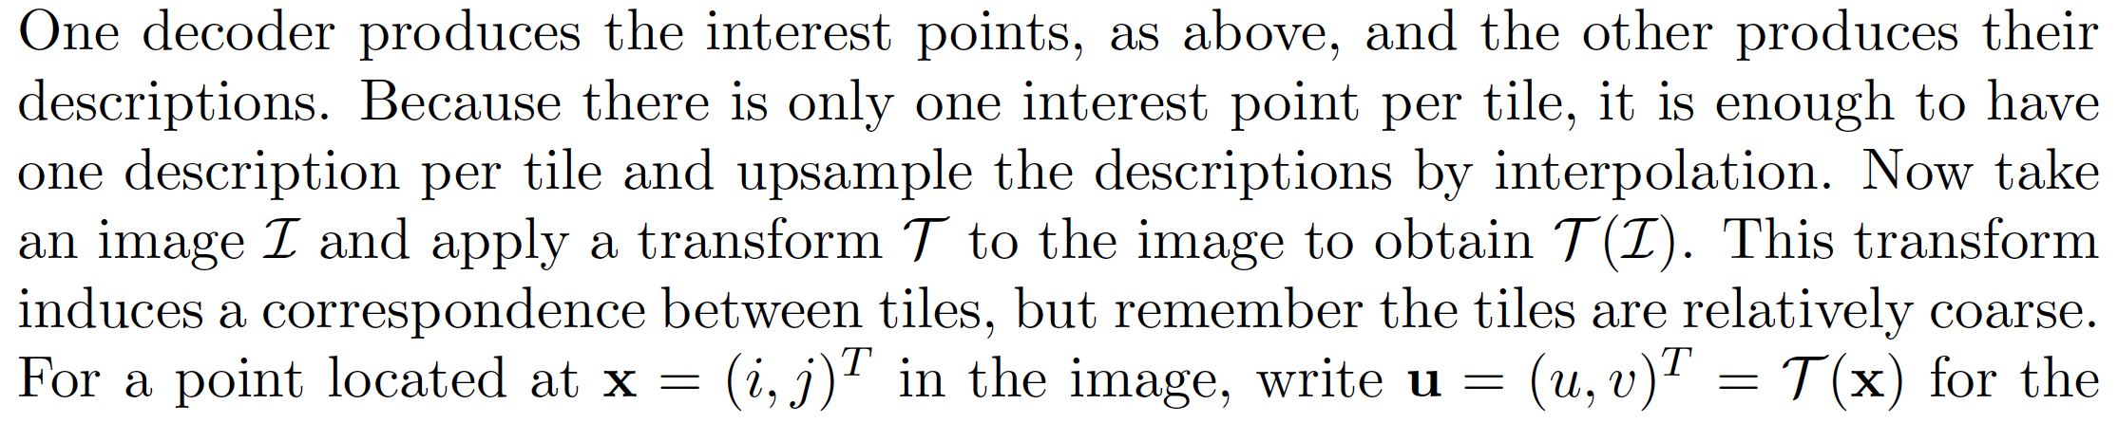
Tiles

Slide 12
Using tile correspondences
Idea:
  Choose an image and an affine transformation
    apply tx to image
    know which tiles in txd image and original correspond
  Loss:
    corresponding tiles should have similar descriptors
    non-corresponding tiles should have different descriptors
    weight this, because there are more non-corresponding

Slide 13
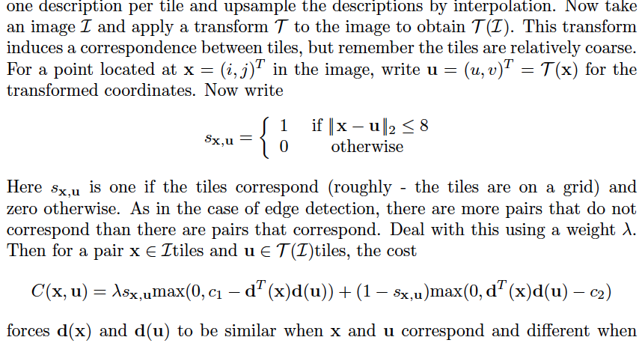
Using tile correspondences

Slide 14
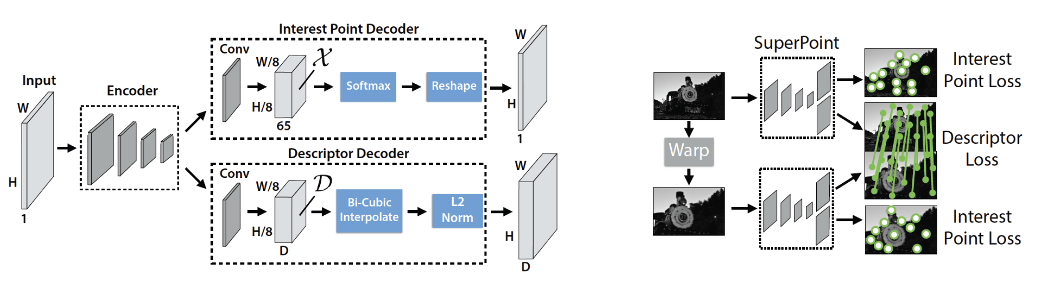

Slide 15
Think about this...
Lots of papers on this topic
ROUGH current SOTA: learned interest points don’t produce notably
better results than initial construction
Likely, this will change

