Slide 1
The Kalman filter
D.A. Forsyth
University of Illinois at Urbana Champaign

Slide 2
Summary
Modelling distributions is just maintenance on
  means, covariances
  IF
    prior is normal
    dynamics are linear + Gaussian noise
    measurement is linear+Gaussian noise
which means
  can obtain the best possible online estimate of state
    given sequence of observations
    with a straightforward recipe
consequences
  recipe for online procedures (tracking, SLAM)

Slide 3


Linear dynamics and measurement
Square matrix of full rank
State changes as:
Measurements are:
This is a normal random variable with zero mean and known covariance
Any matrix whose dimensions are OK
This is a (different!) normal random variable with zero mean and known covariance

Slide 4


Other notation
Read this as: x_i is normally distributed. The mean is a linear function of x_i-1 and the
covariance is known (and can depend on i).
Read this as: y_i is normally distributed. The mean is a linear function of x_i and the
covariance is known (and can depend on i)

Slide 5
Example dynamical models
Drifting points
  new state = old state + gaussian noise
Points moving with constant velocity
  new position=old position + (dt) old velocity + gaussian noise
  new velocity= old velocity+gaussian noise
Points moving with constant acceleration
  new position=old position + (dt) old velocity + gaussian noise
  new velocity= old velocity+(dt) acceleration + gaussian noise

Slide 6
Example measurement models
Usual:
  state=position; measurement=position+gaussian noise
  state=position and velocity; measurement=position+gaussian noise
    but we could infer velocity
  state=position and velocity and acceleration; measurement=position+gaussian noise
    but we could infer velocity
    ballistic movement – we know acceleration
For more complex examples
  there is a theory of observability
    can you determine state from observations?

Slide 7




Key point
is normal.
If is normal
  then
are both normal

Slide 8
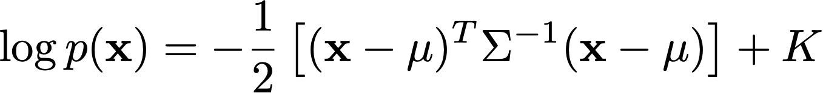
Checking…
Probability distribution is normal iff it has the form:
  and you can check this for each of the relevant dists.

Slide 9


The Kalman Filter
Dynamics and measurement
Notation

Slide 10
The steps:
Have:
Mean and covariance of posterior
after i-1’th measurement
Construct:
Mean and covariance of predictive
distribution just before i’th measurement
Measurement arrives:
Now construct:
Mean and covariance of posterior
distribution just before i’th measurement
posterior mean is weighted combo
of prior mean and measurement
posterior covar is weighted combo
of prior covar, measurement
matrix and measurement covar

Slide 11
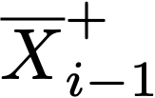

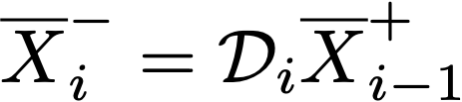


The steps:
Have:
Construct:
Measurement arrives:
Now construct:
Where:

Slide 12
Very simple example
We have a point vehicle in 2D
  so steering direction doesn’t matter
  you can accelerate in any dir.
It is translating
  we supply a known demand to the accelerator,
    changing at each time step
  it sees 2 beacons (which are in its coordinate system)
    beacon 1 measured in vehicle x but not y
    beacon 2 measured in vehicle y but not x
Q:
  recover filtered estimates of:
    position, velocity and acceleration in world coords

Slide 13

Dynamical model
We supply a demand to the accelerator
  acceleration updates as noise
    regard demand as a measurement
  velocity by integrating acceleration
  position by integrating velocity

Slide 14
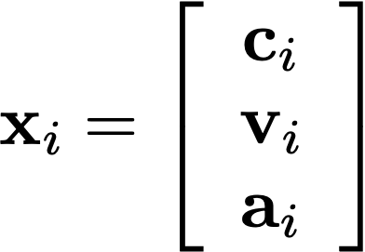
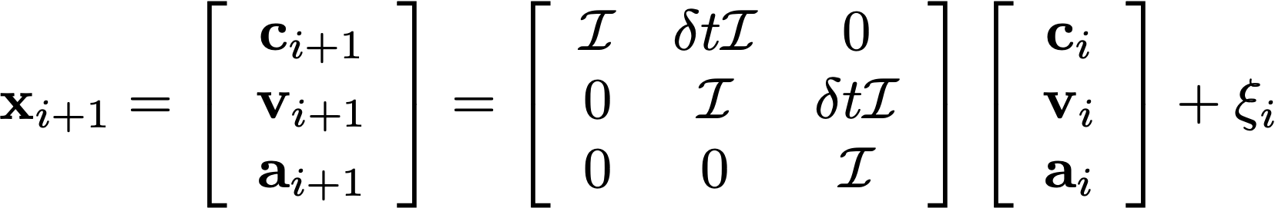

Stack the vectors to get:
Which gives:
Where:

Slide 15
Measurement model
The acceleration at i should be demand
  +noise
Beacons are in car coordinate system)
  beacon 1 measured in car x but not y
  beacon 2 measured in car y but not x

Slide 16
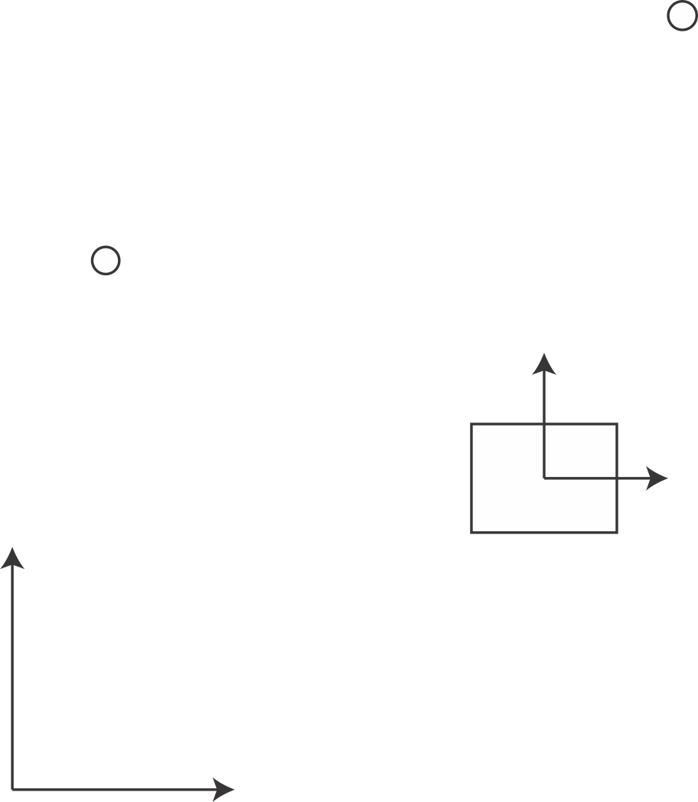







In world coordinates, car is at:
In car coordinates, beacon 1 measurement is:
In car coordinates, beacon 2 measurement is:
World coord
system

Slide 17
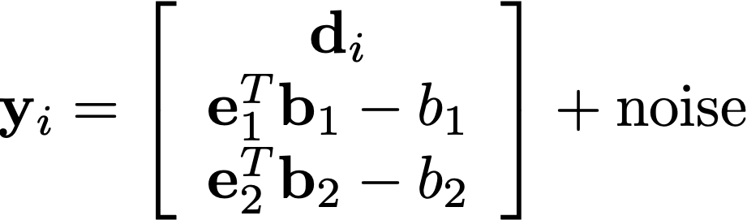
What you measure
The acceleration demand
These are known constants
Measurements from the beacons

Slide 18
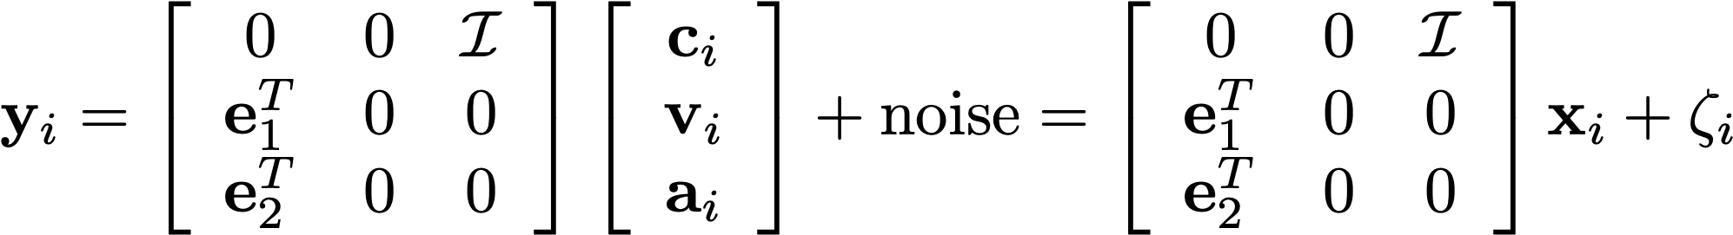

Observation model

Slide 19
The steps:
Have:
Construct:
Measurement arrives:
Now construct:
Where:

Slide 20
Summary
Modelling distributions is just maintenance on
  means, covariances
  IF
    prior is normal
    dynamics are linear + Gaussian noise
    measurement is linear+Gaussian noise
which means
  can obtain the best possible online estimate of state
    given sequence of observations
    with a straightforward recipe
consequences
  recipe for online procedures (tracking, SLAM)

