Slide 1
Multiclass classification
D.A. Forsyth,
University of Illinois at Urbana Champaign

Slide 2
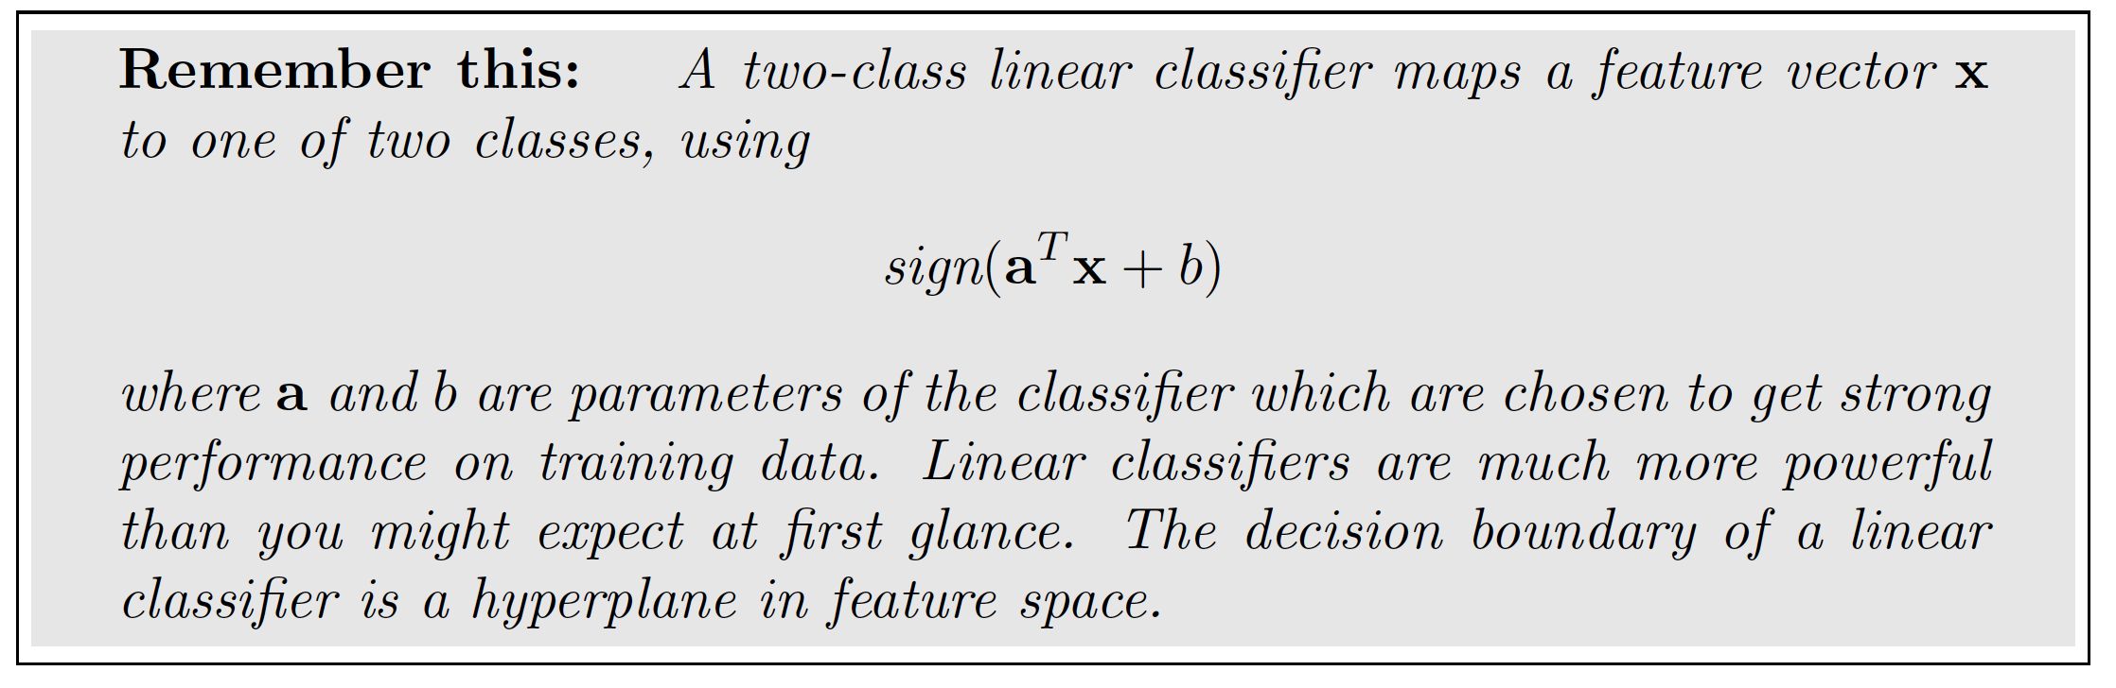
Simple, two-class linear classifier
Assume each data item is (feature vector, label)
  fv is x

Slide 3
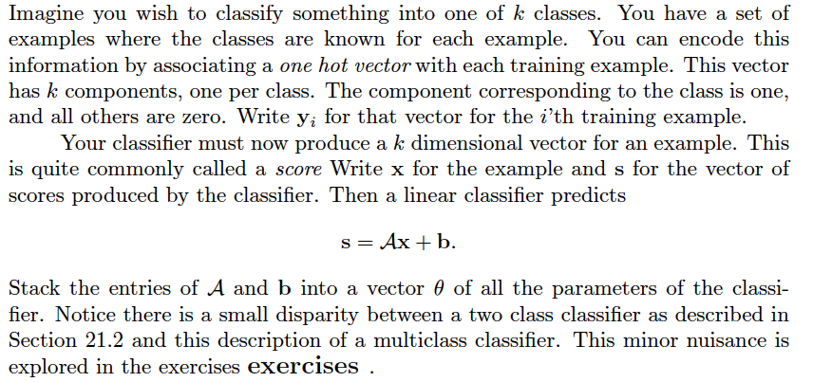
Generalizing this idea

Slide 4
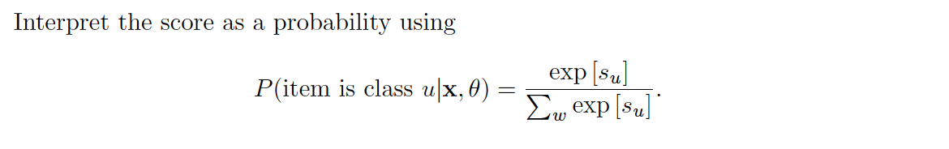
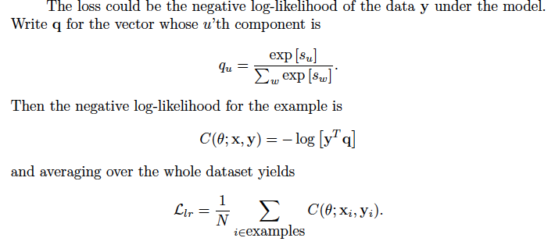
Interpreting the score

Slide 5
Compare to two classes
You could have a_1, b_1 and a_2, b_2
You get:
This all happens because probabilities sum to 1

Slide 6
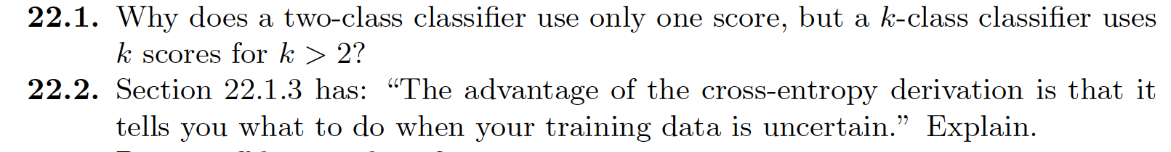
Think about this...

