Slide 1
Recovering Dense Geometry
D.A. Forsyth
University of Illinois at Urbana Champaign

Slide 2
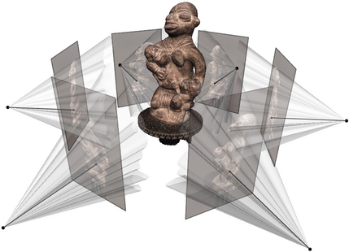
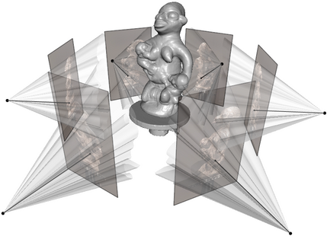
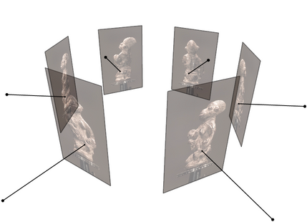
Multi-view stereo
Goal: given several images of the same object or scene, compute a representation of its 3D shape
Source: C. Hernandez, N. Snavely

Slide 3
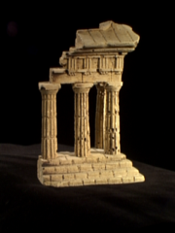
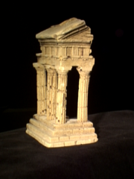
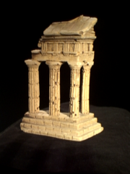
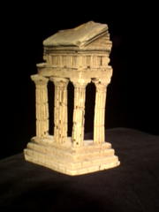
Multi-view stereo: Basic idea
Source: Y. Furukawa

Slide 4
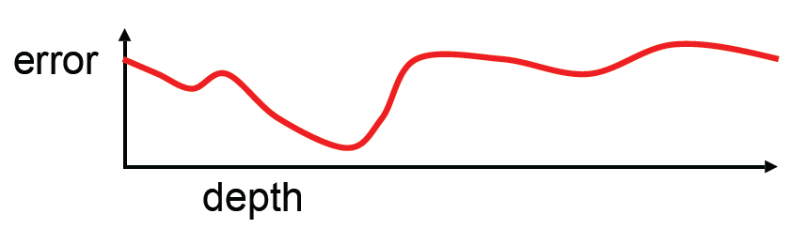
Multi-view stereo: Basic idea
Source: Y. Furukawa

Slide 5
Multi-view stereo: Basic idea
Source: Y. Furukawa

Slide 6
Multi-view stereo: Basic idea
Source: Y. Furukawa

Slide 7
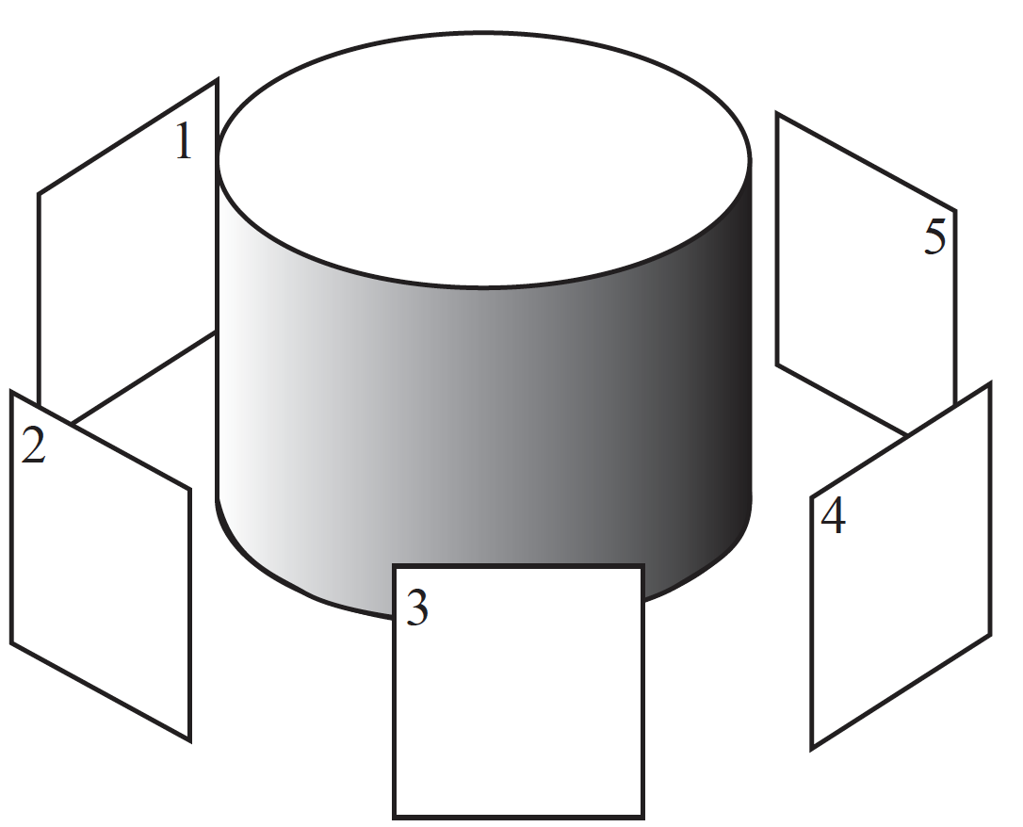
Visibility issues
1 and 2 see things that 3 and 4 can’t, etc...

Slide 8
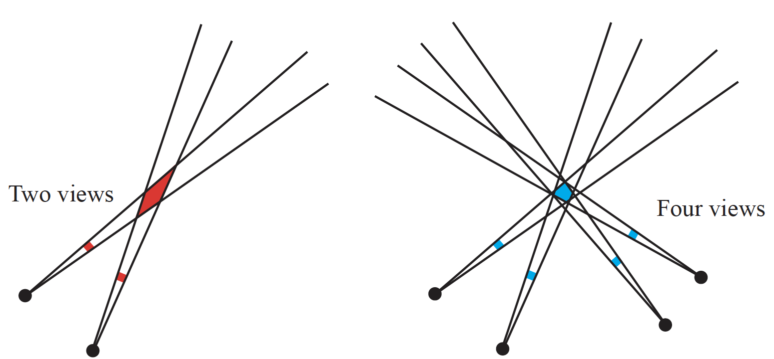
Improved error estimates

Slide 9
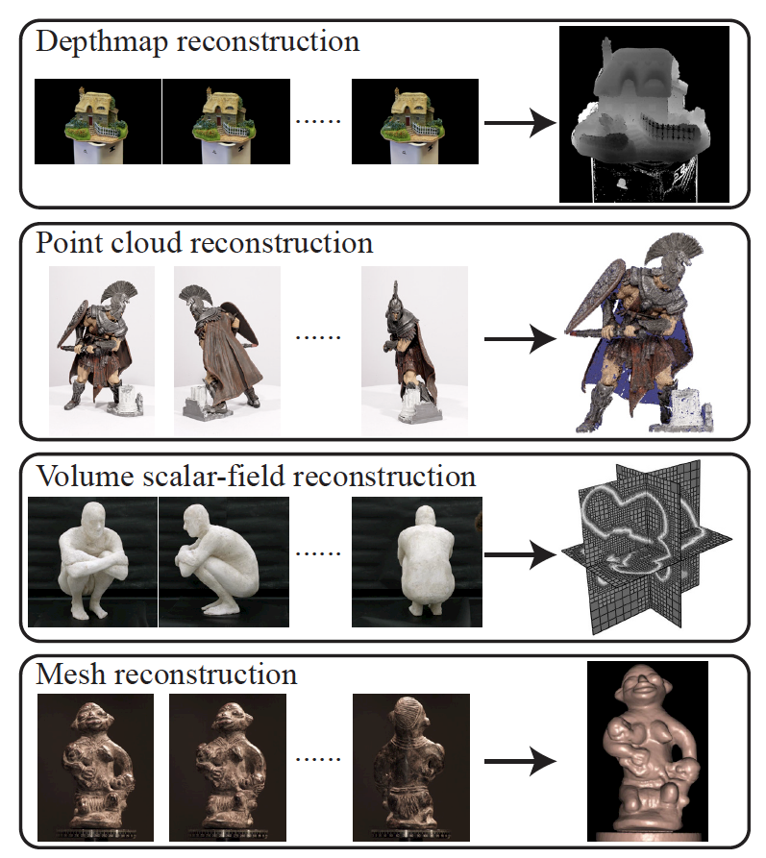
Types
Classify by type of reconstruction
  One type is missing from figure (2015!)
NeRF
  now shorthand for functional approximation to density reconstruction
Furukawa + Hernandez, 15, Multi-View Stereo: A tutorial

Slide 10
What representation of geometry?
The one that is most useful
  Geometric representation = query answer system
    (Malcolm Sabin)
Original sin of geometric modelling
  computations are easy in one rep’n, hard in another
    eg compute volume in point map?
    eg intersect two B-Reps (do-able, but a performance)
    eg intersect ray with surface
      NURBS – tricky; Sturm sequence
      Triangle mesh – straightforward
      CSG – depends on primitives, but often easy
  transforming between rep’ns can be tricky
    CSG -> mesh – easy
    mesh -> CSG - hard

Slide 11
What is it for?
Rendering
  make a new picture of this thing
  applications:
    simulation; entertainment; access to antiquities; etc
Computations
  intersection; volume; length; area; etc
  applications:
    maintenance; support construction; etc
Editing
  adjust the scene, then render some of it
    meaningful segmentation
  applications:
    simulation; entertainment; access to antiquities; etc

Slide 12
Options
Here:
  Multiple depth maps
  Point clouds
  Voxel grids
  Implicit functions
  Density functions
  Primitives
Others
  CSG rep’ns
  NURBS
  etc.

