Slide 1
Normal from single image
D.A. Forsyth,
University of Illinois at Urbana-Champaign

Slide 2
New recipe, normal case
Procedure:
  find many training pairs (image, normal)
  adjust filters so that
    Decode(Encode(image)) is close to normal
    on average, over pairs
  hope that this generalizes to new images
Result:
  Single image normal predictor

Slide 3
Normal from depth
For training:
  If you have depth data, fit a plane locally
  use the plane’s normal
Alternative:
  geometric reasoning

Slide 4
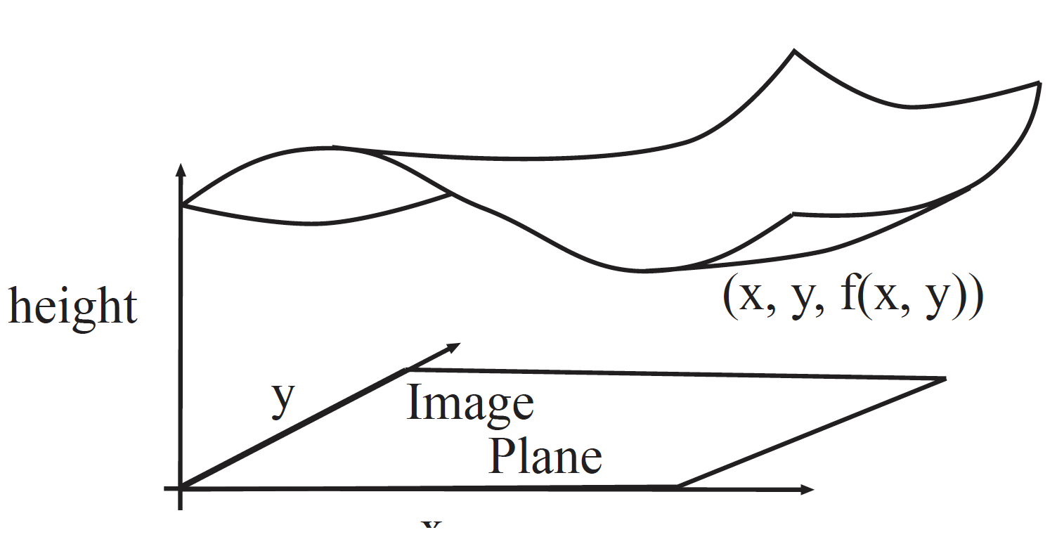
Geometrical model (for now)
At (x, y) in image, depth is f(x, y)
  We see a surface (x, y, f(x, y))

Slide 5
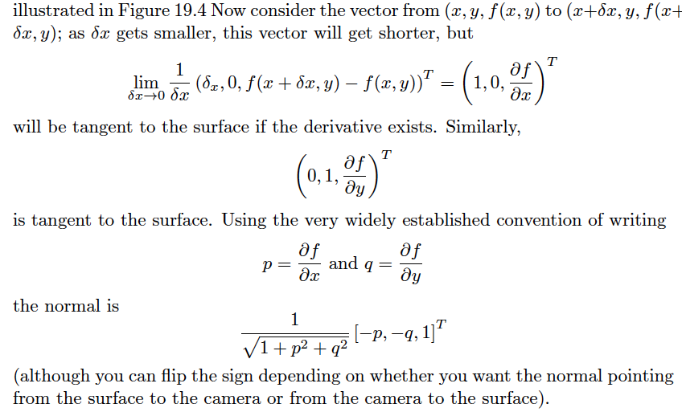
Normal from depth

Slide 6
Normal from depth
Notice that derivatives => noise problems => smoothing
Notice also that there is noise in measured depths
  (property of depth cameras)

Slide 7
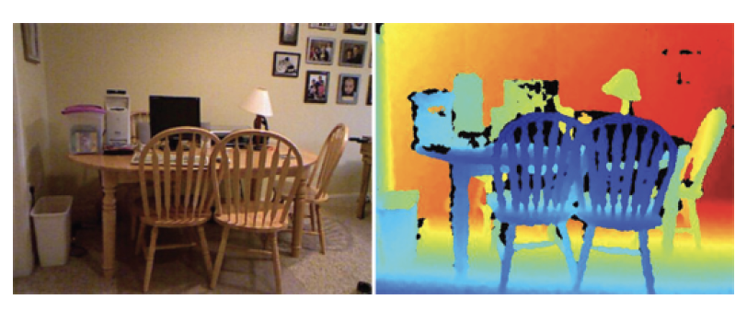
Image and depth
Data example from NYUV2

Slide 8
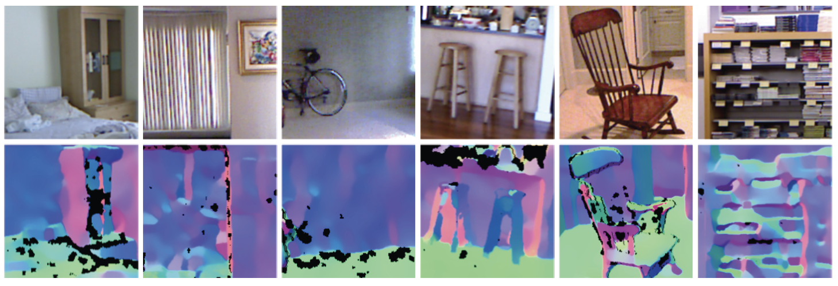
Normal estimates from depth data can be shaky

Slide 9
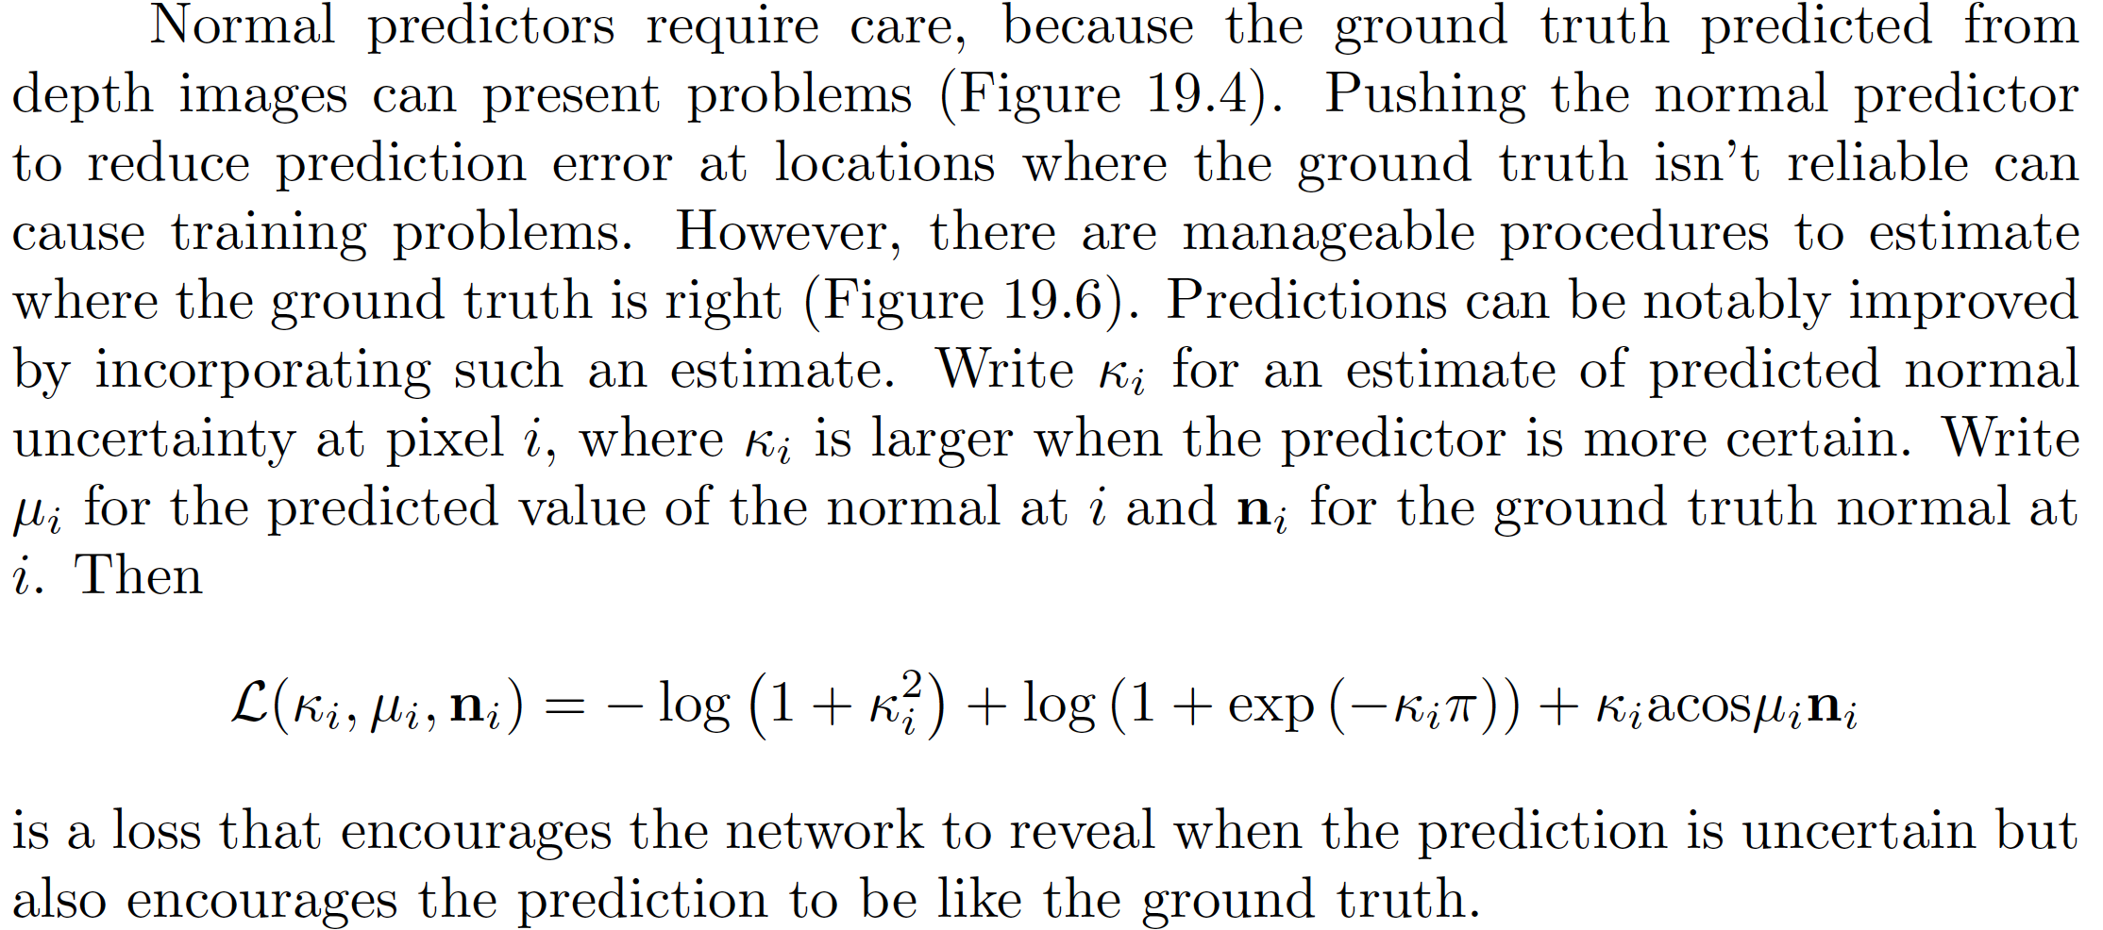
Loss – building in a confidence score

Slide 10
Rough story
If normals associated with similar patches are similar
  k can be big
If they’re not
  k must be small
Result: you can estimate k

Slide 11
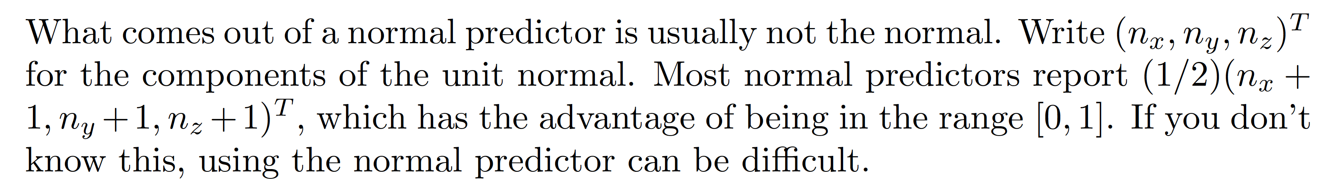
What normal predictors predict

Slide 12
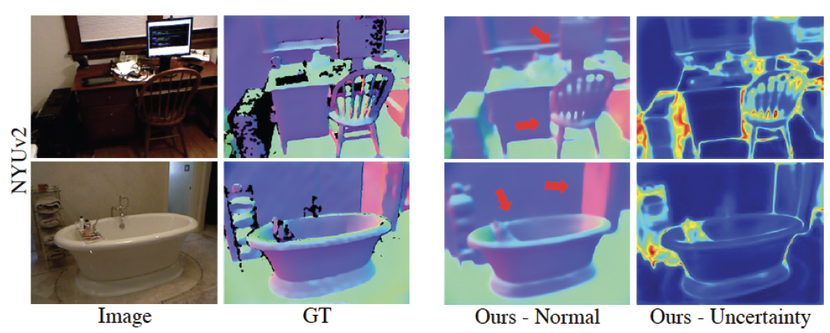
Normal predictors work really well too

Slide 13
Evaluating normal predictors

Slide 14
SOTA

Slide 15
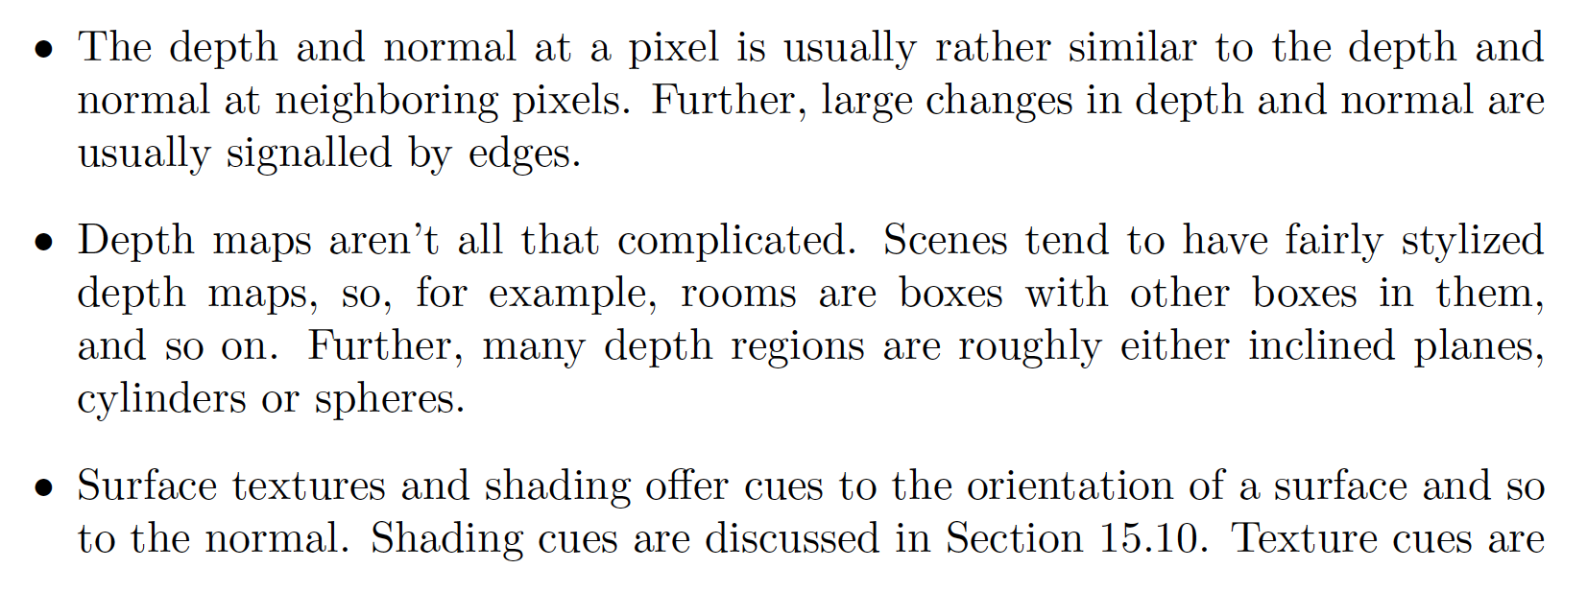
Why does all this work? I

Slide 16
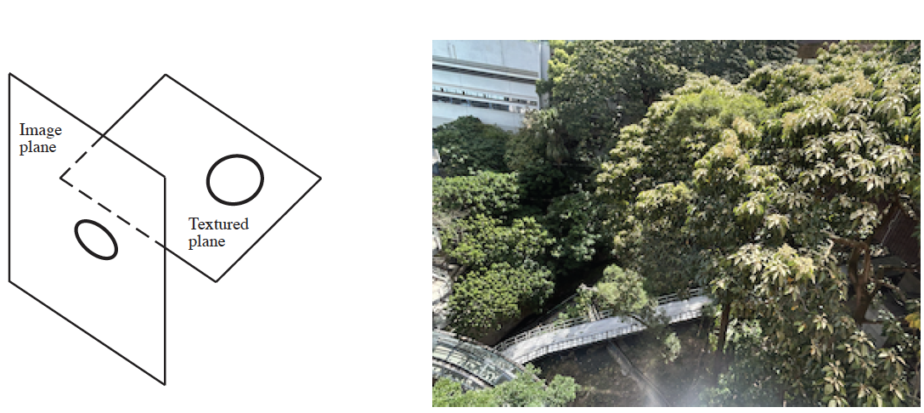
Why does all this work? II
Texture deformations are a cue to normals
  (archaic term: shape from texture)

Slide 17
Depth and normal are linked
You can predict normal from depth
You can predict depth from normal (next slide)
Idea:
  train depth and normal predictors together
    with a consistency loss
  improvements manifest

Slide 18
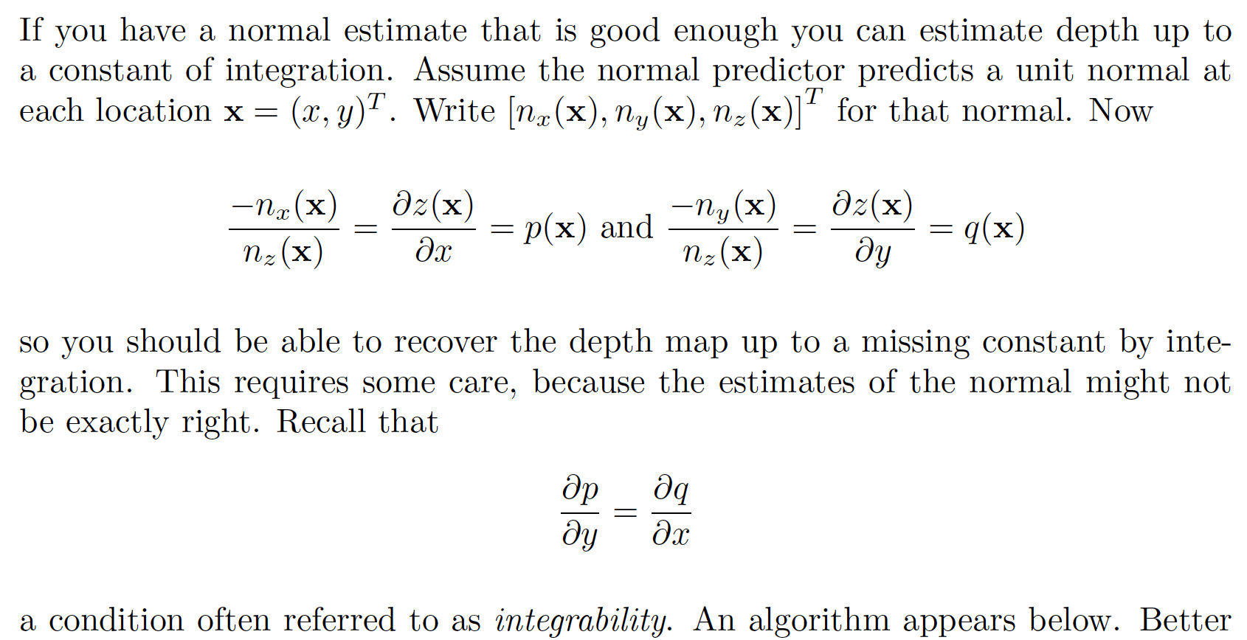
Depth from normal

Slide 19
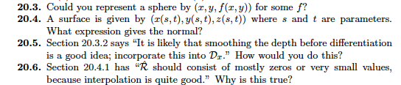
Things to think about...

