Slide 1
Object detection – general points
D.A. Forsyth
University of Illinois at Urbana Champaign

Slide 2
Classification vs detection
Classification:
  there is an X in this image
    what
Detection:
  there is an X HERE in this image
    what AND where
Key issues
  how to specify where
  relationship between what and where
  efficiency, etc
  evaluation
    surprisingly fiddly

Slide 3
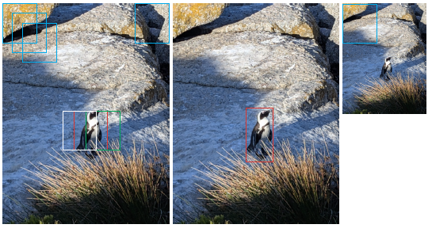
Basic architecture

Slide 4
Need..
to control the number of boxes checked
to manage the classifier
  may see lots of negatives
  must be willing to respond when box isn’t precise
to manage high-scoring boxes
  non-maximum suppression
to refine boxes

Slide 5
Three helpful points
Correlated scores
  boxes overlap, so box scores are correlated
Extrapolating box scores
  manageable, because they are correlated
  bounding box regression
Worthwhile windows
  surprisingly, you can tell whether a box contains an object, even without specifying the object
  means you can reduce the number of boxes you show to classifier

Slide 6
Two threads
Localize then classify
  find boxes that likely contain objects
  decide what is in the box
YOLO: Localize while classifying
  in parallel, score
    boxes for “goodness of box”
    boxes for “what is in it”
  combine

Slide 7
Evaluating detectors
Compare detected boxes w ground truth boxes
Favor
  right number of boxes with right label in right place
Penalize
  awful lot of boxes
  multiple detections of the same thing
Strategy
  Detector makes a ranked list of boxes
  GT is a list of boxes
  Mark detector boxes with relevant/irrelevant
  summarize lists

Slide 8
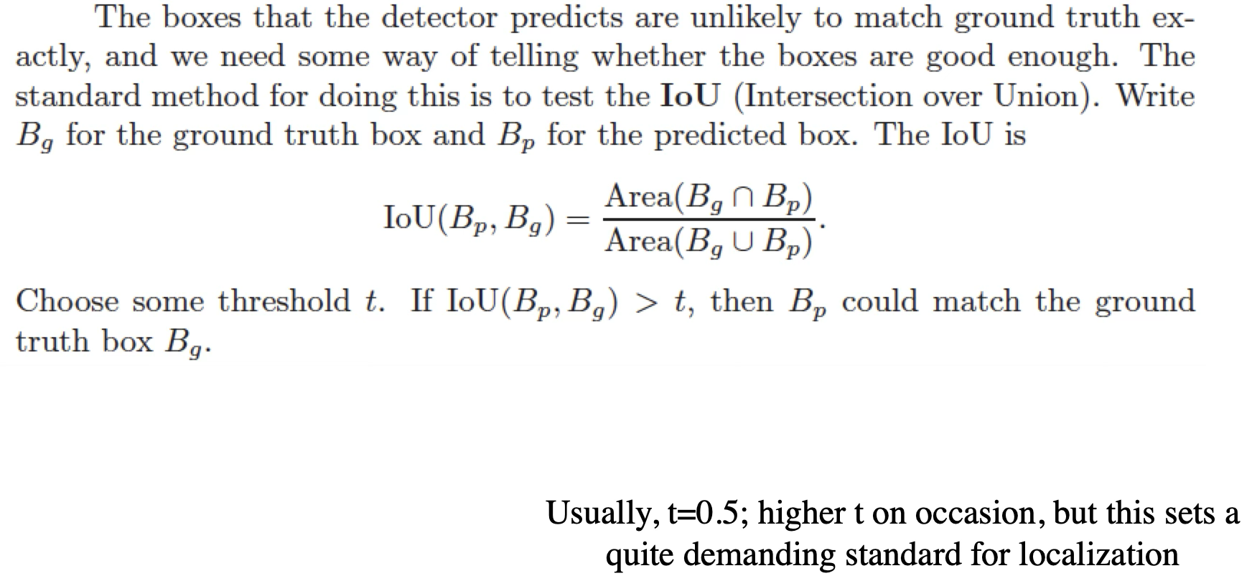
IoU

Slide 9
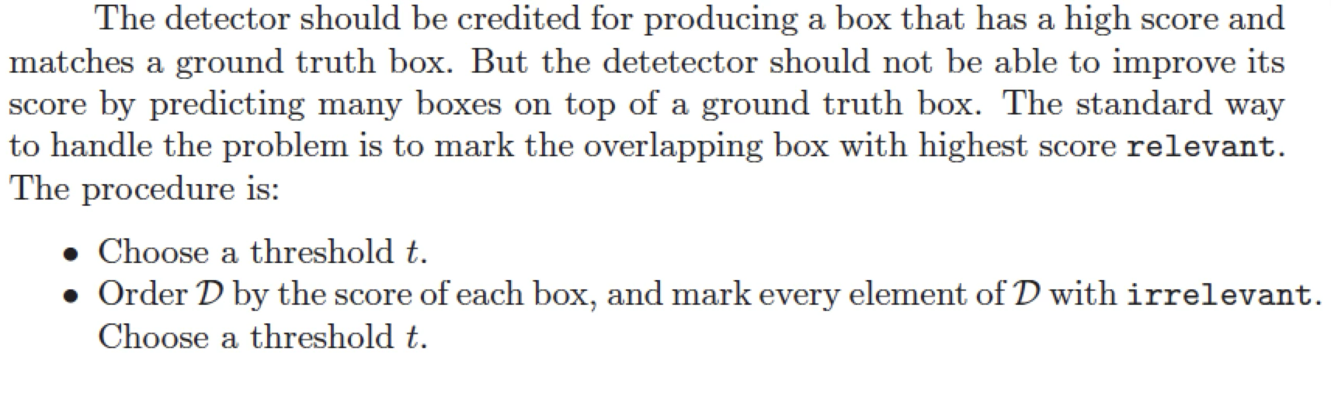
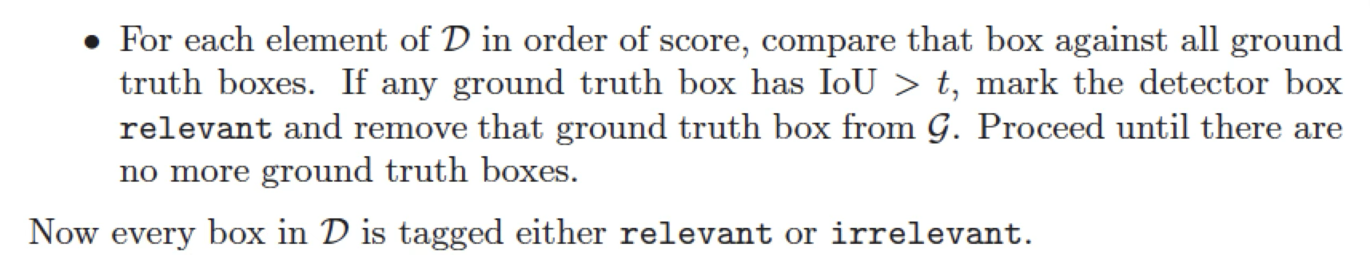
Preventing double dipping

Slide 10
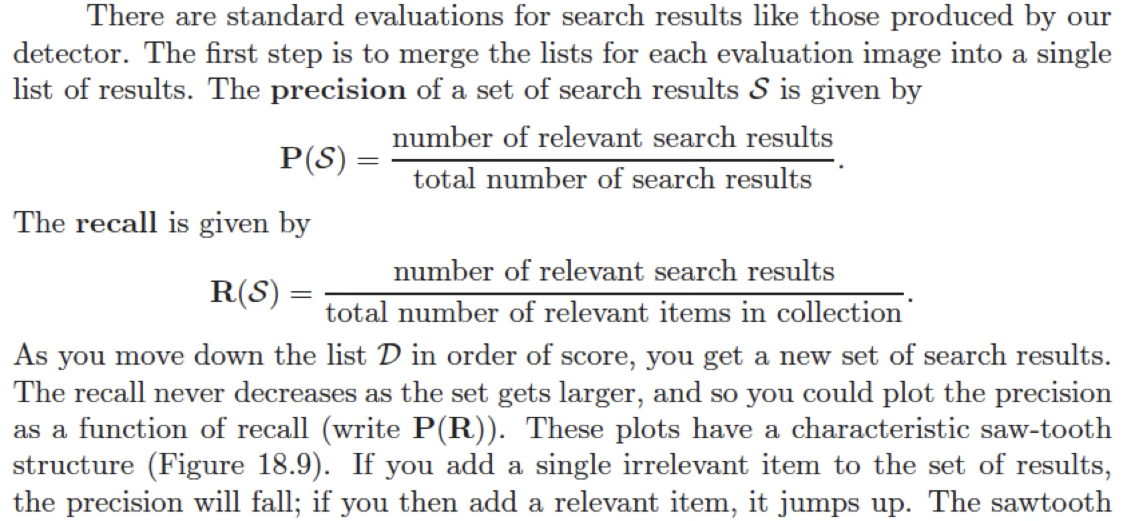
Recall and precision

Slide 11
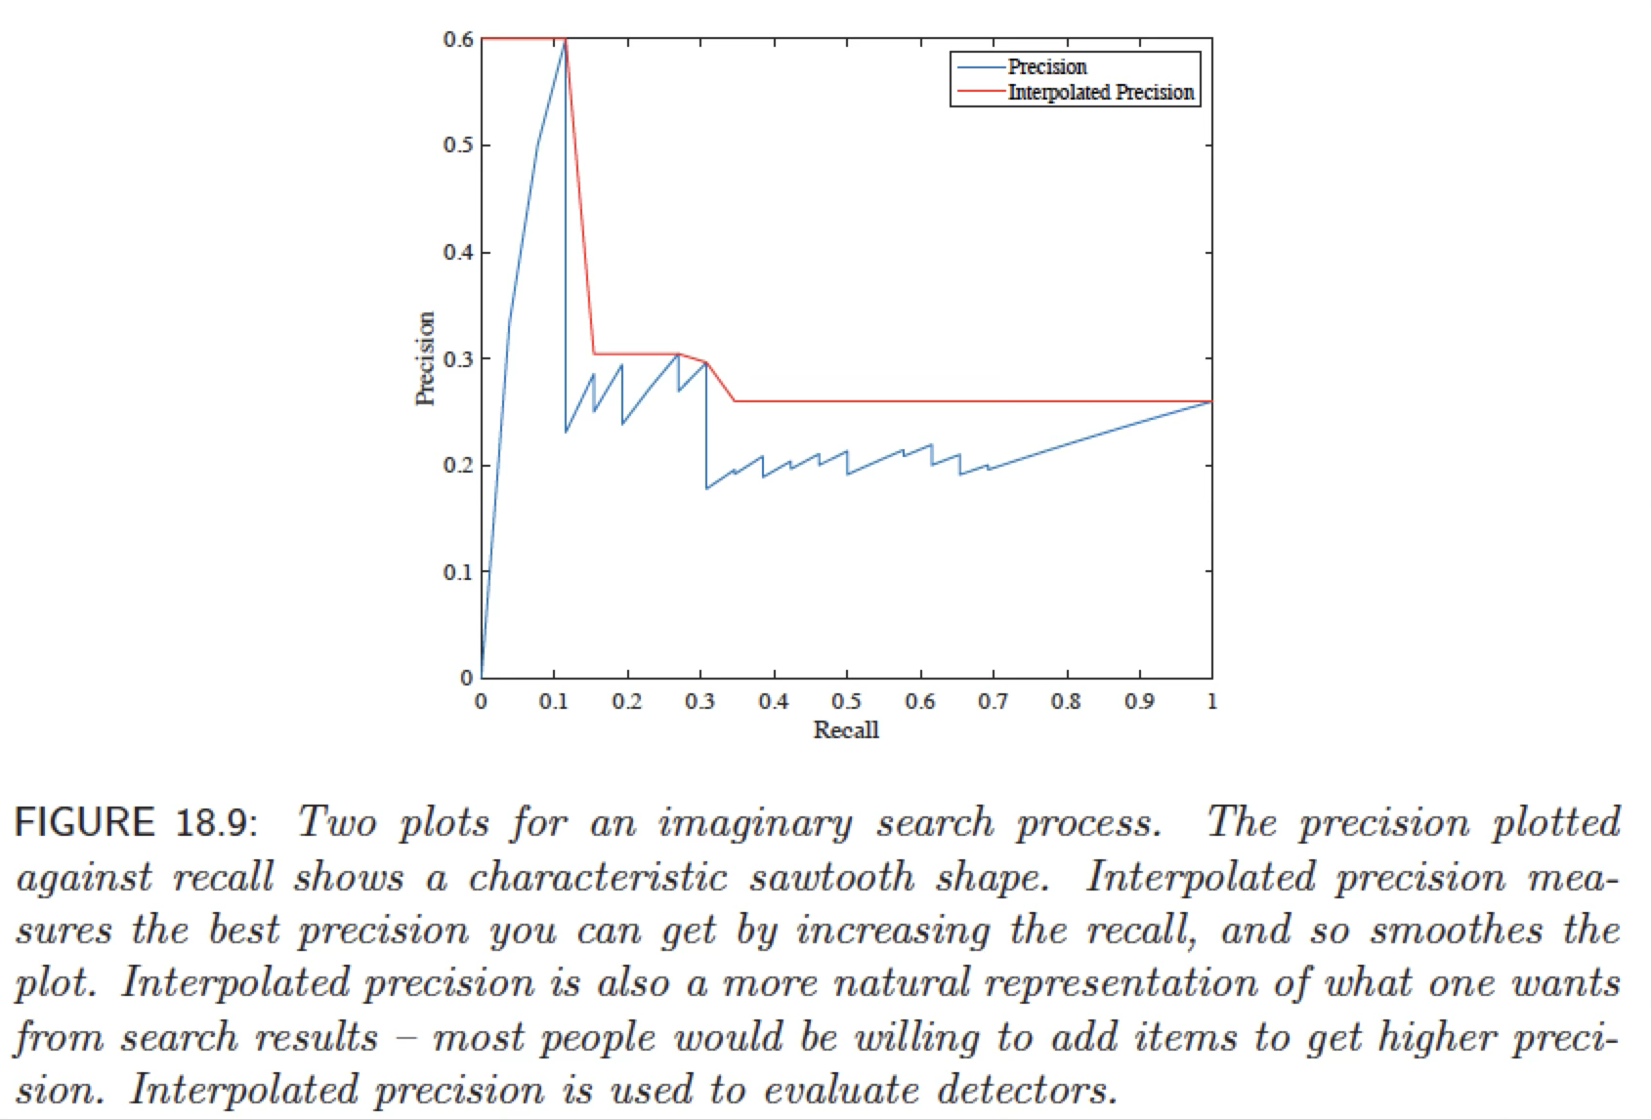
Interpolated precision

Slide 12
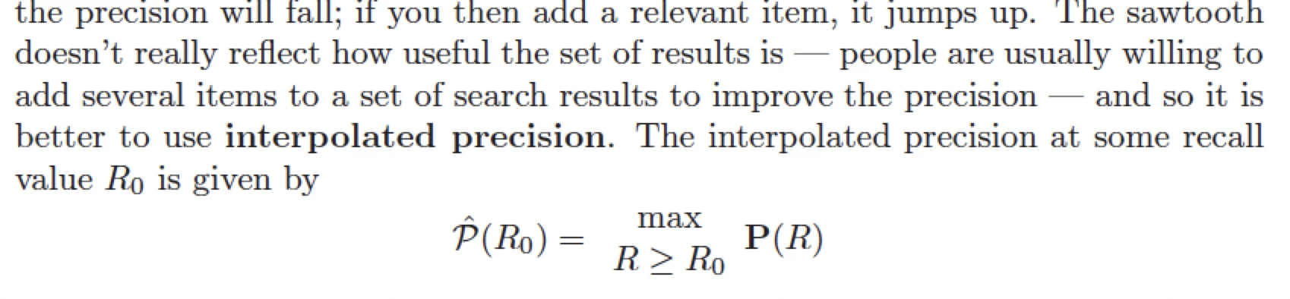
Interpolated precision

Slide 13
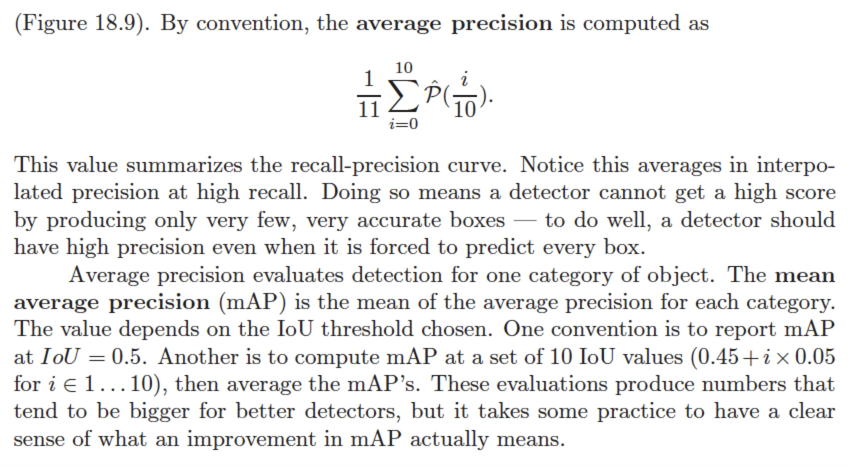
MaP

Slide 14
Variants...
Weight the mean by the frequency of objects
  options:
    emphasize common, easy objects (weight down rare)
    emphasize rare objects (weight down common)
IoU can be computed for things other than boxes

Slide 15
Think about this...
Why is it possible to tell whether a box has an object in it with moderate accuracy, independent of the object identity?
Why should something like bounding box regression work?

