Slide 1
Two view odometry
D.A. Forsyth
University of Illinois at Urbana Champaign

Slide 2
Monocular visual odometry
A calibrated camera
  views a static scene,
  moves,
  views again
Q: how did it move?
  We care, because this allows us to recover movement from single cameras
  We should be able to tell
    Recall epipoles etc are quite informative about movement

Slide 3
Visual odometry
Use eight point algorithm, recover fundamental matrix
Recall:
But we know calibration, which yields essential matrix
Q: what can we get out of essential matrix?

Slide 4
Visual odometry, II
Antisymmetric
Unknown constant
Rotation

Slide 5
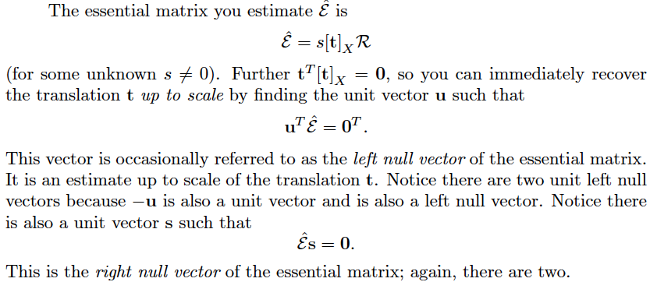
Translation

Slide 6
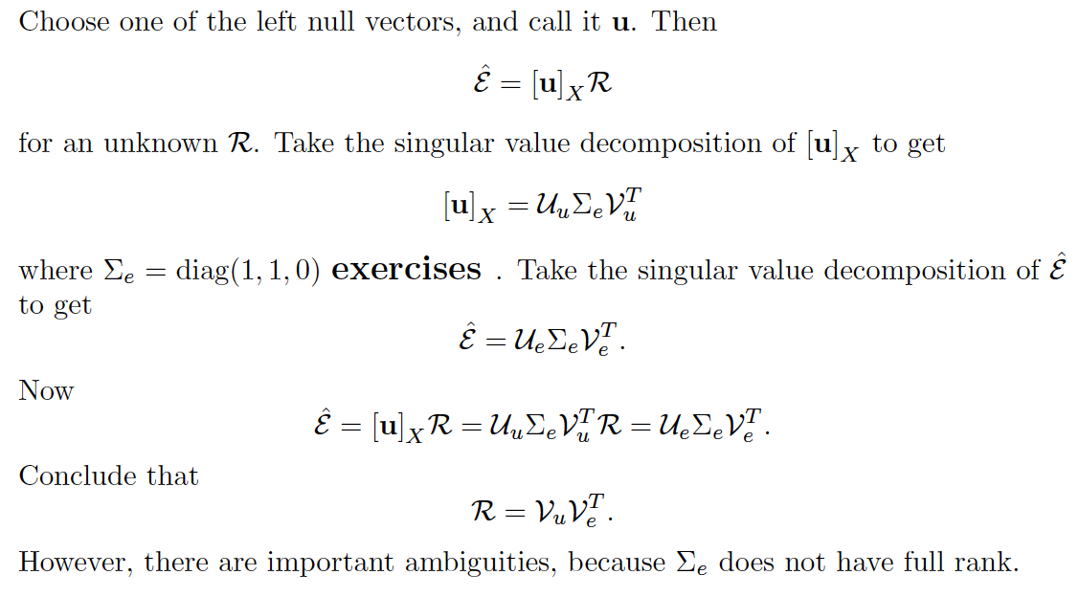
Rotation

Slide 7
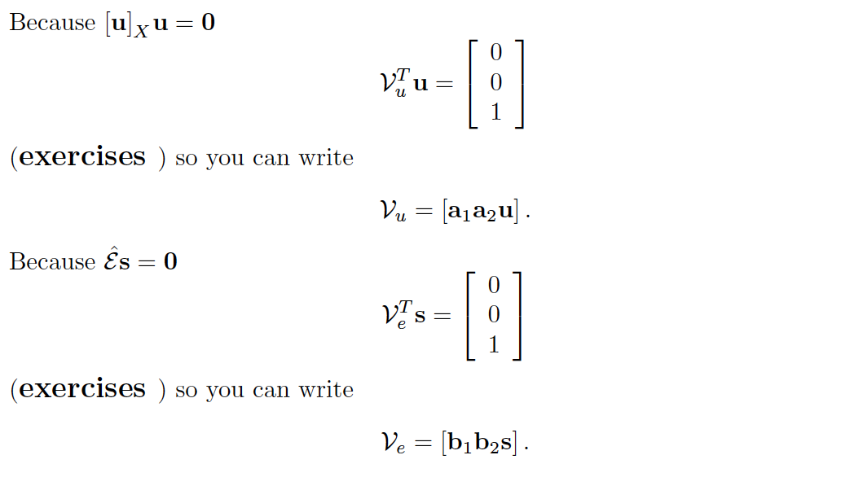
Ambiguities - I

Slide 8


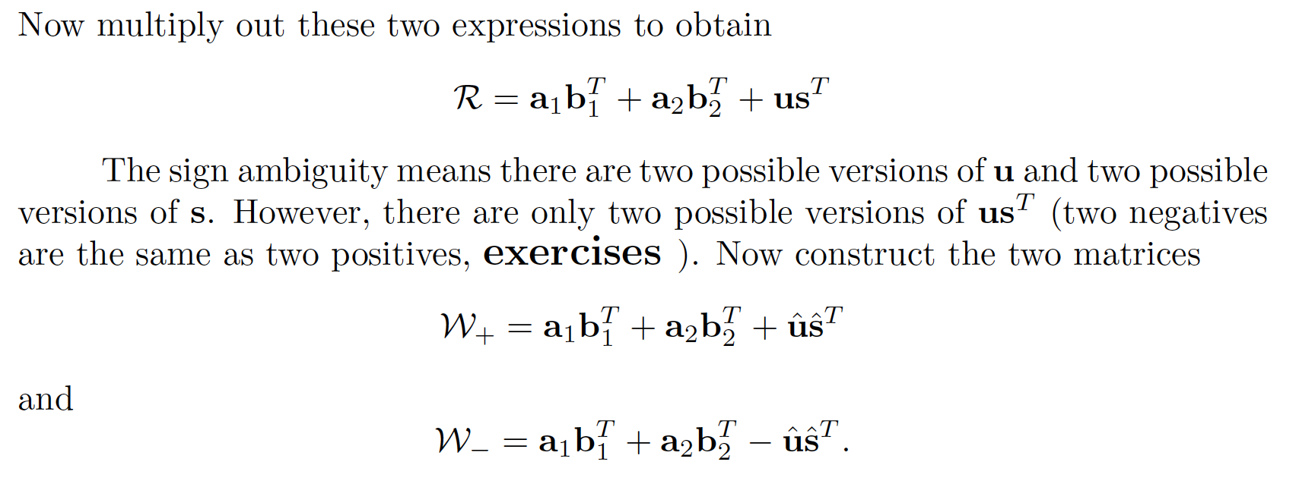
Ambiguities - II

Slide 9
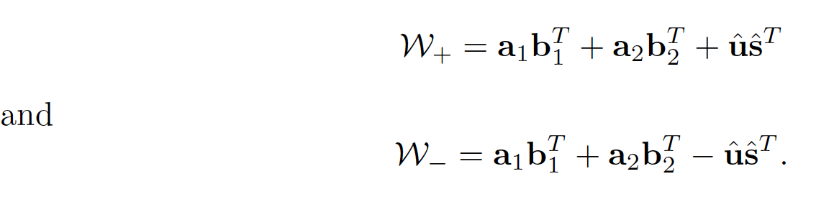
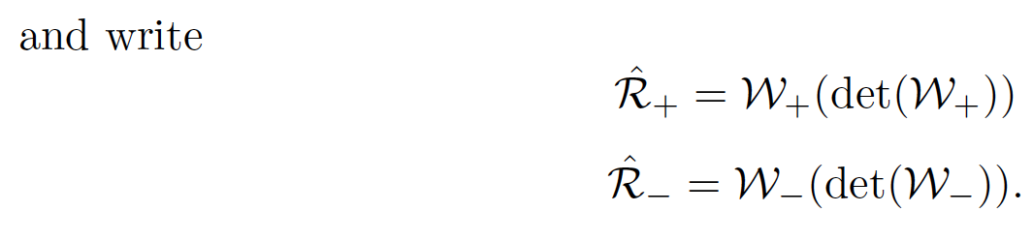
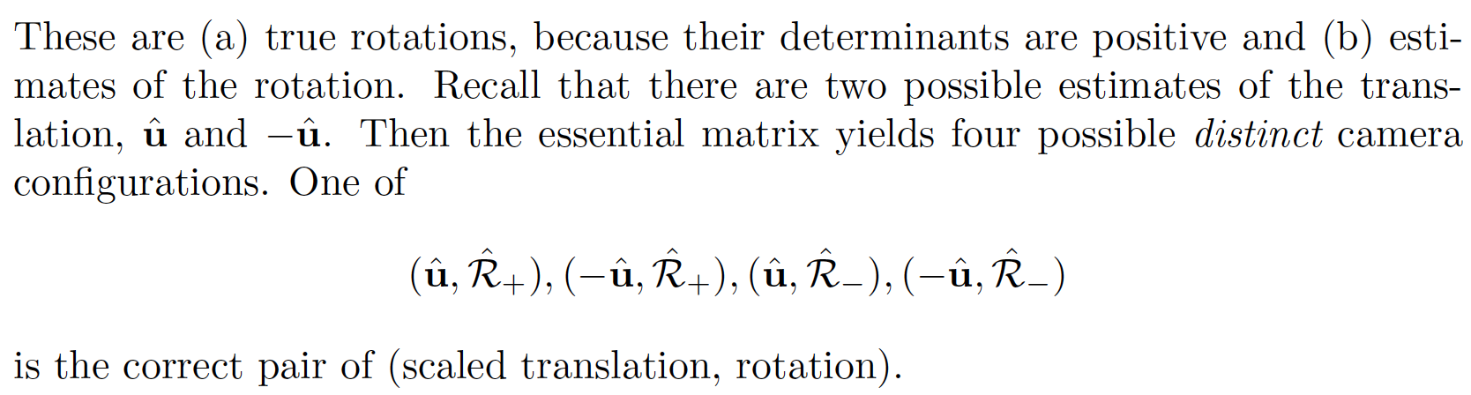
Ambiguities - III

Slide 10
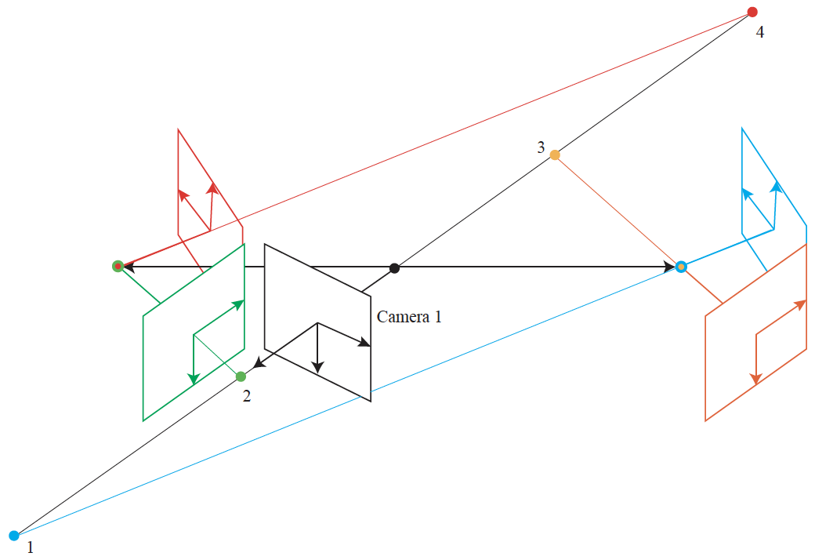
Ambiguities - IV
General case: only one reconstruction has the point
in front of both cameras (green one)

Slide 11
Visual odometry, VII
So we can recover
  Rotation exactly
  Translation up to scale
From an essential matrix
  which we can recover from correspondences
    obtained using RANSAC+eight point algorithm
  and camera calibration matrices

