Slide 1
Object detection: where then what
D.A. Forsyth
University of Illinois at Urbana Champaign

Slide 2
Faster RCNN
Ideas:
  Sample the world of boxes
  Decide which boxes are worth looking at
  Score boxes
  Cleanup
    Threshold
    Non-maximum suppression
    Bounding box regression
Build all this on top of an image encoder

Slide 3
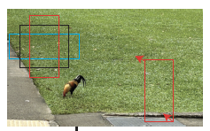
Sampling the world of boxes
4 dimensional
  boxes are axis aligned (eg top left, bottom right)
Samples don’t need to be uniform across dims
Sampling:
  Even grid of centers across image (S x T)
  At each center, 3 scales and 3 aspect ratios

Slide 4
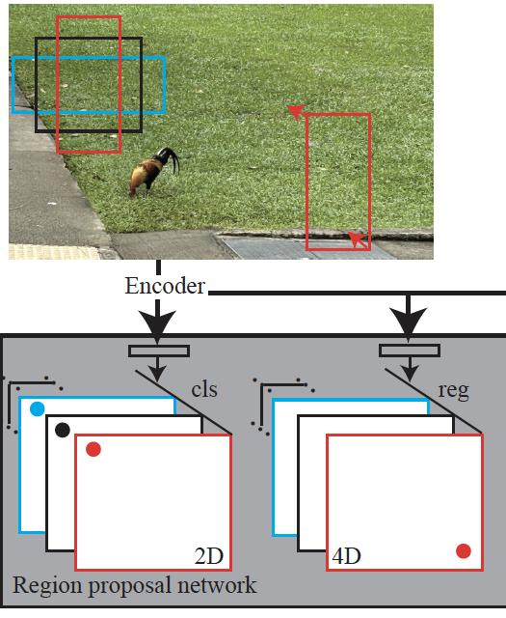
Which boxes are worth looking at
Region proposal network produces:
  (2x9)xSxT block of box scores (cls)
    objectness score
  (4x9)xSxT block of offsets (reg)
    mild improvement to box corners to get score

Slide 5
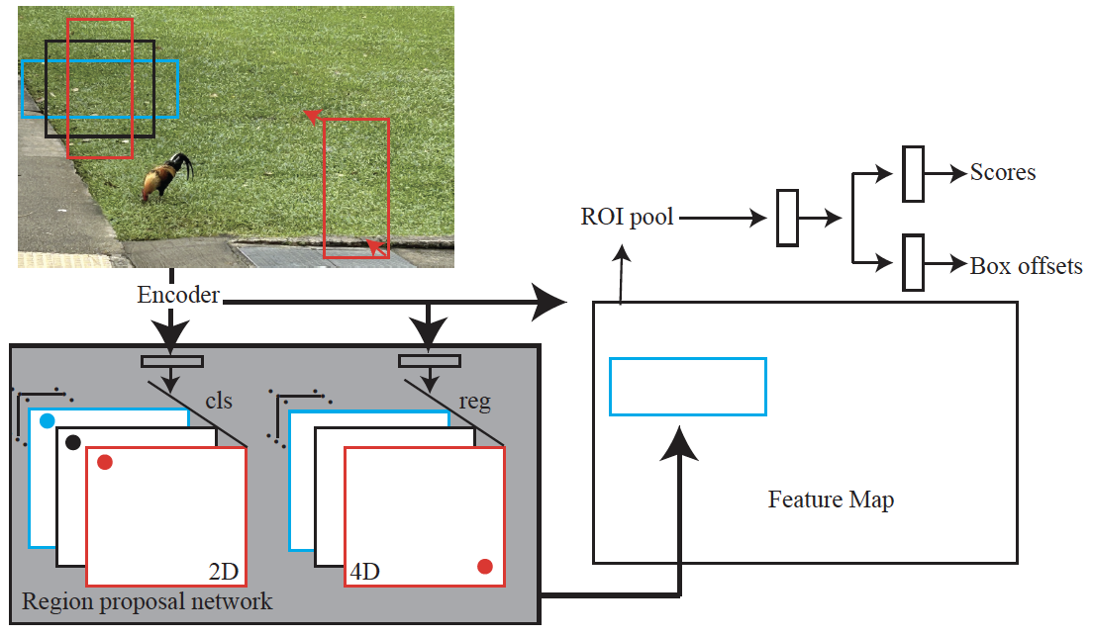
Scoring the boxes
Adjust feature map
region to fixed size
Cut out feature
map region for
box
Choose some RPN boxes

Slide 6
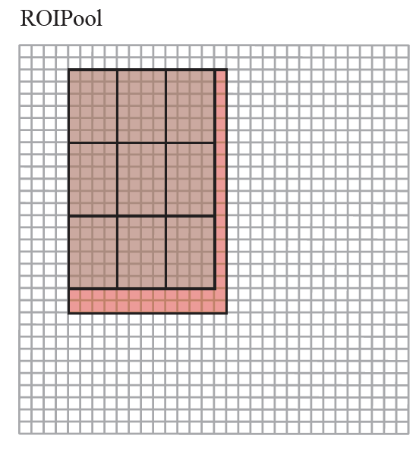
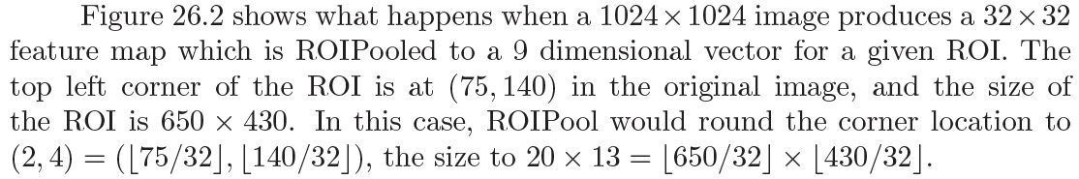
Adjusting the feature map region
Find corresponding window
  by rounding
Within subgrid, max-pool
  subgrid by rounding

Slide 7
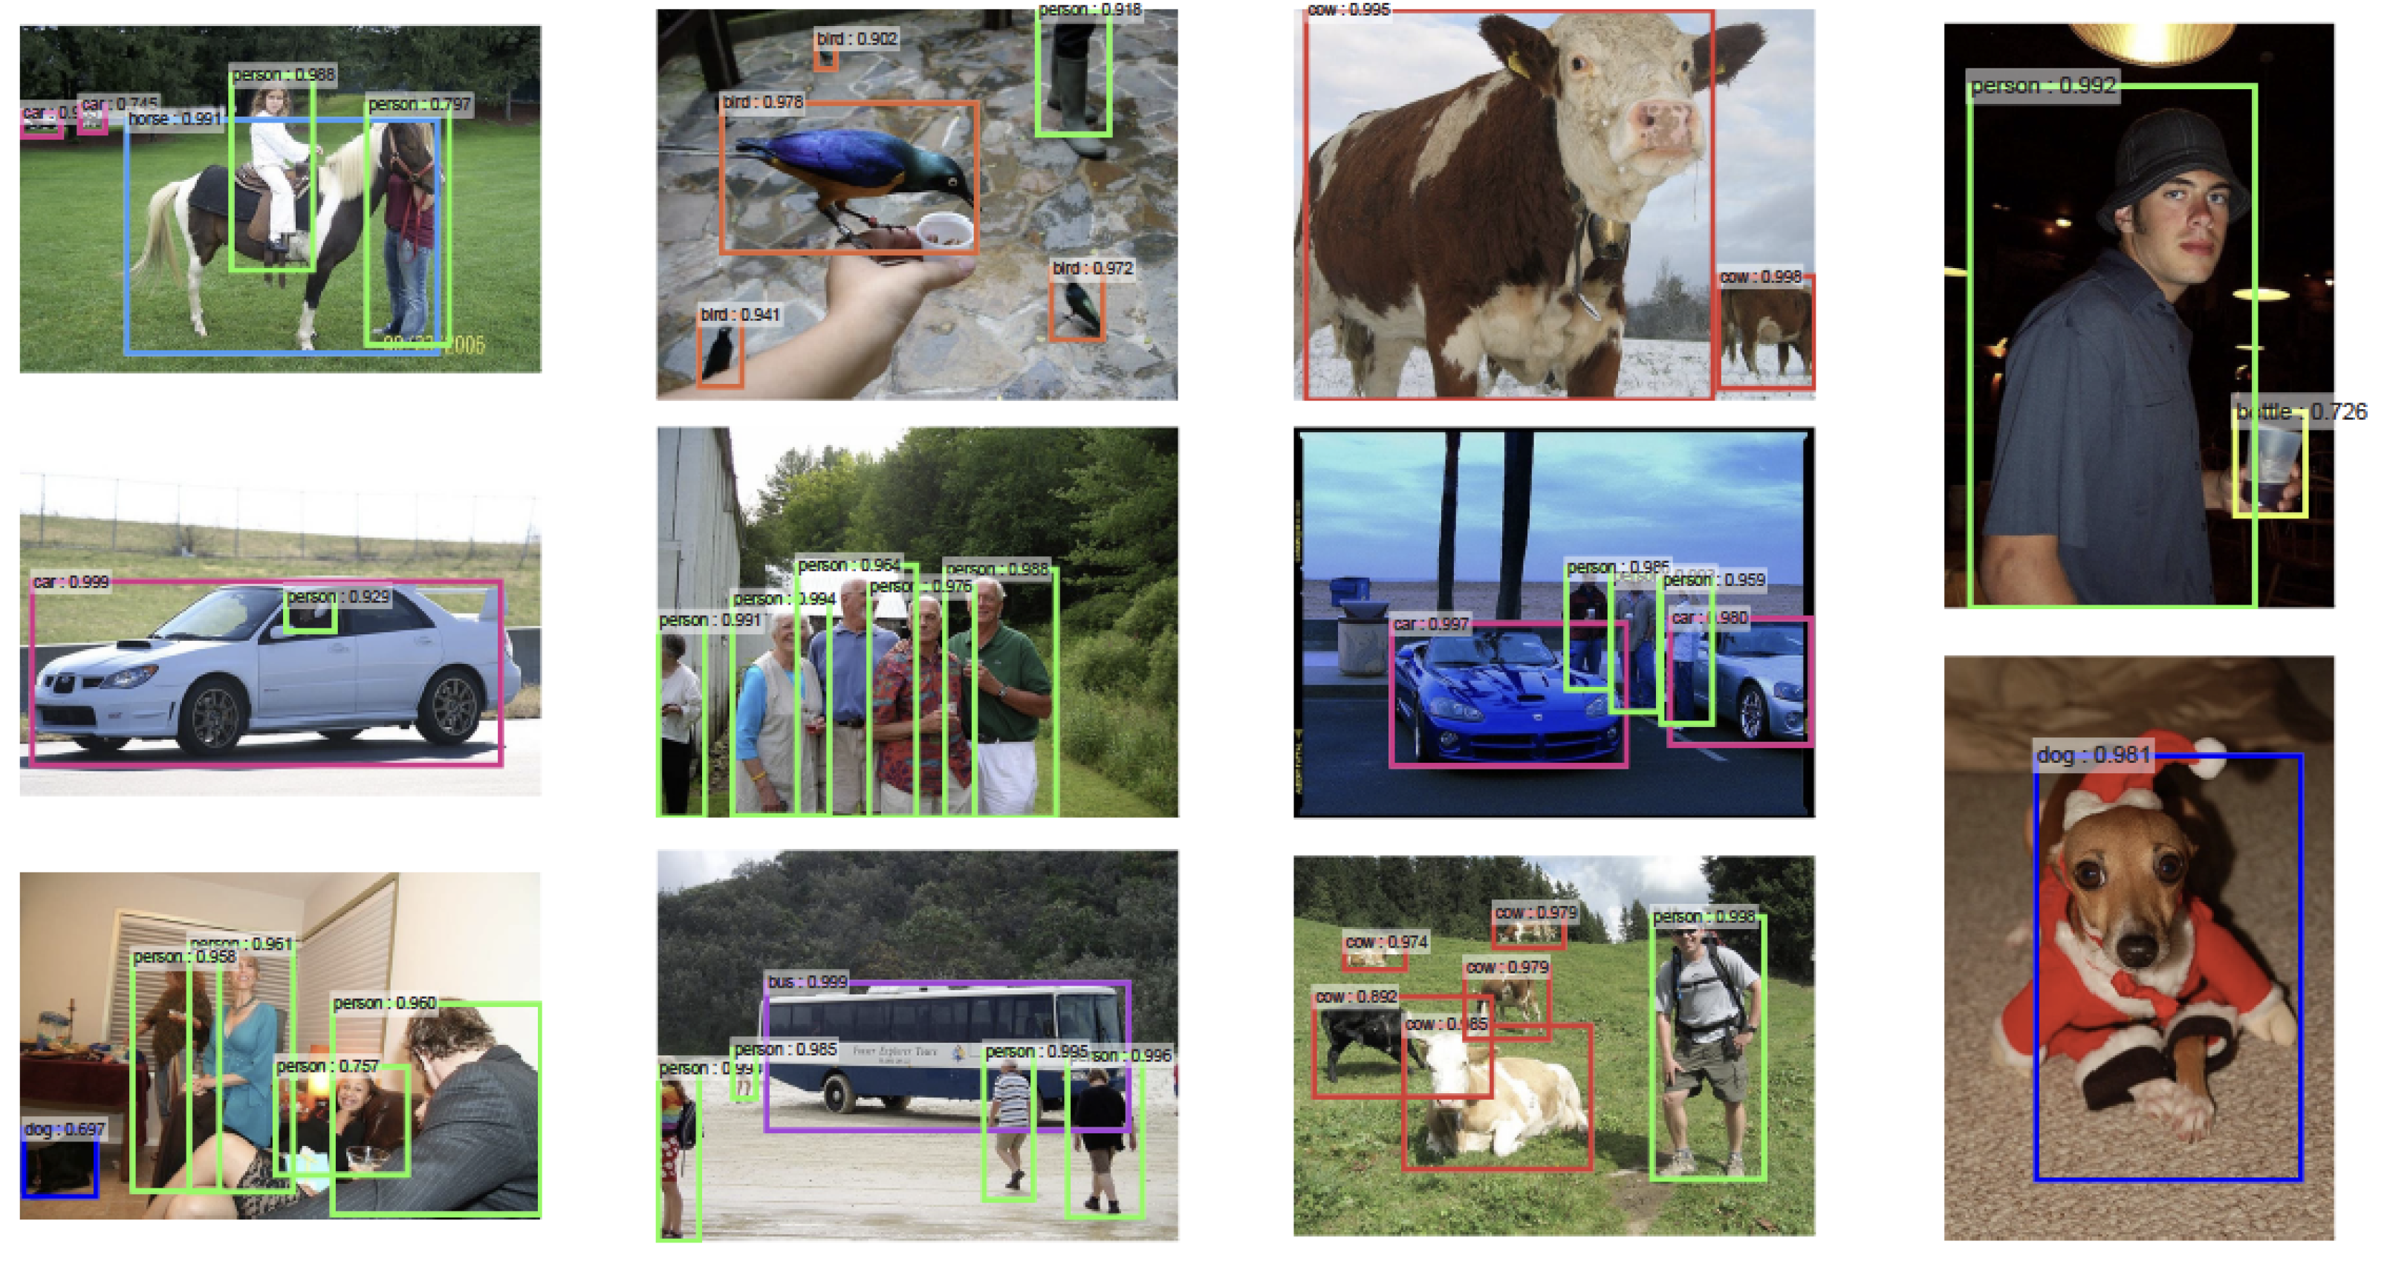
Detection

Slide 8
Training requires care
Data:
  labelled boxes on images
I) Train RPN using pretrained encoder
  Finetune ImageNet encoder
  Note class imbalance
    there are more empty than object boxes
II) Train classifier using pretrained encoder
  Finetune different ImageNet encoder
  Use RPN boxes (now two encoders!)
III) Finetune RPN layers on fixed encoder from II
IV) Finetune classifier, etc
  using RPN, encoder from III

Slide 9
Mask RCNN
Would like a better localization of object
Get by:
  modifying ROIPool
  decoding result into mask as well.

Slide 10
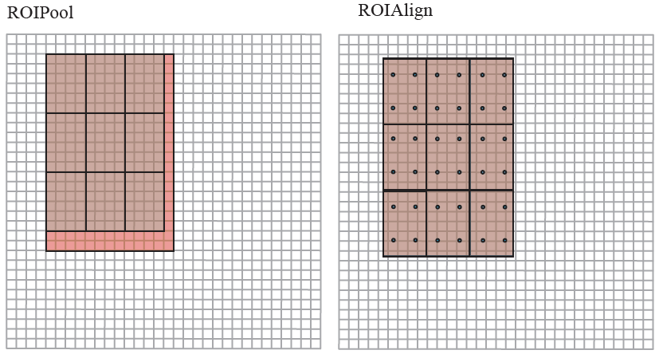
ROIAlign preserves spatial detail

Slide 11
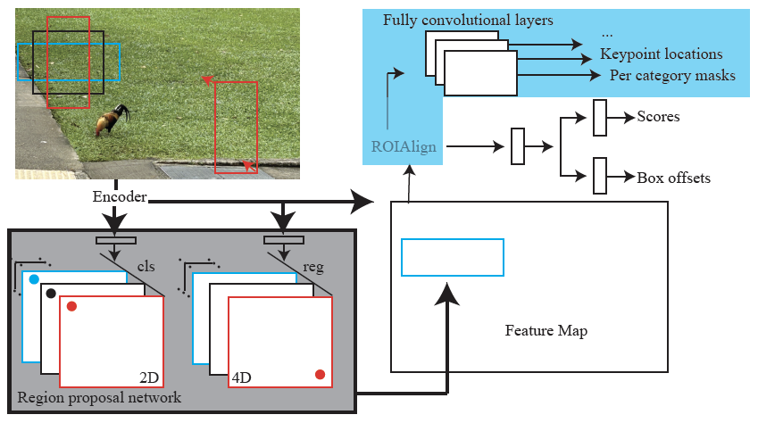
MaskRCNN
New stuff
Adjust feature map
region to fixed size
Cut out feature
map region for
box
Choose some RPN boxes

Slide 12
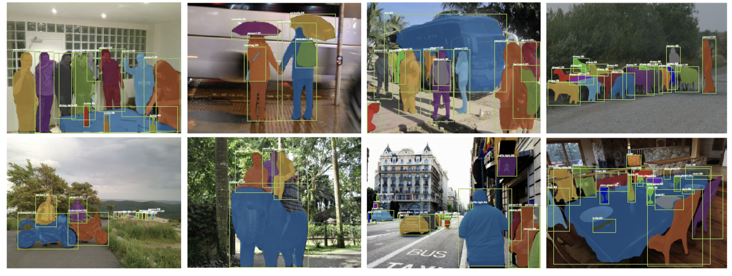
Detection with masks
Evaluation:
  you can compute IoU for masks, too...

Slide 13
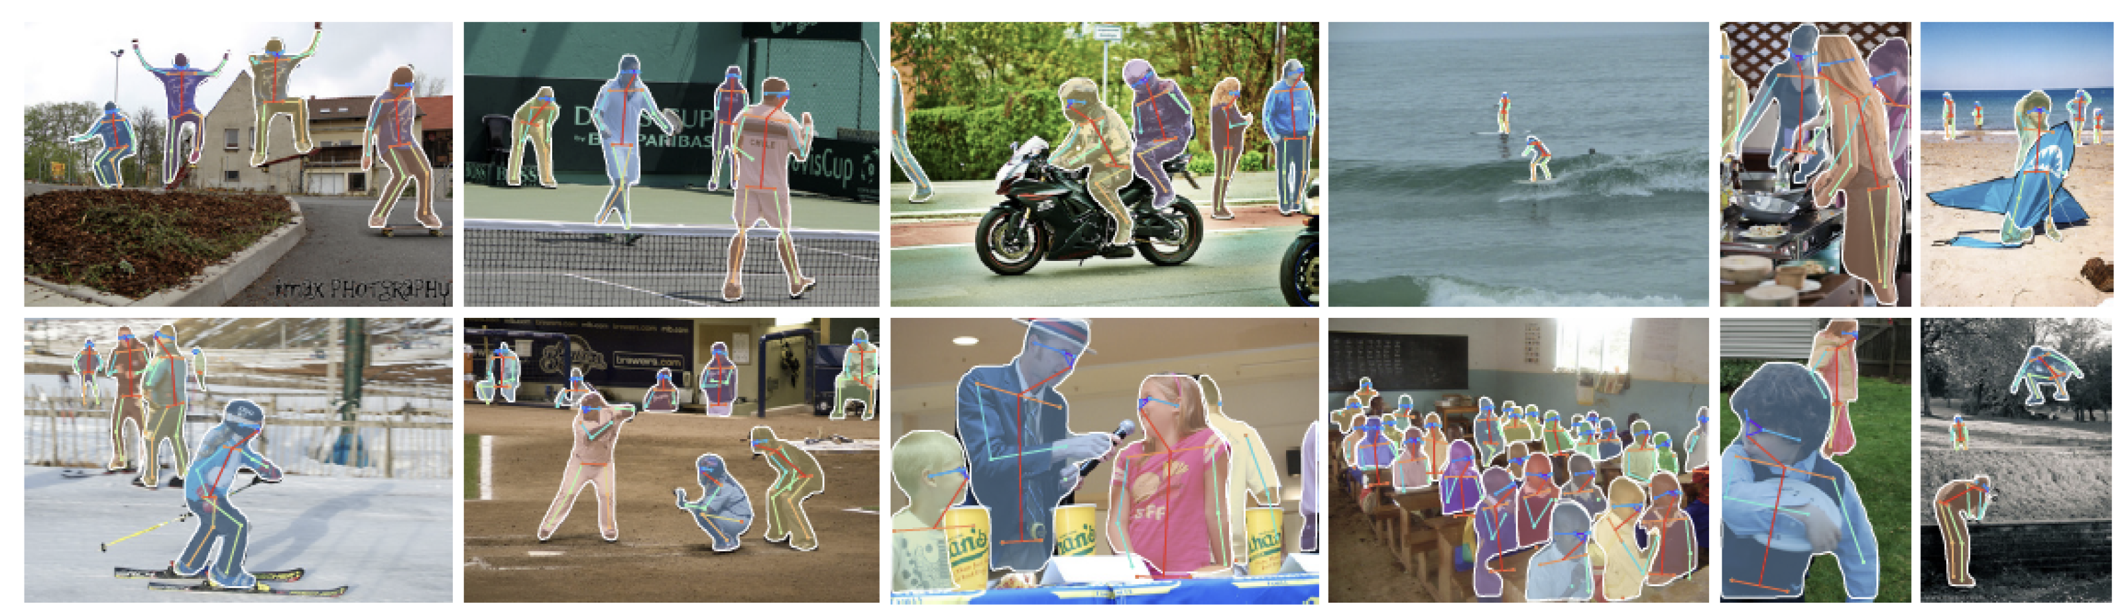
Variants
Predict more stuff from ROI
  eg body keypoints
Bolt onto a semantic segmenter
  to get panoptic segmentation

Slide 14
Became Detectron, Detectron 2
https://detectron2.readthedocs.io/en/latest/

Slide 15
Things to think about...
What other useful things could you predict with MaskRCNN?
How do you guarantee performance?

