Slide 1
Object detection: Where and What together
D.A. Forsyth

Slide 2
Yolo
Predict box objectness score, label scores indep.
Process:
  split image into grid
  each cell predicts box location, confidence
  each cell predicts a class probability
  multiply box and class probabilities
  cleanup
    threshold, NMS

Slide 3
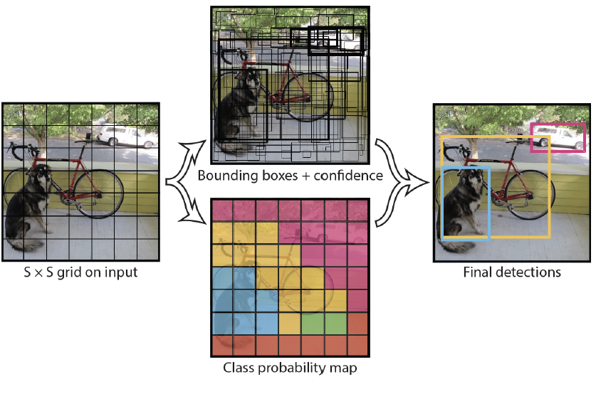

Slide 5
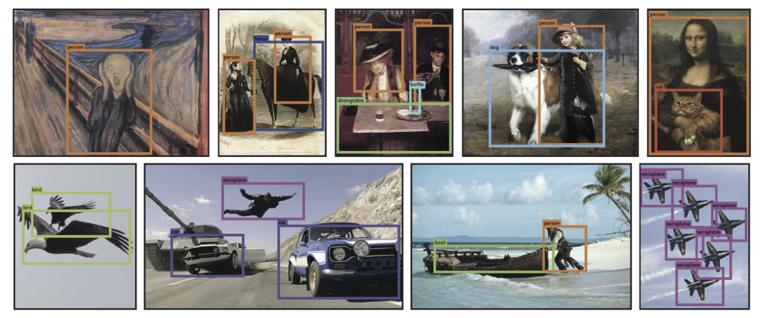
Original caption: “YOLO running on sample artwork and natural images from the internet. It is mostly accurate although it does think one person is an airplane”

Slide 6
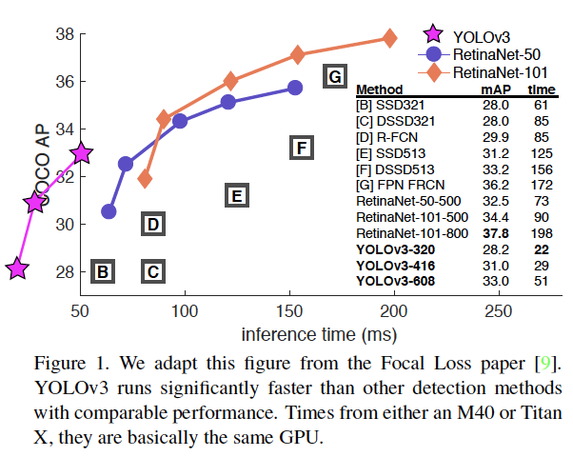
Speed/accuracy payoffs
Figure from: “YOLOv3: An Incremental Improvement”

Slide 7
Yolo variants are maintained
At V.11 now
Still very widely used
Training is relatively straightforward

Slide 8
Things to think about
Why does this work?
What if there are very many objects?
What if there are small objects?
Could YOLO produce masks?

