Slide 1
Estimating Optic Flow with Regression
D.A. Forsyth,
University of Illinois at Urbana Champaign

Slide 2
Change what the decoder does...
Regression – predict “image like thing” from image
An “image like” thing
  may have the same resolution as the image
  continuous (not categorical)
  lots of examples
  can be predicted from an image (but how do we know?)
Examples:
  depth
  normal
  defogged image
  superresolution
  lots of others..
Why not predict flow?

Slide 3
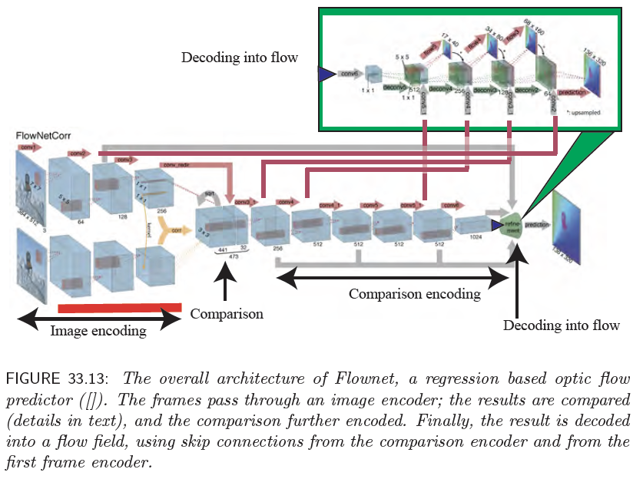

Slide 4
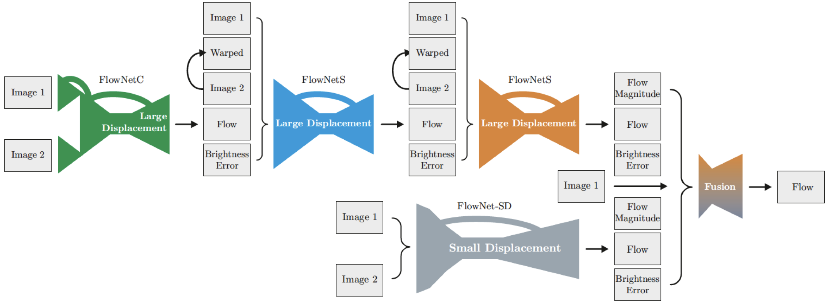
More flownets => better results
Notice analogy with incremental flow estimation
  also, multi scale

Slide 5
More flownets => better results
Warp image 2 backward along flow;
should look like 1
image 1 – warped 2;
cue to flow errors

Slide 6
More flownets => better results
Large displacement has larger stride;
better at large flows
Fewer small displacement
flownets, because small
small displacement is easier
Small displacement has smaller stride;
better at small flows

Slide 7
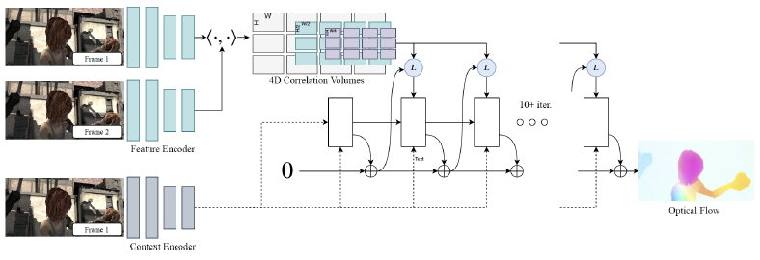
RAFT
Development
  bigger GPUs means you can do more comparison
  RAFT is the natural generalization

Slide 8
RAFT
If images are 3xWxH, then this is WxHxWxH
- compare features at every location in 1 with
every location in 2
Each image is encoded with
the same encoder

Slide 9
RAFT
Essentially, a multi-scale pyramid
For each location in image 1 (at original resolution)
how good is match in image 2 (at each of multiple
resolutions). This is a representation of flow at multiple
precisions
Repeatedly re-estimate flow using:
current estimate, info from correlations,
context from context encoder, revised context

Slide 10
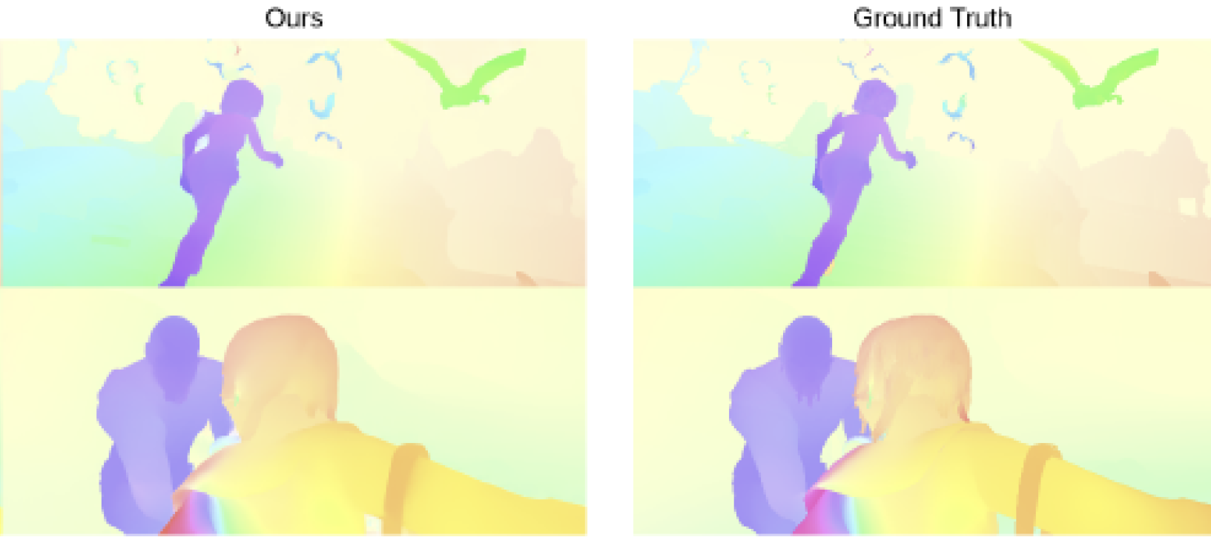
RAFT Flows
SINTEL is a rendered dataset from CGI movie, so ground truth is known
(most unusual)

Slide 11
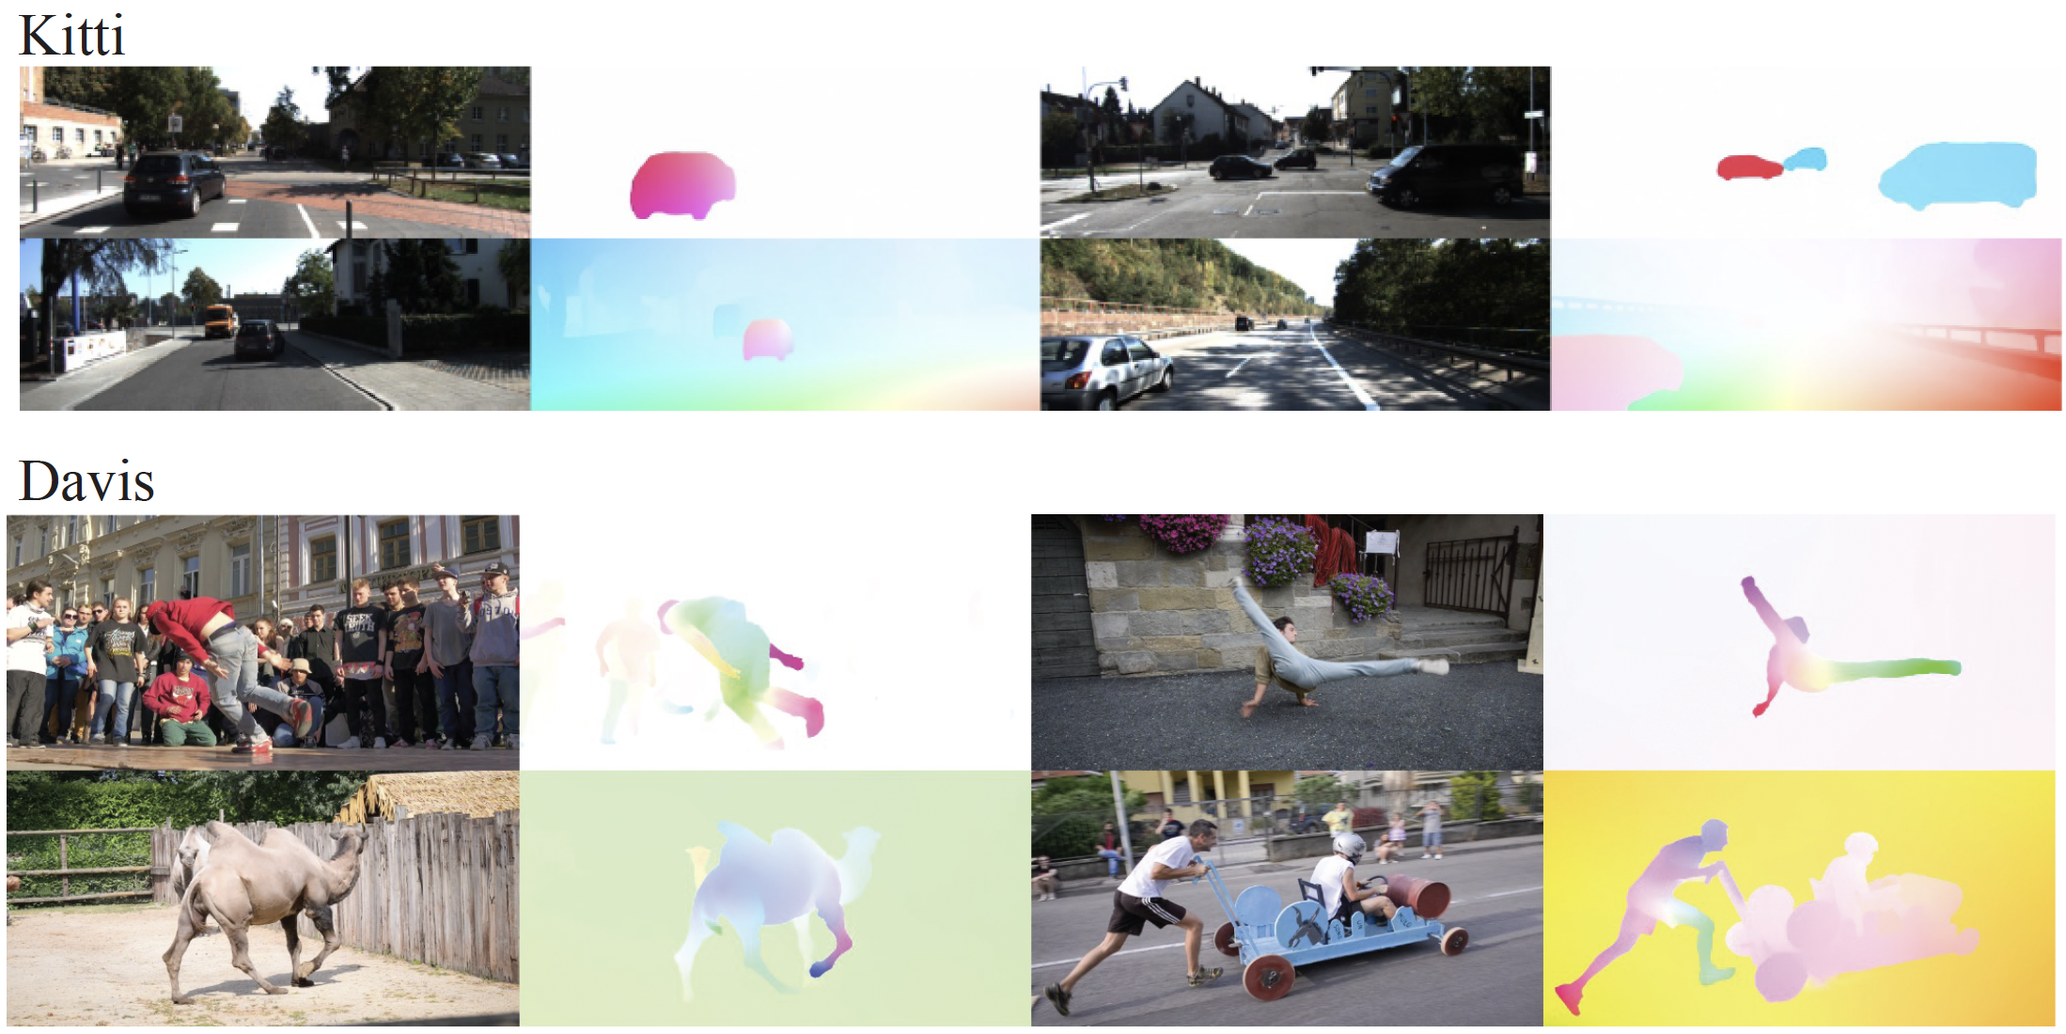
RAFT Flows
KITTI – autonomous car dataset
Davis – 1088x1920 resolution

Slide 12
Significant datasets available
Learning is usually on rendered/synthetic data
Notice there are opportunities for self-learning
  Just minimize photometric loss
  But...

