Slide 1
Denoising images with optimization
D.A. Forsyth
University of Illinois

Slide 2
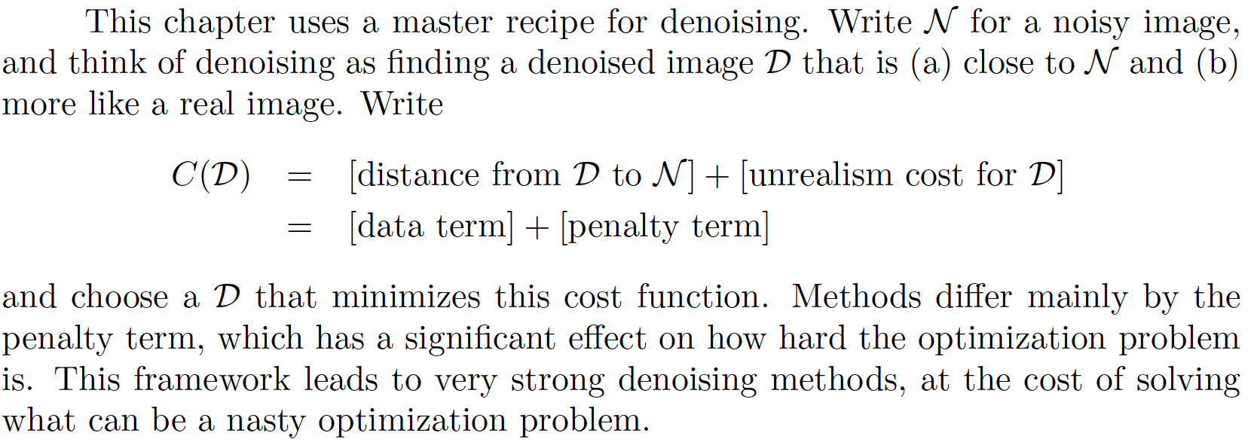
Denoising Images using Optimization

Slide 3
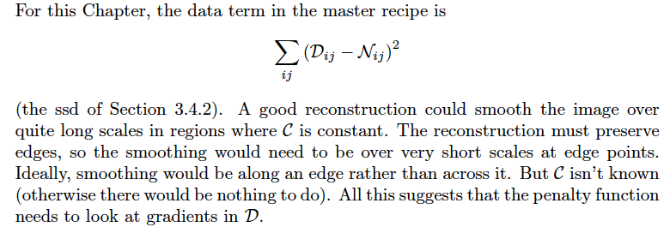
Denoising by weighted least squares - I

Slide 4

Denoising by WLS - II
Straighten
noisy image N into vector n
reconstructed image U into vector u
Cost becomes

Slide 5
Denoising by WLS - III
Idea:
reconstructed image should have large gradients only where there is strong evidence in support
(version of ”pixels are like their neighbors”)
Strong evidence:
Use DOG filters to get smoothed gradient of noisy image
Where this is big, gradients in reconstruction should be cheap

Slide 6
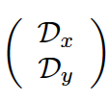
Denoising by WLS - IV
Differentiation is linear, so can write matrices so that gradient of u is given by
What comes out is stacked x and y derivatives
u

Slide 7
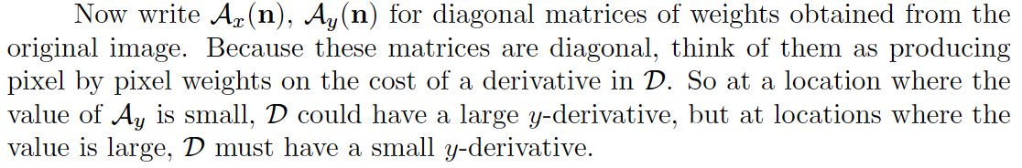
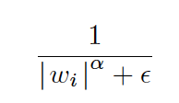
Denoising by WLS -V
Weights could be
Where w_i is either x or y derivative at i’th location, eps is small

Slide 8
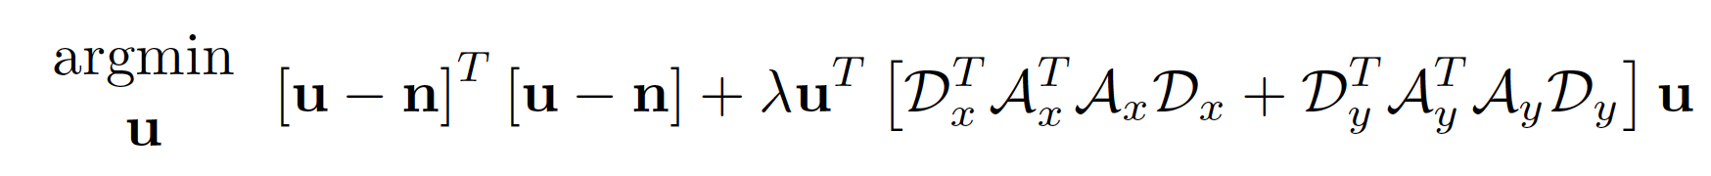
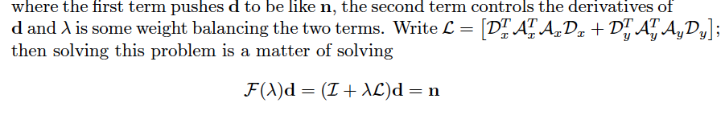
Denoising by WLS - VI
Be close to noisy image
Have big derivatives only if good evidence

Slide 9
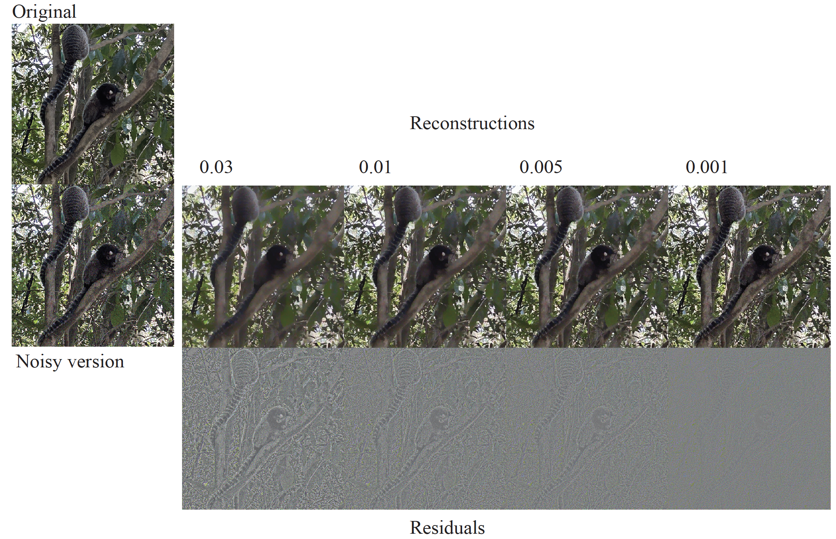

Slide 10

Norms - I
Q: how to measure the ”size” of the penalty?

Slide 11
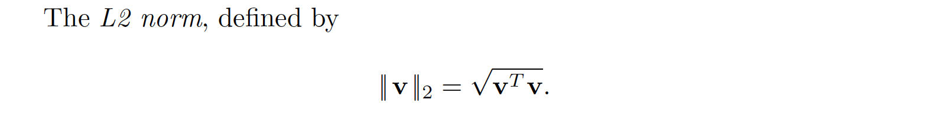
Norms -II
This is squared L2 norm (of what?)

Slide 12
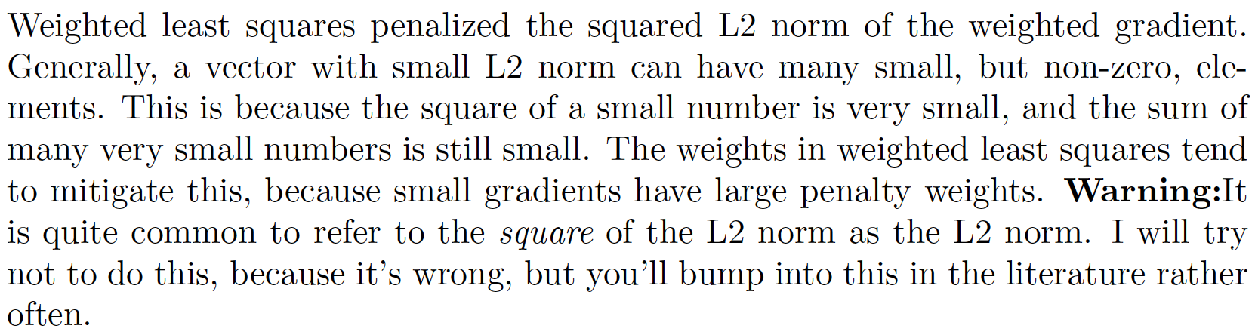
Norms - III

Slide 13
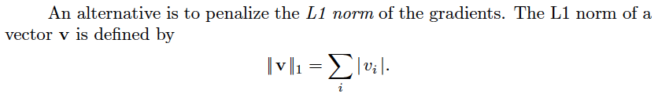
The L1 Norm

Slide 14
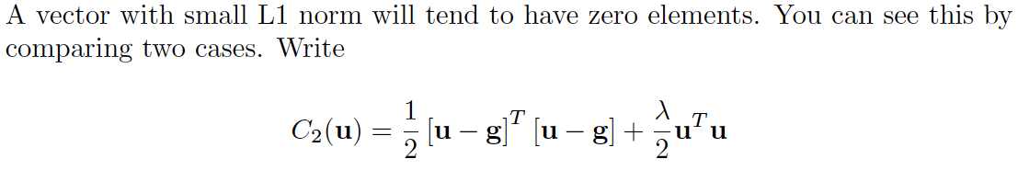
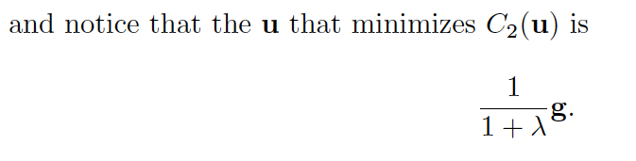
Behavior of L2 norm
Notice – even if lambda is very big, g ISN’T zero
(it’s just small)

Slide 15
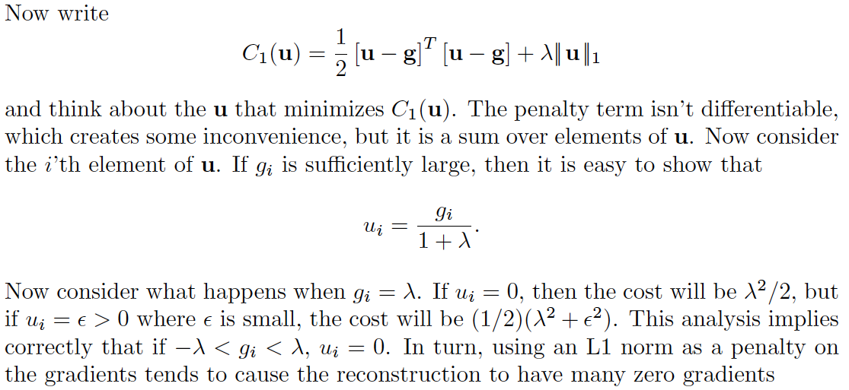
Behavior of L1 norm
The L1 norm encourages g to have zeros in it!

Slide 16
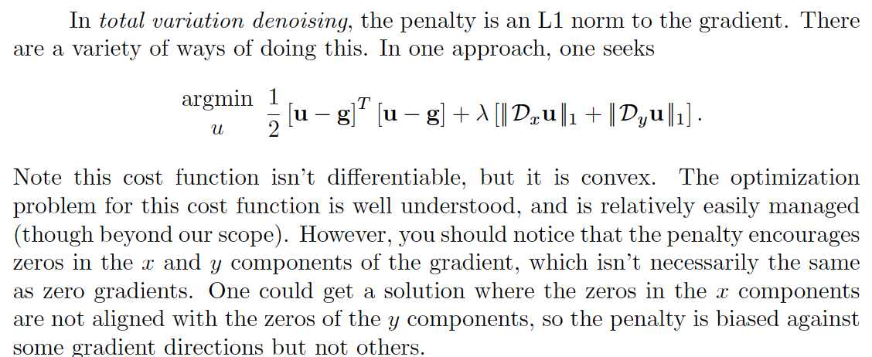
Total variation denoising - I

Slide 17
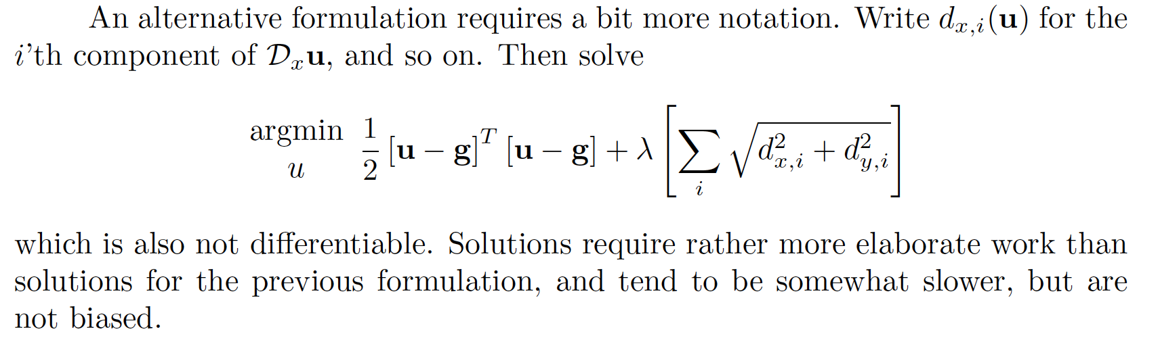
Total variation denoising - II

Slide 18
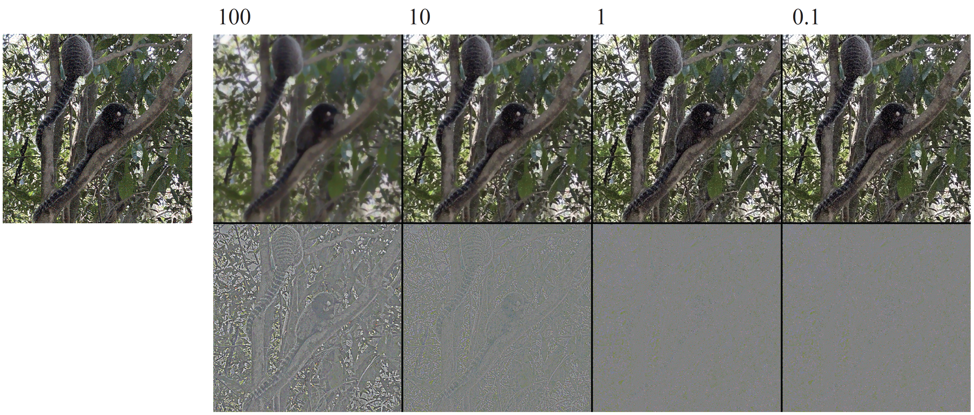

Slide 19
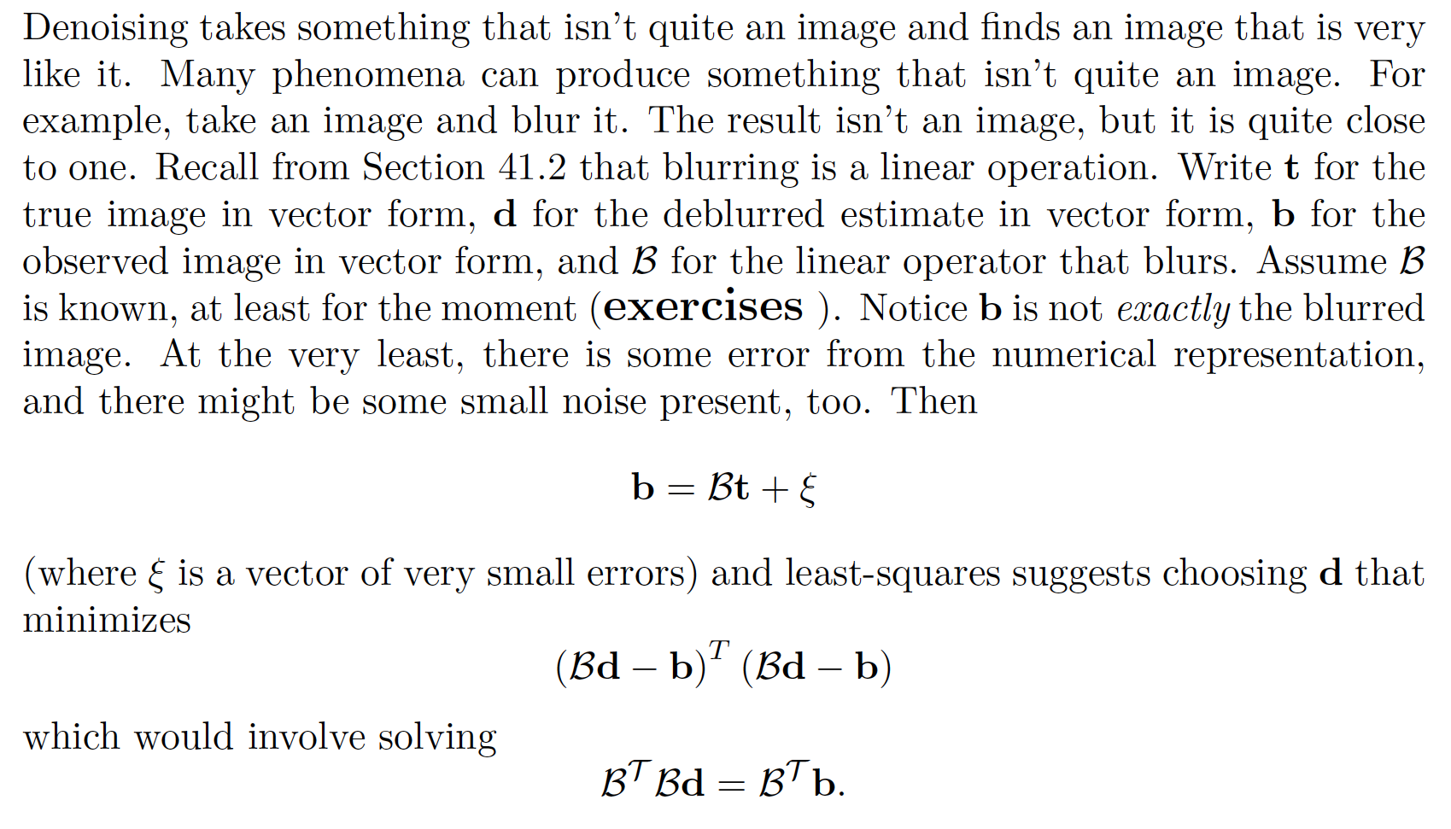
Deblurring - I

Slide 20
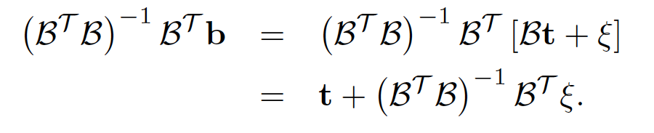
Deblurring - II
But this has some really big eigenvalues!

Slide 21
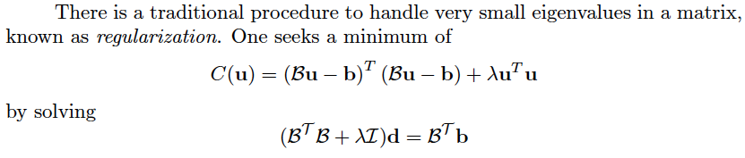
Regularization

Slide 22
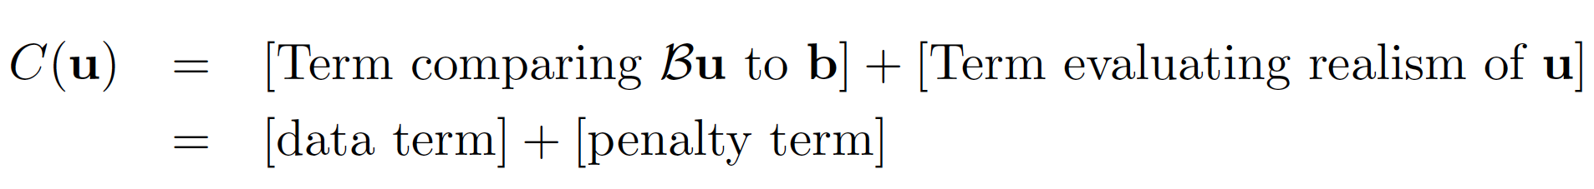
MLS and TVD
Penalty term we used before for MLS or TVD

Slide 23
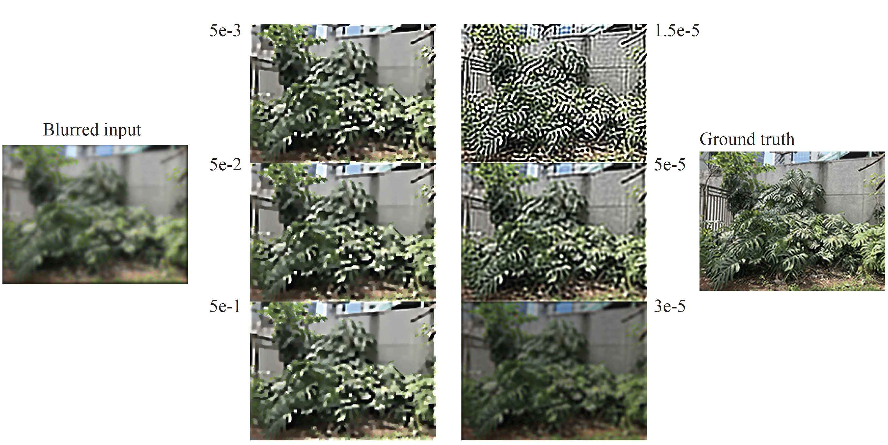
Regularized
WLS

Slide 24
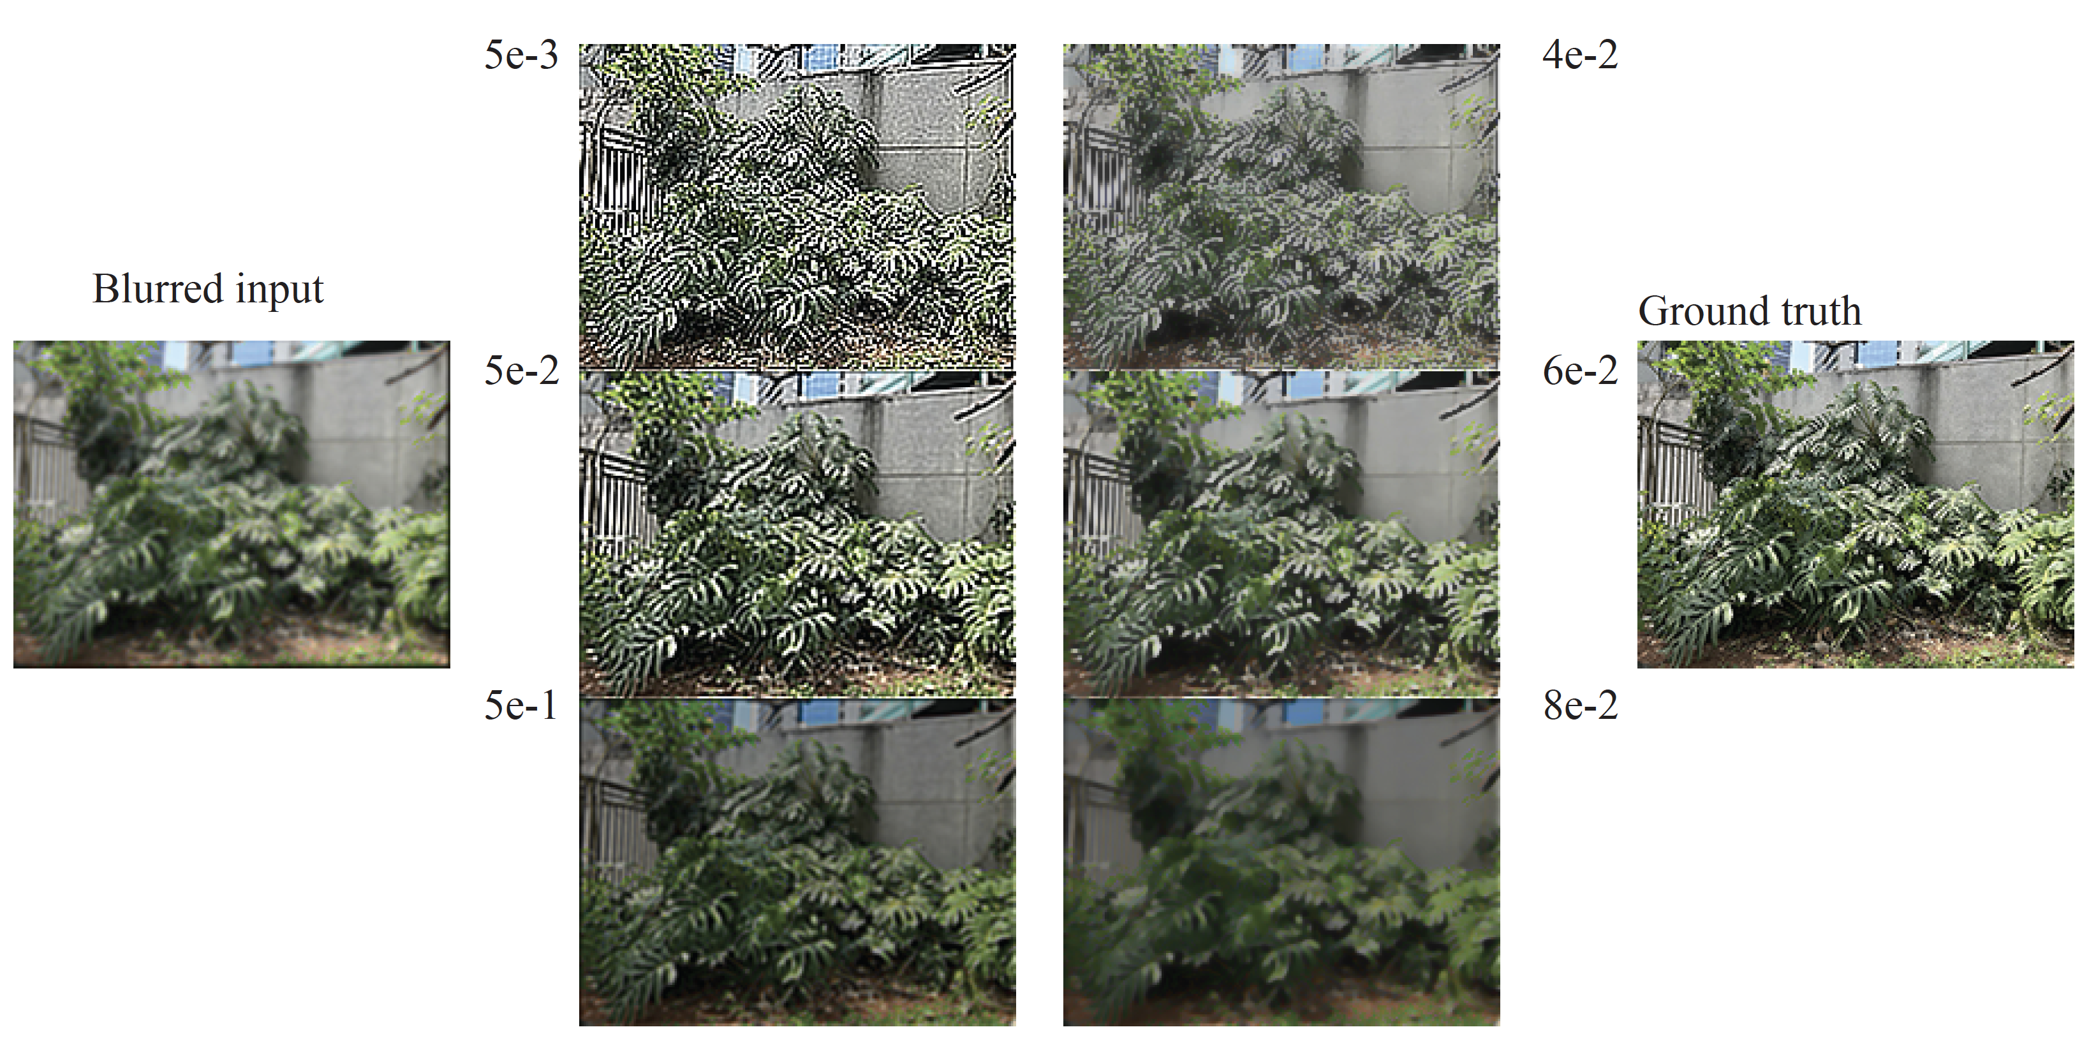
Regularized
TVD

Slide 25
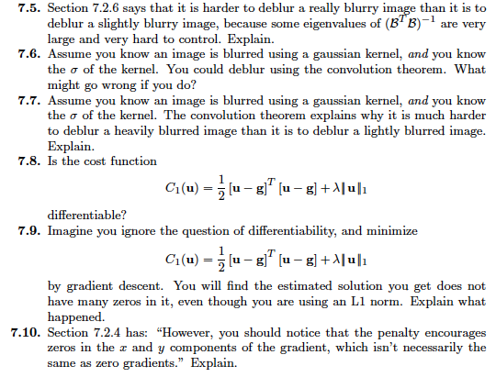
Think about this....

