Slide 1
Optical Flow - Basics
D.A. Forsyth
University of Illinois at Urbana Champaign

Slide 2
Optical flow
Build a field of arrows
  tail at pixel
  head at new location of surface behind pixel
    in next frame
Uses
  inference about your motion (egomotion)
  inference about motion in the world
  inference about depth
  segmentation
  compression

Slide 3
Time to contact example

Slide 10
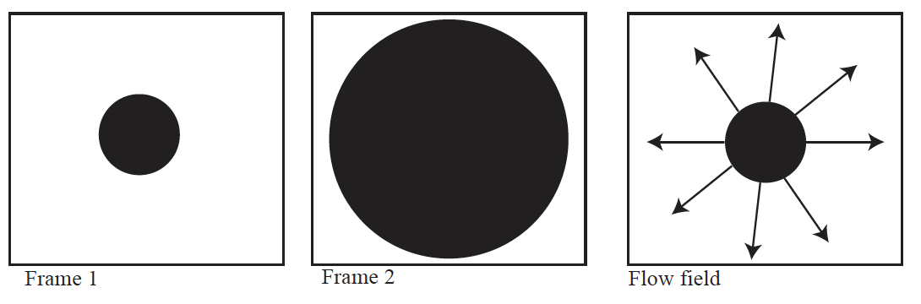
Flow fields reveal your motion

Slide 11
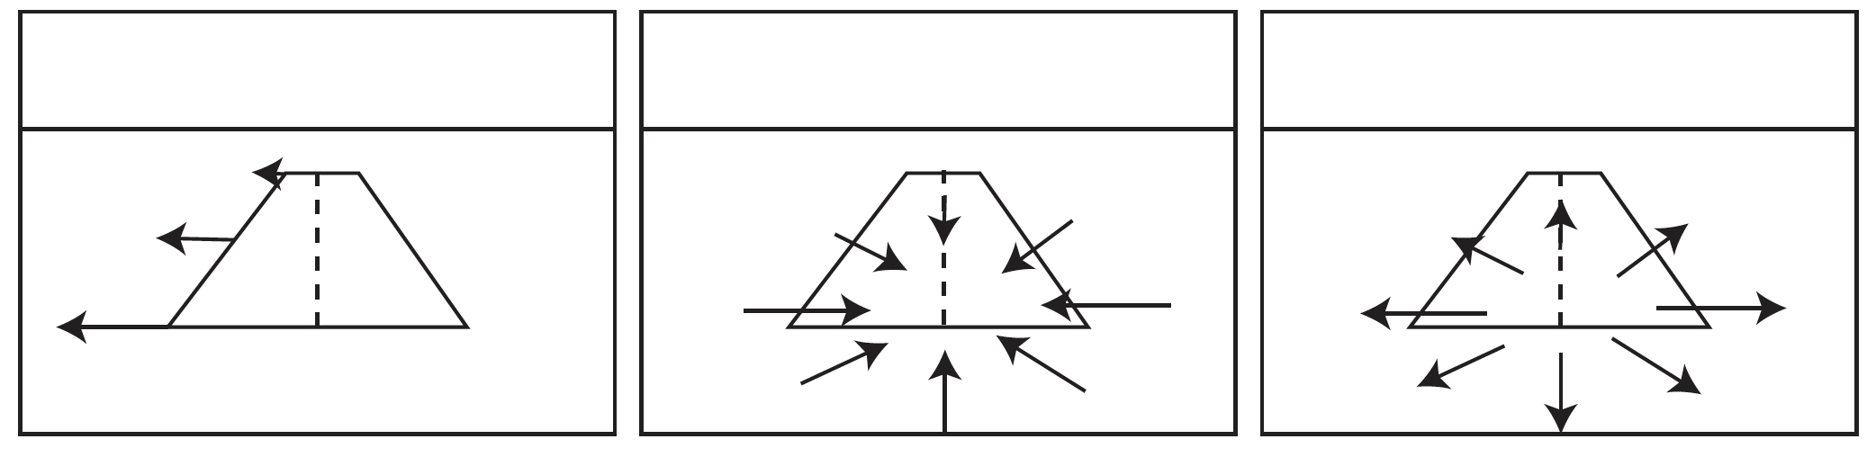
Flow fields reveal your motion

Slide 12
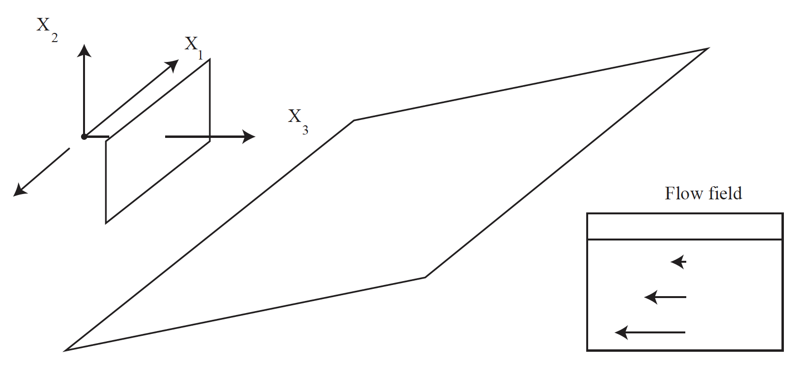
Flow fields reveal shape

Slide 13
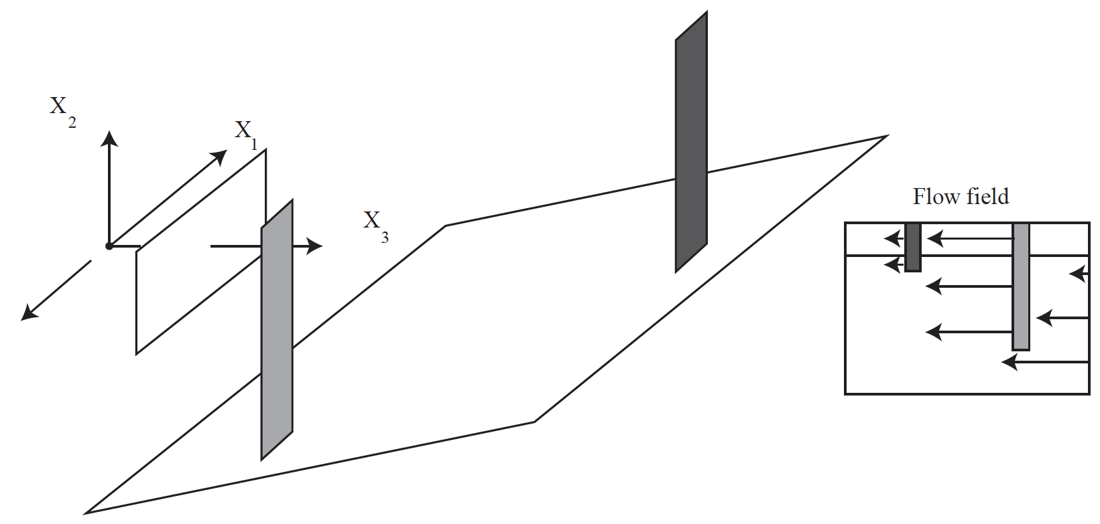
Flow fields reveal segmentation

Slide 14
Why estimating flow is hard
Flow is ambiguous at most points
  the aperture problem
You must interpolate
  but there are discontinuities
Flow is not defined everywhere
  some things are visible only in one frame
Some objects move by large amounts
Motion blurring complicates estimation

Slide 15
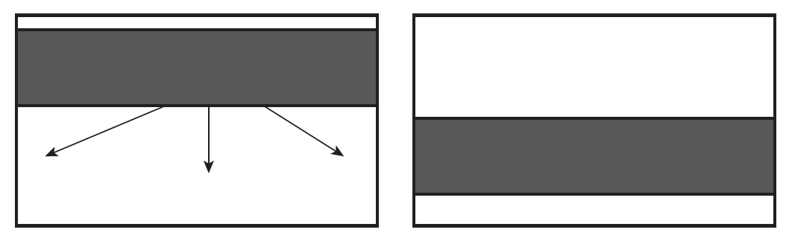
The aperture problem

Slide 16
Flow is often discontinuous

Slide 17
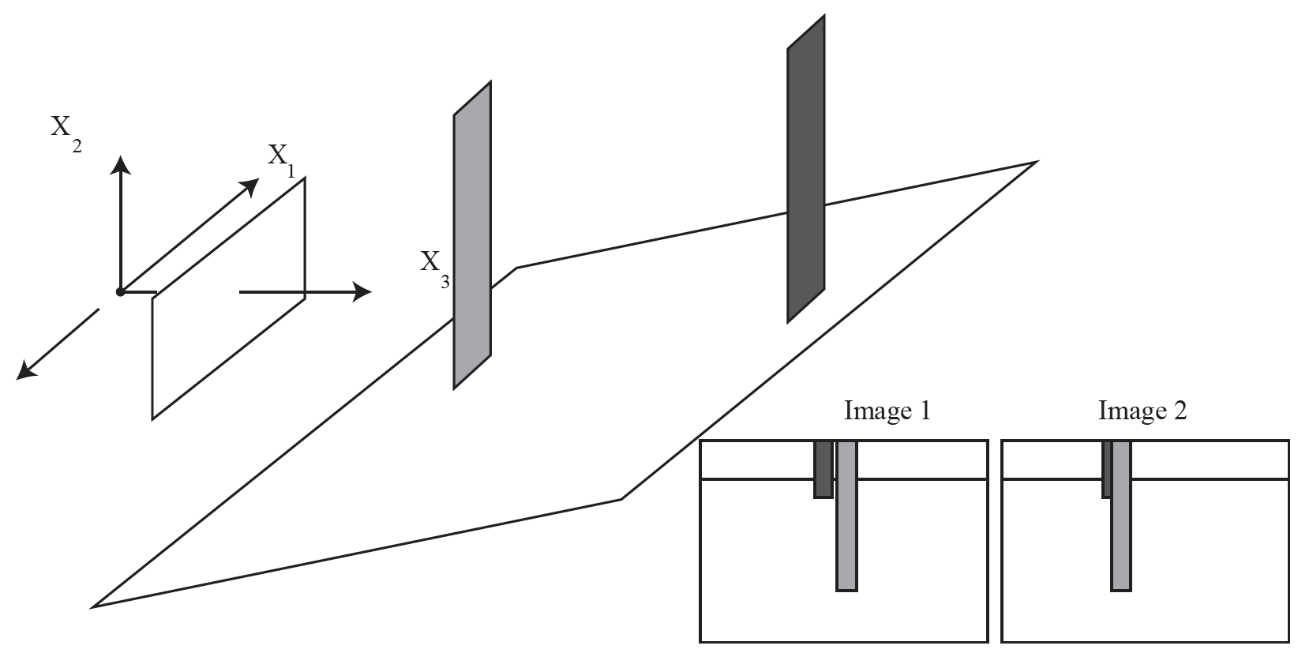
Flow is not defined everywhere

Slide 18
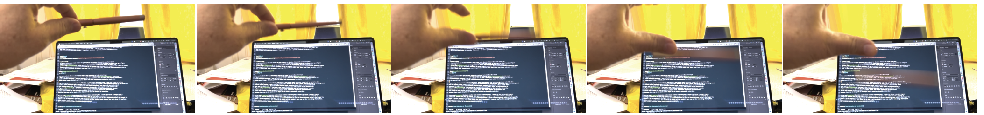
Large movements and motion blur

