Slide 1
Other image to image predictions
D.A. Forsyth
University of Illinois at Urbana-

Slide 2
Further image to image mapping
Generally, it’s worth trying anything with
  image in – image like thing out
Cases here:
  Denoising (did this); superresolution; defogging
Other possibilities:
  Fix underwater pix; derain; fix color balance; change lighting (?)
Recipe needs changing for...
  Edges; semantic segmentation (coming up)

Slide 3
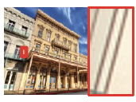
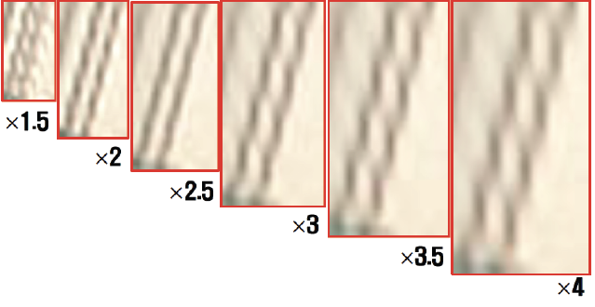
Superresolution
Take low res image, make high res image:
  Baseline: upsample and interpolate
Possibly:
  Build network for each of 1.5xupsample, 2xupsample, etc.
Ideally, network ”doesn’t know”
  by how much you are upsampling
Fully convolutional u-net helps
This was trained for
2x upsampling

Slide 4



Superresolution
In:
  Upsampled, interpolated low resolution image
Out:
  estimated residual
  True high-res image-upsampled interpolated low res
Est true image:

Slide 5
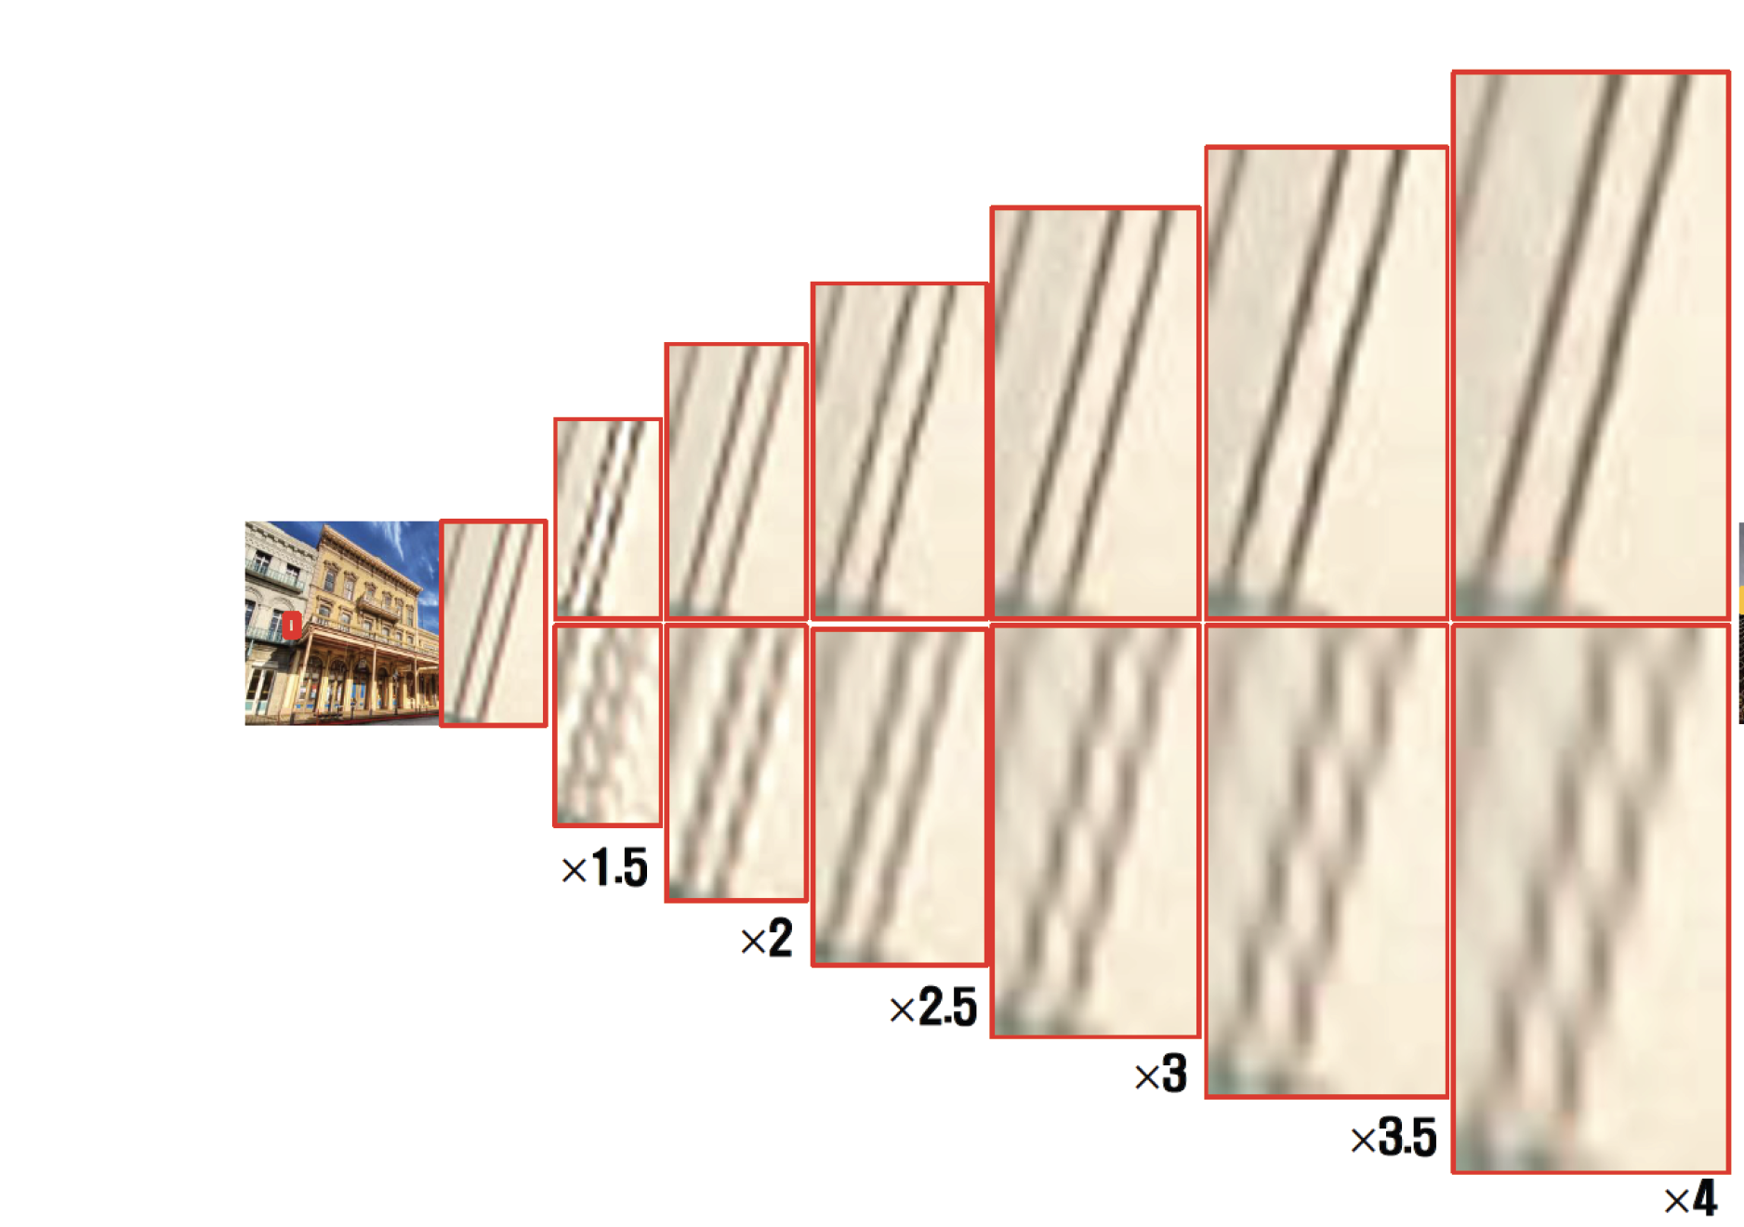
Superresolution works

Slide 6
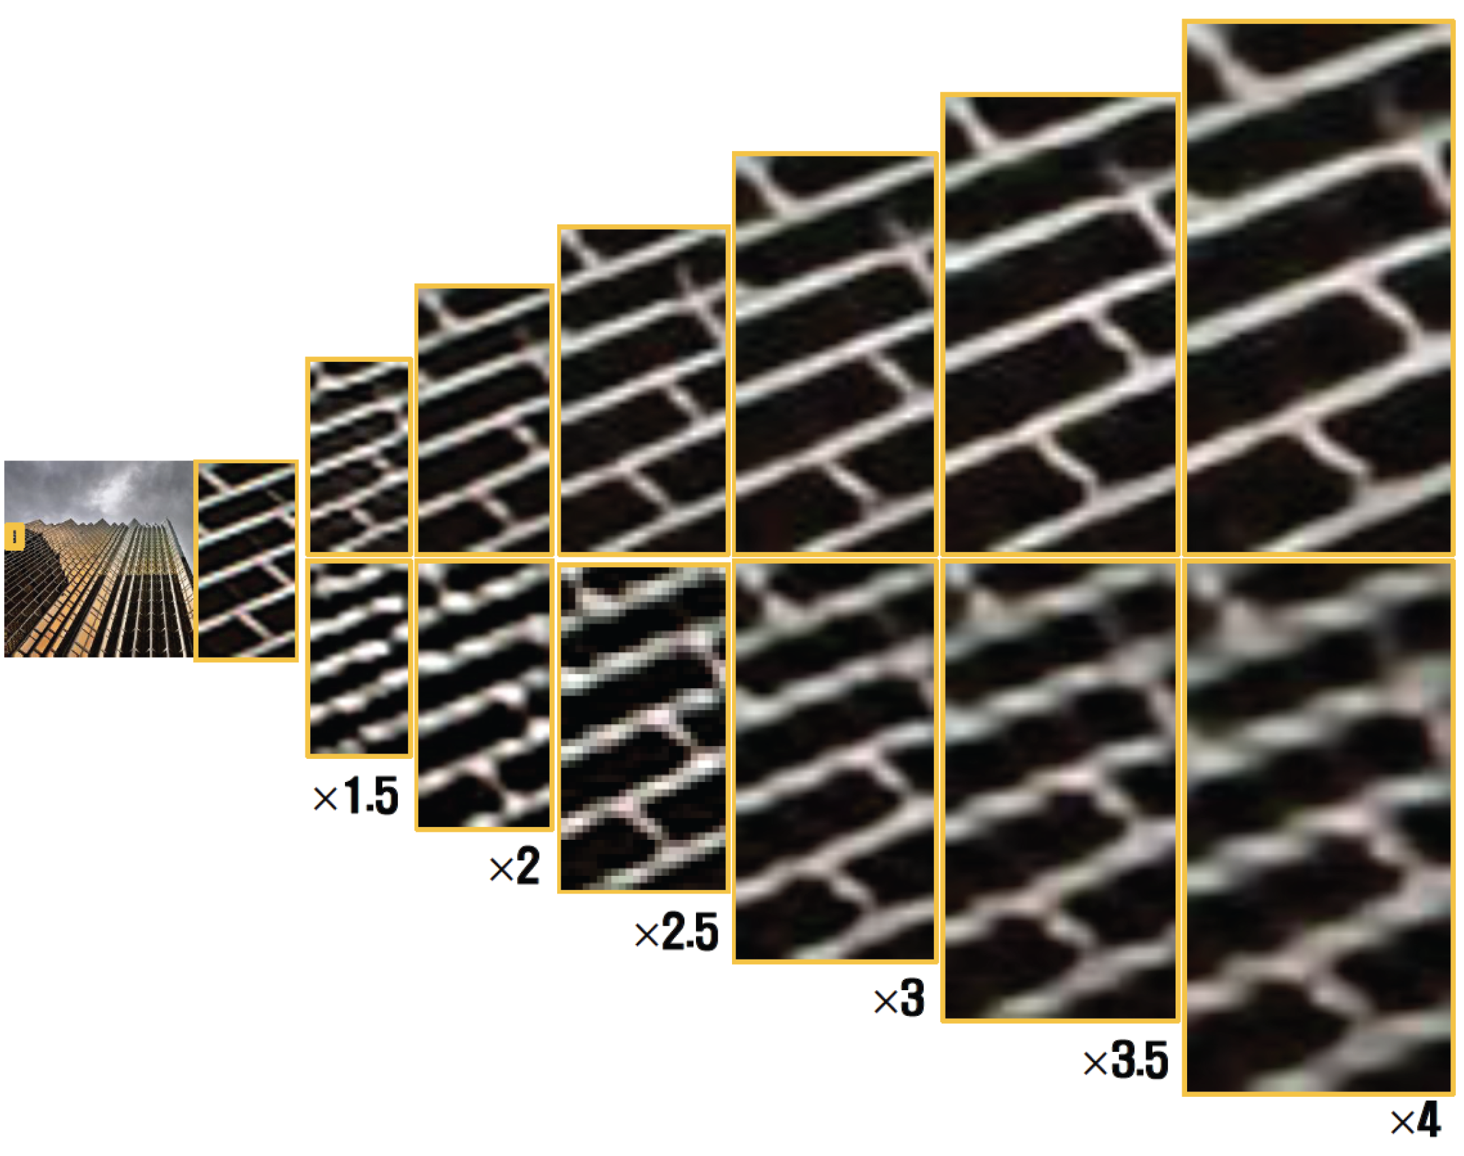
Superresolution works

Slide 7

Training and evaluation
Train on L1/L2 loss
  perhaps some more stuff, later...

Slide 8
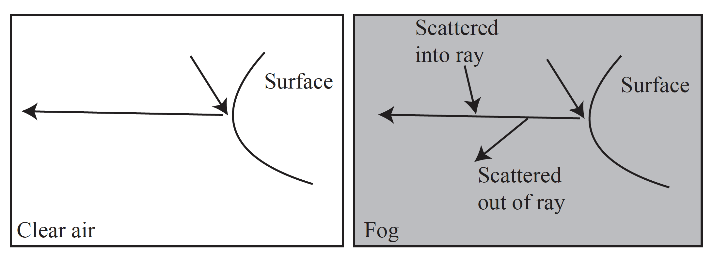
Defogging
Fog scatters light out of and into the ray from surface to eye
  results:
    distant surfaces experience color shift, depending on depth
    image is blurred, blurring depends on depth

Slide 9

Model of defogging
(Doesn’t cover blurring, but..)

Slide 10
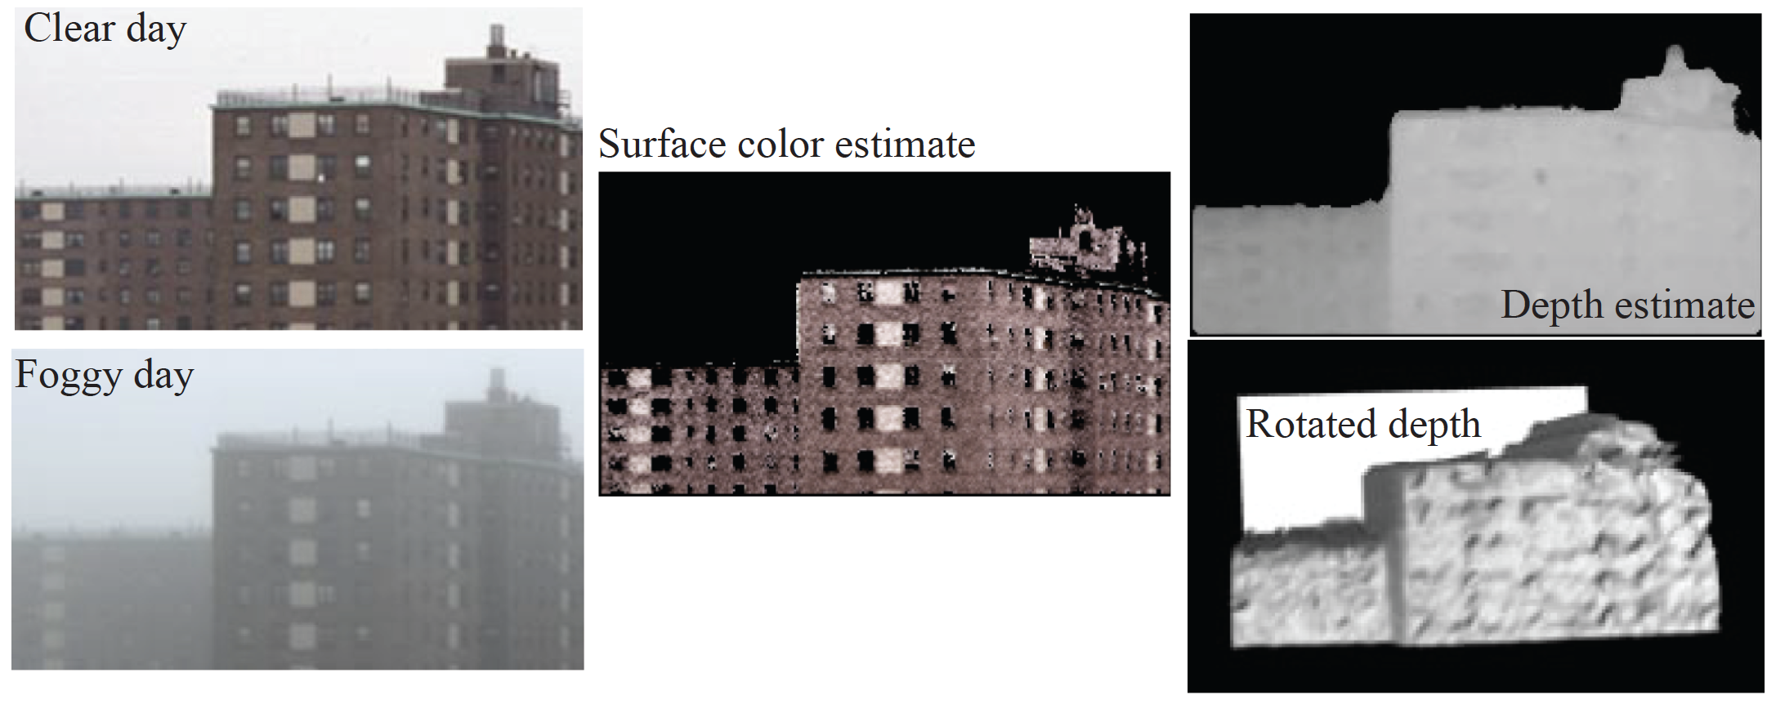
Amusing fact – you can recover depth from fog

Slide 11
Data is hard!
(image of real scene with no fog, image of same scene w/fog)
  is very hard to get.
  you can get them, but hard to get one and very hard to get many
Simulation is straightforward
(image no fog, image with sim fog)
  is easy to get, and works
Evaluation
  usually, PSNR on simulated images, sometimes PSNR on real

Slide 12
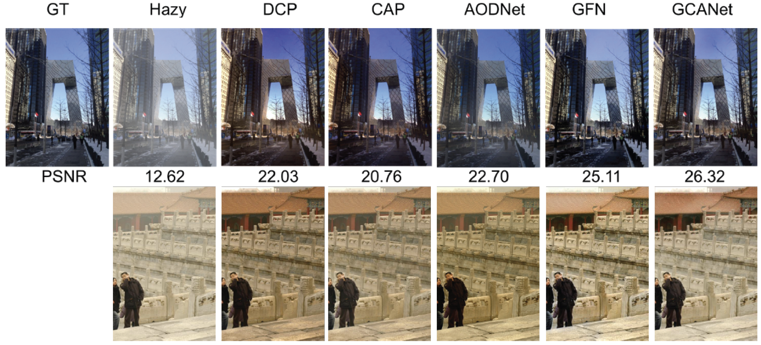
Defogging
This is real foggy
image so original
is unknown

Slide 13

Think about this...

