Slide 1
Forming and using patch dictionaries
D.A. Forsyth
University of Illinois at Urbana Champaign

Slide 2
Forming and using patch dictionaries
Idea:
  other patches in an image are good for denoising
  why not use other patches in other images?
Issues:
  how to find the right patch in a very large number of patches?
  redundancy
  many patches are like one another, and so just make work

Slide 3
Desirable outcome
Procedure to
  accept a patch
  produce a patch/some patches that are similar
Built out of very large number of patches

Slide 4
Why K-means is useful
Take input patch
Find its cluster center
Use patches in the cluster or the cluster center itself to denoise the image

Slide 5
Hierarchical K means
But what if there are too many data points?
  too many clusters, finding cluster center is hard
IDEA:
  Cluster data using K means
  Each cluster is now a dataset
  Cluster each dataset using K means

Slide 6
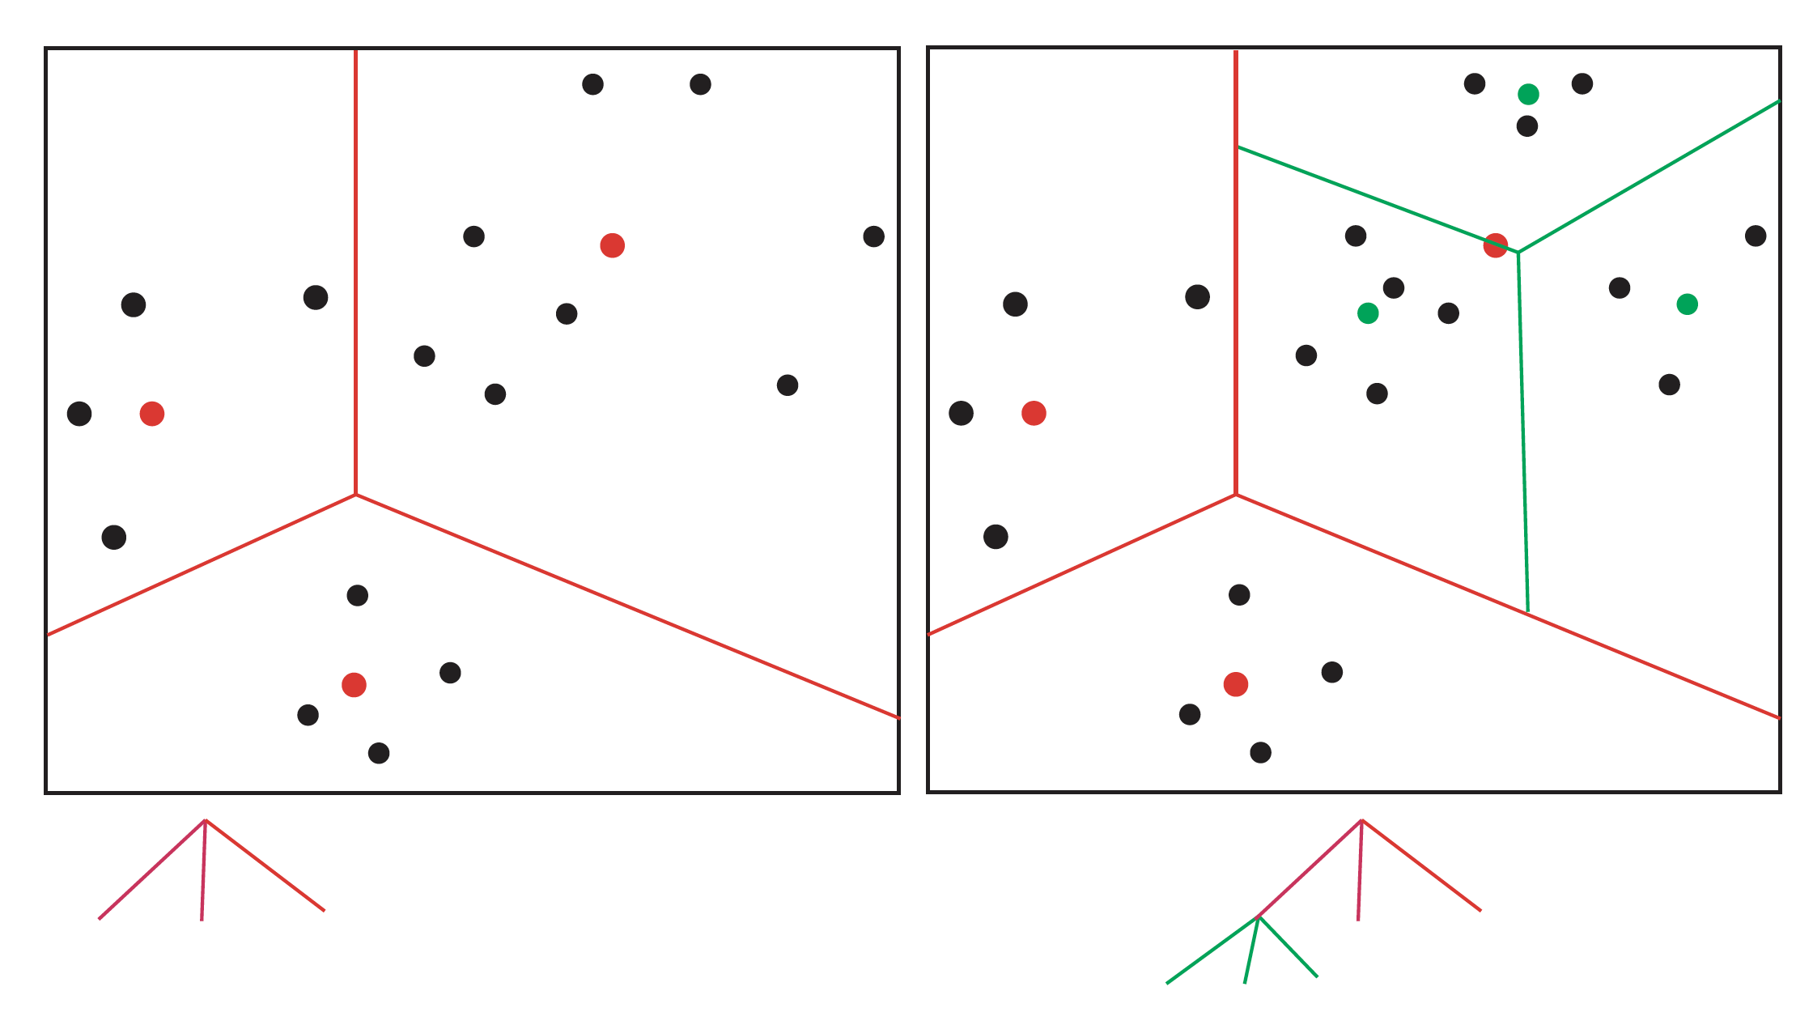
Notice this is a simple tree; you could make it deeper.
Notice this is a simple tree; you could make it deeper.

Slide 7
Nearest neighbors
Idea:
  Find the patch that is closest to query patch, denoise (etc) with that
Issue:
  How to do this fast? (v. hard)

Slide 8
Approximate nearest neighbors
Idea:
  “Walk” input patch down hierarchical k-means tree
  Find closest patch from patches in the leaf cluster
  Use that instead of nearest neighbor

Slide 9
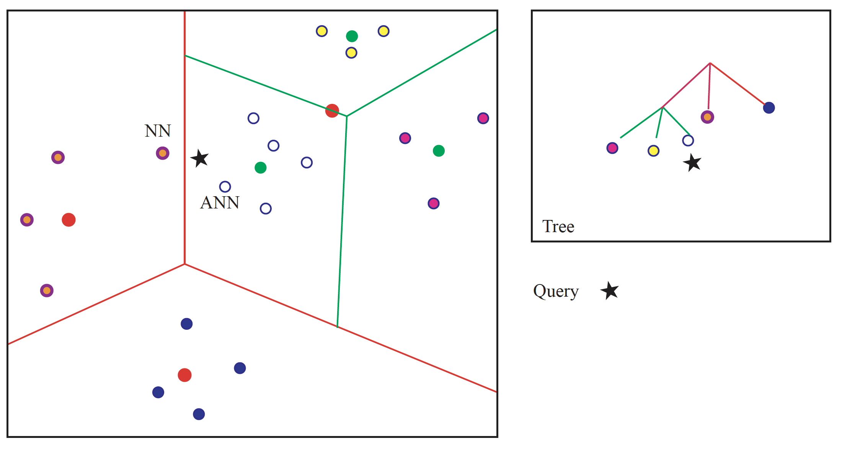
ANN and k-means

Slide 10
ANN and k-means
Idea:
  “Walk” input patch down hierarchical k-means tree
  Find closest patch from patches in the leaf cluster
  Use that instead of nearest neighbor
Fact: not nearest neighbor; with high probability nearly as close
Fact: hard to find a closer neighbor by walking tree

Slide 11
ANN and k means

Slide 13
Denoising with a patch dictionary
Procedure:
  Divide noisy image into patches, which could overlap
  Match each patch using a dictionary (ANN using HKM)
  Reconstruct
    if the patches don’t overlap, easy
    if they do, average

Slide 14
Options when matching
Walk tree, find patch in leaf that is closest to query patch
Walk tree, use mean of all patches in leaf
  - this should be better than you might think
    cause all the patches should be quite similar

Slide 15
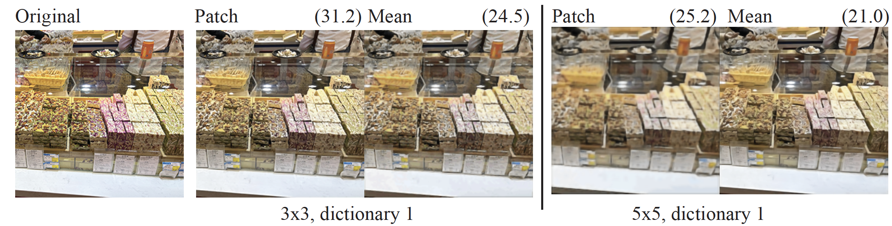
Denoising with a patch dictionary - overlapping

Slide 16
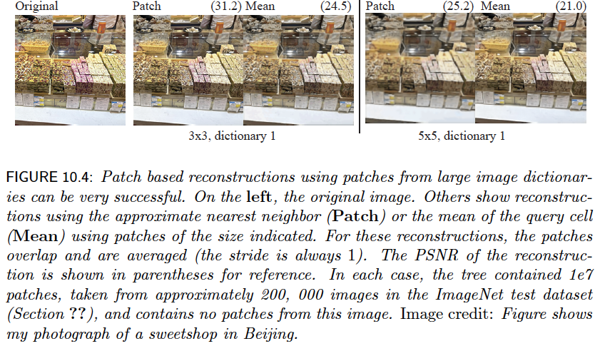

Slide 17
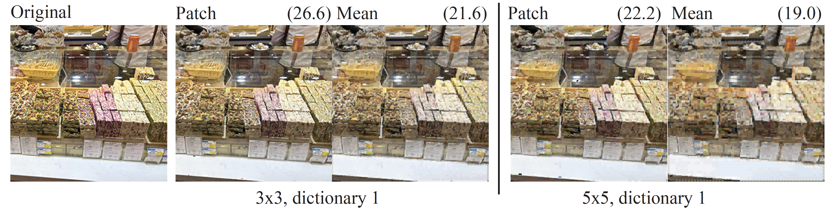
Denoising with a patch dictionary, no overlap

Slide 18
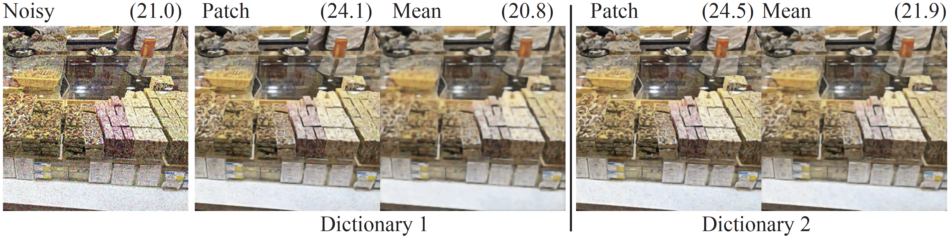
Dictionary size has a significant effect
Dictionary 1 – 1e7 patches, 200, 000 images, 2000 leaves
Dictionary 2 – 5 e 7 patches, 1e6 images

Slide 19
Vector quantization
Walk tree, use mean of all patches in leaf
  - this should be better than you might think
    cause all the patches should be quite similar
Notice that you have built a mapping. You could replace the mean with the number of the leaf to get: patch-> leaf
This has a range of uses – compression, etc.

Slide 20
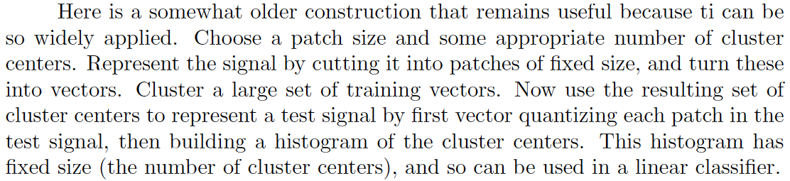
Building features with VQ
Image might have variable size
Histogram has fixed size

Slide 21
VQ and voting
Problem:
you want to classify an image
Strategy:
learning:
get many labelled images
cut into patches
build tree
for each leaf, record the most common label
classifying:
        cut image into patches
        pass patch down tree
        vote for label
Now old-fashioned, but moderately
effective and very good in its time

Slide 22
Denoising from weird noise
Imagine you have very strange noise, and you can simulate it
You want to denoise
Strategy:
  Take many images, and create (noisy – clean) pairs
  Carve into patches and build a HKM tree using only the noisy patches
    (but keep the clean patch – so each data item is (noisy – clean) but the clusters, etc are formed using noisy alone)
To denoise:
      carve up noisy image into patches
      walk the tree with the noisy patches
      at leaf, substitute the clean version of the best match

Slide 23
Image to image mapping
You could do:
  image to edge map (fairly well)
  image to normal map (rather badly)
  quantized image to image
You’d have a lot of trouble with:
  edge map to image
  image to depth map

