Slide 1
Filters as pattern detectors
D.A. Forsyth,
University of Illinois at Urbana Champaign
Some slides adapted from
Svetlana Lazebnik, who adapted from Alyosha Efros, Derek Hoiem

Slide 2
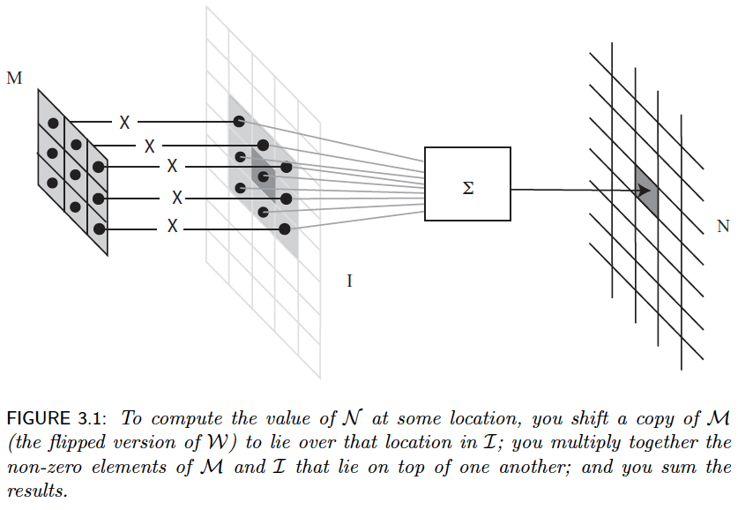
Filters are dot products

Slide 3
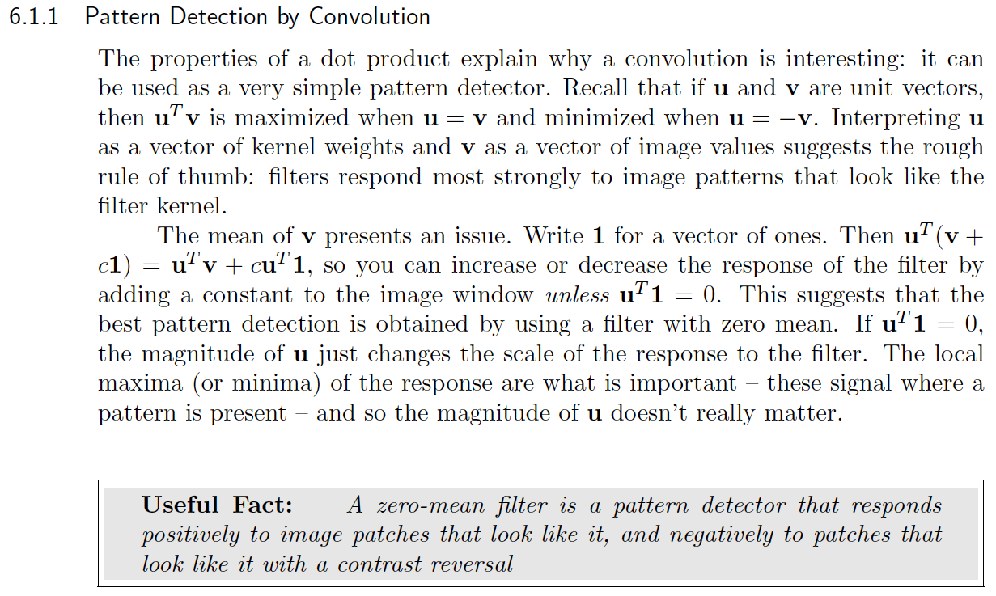
Filters as pattern detectors

Slide 4
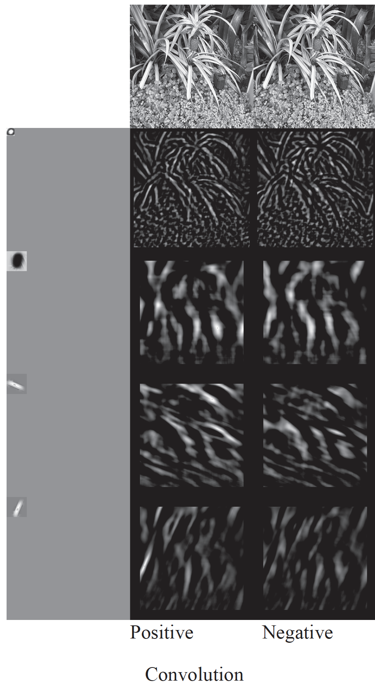
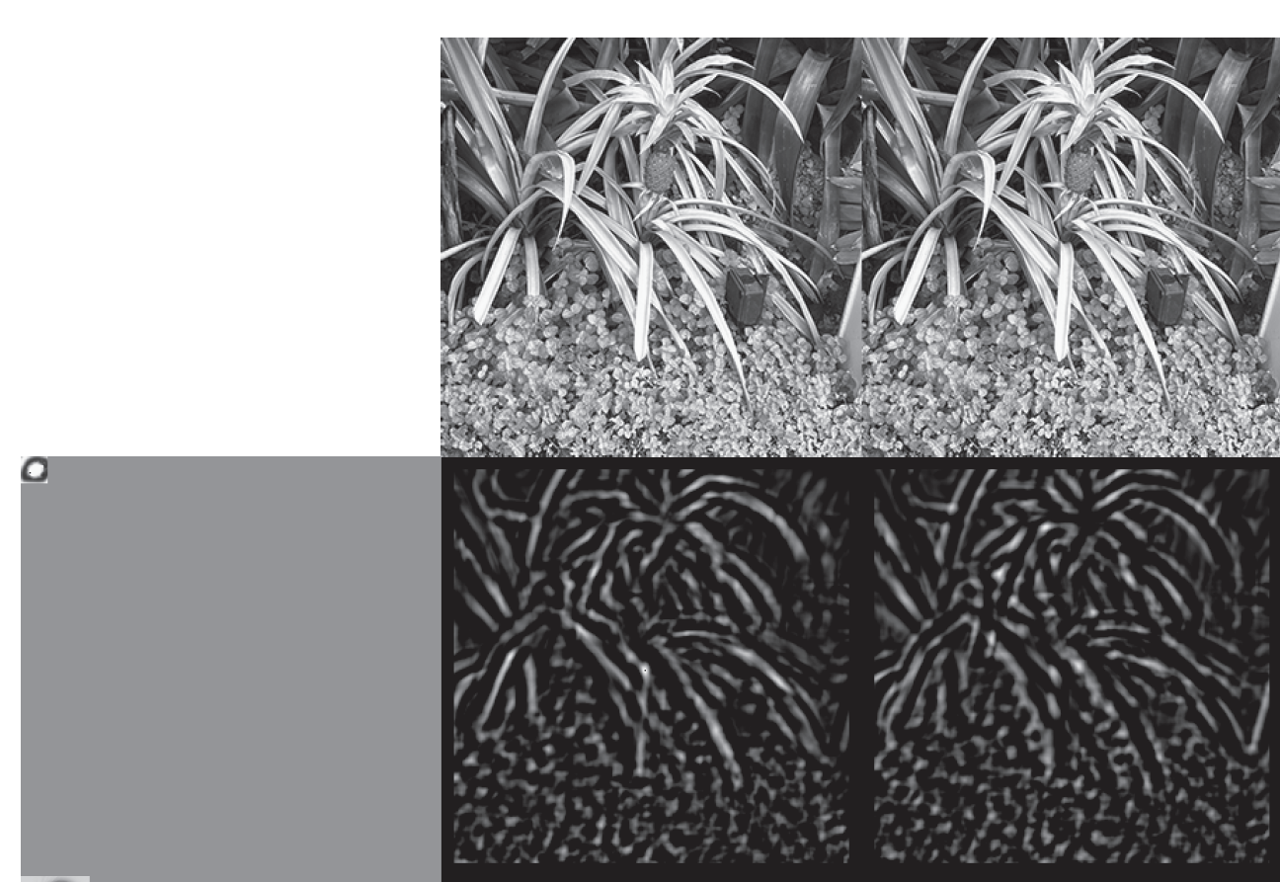
Filters detect patterns

Slide 5
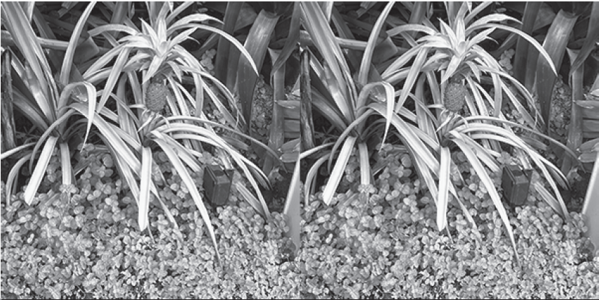
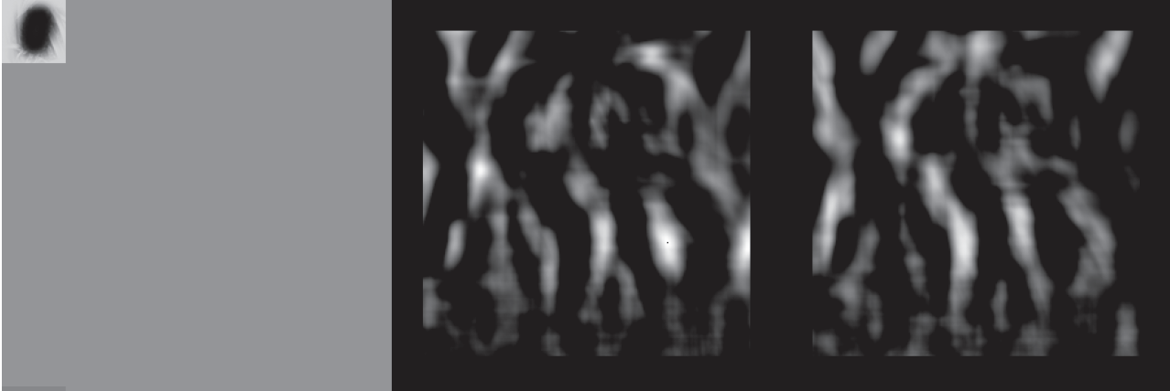
Filters detect patterns

Slide 6
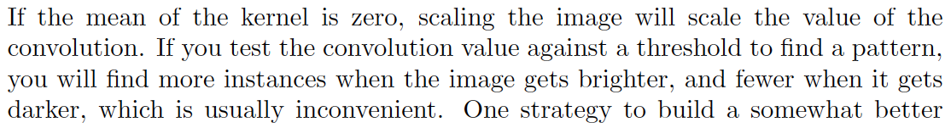
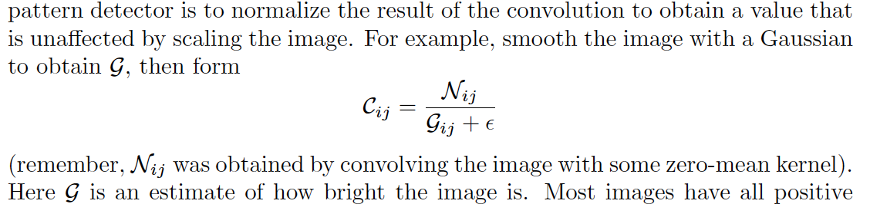
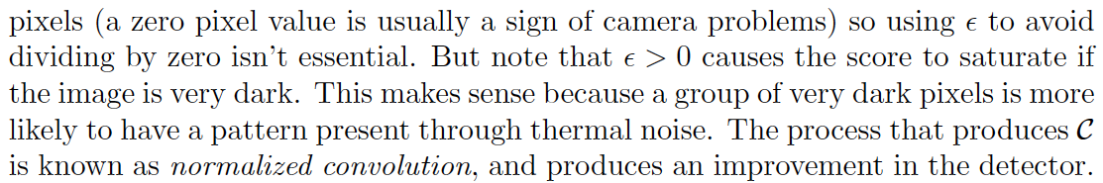
Normalized convolution

Slide 7
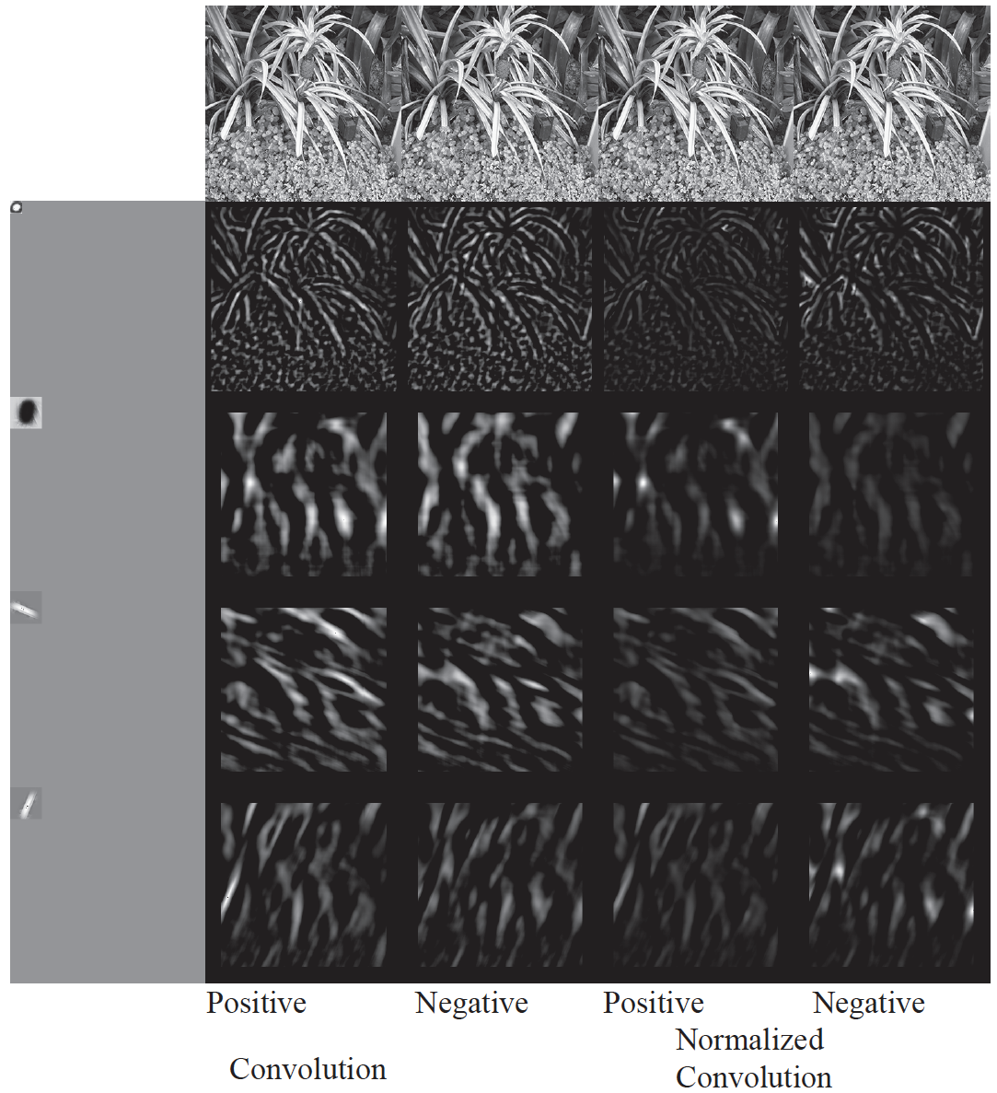

Slide 8
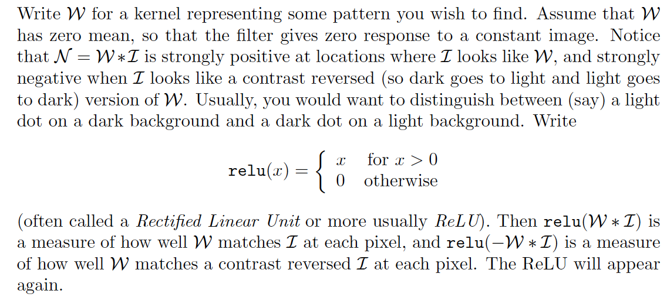
ReLUs

Slide 9
Filters detect patterns

Slide 10
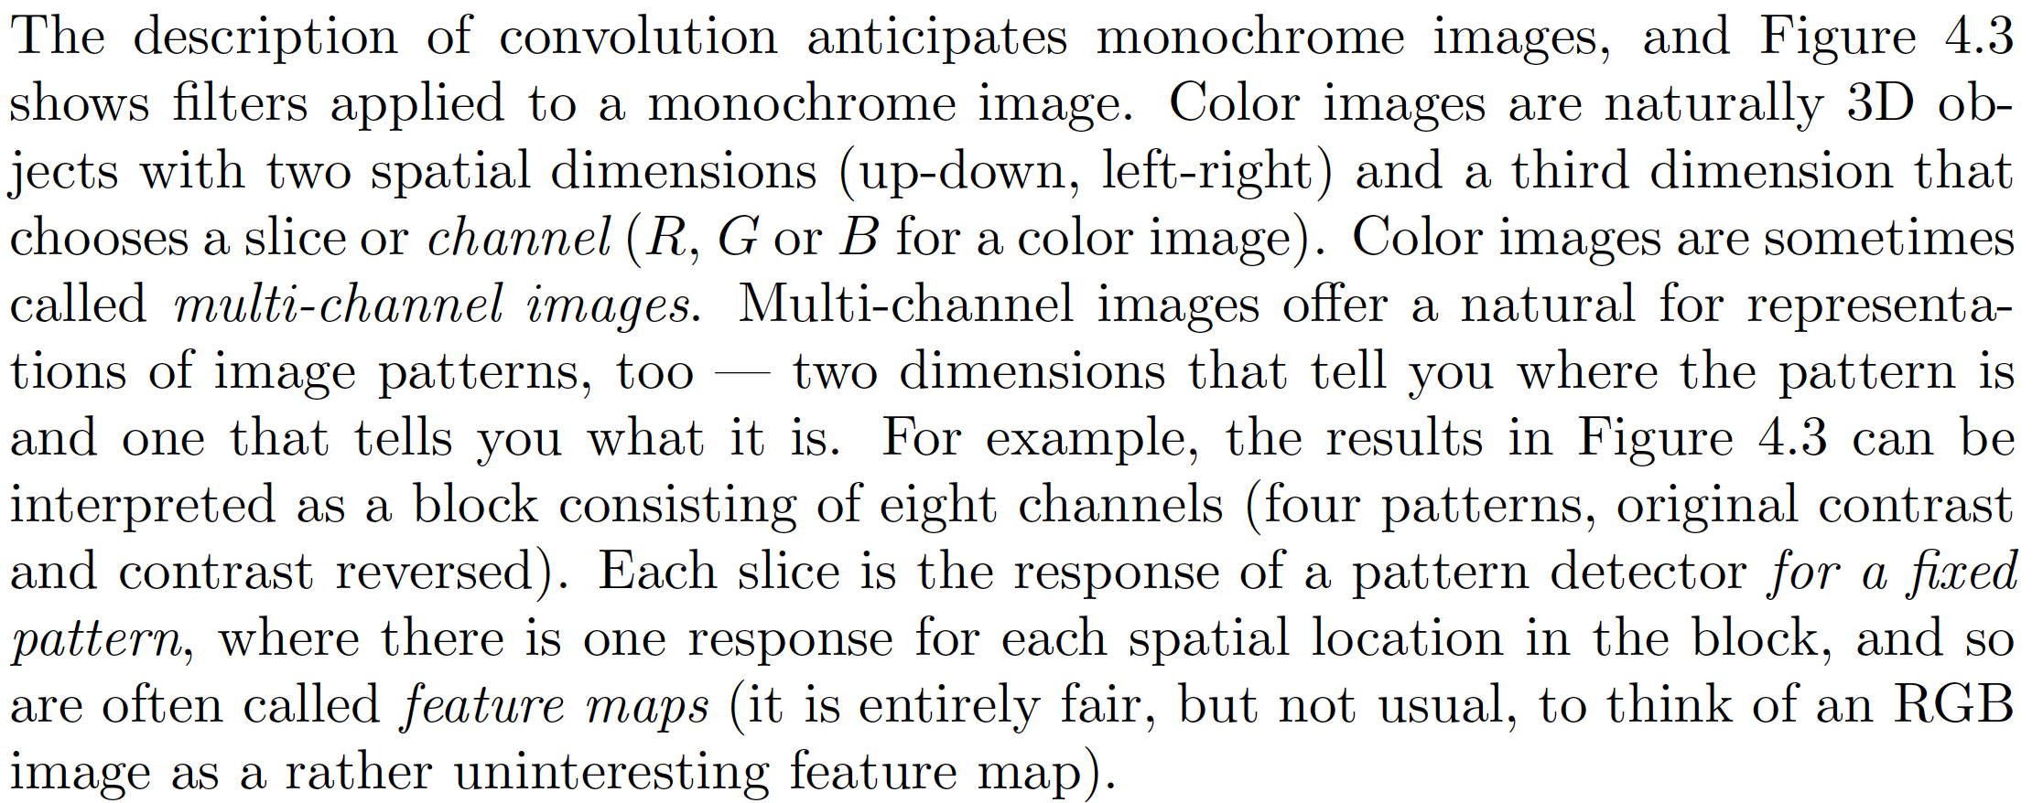
Multi-channel convolution

Slide 11
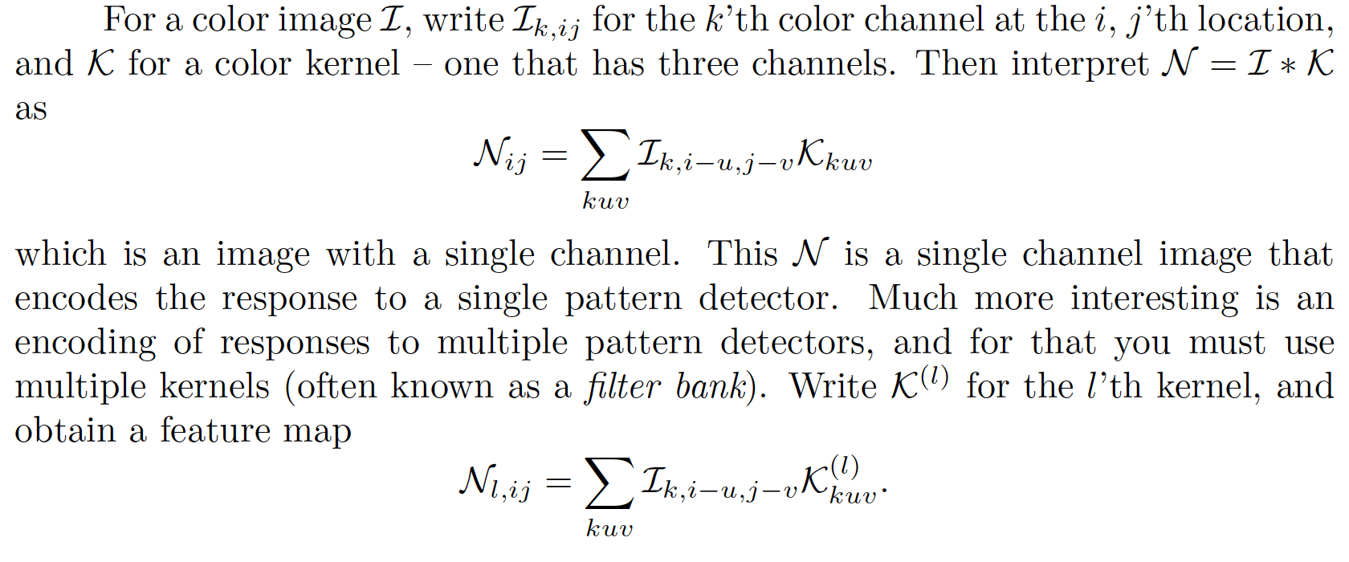
Multi-channel Convolution

Slide 12
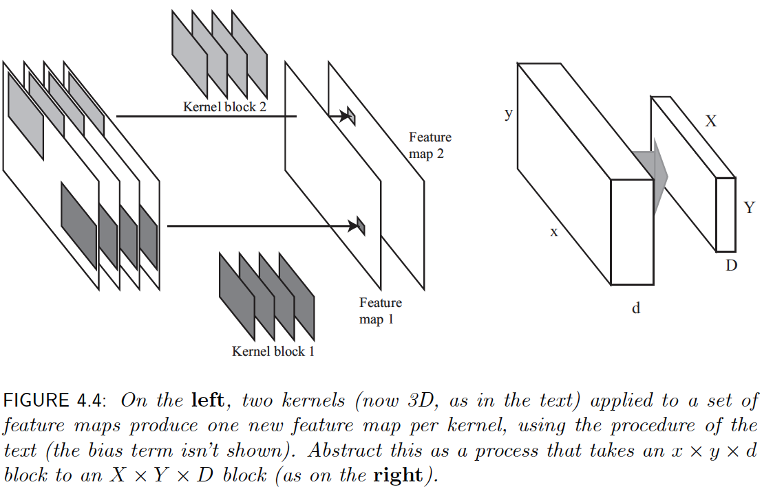
Multi-channel convolution

Slide 13
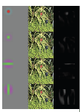
Representing Images with Filter Banks
Filter
Positive response

Slide 14
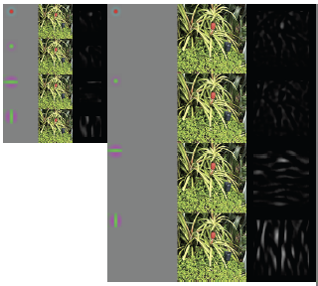
Representing Images with Filter Banks
Positive
response
Positive
response
Filter
Filter

Slide 15
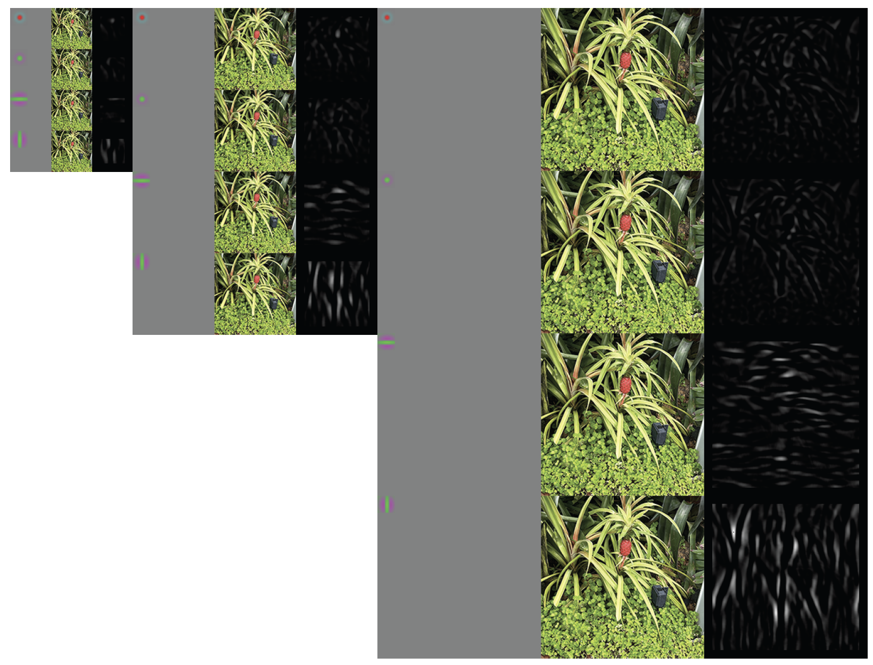
Representing Images with Filter Banks

Slide 16
But which filters should I use?
Up till about 2012:
  choose some, mostly spots and bars
After 2012:
  lots; choose ones that work well in your application using an optimization procedure

Slide 17
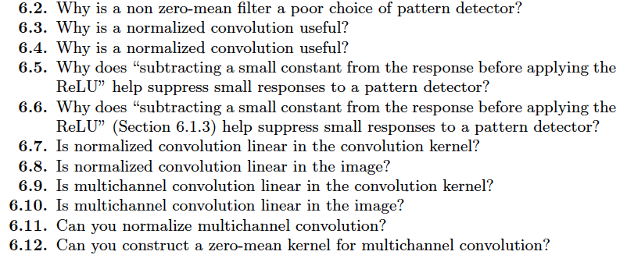
Think about this...

