Slide 1
Semantic Segmentation
D.A. Forsyth
University of Illinois at Urbana Champaign

Slide 2
Ideas:
Simple Image Classification:
  Classify an image into one of two classes by
    Stack some pooling, FC layers on an encoder
    Adjust result into a vector
    Pass to linear classifier
  Learn all parameters with SGD and various losses
    get training examples right
Simple image regression:
  Build U-Net
    input is image
    output is image-like thing (depth,normal, etc)
    train to produce the right answer
Merge these to produce class scores at each pixel
  rather than a depth...

Slide 3
Some more detail...
Construct decoder with k-dim vector
  at each location

Slide 4
Semantic segmentation
Label pixels in images with labels taken from a vocabulary
Notice there are two kinds of label
  “things” == count nouns == what you can count
    car, pedestrian, bike, dog, ...
  “stuff” == mass nouns == others
    grass, sky, water, cloud, ...

Slide 5
Semantic segmentation
A number of variants
  ? - thing labels only
  ? - stuff labels only
Instance segmentation – distinguish between individual objects, so car 1, car 2, pedestrian 1, pedestrian 2
Panoptic segmentation – every pixel gets a label

Slide 6
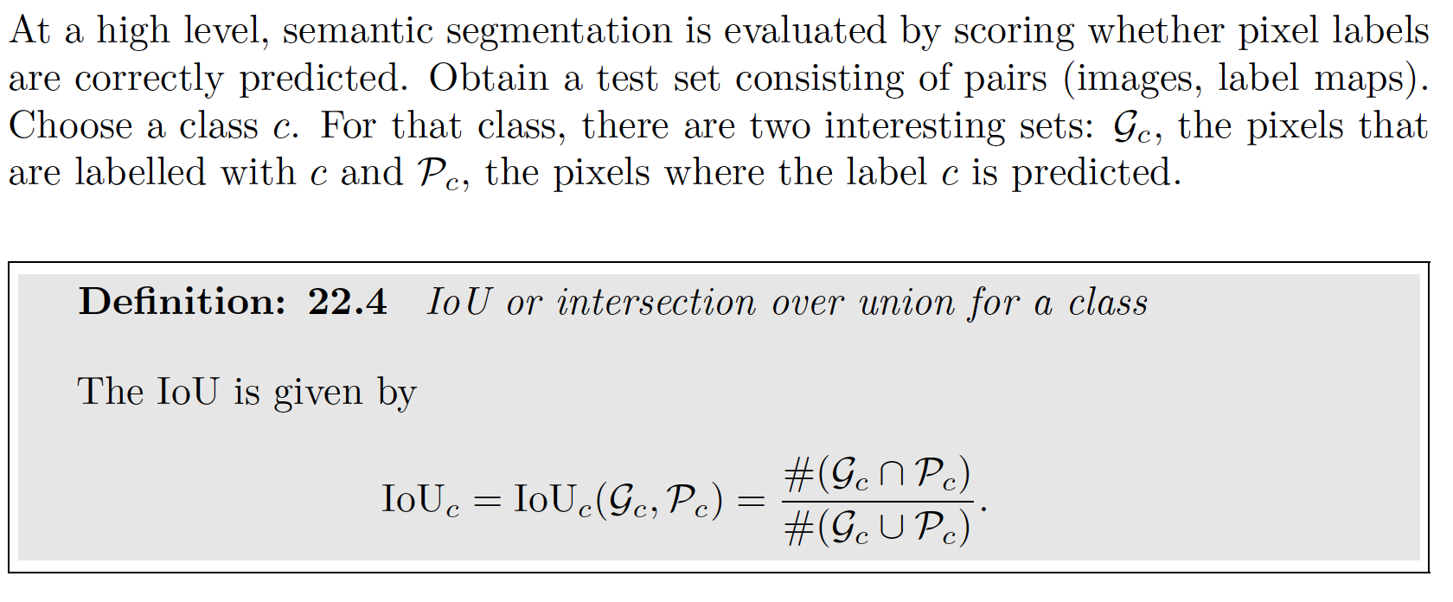
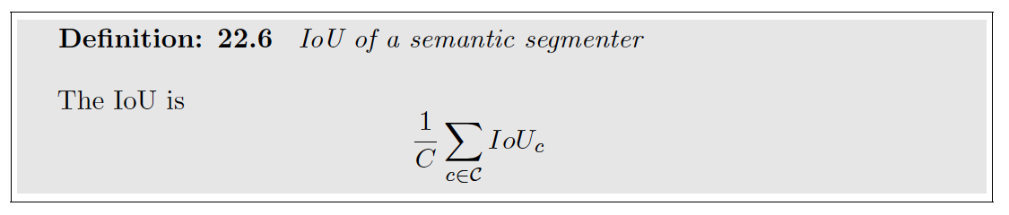
Evaluation

Slide 7
Variants
Some labels are class labels (‘car’, ‘bicycle’),
  some are category labels (‘vehicle’)
IoU per class
  0.76 on Kitti leaderboard
IoU per category
  0.9 on Kitti leaderboard

Slide 8
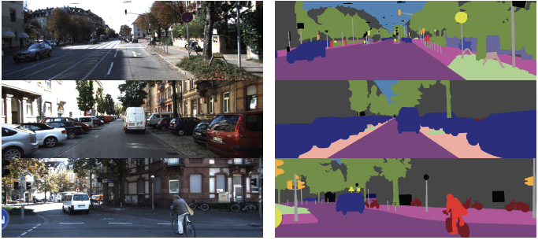
Semantic segmentation on Kitti (labelled data)

Slide 9
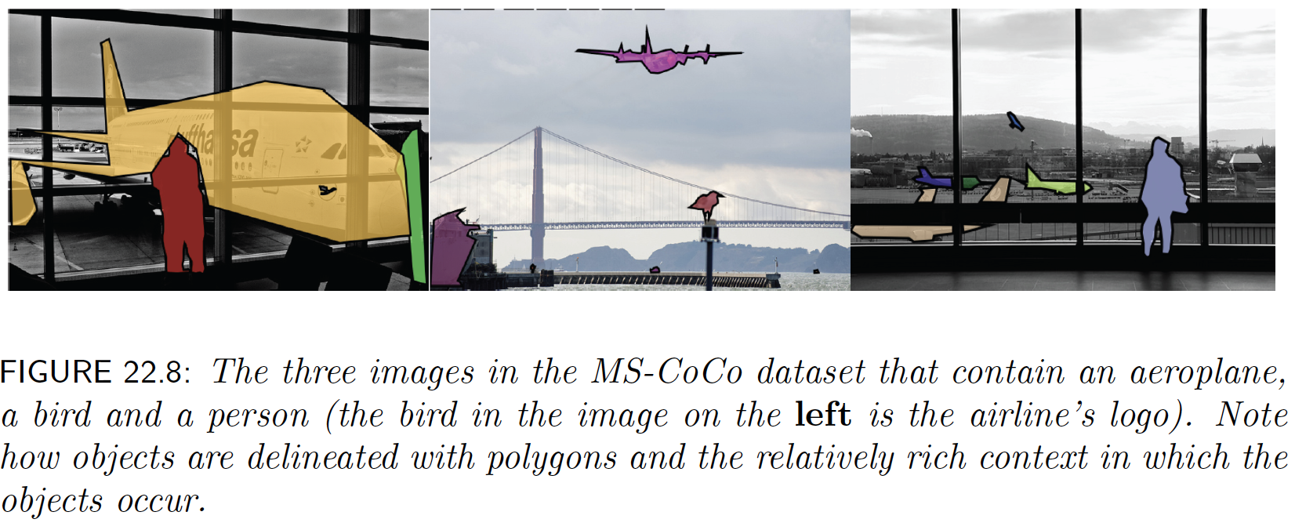
MS-CoCo dataset

Slide 10
Resources
Datasets in text
Numerous segmenters online

Slide 11
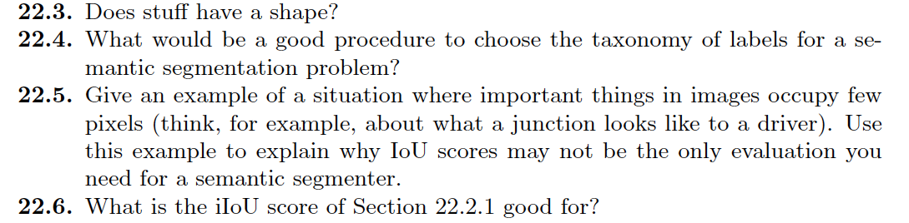
Think about this...

