Slide 1
Classical Structure from Motion Pipelines
D.A. Forsyth
University of Illinois at Urbana-Champaign

Slide 2
Recall cases:
Offline
  work with all images
  structure from motion
    underlying Q:
      how to make best use of all information
    roughly familiar structure
      set up huge optimization problem by constructing start point
      efficiency is now a serious issue
Online
  build best estimate available up to time t
  SLAM
    simultaneous localization and mapping
    build a map at the same time as determining where you are
    new Q:
      how do you make best use of all information up to now
      efficiency often crucial
Hybrids are quite usual, and important

Slide 3
3 or more calibrated cameras
Basically, use recipe above BUT
  In what order should you insert cameras?
    matters – recipe requires shared points
      we don’t know which pictures share many points
      some might share no points
  Optimize everything
    bundle adjustment

Slide 4
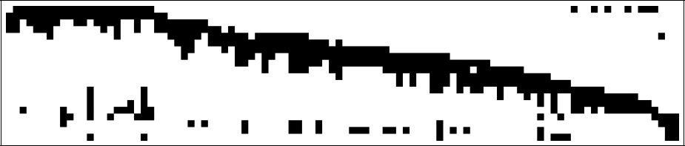
What can you see?
Build a table of what point is visible in what camera
  black is visible
  notice picture is in convenient permutation!
Issue:
  strategy above works only if cameras share points
  many (most) pairs don’t
cameras
points

Slide 5
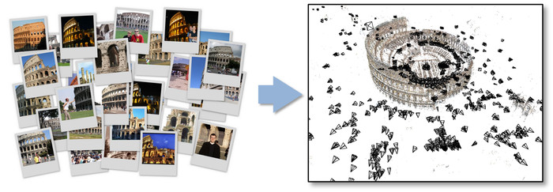
Representative SFM pipeline
N. Snavely, S. Seitz, and R. Szeliski. Photo tourism: Exploring photo collections in 3D. SIGGRAPH 2006
http://phototour.cs.washington.edu/
Notes:
Here’s how the same set of photos appear in our photo explorer. Our system takes the set of photos and automatically determines the relative positions and orientations from which each photo was taken. We can then load the photos into our immersive 3D browser where the user can visualize and explore the photos using spatial relationships.

Slide 6
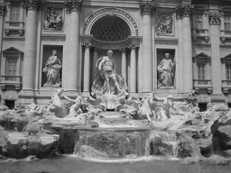
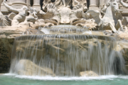
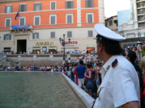
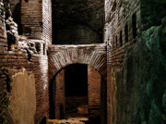

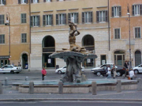
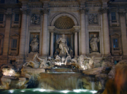
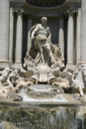
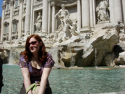
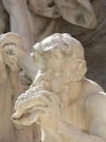
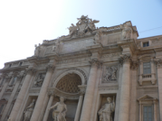
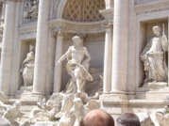
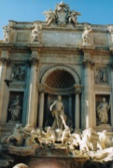
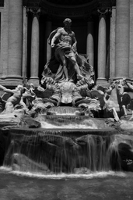
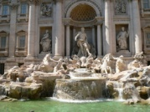
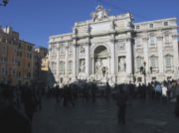
Feature detection
Detect SIFT features
Other popular feature types: SURF, ORB, BRISK, …
Source: N. Snavely

Slide 7
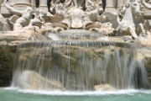
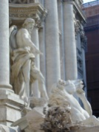

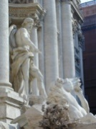





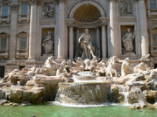
Feature matching
Match features between each pair of images
Source: N. Snavely
Notes:
Next, we match features across each pair of photos using approximate nearest neighbor matching.

Slide 8
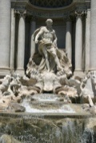


Fundamental matrix
Use RANSAC to estimate fundamental matrix between each pair
Source: N. Snavely
Notes:
The matches are refined by using RANSAC, which is a robust model-fitting technique, to estimate a fundamental matrix between each pair of matching images and keeping only matches consistent with that fundamental matrix.
We then link connected components of pairwise feature matches together to form correspondences across multiple images.
Once we have correspondences, we run structure from motion to recover the camera and scene geometry. Structure from motion solves the following problem:

Slide 9
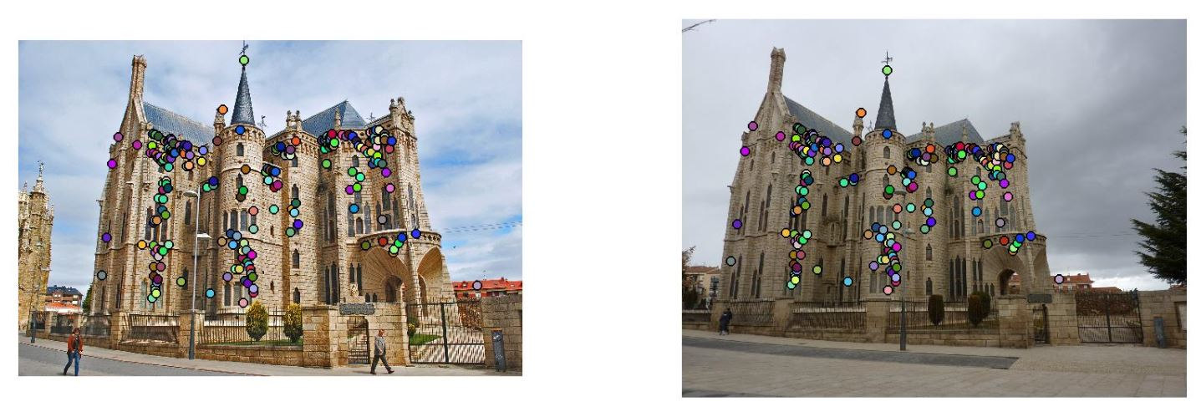
Fundamental matrix
Use RANSAC to estimate fundamental matrix between each pair
Image source
Notes:
The matches are refined by using RANSAC, which is a robust model-fitting technique, to estimate a fundamental matrix between each pair of matching images and keeping only matches consistent with that fundamental matrix.
We then link connected components of pairwise feature matches together to form correspondences across multiple images.
Once we have correspondences, we run structure from motion to recover the camera and scene geometry. Structure from motion solves the following problem:

Slide 10
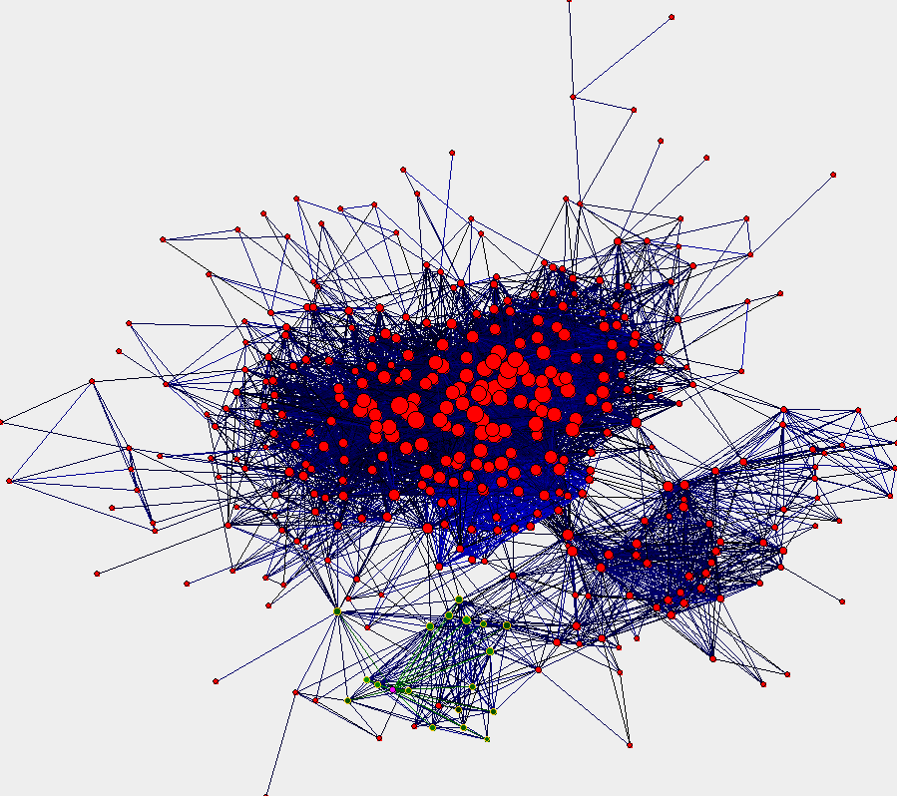
Image connectivity graph
(graph layout produced using the Graphviz toolkit: http://www.graphviz.org/)
Source: N. Snavely

Slide 11
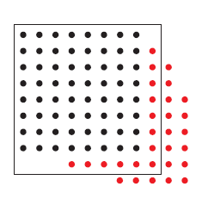
Incremental structure from motion
Initialize motion from two images using fundamental matrix
Initialize structure by triangulation
For each additional view:
  Determine projection matrix of new camera using all the known 3D points that are visible in its image – calibration
  Refine and extend structure: compute new 3D points, re-optimize existing points that are also seen by this camera – triangulation
Refine structure and motion: bundle adjustment
points
cameras

Slide 12


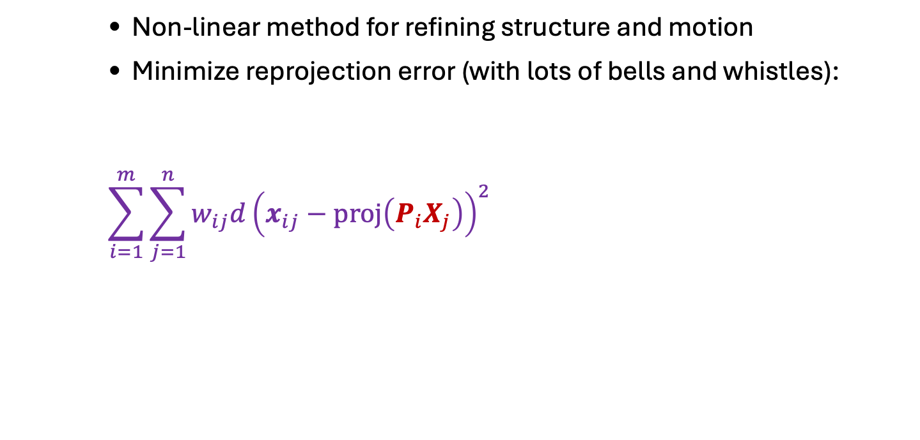









Bundle adjustment
Non-linear method for refining structure and motion
Minimize reprojection error (with lots of bells and whistles):
$$\sum_{i=1}^{m}{\sum_{j=1}^{n}{w_{ij}d{\left(x_{ij}−proj\left(P_{i}X_{j}\right)\right)}^{2}}}$$
$$Xj$$
This might be a robust loss
$$P1Xj$$
$$x1j$$
$$x3j$$
$$P2Xj$$
$$P3Xj$$
$$P1$$
$$x2j$$
visibility flag: is point $j$ visible in
view $i$?
$$P3$$
$$P2$$
B. Triggs et al. Bundle adjustment – A modern synthesis. International Workshop on Vision Algorithms, 1999

Slide 13
SFM software
Bundler
OpenSfM
OpenMVG
VisualSFM
COLMAP
See also Wikipedia’s list of toolboxes

