Slide 1
Structure and motion
D.A. Forsyth
University of Illinois at Urbana-Champaign

Slide 2








Core problem
Given:
  $m$images of $n$ fixed 3D points
  $xij ≅ Pi Xj$, $i = 1, … , m, j = 1, … , n$
  with known correspondences
Estimate:
  $m$ projection matrices $Pi$
  $n$ 3D points $Xj$
$$Xj$$
$$x1j$$
$$x3j$$
$$x2j$$
$$P1$$
$$P3$$
$$P2$$

Slide 3
Cases:
Offline
  work with all images
  structure from motion
    underlying Q:
      how to make best use of all information
    roughly familiar structure
      set up huge optimization problem by constructing start point
      efficiency is now a serious issue
Online
  build best estimate available up to time t
  SLAM
    simultaneous localization and mapping
    build a map at the same time as determining where you are
    new Q:
      how do you make best use of all information up to now
      efficiency often crucial
Hybrids are quite usual, and important

Slide 4
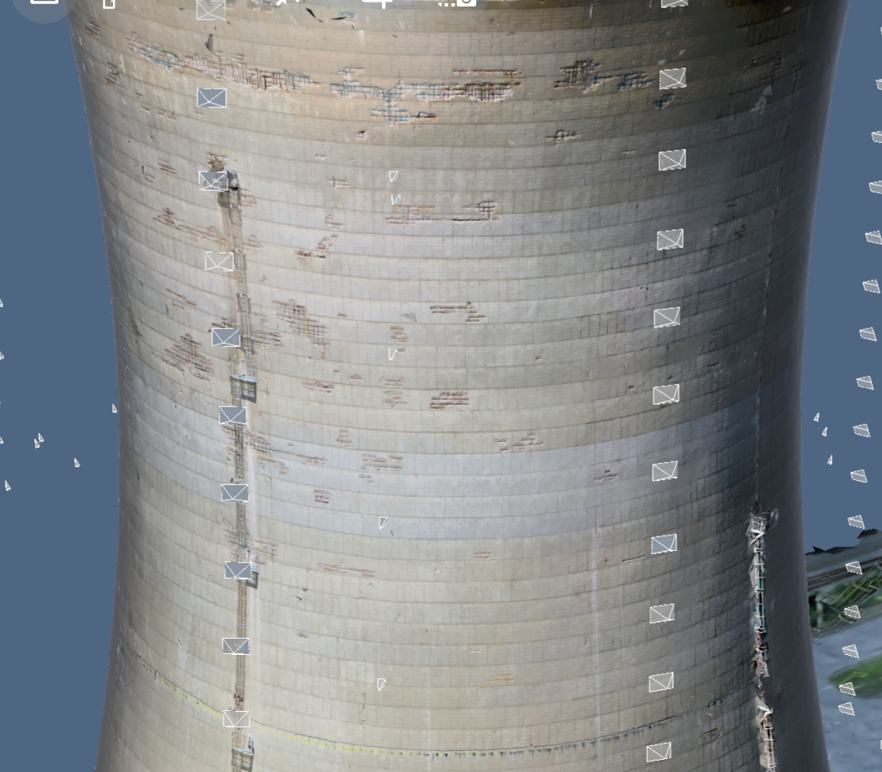
Applications
Enable inspection in hard to reach areas with drone photos and 3D reconstruction
Create 3D model from images
Provide tools to inspect on images and map interactions to 3D
Source: D. Hoiem

Slide 5
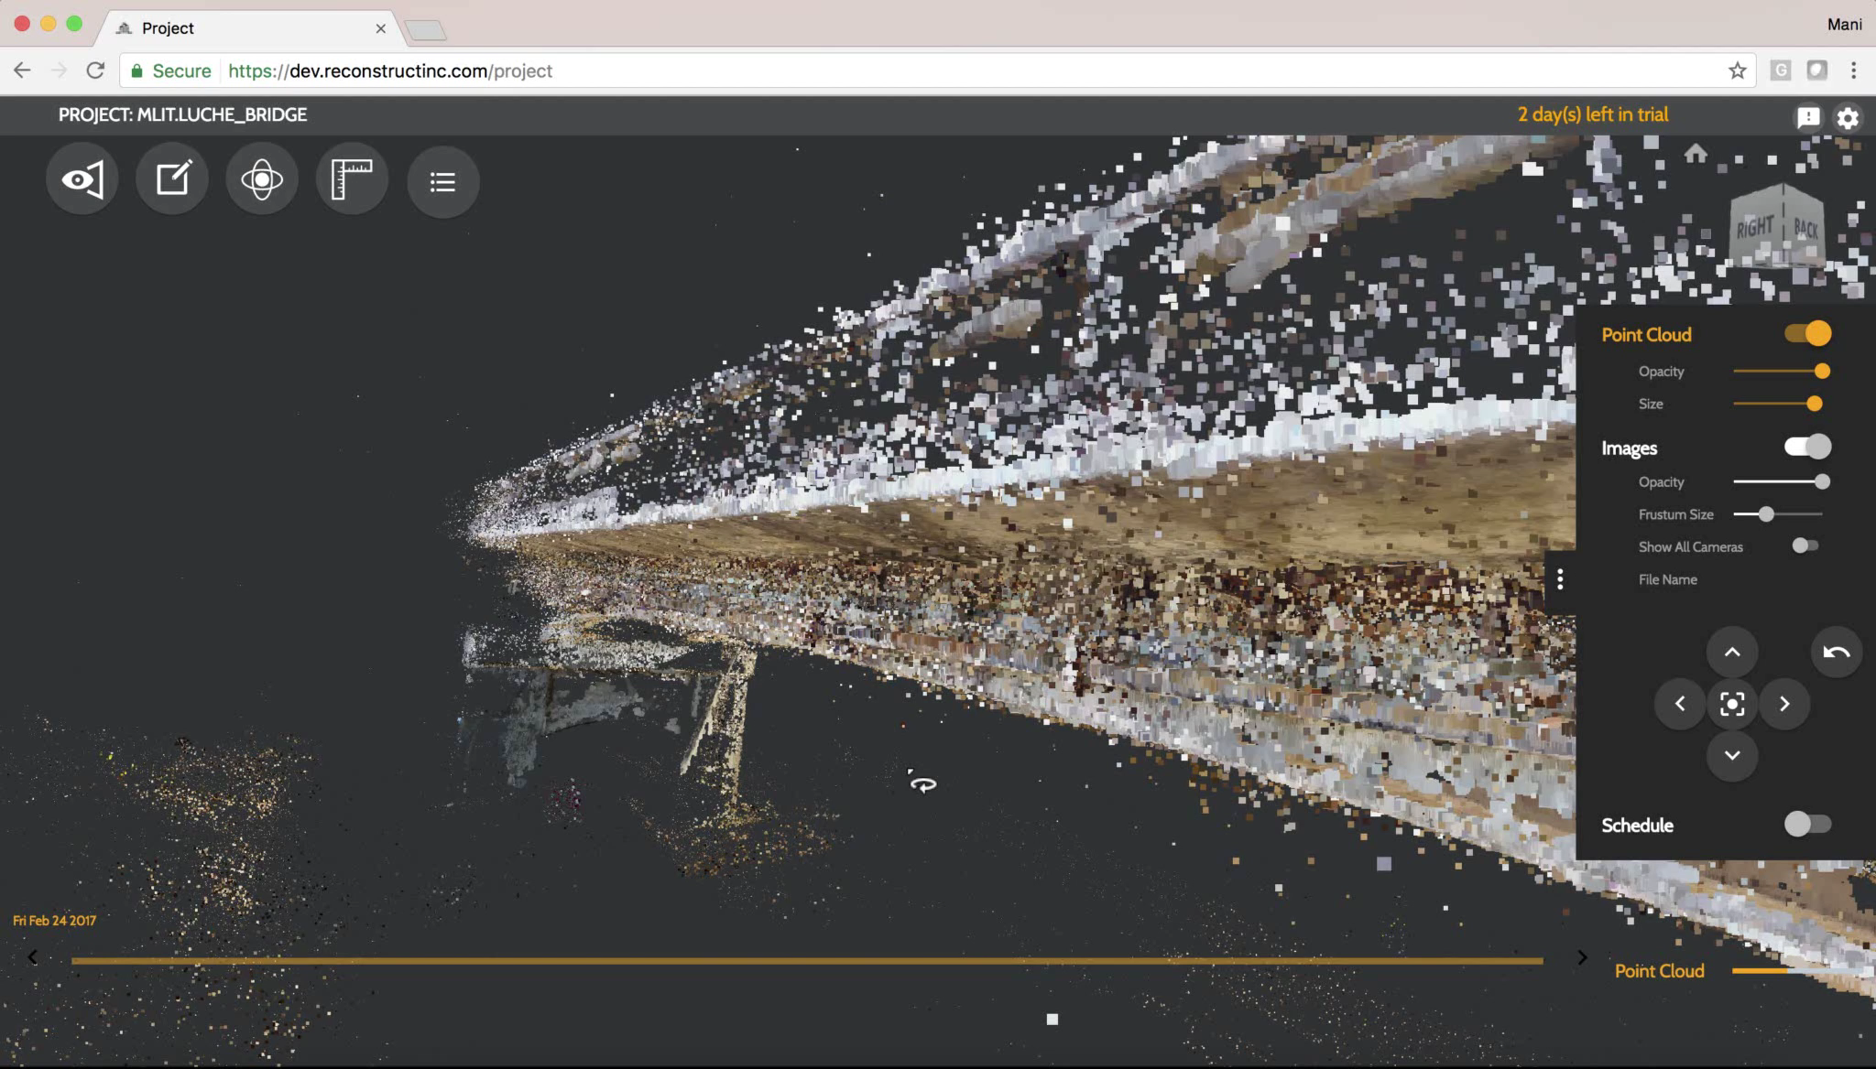
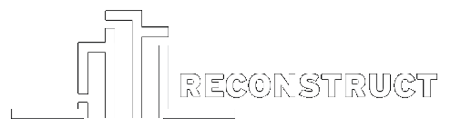
Reconstruct: Inspect aging infrastructure
Derek Hoiem
Luche Bridge, Ministry of Land, Transport, and Infrastructure, Japan

Slide 6
Applications: where is my drone?
Highly relevant
Taste prevents the use of news pictures...

Slide 7


Structure from motion ambiguity
Transform the scene using a transformation $Q$
Apply inverse to the camera matrices
The image observations do not change:
  $$x≅PX=\left(PQ^{−1}\right)(QX)$$

Slide 8
Structure from motion ambiguity
Cases:
  nothing is known about cameras – Q is projective tx
  camera calibrations known – Q is scaled Euclidean

Slide 9
Recall: Two calibrated cameras
Obtain interest points and some matches
Obtain fundamental matrix
  as before, using matches
Obtain essential matrix
  as before, using calibration
Obtain rotation, translation up to scale
  as before, using odometry
Triangulate

Slide 10
Three calibrated cameras
Do two cameras for c1, c2
  reconstruct all points in both c1 and c2
Now figure out c3
  using reconstructions - calibration
  There is only one missing scale!
You can now insert more points into 3D!
  anything in c1 and c3 but not c2
  anything in c2 and c3 but not c1
  just more triangulation

Slide 11
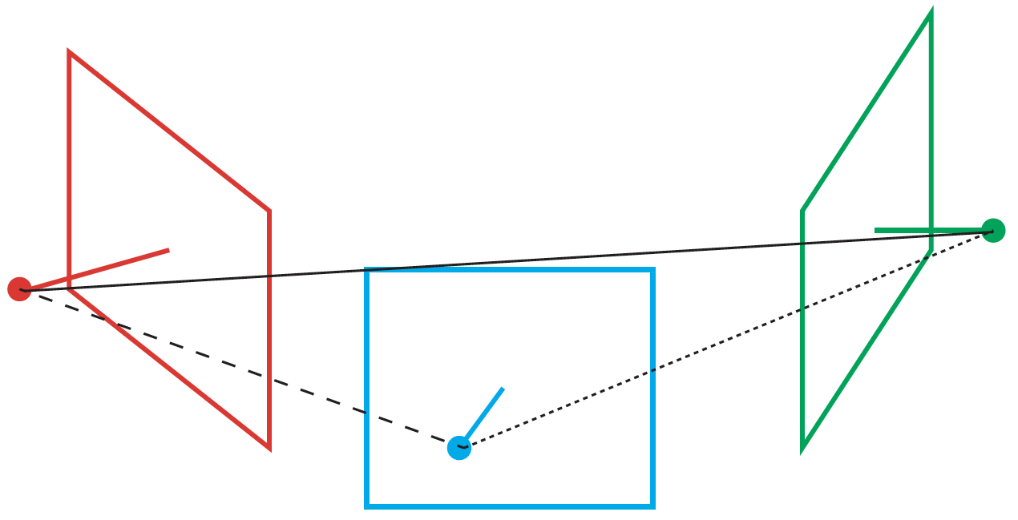
There is only one missing scale...

Slide 13
Three calibrated cameras
You can now insert more points into 3D!
  anything in c1 and c3 but not c2
  anything in c2 and c3 but not c1
  just more triangulation

Slide 14
3 or more calibrated cameras
Issue:
  in what order should you insert cameras?
Online:
  no issue
    in the order you get them, BUT
      how do you get best estimate of points, cameras from data?
Offline
  major issue

