Slide 1
Structure and motion: some ifs ands and buts
D.A. Forsyth
University of Illinois at Urbana-Champaign

Slide 2








Structure from motion (SFM)
Given:
  $m$images of $n$ fixed 3D points
  $xij ≅ Pi Xj$, $i = 1, … , m, j = 1, … , n$
  note known correspondences
Estimate:
  $m$ projection matrices $Pi$
  $n$ 3D points $Xj$
$$Xj$$
$$x1j$$
$$x3j$$
$$x2j$$
$$P1$$
$$P3$$
$$P2$$

Slide 3
Cases:
Offline
  work with all images
  structure from motion
    underlying Q:
      how to make best use of all information
    roughly familiar structure
      set up huge optimization problem by constructing start point
      efficiency is now a serious issue
Online
  build best estimate available up to time t
  SLAM
    simultaneous localization and mapping
    build a map at the same time as determining where you are
    new Q:
      how do you make best use of all information up to now
      efficiency often crucial
Hybrids are quite usual, and important

Slide 4
Difficulties
Degenerate configurations
Dealing with repetitions and symmetries
  which cause matching errors
Reducing error accumulation and closing loops
Making the whole thing efficient!
  See, e.g., Towards Linear-Time Incremental Structure from Motion

Slide 5
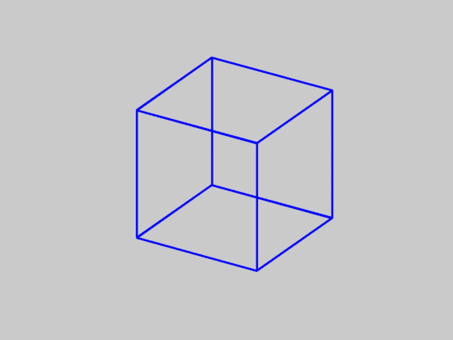
Is SFM always uniquely solvable?
Necker cube
Source: N. Snavely

Slide 6
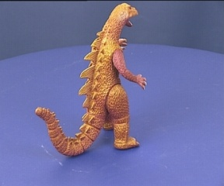
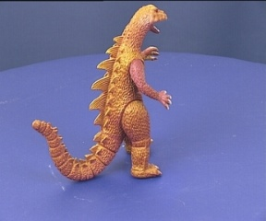
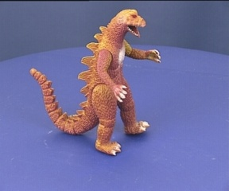
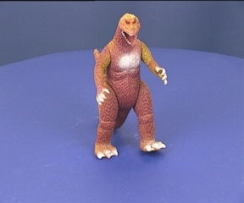
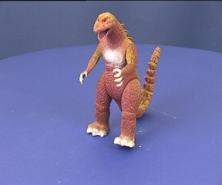
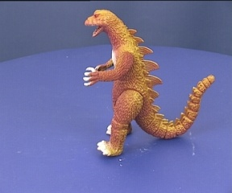
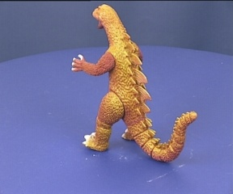
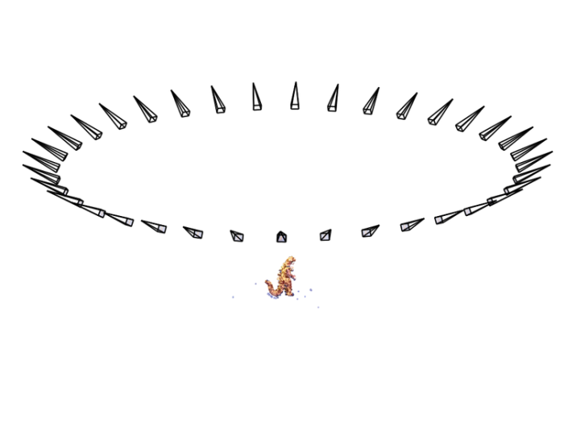
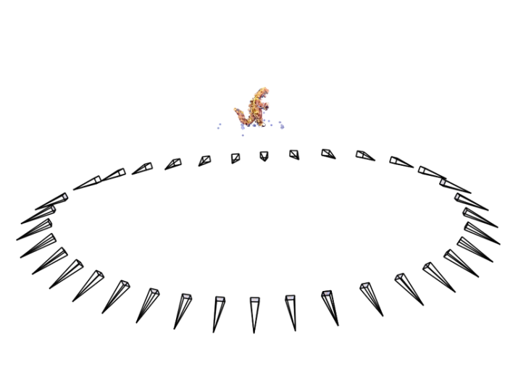
Is SFM always uniquely solvable?
Could actually happen in affine structure from motion:
Source: N. Snavely
Notes:
Necker reversal ambiguity:
This arises because an object rotating by ρ and its mirror image rotating by −ρ generate the same image under parallel projection, see figure 14.9(a). Thus, structure is only recovered up to a reflection about the frontal plane. This ambiguity is absent in the perspective case because the points have different depths in the two interpretations and so do not project to coincident image points.

Slide 7
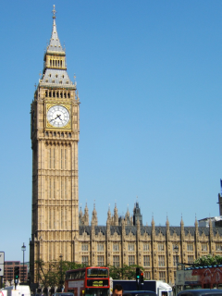
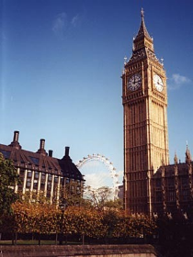

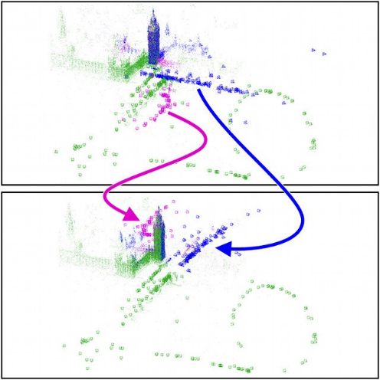
Repetitive structures cause catastrophic failures
https://demuc.de/tutorials/cvpr2017/sparse-modeling.pdf

Slide 8
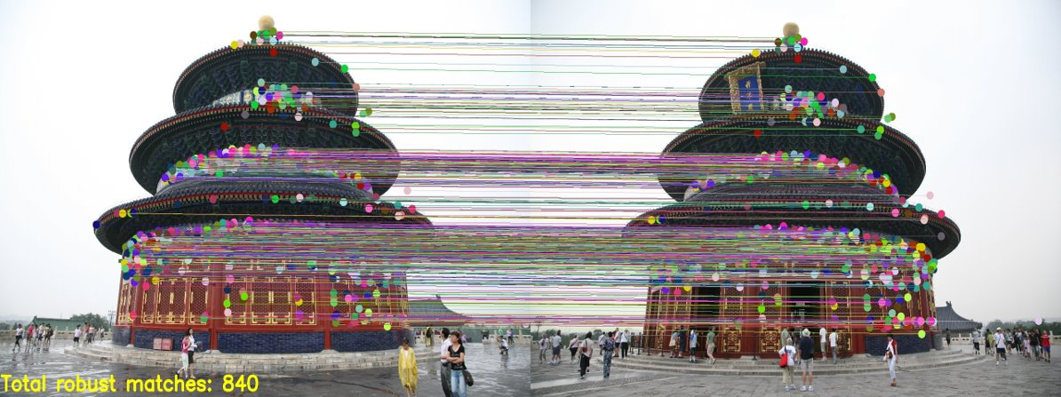
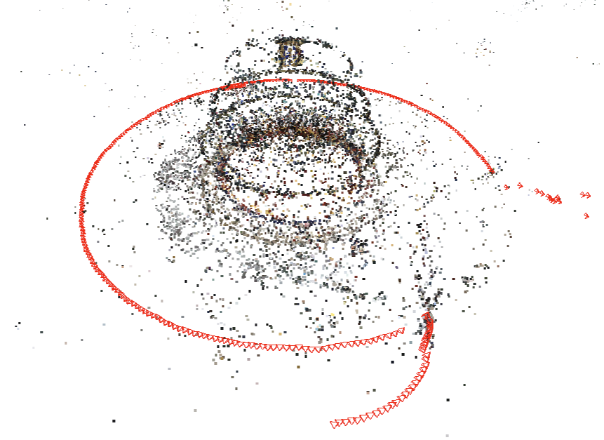
Repetitive structures cause catastrophic failures
R. Kataria et al. Improving Structure from Motion with Reliable Resectioning. 3DV 2020
Notes:
A common cause of failure in structure-from-motion is misregistration of images due to repeated structures. Here, we observe 840 matches on two different sides of the temple which leads to a catastrophic failure. To understand this problem, let’s briefly discuss resectioning.

Slide 9
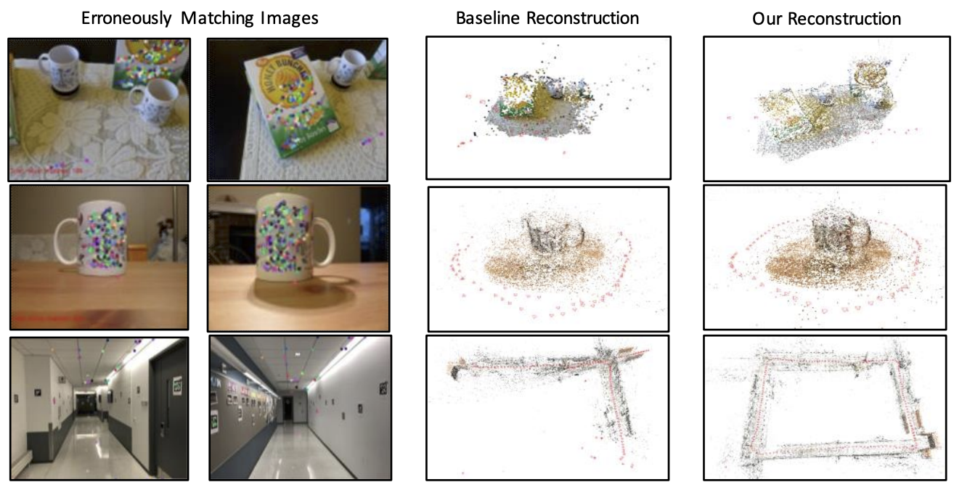
Repetitive structures cause catastrophic failures
R. Kataria et al. Improving Structure from Motion with Reliable Resectioning. 3DV 2020
Notes:
A common cause of failure in structure-from-motion is misregistration of images due to repeated structures. Here, we observe 840 matches on two different sides of the temple which leads to a catastrophic failure. To understand this problem, let’s briefly discuss resectioning.

Slide 10
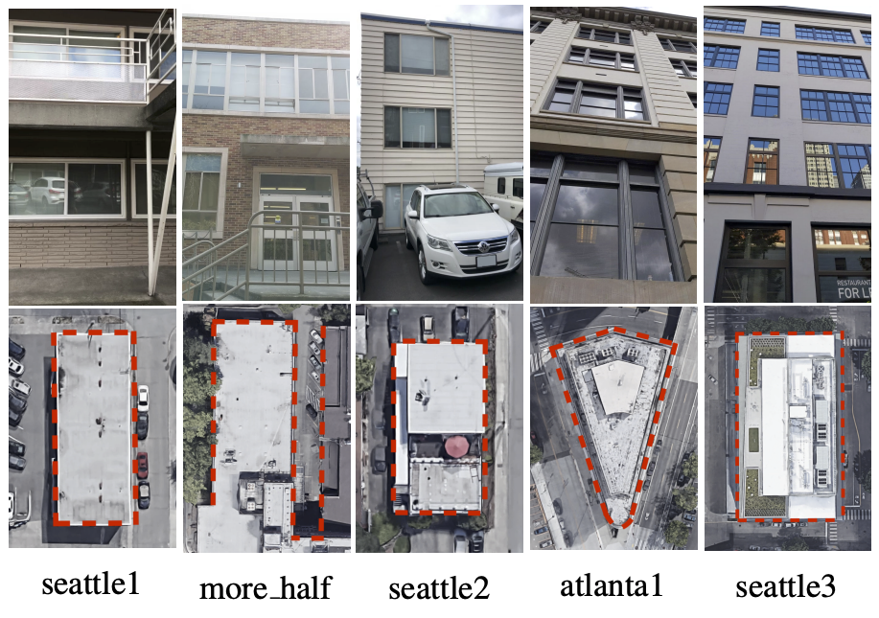
Reducing error accumulation and closing loops
A. Holynski et al. Reducing Drift in Structure From Motion Using Extended Features. arXiv 2020

Slide 11
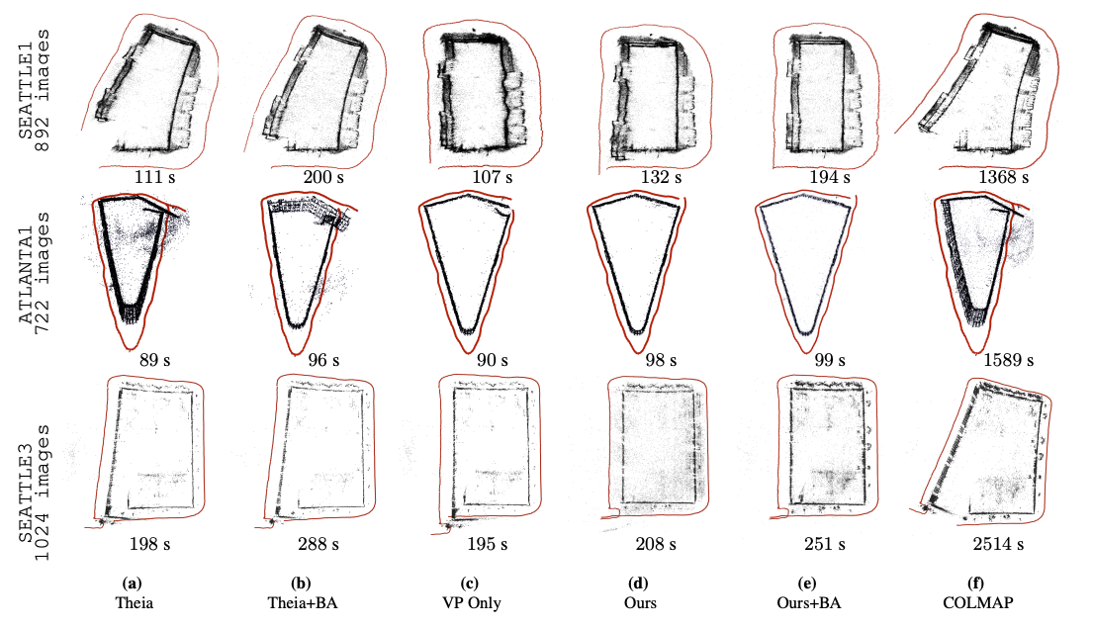
Reducing error accumulation and closing loops
A. Holynski et al. Reducing Drift in Structure From Motion Using Extended Features. arXiv 2020

