Slide 1
Stereo Matching Methods
D.A. Forsyth,
University of Illinois at Urbana Champaign

Slide 2
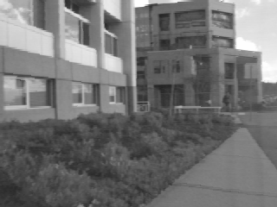
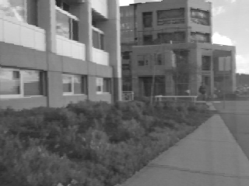
Correspondence search
Left
Right
scanline
Matching cost
disparity
Slide a window along the right scanline and compare contents of that window with the reference window in the left image
Matching cost: SSD or normalized correlation

Slide 3
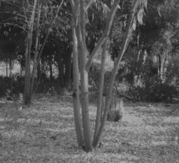
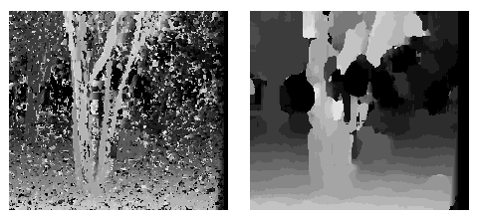
Effect of window size on correspondence search
Window size 3
Window size 20
  Smaller window:
    More detail
    More noise
  Larger window:
    Smoother disparity maps
    Less detail
Notes:
smaller window: more detail, more noise
bigger window: less noise, more detail

Slide 4
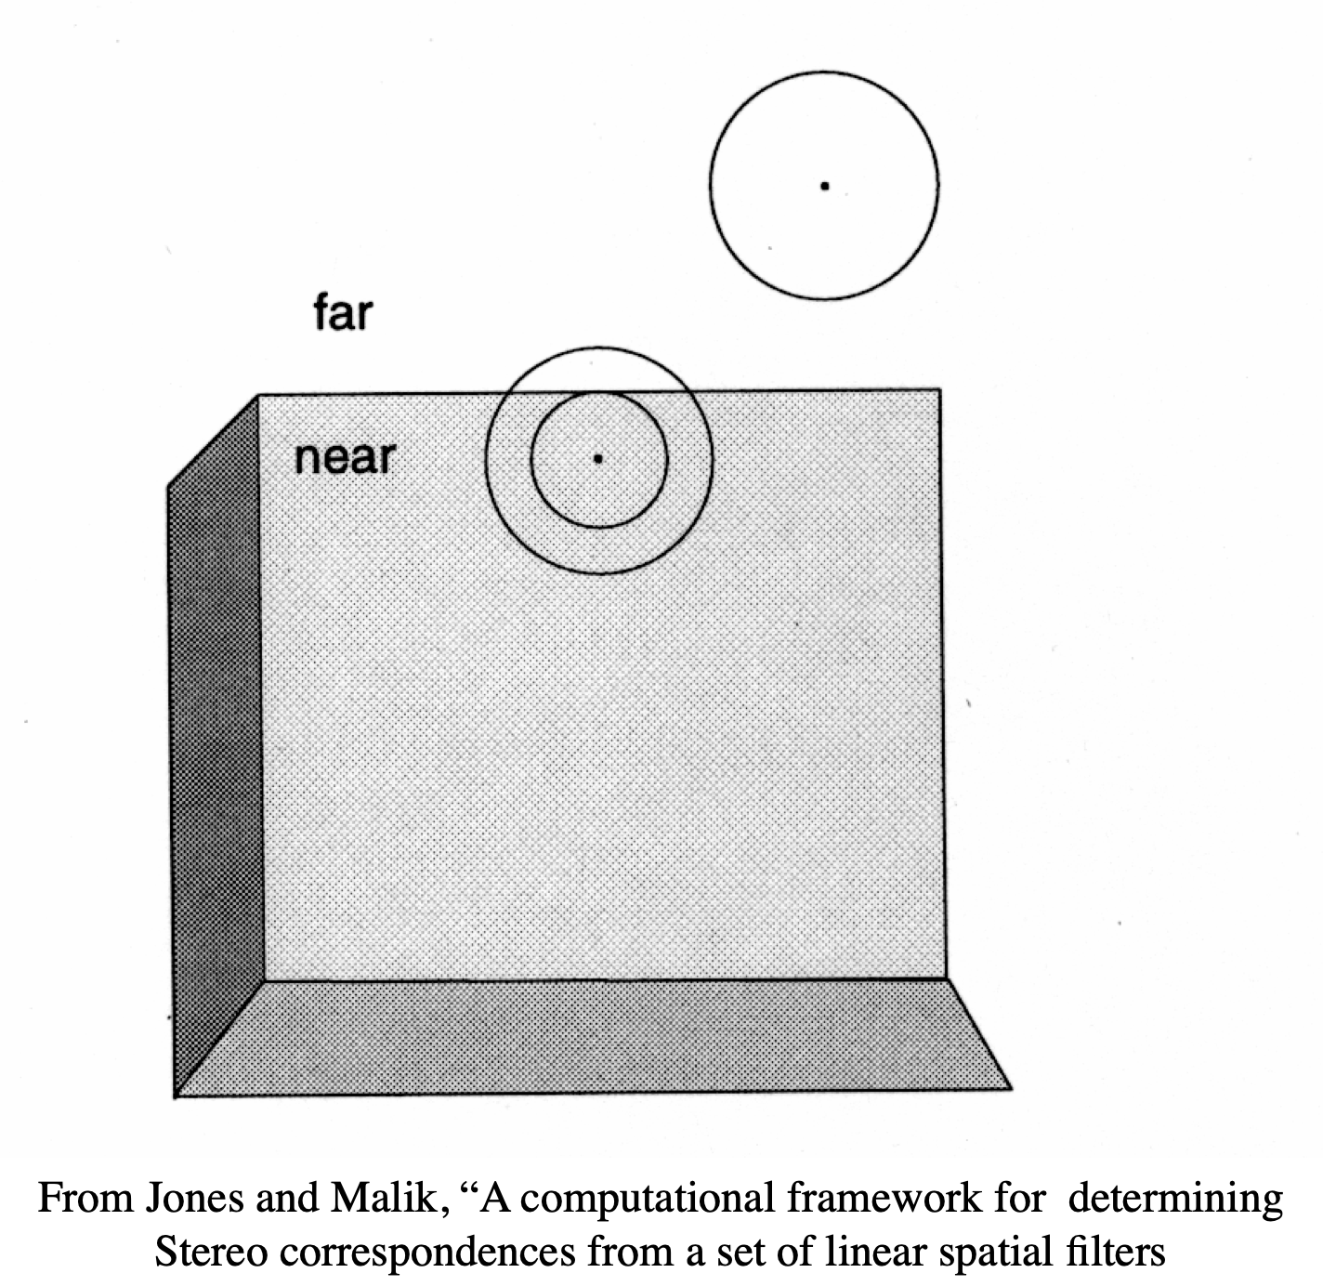
More interesting matching costs
Compute filter outputs for many filters
SSD those
Advantage: more detailed description of points
Disadvantage: Filter support interacts badly with fast changes in depth

Slide 5
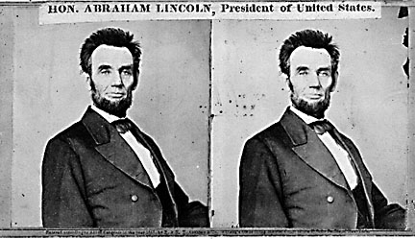
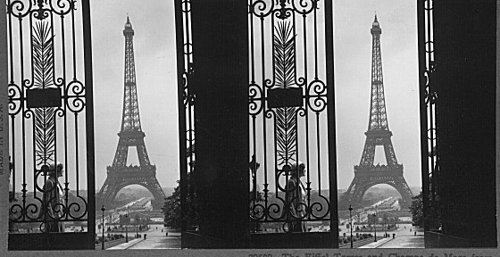
Where will basic search fail?
Textureless surfaces
Occlusions, repetition
Non-Lambertian surfaces, specularities

Slide 6
Dealing with Da Vinci
Consequence:
some points in L (R) image do not
have matches in R (L) image
Note asymmetry in previous algorithm
(find best matching point in other side - what if best matches aren’t consistent?)
Strategy:
match L to R
match R to L
use only consistent matches

Slide 7
Stereo as optimization, simple
Do this line by line
  move along line in left image
    parameters:
      at each location x in left, best matching location b(x) in right.
  objective:
    photometric consistency
      compare I_2(b(x)) to I_1(x)
Constraints
  Uniqueness
  Ordering

Slide 8
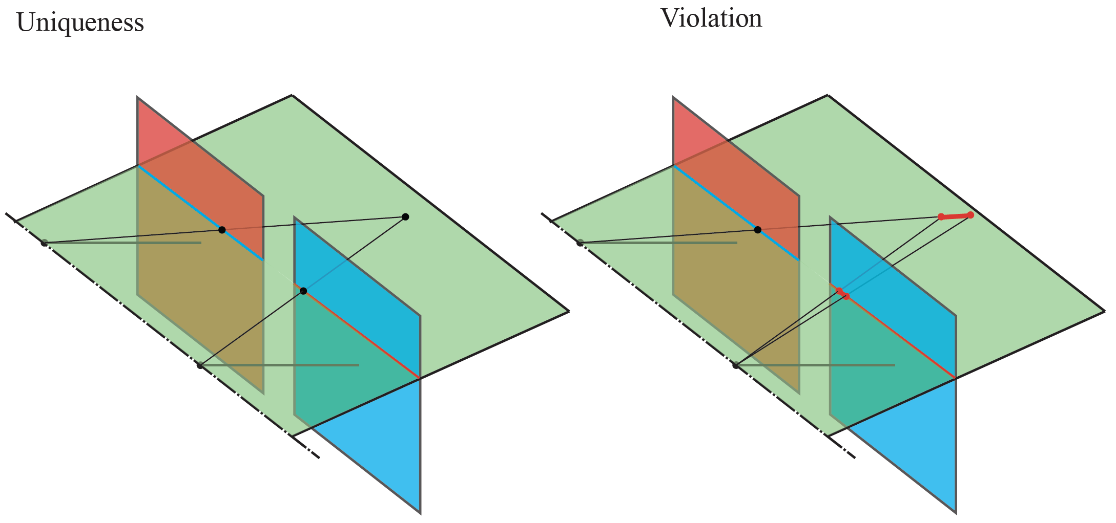
Uniqueness
Each point in one should match at most one point in the other
  Mostly, but not always, true

Slide 9
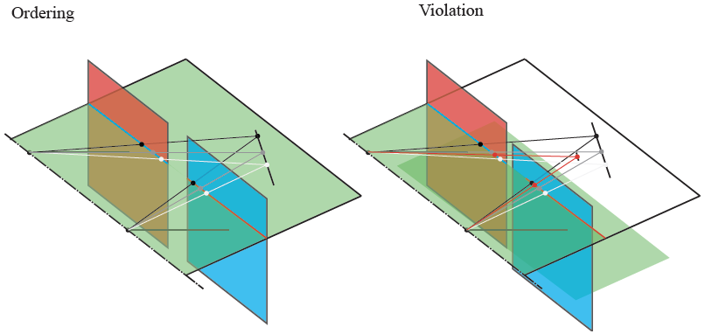
Ordering
Corresponding points should appear in the same order
  Mostly, but not always, true

Slide 10
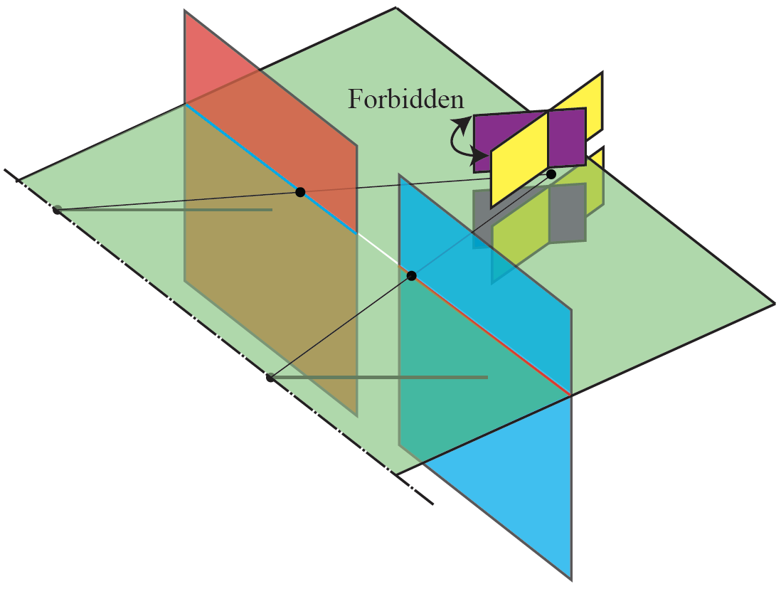
Disparity gradient constraint
The disparity gradient is limited

Slide 11
Smoothness
Large disparity gradients should be rare
  because they imply sharp depth gradients
  and depth gradients tend to be small

Slide 12
Matching by dynamic programming
Match pixels along the entire scanline while preserving uniqueness and ordering
Different scanlines are still optimized independently
  Y. Ohta and T. Kanade. Stereo by Intra- and Inter-Scanline Search Using Dynamic Programming. IEEE Trans. PAMI, 1985

Slide 13
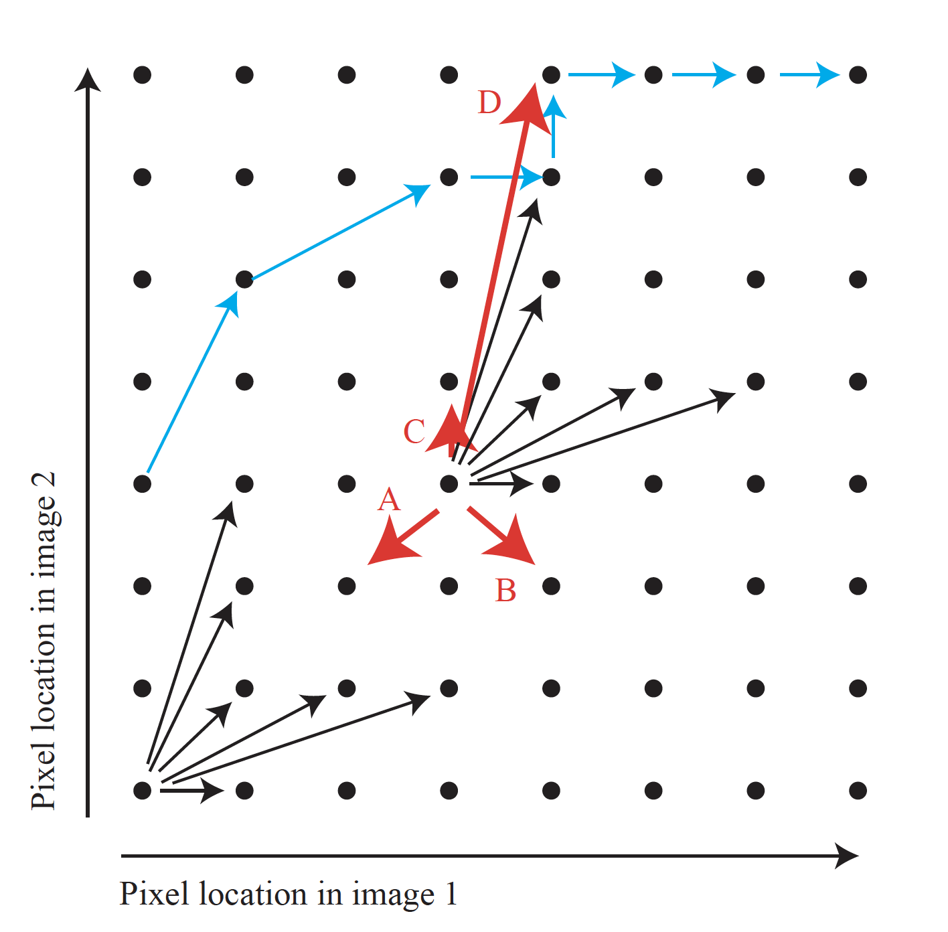
Matching by dynamic programming

Slide 14
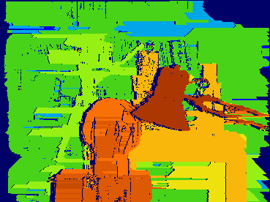
Matching by dynamic programming
Generates streaking artifacts!

Slide 15
Stereo as a conditional random field
Originally:
  find x_1, x_2 that match, compute depth
Now:
  choose depth/disparity at x_1 that causes x_2 to be best match

Slide 16
Setup
Discretize disparity
  For example, 256 values
  Seek one-hot vector at each pixel
    where the 1 tells which disparity at that pixel
Set up cost function
  Per pixel cost
    disparity at this location implies match
      is color (etc) at the matching location the same as at pixel?
  Pairwise cost
    is disparity at this location compatible with disparity at that?

Slide 17


Per pixel cost
Decide photometric cost:
Now use
Basically, the one-hot vector

Slide 18
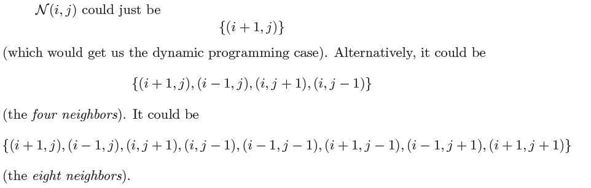
Pairwise costs
Decide neighbors for a pixel
  Examples:

Slide 19
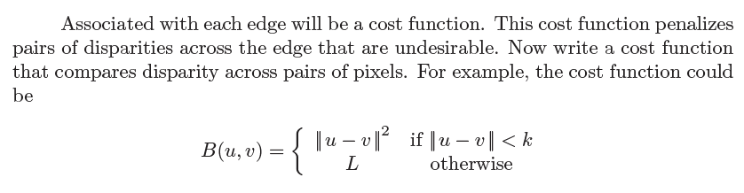
Pairwise costs

Slide 20
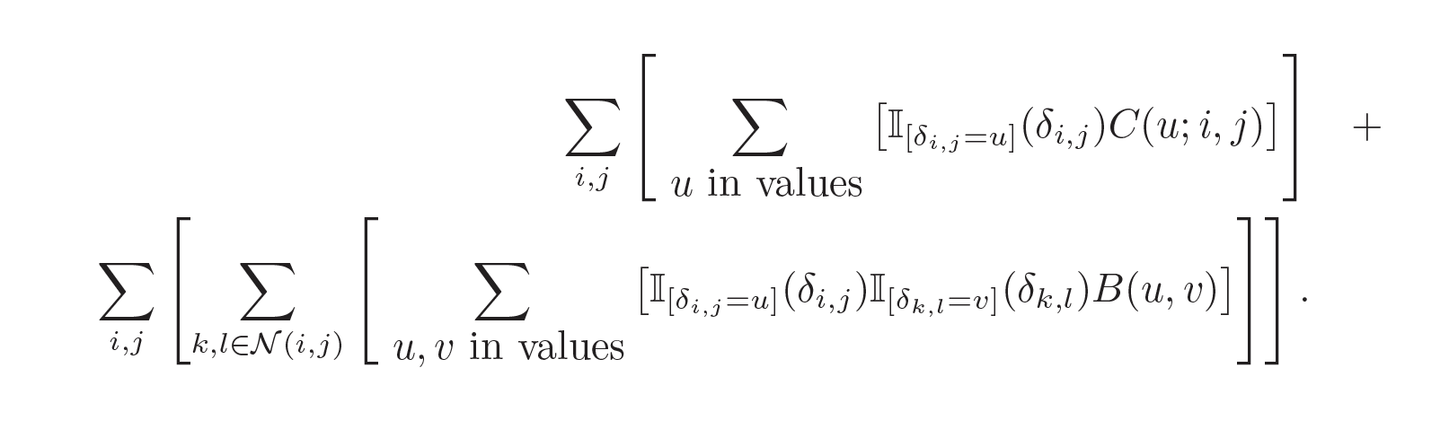
Now solve
per pixel costs
pairwise costs
Basically, the one-hot vector

Slide 21
Summary
This is an intractable optimization problem
  with excellent approximation properties
For a small set of cases, true optimum is known
  (by good luck)
Yields:
  excellent stereo algorithms
  Y. Boykov, O. Veksler, and R. Zabih, Fast Approximate Energy Minimization via Graph Cuts, PAMI 2001

Slide 22
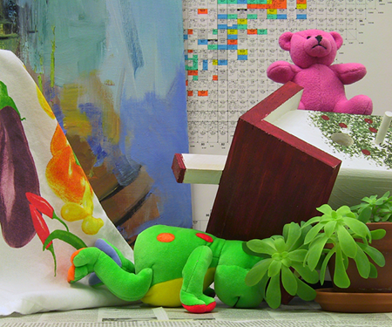
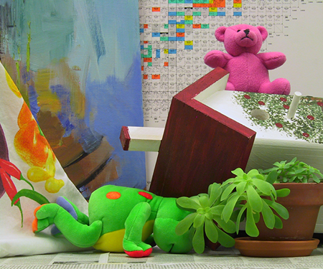
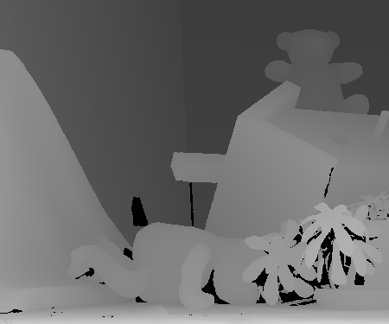
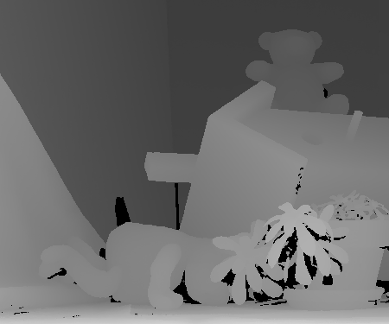
Examples

Slide 23
Resources
Middlebury stereo
  start at
    https://vision.middlebury.edu/stereo/
KITTI
  start at
    https://www.cvlibs.net/datasets/kitti/eval_stereo.php

Slide 24
The application of networks
VERY like optic flow
  RAFT works rather well
Tremendous opportunity for self-supervision
  with photometric consistency

Slide 25
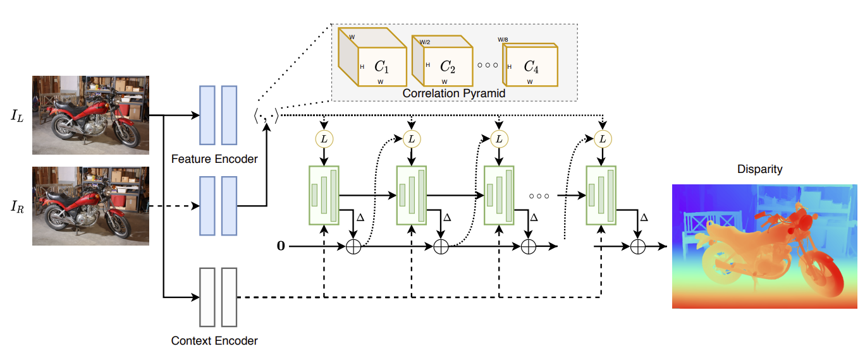
Stereo matching with deep networks
L. Lipson et al. RAFT-Stereo: Multilevel Recurrent Field Transforms for Stereo Matching. arXiv 2021

Slide 26
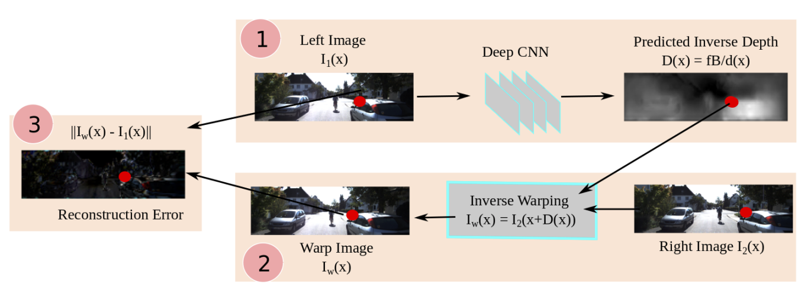
Self-supervised depth estimation
R. Garg et al. Unsupervised CNN for Single View Depth Estimation: Geometry to the Rescue. ECCV 2016

