Slide 1
Stereo overview
D.A. Forsyth
University of Illinois at Urbana Champaign

Slide 2
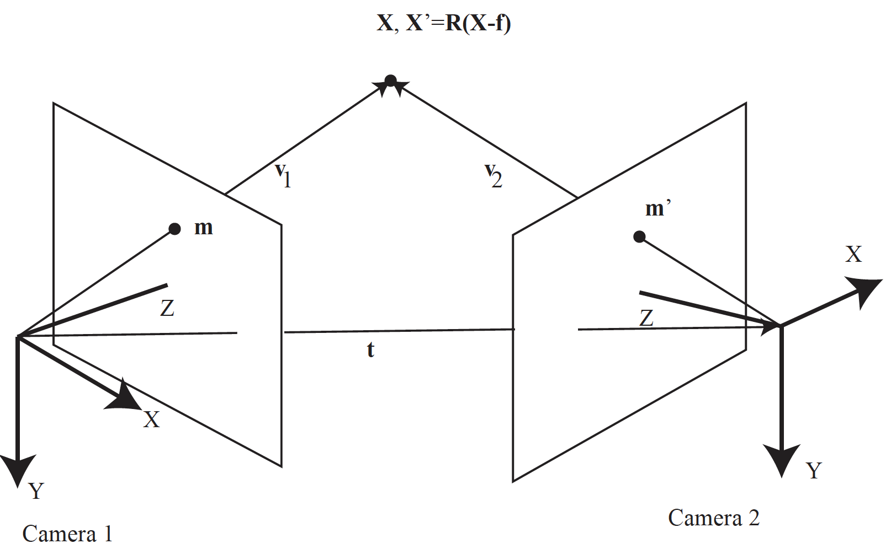
Recall triangulation
IF you know m, m’ correspond
  you can get X

Slide 3
Setup
Two cameras
Images
  at the same time
  OR static scene
Issue:
  what m’ corresponds to m?
Already know:
  epipoles, etc.

Slide 4
Strategy
Matching procedures for ”easy” camera pair
  camera translated along the x-axis
Rectify other pairs into that frame

Slide 5
Stereo image rectification
If the image planes are not parallel, we can find homographies to project each view onto a common plane parallel to the baseline
C. Loop and Z. Zhang. Computing Rectifying Homographies for Stereo Vision. CVPR 1999

Slide 6
Stereo image rectification
If the image planes are not parallel, we can find homographies to project each view onto a common plane parallel to the baseline
C. Loop and Z. Zhang. Computing Rectifying Homographies for Stereo Vision. CVPR 1999

Slide 7
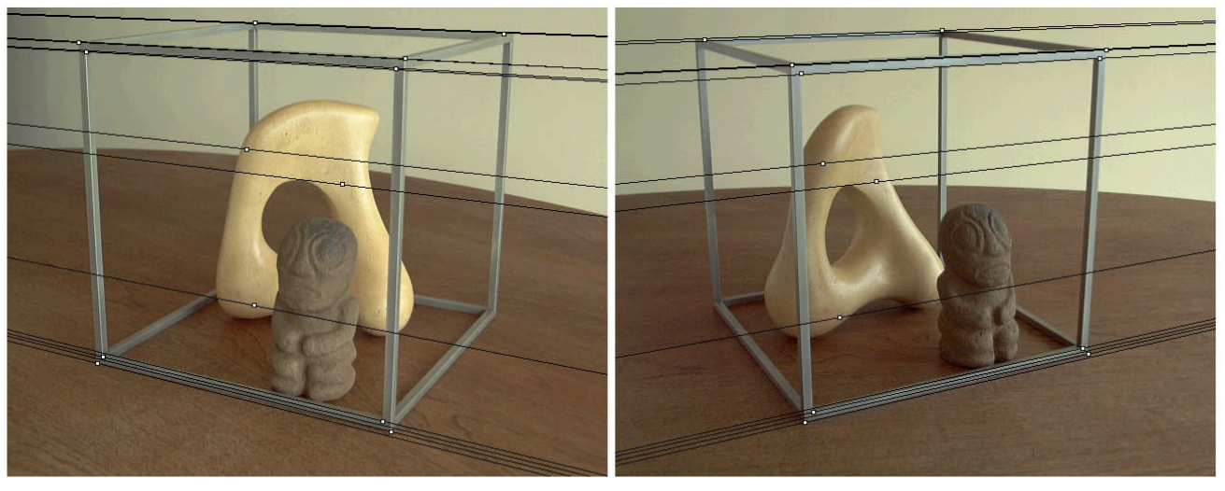
Stereo image rectification
Before rectification:
Image source

Slide 8
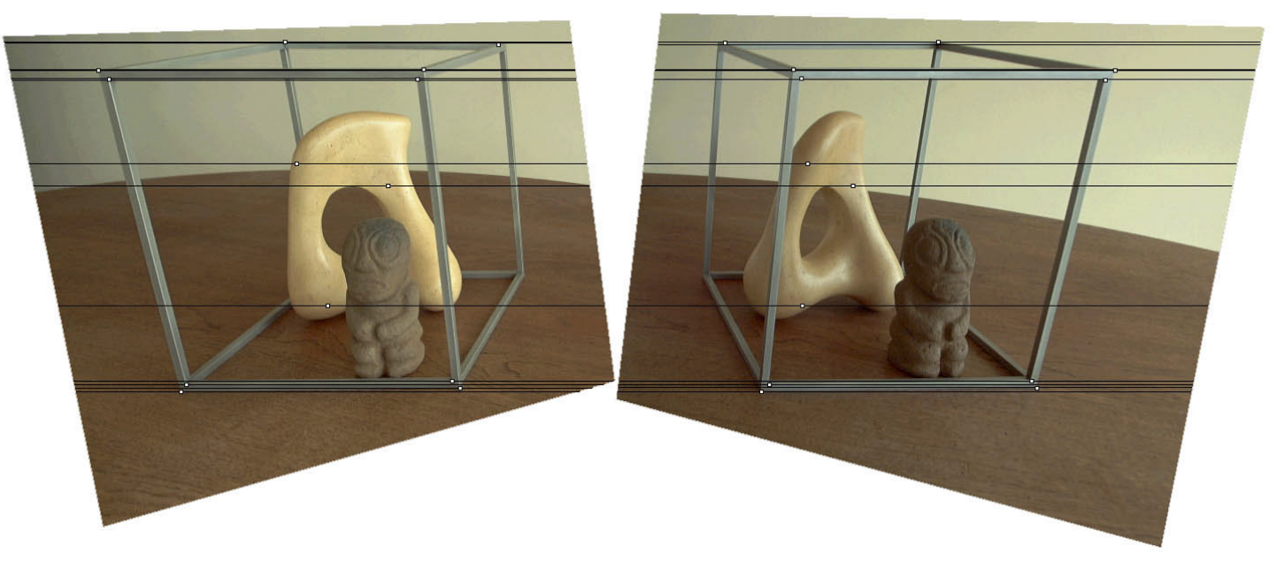
Stereo image rectification
After rectification:
Image source

Slide 9
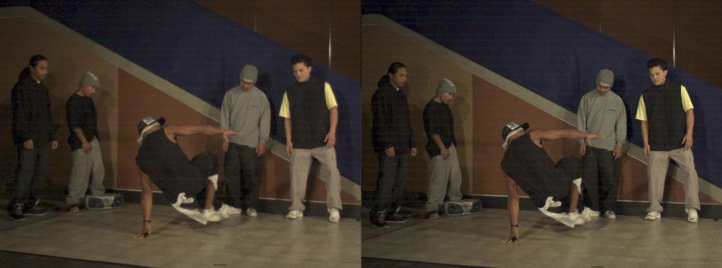
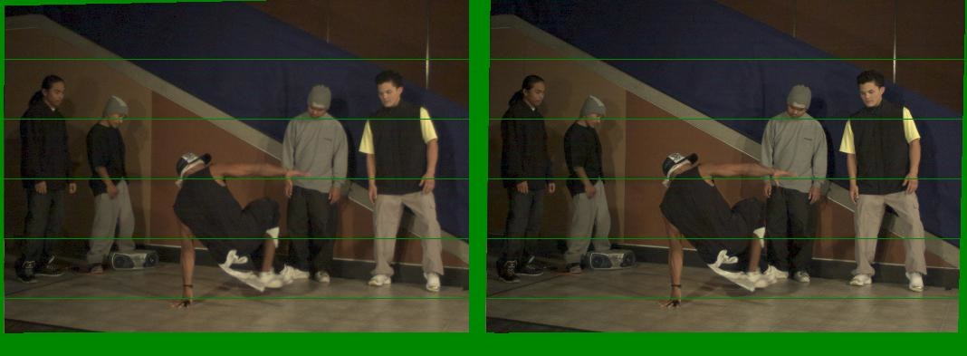
Another rectification example
Unrectified
Rectified

Slide 10
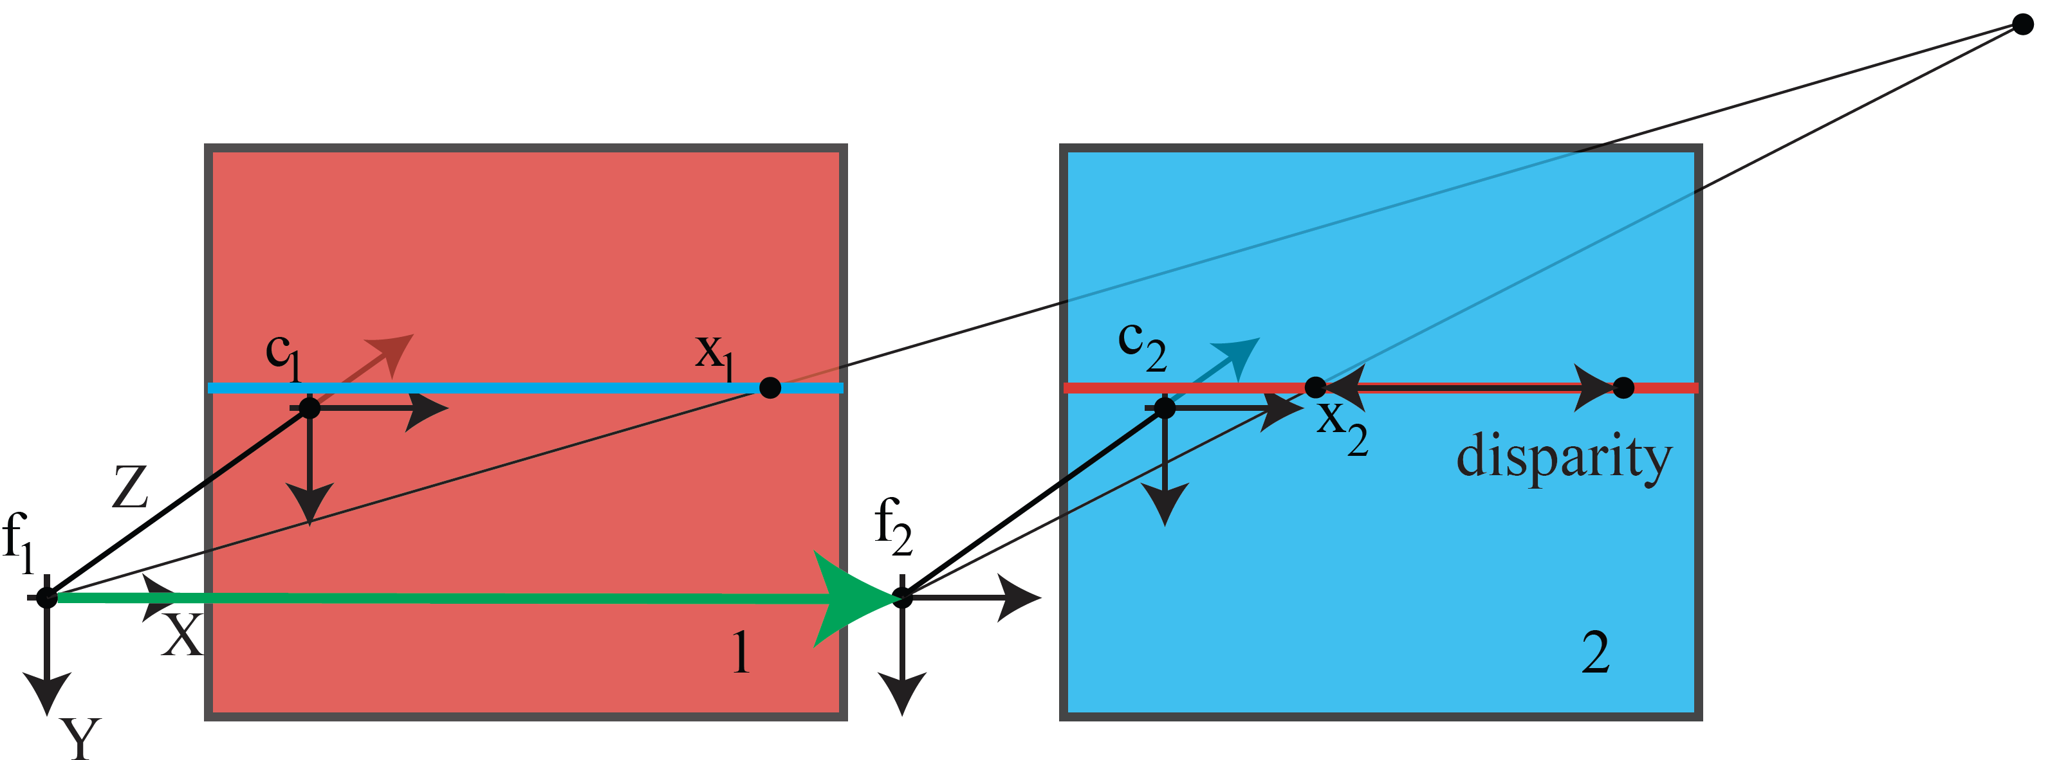
Easy cameras

Slide 11
Easy cameras

Slide 12
Easy cameras
Disparity – the difference in position in the red and blue cameras

Slide 13
Easy cameras
Bigger baseline == better depth resolution
Key question: which x2 matches x1?

Slide 14
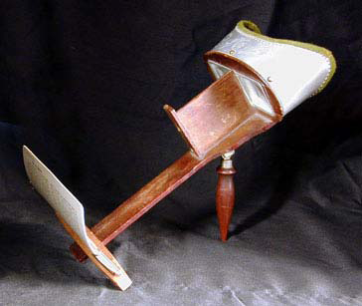
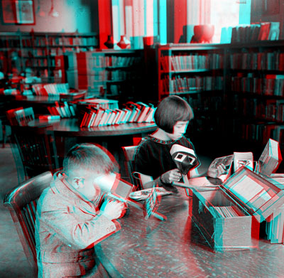
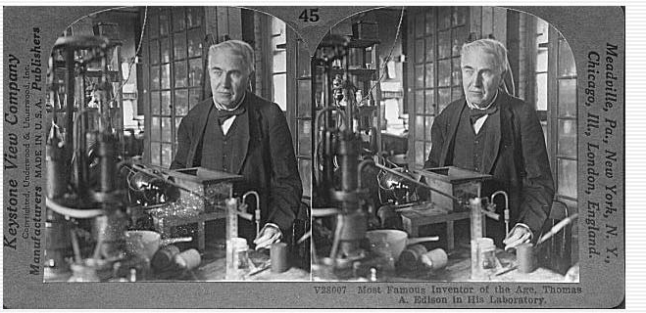
Stereograms
Humans can fuse pairs of images to get a sensation of depth
Stereograms: Invented by Sir Charles Wheatstone, 1838
https://en.wikipedia.org/wiki/Stereoscopy

Slide 15
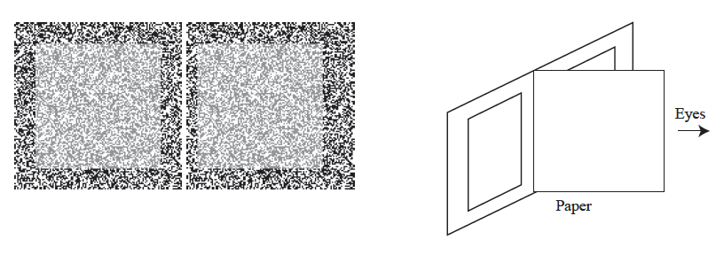
Stereo in people
Not everyone has it
It has nothing to do with semantics
  Random Dot Stereogram, due to Julesz

Slide 16
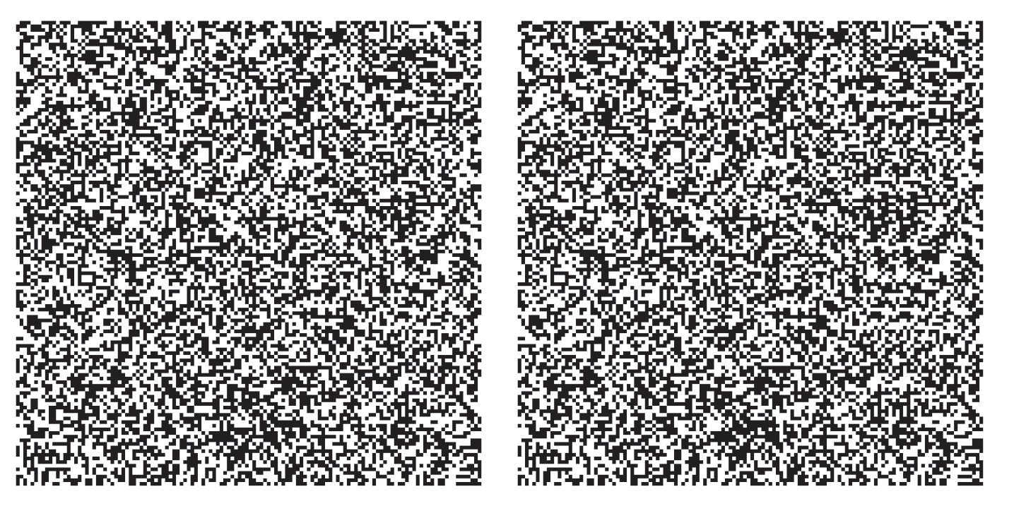
RDS-II

Slide 17
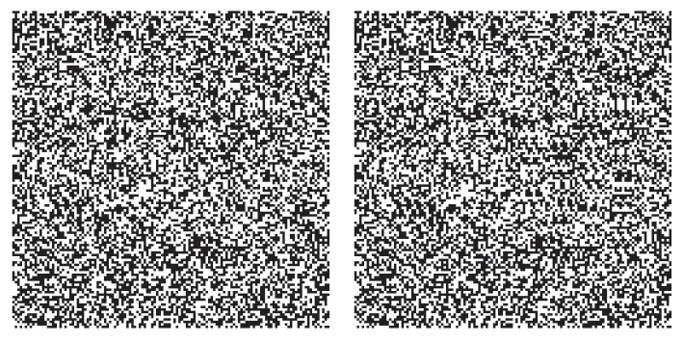
RDS-III

Slide 18
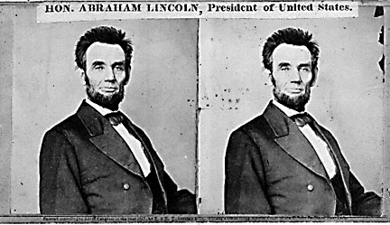
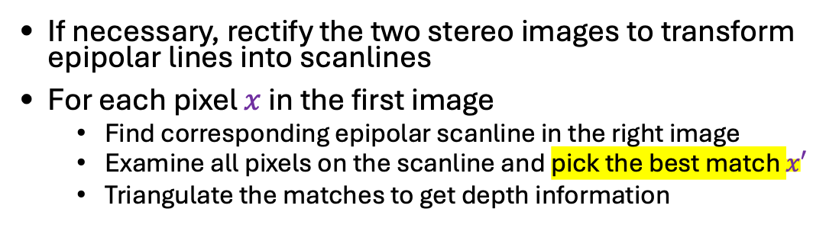
Basic stereo recipe
If necessary, rectify the two stereo images to transform epipolar lines into scanlines
For each pixel $x$ in the first image
  Find corresponding epipolar scanline in the right image
  Examine all pixels on the scanline and pick the best match $x′$
  Triangulate the matches to get depth information
Hard to pick the best match
--might be far away
– some points don’t have matches

Slide 19
Effect of baseline on stereo results
  Larger baseline
    Smaller triangulation error
    Matching is more difficult
  Smaller baseline
    Higher triangulation error
    Matching is easier

Slide 20
Some points don’t have matches
This is a depth cue, though not much used directly
Effect sometimes known as
Da Vinci stereopsis

Slide 21
Some points don’t have matches
This is a depth cue, though not much used directly
Effect sometimes known as
Da Vinci stereopsis

