Slide 1
Tracking by Detection
D.A. Forsyth
University of Illinois at Urbana-Champaign

Slide 2
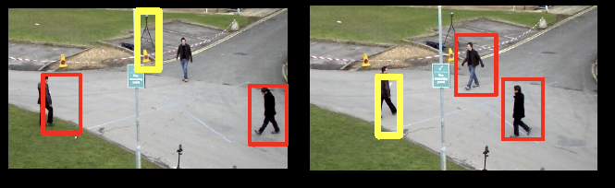
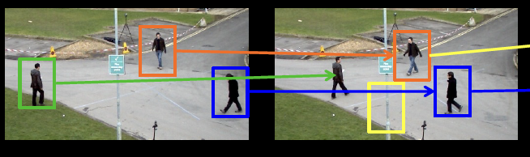
Multi-object tracking

Slide 3
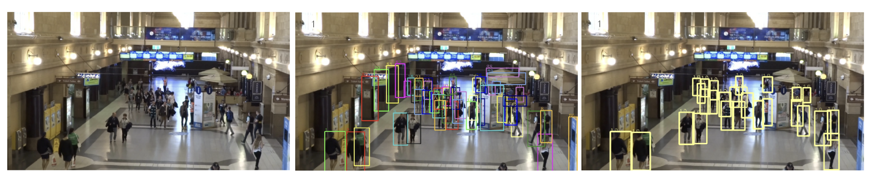
MOT-20 example

Slide 4
Tracking – Why?
Motion capture
  build models of moving people from video
Recognition from motion
  eg cyclists move differently than runners
Surveillance
  who is doing what?
    for security (eg keep people out of sensitive areas in airports)
    for HCI (eg kinect, eyetoy, etc.)

Slide 5
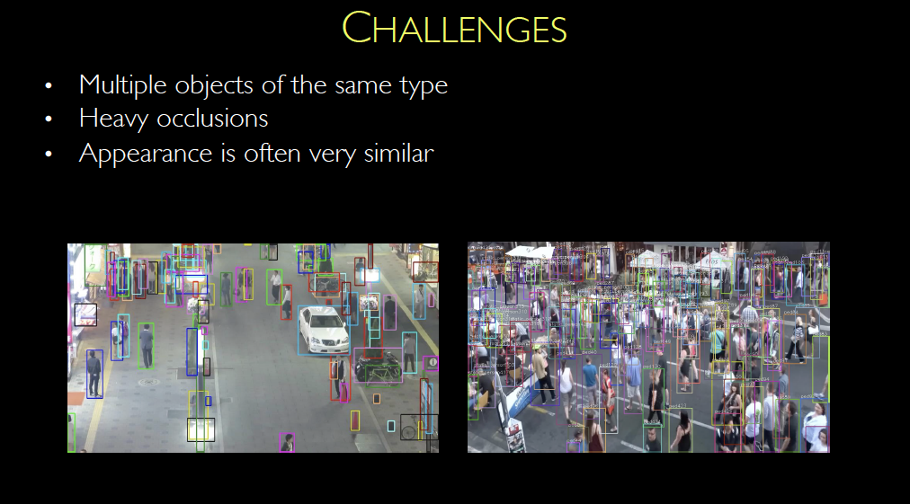
Multiple slides lifted from L. Leal-Taixe’s slides at ICVSS 2022

Slide 6
Tracking - What
Establish state of object using time sequence
  state could be:
    position; position+velocity; position+velocity+acceleration
    or more complex, eg all joint angles for a person
  Biggest problem -- Data Association
    which image pixels are informative, which are not?
Key ideas
  Tracking by detection
    if we know what an object looks like, that selects the pixels to use

Slide 7
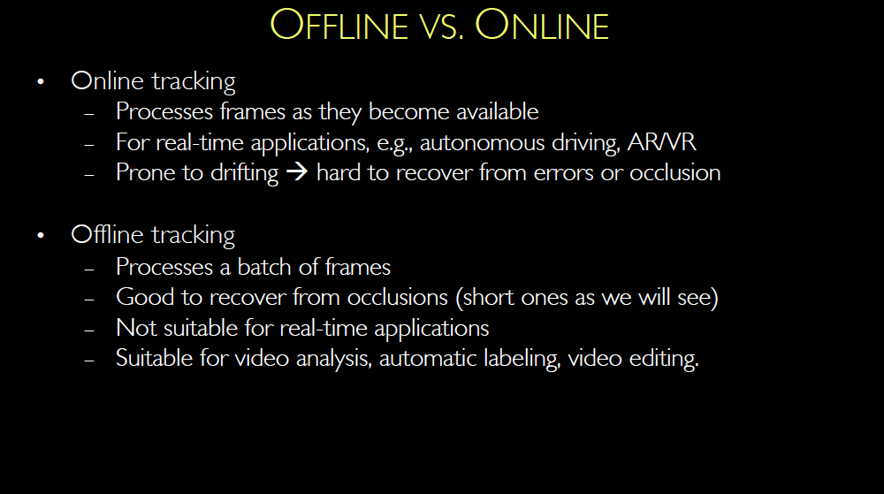

Slide 8
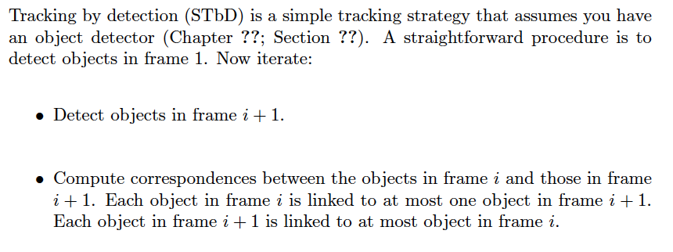
Tracking by detection
Assume
  a reliable detector
  Link detects across time
    weighted bipartite matching

Slide 9
Point tracks reveal public behaviour
Yan+Forsyth, 04

Slide 10
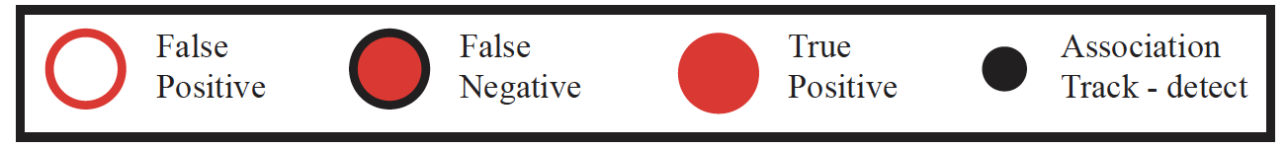
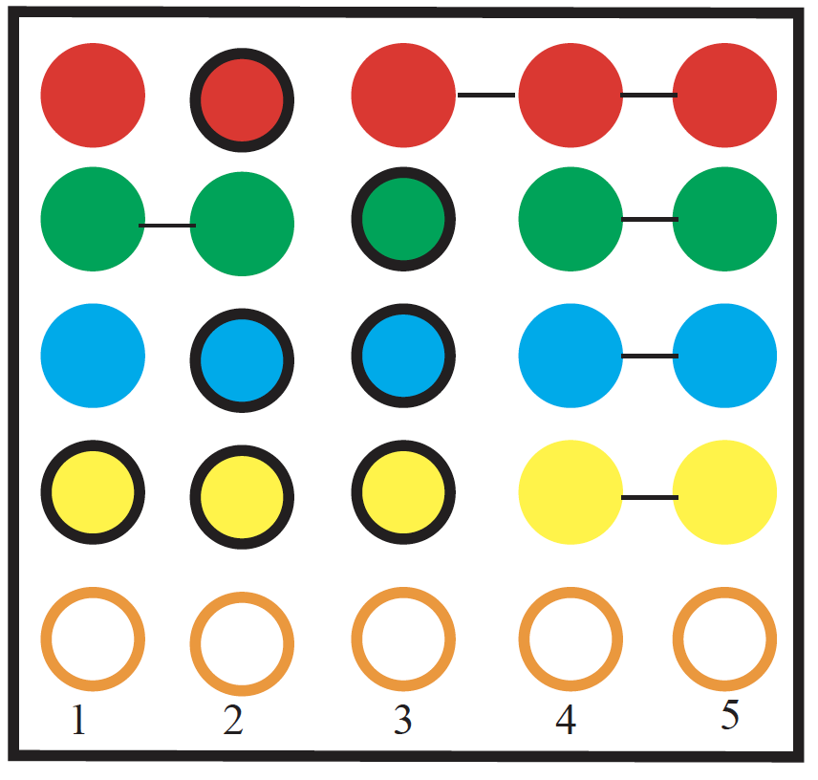
Simplest -> broken tracks

Slide 11
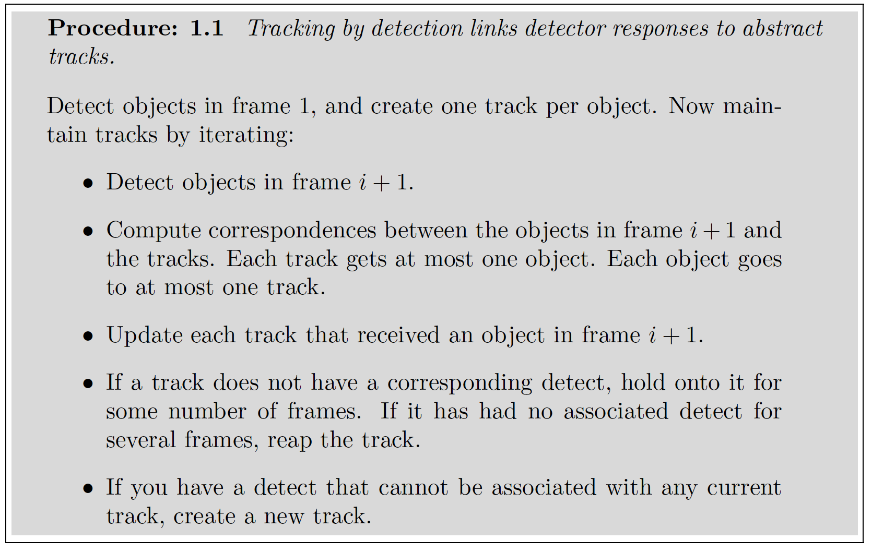
Solution: abstract tracks

Slide 12
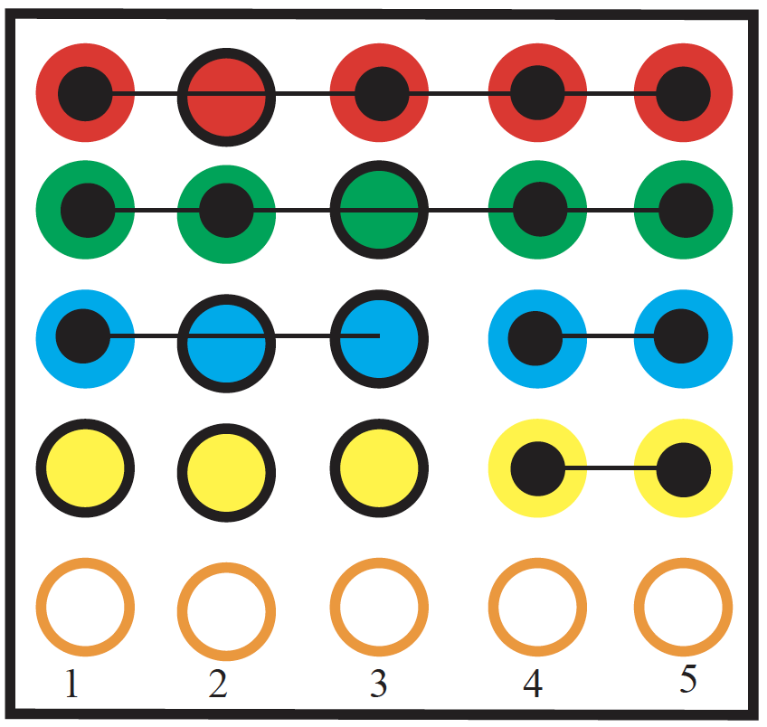

Slide 13
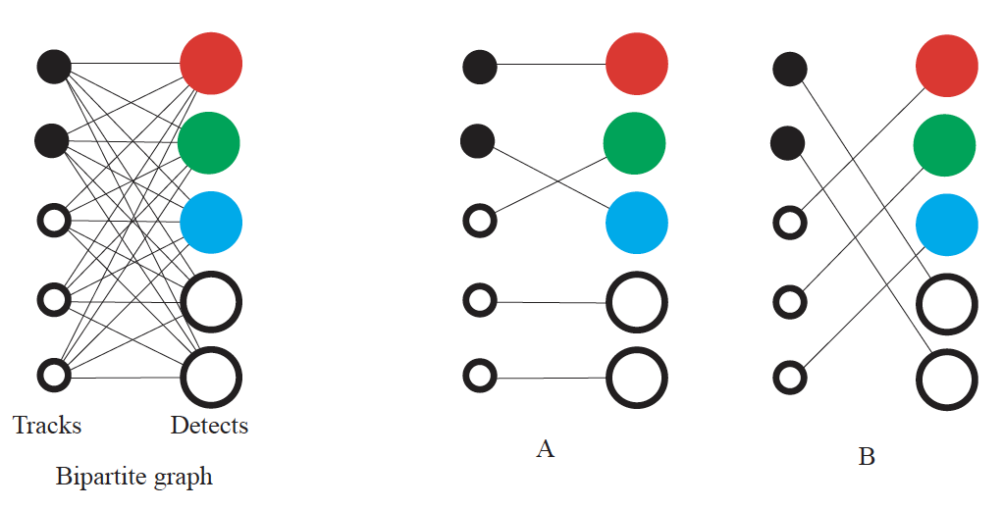
Correspondence
Use the Hungarian algorithm
Weights from appearance, dynamics

Slide 14
Appearance weights
Distance between feature vectors
  tracks could have multiple
    memory
Some test of distance
  between predicted pos’n and true pos’n
    1-IOU has a good record

Slide 15
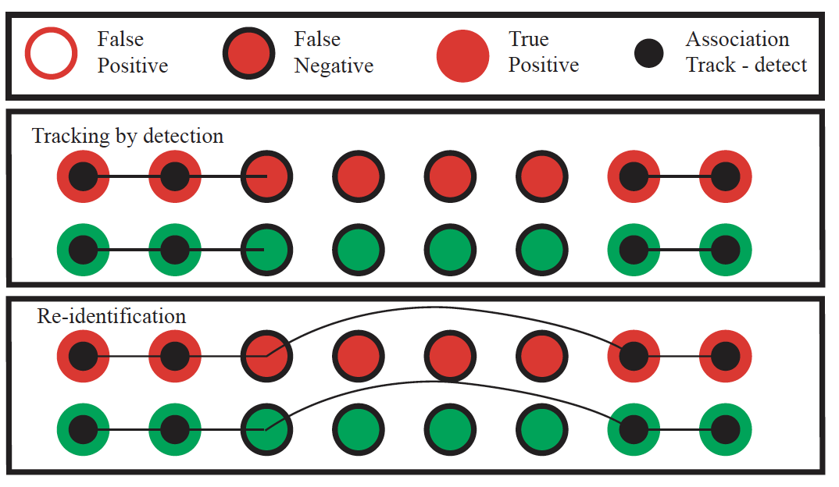
Reidentification

Slide 16
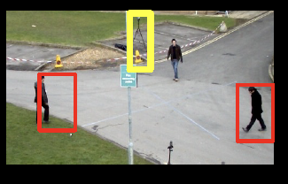
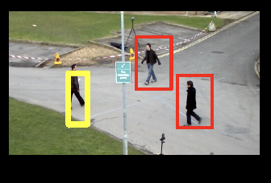
Recall Kalman Filter story
Have:
Mean and covariance of posterior
after i-1’th measurement
Construct:
This predicts where
Boxes might be in
Next frame
Mean and covariance of predictive
distribution just before i’th measurement
Measurement arrives:
Now construct:
Mean and covariance of posterior
distribution just after i’th measurement
posterior mean is weighted combo
of prior mean and measurement

Slide 17
Attaching a Kalman filter
Use filter to represent, update tracks
  one filter to manage state for each track
Associate measurements to tracks with WBM
Now update filter
  usually, a constant velocity model is enough
  sometimes, velocity is zero and noise is large

Slide 18
Evaluation
Fiddly
  detection errors
  correspondence errors
Different metrics weight these differently
Details in text

Slide 19
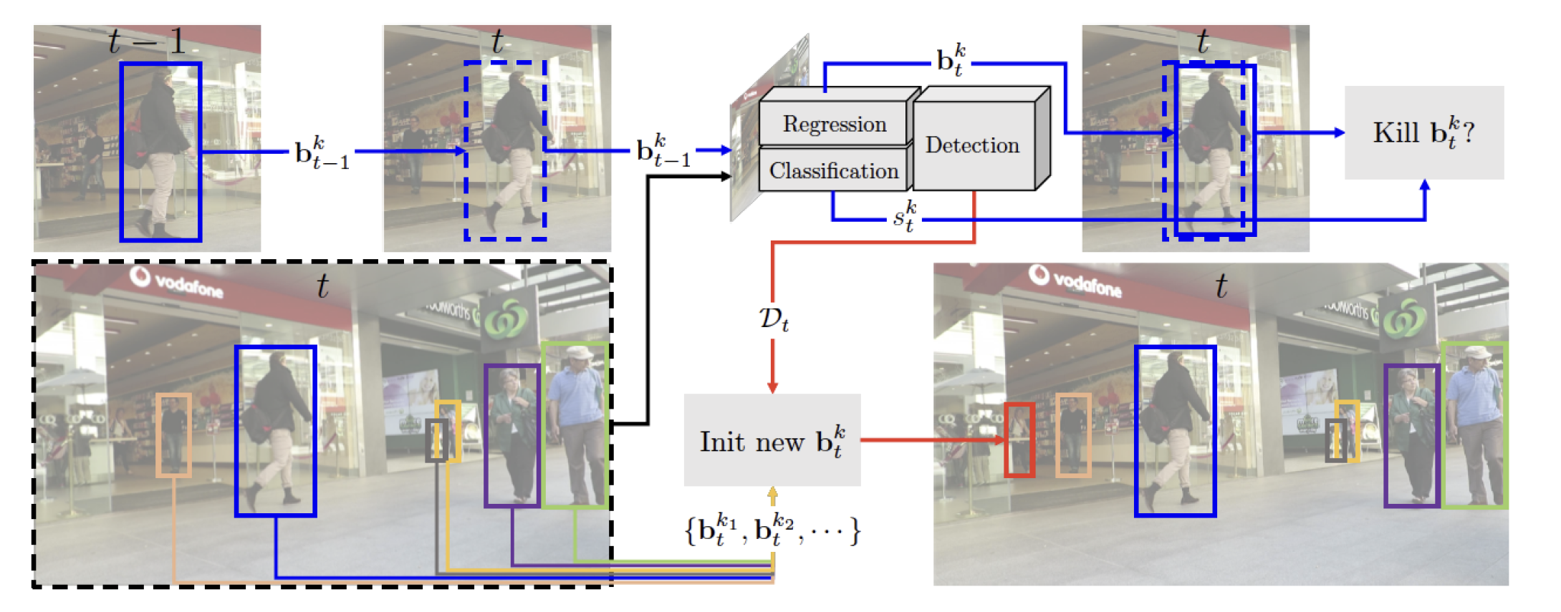
TbD variants- Exploit FasterRCNN

Slide 20
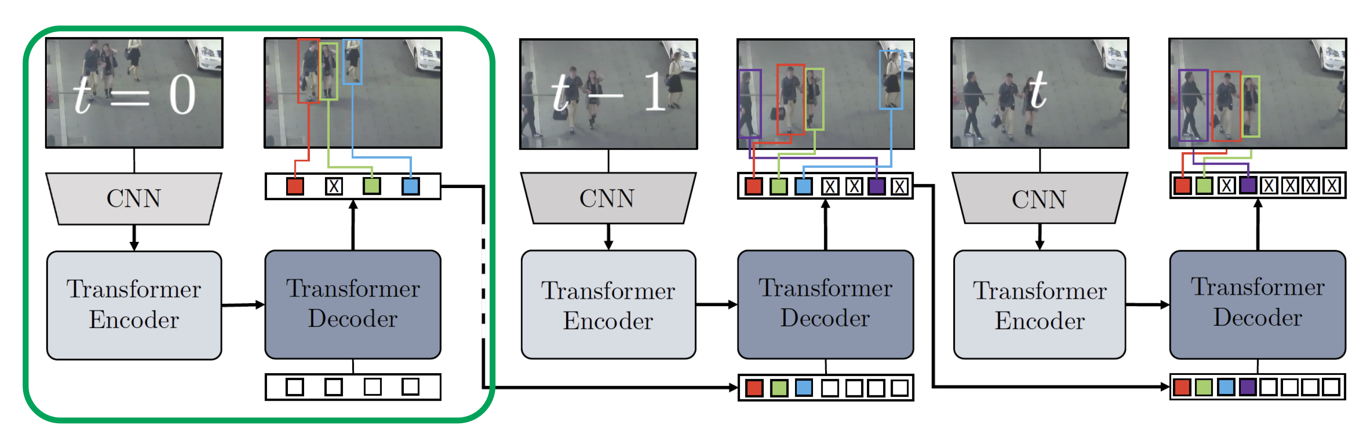
TbD variants- Exploit DetR

Slide 21
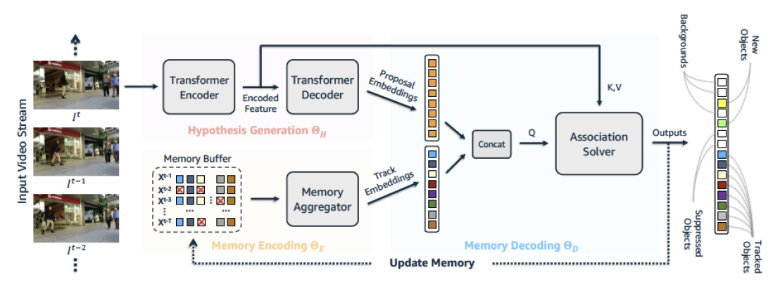
TbD variants - Memory

Slide 22
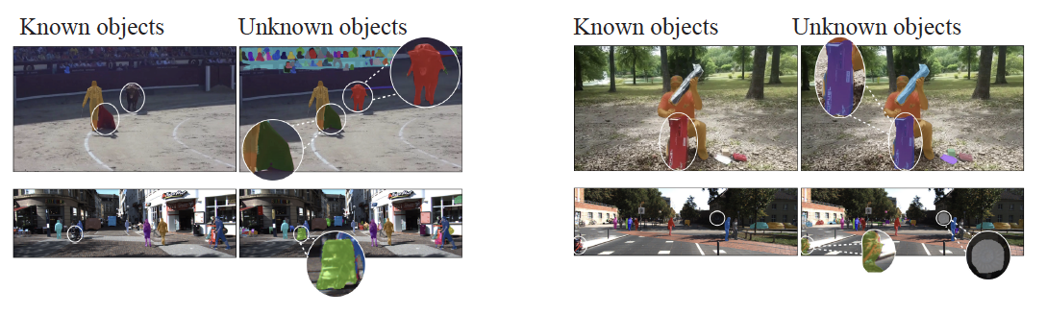
TbD variants – open world
Use RPN to detect objects
  adjust RPN score
Use appearance match for correspondence

Slide 23
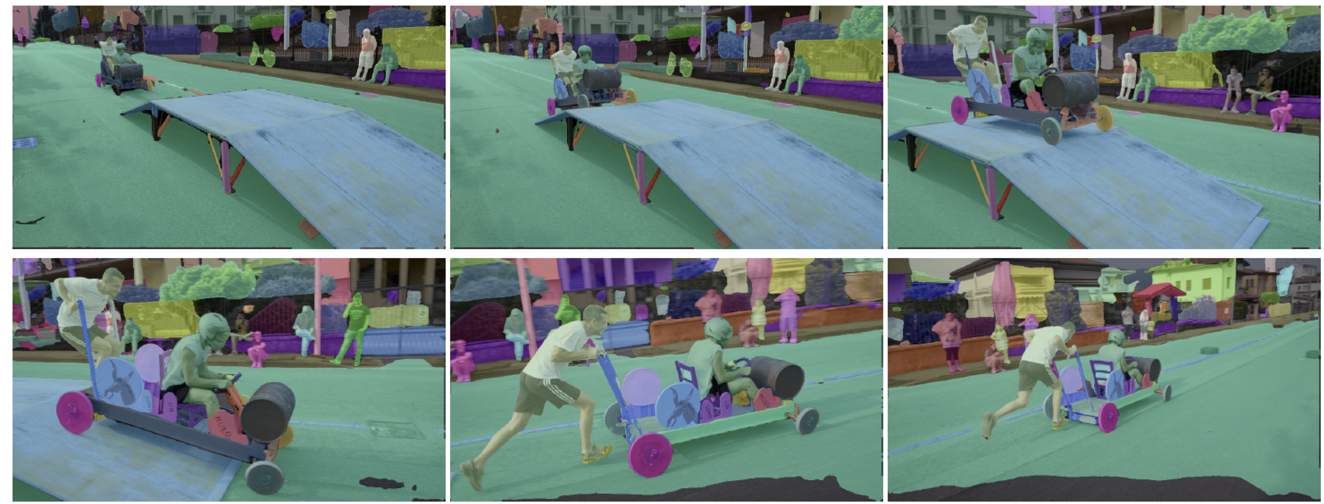
TbD variants – tracking segments

Slide 24
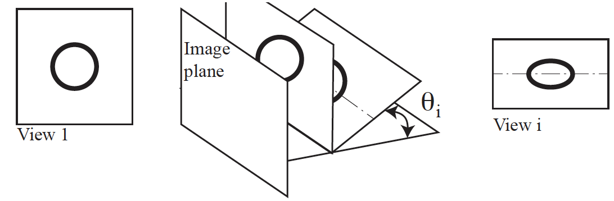
Why not points?
Idea
  apply TbD recipe to interest points
Obstacle
  appearance match using SIFT is a problem
  Foreshortening!

Slide 25
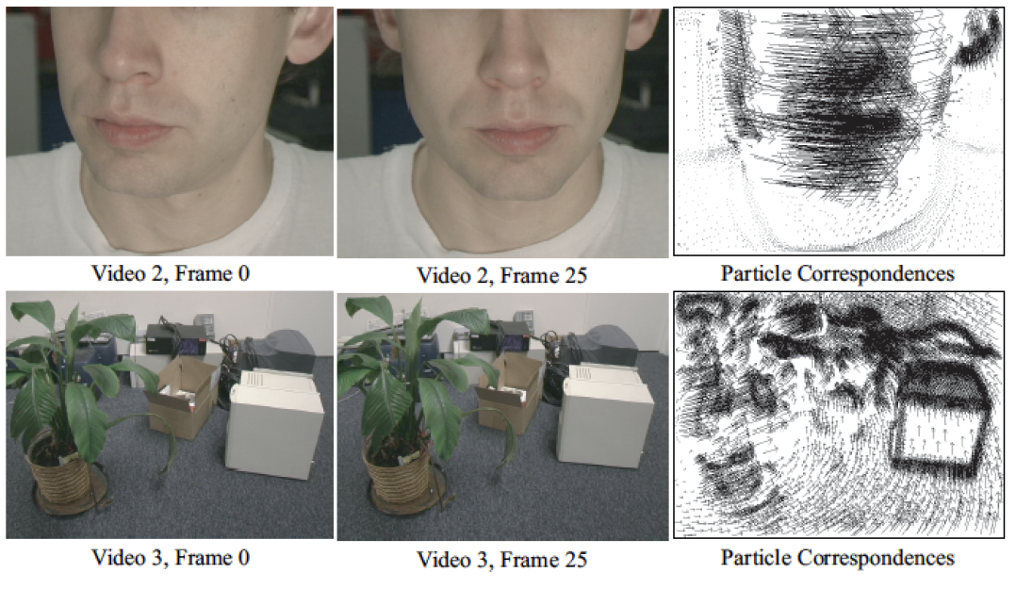
Particle video

Slide 26
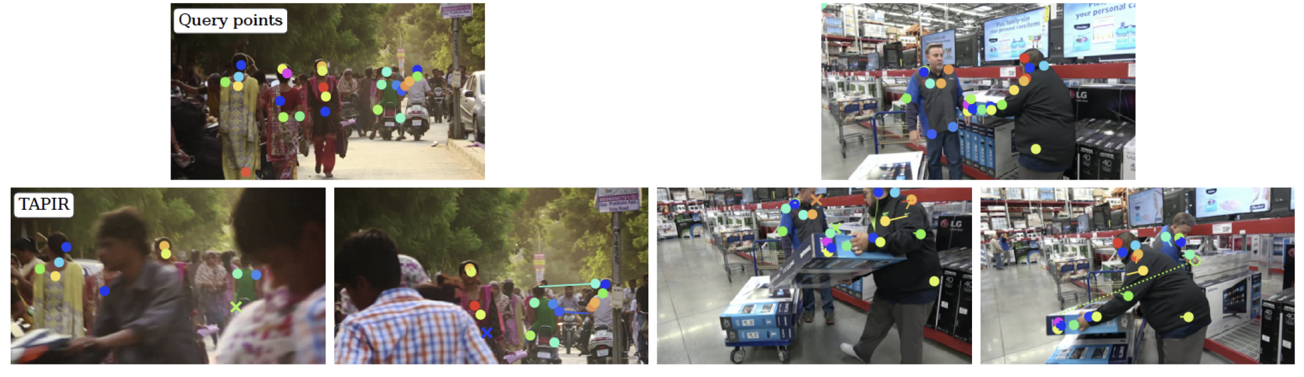
TAPIR
Make coarse point tracks
  refine across space/time
Predict visibility and confidence at each pt

Slide 27
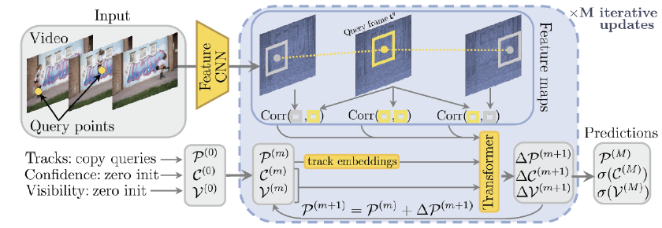
CoTracker3

Slide 28
