Slide 1
Transformers:
Birds Eye View
D.A. Forsyth,
University of Illinois at Urbana Champaign

Slide 2
An architecture
Accepts
  one or more streams of tokens
    very often fixed length
Produces
  stream of tokens
  OR single learned token
Origins in NLP
Apply to images by
  tokenizing image
  getting clever about decoding

Slide 3
Tokenizing an image
Obtain feature representation of tokens
  Convolutional encoder (waning)
  Chop image into patches, project (more usual)
One token per patch, one extra learnable token
  the class token
Often (but not necessarily)
  fixed size images into fixed numbers of tokens

Slide 4
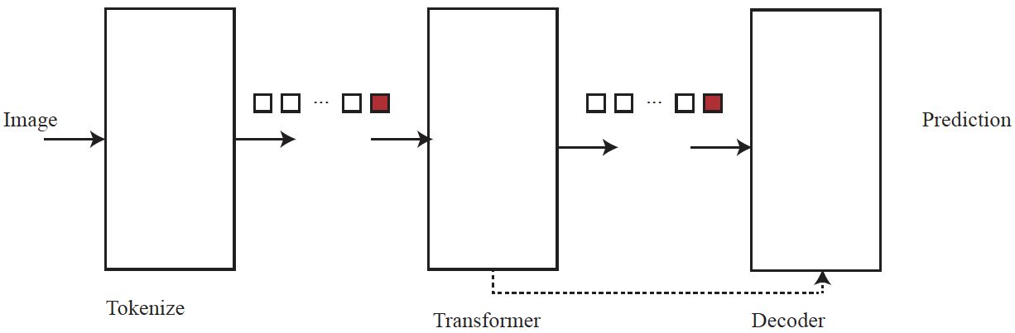
General story

Slide 5
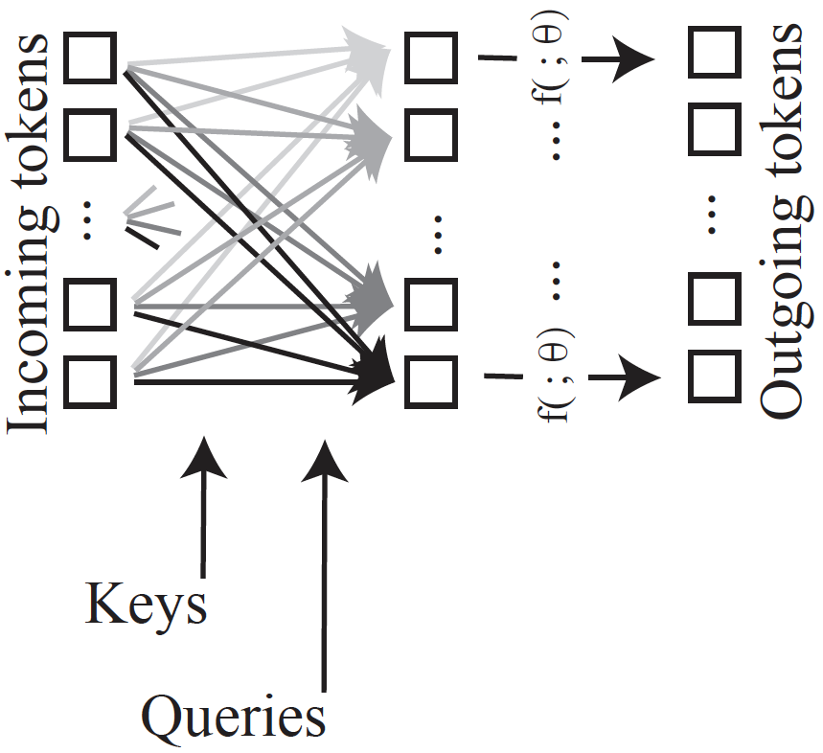
General story, II
These weights are
determined by
attention – depend
on keys and queries.
...
  new tokens obtained by:
    form a weighted combination of input tokens
      weights determined by a similarity measure
    map each resulting token
  report new tokens

Slide 6
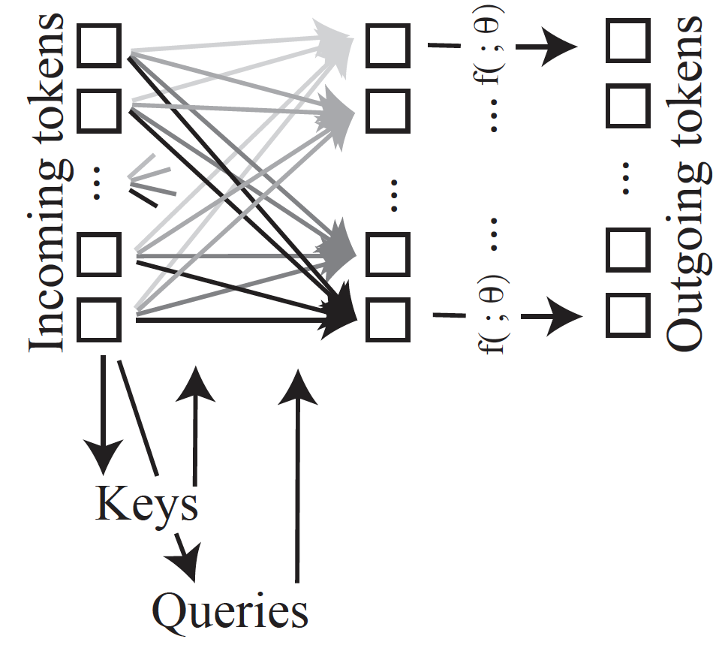
Self-attention
Keys and queries are a
learnable function of
tokens – typically, linear.
Important variants include:
Multi-headed self attention,
(more complex use of keys
and queries)

Slide 7
Properties of transformer w/ SA
Can accept sequences of variable length
  with some work
Permutation invariant in the form described
  obvious nuisance for images
    procedure does not depend on where a patch is!
  easily fixed
    add to each token a positional encoding
      learnable vector, different one for each location in stream
      numerous interesting variations of what and where one provides

Slide 8
Qualitative properties
Every token communicates with every other
Strong evidence of better encoders
Inductive bias
  Convolution, etc has inductive bias
    mostly, pixels depend on nearby pixels
  Transformers seem not to
    or rather, it hasn’t made a nuisance of itself
Issue:
  massive, expensive training demands
  many/most vision transformers are fine-tuned from published weights

Slide 9
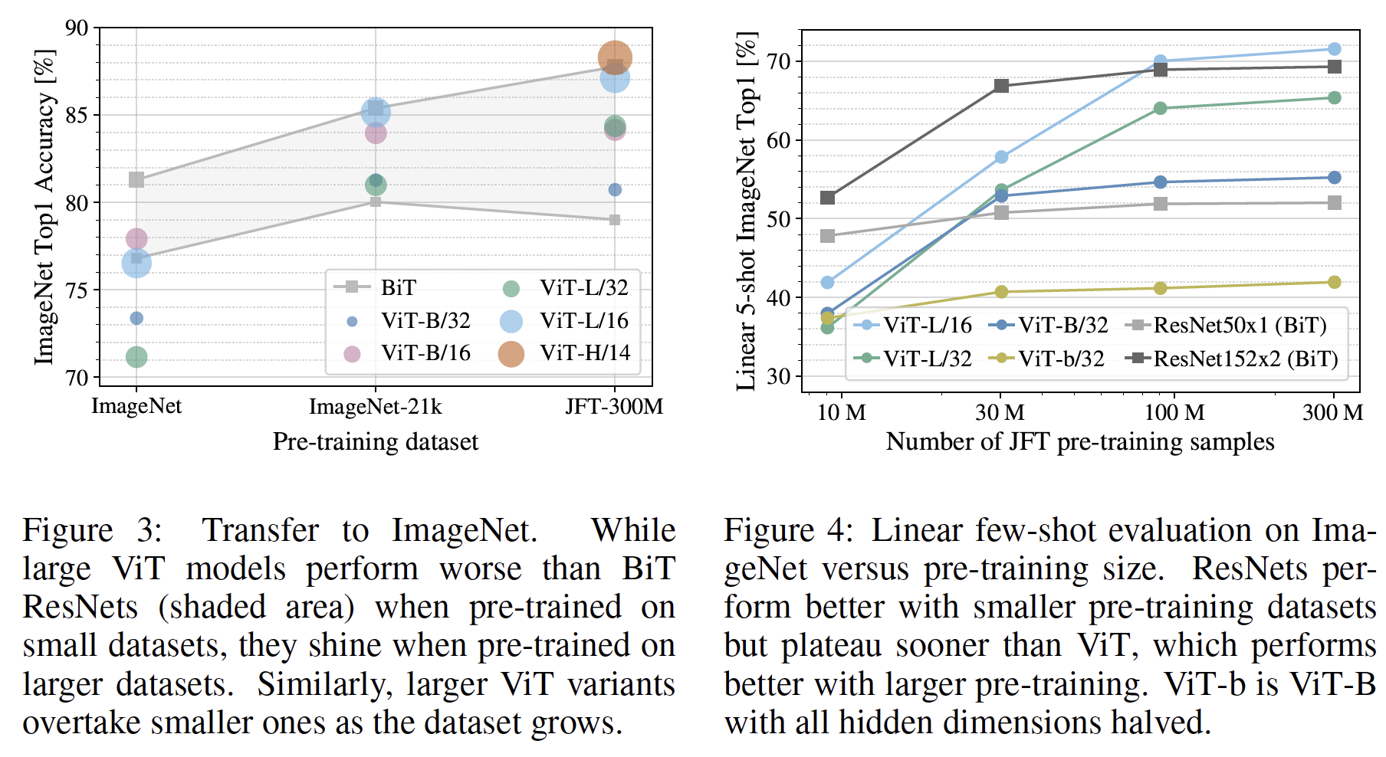
Training effects
Benefit from large scale
pretraining
Don’t plateau at very
large scale
AN IMAGE IS WORTH 16X16 WORDS: TRANSFORMERS FOR IMAGE RECOGNITION AT SCALE, Dosovitsky et al 2021

Slide 10
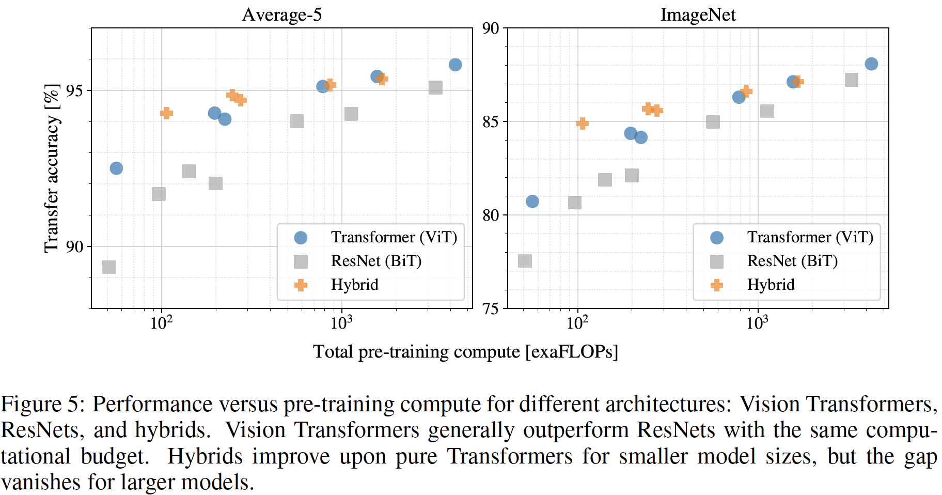
Training effects
Training compute for given accuracy favors ViT’s
AN IMAGE IS WORTH 16X16 WORDS: TRANSFORMERS FOR IMAGE RECOGNITION AT SCALE, Dosovitsky et al 2021

Slide 11
Variants
How image is tokenized
  very wide variation
Where Q and K come from
How to decode
  very wide variation, following slides
Training procedures
  very wide variation, following slides

Slide 12
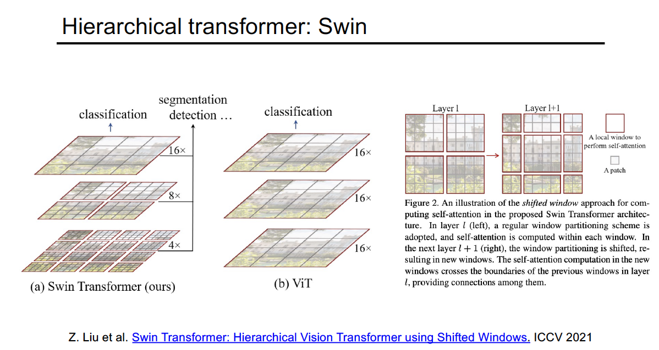

Slide 13
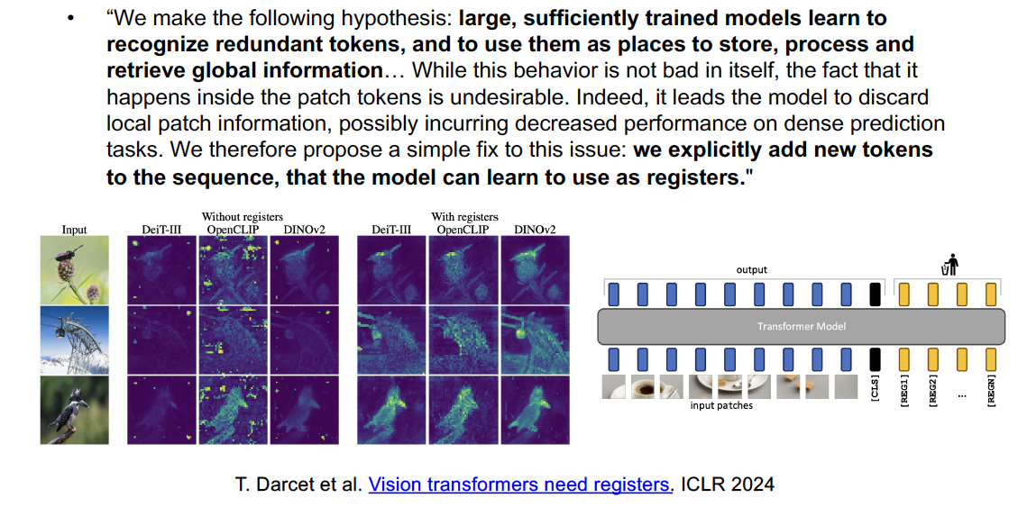
Registers

