Slide 1
Using transformers:
Birds Eye View
D.A. Forsyth,
University of Illinois at Urbana Champaign

Slide 2
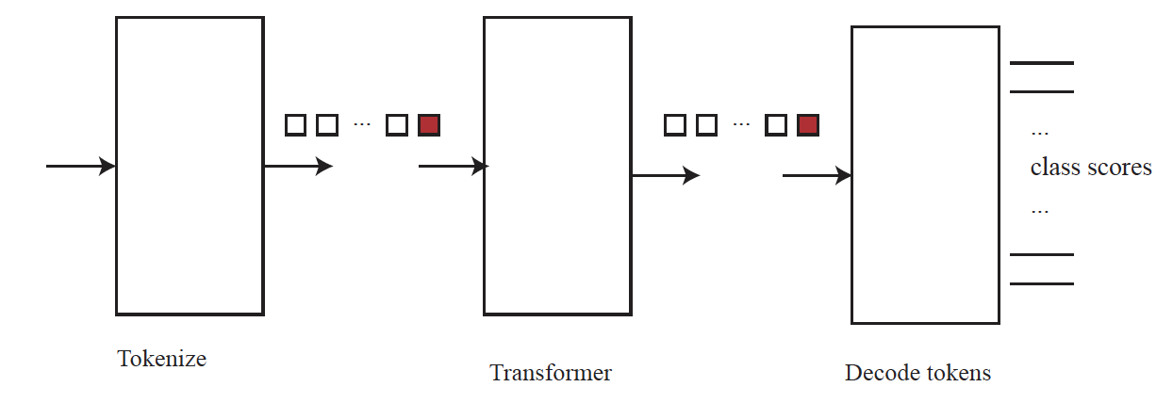
Classification by transformer
Key questions
  details of transformer
  details of decode
    use class token
    use all tokens (how?)

Slide 3
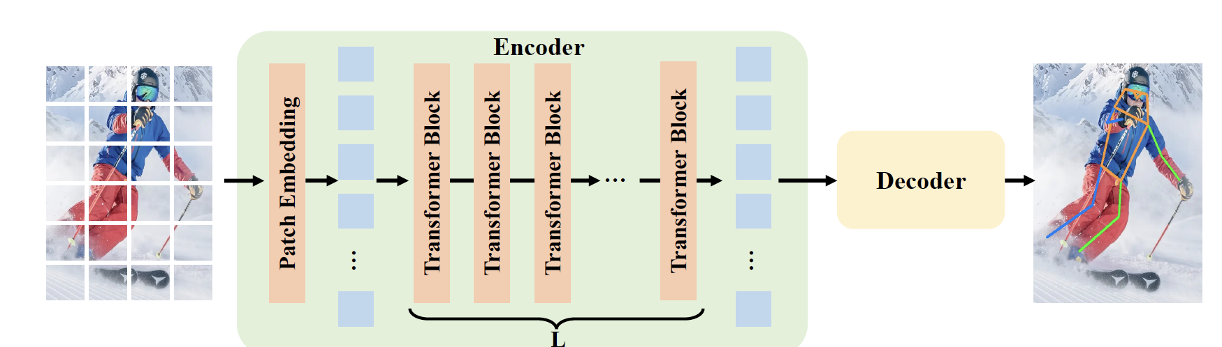
Pose prediction by transformer
Apply to windows containing person
  found by, say, detector
ViTPose: Simple Vision Transformer Baselines for Human Pose Estimation, Xu et al, 2024

Slide 4
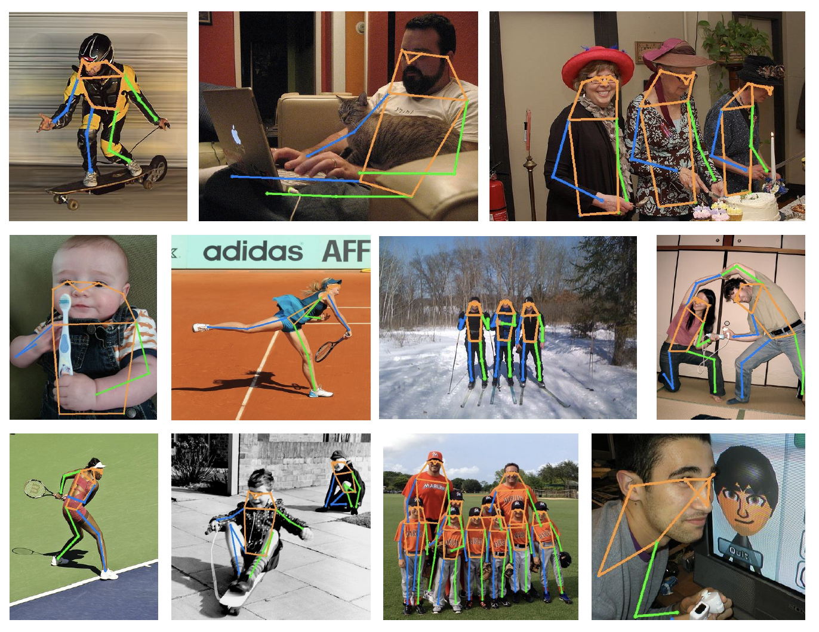
Pose prediction by transformer
ViTPose: Simple Vision Transformer Baselines for Human Pose Estimation, Xu et al, 2024

Slide 5
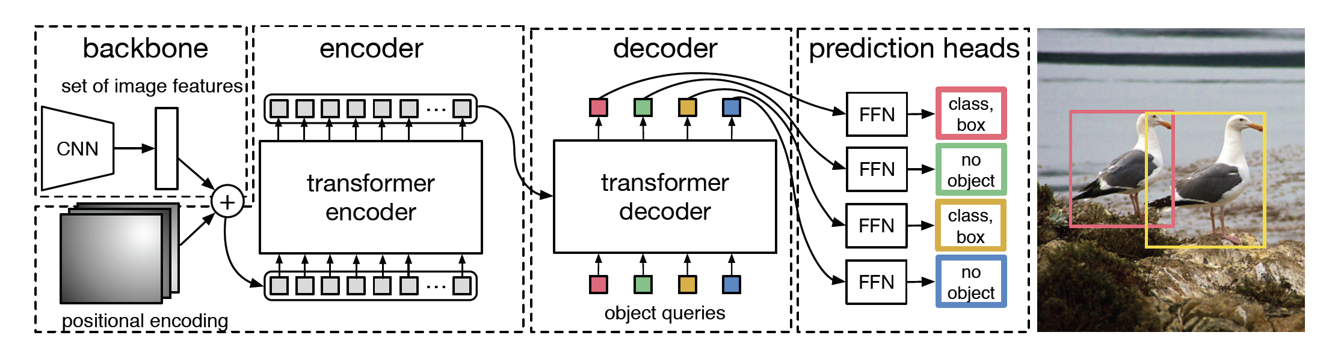
DETR – detection by transformer
Tokenize
Transformer
accept one stream,
make one stream
Transformer
accept two streams,
make one stream
End-to-End Object Detection with Transformers Carion et al, 2020

Slide 6
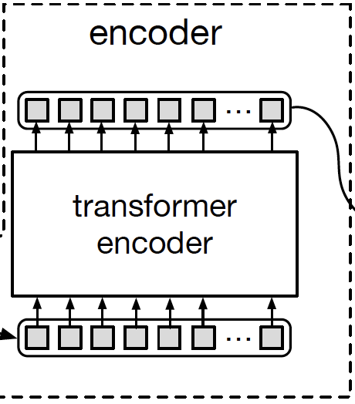
DETR – detection by transformer
Encoder
  Accept image tokens, make new
  using multi-headed self-attention
End-to-End Object Detection with Transformers Carion et al, 2020

Slide 7
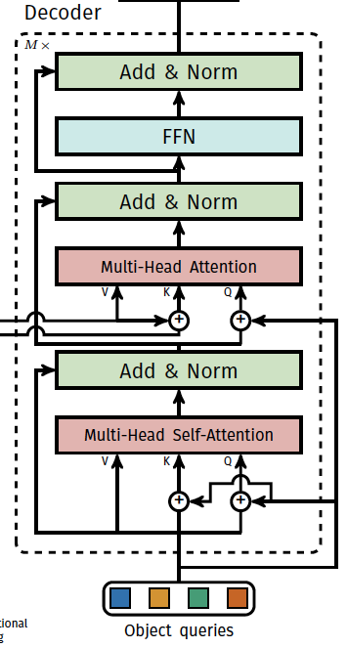
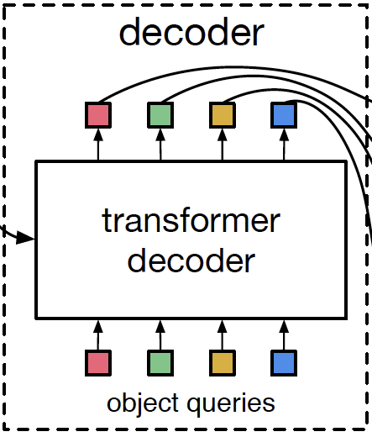
DETR – detection by transformer
Tokens from decoder
Positional encoding
These are learnable
End-to-End Object Detection with Transformers Carion et al, 2020

Slide 8
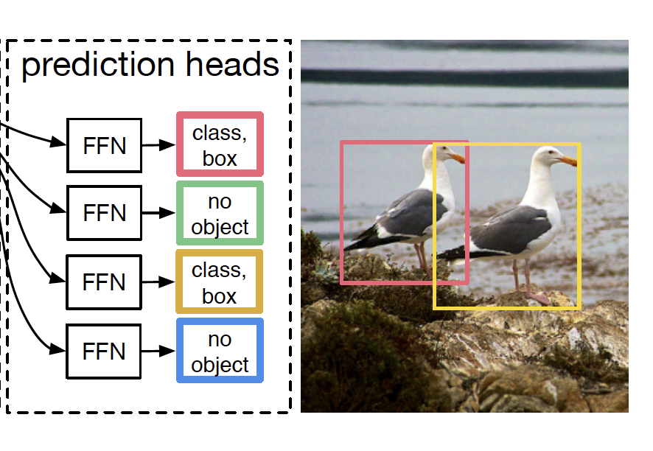
DETR – detection by transformer
prediction head
  accepts output token
  produces
    no object OR
    class scores, box location
Training (roughly!)
  Find large number of images with boxes, classes
  Loss is min over matchings
    from predicted tokens to image boxes
      box loss+class loss
  Use weighted bipartite graph matching to match
  Descent on this
End-to-End Object Detection with Transformers Carion et al, 2020

Slide 9
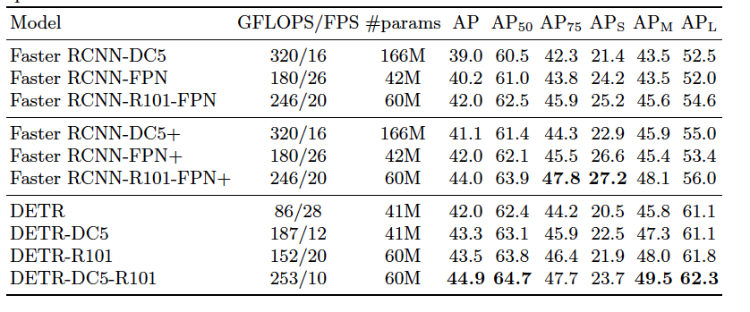
DETR works
End-to-End Object Detection with Transformers Carion et al, 2020

Slide 10
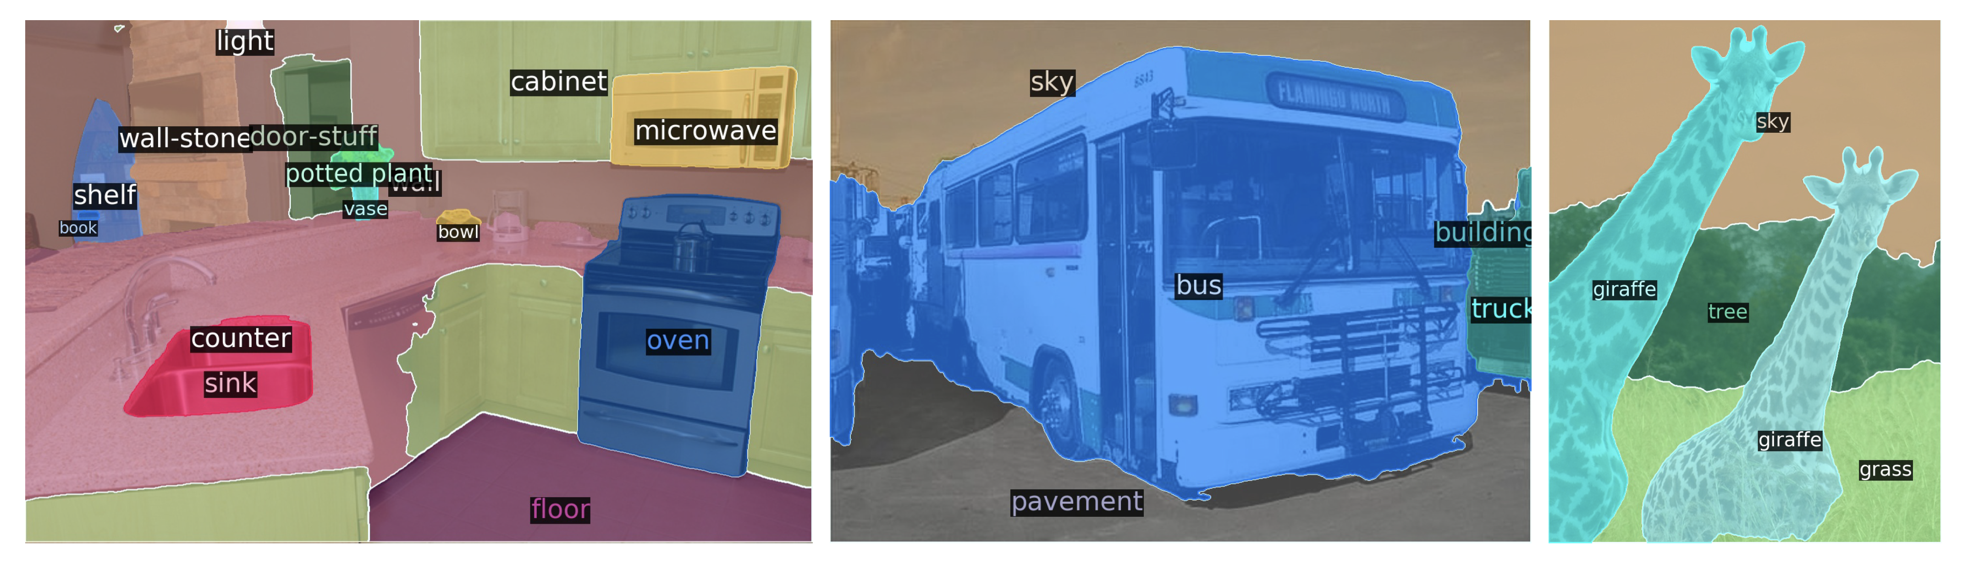
Panoptic segmentation with DETR
Adjust decode to get mask
End-to-End Object Detection with Transformers Carion et al, 2020

Slide 11
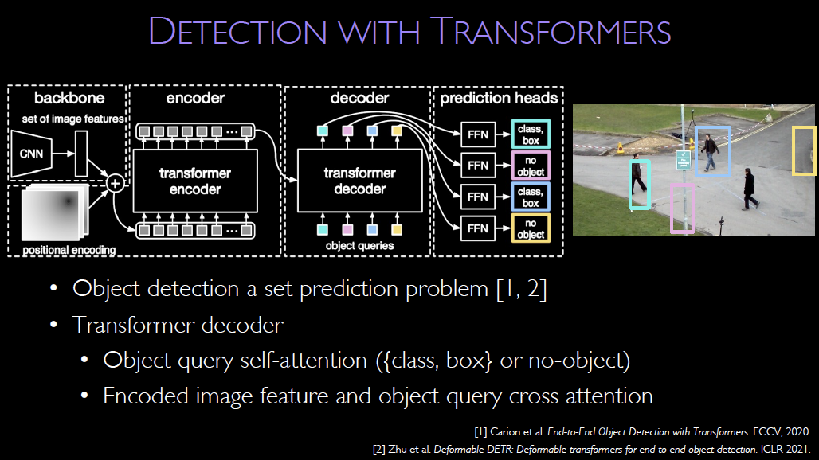

Slide 12
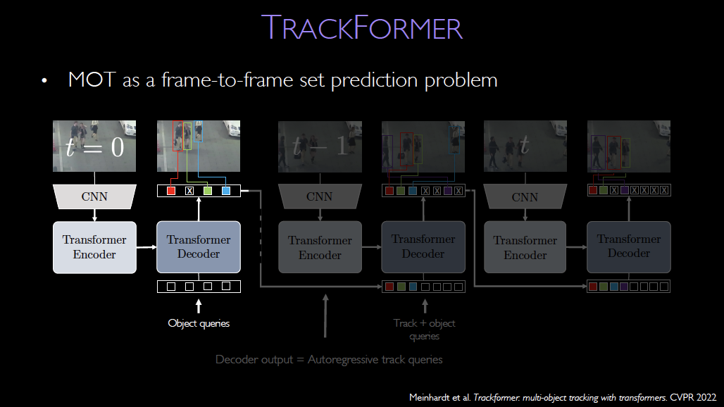

Slide 13
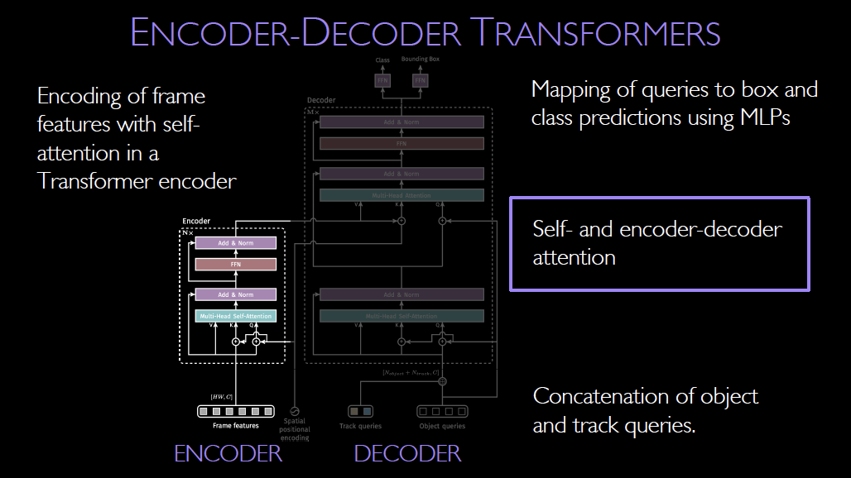

Slide 14
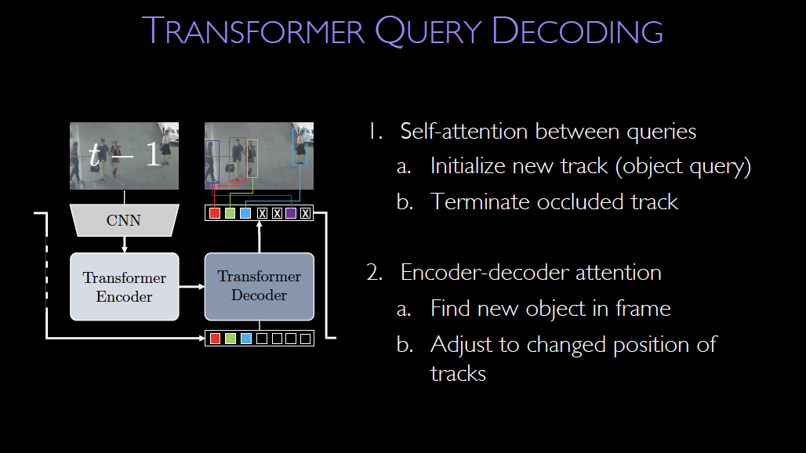

Slide 15
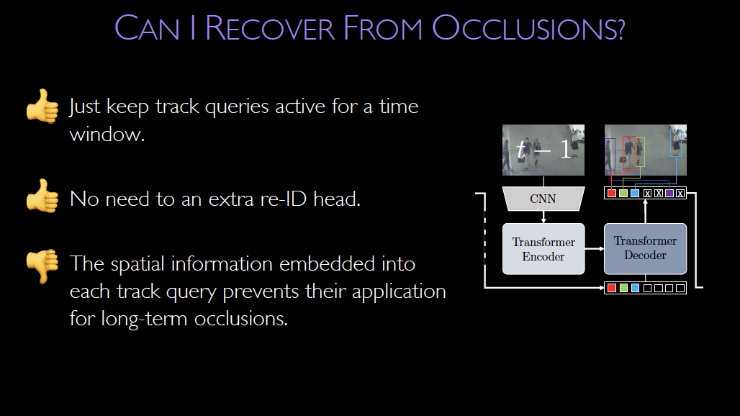

Slide 16
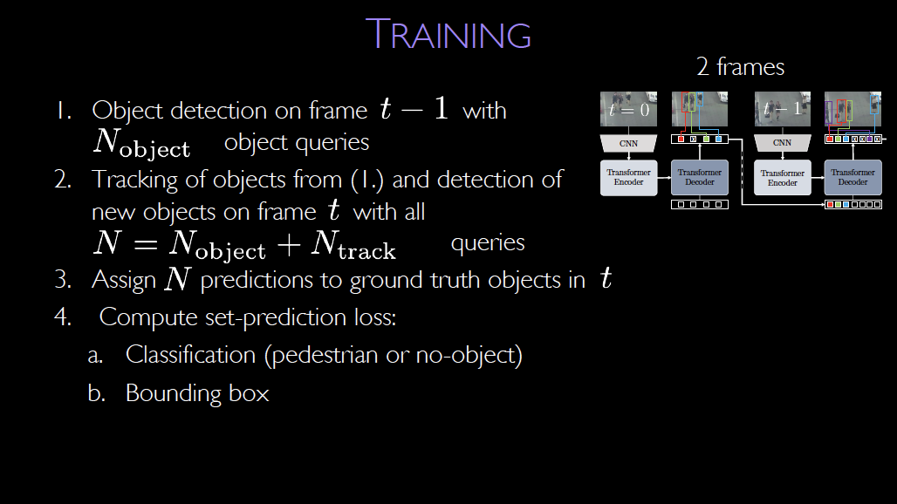

Slide 17
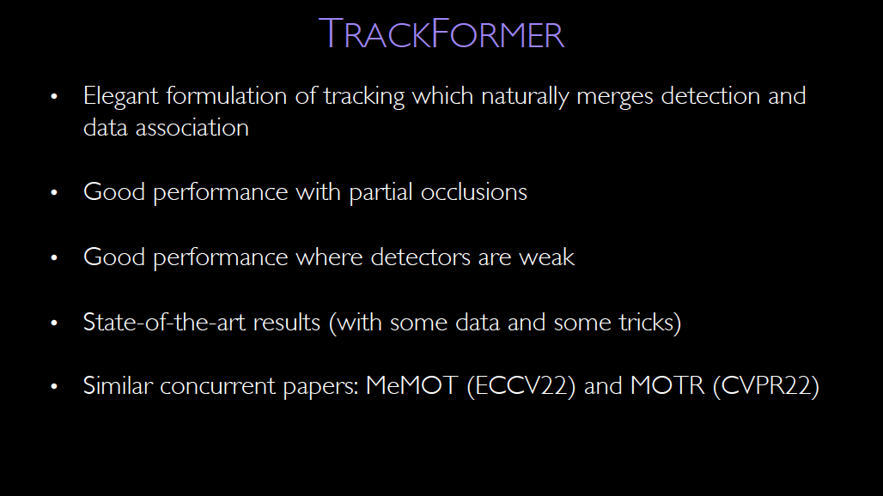

Slide 18
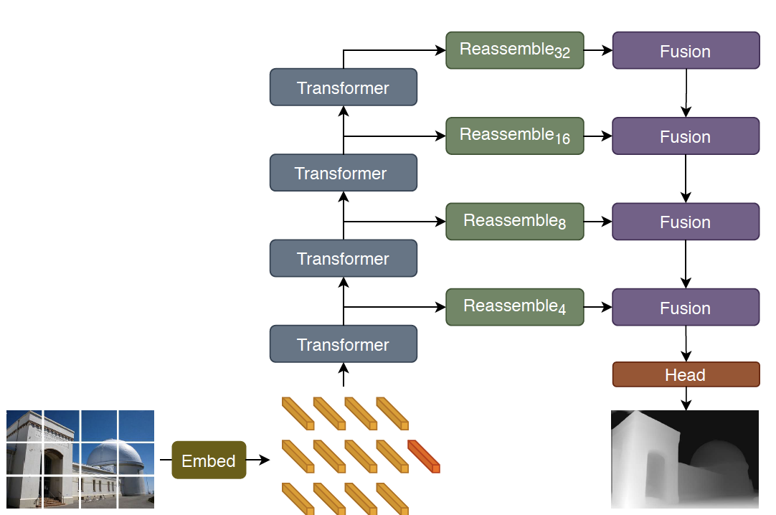
Depth prediction by transformer
Issue:
  decode token streams into image-like thing
  reassemble
    tokens were each cut from particular location in image
Vision Transformers for Dense Prediction, Ranftl et al, 2021

Slide 19
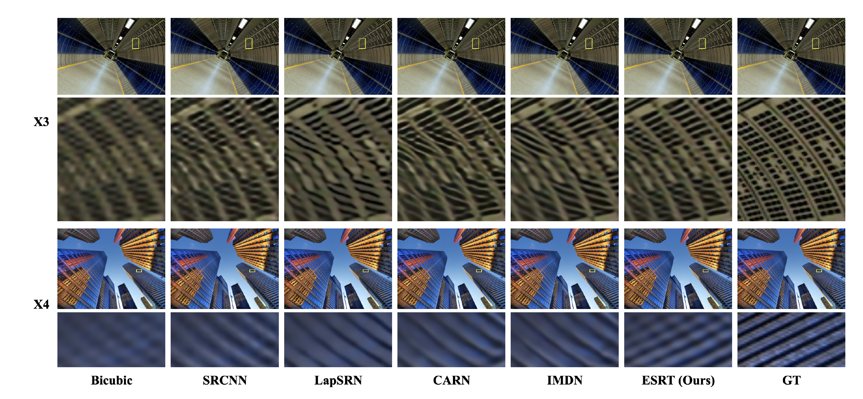
Superresolution by transformer
Transformer for Single Image Super-Resolution Lu et al 2022

Slide 20
The general encoder
key motivating idea
  Q:can you train an encoder that is good at everything?
    then all you need to worry about is decoding
  A:hard to be sure; but you can train encoders that are good at a lot of stuff...
    all evidence is these need to be transformers
    training
      WITHOUT using labels
      on a huge dataset
example: DINO V3

Slide 21
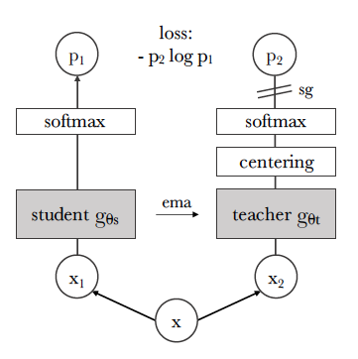
DINO: self-distillation
x1, x2 are two versions of x
  eg crops
Feature is softmax-normalized
  scaled by temperature
Teacher network is
  moving average of student
Centering and sharpening
  adjust teacher features to avoid collapse
  centering:
    add a bias consisting of moving average across batches
  sharpening
    use a different temperature param for teacher

Slide 22
DINO-V3: self-distillation
additional losses
  numerous changes
  losses change during training
1.7e9 images, carefully curated
  and clustered, to manage what images are used when

Slide 23
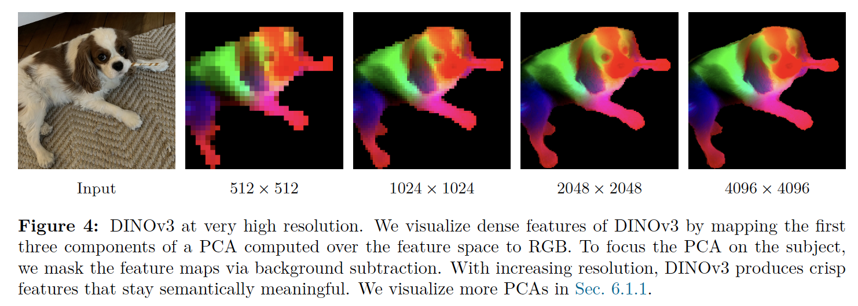
Spatial features
DINOv3, Simeoni et al 25

Slide 24
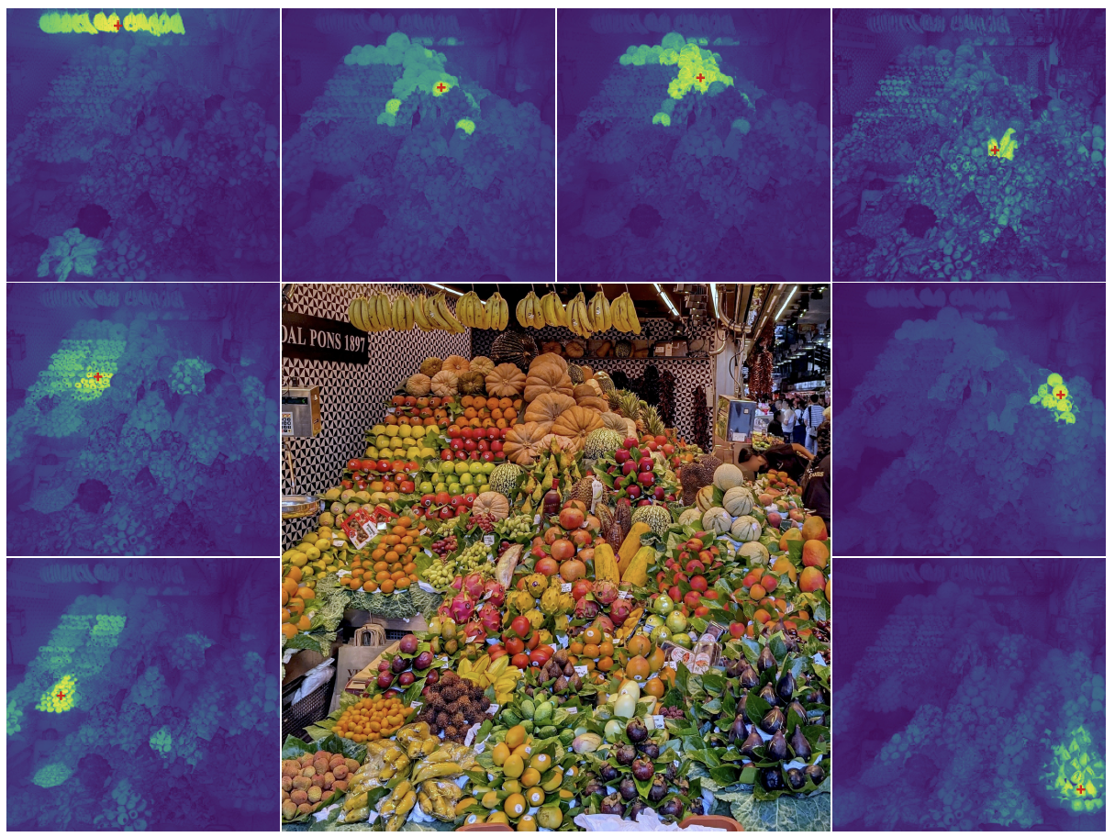
Cosine similarity of DINO v3 features against point marked in red
DINOv3, Simeoni et al 25

Slide 25
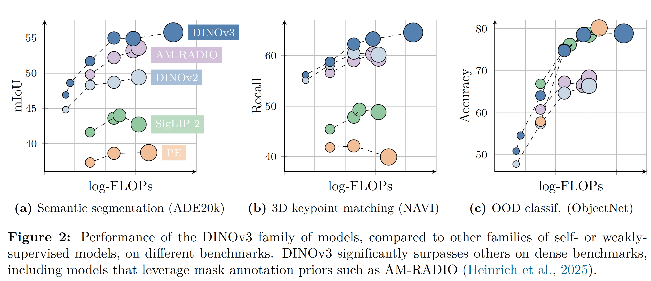
Dense general image features
DINOv3, Simeoni et al 25

Slide 26
Resources
Pretrained models
Start at:
  https://huggingface.co/docs/transformers/index
    there are millions (?)
Look at:
  https://github.com/huggingface/transformers?tab=readme-ov-file
    and scroll to computer vision to get some examples, including
    Segmentation:
      https://huggingface.co/facebook/sam-vit-base
    Depth:
      https://huggingface.co/apple/DepthPro-hf

