Slide 1
Coordinate geometry:
Triangulation
D.A. Forsyth,
University of Illinois at Urbana Champaign

Slide 2
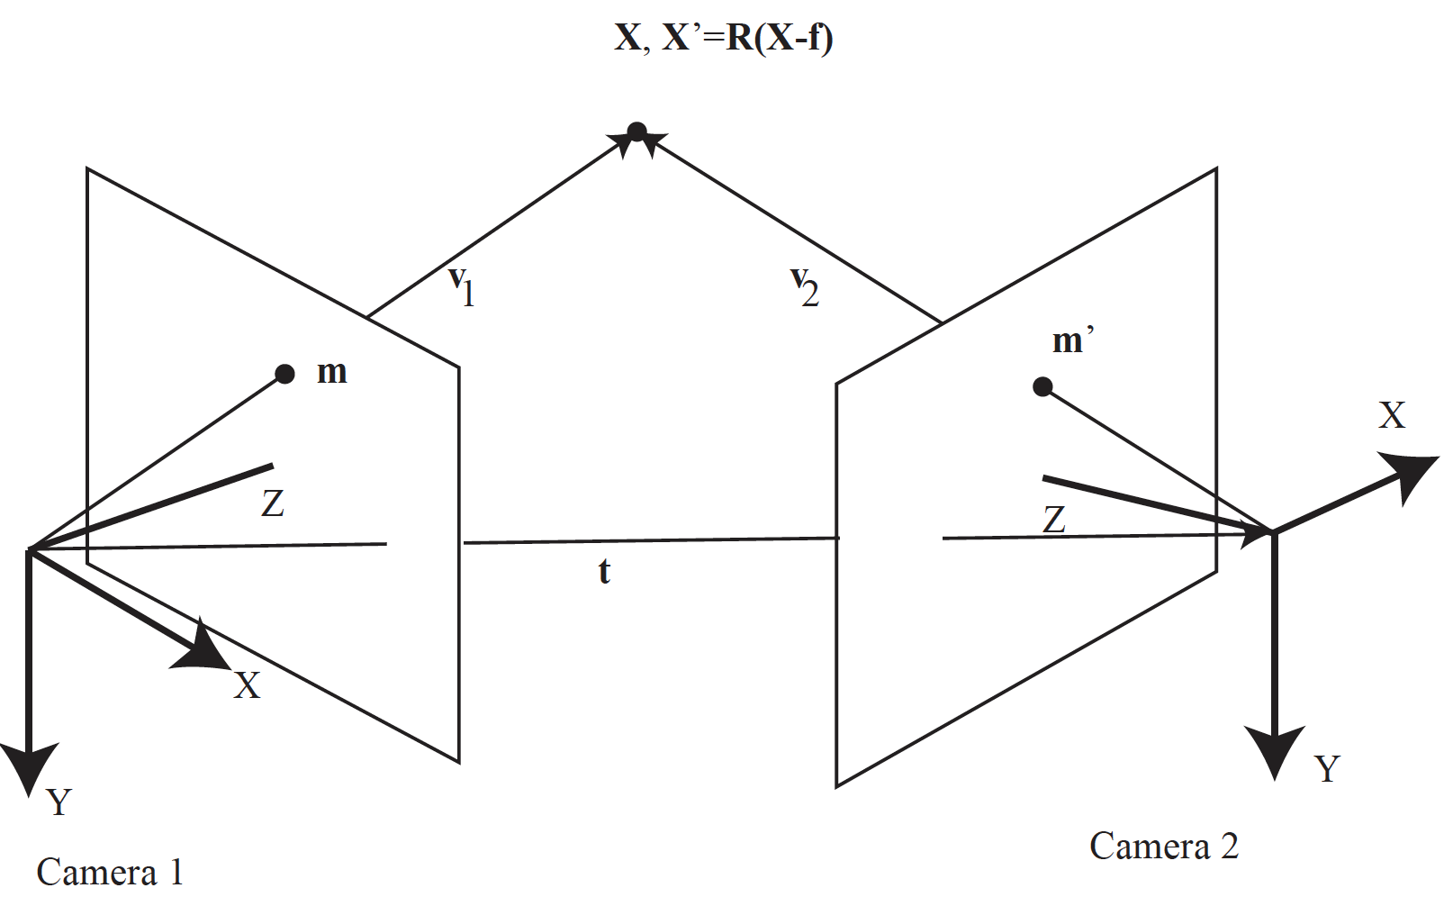
Reconstruct point from two views

Slide 3
Notice
m and m’ are in world coordinates
But
  you have calibrated cameras
  so if x, x’ are in camera coords

Slide 4
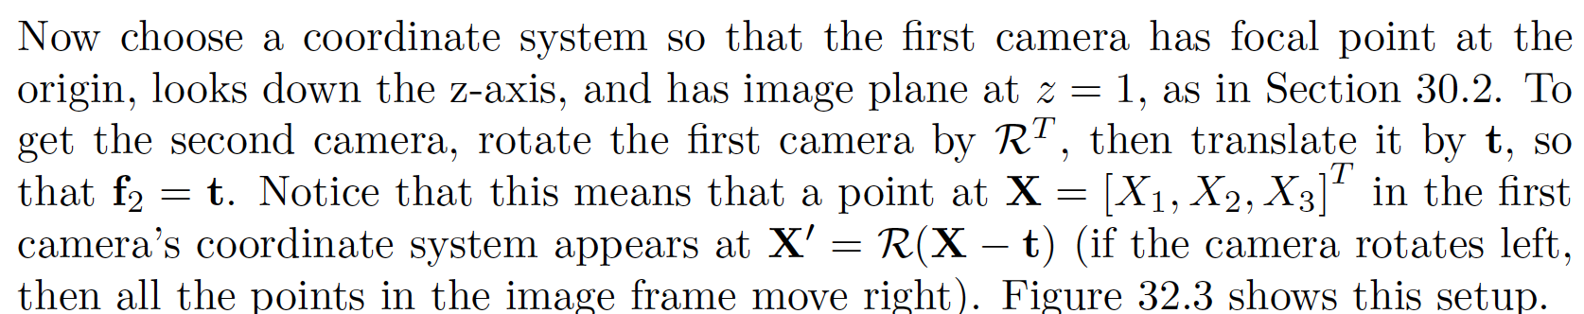

Slide 5
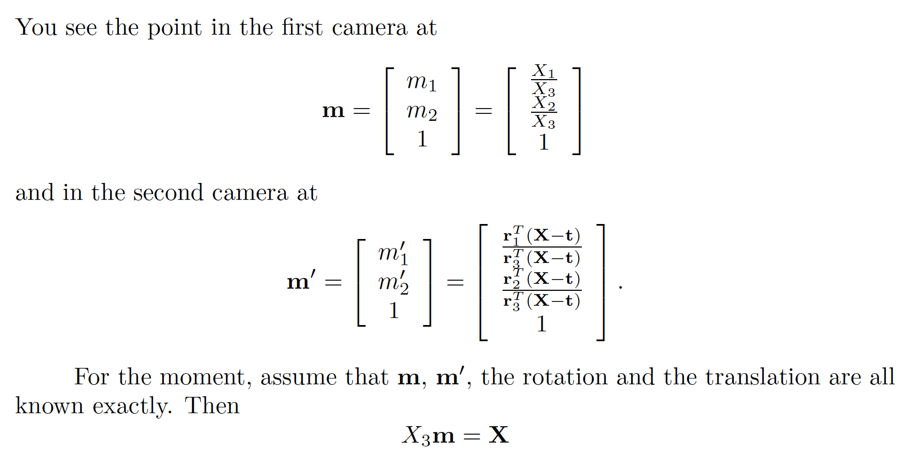

Slide 6
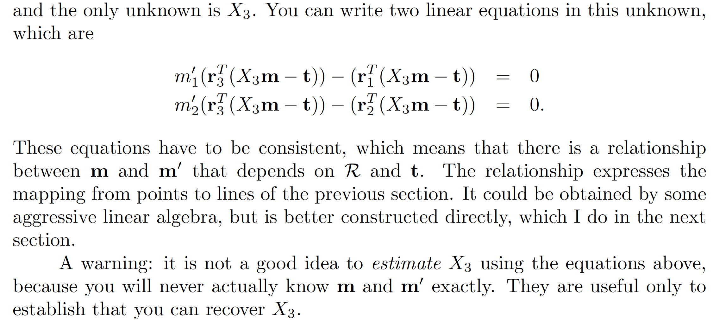

Slide 7
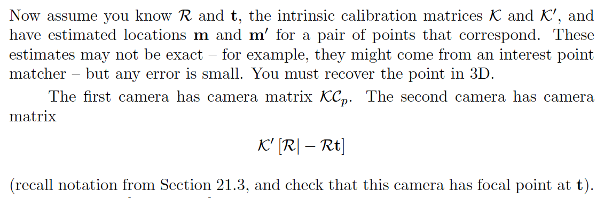
Triangulation
Have m, m’, R, t
Compute reprojection error
  sum:
    residual between X projected into 1 and m
    residual between X projected into 2 and m’
Choose X that minimizes

Slide 8
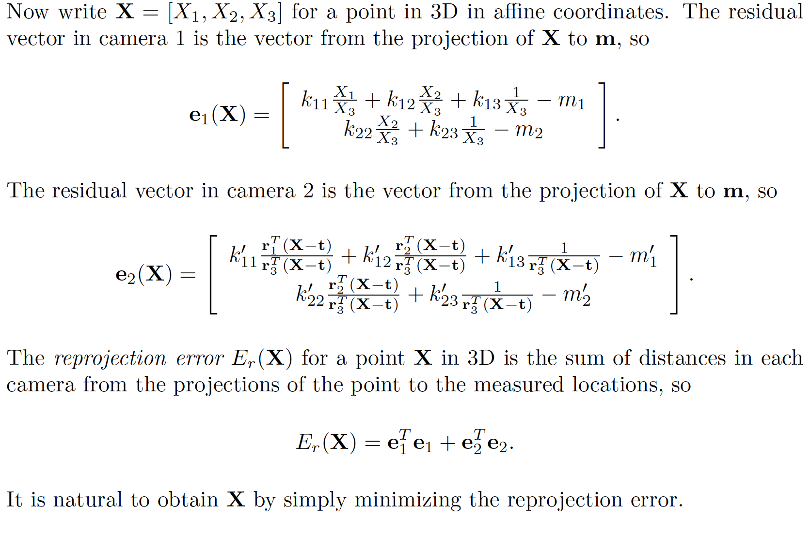

Slide 9
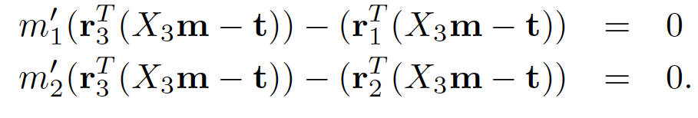
Start point
Least squares on

Slide 10
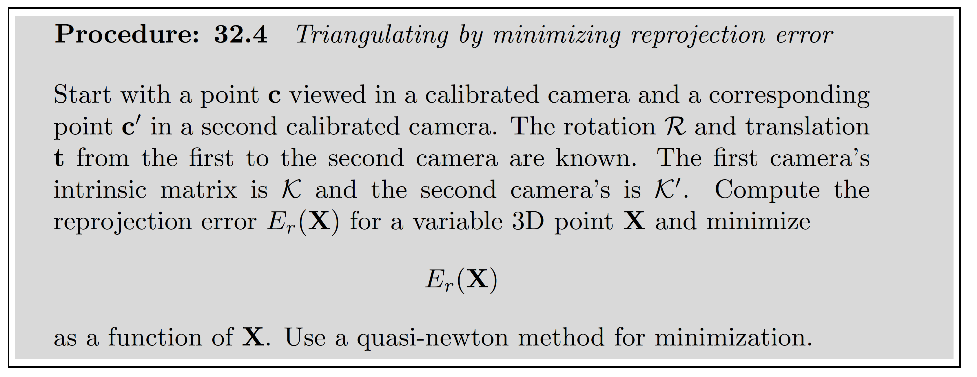
Triangulation

