Slide 1
U-Nets
D.A. Forsyth
University of Illinois at Urbana Champaign

Slide 2
Last blocks
Build an encoder and a decoder to:
  Accept noisy image, produce clean version
By:
  Constructing loss
  Applying SGD to get minimal loss on training data
Using various tricks to get good behavior

Slide 3
Change what the decoder does...
Regression – predict “image like thing” from image
An “image like” thing
  may have the same resolution as the image
  continuous (not categorical)
  lots of examples
  can be predicted from an image (but how do we know?)
Examples:
  depth
  normal
  defogged image
  superresolution
  lots of others..

Slide 4
This recipe isn’t universal ...
Generally, want cases where output
  is image like
  is determined by input
For example, very hard to apply to colorization
  there are many right outputs for the same input
Mostly, quite hard to tell what will work

Slide 5
New recipe, depth case
Procedure:
  find many training pairs (image, depth)
  adjust filters so that
    Decode(Encode(image)) is close to depth
  on average, over pairs
  hope that this generalizes to new images
Result:
  Single image depth predictor

Slide 6
The U-Net
Originally
  a particular architecture
Increasingly
  an encoder followed by a decoder

Slide 7
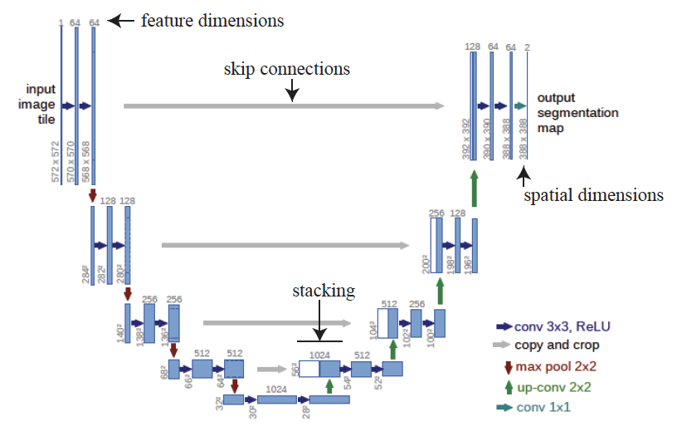
The original U-net
This doesn’t
have to be a
segmentation

Slide 8
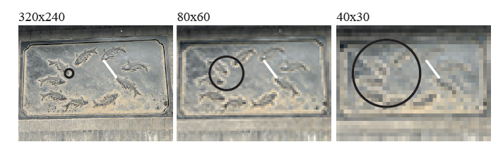
This is fully convolutional
Advantage:
  you can train on one size, test on another
Issue:
  very odd spatial behavior is implicit

Slide 9
This is fully convolutional
Not every image regression network is FC
  in some cases, scale matters a lot – fixed size images

Slide 10
Things to think about...

