Slide 1
VLM Mechanics, Issues and Variants BEV
D.A. Forsyth,
University of Illinois at Urbana Champaign

Slide 2
Vision – language strategies
Shared embedding space
  Get
    reliable image encoder
    reliable language encoder
  fine-tune them to match
    as in CLIP
    how? huge models, etc.
  strategies
    LORA
    Prefix/Prompt tuning

Slide 3
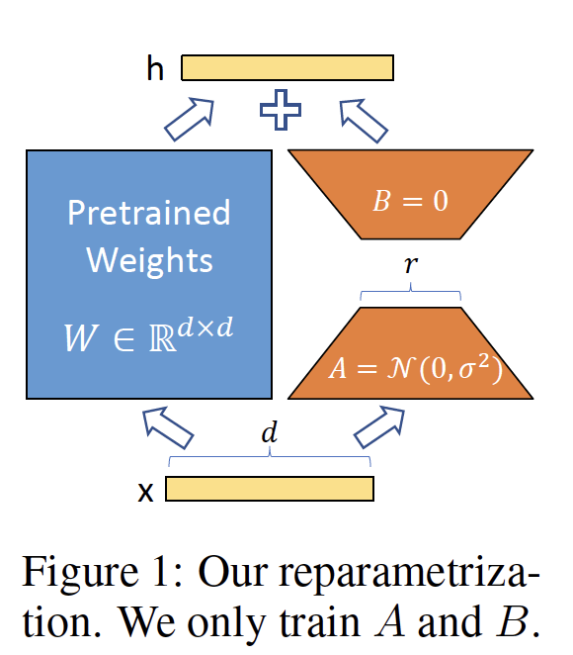
LORA finetuning
Weights in most layers form a matrix
Choose a (some) layer(s)
  Fix weights
  add low rank matrix to weight matrix
  adjust low rank matrix
  Very few weights
  Significant improvements
Curious fact:
  Lora’s are traded in the NSFW world
LORA: LOW-RANK ADAPTATION OF LARGE LANGUAGE MODELS, Hu et al 21

Slide 4
LORA finetuning
Original model
Freeze this
LORA version
Learn these

Slide 5
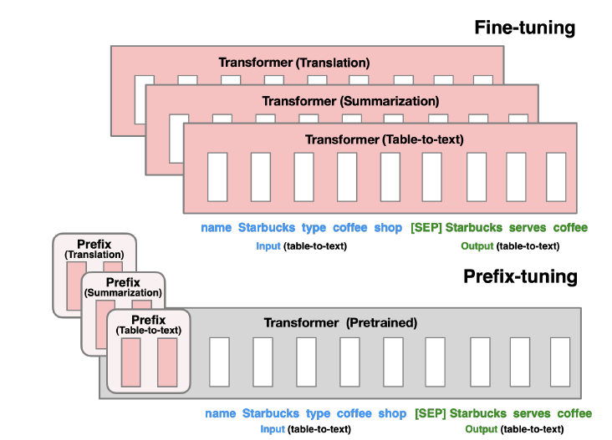
Prefix/Prompt tuning
Prefix/Prompt tuning
  freeze model
    attach learnable tokens to prompt
    update these tokens to improve performance
The Power of Scale for Parameter-Efficient Prompt Tuning
Lester et al 2021
Prefix-Tuning: Optimizing Continuous Prompts for Generation
Li +Liang, 2021

Slide 6
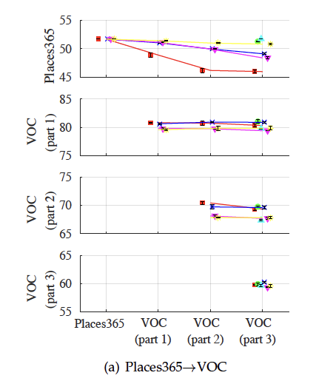
Nuisances: Forgetting
Forgetting
  Fine-tune a pretrained network on new task
  It gets worse on previous tasks
  Robust, widespread effect
There are strategies
Learning without Forgetting
Li+Hoiem 2017

Slide 7
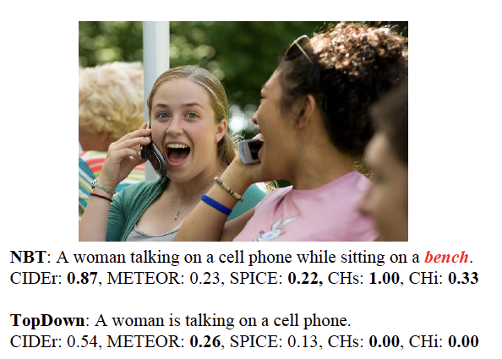
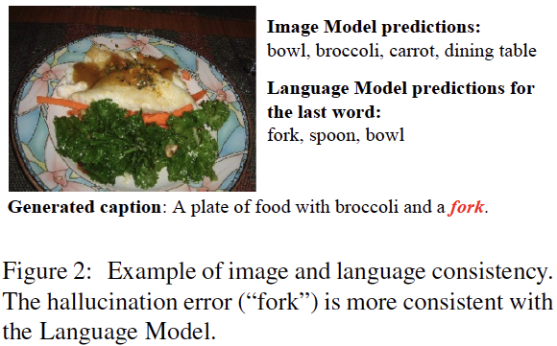
Nuisances: hallucination
Object Hallucination in Image Captioning, Rohrbach et al 2019

Slide 8
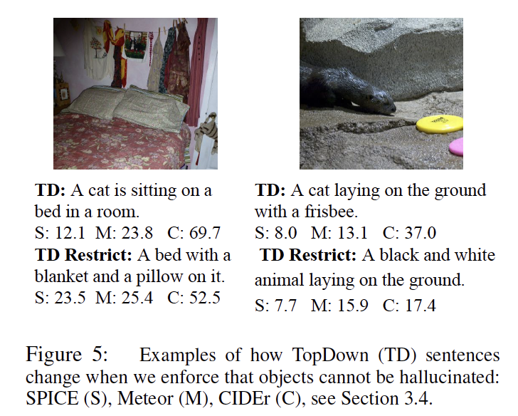
Nuisances: hallucination
Cure strategy: force entities in captions to have corresponding detector responses
Object Hallucination in Image Captioning, Rohrbach et al 2019

Slide 9
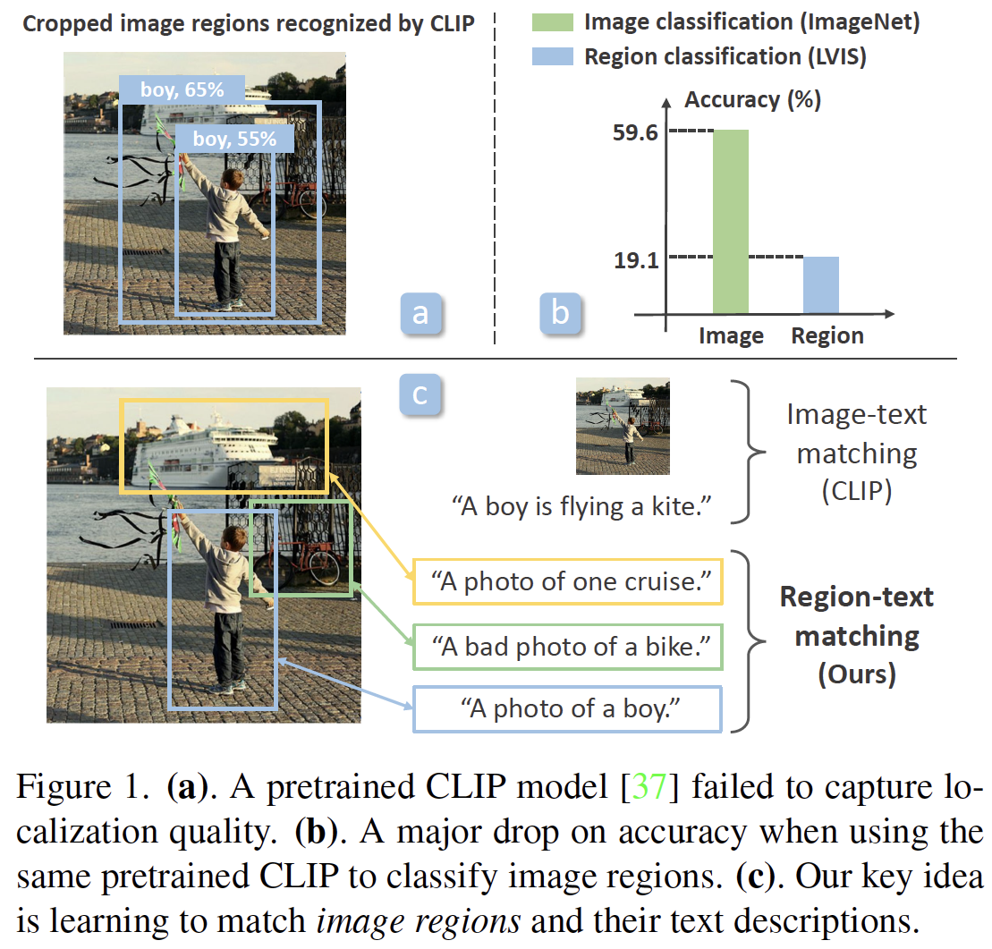
Nuisances: localization issues
RegionCLIP: Region-based Language-Image Pretraining, Zhong et al, 2021

Slide 10
Nuisances: localization issues
Cure:
  use RPN to propose region boxes
  match to word labels using visual features
  Now have a dataset of localized regions – text
    use that to finetune
RegionCLIP: Region-based Language-Image Pretraining, Zhong et al, 2021

Slide 11
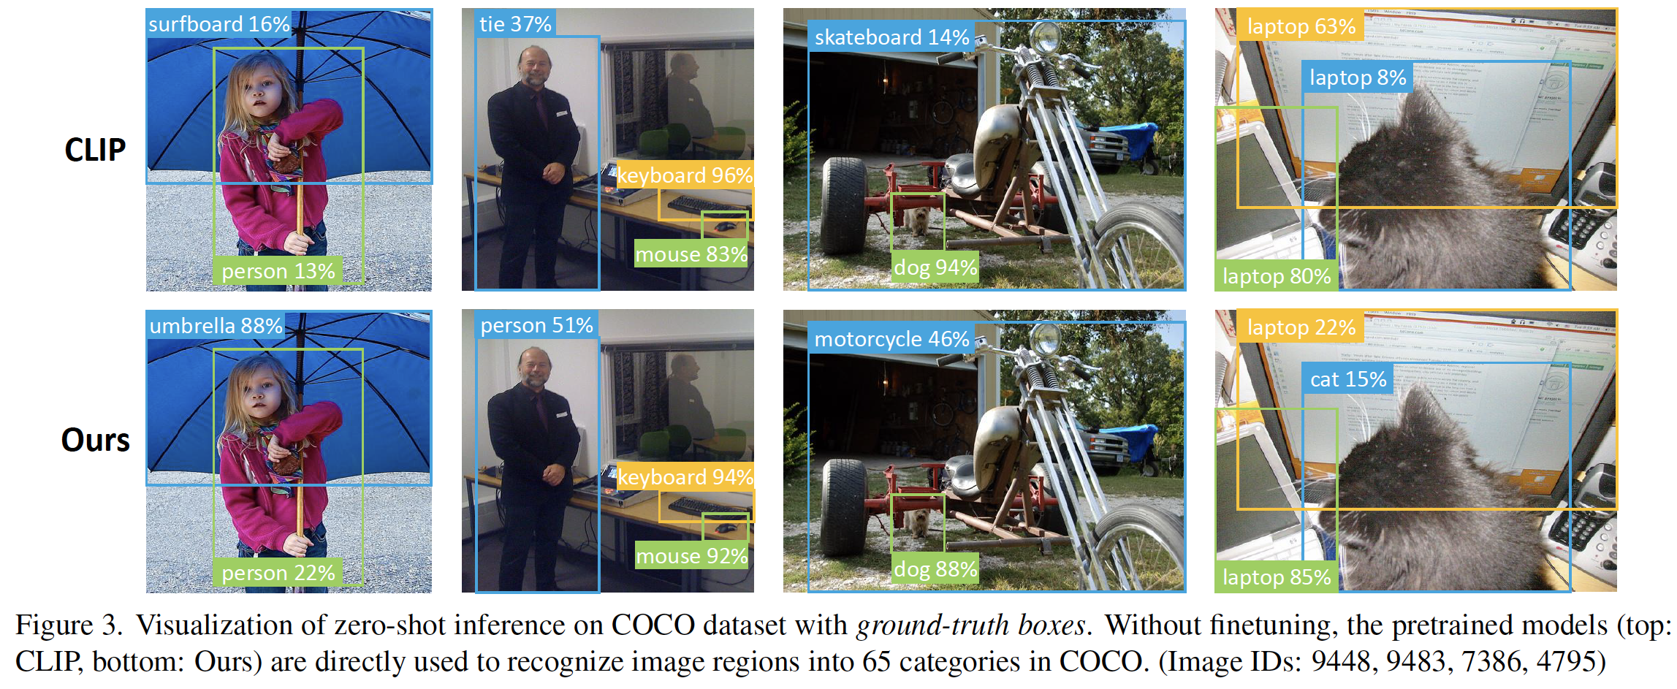
Improvements result
RegionCLIP: Region-based Language-Image Pretraining, Zhong et al, 2021

Slide 12
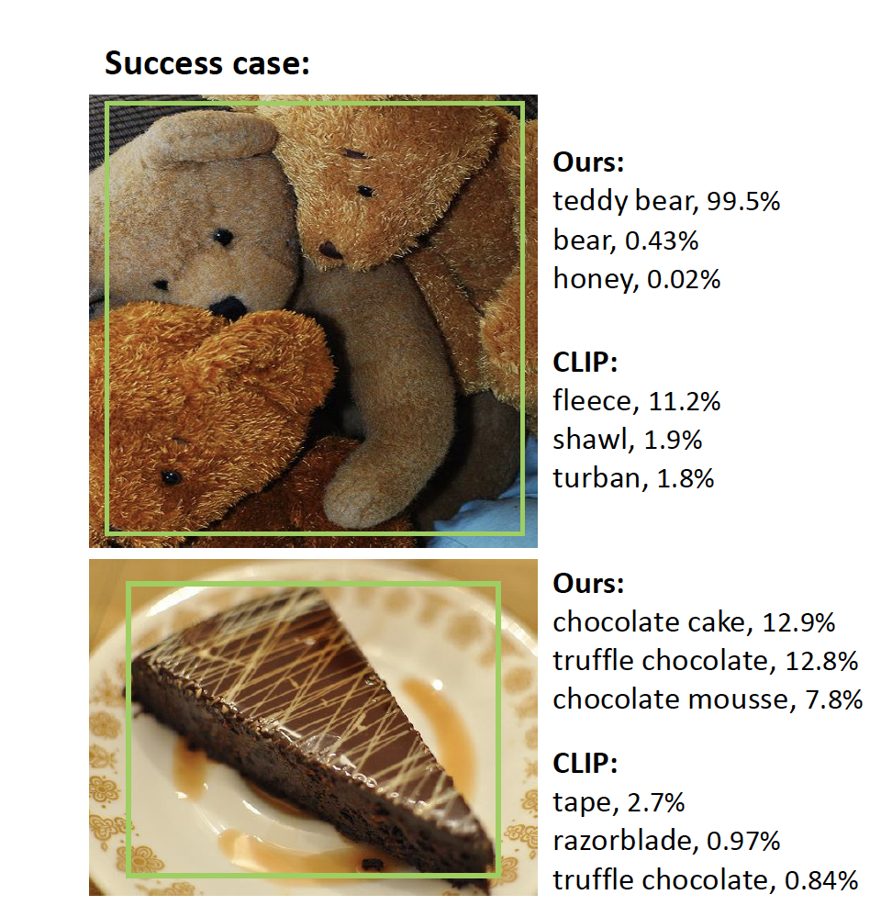
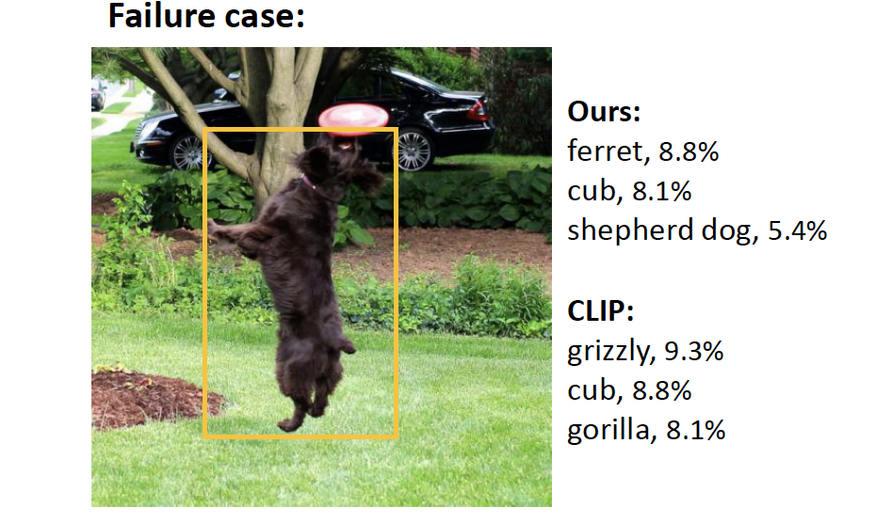
Improvements result
RegionCLIP: Region-based Language-Image Pretraining, Zhong et al, 2021

Slide 13
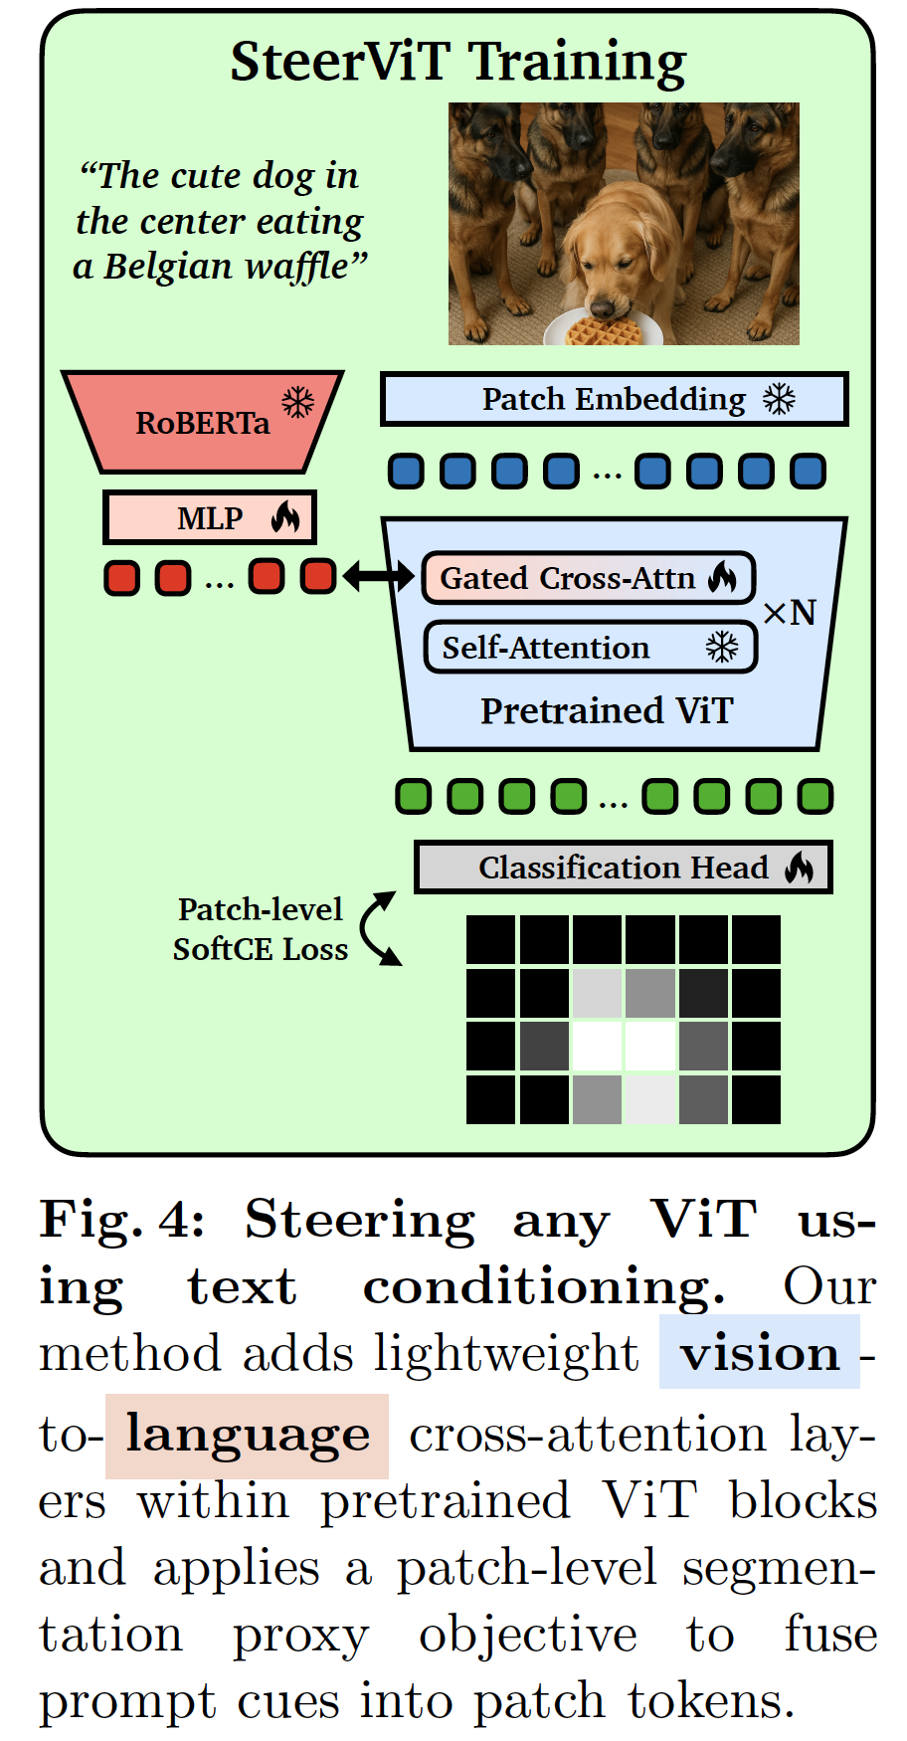
Variants: Focus
Idea:
  finetune vision model to accept cues from language to emphasize features
  use cross-attention
  train with
Steerable Visual Representations, Ruthard et al 2026

Slide 14
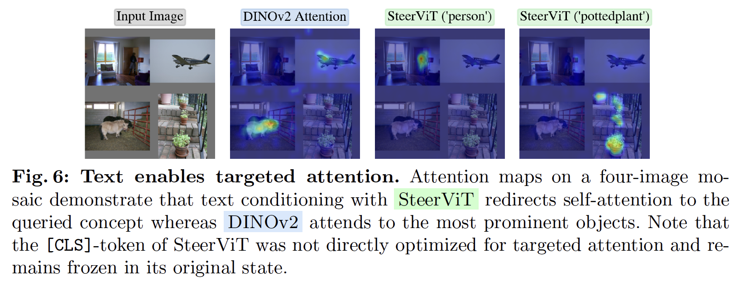
Focus helps
Att’n to CLS token shows steering is helpful
Steerable Visual Representations, Ruthard et al 2026

Slide 15
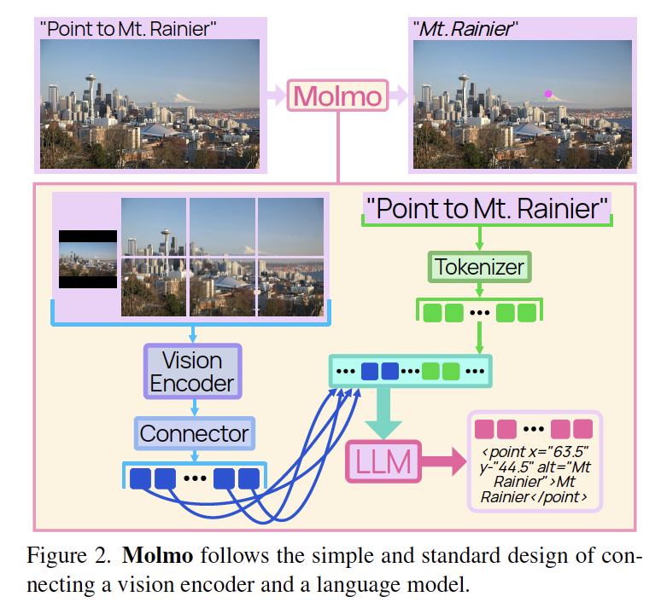
Variants: Pointing
Collect data where people point at named item
Train model to predict these points
  decode to points

Slide 16
Pointing: advantages
Model is discouraged from hallucination
  as above
Significant reduction in required training data
  quality > quantity
Knowing where something is is useful

Slide 17
Resources
everything I cite is on arxiv
  search by name
Open VLM with pretrained weights, all code, open data:
  https://allenai.org/molmo
Survey in:
Detailed models in:
Vision-Language Models for Vision Tasks:A Survey, Zhang et al, 2024
QWEN TECHNICAL REPORT, Bai et al, 2023
Flamingo: a Visual Language Model for Few-Shot Learning, Alayrac, 2022
Molmo and PixMo: OpenWeights and Open Data for State-of-the-Art Vision-Language Models, Deitke et al, 2024

Slide 18
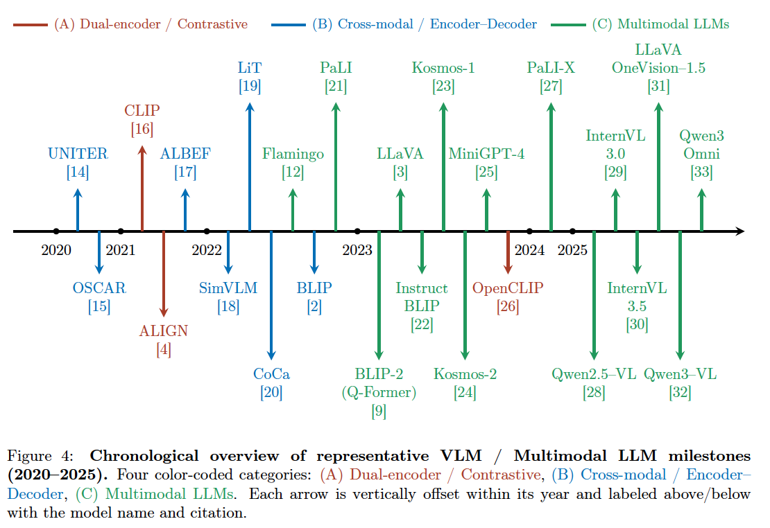
Vision Language Models: A Survey of 26K Papers (CVPR, ICLR, NeurIPS 2023–2025), Lin, 2025

Slide 19
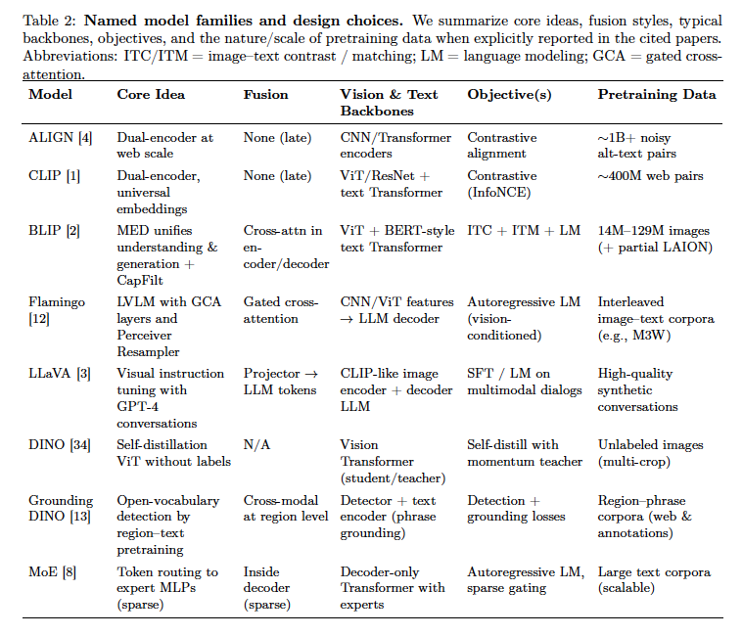
Vision Language Models: A Survey of 26K Papers (CVPR, ICLR, NeurIPS 2023–2025), Lin, 2025

Slide 20
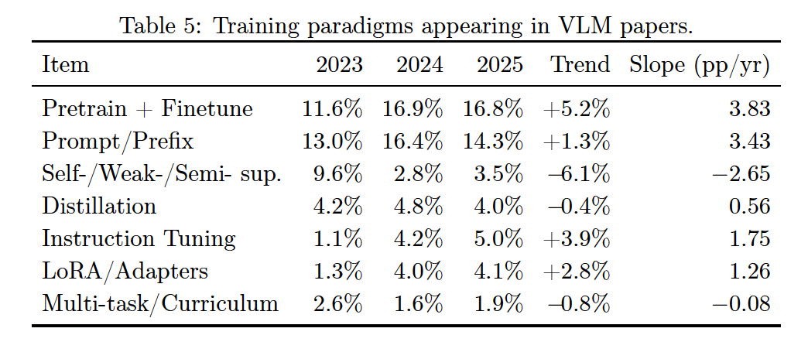
Vision Language Models: A Survey of 26K Papers (CVPR, ICLR, NeurIPS 2023–2025), Lin, 2025

Slide 21
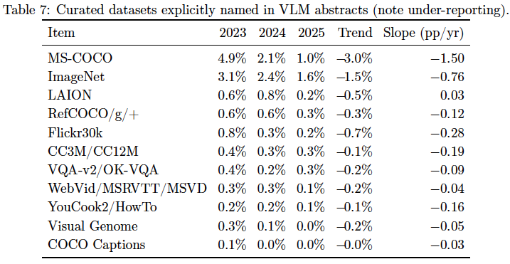
Vision Language Models: A Survey of 26K Papers (CVPR, ICLR, NeurIPS 2023–2025), Lin, 2025

