Slide 1
VLMs
BEV
D.A. Forsyth,
University of Illinois at Urbana Champaign

Slide 2
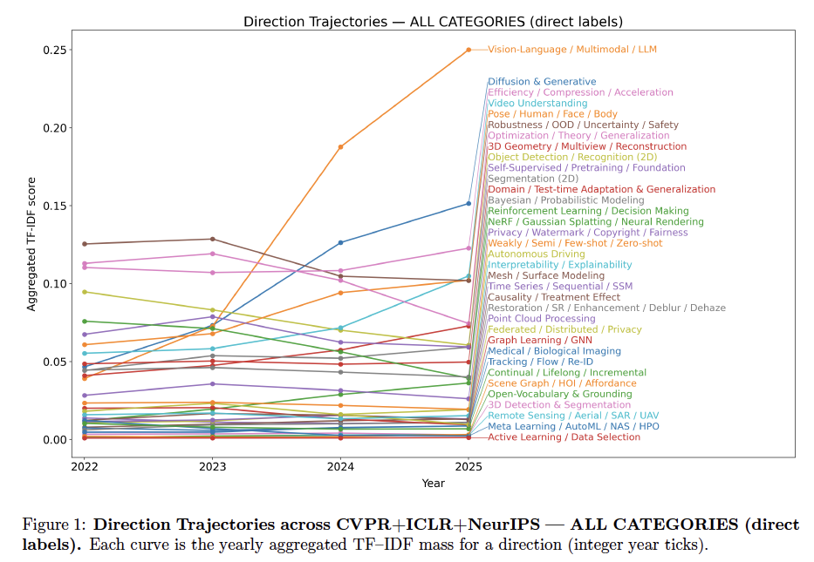
Vision Language Models: A Survey of 26K Papers (CVPR, ICLR, NeurIPS 2023–2025), Lin, 2025

Slide 3
Big Picture
Train models using both images and text
Models should
  accept text/images, produce text/images
  answer questions about images
Advantages
  extremely rich training opportunities
    for a general vision encoder
  lever text descriptions of objects to build detectors
    particularly important for rare or unseen objects
      a version of distributional semantics
An Introduction to Vision-Language Modeling
Bordes et al, 2024

Slide 4
Vision – language strategies
Shared embedding space
  Embed image and language in shared space
    corresponding picture-caption pairs are close
    non corresponding pairs are far apart
  CLIP

Slide 5
Association (CLIP)
4e8 pairs (image, text) from internet queries
  queries:
    all words appearing 100 times or more in English wikipedia
      also, some bigrams
Train ViT, Text encoder so that
  matches are close
  embeddings spread out
Larger models
  ResNet: 18 days on 592 V100’s
  VIT: 12 days on 256 V100’s

Slide 6
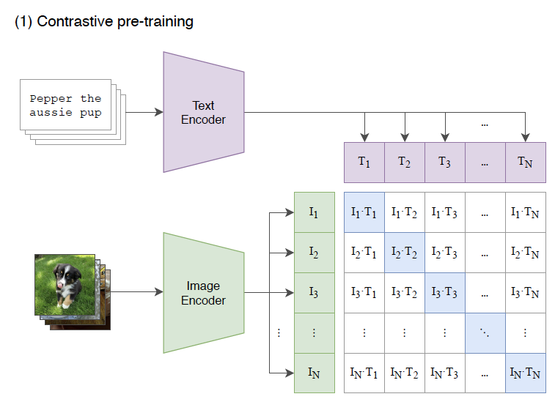
CLIP: joint vision language training
Learning Transferable Visual Models From Natural Language Supervision, Radford et al 21

Slide 7
Evaluating encoder
Take some dataset
Train a linear probe
  multiclass linear classifier
  applied to embedding
  trained on some training split
Look at score, averaged over datasets
  Better at a given compute;
  improves with more compute

Slide 8
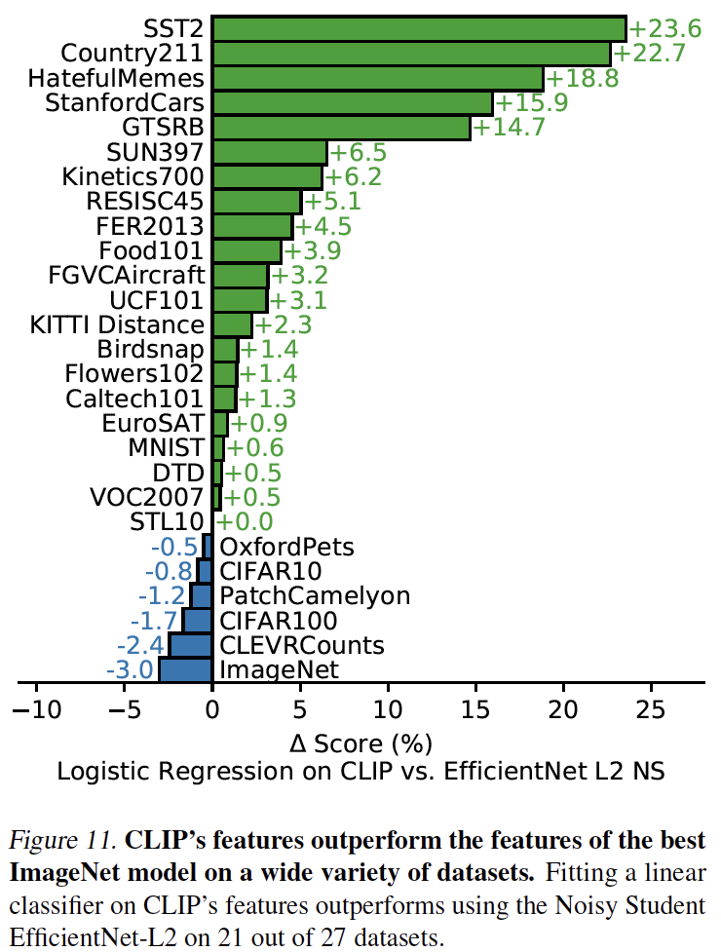
Better than best ImageNet model

Slide 9
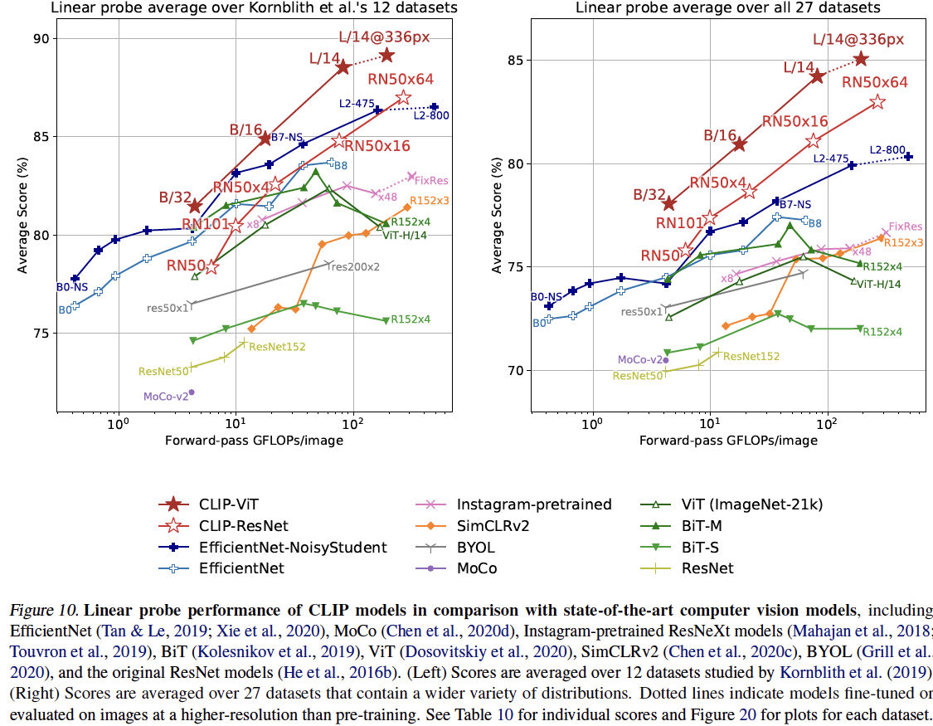
ç√Ω
Better at a given compute;
improves with more compute
This is ViT trained
w/ CLIP
Learning Transferable Visual Models From Natural Language Supervision, Radford et al 21

Slide 10
Zero-shot classification in CLIP
build a list of classes
classify image by
  compute embedding of “class” on language side
    e-class
  compute (image, e-class) distance for each class
  choose the closest

Slide 11
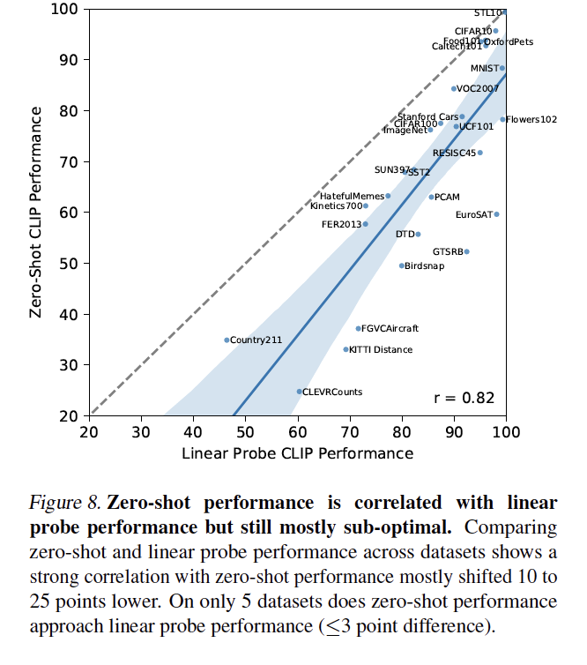
Works
Terminology:
  linear probe = fit linear classifier to features produced by encoder

Slide 12
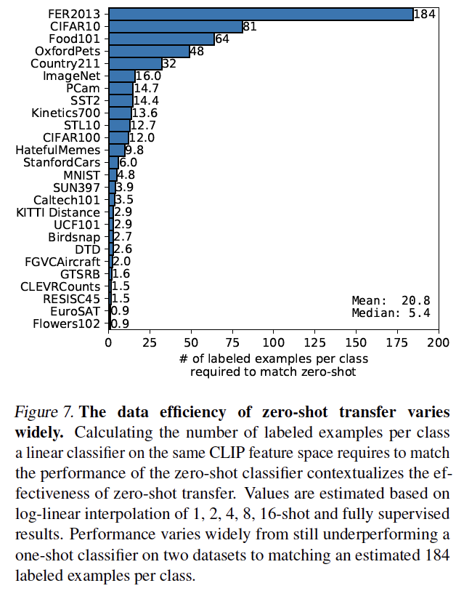
Examples are seldom better
For most datasets, you need more than one example to fit a linear classifier that is better than zero-shot

Slide 13
Vision – language strategies
Cross-attention
  Both models are transformers
    pass tokens across models

Slide 14
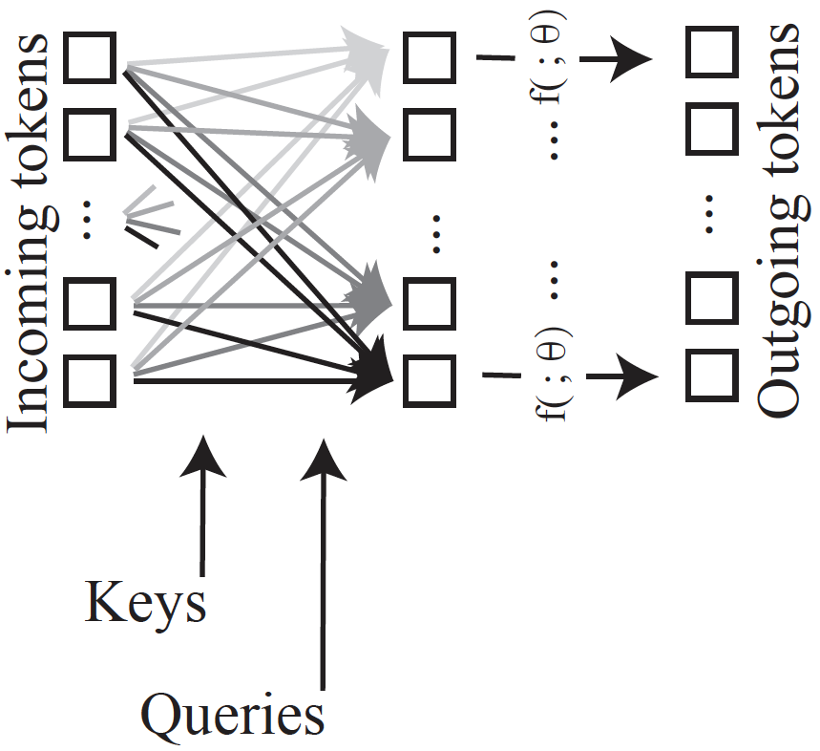
Transformers again
Details now matter
These weights are
determined by
attention – depend
on keys and queries.

Slide 15
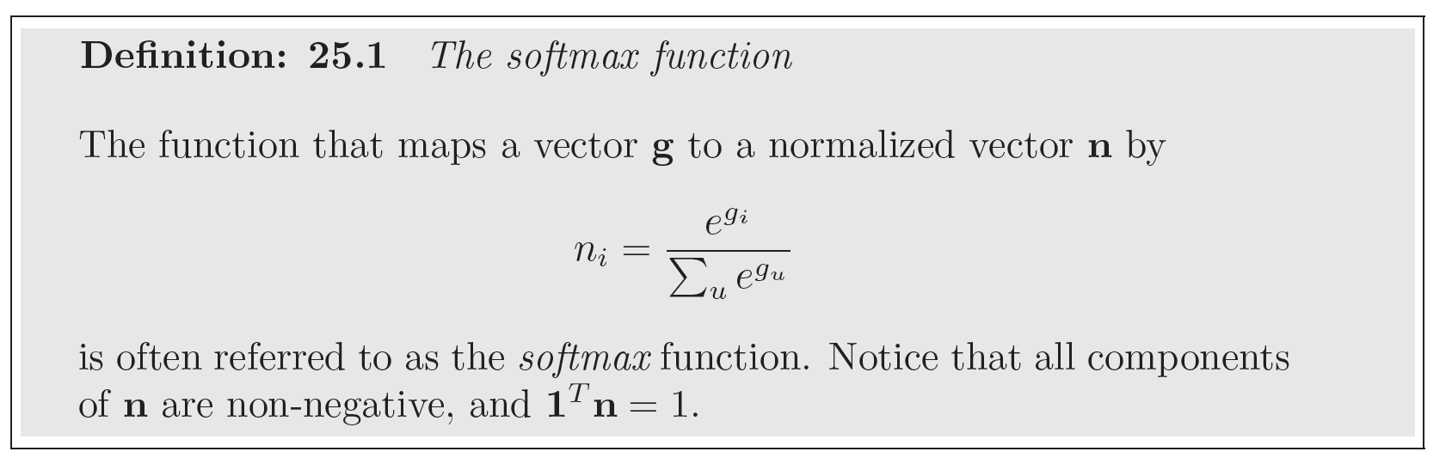
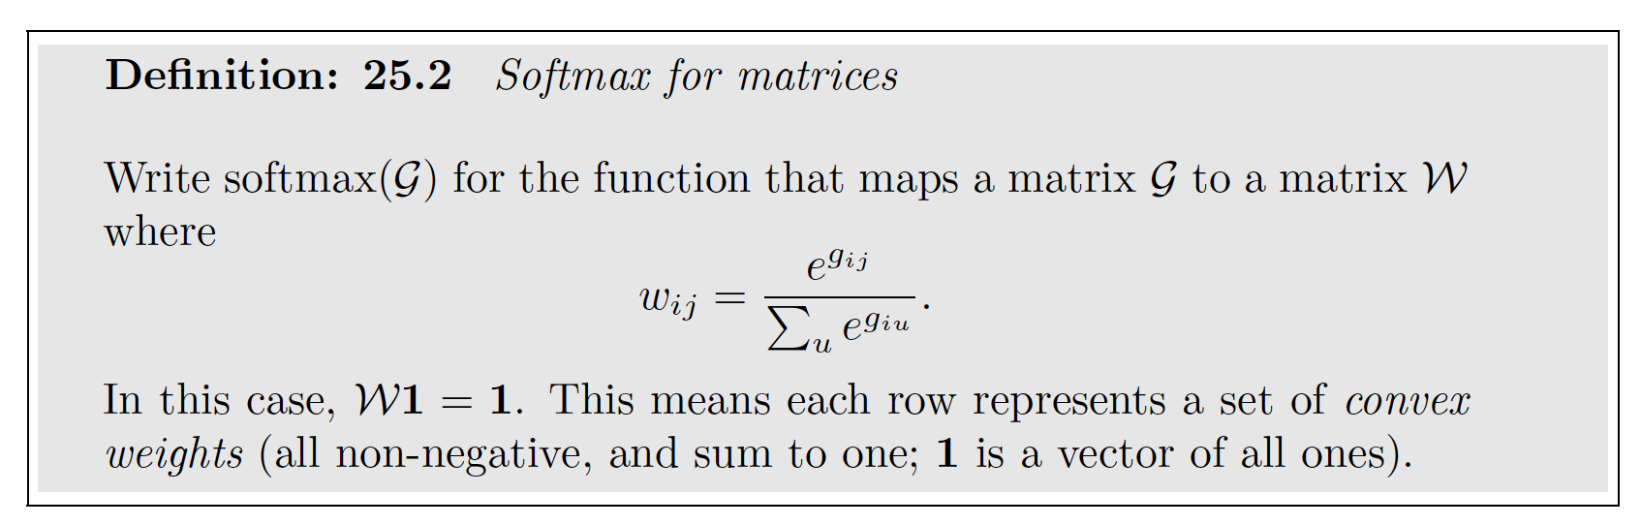
Softmax

Slide 16
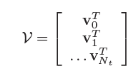
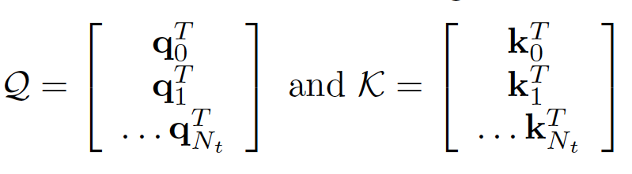
Tokens, keys and queries
Tokens
  e_t = e_l dimensional vectors
  stack into matrix
Keys and Queries
  d_k dimensional vectors
    There are N_t+1 of them
      there are a variety of places they could come from
  Stack into matrices

Slide 17
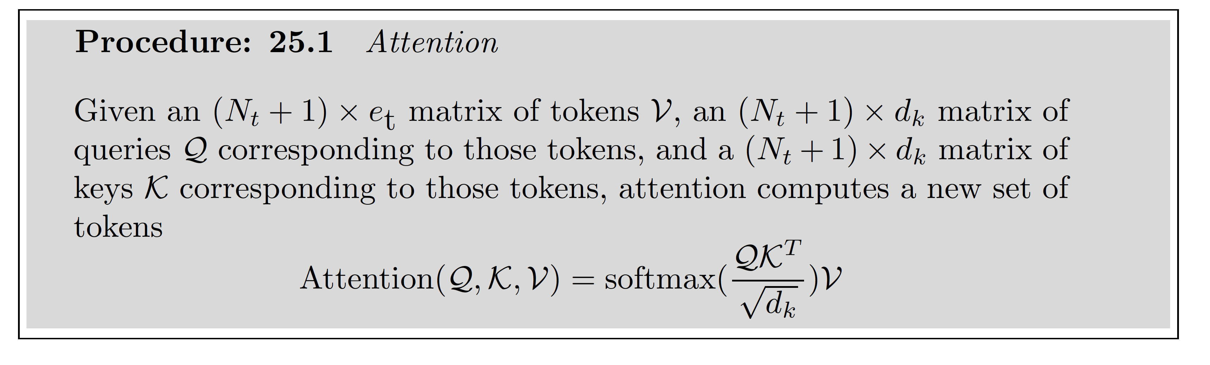
Attention
This is an N_t+1 x N_t+1 non-negative matrix.
Rows sum to one.

Slide 18
Attention
Result is an N_t+1 x e_t matrix - another matrix of tokens.
Each new token has received a contribution from all others.
Contributions are larger when key and query are similar, smaller when they
are different.

Slide 19
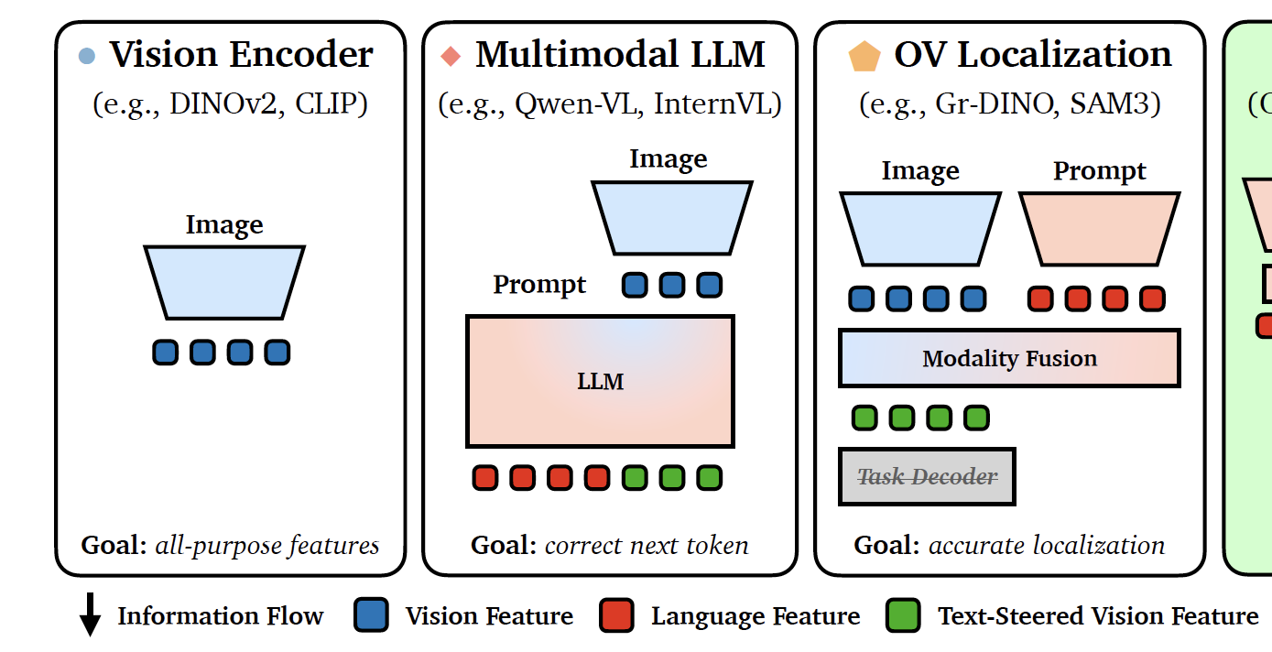
Architectures
Steerable Visual Representations, Ruthard et al 2026

Slide 20
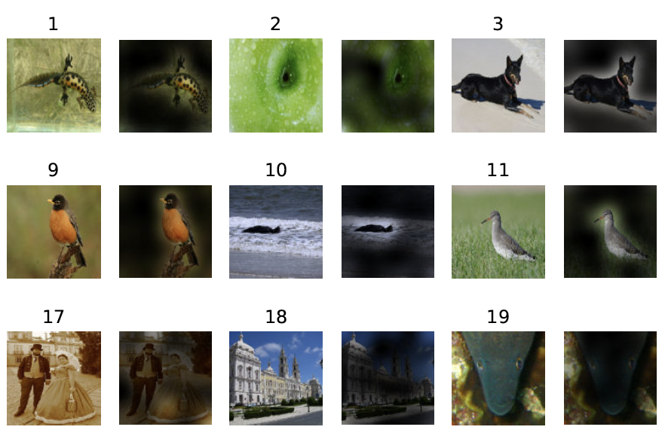
Attention to class token
AN IMAGE IS WORTH 16X16 WORDS: TRANSFORMERS FOR IMAGE RECOGNITION AT SCALE Dosovitskiy et al, 2021

Slide 21
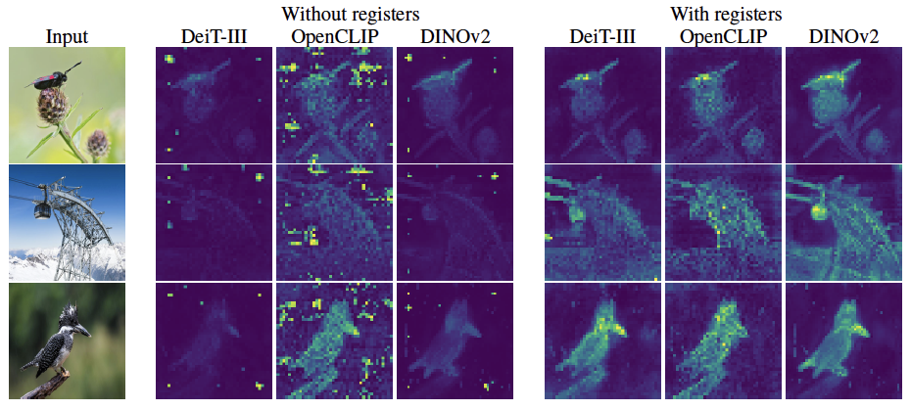
Attention to class token
VISION TRANSFORMERS NEED REGISTERS, Darcet et al, 2024

Slide 22
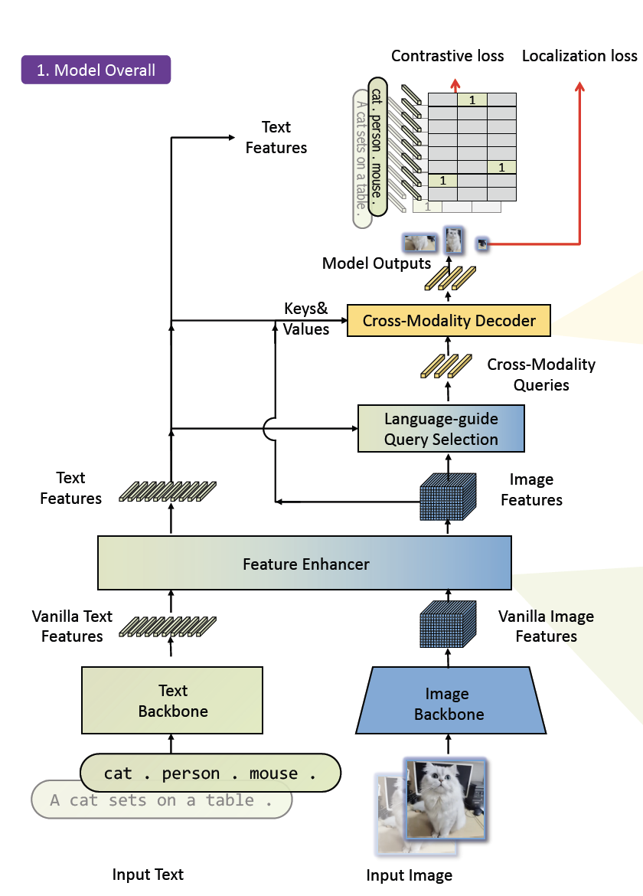
Grounding DINO: Marrying DINO with Grounded Pre-Training for Open-Set Object Detection.
Liu et al 2024

Slide 23
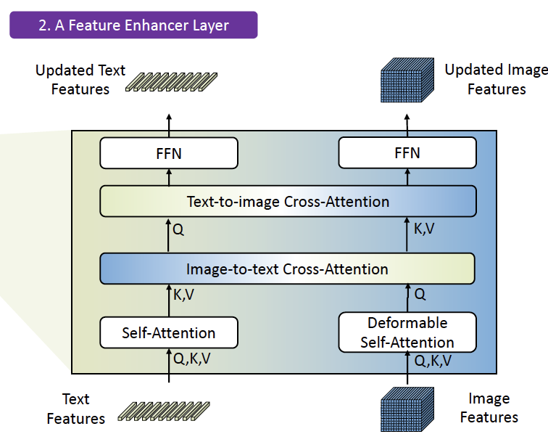
Grounding DINO: Marrying DINO with Grounded Pre-Training for Open-Set Object Detection.
Liu et al 2024

Slide 24
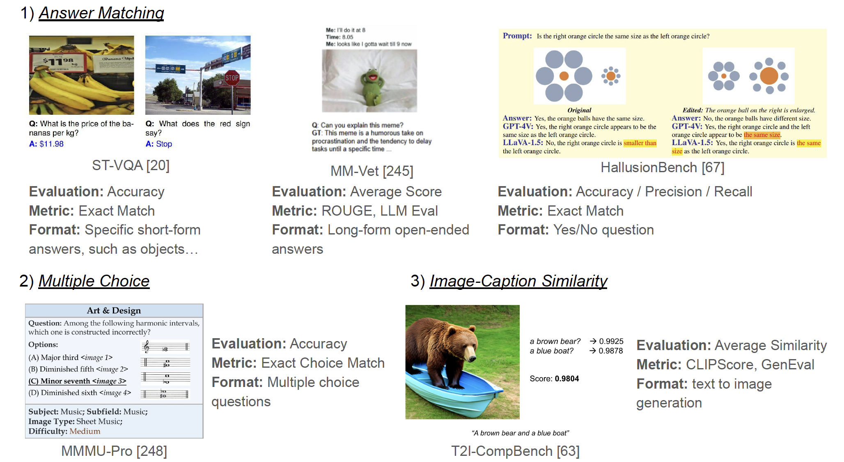
Evaluation strategies - I
A Survey of State of the Art Large Vision Language Models: Alignment,
Benchmark, Evaluations and Challenges, Li et al, 2025

Slide 25
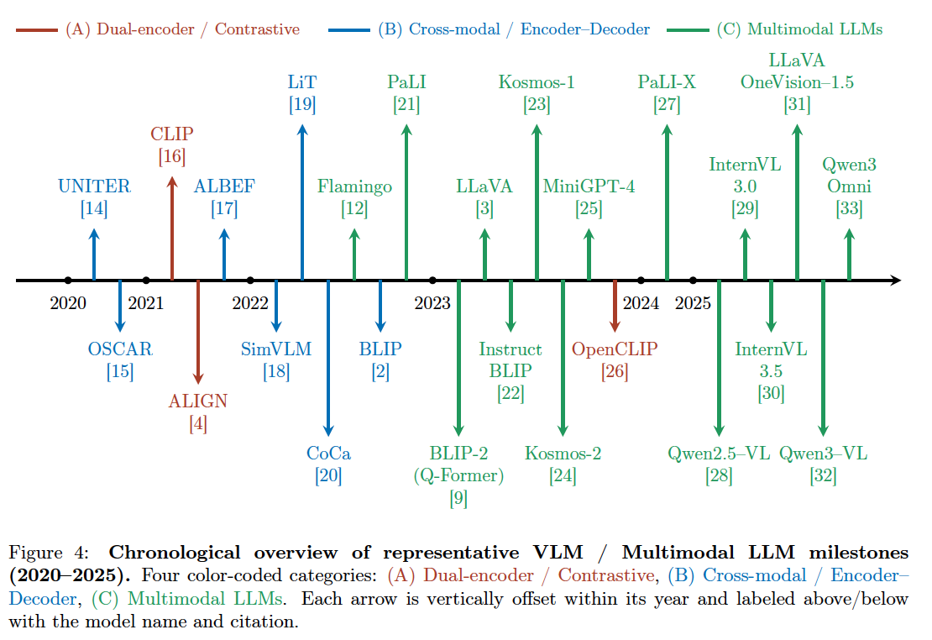
Vision Language Models: A Survey of 26K Papers (CVPR, ICLR, NeurIPS 2023–2025), Lin, 2025

Slide 26
Resources
everything I cite is on arxiv
  search by name
Open VLM with pretrained weights, all code, open data:
  https://allenai.org/molmo
Survey in:
Detailed models in:
Vision-Language Models for Vision Tasks:A Survey, Zhang et al, 2024
QWEN TECHNICAL REPORT, Bai et al, 2023
Flamingo: a Visual Language Model for Few-Shot Learning, Alayrac, 2022
Molmo and PixMo: OpenWeights and Open Data for State-of-the-Art Vision-Language Models, Deitke et al, 2024

