Slide 1
Building a working autoencoder – I
Network tricks - B
D.A. Forsyth
University of Illinois at Urbana Champaign

Slide 2
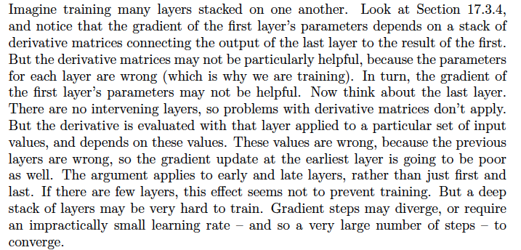
Gradient problems

Slide 3
Residual connections

Slide 4
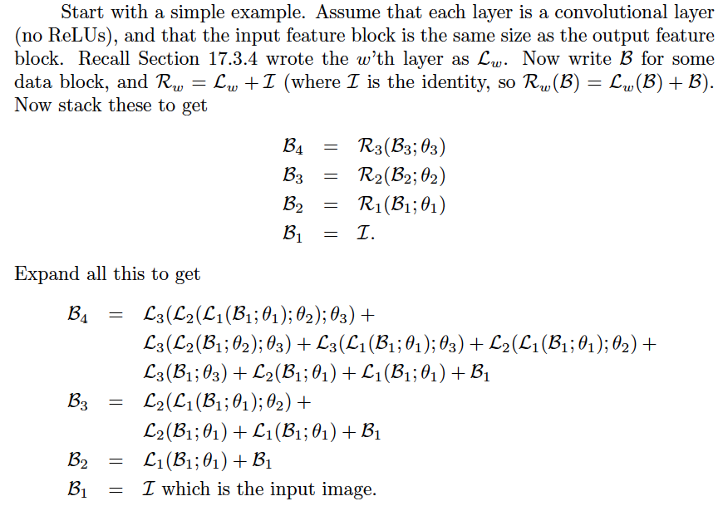
Residual connections

Slide 5
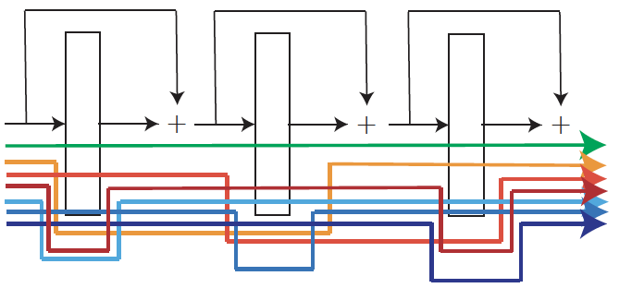
Residual connections

Slide 6
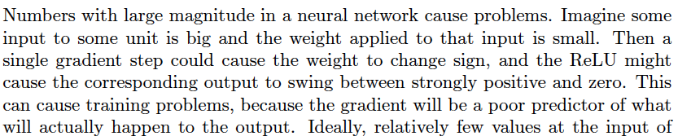
Batch normalization
Large numbers in blocks cause problems

Slide 7
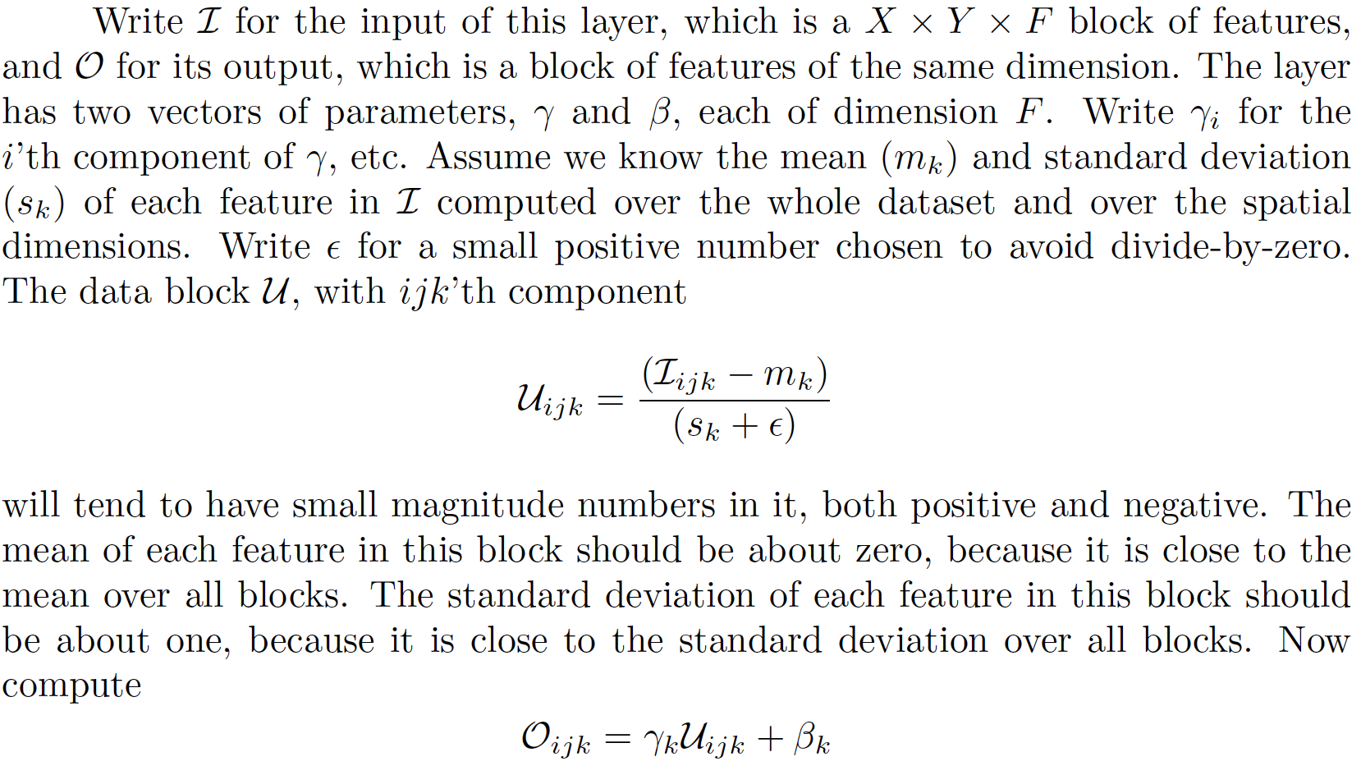
Batch normalization

