Slide 1
Building a working autoencoder – II
Examples
D.A. Forsyth
University of Illinois at Urbana Champaign

Slide 2
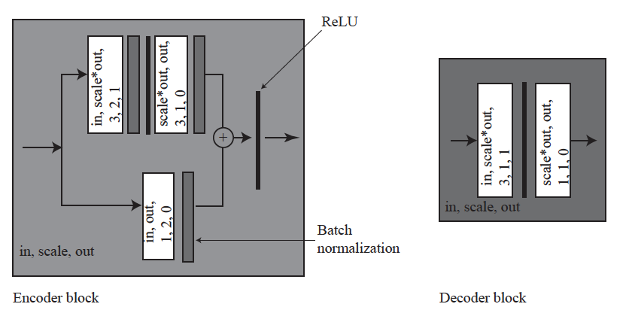
Example blocks

Slide 3
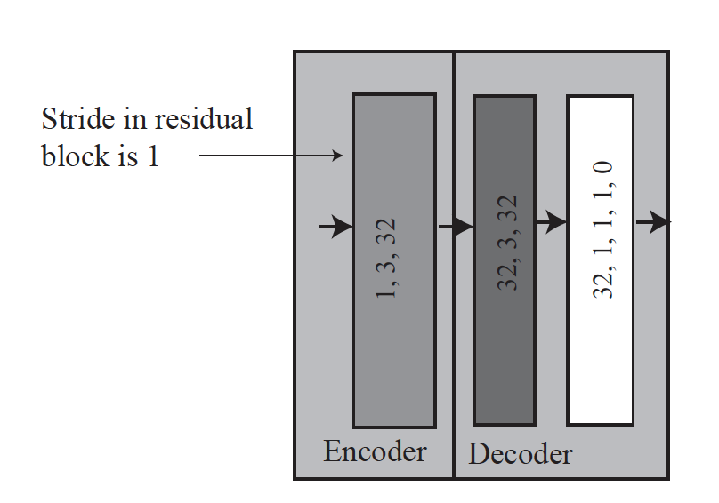
Small autoencoder

Slide 4
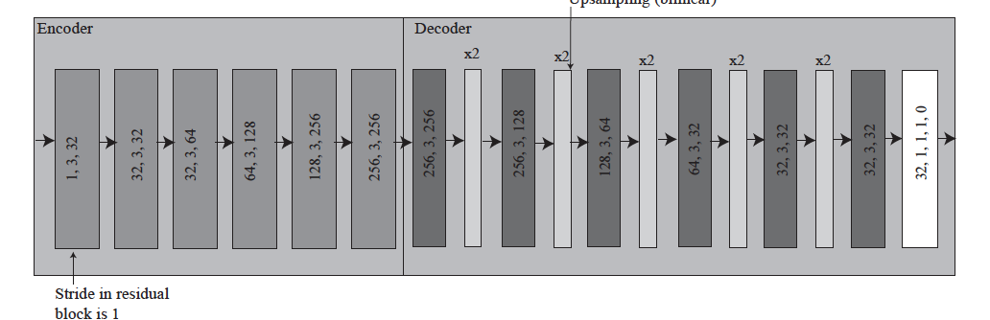
Bigger autoencoder

Slide 5
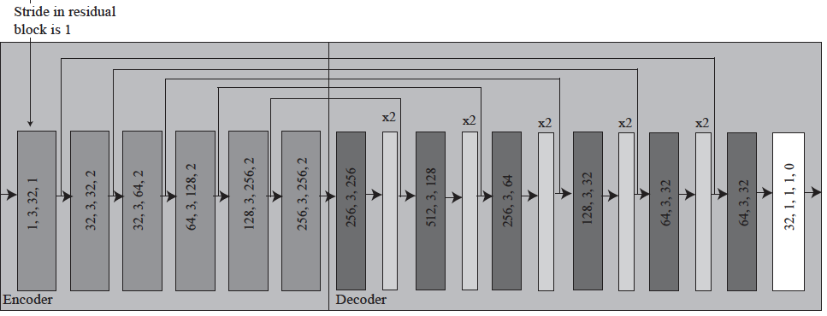
Bigger with skip

Slide 6
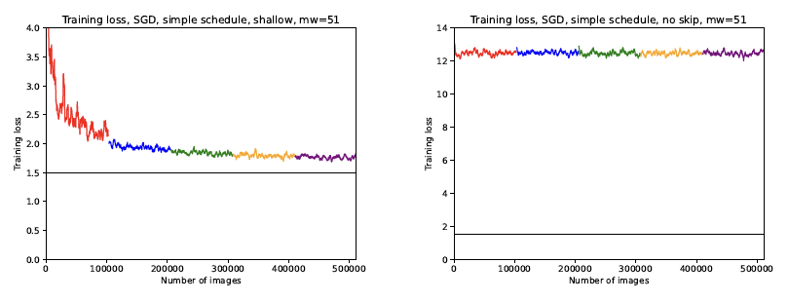
Training

Slide 7
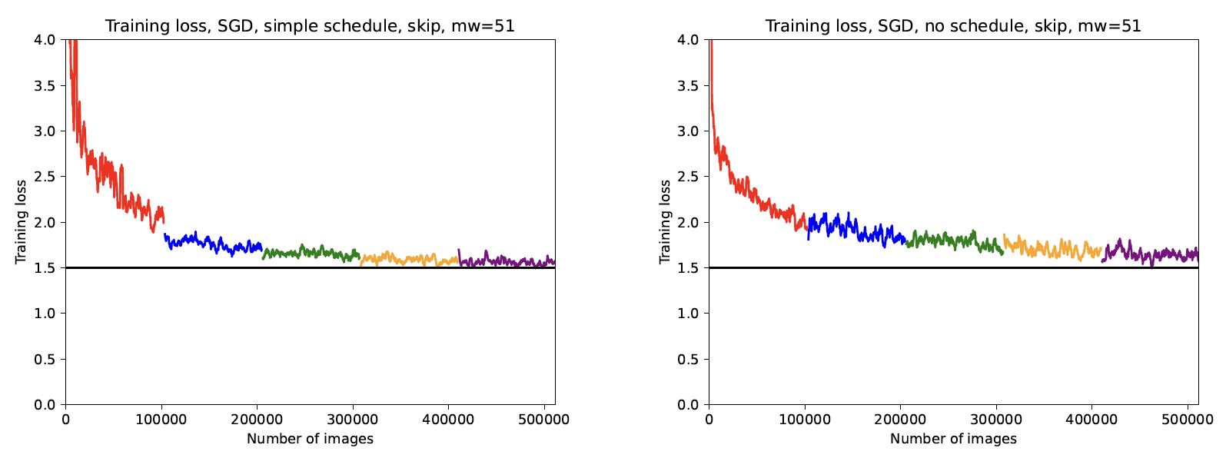
Learning rate schedules help

