Slide 1
Building a working autoencoder – III
Optimization tricks
D.A. Forsyth
University of Illinois at Urbana Champaign

Slide 2
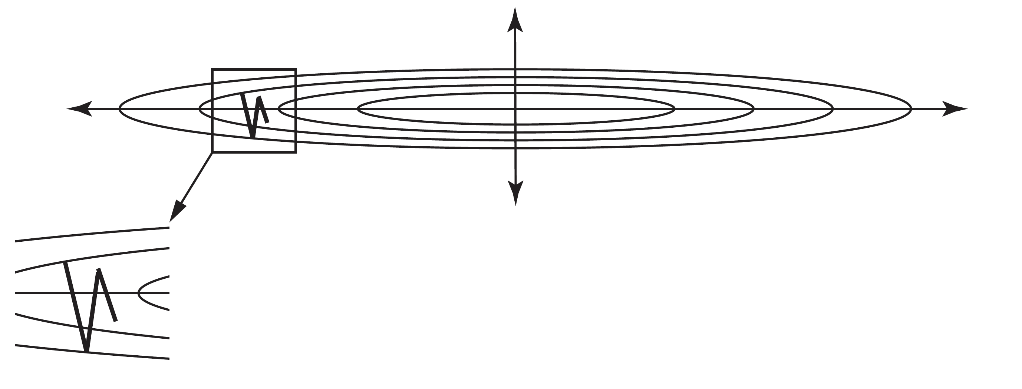
Gradients aren’t ideal...

Slide 3
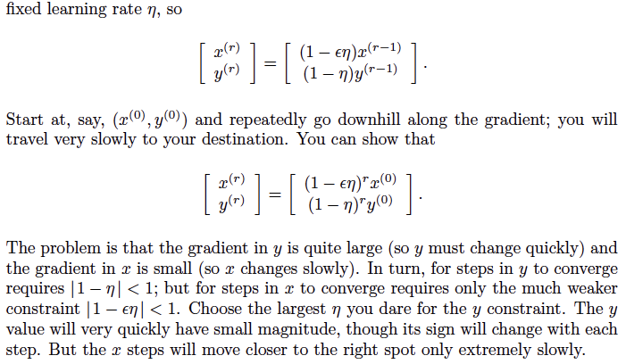
Gradients aren’t ideal...

Slide 4
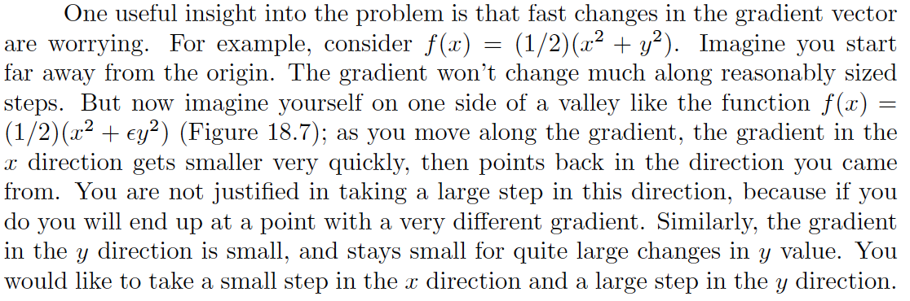
But you can’t do Newton’s method
Too many variables; too expensive
Insight:

Slide 5
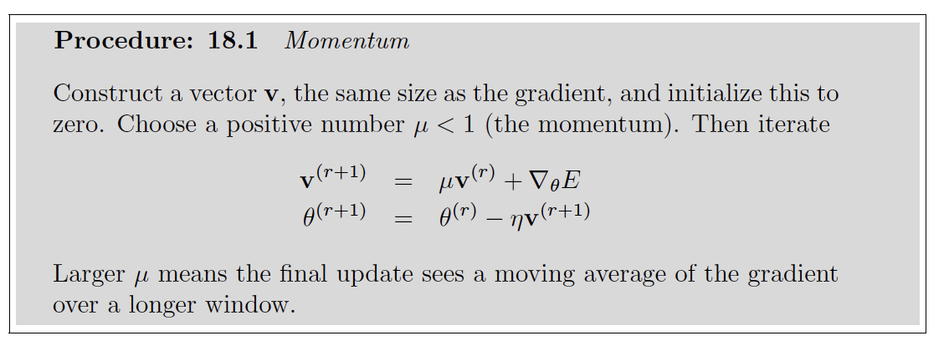
Momentum
Smooth the gradient using moving average

Slide 6
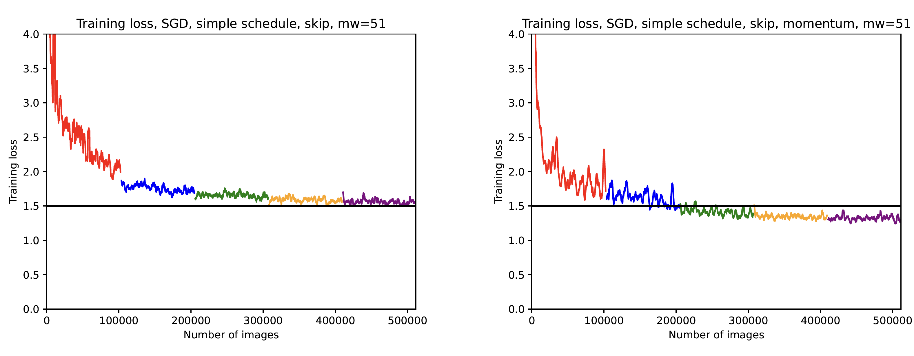
Momentum helps

Slide 7
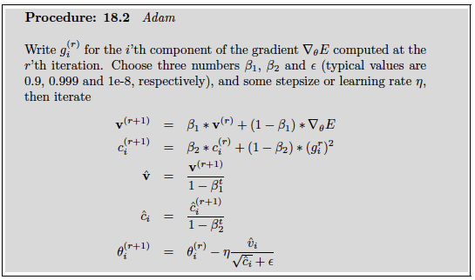
Adam – momentum variant

Slide 8
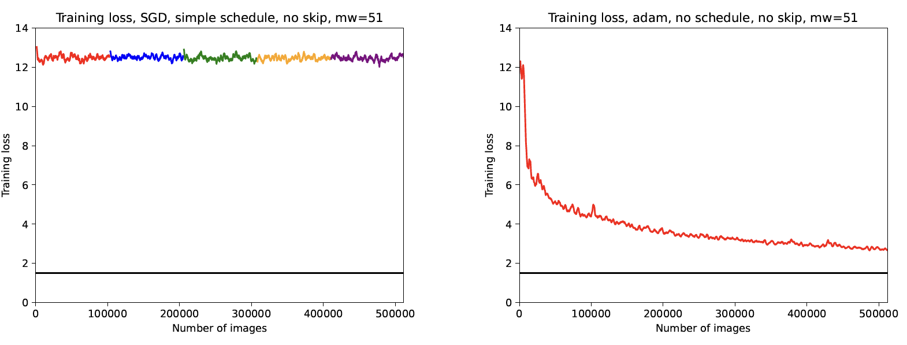
Adam can help a lot

Slide 9
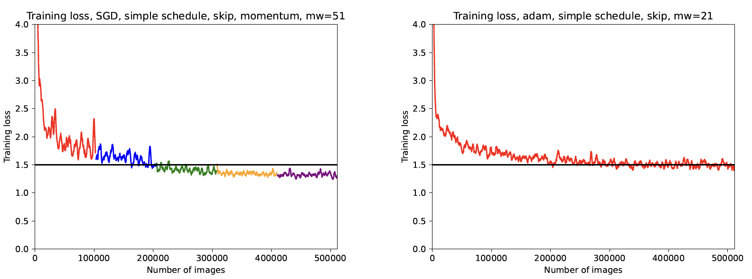
but isn’t perfect...

Slide 10
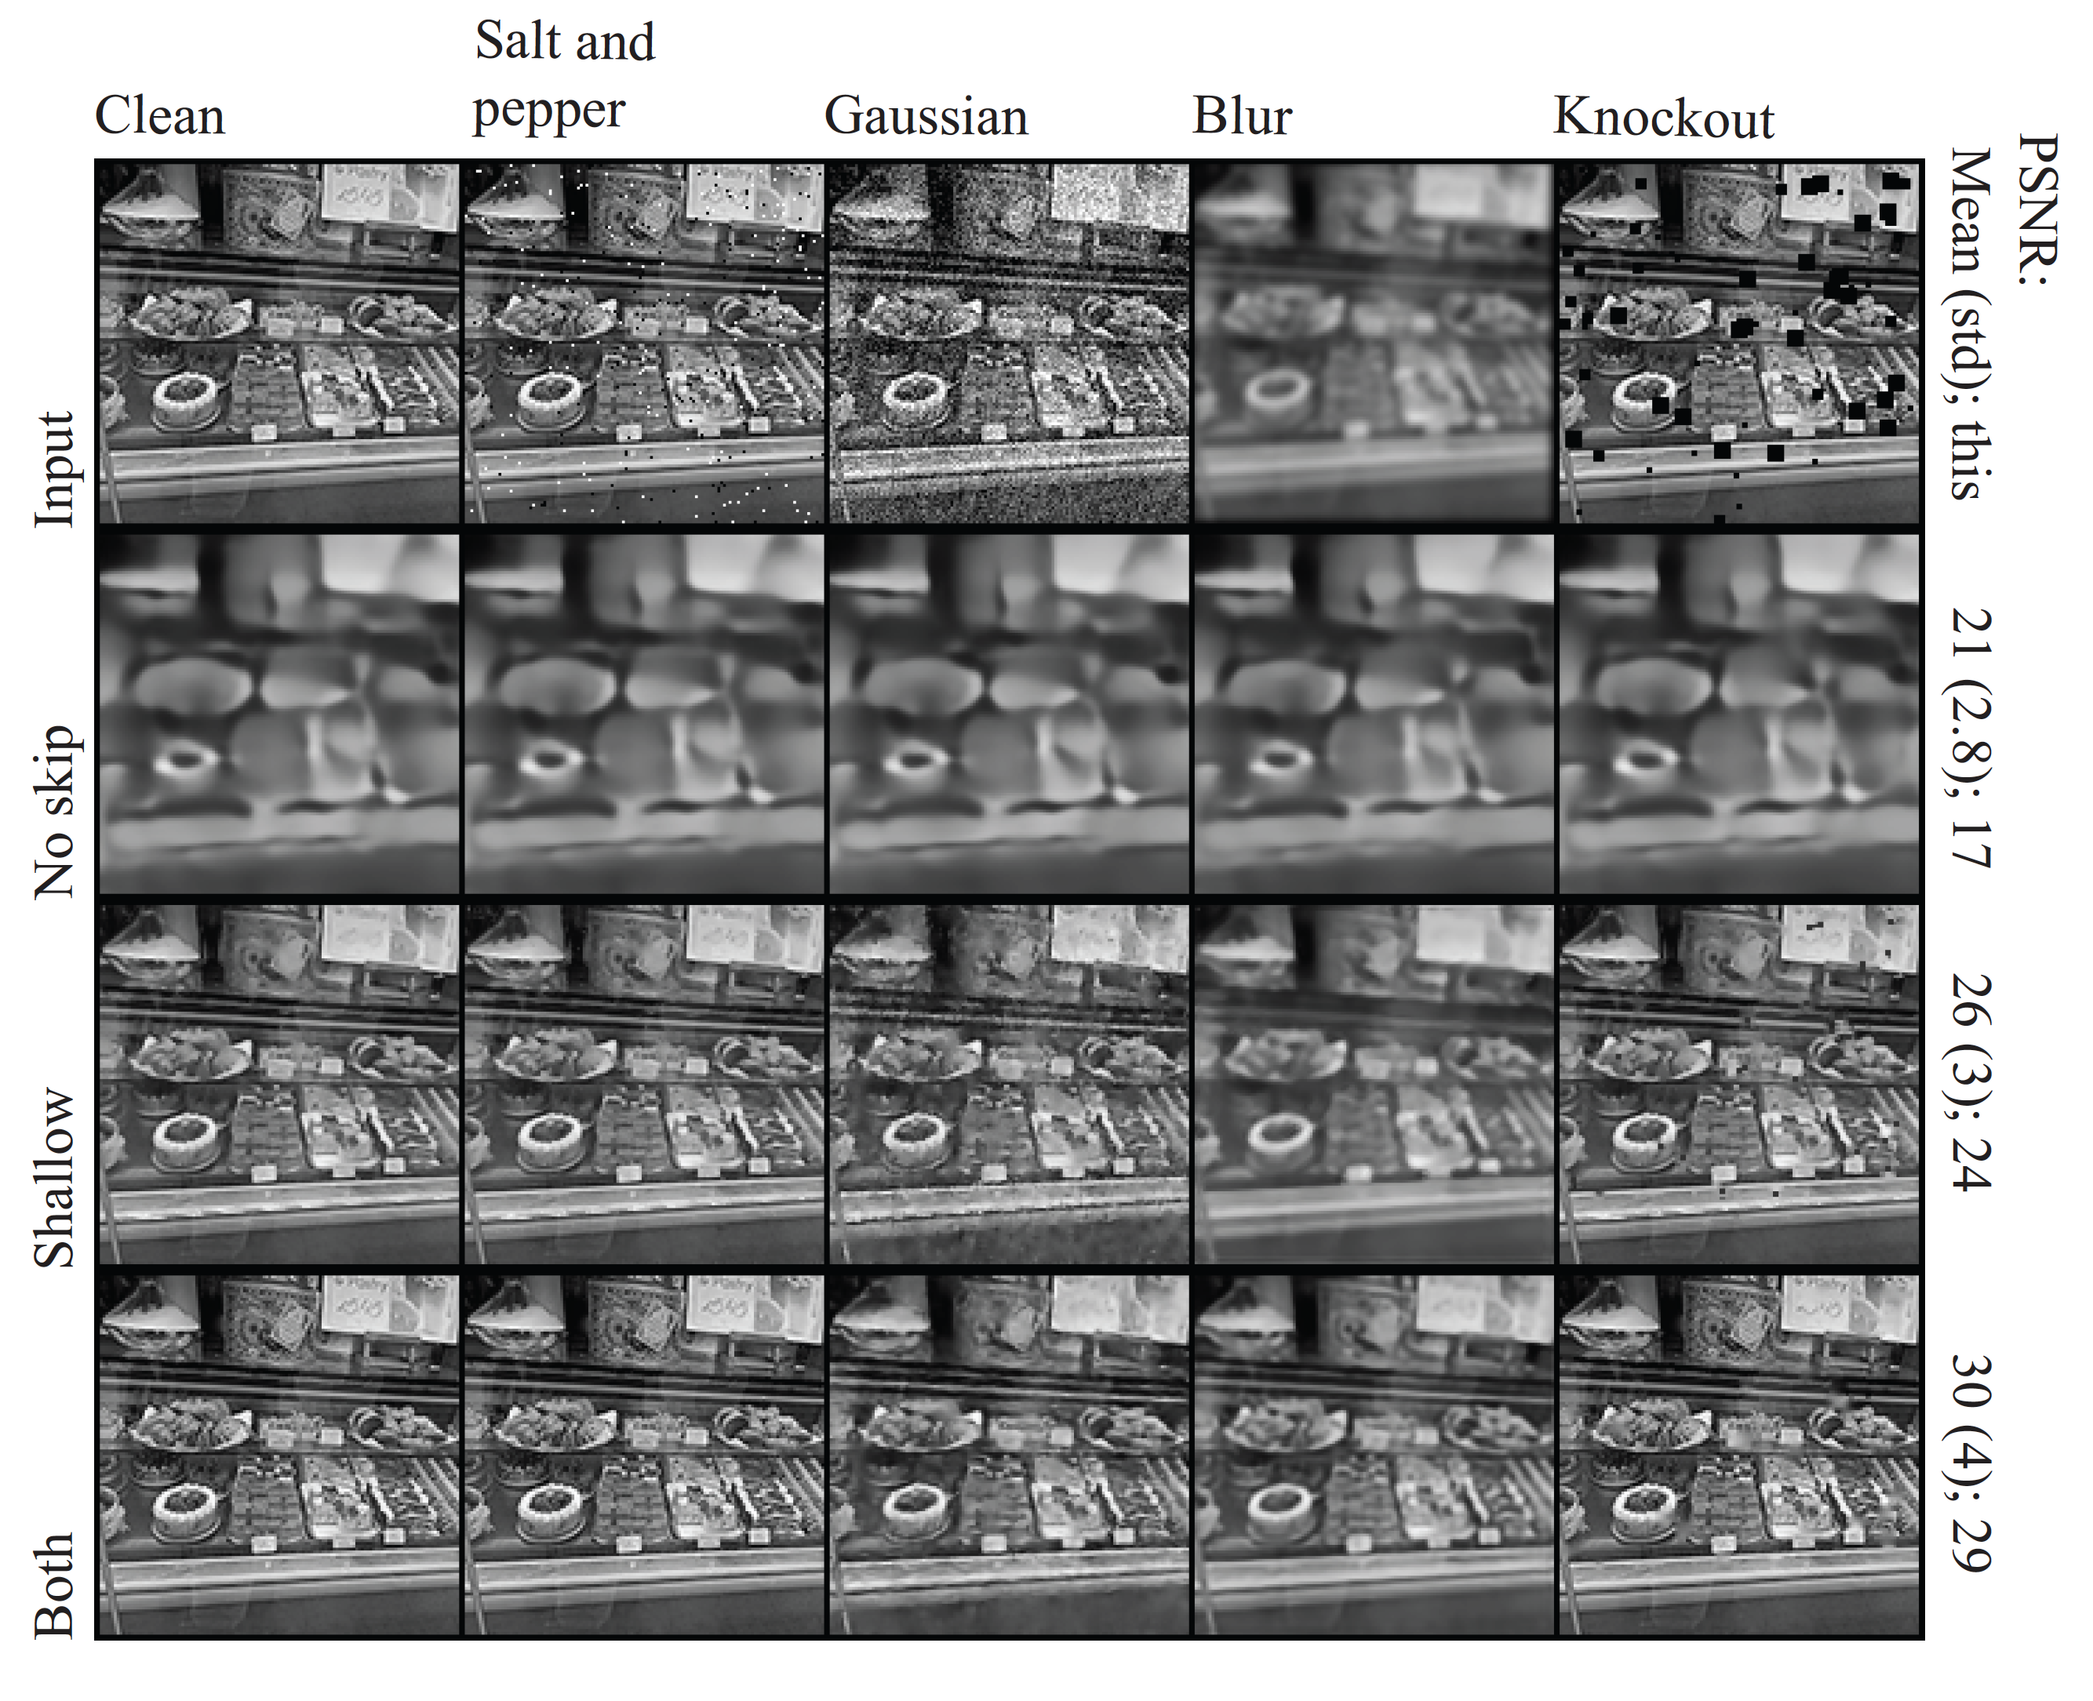

Slide 11
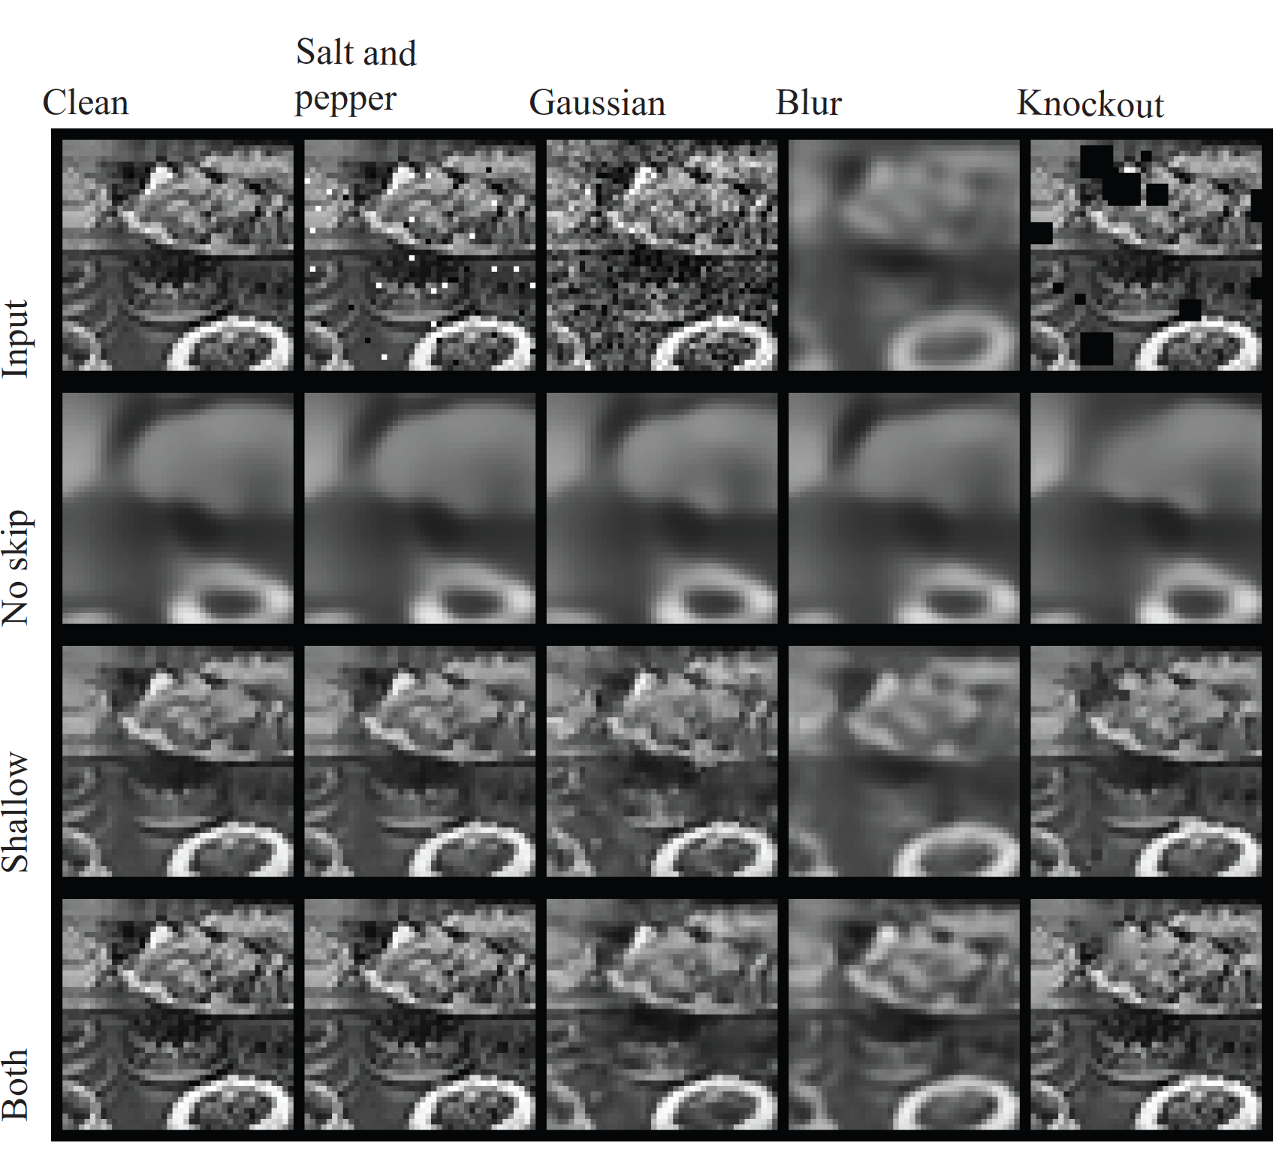

Slide 12
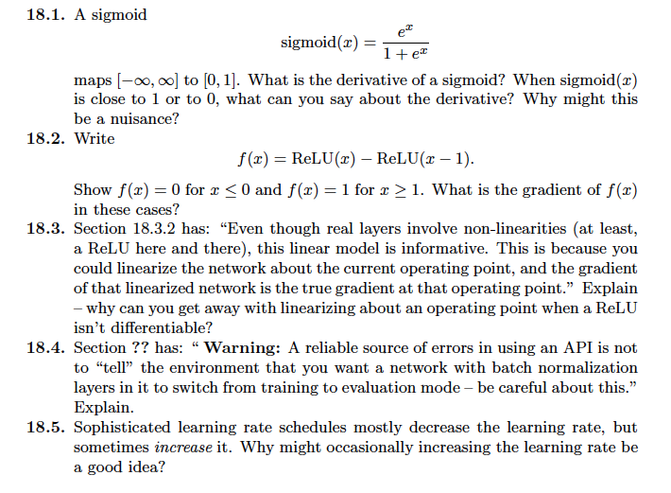
Things to think about

