Slide 1
Image processing basics
Many slides adapted from Alyosha Efros, Derek Hoiem
Andy Warhol, Marilyn Diptych, 1962 (source)

Slide 2
Image processing basics: Outline
Images as sampled functions
Sampling and reconstruction, aliasing
Image resampling, interpolation
Image transformations

Slide 3
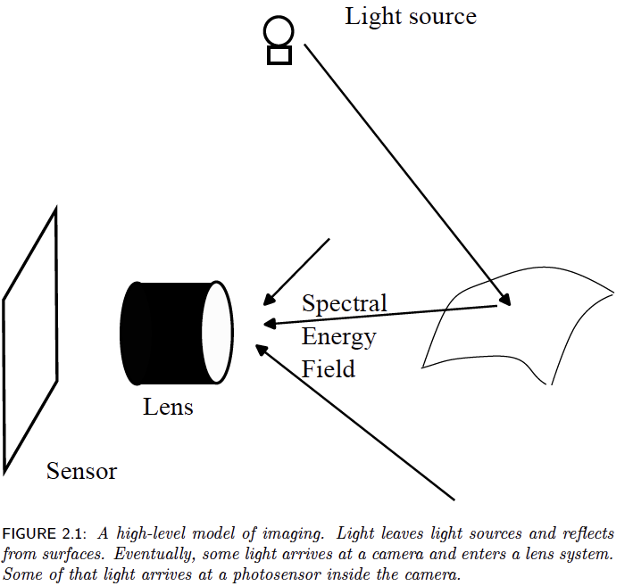

Slide 4
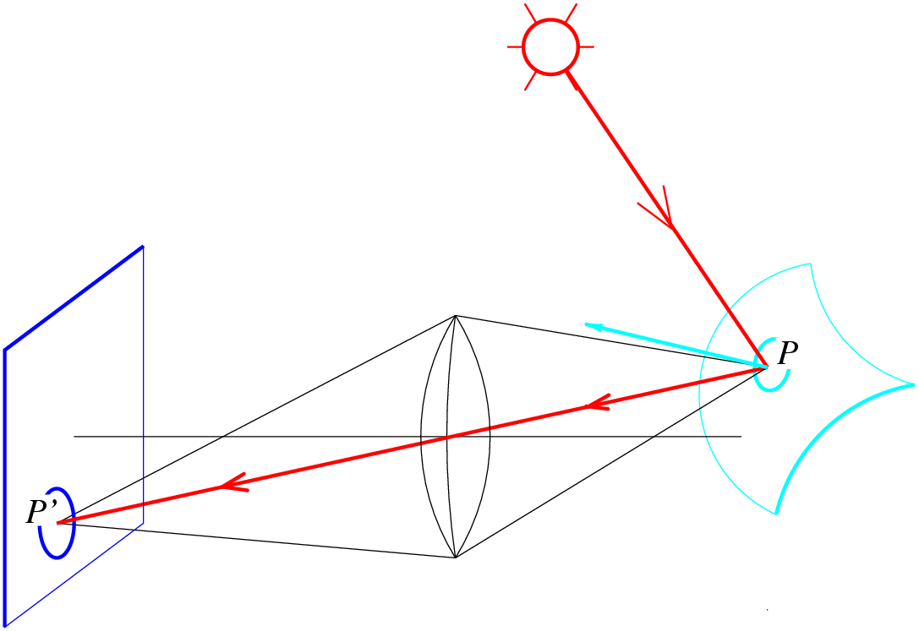
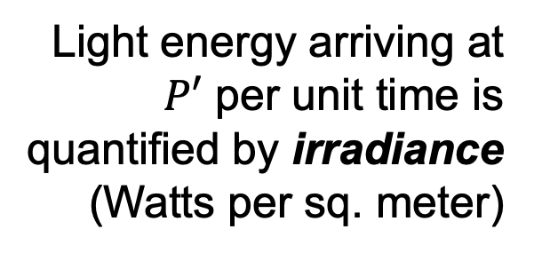
Image formation (preview)
What determines the brightness of an image pixel?
Light source(s)
Image plane
Scene surface
Light energy arriving at $P′$ per unit time is quantified by irradiance (Watts per sq. meter)
Strictly speaking, we need spectral irradiance to account for light across different wavelengths
Camera (lenses, shutter)
Notes:
Review slide (skip)

Slide 5
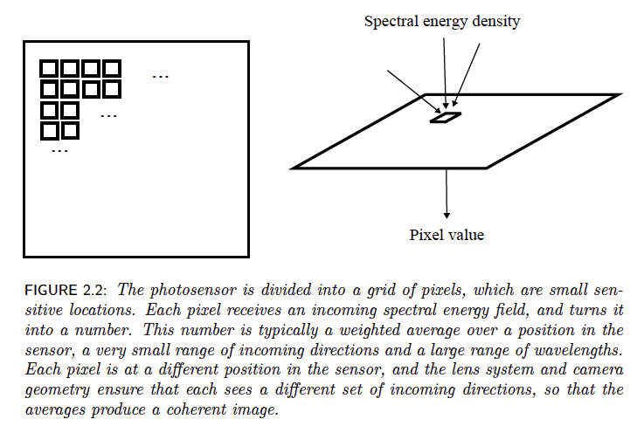

Slide 6
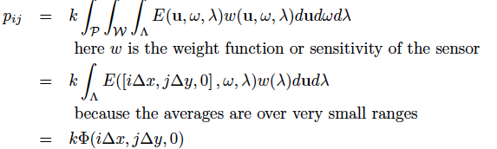

Slide 7
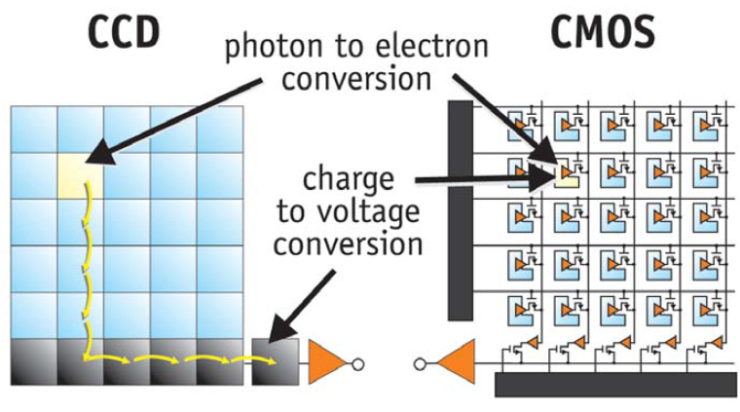
Images as sampled functions

Slide 8
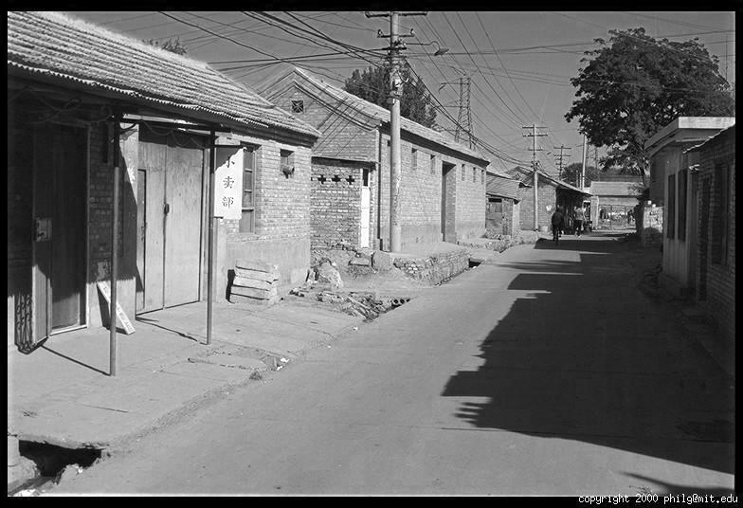
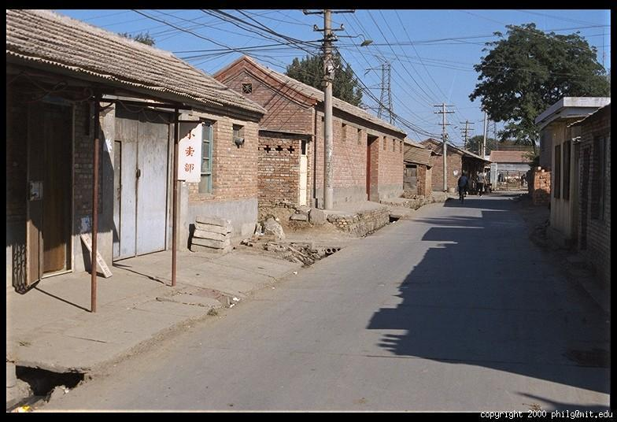
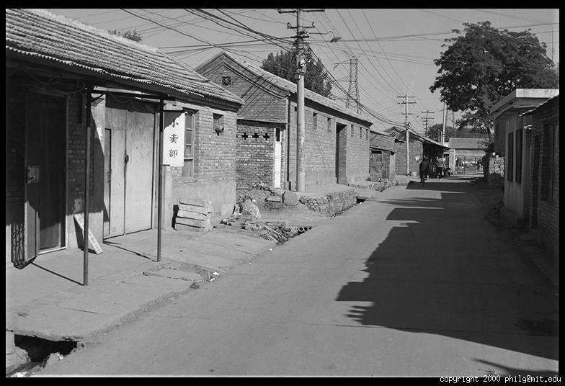
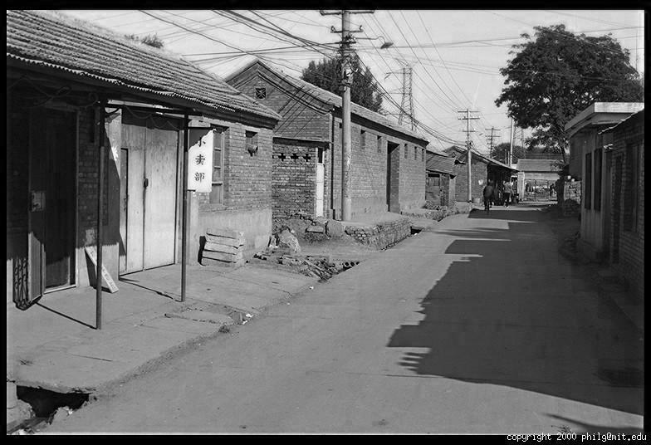
Digital color image
R
G
B

Slide 9
Images in Python
im = cv2.imread(filename) # read image
im = cv2.cvtColor(im, cv2.COLOR_BGR2RGB) # order channels as RGB
im = im / 255 # values range from 0 to 1
RGB image im is a H x W x 3 matrix (numpy.ndarray)
im[0,0,0] is the top-left pixel value in R-channel
im[y, x, c] is the value y+1 pixels down, x+1 pixels to right in the c^{th} channel
im[H-1, W-1, 2] is the bottom-right pixel in B-channel
column
row
R
0.92 | 0.93 | 0.94 | 0.97 | 0.62 | 0.37 | 0.85 | 0.97 | 0.93 | 0.92 | 0.99
0.95 | 0.89 | 0.82 | 0.89 | 0.56 | 0.31 | 0.75 | 0.92 | 0.81 | 0.95 | 0.91
0.89 | 0.72 | 0.51 | 0.55 | 0.51 | 0.42 | 0.57 | 0.41 | 0.49 | 0.91 | 0.92
0.96 | 0.95 | 0.88 | 0.94 | 0.56 | 0.46 | 0.91 | 0.87 | 0.90 | 0.97 | 0.95
0.71 | 0.81 | 0.81 | 0.87 | 0.57 | 0.37 | 0.80 | 0.88 | 0.89 | 0.79 | 0.85
0.49 | 0.62 | 0.60 | 0.58 | 0.50 | 0.60 | 0.58 | 0.50 | 0.61 | 0.45 | 0.33
0.86 | 0.84 | 0.74 | 0.58 | 0.51 | 0.39 | 0.73 | 0.92 | 0.91 | 0.49 | 0.74
0.96 | 0.67 | 0.54 | 0.85 | 0.48 | 0.37 | 0.88 | 0.90 | 0.94 | 0.82 | 0.93
0.69 | 0.49 | 0.56 | 0.66 | 0.43 | 0.42 | 0.77 | 0.73 | 0.71 | 0.90 | 0.99
0.79 | 0.73 | 0.90 | 0.67 | 0.33 | 0.61 | 0.69 | 0.79 | 0.73 | 0.93 | 0.97
0.91 | 0.94 | 0.89 | 0.49 | 0.41 | 0.78 | 0.78 | 0.77 | 0.89 | 0.99 | 0.93
G
0.92 | 0.93 | 0.94 | 0.97 | 0.62 | 0.37 | 0.85 | 0.97 | 0.93 | 0.92 | 0.99
0.95 | 0.89 | 0.82 | 0.89 | 0.56 | 0.31 | 0.75 | 0.92 | 0.81 | 0.95 | 0.91
0.89 | 0.72 | 0.51 | 0.55 | 0.51 | 0.42 | 0.57 | 0.41 | 0.49 | 0.91 | 0.92
0.96 | 0.95 | 0.88 | 0.94 | 0.56 | 0.46 | 0.91 | 0.87 | 0.90 | 0.97 | 0.95
0.71 | 0.81 | 0.81 | 0.87 | 0.57 | 0.37 | 0.80 | 0.88 | 0.89 | 0.79 | 0.85
0.49 | 0.62 | 0.60 | 0.58 | 0.50 | 0.60 | 0.58 | 0.50 | 0.61 | 0.45 | 0.33
0.86 | 0.84 | 0.74 | 0.58 | 0.51 | 0.39 | 0.73 | 0.92 | 0.91 | 0.49 | 0.74
0.96 | 0.67 | 0.54 | 0.85 | 0.48 | 0.37 | 0.88 | 0.90 | 0.94 | 0.82 | 0.93
0.69 | 0.49 | 0.56 | 0.66 | 0.43 | 0.42 | 0.77 | 0.73 | 0.71 | 0.90 | 0.99
0.79 | 0.73 | 0.90 | 0.67 | 0.33 | 0.61 | 0.69 | 0.79 | 0.73 | 0.93 | 0.97
0.91 | 0.94 | 0.89 | 0.49 | 0.41 | 0.78 | 0.78 | 0.77 | 0.89 | 0.99 | 0.93
B
0.92 | 0.93 | 0.94 | 0.97 | 0.62 | 0.37 | 0.85 | 0.97 | 0.93 | 0.92 | 0.99
0.95 | 0.89 | 0.82 | 0.89 | 0.56 | 0.31 | 0.75 | 0.92 | 0.81 | 0.95 | 0.91
0.89 | 0.72 | 0.51 | 0.55 | 0.51 | 0.42 | 0.57 | 0.41 | 0.49 | 0.91 | 0.92
0.96 | 0.95 | 0.88 | 0.94 | 0.56 | 0.46 | 0.91 | 0.87 | 0.90 | 0.97 | 0.95
0.71 | 0.81 | 0.81 | 0.87 | 0.57 | 0.37 | 0.80 | 0.88 | 0.89 | 0.79 | 0.85
0.49 | 0.62 | 0.60 | 0.58 | 0.50 | 0.60 | 0.58 | 0.50 | 0.61 | 0.45 | 0.33
0.86 | 0.84 | 0.74 | 0.58 | 0.51 | 0.39 | 0.73 | 0.92 | 0.91 | 0.49 | 0.74
0.96 | 0.67 | 0.54 | 0.85 | 0.48 | 0.37 | 0.88 | 0.90 | 0.94 | 0.82 | 0.93
0.69 | 0.49 | 0.56 | 0.66 | 0.43 | 0.42 | 0.77 | 0.73 | 0.71 | 0.90 | 0.99
0.79 | 0.73 | 0.90 | 0.67 | 0.33 | 0.61 | 0.69 | 0.79 | 0.73 | 0.93 | 0.97
0.91 | 0.94 | 0.89 | 0.49 | 0.41 | 0.78 | 0.78 | 0.77 | 0.89 | 0.99 | 0.93
How are the three color channels acquired?

Slide 10
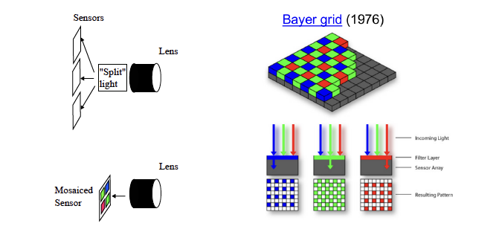
Acquiring 3 channels

Slide 11
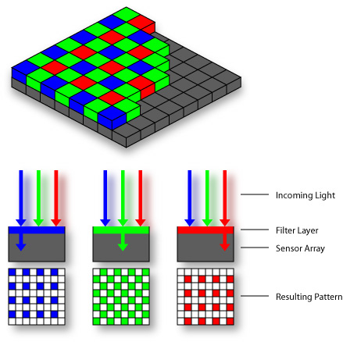
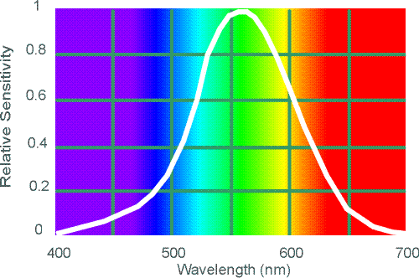

How are the three channels acquired?
Bayer grid (1976)
Why more green?
Human Luminance Sensitivity Function
Demosaicing:
Estimation of missing components from neighboring values
HOW? - shortly!
Source: Wikipedia

Slide 12

Images as sampled functions
We like to think of a digital image as a sampled representation of a continuous function $f(x,y)$ defined over a continuous 2D domain
Notes:
Render with scanalyze????

Slide 13
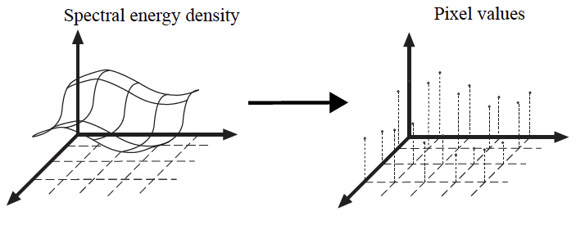
Sampling

Slide 14
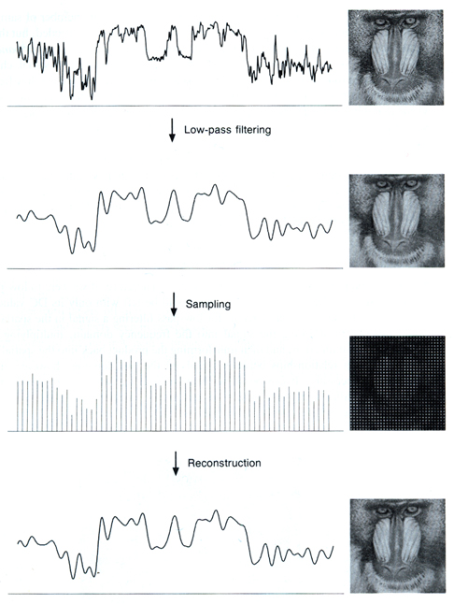
Sampling and reconstruction
  Sampling: recording the function’s values at a discrete set of locations
  Reconstruction: converting a sampled representation back into a continuous function by “guessing” what happens between the samples
Source: S. Marschner (via A. Efros)

Slide 15
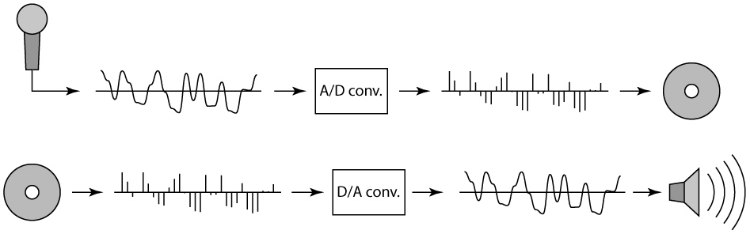
1D example: Digital audio
Recording: sound to analog to samples to disc
Playback: disc to samples to analog to sound again
Source: S. Marschner (via A. Efros)

Slide 16
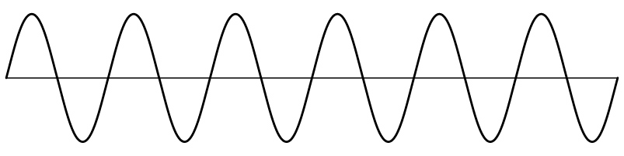
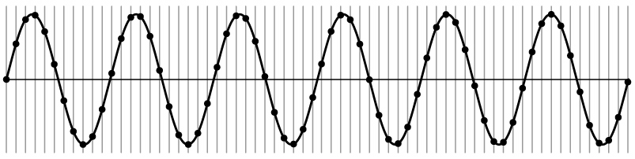
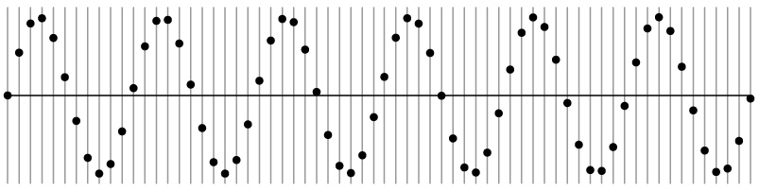
Sampling and reconstruction
Simple example: a sine wave
Source: S. Marschner (via A. Efros)

Slide 17
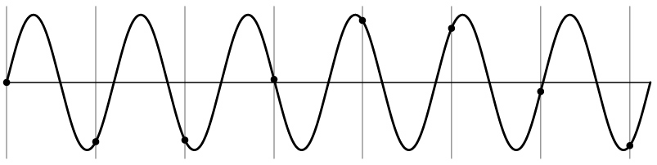
Sampling and reconstruction
Simple example: a sine wave
What if we “missed” things between the samples?
  Unsurprising result: information is lost
Source: S. Marschner (via A. Efros)

Slide 18

Sampling and reconstruction
Simple example: a sine wave
What if we “missed” things between the samples?
  Unsurprising result: information is lost
  Surprising result: indistinguishable from lower frequencies
Source: S. Marschner (via A. Efros)

Slide 19
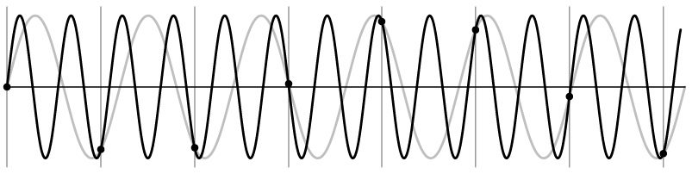
Sampling and reconstruction
Simple example: a sine wave
What if we “missed” things between the samples?
  Unsurprising result: information is lost
  Surprising result: indistinguishable from lower frequencies
  (or even higher frequencies)
Source: S. Marschner (via A. Efros)

Slide 20
Sampling and reconstruction
Simple example: a sine wave
What if we “missed” things between the samples?
  Unsurprising result: information is lost
  Surprising result: indistinguishable from lower frequencies
  (or even higher frequencies)
  Aliasing: signal “traveling in disguise” as other frequencies
Source: S. Marschner (via A. Efros)

Slide 21
Wagon wheel effect
Actual motion
Perceived motion
https://en.wikipedia.org/wiki/Wagon-wheel_effect
https://maycontainmaths.wordpress.com/2015/02/22/the-wagon-wheel-effect/

Slide 22
Wagon wheel effect
Actual motion
Perceived motion
https://en.wikipedia.org/wiki/Wagon-wheel_effect
https://maycontainmaths.wordpress.com/2015/02/22/the-wagon-wheel-effect/

Slide 23
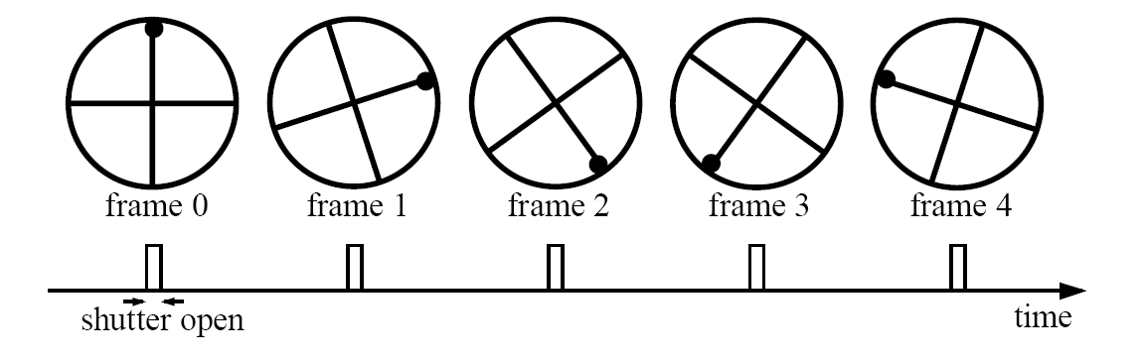
Wagon wheel effect
Without dot, wheel appears to be slowly rotating backwards!
Source: S. Seitz (via A. Efros)

Slide 24
Aliasing in images

Slide 25
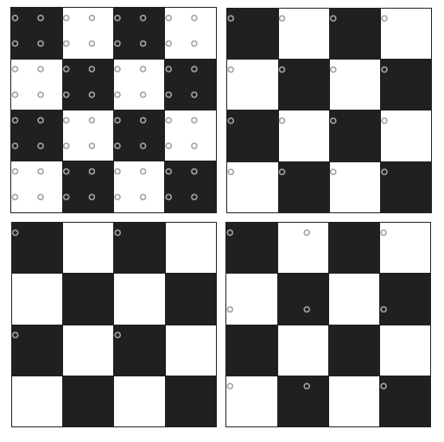
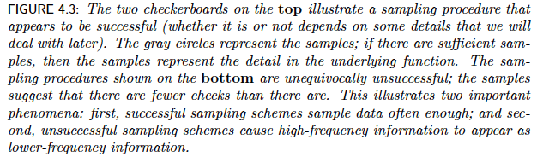
What’s happening?

Slide 26
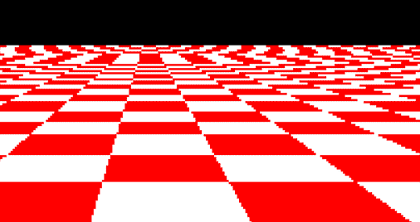
Aliasing “in the wild”
Disintegrating textures
Moire patterns, false color
Source
Source
Source

Slide 27
Nyquist-Shannon sampling theorem
When sampling a signal at discrete intervals, the sampling frequency must be at least twice the maximum frequency of the input signal to allow us to reconstruct the original perfectly from the sampled version
bad
good
https://en.wikipedia.org/wiki/Nyquist-Shannon_sampling_theorem

Slide 28
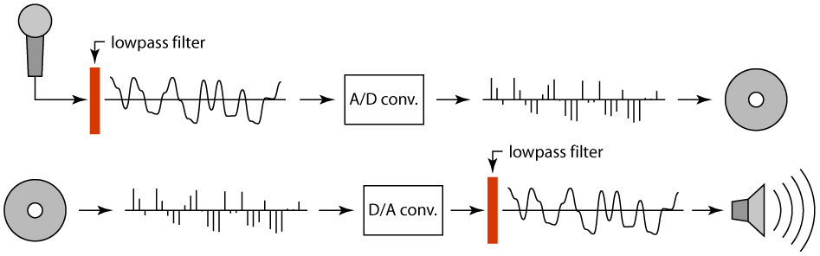
Anti-aliasing
What are possible solutions?
  Sample more often (if you can)
  Get rid of all frequencies that are greater than half the new sampling frequency
    Will lose information, but that’s better than aliasing
    How to get rid of high frequencies?
      Apply a smoothing or low-pass filter (later)

Slide 29
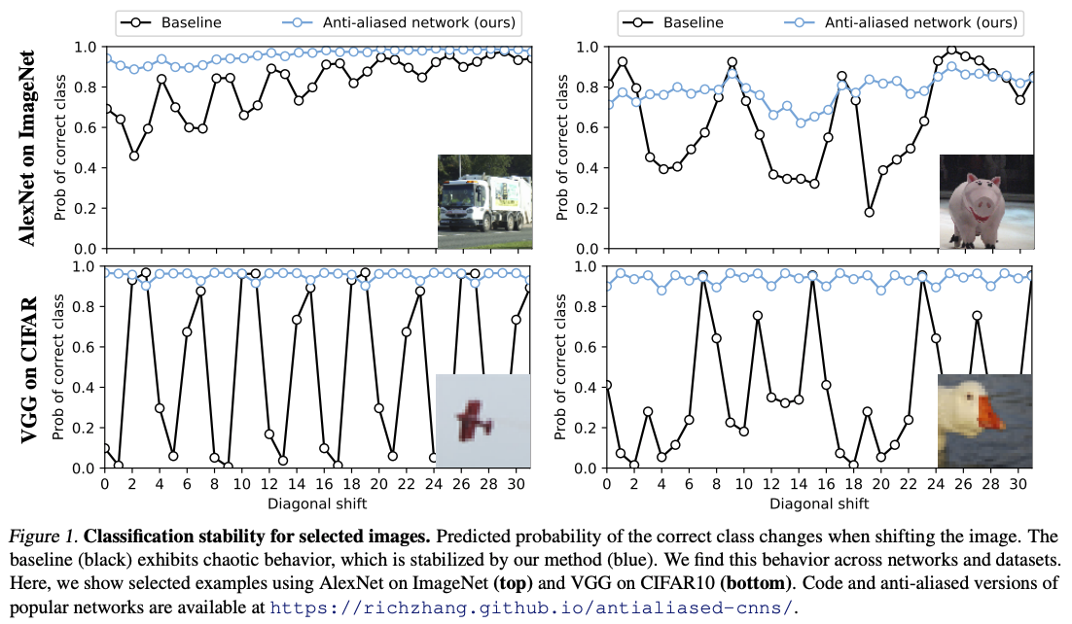
Why should you care about anti-aliasing?
R. Zhang. Making convolutional networks shift-invariant again. ICML 2019

Slide 30
Image processing basics: Outline
Images as sampled functions
Sampling and reconstruction, aliasing
Image resampling, interpolation

Slide 31
Subsampling an image
How do we reduce the size of an image by a factor of two?

Slide 32
Subsampling an image
How do we reduce the size of an image by a factor of two?
  How about throwing away every other row and column to create a half-size image?

Slide 33
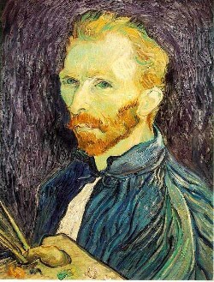
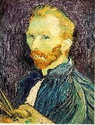

Subsampling without pre-filtering
1/2
1/4 (2x zoom)
1/8 (4x zoom)
Source: S. Seitz (via D. Hoiem)

Slide 35



Subsampling with pre-filtering
1/2
1/4
1/8
Image is smoothed with a Gaussian filter before subsampling
Source: S. Seitz (via D. Hoiem)

Slide 36
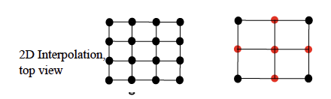
Interpolation
Downsample to 3x3:
Must supply red pixels
Procedures:
-nearest neighbor value
-bilinear interpolation
-other interpolation
4x4

Slide 37
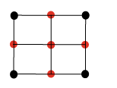

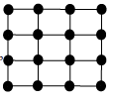
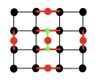
Linear and Bilinear Interpolation
Known
?
Unknown
Known
f(t)=(1-t)f(0)+t f(1)
4x4
3x3
In 1D

Slide 38
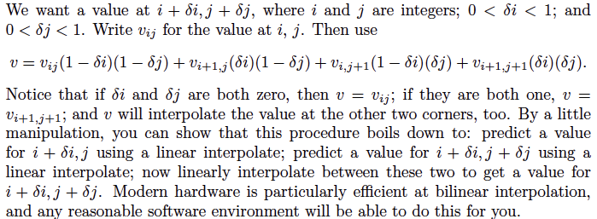
Bilinear interpolation

Slide 39
Upsampling an image
How do we increase the size of an image by a factor of two?
Let’s increase the resolution of the sampling grid!

Slide 40
Upsampling an image
How do we increase the size of an image by a factor of two?
What should this value be?
Need to interpolate!

Slide 41

















Upsampling an image
How do we increase the size of an image by a factor of two?
$$(0,0)$$
$$(1,0)$$
$$(2,0)$$
$$(3,0)$$
$$f\left(0.5, 0.5\right)=?$$
$$(0,1)$$
$$(1,1)$$
$$(2,1)$$
$$(3,1)$$
$$(0,2)$$
$$(1,2)$$
$$(2,2)$$
$$(3,2)$$
$$(0,3)$$
$$(1,3)$$
$$(2,3)$$
$$(3,3)$$

Slide 42
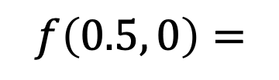
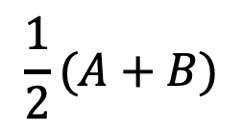
Bilinear interpolation
Let $f\left(0, 0\right)=A, f\left(1, 0\right)=B, f\left(0, 1\right)=C, f\left(1, 1\right)=D$
A
B
$$\frac{1}{2}(A+B)$$
$$f\left(0.5, 0\right)=$$
C
D

Slide 43
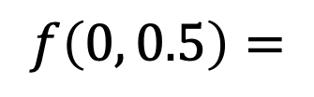
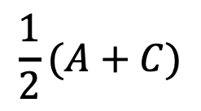
Bilinear interpolation
Let $f\left(0, 0\right)=A, f\left(1, 0\right)=B, f\left(0, 1\right)=C, f\left(1, 1\right)=D$
A
B
$$\frac{1}{2}(A+C)$$
$$f\left(0, 0.5\right)=$$
C
D

Slide 44
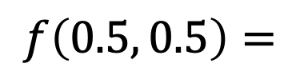
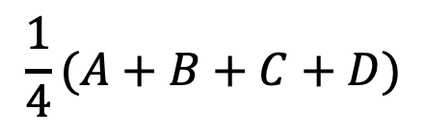
Bilinear interpolation
Let $f\left(0, 0\right)=A, f\left(1, 0\right)=B, f\left(0, 1\right)=C, f\left(1, 1\right)=D$
A
B
$$f\left(0.5, 0.5\right)=$$
C
D
$$\frac{1}{4}(A+B+C+D)$$

Slide 45
Application: Demosaicing

Slide 46
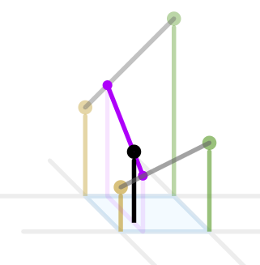
Bilinear interpolation more generally
B
A
D
C
http://en.wikipedia.org/wiki/Bilinear_interpolation

Slide 47

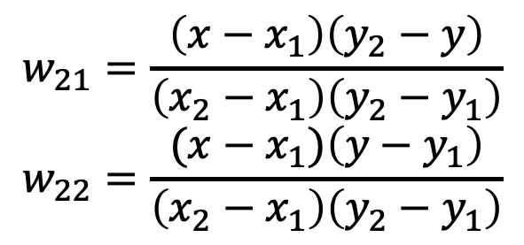
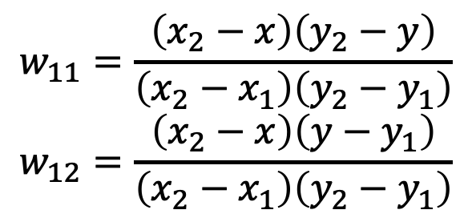



Bilinear interpolation more generally
$$\left(x_{1},y_{1}\right)$$
$$\left(x_{2},y_{1}\right)$$
A
B
$$f\left(x,y\right)=w_{11}A+w_{21}B{+w}_{12}C+w_{22}D$$
C
D
$$\left(x_{1},y_{2}\right)$$
$$\left(x_{2},y_{2}\right)$$
$$w_{11}=\frac{\left(x_{2}−x\right)\left(y_{2}−y\right)}{\left(x_{2}−x_{1}\right)\left(y_{2}−y_{1}\right)}$$
$$w_{12}=\frac{\left(x_{2}−x\right)\left(y−y_{1}\right)}{\left(x_{2}−x_{1}\right)\left(y_{2}−y_{1}\right)}$$
$$w_{21}=\frac{\left(x−x_{1}\right)\left(y_{2}−y\right)}{\left(x_{2}−x_{1}\right)\left(y_{2}−y_{1}\right)}$$
$$w_{22}=\frac{(x−x_{1})\left(y−y_{1}\right)}{\left(x_{2}−x_{1}\right)\left(y_{2}−y_{1}\right)}$$
http://en.wikipedia.org/wiki/Bilinear_interpolation

Slide 48
Bilinear interpolation: Basis function view
Interpolated function is sum of basis functions or “bumps” centered at the four adjacent grid points, weighted by the image values at the corresponding points
B
Bilinear basis function
A
D
C

Slide 49
Other kinds of interpolation
Source: Wikipedia

Slide 50
Interpolation and function extrema
When you use linear interpolation, extrema of the image function can only occur at the original sample points
What about nonlinear interpolation?
Image source

Slide 51
Image processing basics: Outline
Images as sampled functions
Sampling and reconstruction, aliasing
Image resampling, interpolation
Image transformations

Slide 52
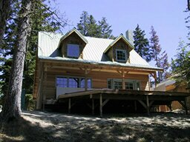
Image transformations
Downsampling
T

Slide 53
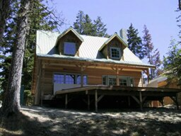
Image transformations
Upsampling
T

Slide 54
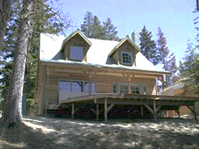
Image transformations
Contrast change
T

Slide 55

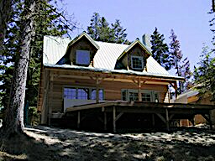
Image transformations
Blurring/sharpening
T

Slide 56
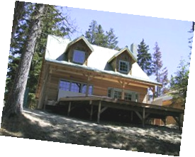
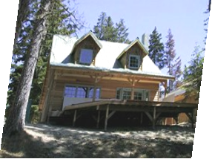


Image transformations
Warping
T

Slide 57
Point processing
Change range of image:
  Apply the same function to each pixel value
Many applications
Common
  Linear sensors produce strange pictures
    The world has high dynamic range, 8 bits is too few
    Typically 12 bit sensor, 8 bit image
  Most cameras process sensor results before they report them

Slide 58

From wikipedia

Slide 59

From wikipedia

Slide 60

From wikipedia

Slide 61


Slide 62

Negative

Slide 63

Contrast adjustment

Slide 64

Gamma correction

Slide 65


Point processing
Change range of image: $g = T(f)$
Affine contrast adjustment: $g=af+b$
f
g
T
x
x
f
g
T

Slide 66


Point processing
Change range of image: $g = T(f)$
Piecewise-linear contrast adjustment:
f
g
T
x
x

Slide 67




Point processing
Change range of image: $g = T(f)$
Gamma correction: $g=af^{γ}$
f
g
T
x
x
$$γ=1/2$$
Original
$$γ=2$$
Source

Slide 68

Image filtering
Roughly speaking, replace image value at $x$ with some function of values in its spatial neighborhood $N(x)$:
$$g(x) = T(f(N(x)))$$
f
g
T
N(x)
x

Slide 69

Image filtering
Roughly speaking, replace image value at $x$ with some function of values in its spatial neighborhood $N(x)$:
$$g(x) = T(f(N(x)))$$
f
g
T
Examples: smoothing, sharpening, edge detection, etc.

Slide 70

Image warping
Change domain of image:
$x^{′}=T\left(x\right), g(x′) = f(x)$
f
g
T
x
T(x)

Slide 71
Image warping
Change domain of image:
$x^{′}=T\left(x\right), g(x′) = f(x)$
f
g
T

Slide 72
Image warping
Examples of global parametric warps:
scaling (uniform or non-uniform)
translation
rotation
perspective homography
affine
cylindrical (not covered in this class)

Slide 73


Slide 74



Parametric (global) warping
T
$$p = (x,y)$$
$$p′ = (x′,y′)$$
Transformation $T$ is a coordinate-changing machine:
$$p^{′}= T\left(p\right)$$
$T$ is global: it is the same for any point $p$ and can be described by just a few numbers (parameters)

Slide 75

Translation

Slide 76

Rotation

Slide 77












Rotation
Rotate the image by an angle of $θ$about the origin:
$$x′ = r cos⁡(φ+θ)$$
$$y′ = r sin⁡(φ+θ)$$
$$= r cos⁡(φ) cos⁡(θ) – r sin⁡(φ) sin⁡(θ)$$
$$= x cos⁡(θ) − y sin⁡(θ)$$
$$= r sin⁡(φ) cos⁡(θ) + r cos⁡(φ) sin⁡(θ)$$
$$= x sin⁡(θ) + y cos⁡(θ)$$
$$(x′, y′)$$
Apply trig identities
Substitute
$$x = r cos⁡(φ)$$
$$y = r sin⁡(φ)$$
$$(x, y)$$
$$r$$
$$θ$$
$$φ$$

Slide 78







Rotation
Rotate the image by an angle of $θ$about the origin:
$$x′= x cos⁡(θ) − y sin⁡(θ)$$
$$y′= x sin⁡(θ) + y cos⁡(θ)$$
$$(x′, y′)$$
$$(x, y)$$
In matrix form:
$\left(\begin{aligned}x′ \\ y′\end{aligned}\right)=\left[\begin{matrix}cos⁡(θ) & −sin⁡(θ) \\ sin⁡(θ) & cos⁡(θ)\end{matrix}\right]$ $\left(\begin{aligned}x \\ y\end{aligned}\right)$
$$θ$$

Slide 79



Rotation
2D rotation in matrix form:
Note: even though $cos⁡(θ)$ and $sin⁡(θ)$ are nonlinear functions of $θ$, $x′$ and $y′$ are linear combinations of $x$ and $y$
What is the inverse transformation?
  Rotation by –$θ$
  For rotation matrices, $R^{−1}=R^{T}$
$\left(\begin{aligned}x′ \\ y′\end{aligned}\right)=\left[\begin{matrix}cos⁡(θ) & −sin⁡(θ) \\ sin⁡(θ) & cos⁡(θ)\end{matrix}\right]$ $\left(\begin{aligned}x \\ y\end{aligned}\right)$
$$R⁡(θ)$$

Slide 80

Uniform scaling

Slide 81

Non-uniform scaling

Slide 82

Affine transformation

Slide 83

Projective transformation

Slide 84


Translation
$$x^{′}=x+t_{x} \\ y^{′}=y+t_{y}$$
$$tx = 2 \\ ty = 1$$

Slide 85


Uniform scaling
$$x^{′}=s∗x \\ y^{′}=s∗y$$
$$s = 2$$

Slide 86



Non-uniform scaling
$$x^{′}=s_{x}∗x \\ y^{′}=s_{y}∗y$$
In matrix form:
$\left(\begin{aligned}x′ \\ y′\end{aligned}\right)=\left[\begin{matrix}s_{x} & 0 \\ 0 & s_{y}\end{matrix}\right]$ $\left(\begin{aligned}x \\ y\end{aligned}\right)$
$s_{x}$ = 2,
$s_{y}=$ 0.5

Slide 87

Rotation
Rotate the image by an angle of $θ$about the origin:
$$θ$$

Slide 88


Affine transformation
Combination of translation, non-uniform scaling, rotation, and shear
$\left(\begin{aligned}x′ \\ y′\end{aligned}\right)=\left[\begin{matrix}a & b \\ c & d\end{matrix}\right]$ $\left(\begin{aligned}x \\ y\end{aligned}\right)+\left(\begin{aligned}e \\ f\end{aligned}\right)$

Slide 89

Projective homography
A transformation that preserves straight lines, but not parallelism
$$x^{′}=\frac{ax+by+c}{gx+hy+i}, y^{′}=\frac{dx+ey+f}{gx+hy+i}$$

Slide 90




Warping pixels
Given a coordinate transform $(x′,y′) = T(x,y)$ and a source image $f(x,y)$, how do we compute a transformed image $g(x′,y′) = f(T(x,y))$?
T(x,y)
y
$$y′$$
x
$$x′$$
f(x,y)
$$g(x′,y′)$$

Slide 91

Forward warping
Send each pixel $f(x,y)$ to its corresponding location $(x′,y′) = T(x,y)$ in the second image
T(x,y)
y
$$y′$$
x
$$x′$$
f(x,y)
$$g(x′,y′)$$

Slide 92

Forward warping
Send each pixel $f(x,y)$ to its corresponding location $(x′,y′) = T(x,y)$ in the second image
  What if $(x′,y′)$is not an integer location on the pixel grid?
  We can “distribute” colors among the neighboring grid locations – known as splatting
  Often (usually) holes in target image!
T(x,y)
y
$$y′$$
x
$$x′$$
f(x,y)
$$g(x′,y′)$$

Slide 93


Inverse warping
For each pixel grid location $(x′,y′)$ in the second image, get the color from its corresponding location $\left(x,y\right)= T^{−1}\left(x^{′},y^{′}\right)$
in the first image
$$T^{−1}(x′,y′)$$
y
$$y′$$
x
$$x′$$
f(x,y)
$$g(x′,y′)$$

Slide 94

Inverse warping
For each pixel grid location $(x′,y′)$ in the second image, get the color from its corresponding location $\left(x,y\right)= T^{−1}\left(x^{′},y^{′}\right)$
in the first image
  What if $\left(x,y\right)$ is not an integer location on the original pixel grid?
  Interpolate!
$$T^{−1}(x′,y′)$$
y
$$y′$$
x
$$x′$$
f(x,y)
$$g(x′,y′)$$

Slide 95
Forward vs. inverse warping
Which is better?
  Usually inverse: more efficient, doesn’t have a problem with holes
  However, it requires an invertible warp function, which is not always possible

Slide 96
Images relative to other images:
Principal components analysis can be applied to images
(sometimes useful)

Slide 97

Principal components analysis:

Slide 98


Principal components analysis:

Slide 99


Slide 100



Slide 101


