Slide 1
A gentle introduction to Fourier analysis
Image source
Many slides borrowed from S. Seitz, A. Efros, D. Hoiem, B. Freeman, A. Zisserman

Slide 2
Mystery 1
Why can downsampling sometimes lead to aliasing?

Slide 3


Mystery 2
Why does filtering with a Gaussian give a nice smooth image, but filtering with a box filter gives artifacts?
Gaussian
Box filter
Notes:
Things we can’t understand without thinking in frequency
3

Slide 4
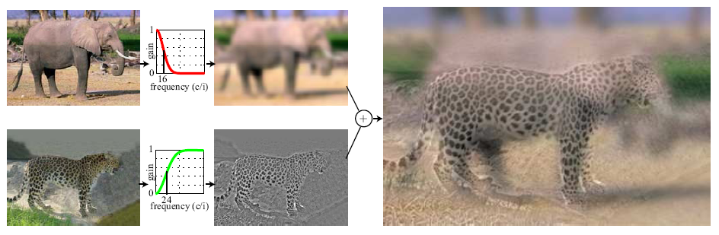
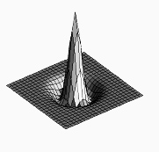

Mystery 3
How do hybrid images work?
“Low frequencies”
“High frequencies”
A. Oliva, A. Torralba, P.G. Schyns, Hybrid Images, SIGGRAPH 2006

Slide 5
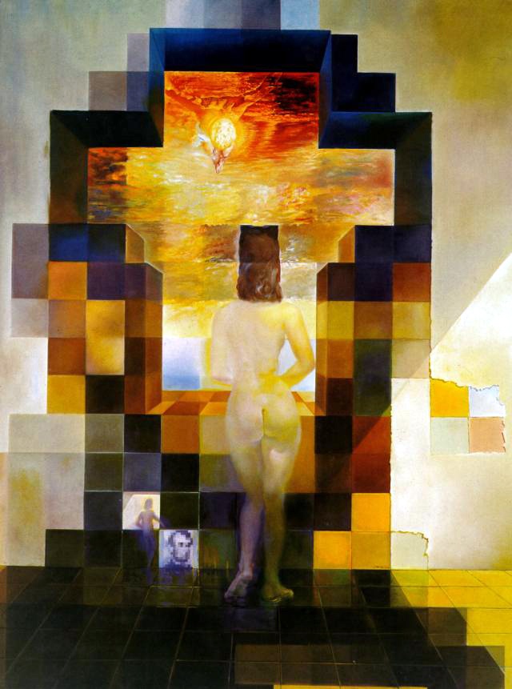
Salvador Dali
“Gala Contemplating the Mediterranean Sea,
which at 30 meters becomes the portrait
of Abraham Lincoln”, 1976

Slide 6
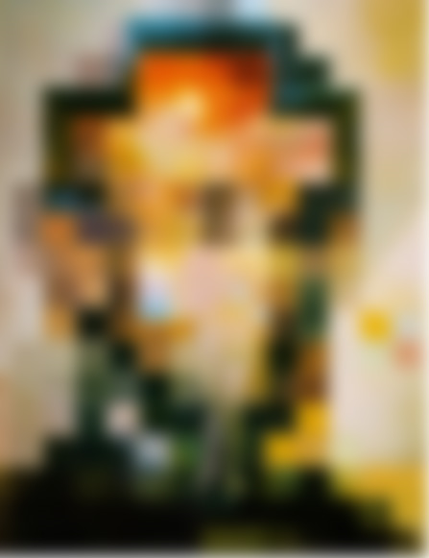

Slide 8
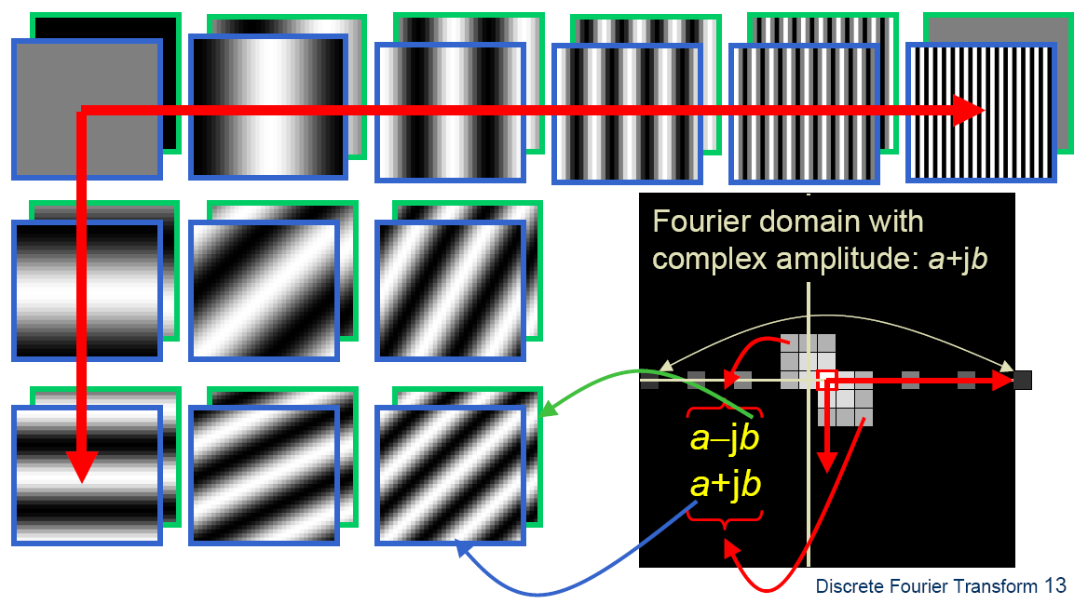

Fourier analysis
To understand such phenomena, we need a representation of images that allows us to tease apart slow and fast changes

Slide 9
Outline
Fourier series
1D Fourier transform
  Definition and properties
  Discrete Fourier transform
2D Fourier transform
  Definition
  Examples and properties
Convolution theorem
Understanding the sampling theorem

Slide 10
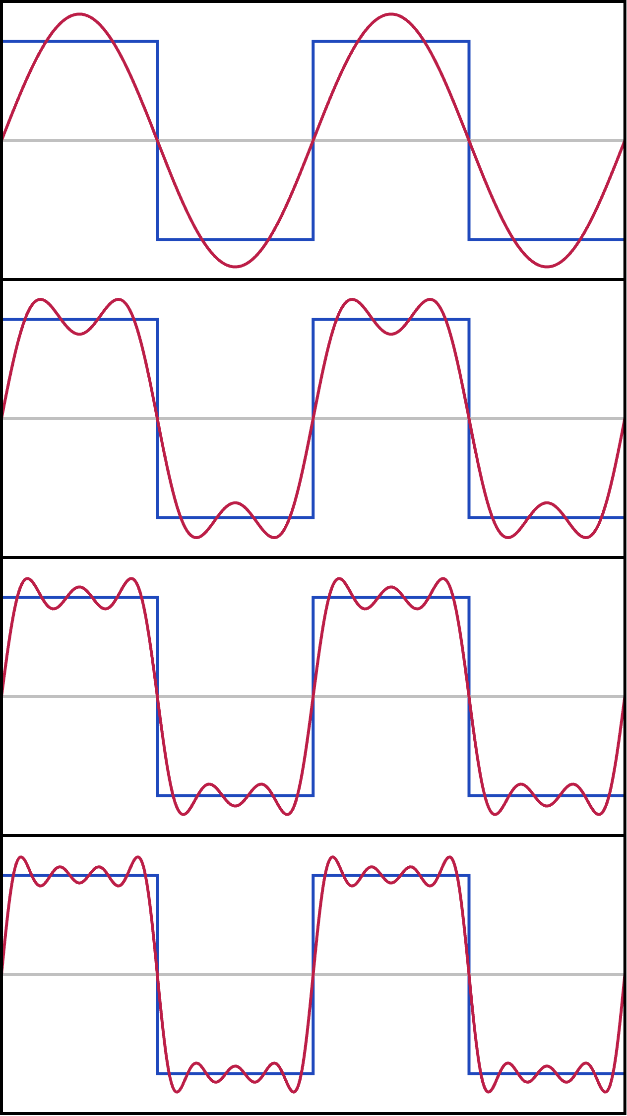
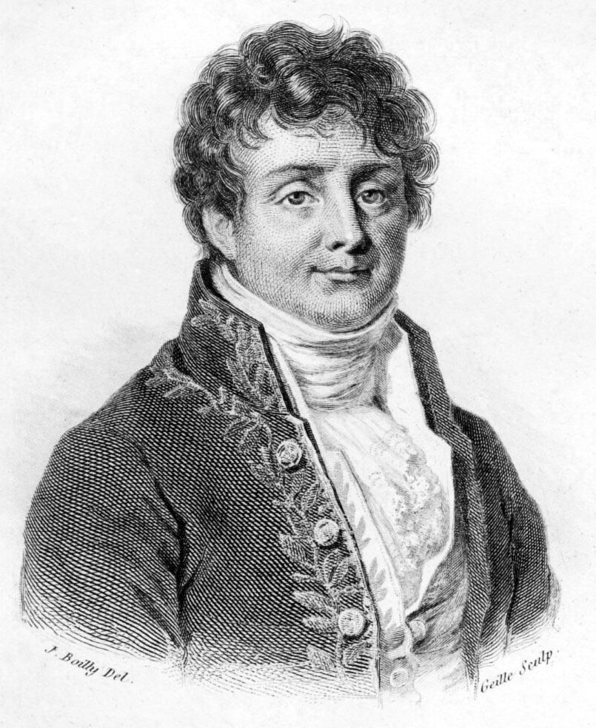
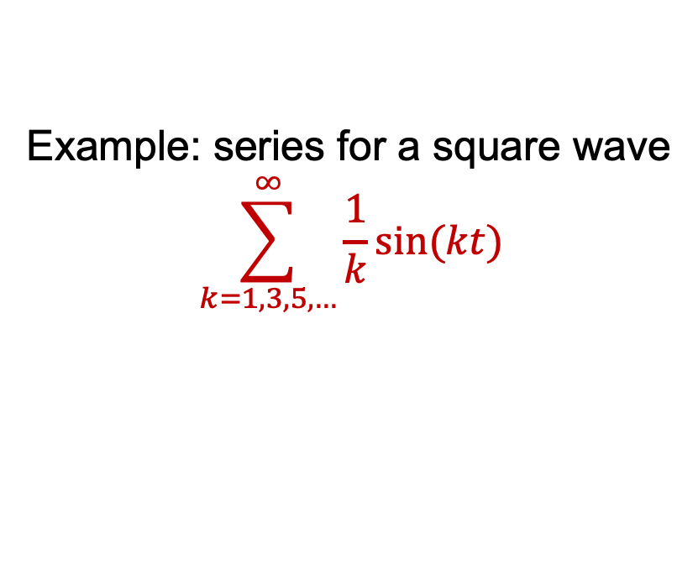
Fourier series
Any(**) periodic function on
[0, 1] can be expressed as a weighted sum of sinusoids of different frequencies (1807)
Example: series for a square wave
$$\sum_{k=1,3,5,…}^{∞}{\frac{1}{k}sin⁡(kt)}$$
**=bunch of
important details
here
Periodic means f(0)=f(1)
Jean-Baptiste Joseph Fourier (1768-1830)
Image: Wikipedia

Slide 11
Fourier series
Generally, we have for a (reasonable) periodic f(t)
And we need to figure out the weights for a given f(t).

Slide 12
Fourier series: useful facts
Fact 1
Fact 2
Fact 3

Slide 13
Fourier series: using facts
If:
(fact 1 makes all the cosine/sine terms go away!)
(fact 2 makes all the other terms go away!
And fact 3 sets the scale)

Slide 14
Fourier series: issues
A’s and B’s are inelegant -> complex exponentials
Did NOT show that the series converges to the function
  Read Korner’s wonderful book Fourier Analysis
  We’re OK for anything we care about
In principle, we can go forward
  Function -> A’s, B’s
Or backward
  A’s, B’s -> Function
Is this right? (mostly yes, but details…)

Slide 15
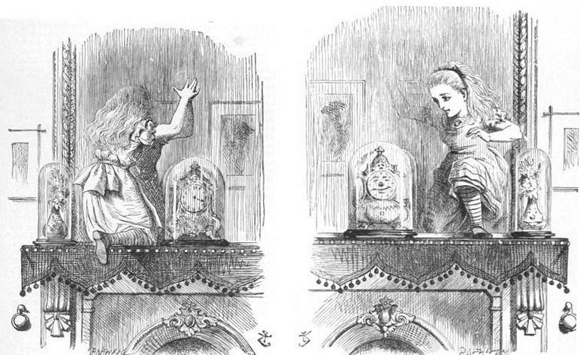
Complex exponentials
This i is the square root of -1 !!!
Advantage:
if the function is complex, can represent cleanly
don’t need to remember which is A, which B

Slide 16
Complex exponentials: compact facts
k, n integers
This minus sign matters!

Slide 17
Fourier series with complex exponentials: using fact
If:
Using the fact! (this is analogous
to an orthonormal basis in linear
algebra)

Slide 18
Fourier series with complex exponentials: issues
But this is just for a periodic function on [0, 1]
  Easy to extend to other intervals
  Easy to extend to the circle
But what about functions on [-infinity, infinity]?
  These could wiggle often in numerous places
  IDEA: use “more” basis elements
The Fourier transform

Slide 19
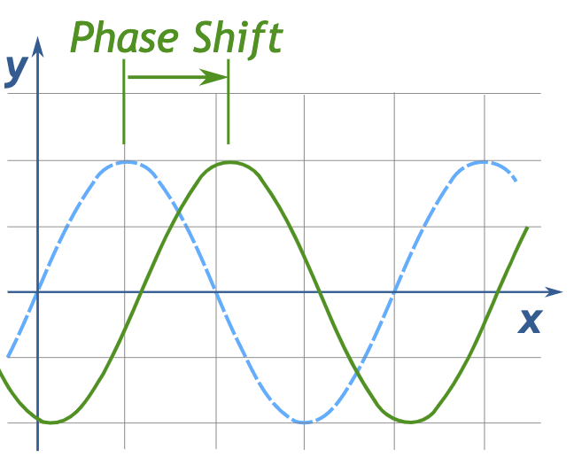

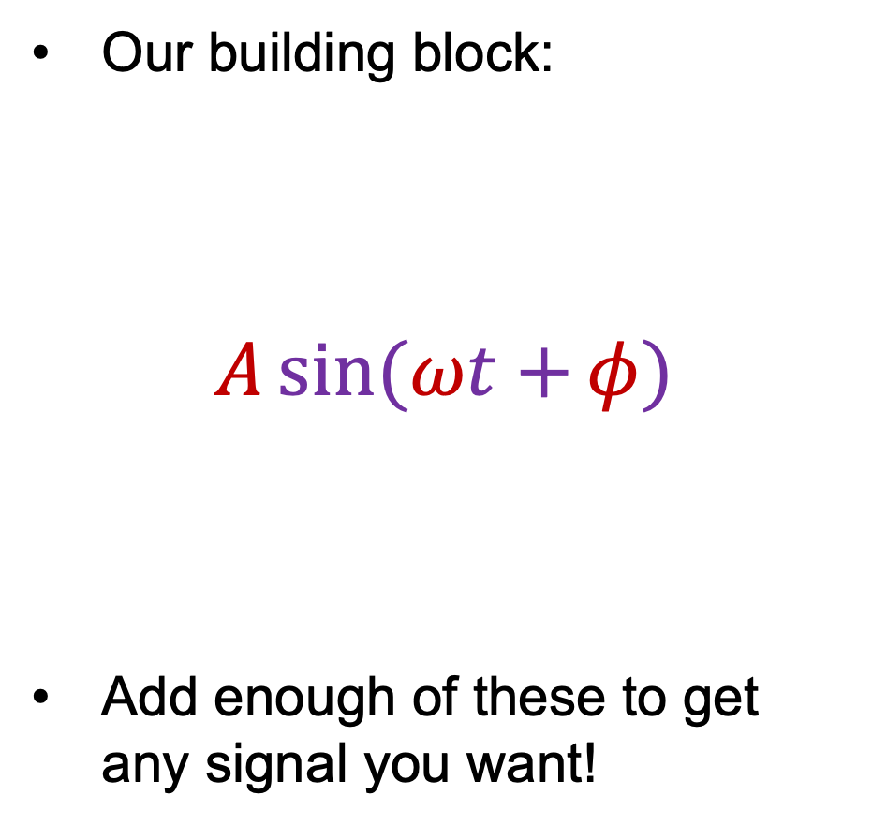


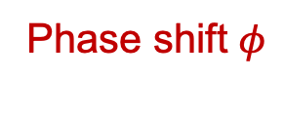
Fourier analysis
Our building block:
$$A\sin{(ωt+}φ)$$
Add enough of these to get any signal you want!
Frequency
Phase shift $φ$
Amplitude $A$
Amplitude
Phase
$$t$$
Period $\frac{2π}{ω}$

Slide 20

1D Fourier transform
Let’s define an (overcomplete) set of basis functions:
$$ψ_{u}\left(t\right)=e^{i2πut}, u∈(−∞,∞)$$
Compare
Integer

Slide 21
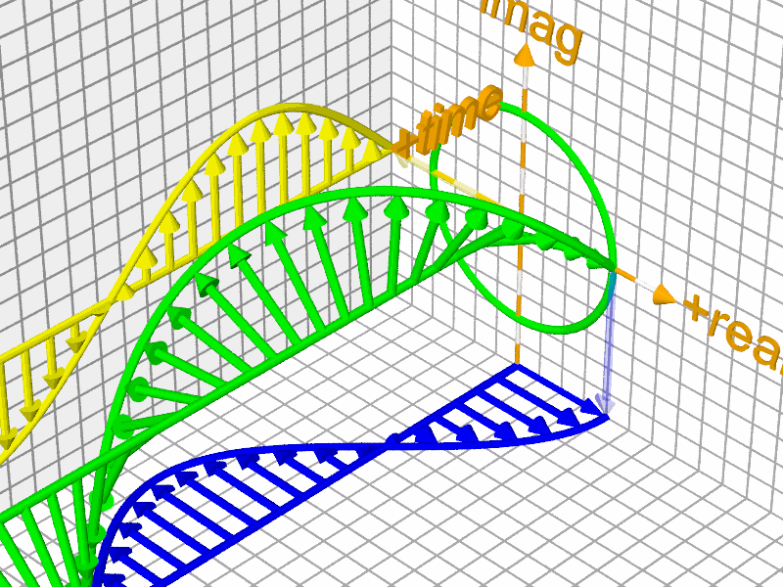









1D Fourier transform
Let’s define an (overcomplete) set of basis functions:
$$ψ_{u}\left(t\right)=e^{i2πut}, u∈(−∞,∞)$$
Euler’s formula: $e^{iθ}=\cos{θ}+i sin θ$
$$Im$$
$$i$$
$$e^{iθ}$$
$$\sin{θ}$$
$$θ$$
$$Re$$
Image source
$$\cos{θ}$$
$$1$$

Slide 22
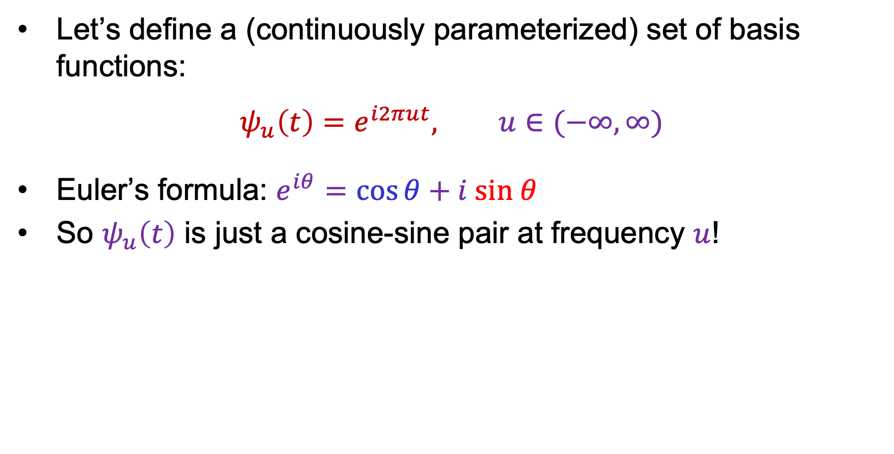
1D Fourier transform
Let’s define a (continuously parameterized) set of basis functions:
$$ψ_{u}\left(t\right)=e^{i2πut}, u∈(−∞,∞)$$
Euler’s formula: $e^{iθ}=\cos{θ}+i sin θ$
So $ψ_{u}\left(t\right)$ is just a cosine-sine pair at frequency $u$!

Slide 23
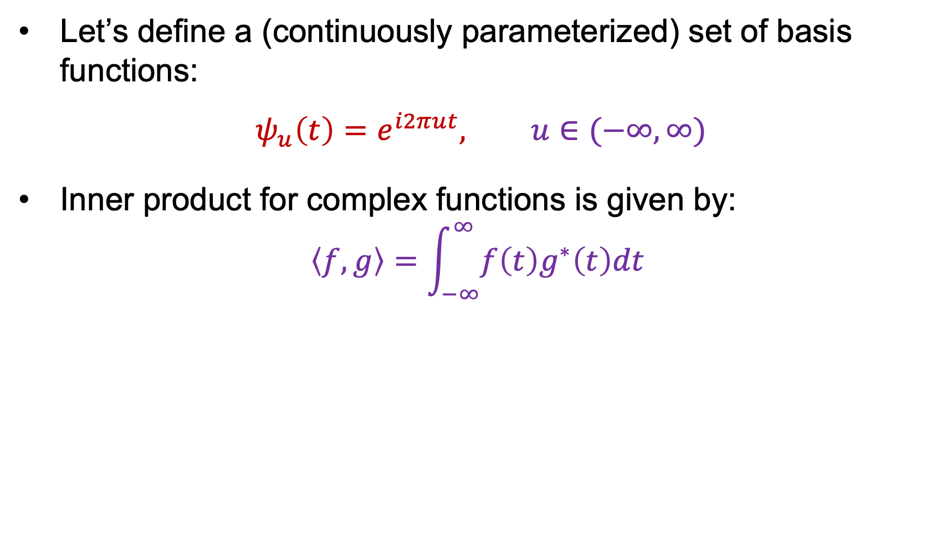
1D Fourier transform
Let’s define a (continuously parameterized) set of basis functions:
$$ψ_{u}\left(t\right)=e^{i2πut}, u∈(−∞,∞)$$
Inner product for complex functions is given by:
$$\left\langle f,g\right\rangle =\int_{−∞}^{∞}{f\left(t\right)g^{∗}\left(t\right)dt }$$
Complex conjugate:
real part stays the same,
imaginary part is flipped

Slide 24
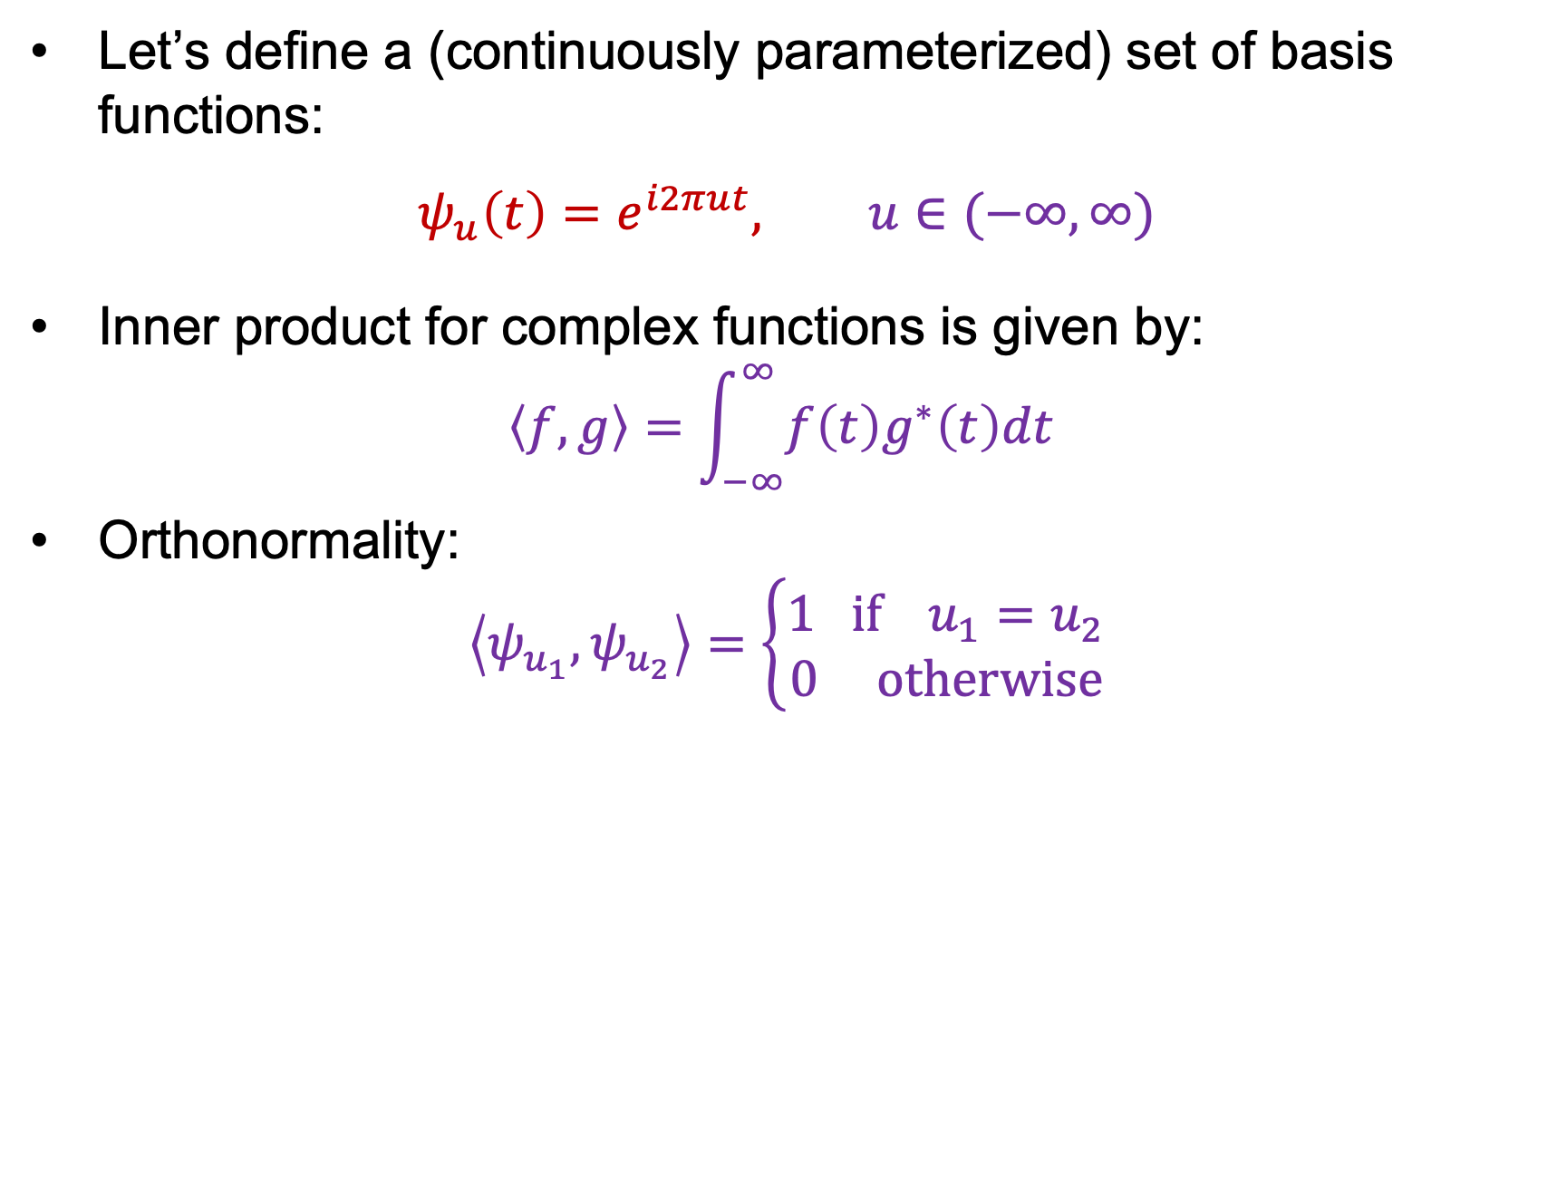
1D Fourier transform
Let’s define a (continuously parameterized) set of basis functions:
$$ψ_{u}\left(t\right)=e^{i2πut}, u∈(−∞,∞)$$
Inner product for complex functions is given by:
$$\left\langle f,g\right\rangle =\int_{−∞}^{∞}{f\left(t\right)g^{∗}\left(t\right)dt }$$
Orthonormality:
$$\left\langle ψ_{u_{1}},ψ_{u_{2}}\right\rangle =\left\{\begin{aligned}1 if{ u}_{1}=u_{2} \\ 0 otherwise\end{aligned}\right.$$

Slide 25
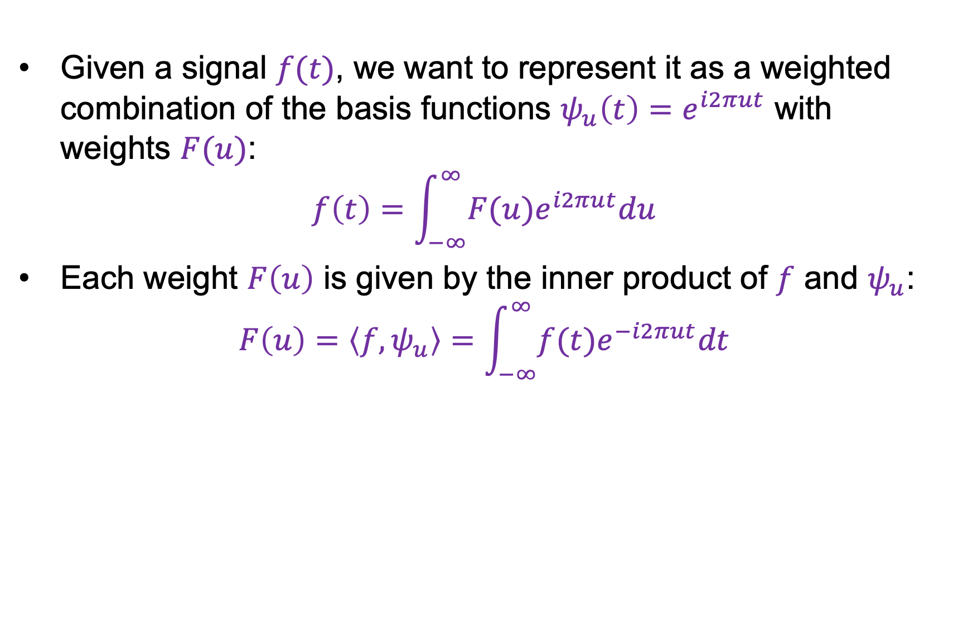
1D Fourier transform
Given a signal $f(t)$, we want to represent it as a weighted combination of the basis functions $ψ_{u}\left(t\right)=e^{i2πut}$ with weights $F(u)$:
$$f\left(t\right)=\int_{−∞}^{∞}{F(u)e^{i2πut}du}$$
Each weight $F\left(u\right)$ is given by the inner product of $f$ and $ψ_{u}$:
$$F\left(u\right)=\left\langle f,ψ_{u}\right\rangle =\int_{−∞}^{∞}{f(t)e^{−i2πut}dt}$$

Slide 26
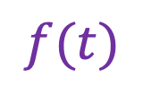
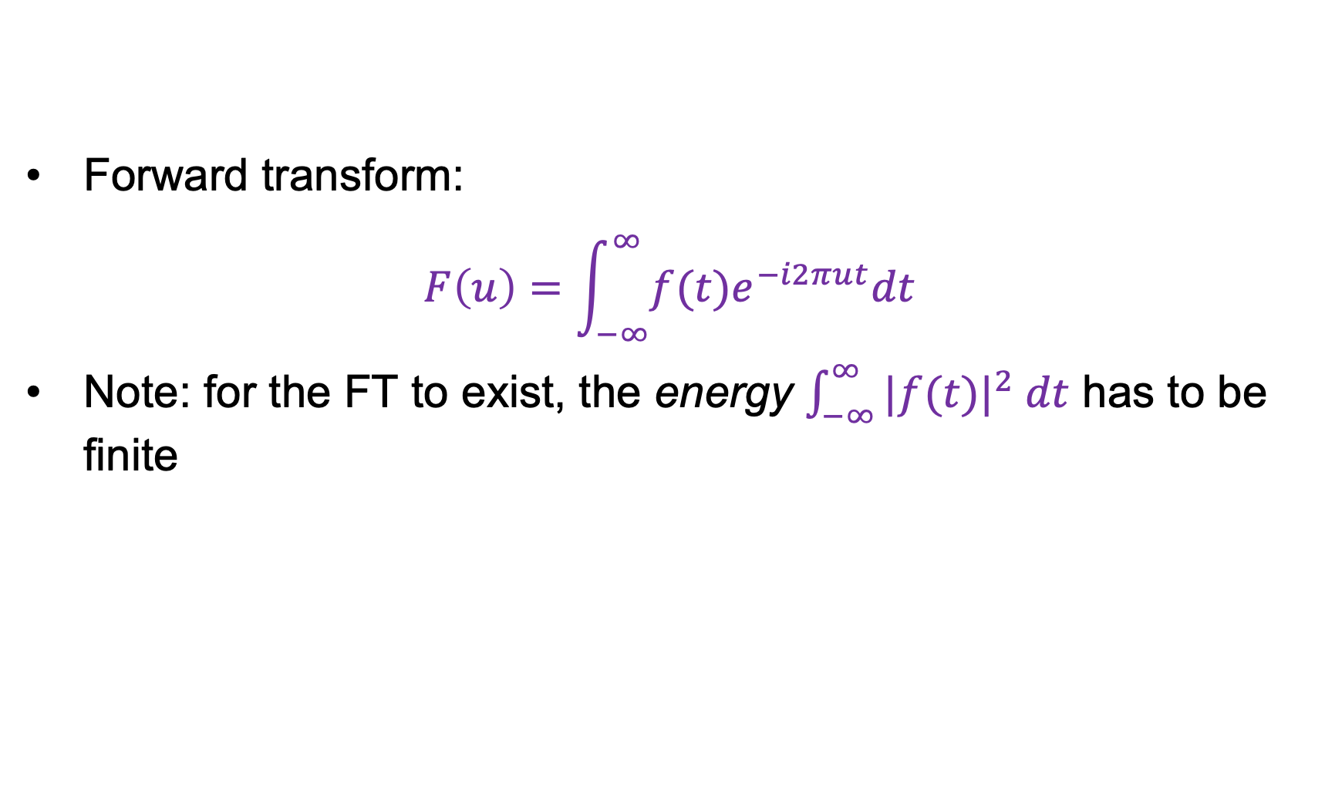

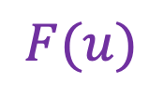
1D Fourier transform
$$ℱ$$
$$f(t)$$
Forward transform:
$$F\left(u\right)=\int_{−∞}^{∞}{f(t)e^{−i2πut}dt}$$
Note: for the FT to exist, the energy $\int_{−∞}^{∞}{|f(t)|^{2} dt}$ has to be finite
$$F(u)$$

Slide 27
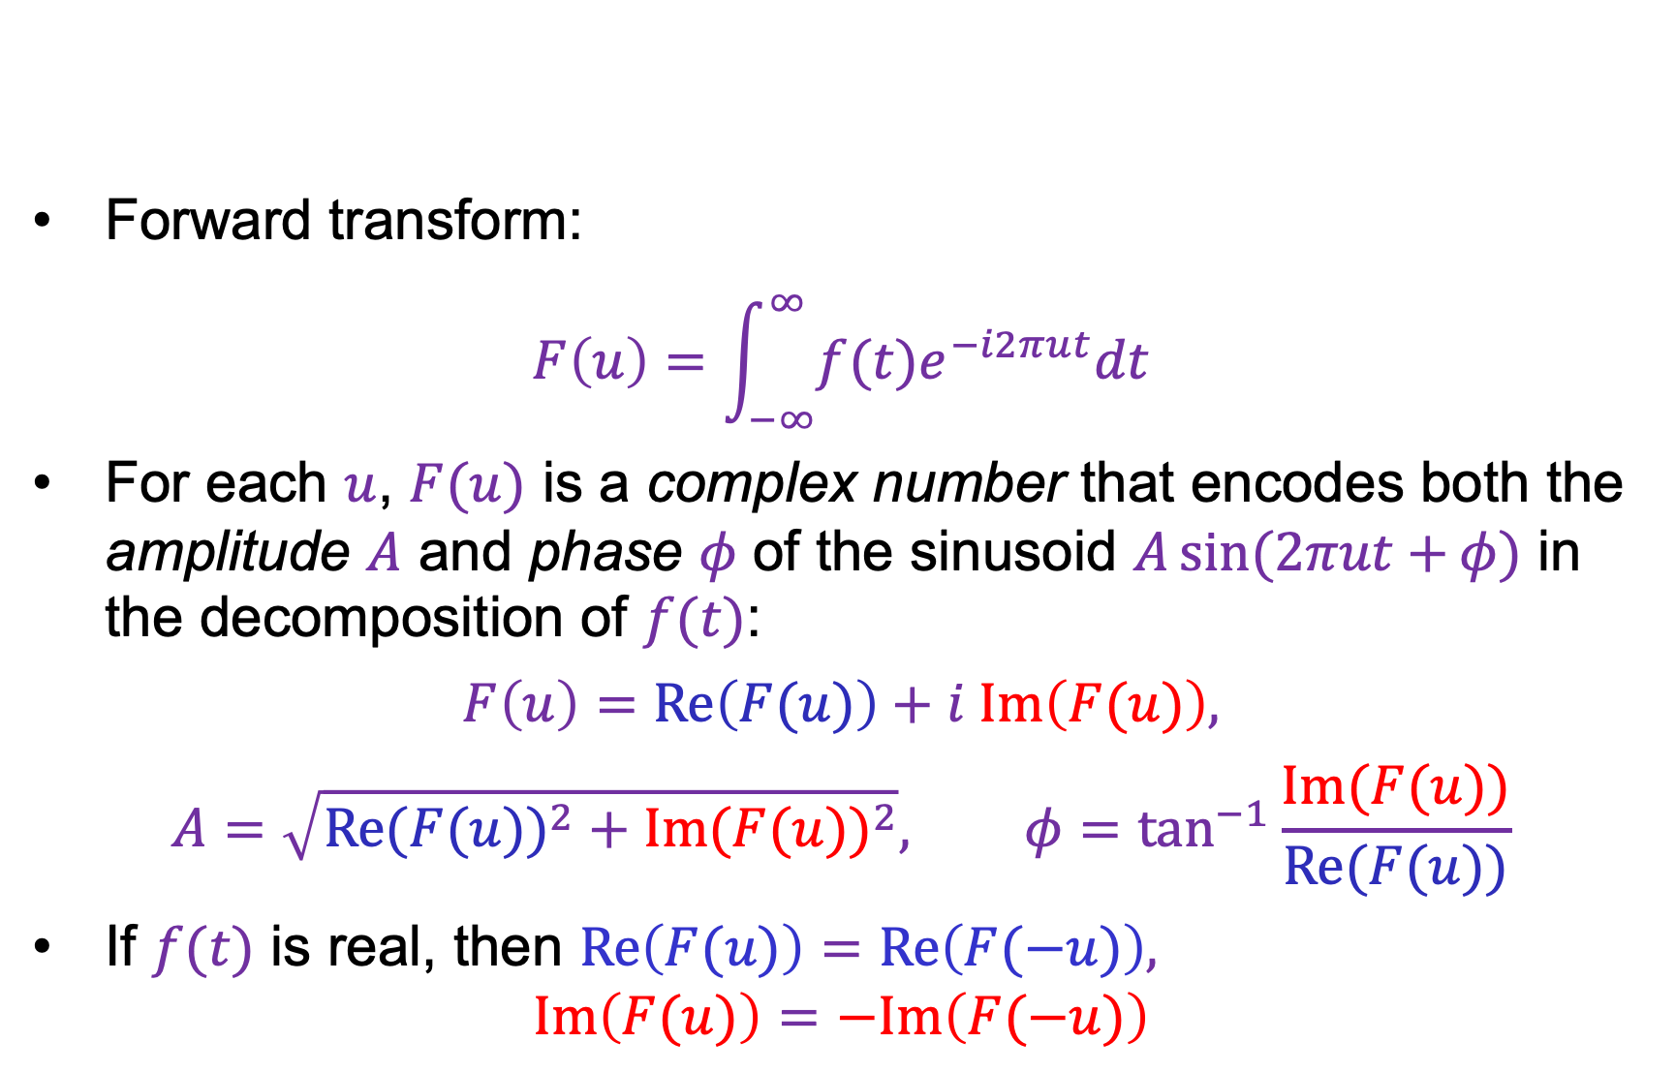
1D Fourier transform
$$ℱ$$
$$f(t)$$
Forward transform:
$$F\left(u\right)=\int_{−∞}^{∞}{f(t)e^{−i2πut}dt}$$
For each $u$, $F(u)$ is a complex number that encodes both the amplitude $A$ and phase $φ$ of the sinusoid $A\sin{(2πut+}φ)$ in the decomposition of $f(t)$:
$$F\left(u\right)=Re\left(F(u)\right)+i Im\left(F(u)\right),$$
$$A=\sqrt{{Re(F(u))}^{2}+{Im(F(u))}^{2}}, φ=\tan^{−1}{\frac{Im(F(u))}{Re(F(u))}}$$
If $f(t)$ is real, then $Re\left(F(u)\right)=Re\left(F(−u)\right),$
$Im\left(F(u)\right)=−Im\left(F(−u)\right)$
$$F(u)$$

Slide 28
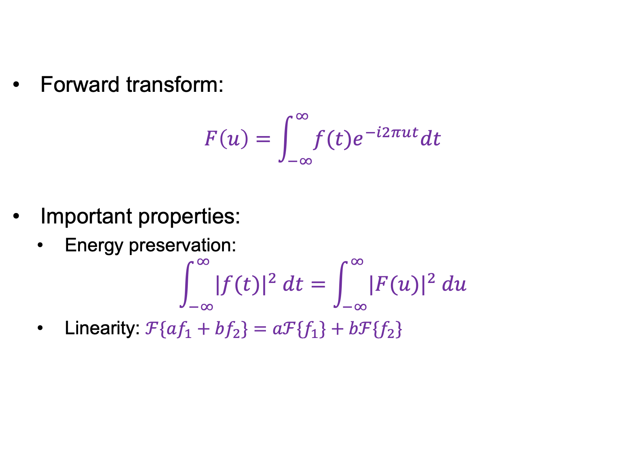
1D Fourier transform
$$ℱ$$
$$f(t)$$
Forward transform:
$$F\left(u\right)=\int_{−∞}^{∞}{f(t)e^{−i2πut}dt}$$
Important properties:
  Energy preservation:
$$\int_{−∞}^{∞}{|f(t)|^{2} dt}=\int_{−∞}^{∞}{|F(u)|^{2} du}$$
  Linearity: $ℱ\{af_{1}+bf_{2}\}=aℱ{\{f}_{1}\}+bℱ{\{f}_{2}\}$
$$F(u)$$
Parseval’s
Theorem!

Slide 29

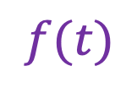
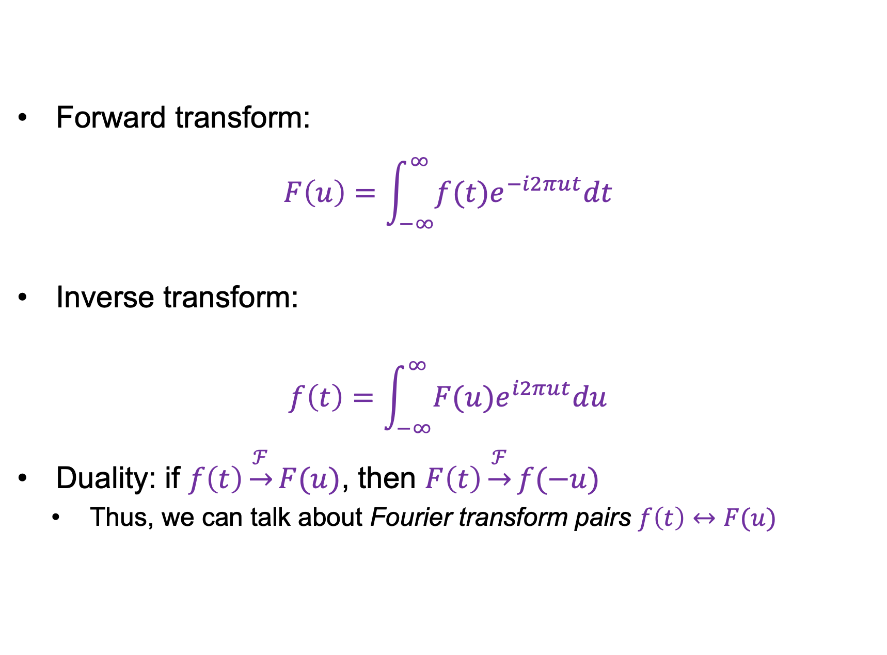

1D Fourier transform
$$ℱ$$
$$f(t)$$
Forward transform:
$$F\left(u\right)=\int_{−∞}^{∞}{f(t)e^{−i2πut}dt}$$
Inverse transform:
$$f\left(t\right)=\int_{−∞}^{∞}{F(u)e^{i2πut}du}$$
Duality: if $f\left(t\right)\underset{→}{ℱ}F(u)$, then $F\left(t\right)\underset{→}{ℱ}f(−u)$
  Thus, we can talk about Fourier transform pairs $f\left(t\right)↔F(u)$
$$F(u)$$
$$ℱ^{−1}$$
$$F(u)$$
$$f(t)$$

Slide 30
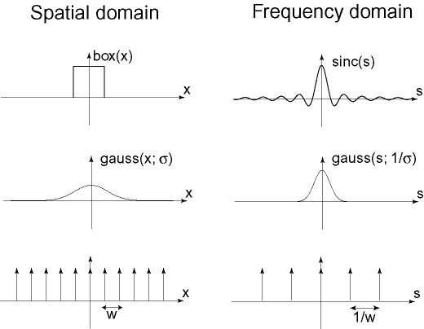



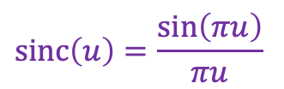
Important Fourier transform pairs
$$box(t)$$
$$sinc\left(u\right)=\frac{\sin\left(πu\right)}{πu}$$
$$−0.5$$
$$0.5$$

Slide 31


Important Fourier transform pairs
$$box(t)$$
$$sinc\left(u\right)=\frac{\sin\left(πu\right)}{πu}$$
$$−0.5$$
$$0.5$$
$$\operatorname{gauss}\left(u;\frac{1}{σ}\right)$$
$$\operatorname{gauss}\left(t;σ\right)$$

Slide 32


Important Fourier transform pairs
$$box(t)$$
$$sinc\left(u\right)=\frac{\sin\left(πu\right)}{πu}$$
$$−0.5$$
$$0.5$$
$$\operatorname{gauss}\left(u;\frac{1}{σ}\right)$$
$$\operatorname{gauss}\left(t;σ\right)$$
$$f\left(t\right)=1$$
$$unit impulse δ\left(u\right)$$
*The last one is formal since these functions don’t meet the mathematical requirements for FT

Slide 33






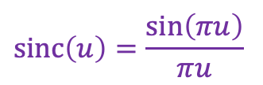

Important Fourier transform pairs
$$box(t)$$
$$sinc\left(u\right)=\frac{\sin\left(πu\right)}{πu}$$
$$−0.5$$
$$0.5$$
Notice that when
f has narrower support,
FT(f) has broader, and
Vice versa!
$$\operatorname{gauss}\left(u;\frac{1}{σ}\right)$$
$$\operatorname{gauss}\left(t;σ\right)$$
$$f\left(t\right)=1$$
$$unit impulse δ\left(u\right)$$
*The last one is formal since these functions don’t meet the mathematical requirements for FT

Slide 34
Outline
1D Fourier transform
  Definition and properties
  Discrete Fourier transform

Slide 35





Discrete Fourier transform (DFT)
Now suppose our signal consists of $N$ samples $f\left(n\right)$,
$n=0,…, N−1$
We can also discretize frequencies to $k/N$, $k=0,…, N−1$
($k$ cycles per $N$ samples)
$$f(n)$$
$$|F\left(k\right)|$$
$$n$$
$$k$$
Image source

Slide 36
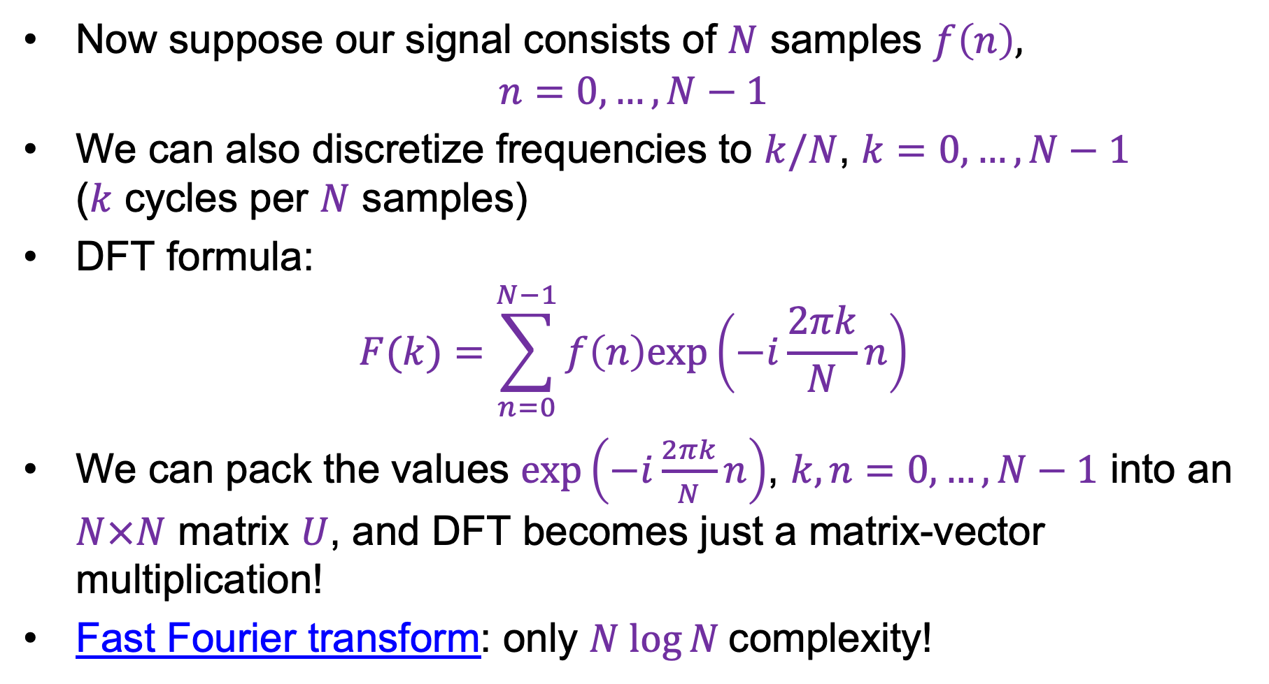
Discrete Fourier transform (DFT)
Now suppose our signal consists of $N$ samples $f\left(n\right)$,
$n=0,…, N−1$
We can also discretize frequencies to $k/N$, $k=0,…, N−1$
($k$ cycles per $N$ samples)
DFT formula:
$$F(k)=\sum_{n=0}^{N−1}{f\left(n\right)exp\left(−i\frac{2πk}{N}n\right)}$$
We can pack the values $exp\left(−i\frac{2πk}{N}n\right)$, $k,n=0,…, N−1$ into an $N×N$ matrix $U$, and DFT becomes just a matrix-vector multiplication!
Fast Fourier transform: only $N log⁡N$complexity!
Image source

Slide 37
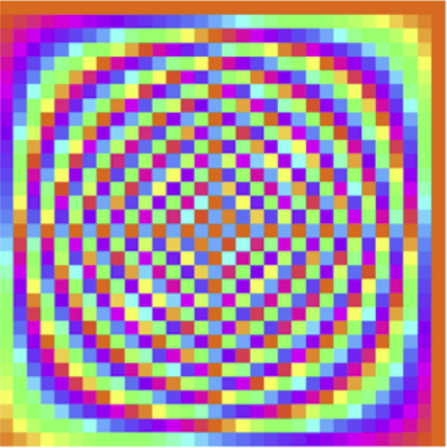
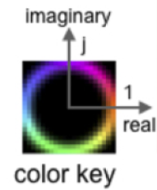


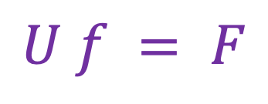


DFT: Just a change of basis!
$$U f = F$$
$$=$$
$$U$$
$$f$$
$$F$$
Source

Slide 38
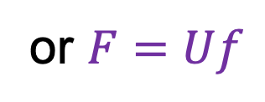

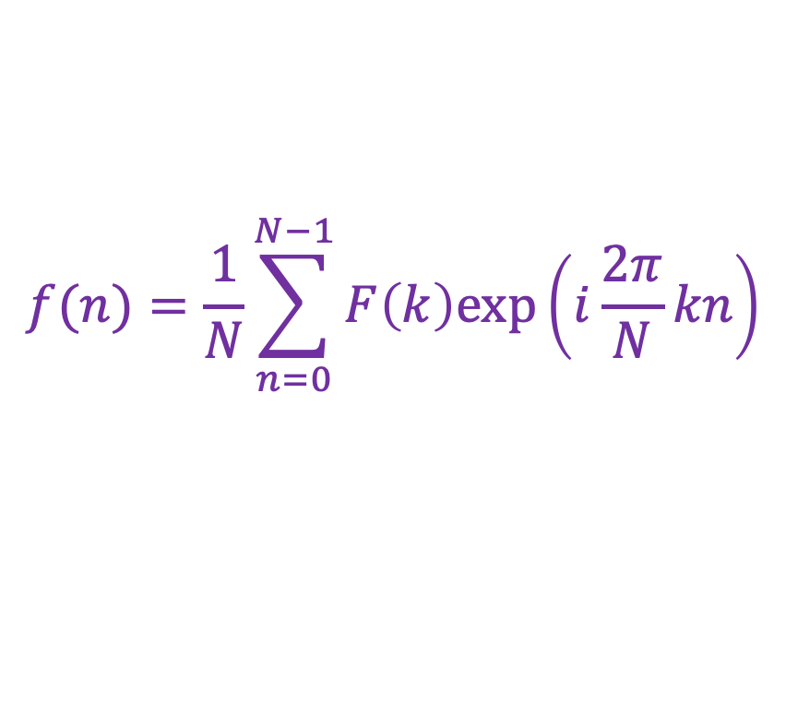
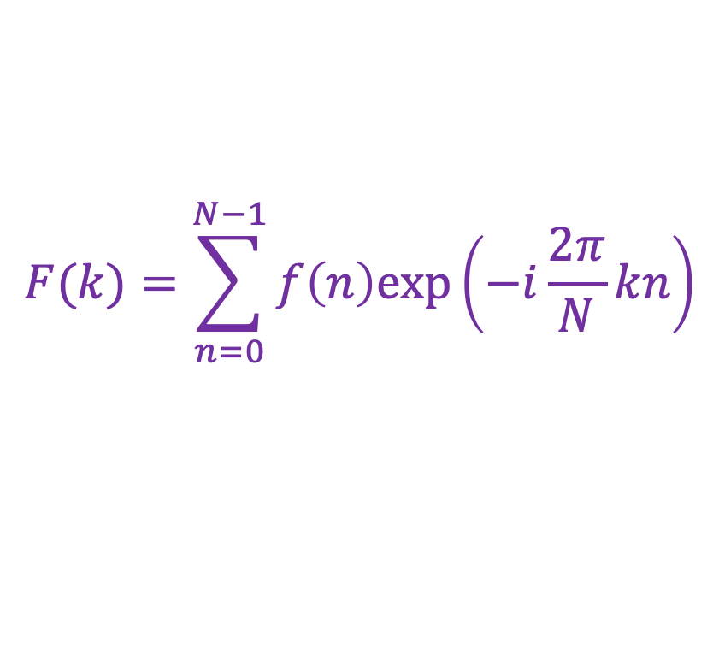
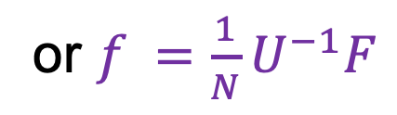
Inverse DFT
Forward DFT:
Inverse DFT:
where $U^{−1}$ is the transpose of the complex conjugate of $U$
$$F(k)=\sum_{n=0}^{N−1}{f\left(n\right)exp\left(−i\frac{2π}{N}kn\right)}$$
or $F=Uf$
$$f(n)=\frac{1}{N}\sum_{n=0}^{N−1}{F\left(k\right)exp\left(i\frac{2π}{N}kn\right)}$$
or $f =\frac{1}{N}U^{−1}F$

Slide 39
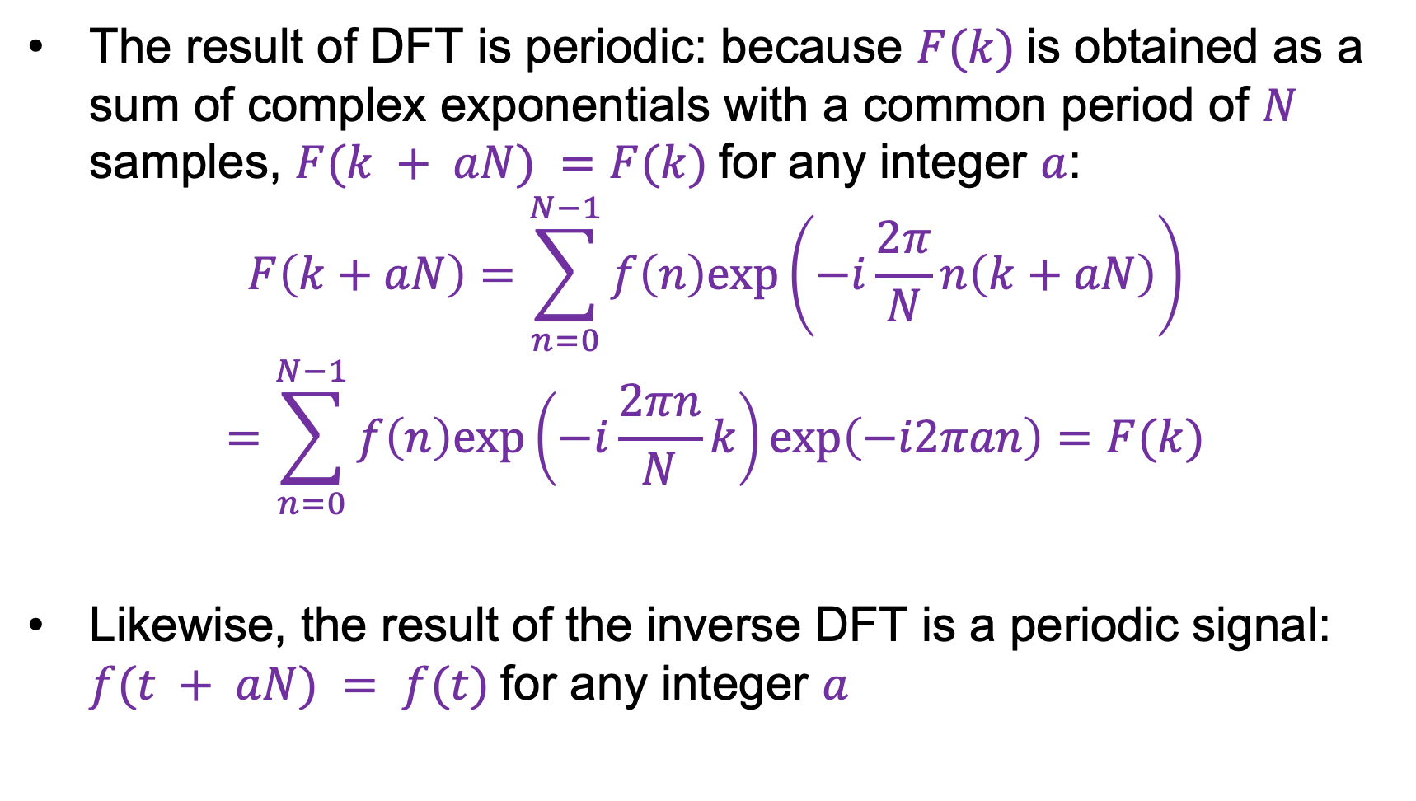
Periodicity of DFT and inverse DFT
The result of DFT is periodic: because $F(k)$is obtained as a sum of complex exponentials with a common period of $N$ samples, $F(k + aN) =F(k)$for any integer $a$:
$$F\left(k+aN\right)=\sum_{n=0}^{N−1}{f\left(n\right)exp\left(−i\frac{2π}{N}n\left(k+aN\right)\right)}$$
$$=\sum_{n=0}^{N−1}{f\left(n\right)exp\left(−i\frac{2πn}{N}k\right)exp\left(−i2πan\right)}=F(k)$$
Likewise, the result of the inverse DFT is a periodic signal: $f(t + aN) = f(t)$for any integer $a$

Slide 40
Outline
1D Fourier transform
  Definition and properties
  Discrete Fourier transform
2D Fourier transform

Slide 41
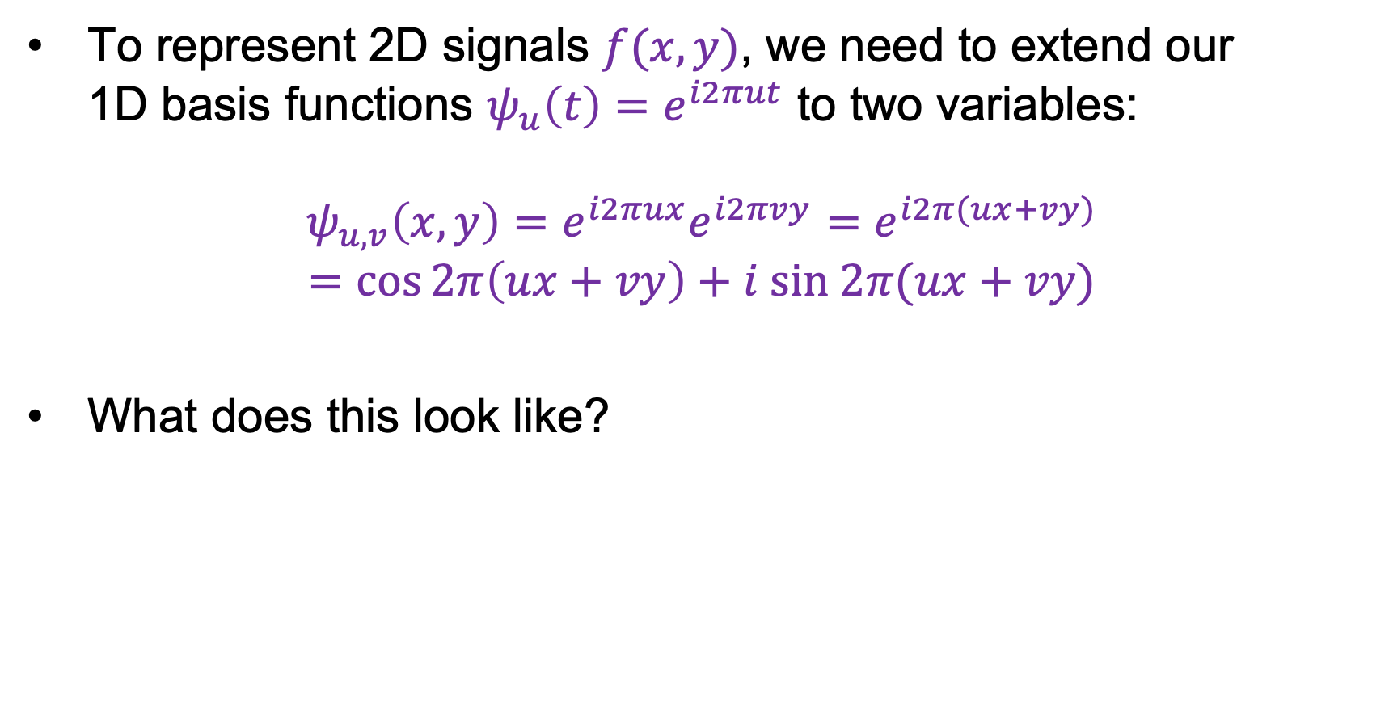
2D Fourier transform
To represent 2D signals $f(x,y)$, we need to extend our
1D basis functions $ψ_{u}\left(t\right)=e^{i2πut}$ to two variables:
$$ψ_{u,v}\left(x,y\right)=e^{i2πux}e^{i2πvy}=e^{i2π(ux+vy)}$$
$$=\cos{2π\left(ux+vy\right)}+i sin 2π(ux+vy)$$
What does this look like?

Slide 42
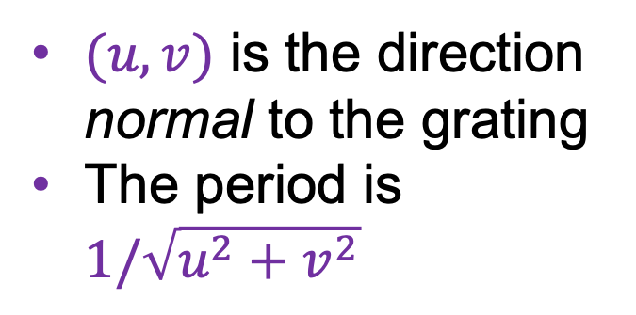


2D Fourier transform
2D basis functions are oriented sinusoidal “gratings”:
$$u$$
$(u,v)$ is the direction normal to the grating
The period is $1/\sqrt{u^{2}+v^{2}}$
$$v$$

Slide 43


Basis function examples
Real component
$$(u,v)$$

Slide 44
Basis function examples
Real component
$$(u,v)$$

Slide 45
Basis function examples
Real component
$$(u,v)$$

Slide 46
Linear combination of basis functions
Real component
$$(u,v)$$

Slide 47
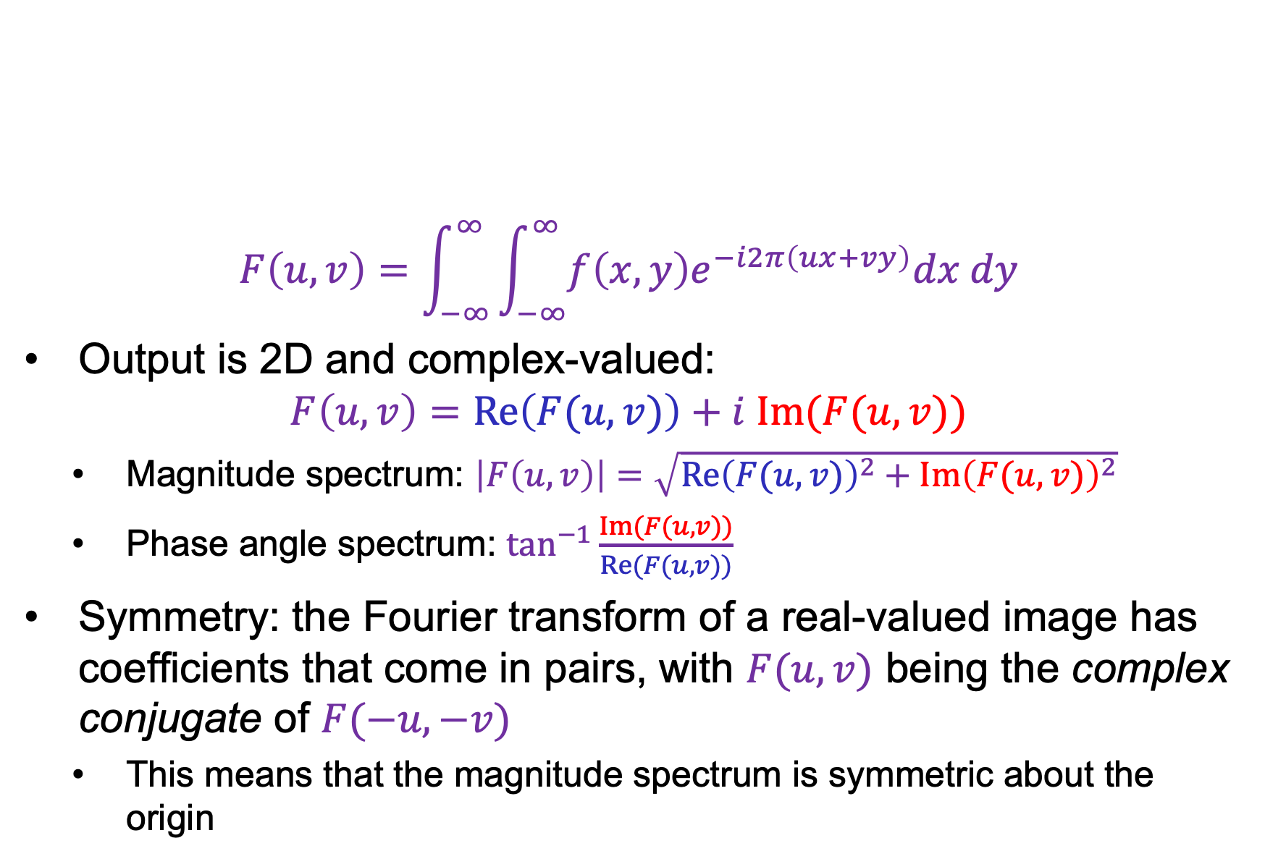
2D Fourier transform
$$F\left(u,v\right)=\int_{−∞}^{∞}{\int_{−∞}^{∞}{f\left(x,y\right)e^{−i2π\left(ux+vy\right)}dx dy}}$$
Output is 2D and complex-valued:
$$F\left(u,v\right)=Re\left(F(u,v)\right)+i Im(F(u,v))$$
  Magnitude spectrum: $\left|F\left(u,v\right)\right|=\sqrt{{Re\left(F(u,v)\right)}^{2}+{Im\left(F(u,v)\right)}^{2}}$
  Phase angle spectrum: $\tan^{−1}{\frac{Im(F(u,v))}{Re(F(u,v))}}$
Symmetry: the Fourier transform of a real-valued image has coefficients that come in pairs, with $F(u, v)$ being the complex conjugate of $F(−u, −v)$
  This means that the magnitude spectrum is symmetric about the origin

Slide 48
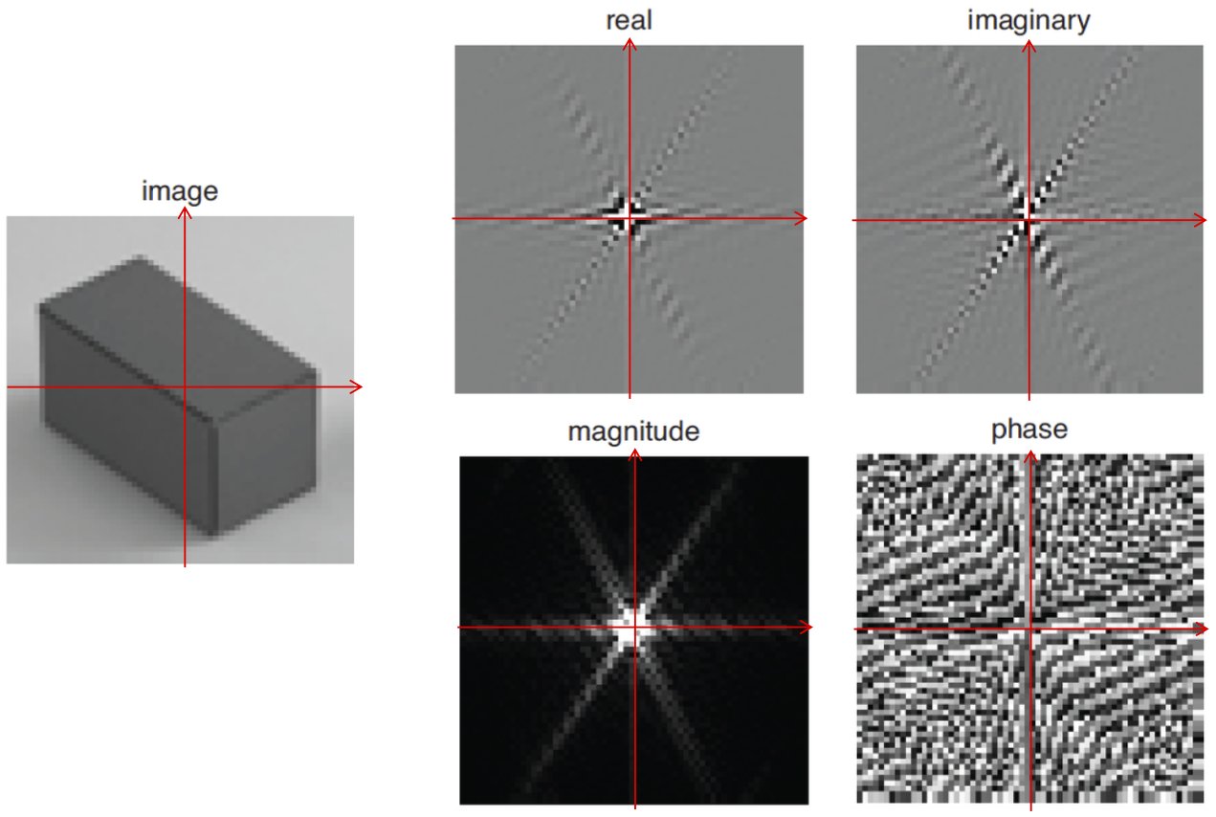

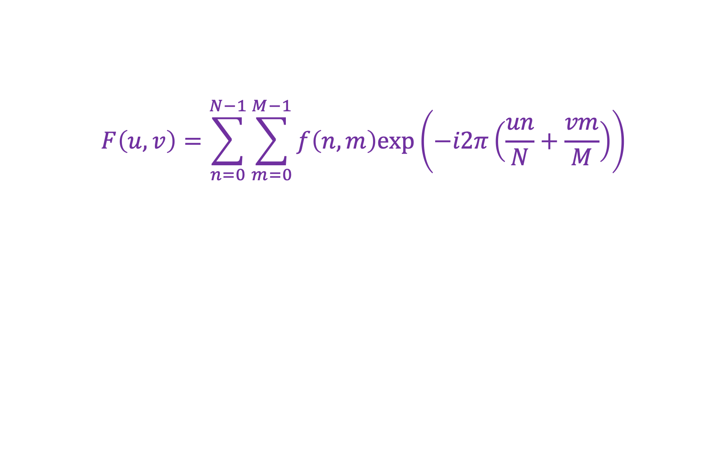



2D discrete Fourier transform
$$F\left(u,v\right)=\sum_{n=0}^{N−1}{\sum_{m=0}^{M−1}{f\left(n,m\right)exp\left(−i2π\left(\frac{un}{N}+\frac{vm}{M}\right)\right)}}$$
$$Re(F\left(u,v\right))$$
$$Im(F\left(u,v\right))$$
$$|F\left(u,v\right)|$$
$$\tan^{−1}{Im(F(u,v))/Re(F(u,v))}$$
Source: B. Freeman

Slide 49
Real image examples

Slide 50
Real image examples

Slide 51
Which image goes with which spectrum?

Slide 52
Phase vs. magnitude
Which has more information, the phase or the magnitude?
Let’s take the phase from one image and combine it with the magnitude from another image

Slide 53
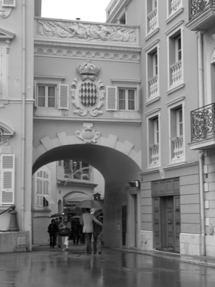
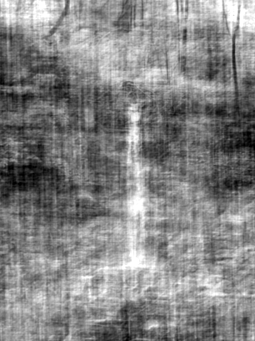
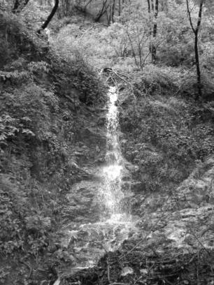
Magnitude
Phase

Slide 54

Phase
Magnitude

Slide 55

Images with periodic patterns
The magnitude image has peaks corresponding to the frequencies of repetition
Image
Magnitude image
Source: A. Zisserman

Slide 56

Application: Removing periodic patterns
Magnitude image
Remove peaks
Source: A. Zisserman

Slide 57


Periodic patterns
Lunar orbital image (1966)
Magnitude image
Remove peaks
Join lines removed
Why are there multiple peaks in the
magnitude image?
Remove peaks
Source: A. Zisserman

Slide 58
Application: Removing periodic patterns
Lunar orbital image (1966)
Magnitude image
Remove peaks
Join lines removed
Remove peaks
You should think of this as a kind of local smoothing
But in the Fourier domain!
Source: A. Zisserman

Slide 59


Image transformations
How does the FT change when the image is scaled?
Scaled by the inverse factor!

Slide 60

In 1D
2D is easy, follows this form

Slide 61

Important effect
“wider” function
has
“narrower”
Fourier transform
“narrower” function
has
“wider”
Fourier transform

Slide 62


Image transformations
How does the FT change when the image is rotated?
Rotates the same way!

Slide 63

In 2D
(both fairly easy to prove)

Slide 64
Image transformations
How does the FT change when the image is rotated?
Caution: in real images this is not always the case because of edge artifacts (recall that DFT treats images as periodically tiled)
Image source

Slide 65
Image transformations
How does the FT change when the image is translated?
Magnitude spectrum doesn’t change, phase gets modulated

Slide 66

Translation in 1D
ND works the same way

Slide 67

A model of Sampling
We want to model sampling in a way that allows us to take Fourier Transforms.
Challenges:
Should be able to compute a meaningful integral of the sampled data

Slide 68
A trick – the delta function
Define the delta function in 1D by
This isn’t a function in any familiar sense, but it is useful and crops up in all sorts of places

Slide 69

Sampling in 1D

Slide 70

Sampling in 1D

Slide 71

Delta functions in 2D

Slide 72

Sampling in 2D

Slide 73

Sampling in 2D

Slide 74
Outline
1D Fourier transform
  Definition and properties
  Discrete Fourier transform
2D Fourier transform
  Definition
  Examples and properties
Convolution theorem

Slide 75

Convolution theorem
Convolution in the spatial domain translates to multiplication in the frequency domain (and vice versa)
The Fourier transform of the convolution of two functions is the product of their Fourier transforms:
$$ℱ\{f∗g\}=ℱ\{f\} ℱ\{g\}$$
The inverse Fourier transform of the product of two Fourier transforms is the convolution of the two inverse Fourier transforms:
$$ℱ^{−1}\{FG\}=ℱ^{−1}\{F\}∗ℱ^{−1}\{G\}$$

Slide 76









2D convolution theorem example
Image
Filter
Filtered image
$$=$$
*
FT(Image)
FT(Filter)
FT(Filtered image)
$$×$$
$$=$$

Slide 77

Easy to prove
Swap integration bounds
Move g out of integral
Shift result from before

Slide 78

Convolution theorem
Suppose $f$ and $g$ both consist of $N$ pixels
What is the complexity of computing $f∗g$ in the spatial domain?
  $O(N^{2})$
And what is the complexity of computing $ℱ^{−1}\left\{ℱ\left\{f\right\}ℱ\left\{g\right\}\right\}$?
  $O(N\log{N})$ using FFT
Thus, convolution of an image with a large filter can be more efficiently done in the frequency domain

Slide 79
Understanding the behavior of filtering
Why does filtering with a Gaussian give a nice smooth image, but filtering with a box filter gives artifacts?
Gaussian
Box filter
Notes:
Things we can’t understand without thinking in frequency
79

Slide 80
Recall: Fourier transform pairs
$$box(t)$$
$$sinc\left(u\right)=\frac{\sin\left(πu\right)}{πu}$$
$$−0.5$$
$$0.5$$
$$\operatorname{gauss}\left(u;\frac{1}{σ}\right)$$
$$\operatorname{gauss}\left(t;σ\right)$$

Slide 81
Filtering with a Gaussian

Slide 82
Filtering with a box filter

Slide 83

Low-pass and high-pass filtering
Image
Low-pass filtered
High-pass filtered
Demo
Source: A. Zisserman

Slide 84
Closer look at low-pass filtering
Do we like this low-pass filtering result?
No – it causes ringing artifacts in the image (why?)
  Recall: it’s equivalent to convolving with a sinc function in the spatial domain
This is why Gaussian filtering is preferred
Image
Low-pass filtered

Slide 85

Hybrid images in the frequency domain
Source

Slide 86

Human contrast sensitivity curve
Depending on viewing distance, peak sensitivity will occur at different frequencies
Notes:
86

Slide 87
Outline
1D Fourier transform
  Definition and properties
  Discrete Fourier transform
2D Fourier transform
  Definition
  Examples and properties
Convolution theorem
Understanding the sampling theorem

Slide 88
Understanding sampling and aliasing

Slide 89


Recall: Nyquist-Shannon sampling theorem
When sampling a signal at discrete intervals, the sampling frequency must be at least twice the maximum frequency of the input signal to allow us to reconstruct the original perfectly from the sampled version
bad
good
https://en.wikipedia.org/wiki/Nyquist-Shannon_sampling_theorem

Slide 90









Understanding the sampling theorem
Suppose we have a continuous function $f(t)$ and we want to sample it at discrete intervals with a spacing of $T$
This can be accomplished by multiplying it by the comb function or impulse train:
$$comb\left(t\right)=\sum_{n=−∞}^{∞}{δ(t−nT)}$$
$$f(t)$$
$$×$$
$$=$$
$$f_{s}\left(t\right)=\sum_{n=−∞}^{∞}{f(t)δ(t−nT)}$$
$$T$$
Source: A. Zisserman

Slide 91





Understanding the sampling theorem
Let’s (formally) take the Fourier transform:
$$F\left(u\right)$$
$$F_{s}\left(u\right)=F\left(u\right) ∗ \frac{1}{T}comb\left(t;\frac{1}{T}\right)$$
$$f_{s}\left(t\right)=f\left(t\right) × comb(t;T)$$
*Officially, the FT of the comb function doesn’t exist since it’s periodic, and since $δ$ is a weird function
Source: A. Zisserman

Slide 92



Understanding the sampling theorem
Let’s (formally) take the Fourier transform:
$$F\left(u\right)$$
$$F_{s}\left(u\right)=F\left(u\right) ∗ \frac{1}{T}comb\left(t;\frac{1}{T}\right)$$
$$f_{s}\left(t\right)=f\left(t\right) × comb(t;T)$$
$$=$$
Source: A. Zisserman
Replicated copies of $F(u)$!

Slide 93





Understanding the sampling theorem
How do we reconstruct $f(t)$?
Let’s apply a box filter in the
frequency domain (equivalent to
convolving with a sinc function
in the original domain)
When will this succeed?
  When the sampling frequency $1/T$exceeds
  twice the greatest frequency contained in $F\left(u\right)$!
$$1/T$$
$$f(t)$$
$$F\left(u\right)$$
Source: A. Zisserman

Slide 94

Understanding the sampling theorem
If the sampling frequency is too small, frequencies above the Nyquist limit are “folded back” onto smaller frequencies, resulting in aliasing
Source: A. Zisserman

Slide 95






Sampling theorem in 2D
If the Fourier transform of a continuous function $f(x,y)$ is zero for all frequencies beyond $u_{b}$ and $v_{b}$, i.e., if the Fourier transform is band-limited, then $f(x,y)$ can be completely reconstructed from its samples as long as the sampling distances $w$and $h$ along the $x$ and $y$ directions are such that $w≤\frac{1}{2u_{b}}$ and $h≤\frac{1}{2v_{b}}$
$$h$$
$$h$$
Source: A. Zisserman
$$w$$
$$w$$

Slide 96
Aside: Analyzing interpolation methods
Perfect reconstruction of the subsampled signal requires convolution with a sinc filter in the spatial domain, which is bad because sinc has infinite support
Instead, simpler reconstruction (interpolation) methods are typically used

Slide 97



Aside: Analyzing different interpolation methods
Linear reconstruction can be done by convolving the sampled signal with a triangle filter:
However, the Fourier transform of the triangle filter is the ${sinc}^{2}$ function, so multiplying the signal’s spectrum by it introduces high-frequency artifacts
$$∗$$
$$=$$
Image source

Slide 98


Bilinear interpolation closeup
Image source

Slide 99

Why else should you care about Fourier analysis?
S.-Y. Wang et al. CNN-generated images are surprisingly easy to spot... for now. CVPR 2020

Slide 100

Why else should you care about Fourier analysis?
Checkerboard and repetition artifacts in GAN-generated images
https://distill.pub/2016/deconv-checkerboard/

Slide 101

Smoothing and downsampling

Slide 102

Smoothing and downsampling
Smoothed by gaussian sigma 1 pixel

Slide 103

Smoothing and downsampling
Smoothed by gaussian sigma 2 pixels

Slide 104
What smoothing filter to use?
Why does smoothing with a Gaussian help?
Is there a better filter than a Gaussian?
Can you resample without loss?

