Slide 1
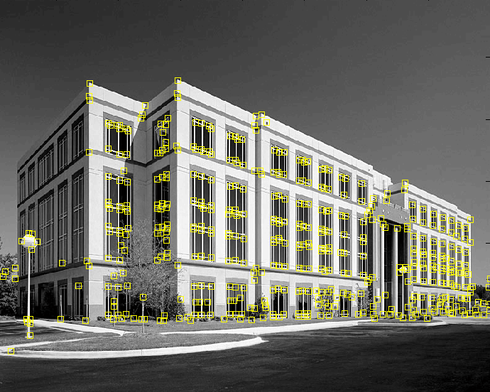
Corner detection
9300 Harris Corners Pkwy, Charlotte, NC

Slide 2
Outline
Keypoint detection: Motivation
Deriving a corner detection criterion
The Harris corner detector
Invariance properties of corners

Slide 3
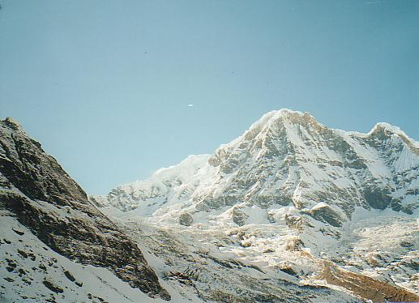
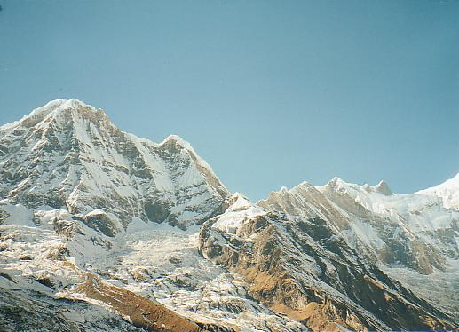
Why extract keypoints?
Motivation: image alignment
  We have two images – how do we combine them?

Slide 4
Why extract keypoints?
Motivation: image alignment
  We have two images – how do we combine them?

Slide 5
Why extract keypoints?
Motivation: image alignment
  We have two images – how do we combine them?

Slide 6
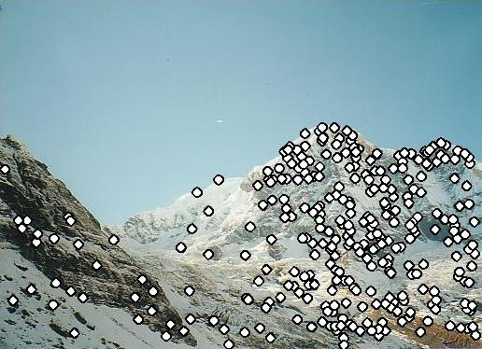
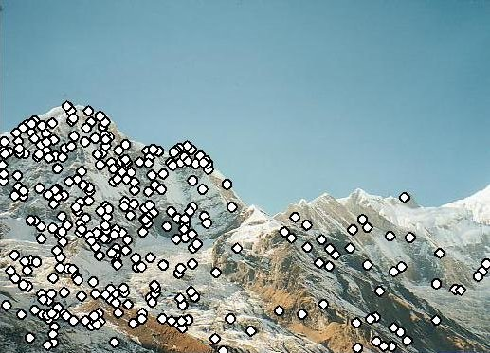
Why extract keypoints?
Motivation: image alignment
  We have two images – how do we combine them?
Step 1: extract keypoints
Step 2: match keypoint features

Slide 7
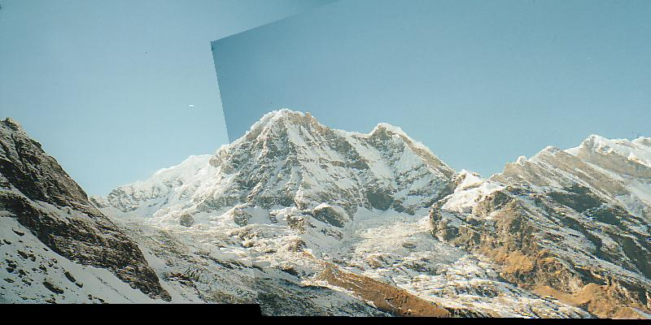
Why extract keypoints?
Motivation: image alignment
  We have two images – how do we combine them?
Step 1: extract keypoints
Step 2: match keypoint features
Step 3: align images

Slide 8
Characteristics of good keypoints
Compactness and efficiency
  Many fewer keypoints than image pixels
Saliency
  Each keypoint is distinctive
Locality
  A keypoint occupies a relatively small area of the image; robust to clutter and occlusion
Repeatability
  The same keypoint can be found in several images despite geometric and photometric transformations

Slide 9
Keypoint representations support very fast methods
In some applications, GPU just isn’t available
-too heavy; too much power; etc
And there isn’t much CPU either
Idea: reduce image to keypoints, work with those

Slide 10
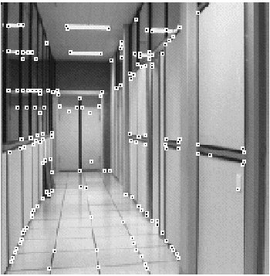
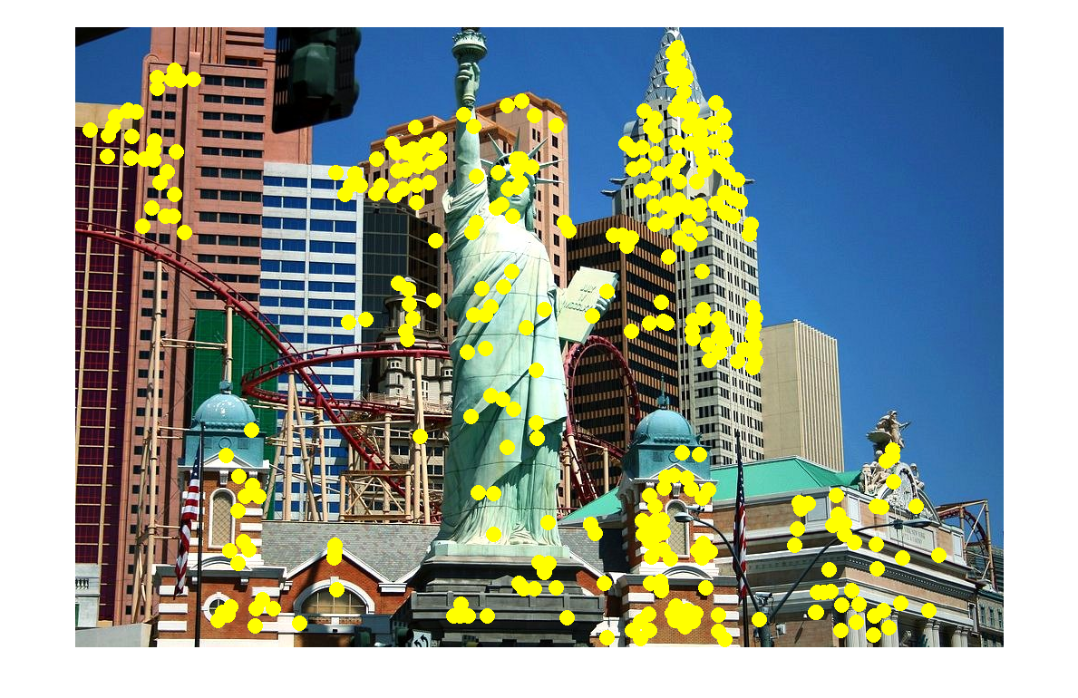
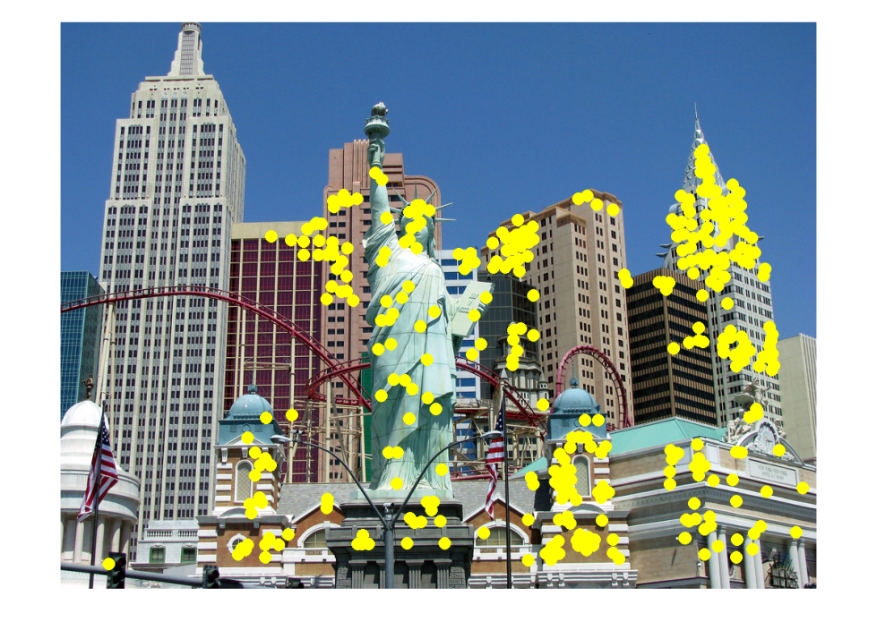
Applications
Keypoints are useful for:
  Image alignment
  3D reconstruction
  Motion tracking
  Robot navigation
  Database indexing and retrieval

Slide 11
Corner detection: Outline
Motivation
Deriving a corner detection criterion

Slide 12

Deriving a corner detection criterion
Basic idea: we should easily recognize the point by looking through a small window
Shifting a window in any direction should give a large change in intensity
“flat” region:
no change in all directions
“edge”:
no change along the edge direction
“corner”:
significant change in all directions

Slide 13
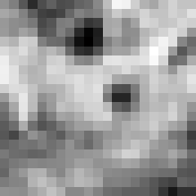


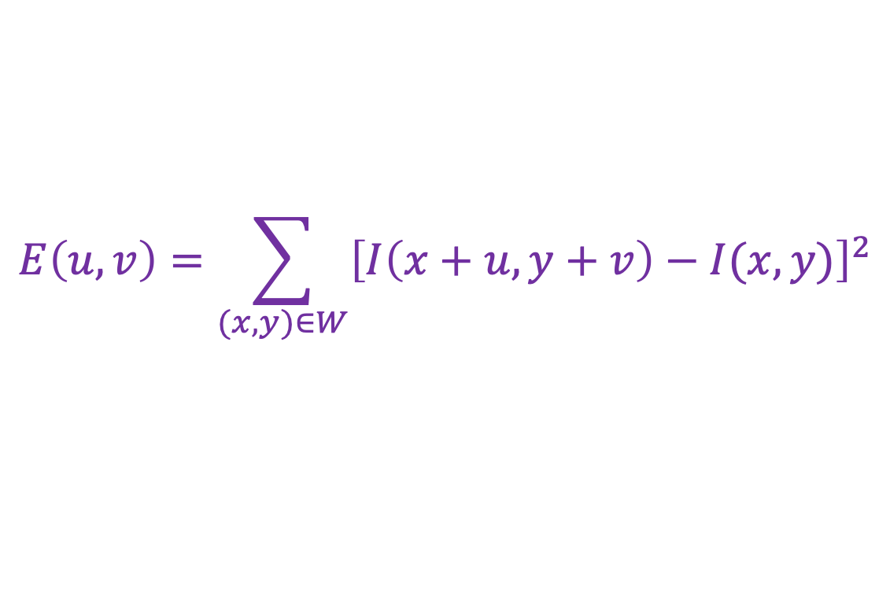
Deriving a corner detection criterion
Change in appearance of window $W$ for the shift $(u,v)$:
$$E\left(u,v\right)=\sum_{(x,y)∈W}{{\left[I\left(x+u,y+v\right)−I(x,y)\right]}^{2}}$$
I(x, y)
E(u, v)
E(3,2)

Slide 14
Deriving a corner detection criterion
Change in appearance of window $W$ for the shift $(u,v)$:
$$E\left(u,v\right)=\sum_{(x,y)∈W}{{\left[I\left(x+u,y+v\right)−I(x,y)\right]}^{2}}$$
I(x, y)
E(u, v)
E(0,0)

Slide 15

Deriving a corner detection criterion
Change in appearance of window $W$ for the shift $(u,v)$:
We want to find out how this function behaves for small shifts
$$E\left(u,v\right)=\sum_{(x,y)∈W}{{\left[I\left(x+u,y+v\right)−I(x,y)\right]}^{2}}$$
E(u, v)
Notes:
Specifically, E has to have a unique minimum at (0,0)

Slide 16




Deriving a corner detection criterion
First-order Taylor approximation for small shifts $(u, v)$:
$$I\left(x+u,y+v\right)≈I\left(x,y\right)+I_{x}u+I_{y}v$$
Recall: first-order Taylor approximation for a 1D function:
$$f\left(x+u\right)≈f\left(x\right)+f^{′}\left(x\right)u$$
$$x$$
$$x+u$$

Slide 17
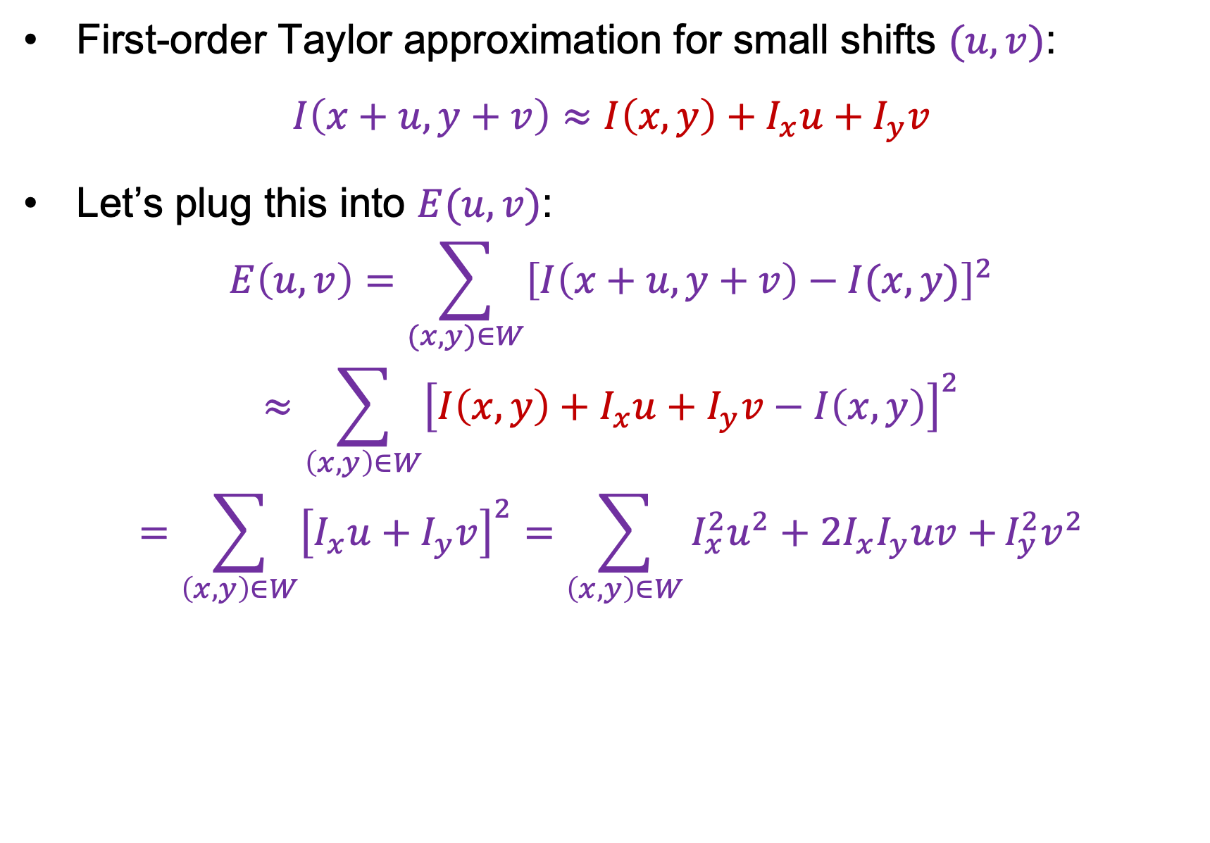
Deriving a corner detection criterion
First-order Taylor approximation for small shifts $(u, v)$:
$$I\left(x+u,y+v\right)≈I\left(x,y\right)+I_{x}u+I_{y}v$$
Let’s plug this into $E(u,v)$:
$$E\left(u,v\right)=\sum_{(x,y)∈W}{{\left[I\left(x+u,y+v\right)−I(x,y)\right]}^{2}}$$
$$≈\sum_{\left(x,y\right)∈W}{{\left[I\left(x,y\right)+I_{x}u+I_{y}v−I\left(x,y\right)\right]}^{2}}$$
$$=\sum_{\left(x,y\right)∈W}{{\left[I_{x}u+I_{y}v\right]}^{2}}=\sum_{\left(x,y\right)∈W}{I_{x}^{2}u^{2}+2I_{x}I_{y}uv+}I_{y}^{2}v^{2}$$

Slide 18
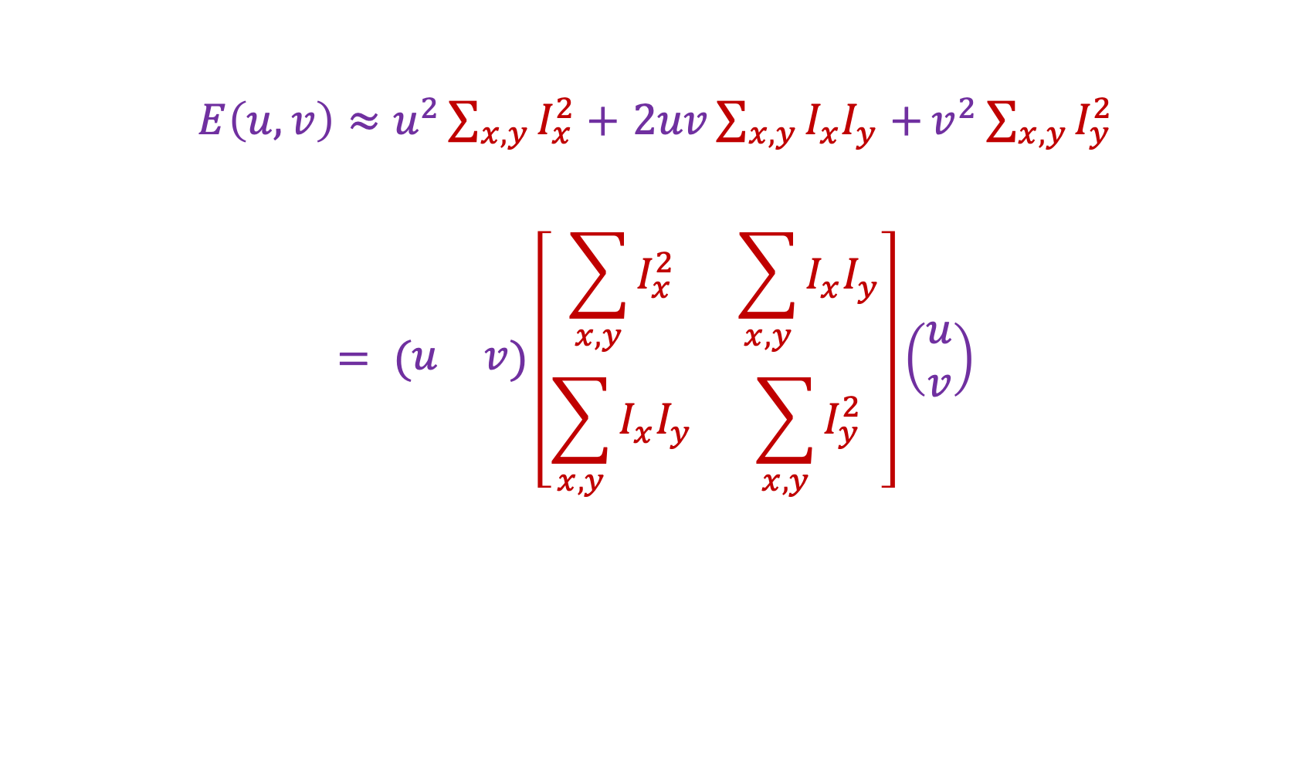

Deriving a corner detection criterion
$E\left(u,v\right)≈u^{2}\sum_{x,y}{I_{x}^{2}}+$ $2uv\sum_{x,y}{I_{x}I_{y}+}v^{2}\sum_{x,y}{I_{y}^{2}}$
$$= (\begin{matrix}u & v\end{matrix})\left[\begin{matrix}\sum_{x,y}{I_{x}^{2}} & \sum_{x,y}{I_{x}I_{y}} \\ \sum_{x,y}{I_{x}I_{y}} & \sum_{x,y}{I_{y}^{2}}\end{matrix}\right]\left(\begin{aligned}u \\ v\end{aligned}\right)$$
Second moment matrix $M$

Slide 19
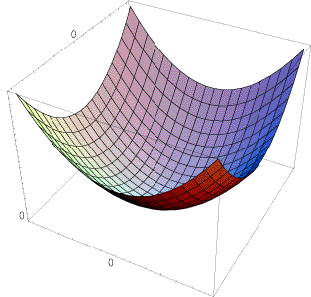
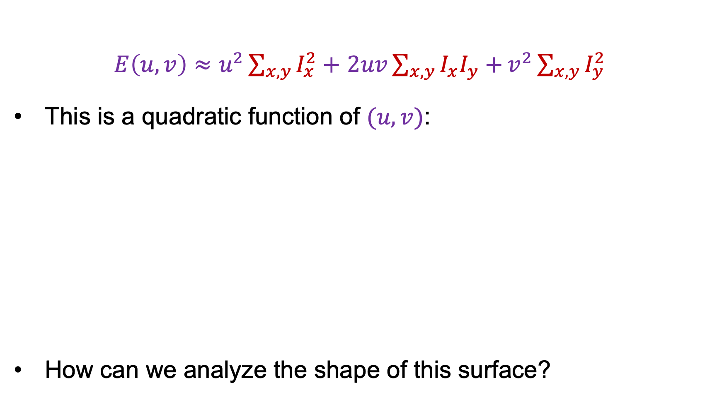

Deriving a corner detection criterion
$E\left(u,v\right)≈u^{2}\sum_{x,y}{I_{x}^{2}}+$ $2uv\sum_{x,y}{I_{x}I_{y}+}v^{2}\sum_{x,y}{I_{y}^{2}}$
This is a quadratic function of $(u,v)$:
How can we analyze the shape of this surface?
E(u, v)
$$≈$$

Slide 20
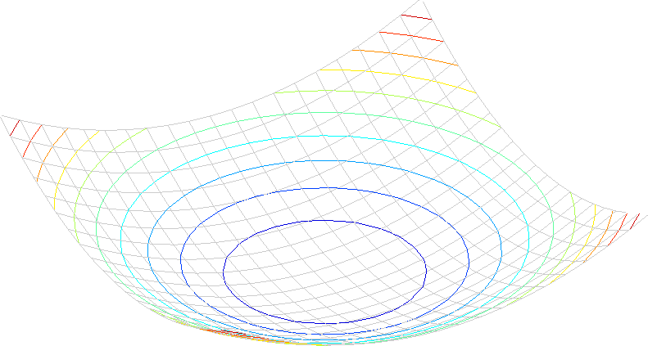

Interpreting the second moment matrix
A horizontal “slice” of $E(u, v)$ is given by the equation of an ellipse:
$$\left(\begin{matrix}u & v\end{matrix}\right)M\left(\begin{aligned}u \\ v\end{aligned}\right)=const.$$

Slide 21
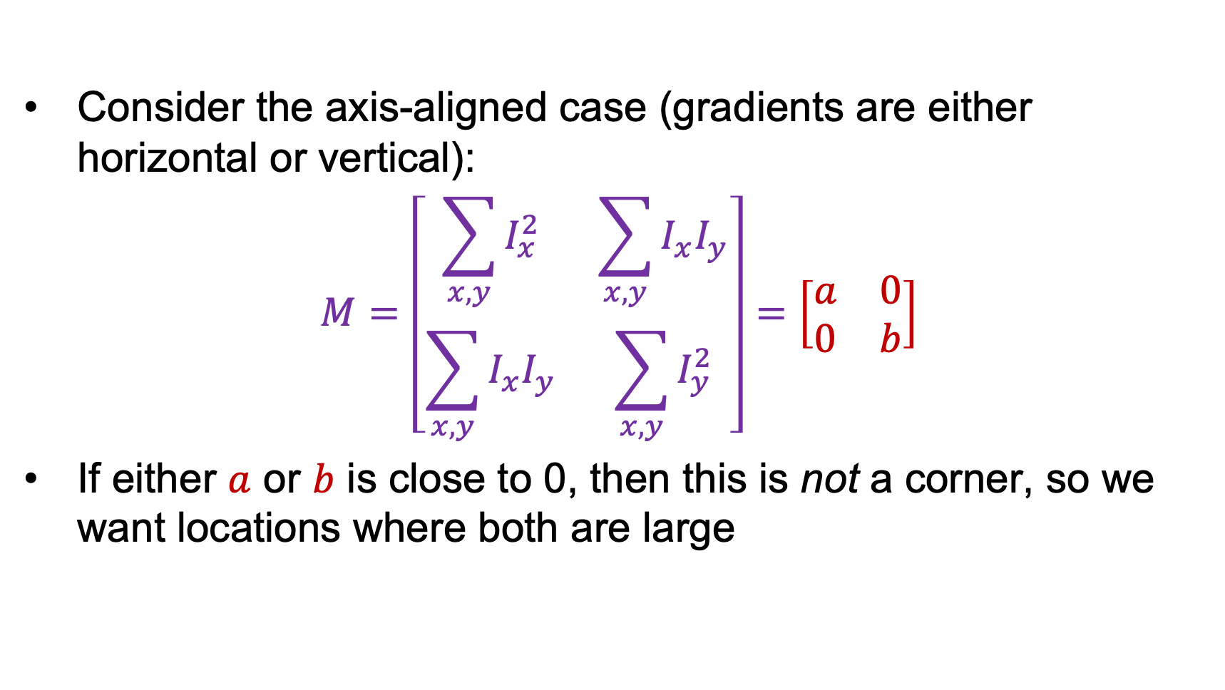




Interpreting the second moment matrix
Consider the axis-aligned case (gradients are either horizontal or vertical):
$$M=\left[\begin{matrix}\sum_{x,y}{I_{x}^{2}} & \sum_{x,y}{I_{x}I_{y}} \\ \sum_{x,y}{I_{x}I_{y}} & \sum_{x,y}{I_{y}^{2}}\end{matrix}\right]=\left[\begin{matrix}a & 0 \\ 0 & b\end{matrix}\right]$$
If either $a$ or $b$ is close to 0, then this is not a corner, so we want locations where both are large
$$a=0,b=0$$
$$b=0$$
$$a=0$$
$$a>0,b>0$$

Slide 22
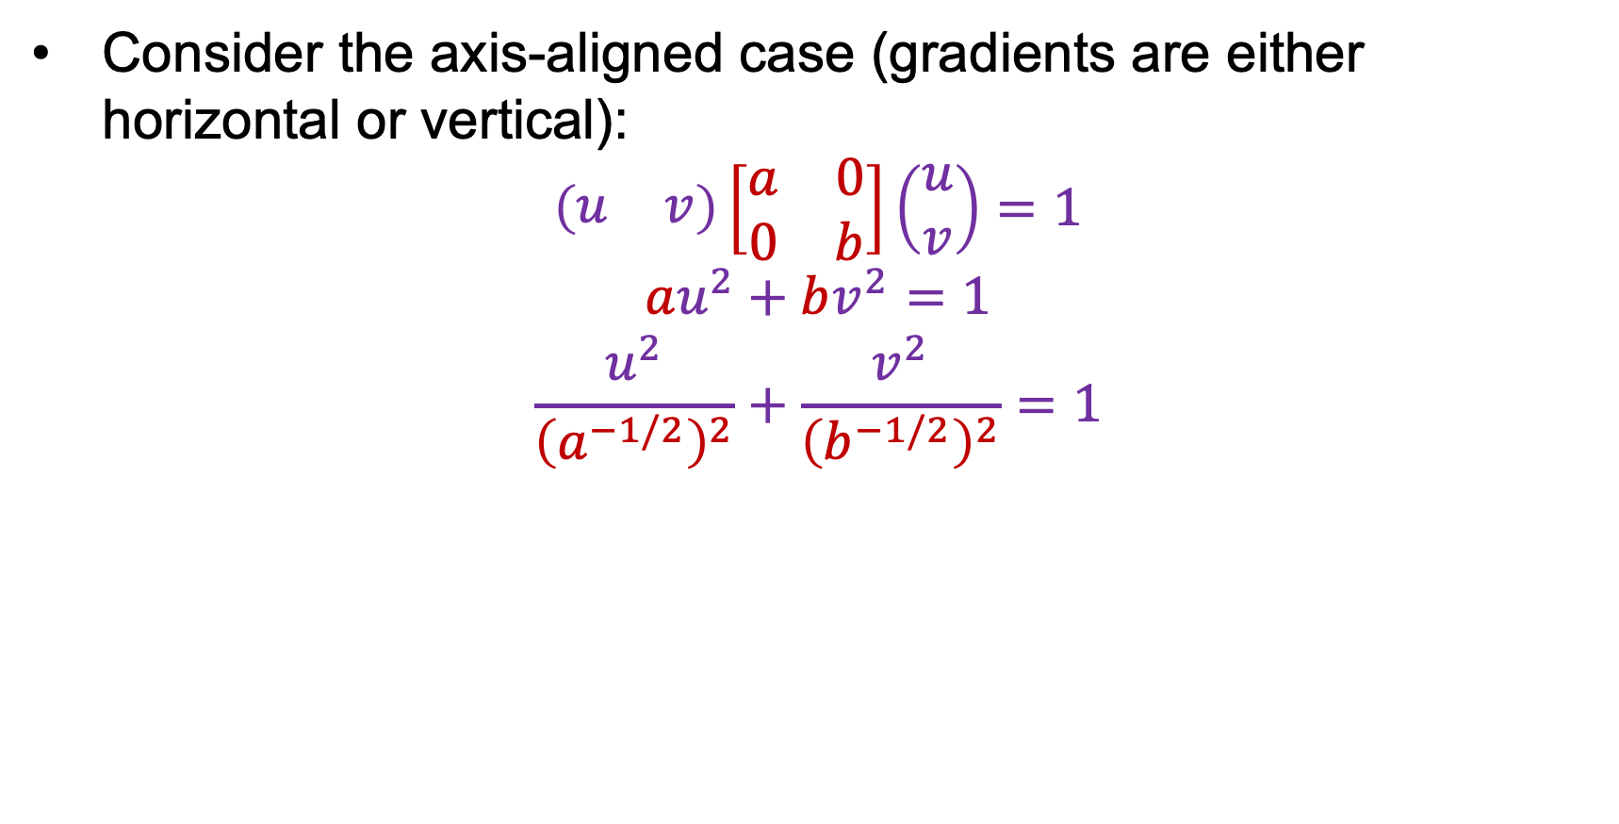
Interpreting the second moment matrix
Consider the axis-aligned case (gradients are either horizontal or vertical):
$$\left(\begin{matrix}u & v\end{matrix}\right)\left[\begin{matrix}a & 0 \\ 0 & b\end{matrix}\right]\left(\begin{aligned}u \\ v\end{aligned}\right)=1$$
$$au^{2}+bv^{2}=1$$
$$\frac{u^{2}}{{\left(a^{−1/2}\right)}^{2}}+\frac{v^{2}}{{\left(b^{−1/2}\right)}^{2}}=1$$
a^{-1/2}
Minor axis
Major axis
b^{-1/2}

Slide 23

Interpreting the second moment matrix
In general, need to diagonalize $M$:
$$M=R^{−1}\left[\begin{matrix}λ_{1} & 0 \\ 0 & λ_{2}\end{matrix}\right]R$$
The axis lengths of the ellipse are determined by the eigenvalues and the orientation is determined by $R$
direction of the fastest change
direction of the slowest change
(λ_{max})^{-1/2}
(λ_{min})^{-1/2}

Slide 24
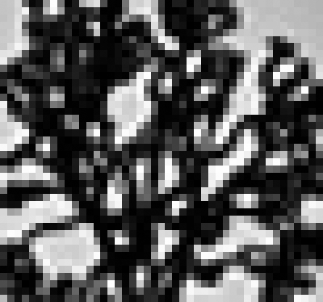
Visualization of second moment matrices

Slide 25
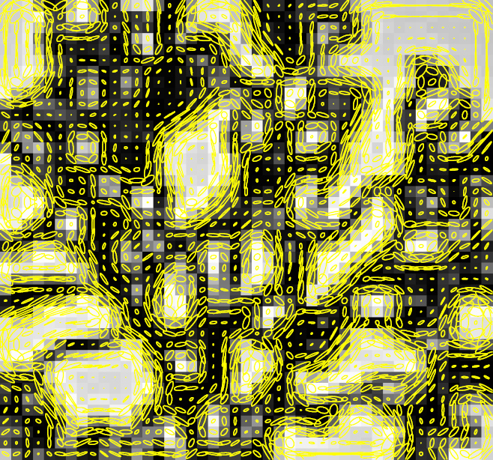
Visualization of second moment matrices
Note: axes are rescaled so ellipse areas are proportional to edge energy (i.e., bigger ellipses correspond to stronger edges)

Slide 26

Interpreting the eigenvalues
Classification of image points using eigenvalues of $M$:
λ₂
“Edge”
λ₂ >> λ₁
“Corner”
λ₁ and λ₂ are large,
λ₁ ~ λ₂;
E increases in all directions
λ₁ and λ₂ are small;
E is almost constant in all directions
“Flat” region
“Edge”
λ₁ >> λ₂
λ₁

Slide 27

Corner response function
$$R=\det\left(M\right)−α trace{\left(M\right)}^{2}=λ_{1}λ_{2}−α{(λ_{1}+λ_{2})}^{2}$$
$α$: constant (0.04 to 0.06)
“Edge”
R < 0
“Corner”
R > 0
|R| small
“Flat” region
“Edge”
R < 0

Slide 28
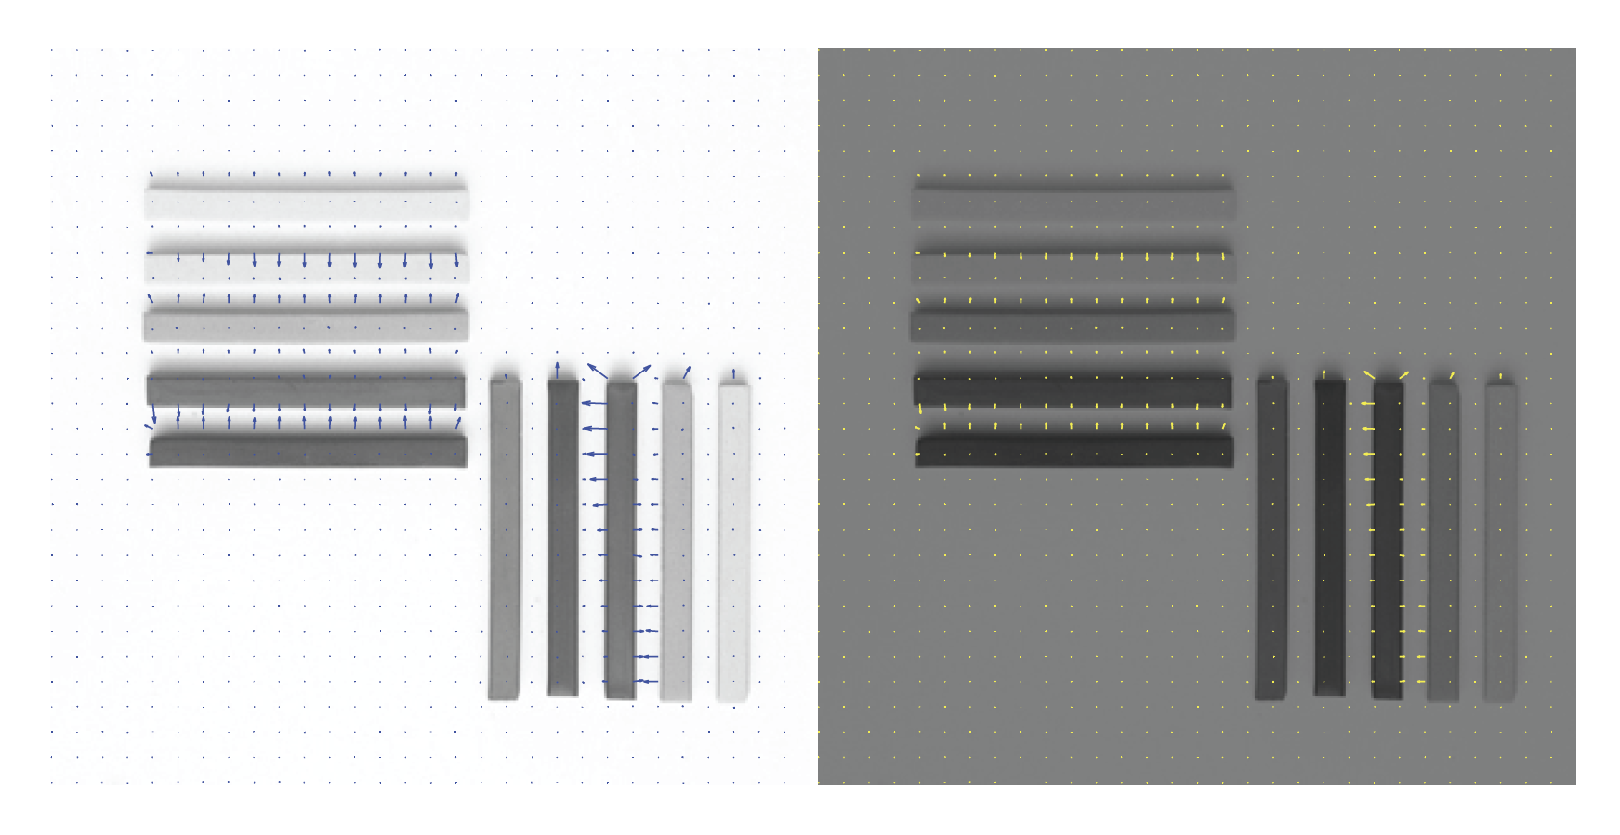

Slide 29
Outline
Keypoint detection: Motivation
Deriving a corner detection criterion
The Harris corner detector

Slide 30
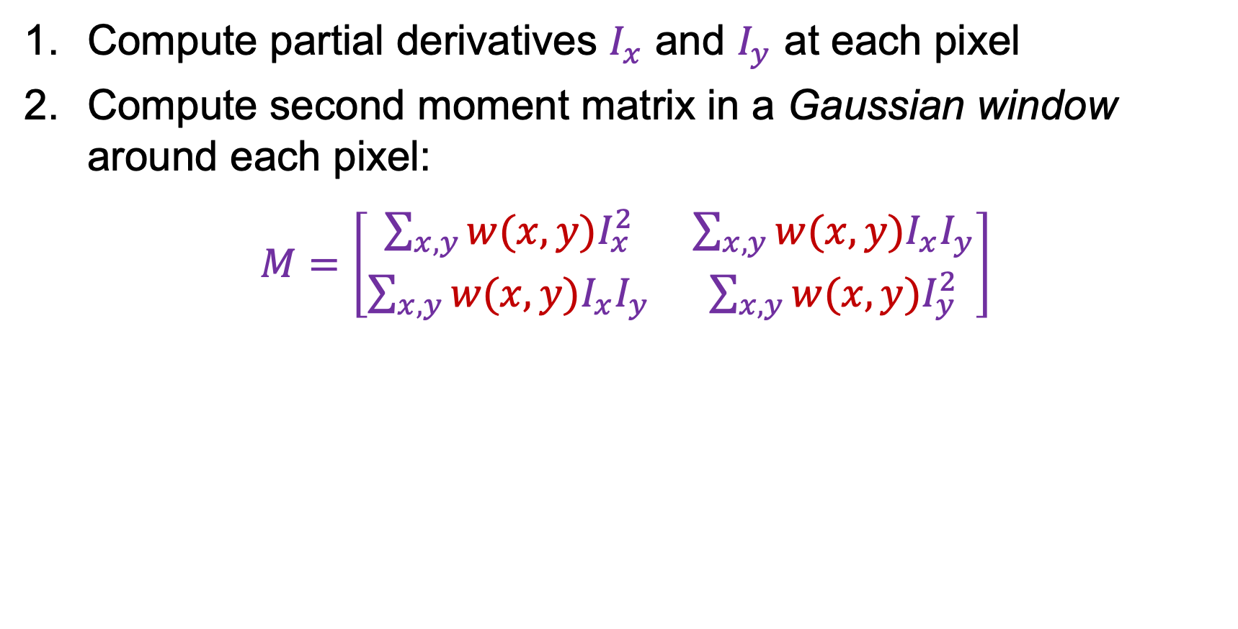
The Harris corner detector
Compute partial derivatives $I_{x}$ and $I_{y}$ at each pixel
Compute second moment matrix in a Gaussian window around each pixel:
$M=\left[\begin{matrix}\sum_{x,y}{w(x,y)I_{x}^{2}} & \sum_{x,y}{{w(x,y)I}_{x}I_{y}} \\ \sum_{x,y}{w(x,y)I_{x}I_{y}} & \sum_{x,y}{w(x,y)I_{y}^{2}}\end{matrix}\right]$
C.Harris and M.Stephens, A Combined Corner and Edge Detector, Proceedings of the 4th Alvey Vision Conference: pages 147—151, 1988.

Slide 31
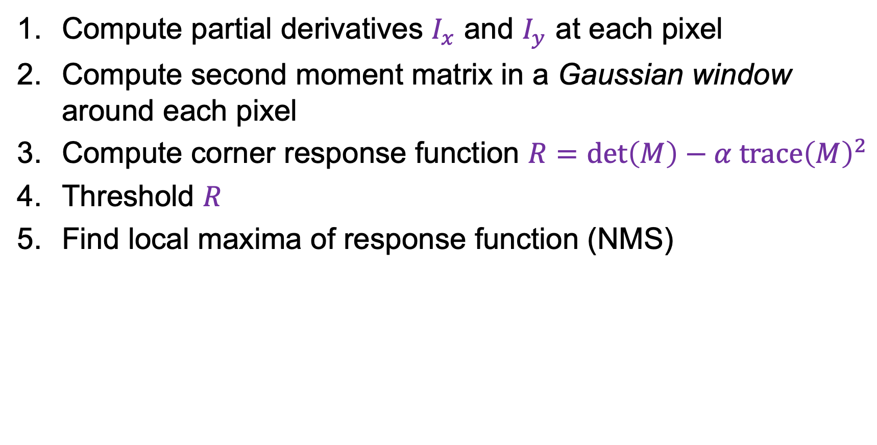
The Harris corner detector
Compute partial derivatives $I_{x}$ and $I_{y}$ at each pixel
Compute second moment matrix in a Gaussian window around each pixel
Compute corner response function $R=\det\left(M\right)−α trace{\left(M\right)}^{2}$
Threshold $R$
Find local maxima of response function (NMS)
C.Harris and M.Stephens, A Combined Corner and Edge Detector, Proceedings of the 4th Alvey Vision Conference: pages 147—151, 1988.

Slide 32
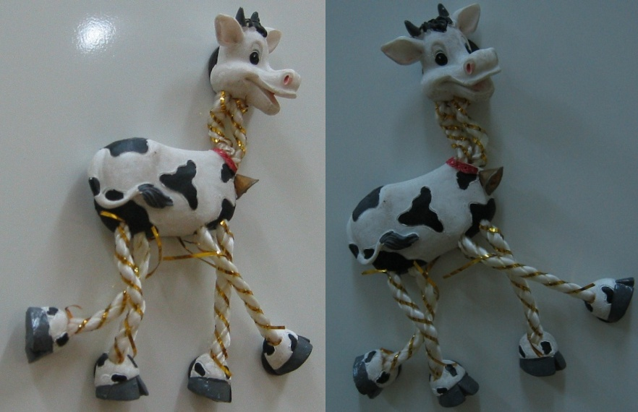
Harris Detector: Example

Slide 33
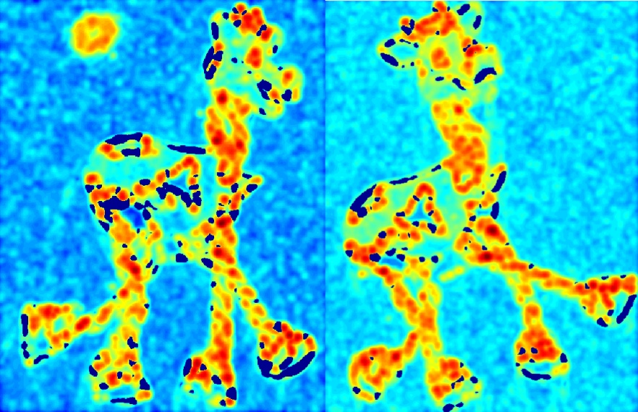

Harris Detector: Example
Compute corner response $R$

Slide 34
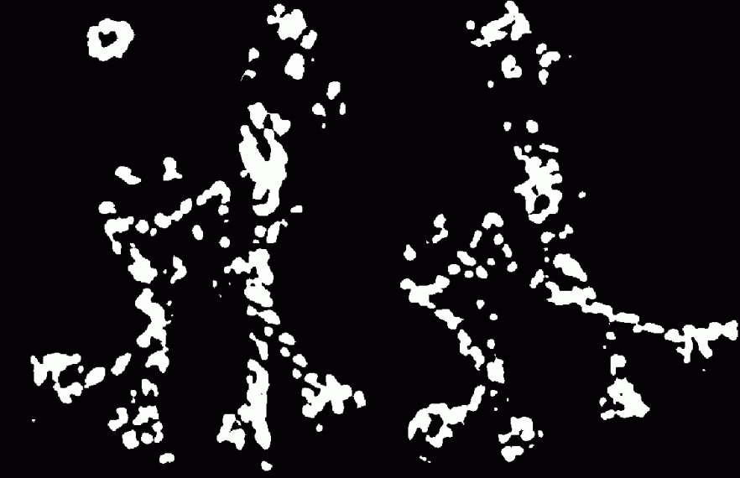
Harris Detector: Example
Find points with large corner response: $R$ > threshold

Slide 35
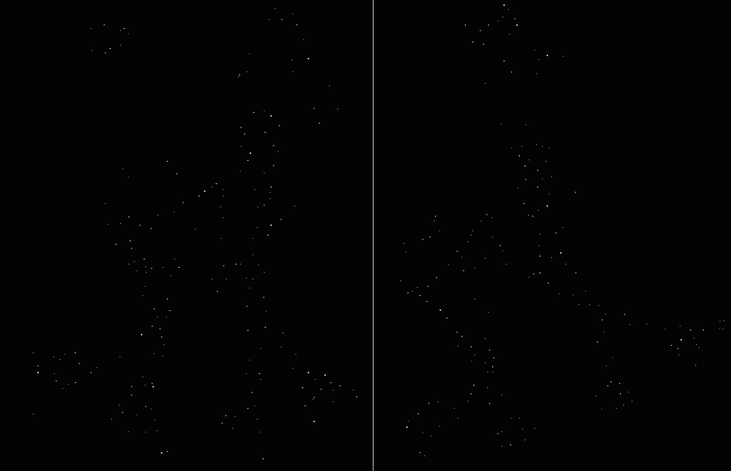

Harris Detector: Example
Take only the points of local maxima of $R$

Slide 36

Harris Detector: Example

Slide 37
Outline
Keypoint detection: Motivation
Deriving a corner detection criterion
The Harris corner detector
Behavior of corner features w.r.t. image transformations

Slide 38
Behavior w.r.t. image transformations
To be useful for image matching, “the same” corner features need to show up despite geometric and photometric transformations
We need to analyze how
the corner response function and the corner locations change in response to various transformations

Slide 39
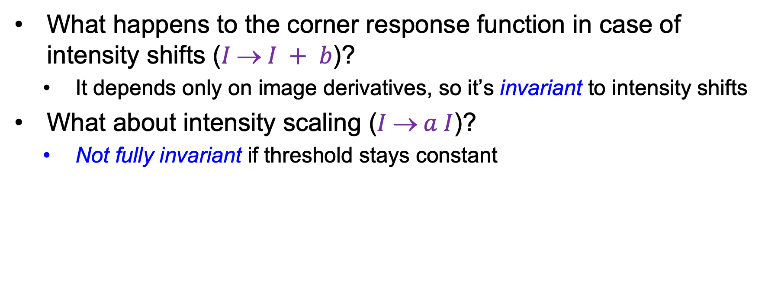
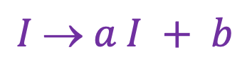
Affine intensity change
$$I  a I + b$$
What happens to the corner response function in case of intensity shifts ($I  I + b$)?
  It depends only on image derivatives, so it’s invariant to intensity shifts
What about intensity scaling ($I  a I$)?
  Not fully invariant if threshold stays constant
R
R
threshold
x (image coordinate)
x (image coordinate)

Slide 40
Image translation
How do the detected corner locations change if the image pattern is translated?
  All the ingredients of the second moment matrix are shift-invariant, and so is the corner response function
  However, the locations of the corners are equivariant (or covariant) w.r.t. shifts
Translate the image – the corners translate

Slide 41
Image rotation
How do the detected corner locations change if the image pattern is rotated?
  Assuming the second moment matrix is calculated over a circular neighborhood (and ignoring resampling issues), the rotation changes but the eigenvalues stay the same, so the response function is invariant
  The locations of the corners are equivariant (or covariant) w.r.t. rotations
Rotate the image – the corners rotate

Slide 42
Image scaling
How do the detected corner locations change if the image pattern is scaled?

Slide 43
Image scaling
Not corners!
Corner
How do the detected corner locations change if the image pattern is scaled?
  Assuming fixed-size neighborhoods for calculating the second moment matrix, the corner response function is not invariant and the corner locations are not equivariant w.r.t. scaling
Scale the image – lose/gain some corners (but not too bad)

Slide 44
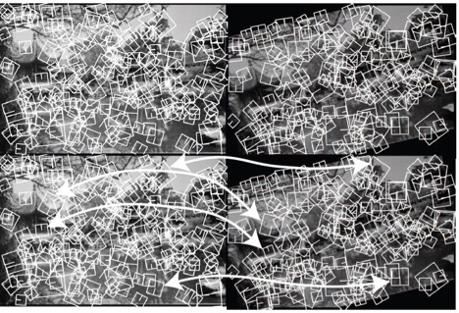
Next: describing the image around a corner
Corresponding neighborhoods are
scaled and rotated appropriately.
Arrows identify matches; look
for others on your own.

