Slide 1
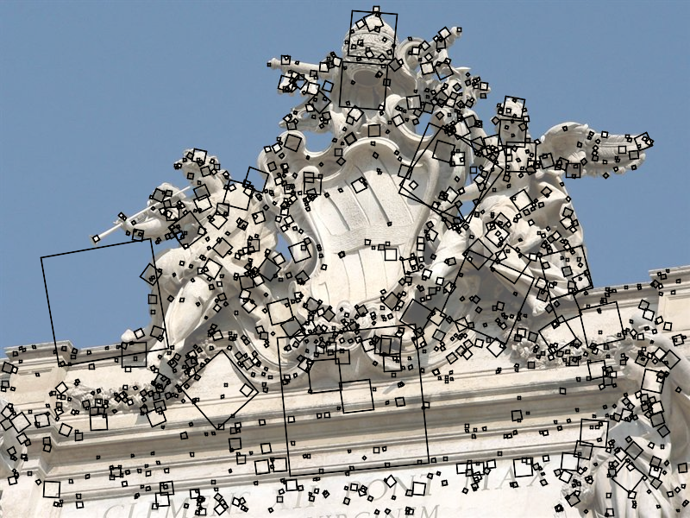
SIFT keypoint detection
D. Lowe, Distinctive image features from scale-invariant keypoints,
IJCV 60 (2), pp. 91-110, 2004

Slide 2
Overview
Windows
  Location and scale
Laplacian of Gaussian filter
Orientation
SIFT descriptors
Learning to find interest points and their descriptions

Slide 3
What we want
We want to find patches that are “worth representing”
  to match from image to image
  to represent textures
  to represent objects
And describe them in a distinctive way
What we have
  Corner detection
    A corner can be localized
      It is covariant to translation, rotation
        Tolerable behavior under scale (this can be fixed, but we won’t)

Slide 4
What we need
Build a window around the corner
  Covariant to translation, rotation, scale
    i.e. if the image is translated, rotated, scaled, so are the neighborhoods
    important to ensure that the representation of the patch is stable
  Localizable in translation, rotation, scale
    we can estimate the position, orientation and size of the patch
    and get the answer about right
Describe that window
(methods exist for richer sets of requirements, but…)

Slide 5
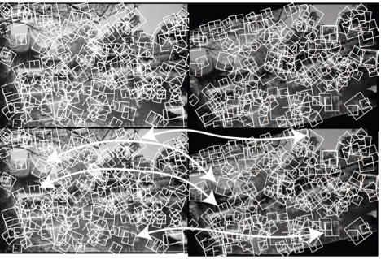
Corresponding neighborhoods are
scaled and rotated appropriately.
Arrows identify matches; look
for others on your own.

Slide 6
Keypoint detection with scale selection
We want to extract keypoints with characteristic scales that are equivariant (or covariant) w.r.t. to scaling of the image
Scale-invariant response function
K. Mikolajczyk and C. Schmid. Indexing based on scale invariant interest points. ICCV 2001
T. Lindeberg, Feature detection with automatic scale selection, IJCV 30(2), pp. 77-116, 1998

Slide 7
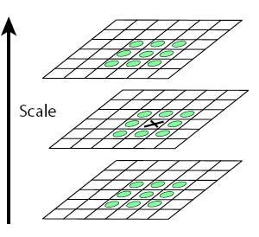

Scale of a window
At each corner, find the characteristic scale.
  Do so using method that is equivariant (or covariant) w.r.t. to scaling of the image
Approach: f$or corner at (x,y)$ search a range of scales ($σ$) so that a scale-covariant function reaches a local maximum in scale
“scale space”

Slide 8
Scale of a window
At each corner, find the characteristic scale.
  Do so using method that is equivariant (or covariant) w.r.t. to scaling of the image
Approach: f$or corner at (x,y)$ search a range of scales ($σ$) so that a scale-covariant function reaches a local maximum in scale
“scale space”

Slide 9

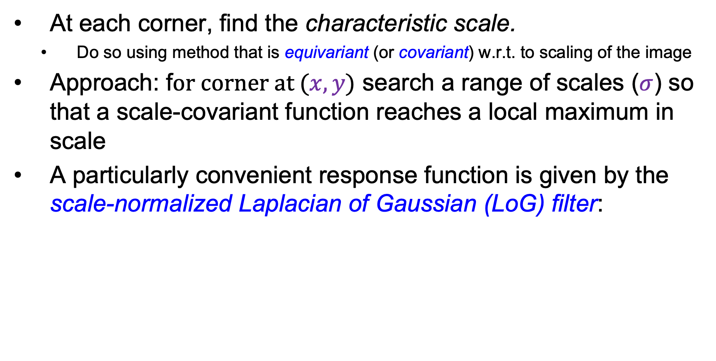
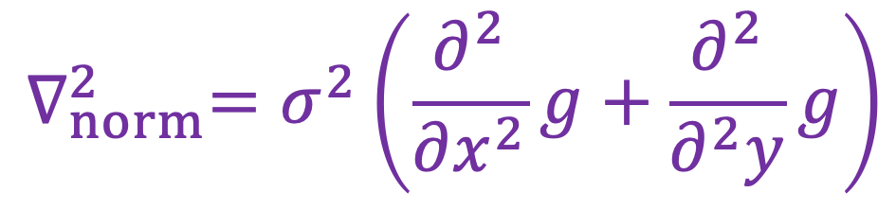
Scale of a window
At each corner, find the characteristic scale.
  Do so using method that is equivariant (or covariant) w.r.t. to scaling of the image
Approach: f$or corner at (x,y)$ search a range of scales ($σ$) so that a scale-covariant function reaches a local maximum in scale
A particularly convenient response function is given by the scale-normalized Laplacian of Gaussian (LoG) filter:
$$∇_{norm}^{2}=σ^{2}\left(\frac{∂^{2}}{∂x^{2}}g+\frac{∂^{2}}{∂^{2}y}g\right)$$

Slide 10






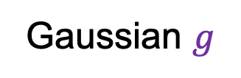
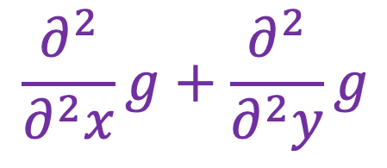
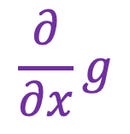
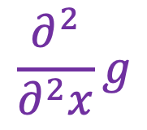
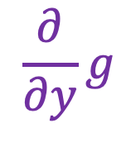
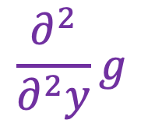
Laplacian of Gaussian
$$\frac{∂}{∂y}g$$
$$\frac{∂^{2}}{∂^{2}y}g$$
Gaussian $g$
+
$$\frac{∂}{∂x}g$$
$$\frac{∂^{2}}{∂^{2}x}g$$
$$\frac{∂^{2}}{∂^{2}x}g+\frac{∂^{2}}{∂^{2}y}g$$
Is this filter separable?
Source: J. Johnson and D. Fouhey

Slide 11
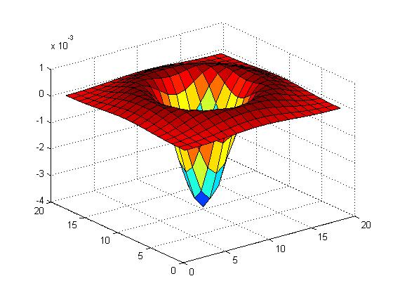

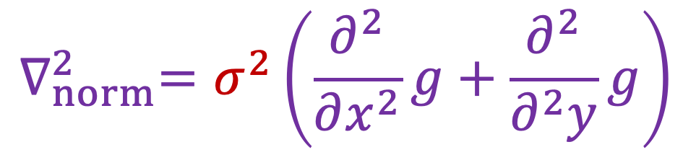
Scale-normalized Laplacian
You need to multiply the LoG by $σ^{2}$ to make responses comparable across scales
$$∇_{norm}^{2}=σ^{2}\left(\frac{∂^{2}}{∂x^{2}}g+\frac{∂^{2}}{∂^{2}y}g\right)$$

Slide 12
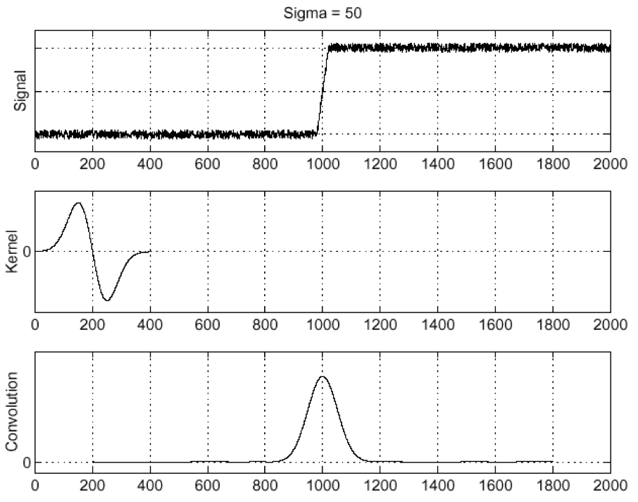
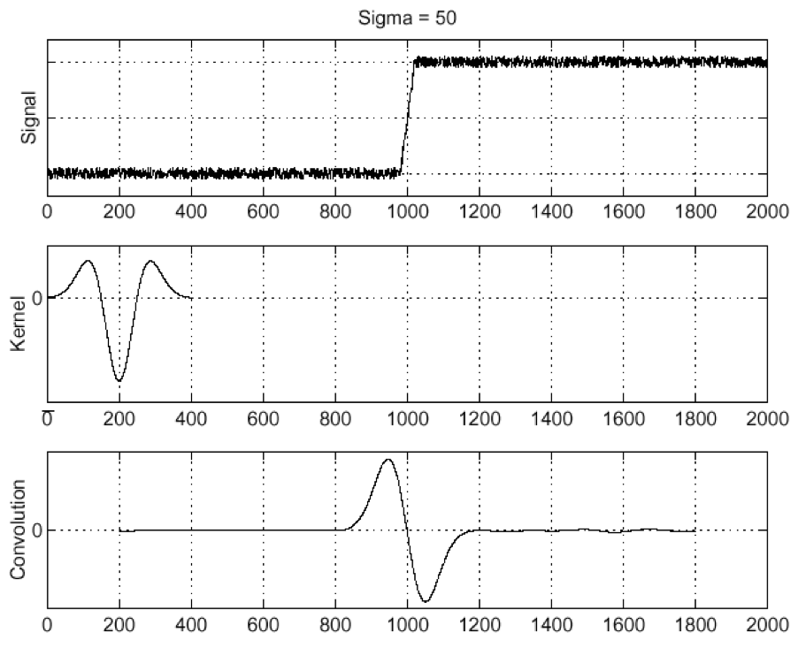
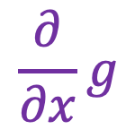

Edge detection with LoG
Edge
Derivative of Gaussian
Laplacian of Gaussian
$$\frac{∂}{∂x}g$$
$$\frac{∂^{2}}{∂^{2}x}g$$
Edge = local maximum of derivative
Edge = zero-crossing of Laplacian
D. Marr and E. Hildreth, Theory of Edge Detection, Proc. of the Royal Society of London. Series B, Biological Sciences, 207 (1167): 187–217, 1980

Slide 13
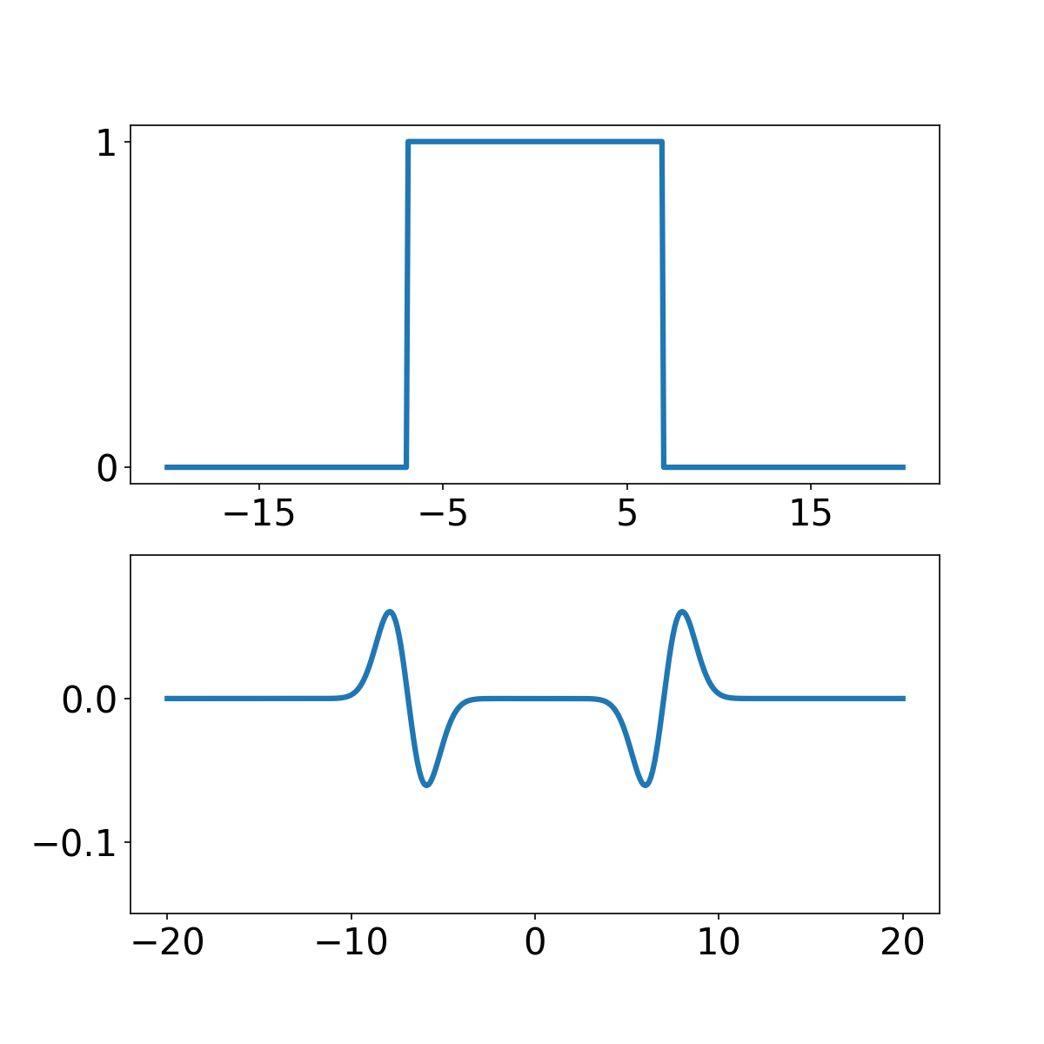


Blob detection with LoG
Let’s convolve a 1D “blob” with the Laplacian:
$$f$$
$$f∗\frac{∂^{2}}{∂^{2}x}g$$
Source: J. Johnson and D. Fouhey

Slide 14
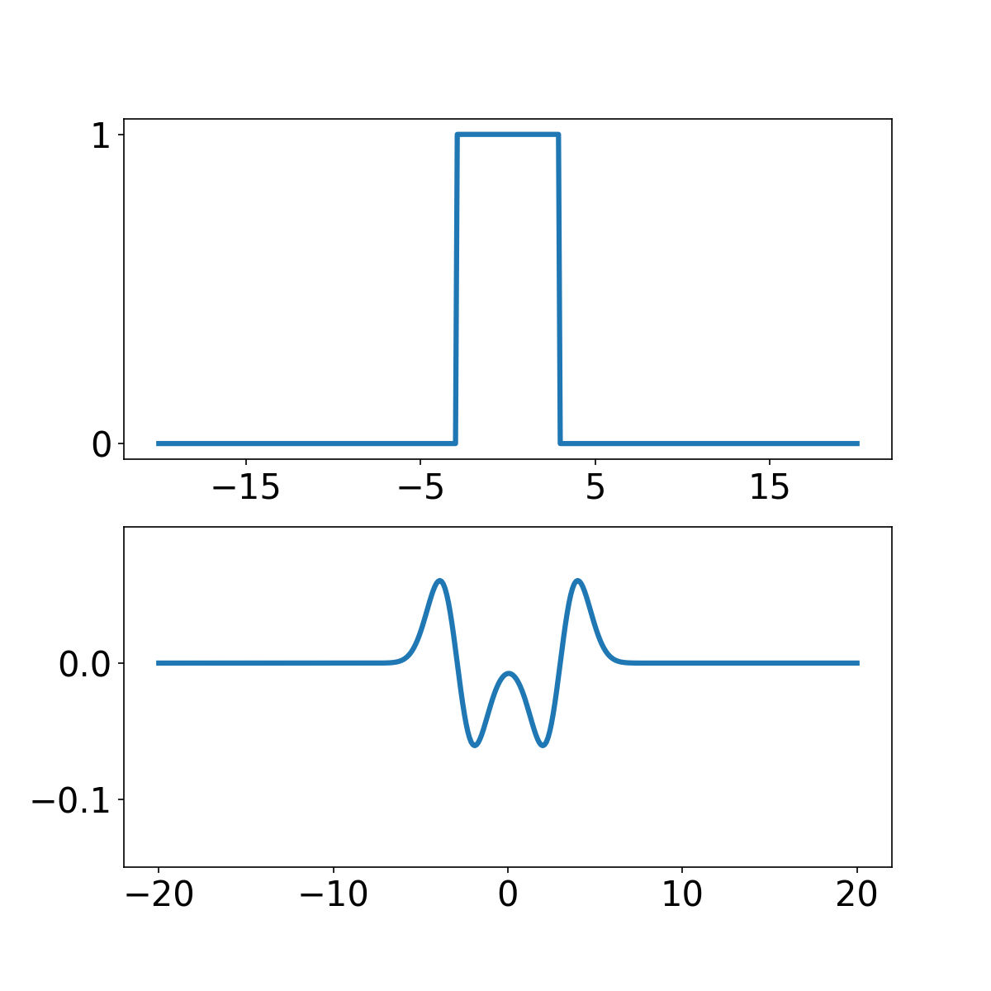
Blob detection with LoG
Let’s convolve a 1D “blob” with the Laplacian:
$$f$$
$$f∗\frac{∂^{2}}{∂^{2}x}g$$
Source: J. Johnson and D. Fouhey

Slide 15
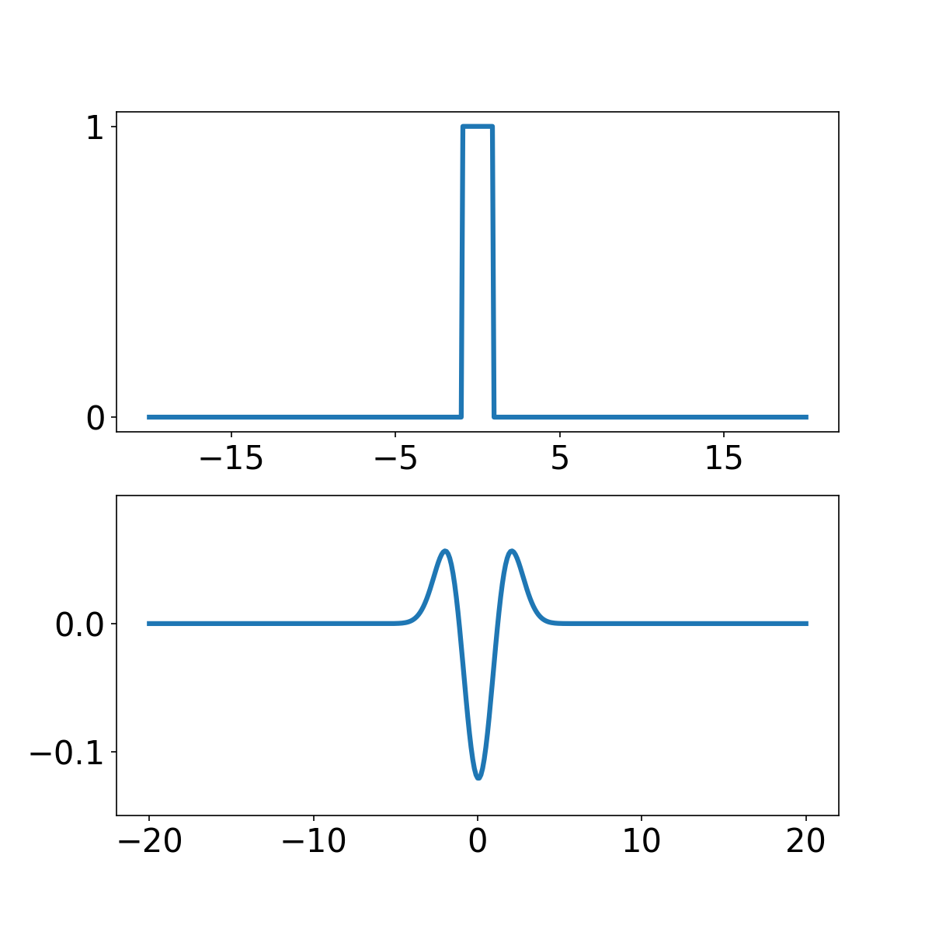
Blob detection with LoG
Let’s convolve a 1D “blob” with the Laplacian:
$$f$$
$$f∗\frac{∂^{2}}{∂^{2}x}g$$
Source: J. Johnson and D. Fouhey

Slide 16
Spatial selection
The magnitude of the Laplacian response will achieve a maximum at the center of the blob, provided the scale of the Laplacian is “matched” to the scale of the blob
maximum

Slide 17
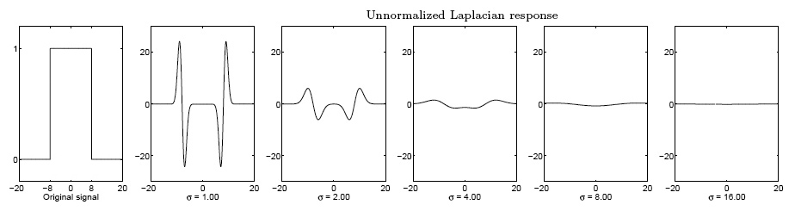
Scale selection
We want to find the characteristic scale of the blob by convolving it with Laplacians at several scales and looking for the maximum response
However, Laplacian response decays as scale increases:
original signal
(radius=8)
increasing σ

Slide 18
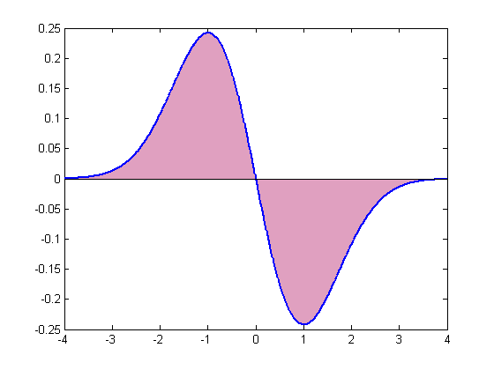
Scale normalization
The response of a derivative of Gaussian filter to a perfect step edge decreases as σ increases:
To keep response the same (scale-invariant), must multiply Gaussian derivative by σ
Laplacian is the second Gaussian derivative, so it must be multiplied by σ²
Notes:
The area under the first derivative of Gaussian from –infinity to 0 is equal to the value of the Gaussian at zero

Slide 19
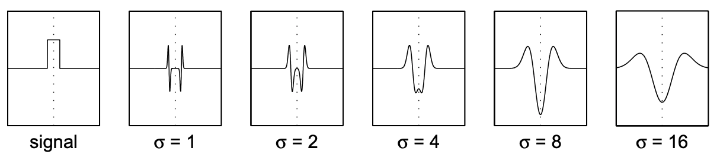

Scale selection
We can find the characteristic scale of the blob by convolving it with scale-normalized Laplacians at several scales ($σ$) and looking for the maximum response
maximum

Slide 20
Extremal scale

Slide 21
Overview
Multiscale blob detection: Key idea
Laplacian of Gaussian filter
Multiscale blob detection algorithm

Slide 22


2D multiscale blob detection
Convolve image with scale-normalized Laplacian at several scales (values of $σ$)
Find maxima of squared Laplacian response in space and across scales
$$σ$$
“Scale space”

Slide 23
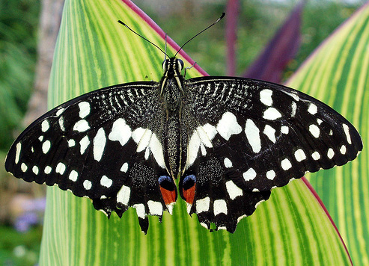
2D multiscale blob detection: Example

Slide 24
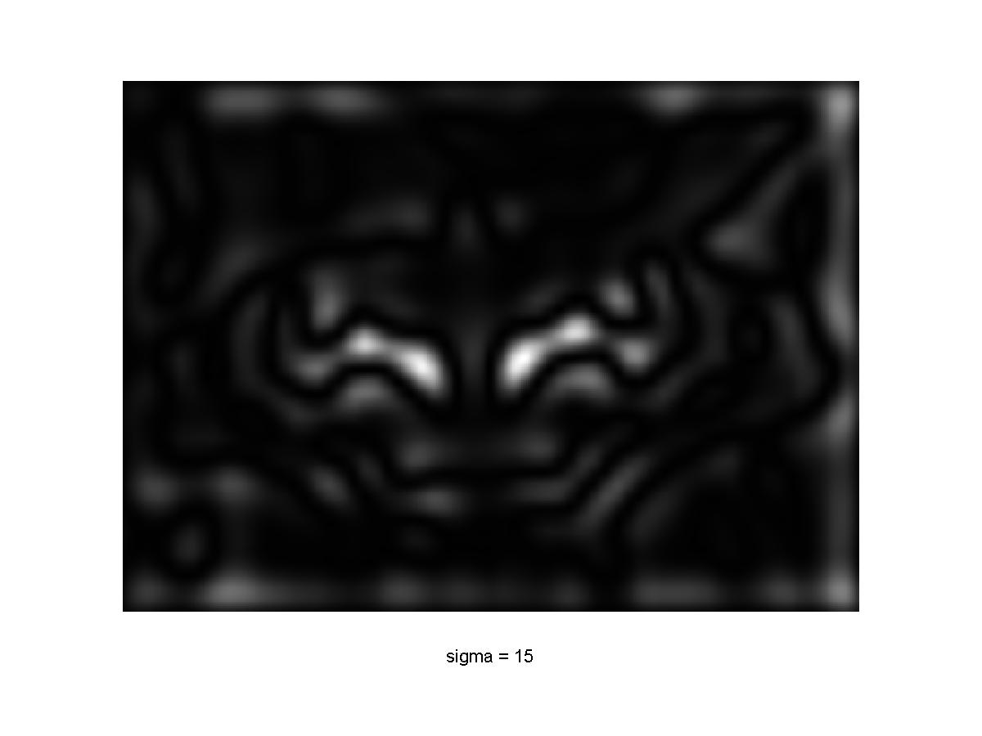
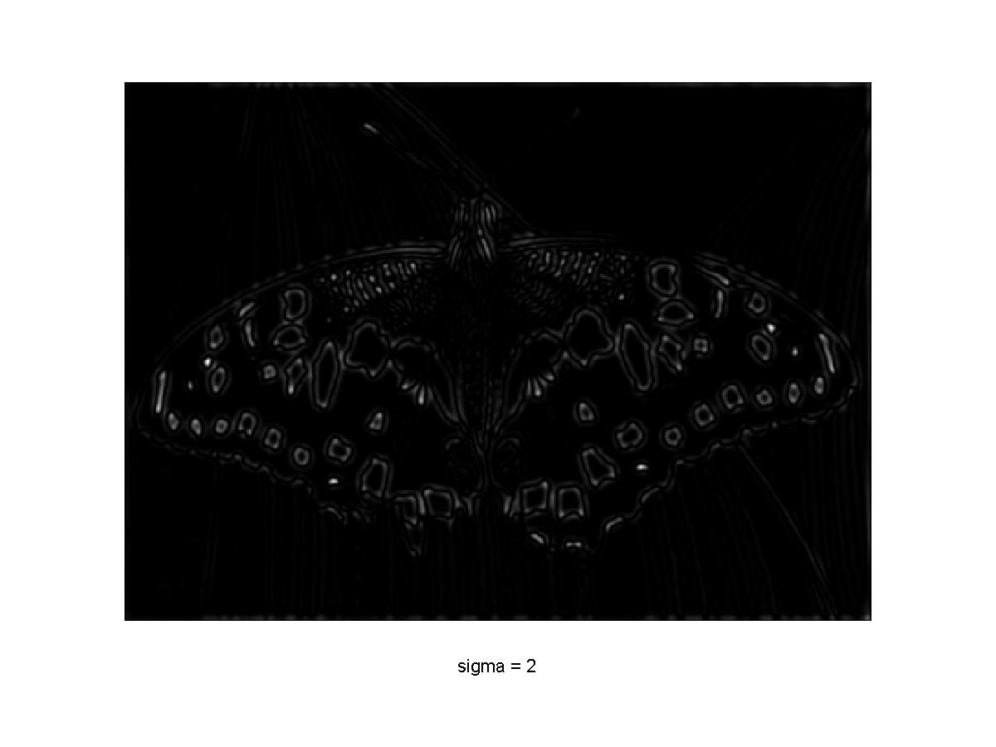
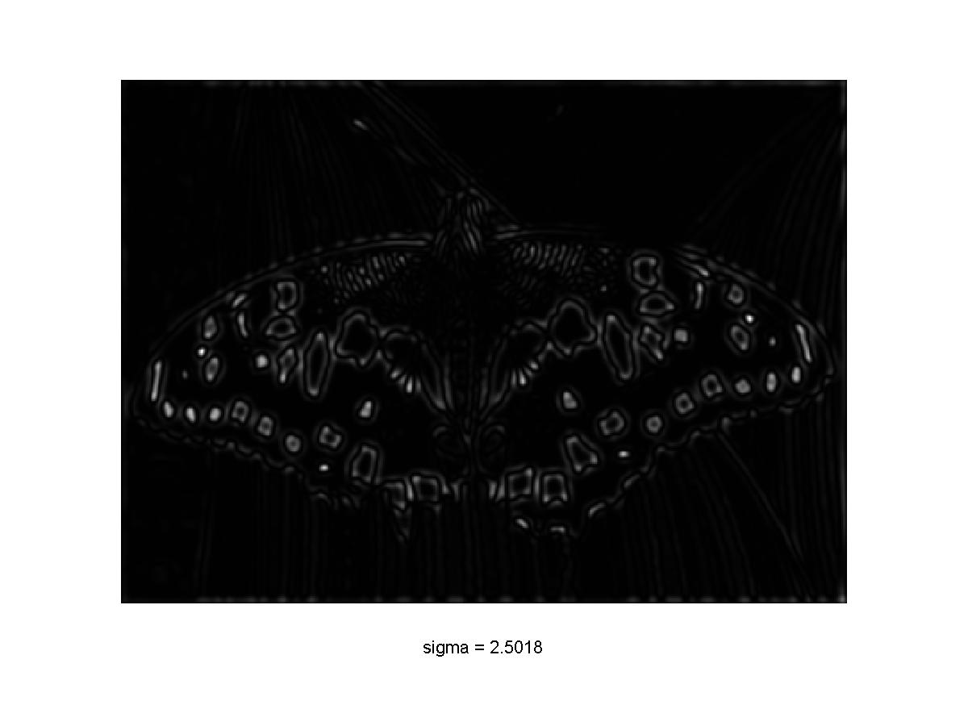
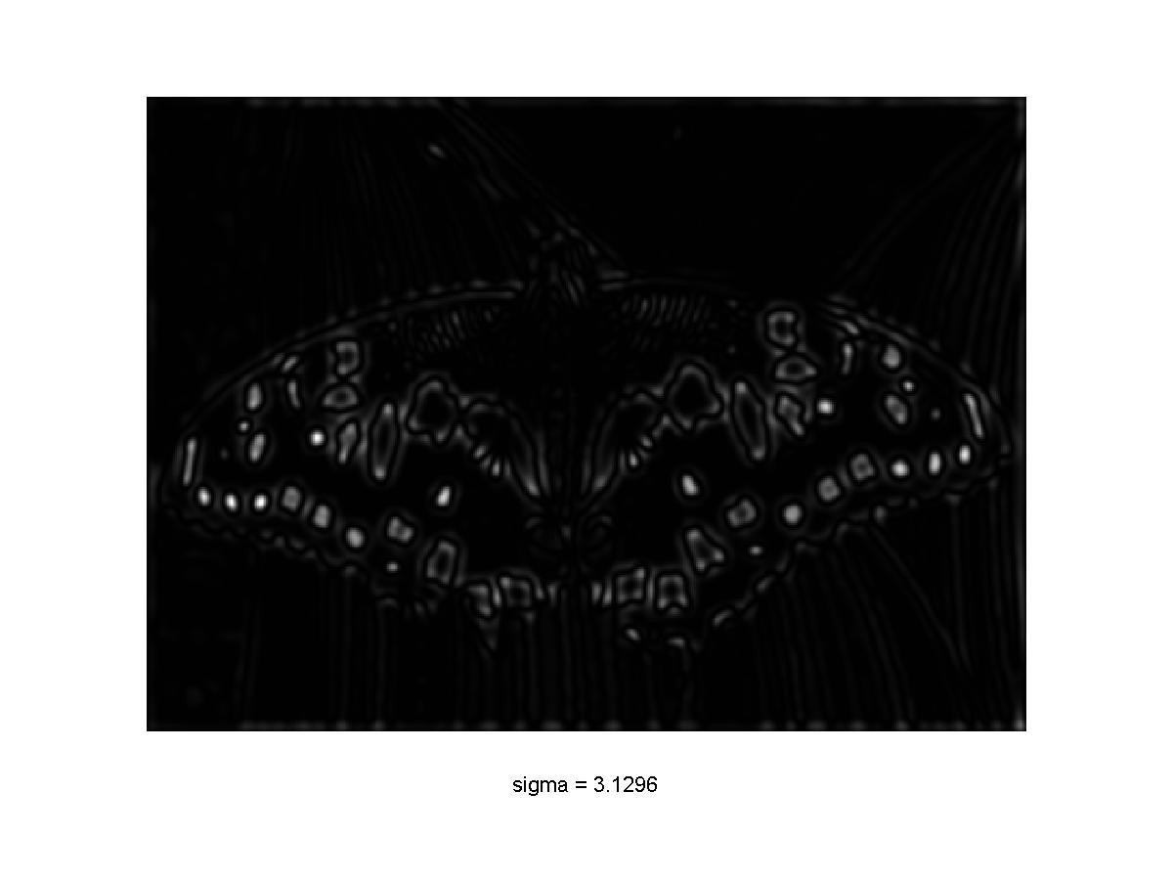
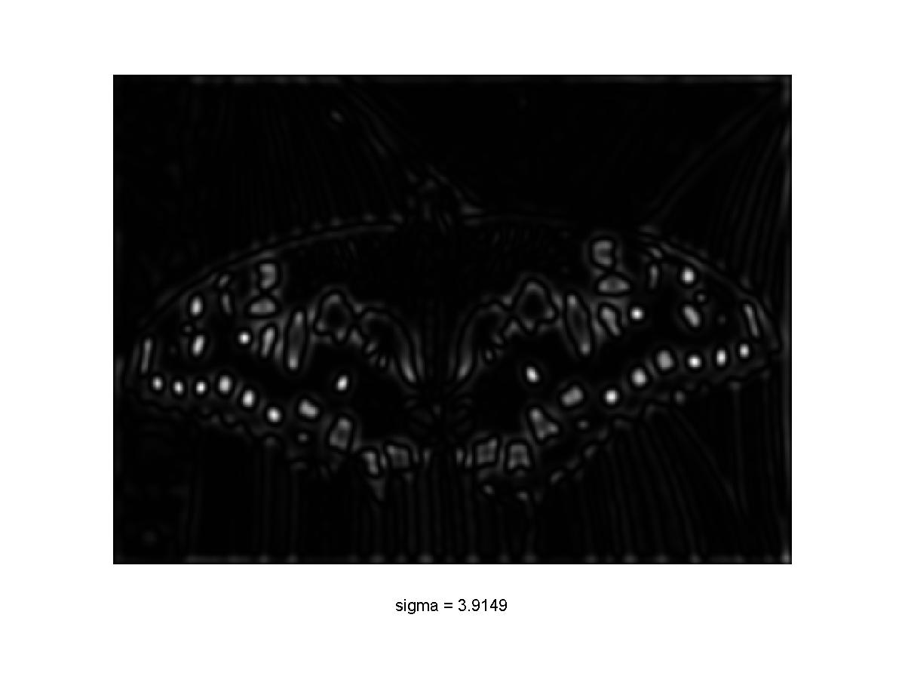
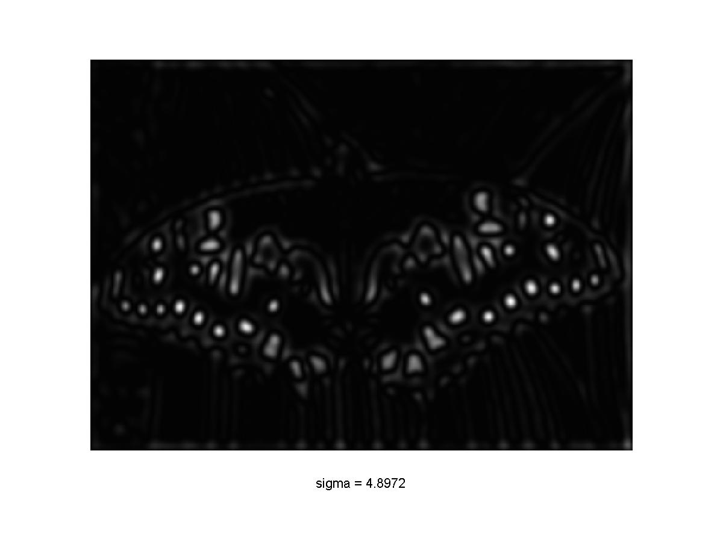

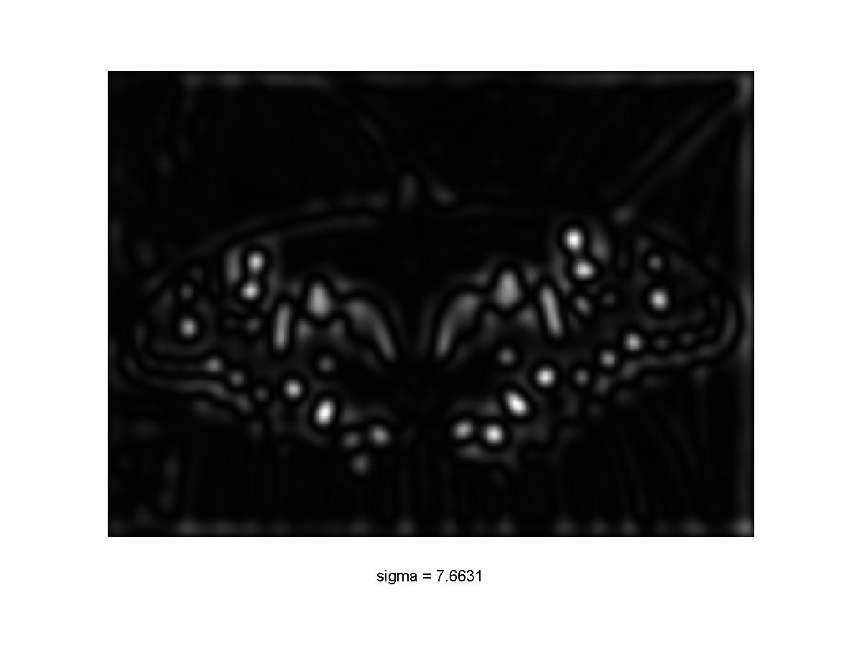
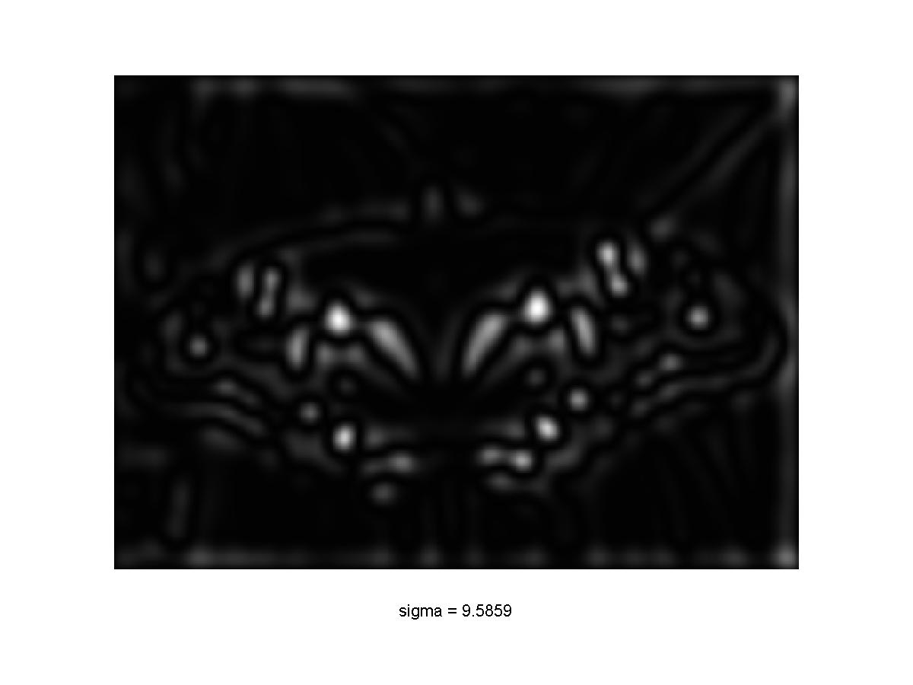
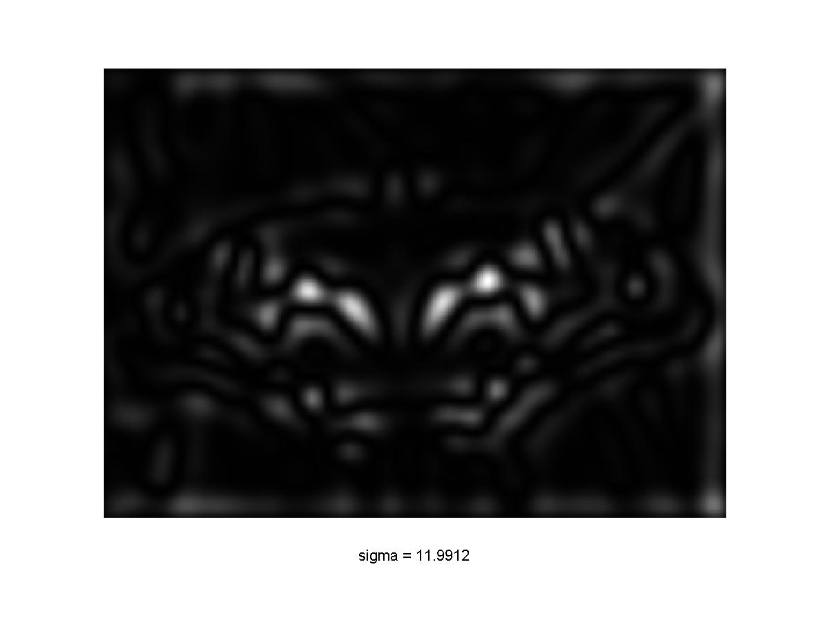
2D multiscale blob detection: Example

Slide 25
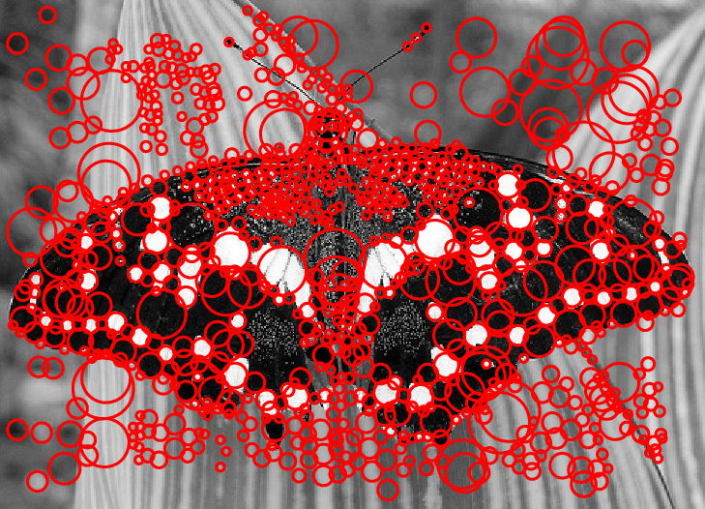
2D multiscale blob detection: Example
After scale-space NMS

Slide 26

Technical detail 1: Drawing circles
At what scale does the Laplacian achieve a maximum response to a binary circle of radius $r$?
r
image
Laplacian

Slide 27
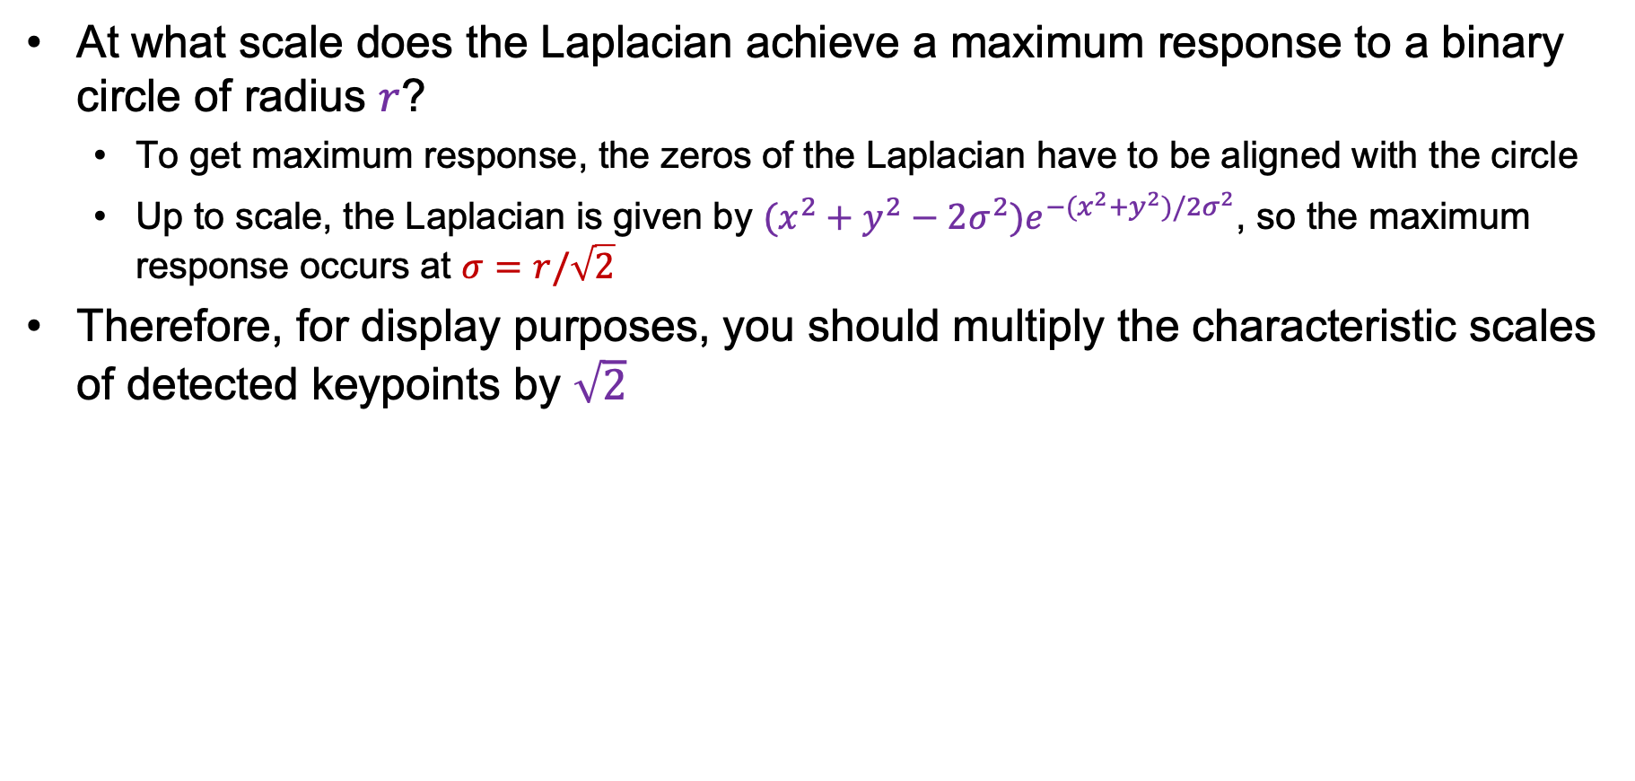
Technical detail 1: Drawing circles
At what scale does the Laplacian achieve a maximum response to a binary circle of radius $r$?
  To get maximum response, the zeros of the Laplacian have to be aligned with the circle
  Up to scale, the Laplacian is given by $(x^{2}+y^{2}−2σ^{2})e^{−(x^{2}+y^{2})/2σ^{2}}$, so the maximum response occurs at $σ=r/\sqrt{2}$
Therefore, for display purposes, you should multiply the characteristic scales of detected keypoints by $\sqrt{2}$
circle
r
0
Laplacian
image

Slide 28
Technical detail 2: Eliminating edge responses
Laplacian has strong response along edges

Slide 29
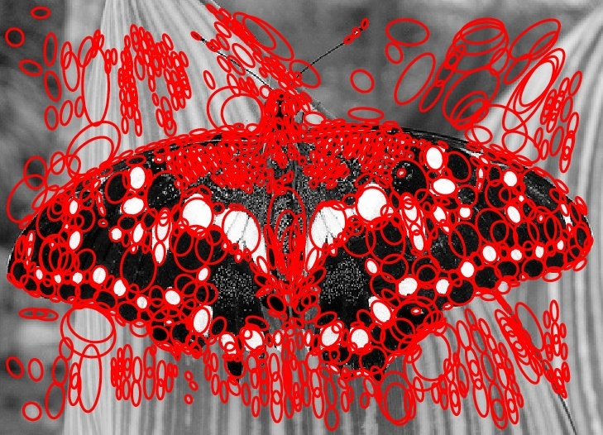
Technical detail 2: Eliminating edge responses
Laplacian has strong response along edges
Solution: filter based on Harris response function over neighborhoods containing the “blobs”

Slide 30
Overview
Windows
  Location and scale
Laplacian of Gaussian filter
Orientation
SIFT descriptors
Learning to find interest points and their descriptions

Slide 31
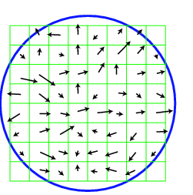
Orientation
We have
  Location, scale of window
Very effective hack for finding a reference orientation:
  Create histogram of local gradient directions in the patch
  Assign reference orientation at peak of smoothed histogram
Two peaks? Choose biggest
Same size? Choose randomly
0
2
π

Slide 32
At this point we have
Our windows – how do we describe the contents?

Slide 33
Overview
Windows
  Location and scale
Laplacian of Gaussian filter
Orientation
SIFT descriptors
Learning to find interest points and their descriptions

Slide 34
SIFT features
SIFT features
  SIFT=Scale Invariant Feature Transform
  Very strong record of effectiveness in matching applications
  SIFT features behave very well using nearest neighbors matching
    i.e. the nearest neighbor to a query patch is usually a matching patch

Slide 35
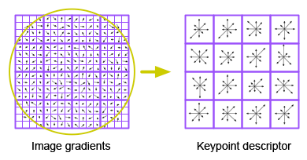
Describing a window’s contents
We want description to be:
  Invariant to changes in image brightness: - use orientations
  Robust to noise: - ignore orientations with small magnitude
  Distinctive: - use lots of local orientations
  Invariant to small errors in location:
    “bucket” the orientations in image
    Use a histogram for each bucket

Slide 37
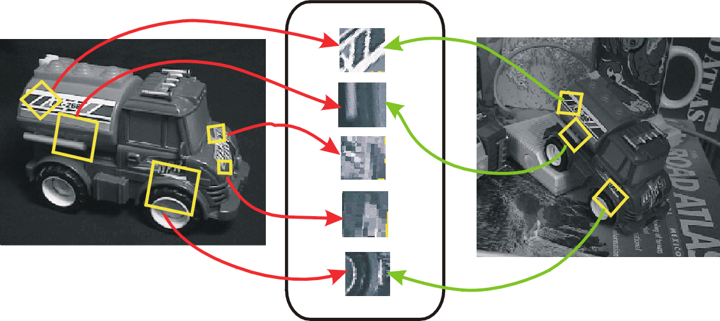
SIFT for matching
The main goal of SIFT is to enable image matching in the presence of significant transformations
  To recognize the same keypoint in multiple images, we need to match appearance descriptors or “signatures” in their neighborhoods
  Descriptors that are locally invariant w.r.t. scale and rotation can handle a wide range of global transformations

Slide 38
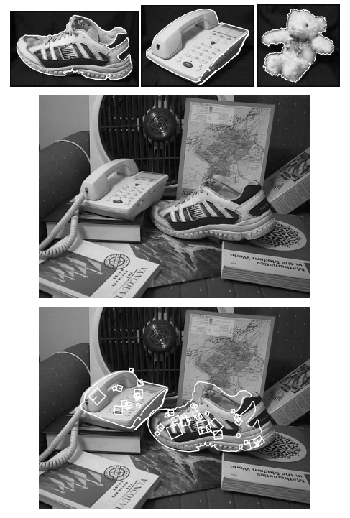
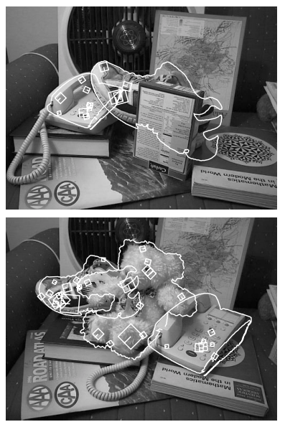
SIFT: Scale-invariant feature transform
D. Lowe. Object recognition from local scale-invariant features. ICCV 1999
D. Lowe. Distinctive image features from scale-invariant keypoints. IJCV 60 (2), pp. 91-110, 2004

Slide 39
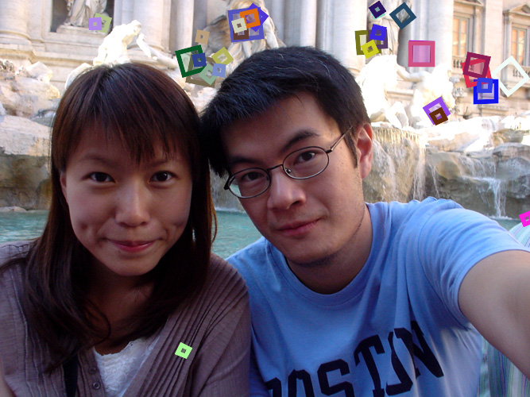
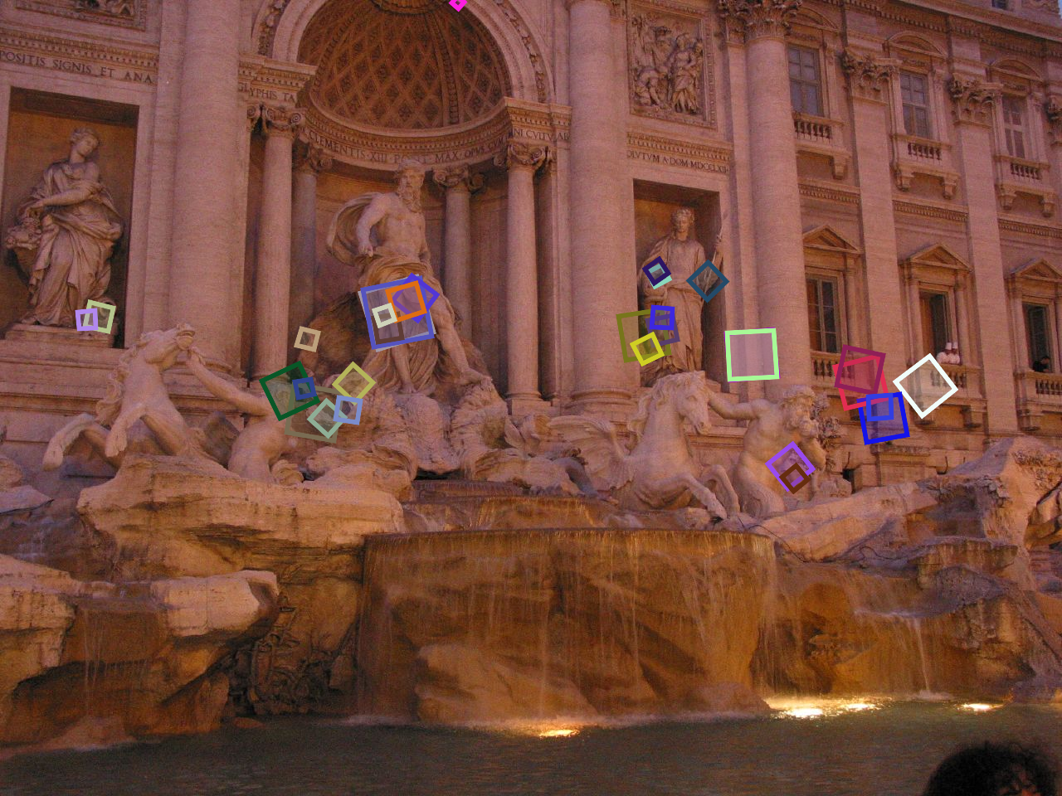
SIFT for matching
Extraordinarily robust detection and description technique
  Can handle changes in viewpoint
    Up to about 60 degree out-of-plane rotation
  Can handle significant changes in illumination
    Sometimes even day vs. night
  Fast and efficient—can run in real time
  Lots of code available
Source: N. Snavely

Slide 40
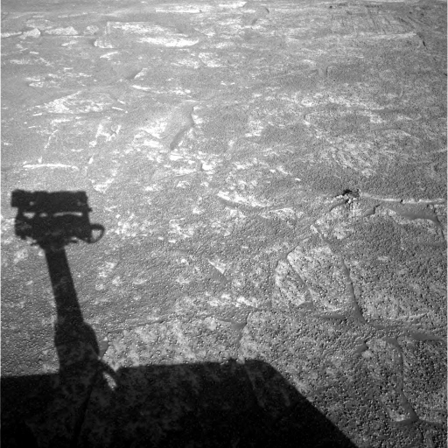

A hard matching problem
NASA Mars Rover images

Slide 41


Answer below (look for tiny colored squares…)
NASA Mars Rover images
with SIFT feature matches
Figure by Noah Snavely

Slide 42
Neighborhoods and SIFT - Key Points
Algorithms to find neighborhoods
  Represented by location, scale and orientation
  Neighborhood is covariant
    If image is translated, scaled, rotated
    Neighborhood is translated, scaled, rotated
    Important property for matching
  Affine covariant constructions are available
Once found, describe with SIFT features
  A representation of local orientation histograms, comparable to HOG
  Normalized differently

Slide 43
Learning to detect and describe keypoints
You should be able to learn all this
  keypoints are stable under rotation, translation, scale (homographies)
  descriptions are stable under rotation, translation, scale (homographies)
DeTone et al, 18

Slide 44
SuperPoint
DeTone et al, 18

Slide 45
SuperPoint
DeTone et al, 18

Slide 46
SuperPoint
DeTone et al, 18

Slide 47
SuperPoint
DeTone et al, 18

Slide 48
SuperPoint
DeTone et al, 18

Slide 49

SuperPoint

Slide 50
DeTone et al, 18

Slide 51
Overview
Windows
  Location and scale
Laplacian of Gaussian filter
Orientation
SIFT descriptors
Learning to find interest points and their descriptions

