Slide 1
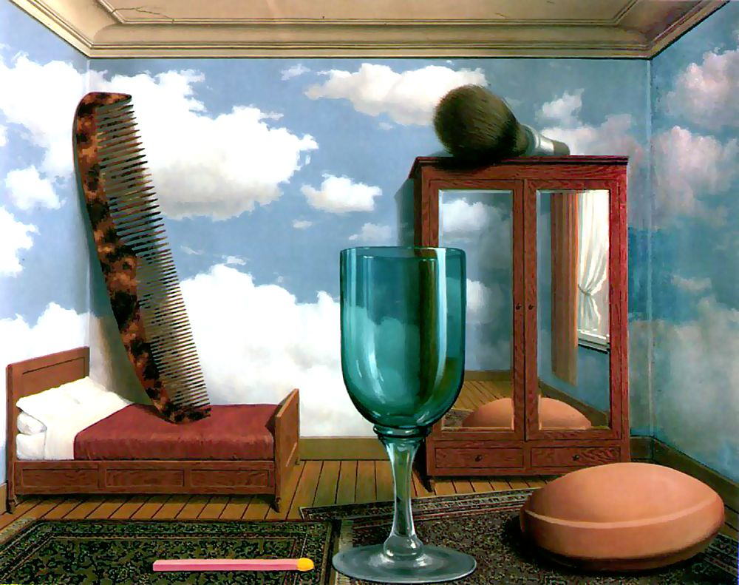
Single-view metrology
Many slides adapted from S. Seitz, D. Hoiem
R. Magritte, Personal Values, 1952

Slide 2
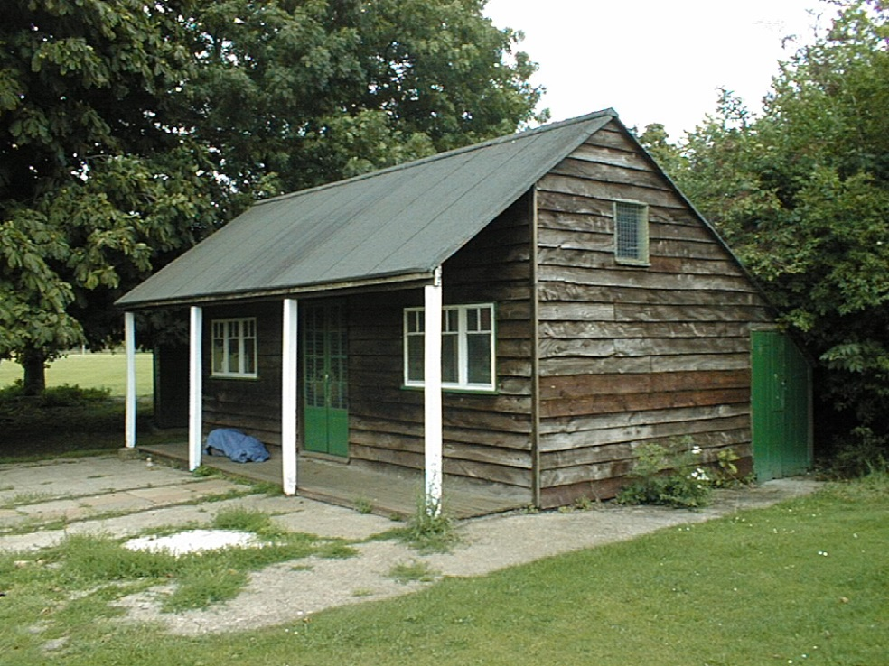
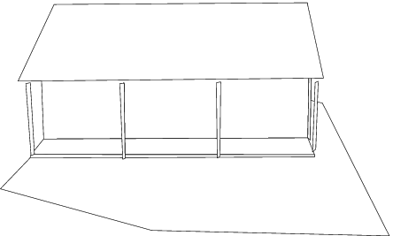
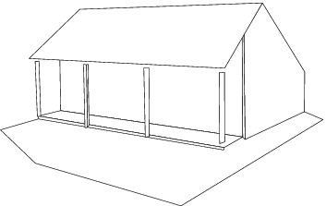
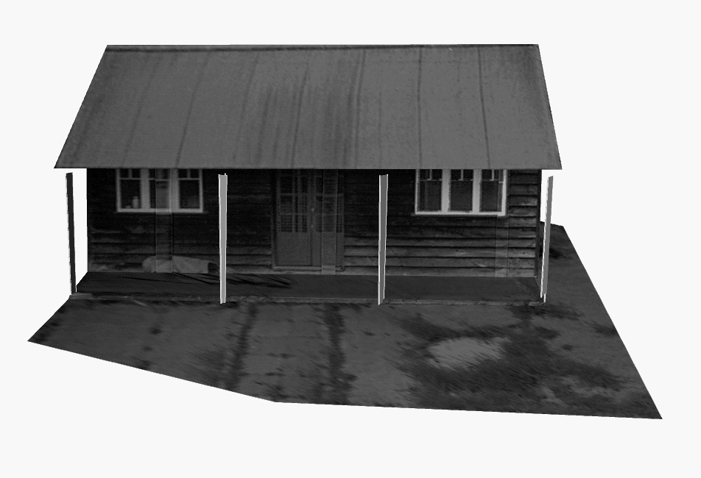
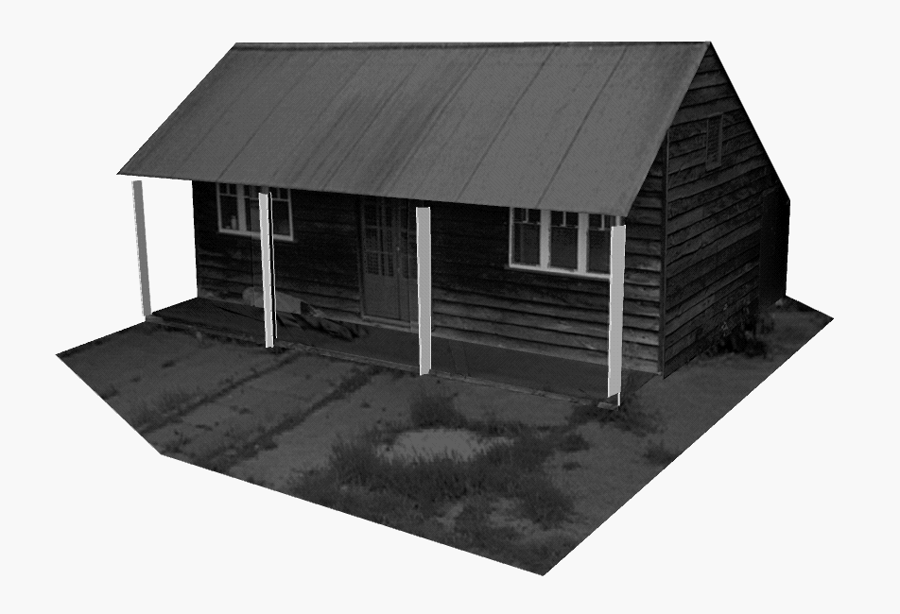
Application: 3D from a single image
A. Criminisi et al. Single View Metrology. IJCV 2000

Slide 3
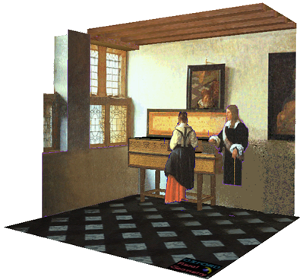
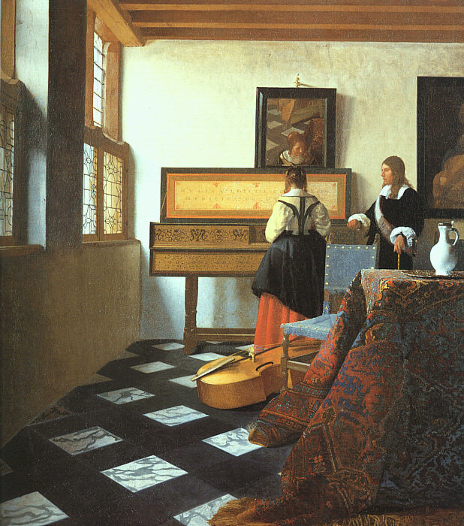
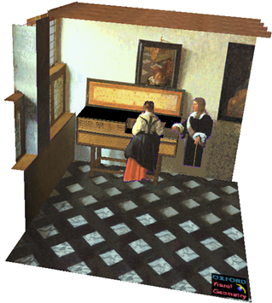
Application: 3D from a single image
J. Vermeer, Music Lesson, 1662
A. Criminisi et al. Bringing Pictorial Space to Life: computer techniques for the analysis of paintings,
Proc. Computers and the History of Art, 2002

Slide 4
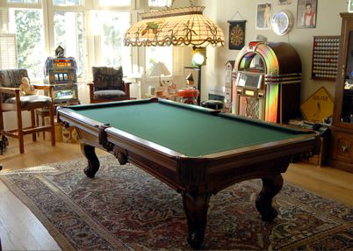
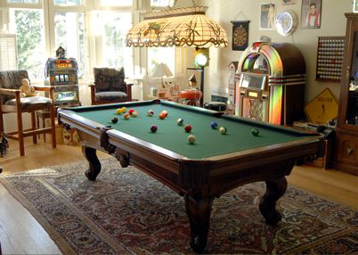
Application: Image editing, augmented reality
K. Karsch and V. Hedau and D. Forsyth and D. Hoiem. Rendering Synthetic Objects into Legacy Photographs. SIGGRAPH Asia 2011

Slide 5
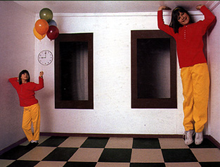
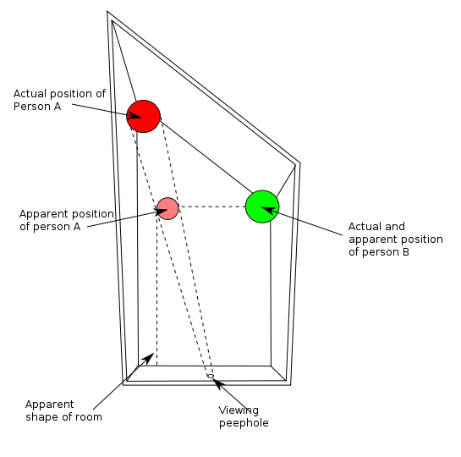
Reminder: Beware!
http://en.wikipedia.org/wiki/Ames_room

Slide 6
Outline
Camera calibration using vanishing points
Measurements from a single image
Applications of single-view metrology

Slide 7
Camera calibration using vanishing points
If world coordinates of reference 3D points are not known,
in special cases, we may be able to use vanishing points
Source: A. Efros, A. Criminisi

Slide 8
Camera calibration using vanishing points
If world coordinates of reference 3D points are not known,
in special cases, we may be able to use vanishing points
Vertical vanishing
point
Vanishing
line
Vanishing
point
Vanishing
point
Source: A. Efros, A. Criminisi

Slide 9

Review: Vanishing points
image plane
vanishing point$v$
line in the scene
camera
center
All lines having the same direction share the same vanishing point

Slide 10

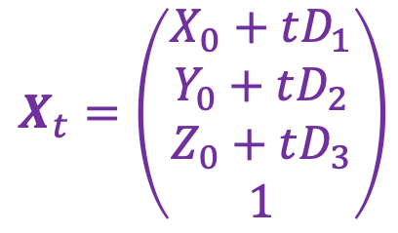


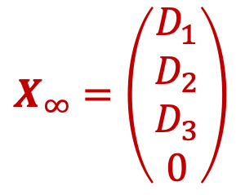
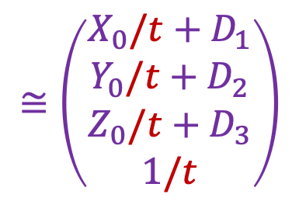
Computing vanishing points
$$v$$
$$X_{t}$$
$$X_{0}$$
Let’s parameterize the line using point $X_{0}={(X_{0},Y_{0},Z_{0},1)}^{T}$ and direction vector $D={(D_{1},D_{2},D_{3})}^{T}$:
$$X_{t}=\left(\begin{aligned}X_{0}+tD_{1} \\ Y_{0}+tD_{2} \\ Z_{0}+tD_{3} \\ 1\end{aligned}\right)$$
$$≅\left(\begin{aligned}X_{0}/t+D_{1} \\ Y_{0}/t+D_{2} \\ Z_{0}/t+D_{3} \\ 1/t\end{aligned}\right)$$
$$X_{∞}=\left(\begin{aligned}D_{1} \\ D_{2} \\ D_{3} \\ 0\end{aligned}\right)$$
$X∞$ is a point at infinity, $v$ is its projection: $v≅PX∞$

Slide 11
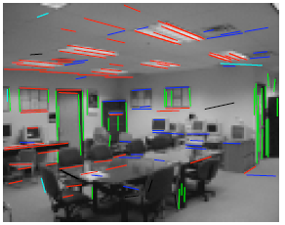
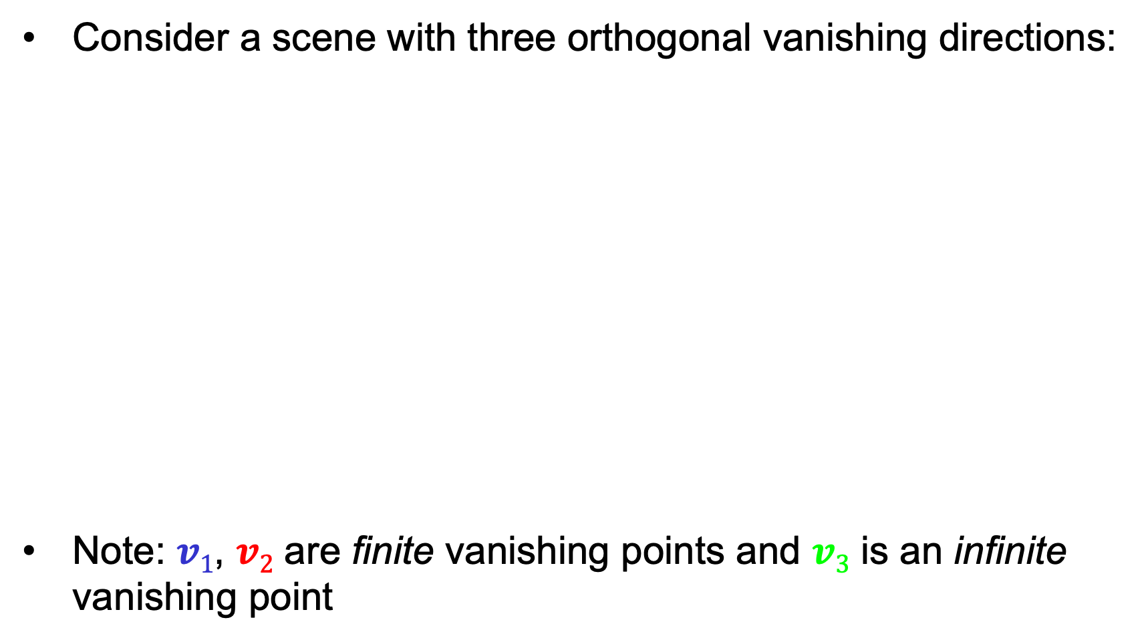



Calibration from vanishing points
Consider a scene with three orthogonal vanishing directions:
Note: $v1$, $v2$ are finite vanishing points and $v3$ is an infinite vanishing point
.
.
$$v1$$
$$v2$$
$$v3$$
Notes:
The third homogeneous coordinate of an infinite vanishing point is 0. Infinite vanishing points correspond to directions of lines that are parallel to the image plane.

Slide 12
Calibration from vanishing points
Consider a scene with three orthogonal vanishing directions:
We can align the world coordinate system with these directions
.
.
$$v1$$
$$v2$$
$$v3$$

Slide 13
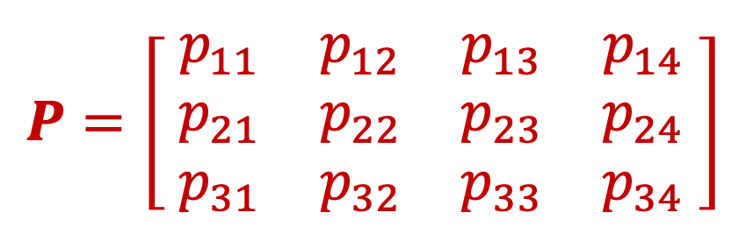
Projection of the world coordinate system
$$P=\left[\begin{matrix}{ p}_{11} & p_{12} & p_{13} & p_{14} \\ { p}_{21} & p_{22} & p_{23} & p_{24} \\ { p}_{31} & p_{32} & p_{33} & p_{34} \end{matrix}\right]$$

Slide 14

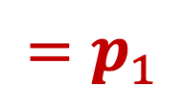
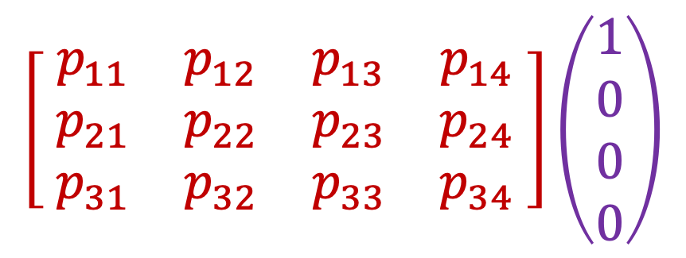

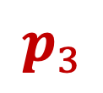

Projection of the world coordinate system
$$\left[\begin{matrix}{ p}_{11} & p_{12} & p_{13} & p_{14} \\ { p}_{21} & p_{22} & p_{23} & p_{24} \\ { p}_{31} & p_{32} & p_{33} & p_{34} \end{matrix}\right]\left(\begin{aligned}1 \\ 0 \\ 0 \\ 0\end{aligned}\right)$$
$$=p_{1}$$
$$p_{1}$$
$$p_{2}$$
$$p_{3}$$
$$p_{4}$$

Slide 15
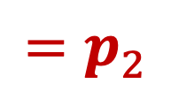
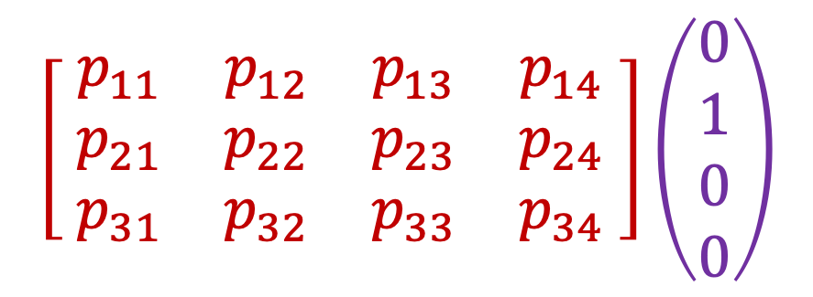
Projection of the world coordinate system
$$\left[\begin{matrix}{ p}_{11} & p_{12} & p_{13} & p_{14} \\ { p}_{21} & p_{22} & p_{23} & p_{24} \\ { p}_{31} & p_{32} & p_{33} & p_{34} \end{matrix}\right]\left(\begin{aligned}0 \\ 1 \\ 0 \\ 0\end{aligned}\right)$$
$$=p_{2}$$
$$p_{1}$$
$$p_{2}$$
$$p_{3}$$
$$p_{4}$$

Slide 16
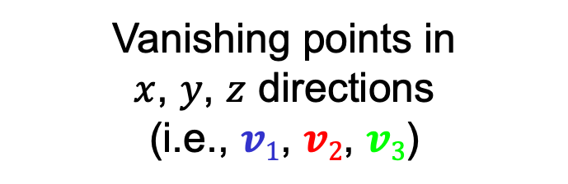
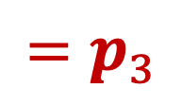
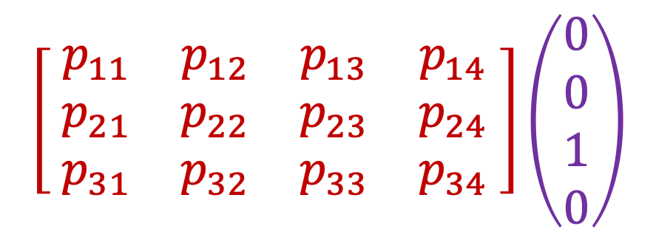
Projection of the world coordinate system
$$\left[\begin{matrix}{ p}_{11} & p_{12} & p_{13} & p_{14} \\ { p}_{21} & p_{22} & p_{23} & p_{24} \\ { p}_{31} & p_{32} & p_{33} & p_{34} \end{matrix}\right]\left(\begin{aligned}0 \\ 0 \\ 1 \\ 0\end{aligned}\right)$$
$$=p_{3}$$
$$p_{1}$$
$$p_{2}$$
$$p_{3}$$
$$p_{4}$$
Vanishing points in
$x$, $y$, $z$ directions
(i.e., $v1$, $v2$, $v3$)

Slide 17
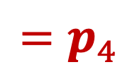
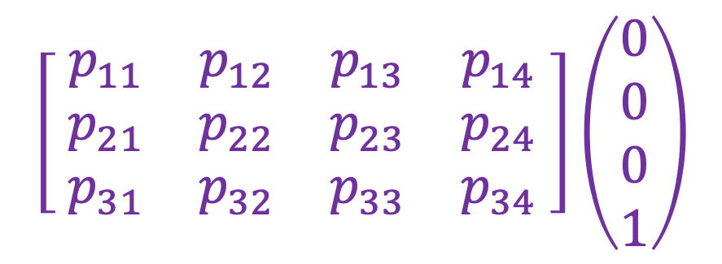
Projection of the world coordinate system
$$\left[\begin{matrix}{ p}_{11} & p_{12} & p_{13} & p_{14} \\ { p}_{21} & p_{22} & p_{23} & p_{24} \\ { p}_{31} & p_{32} & p_{33} & p_{34} \end{matrix}\right]\left(\begin{aligned}0 \\ 0 \\ 0 \\ 1\end{aligned}\right)$$
$$=p_{4}$$
$$p_{1}$$
$$p_{2}$$
$$p_{3}$$
$$p_{4}$$
Vanishing points in
$x$, $y$, $z$ directions
(i.e., $v1$, $v2$, $v3$)
Projection of world origin
Problem: this only gives us the four columns up to independent scale factors, additional constraints needed to solve for them

Slide 18
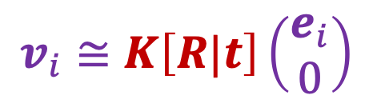

Calibration from vanishing points
Let us align the world coordinate system with three orthogonal vanishing directions in the scene:
$e_{1}=\left(\begin{aligned}1 \\ 0 \\ 0\end{aligned}\right),$ $e_{2}=\left(\begin{aligned}0 \\ 1 \\ 0\end{aligned}\right), e_{3}=\left(\begin{aligned}0 \\ 0 \\ 1\end{aligned}\right)$
$$v_{i}≅K\left[R|t\right]\left(\begin{aligned}e_{i} \\ 0\end{aligned}\right)$$

Slide 19

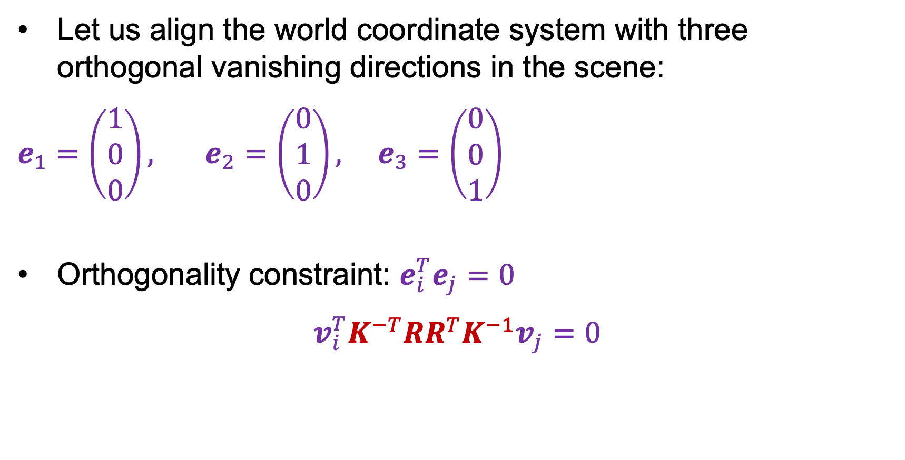



Calibration from vanishing points
Let us align the world coordinate system with three orthogonal vanishing directions in the scene:
$e_{1}=\left(\begin{aligned}1 \\ 0 \\ 0\end{aligned}\right),$ $e_{2}=\left(\begin{aligned}0 \\ 1 \\ 0\end{aligned}\right), e_{3}=\left(\begin{aligned}0 \\ 0 \\ 1\end{aligned}\right)$
Orthogonality constraint: $e_{i}^{T}e_{j}=0$
$$v_{i}^{T}K^{−T}RR^{T}K^{−1}v_{j}=0$$
$$v_{i}≅KRe_{i}$$
$$e_{i}≅R^{T}K^{−1}v_{i}$$
$$e_{i}^{T}$$
$$e_{j}$$

Slide 20
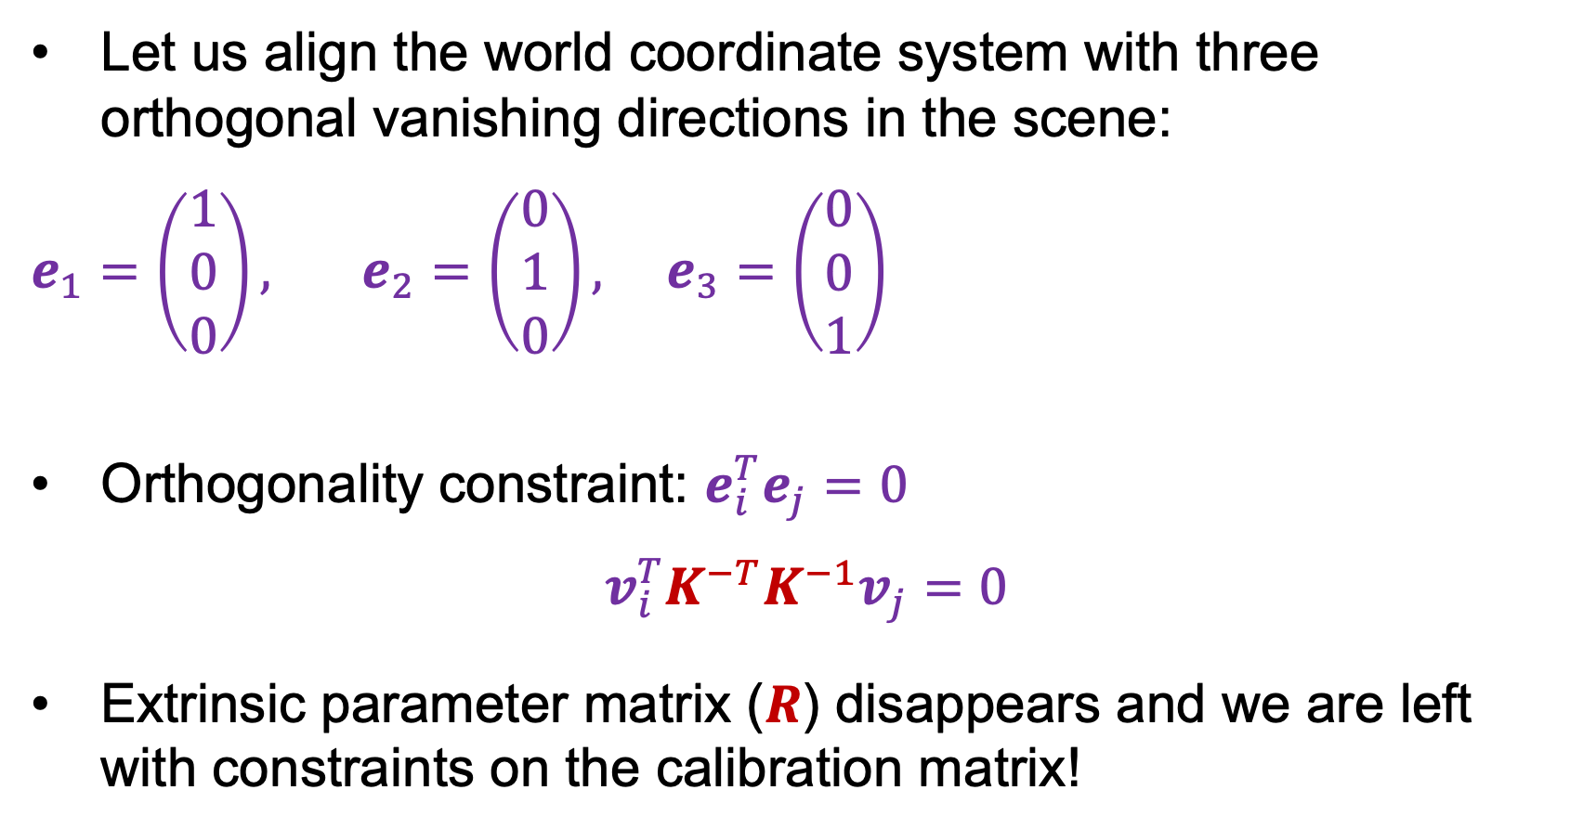
Calibration from vanishing points
Let us align the world coordinate system with three orthogonal vanishing directions in the scene:
$e_{1}=\left(\begin{aligned}1 \\ 0 \\ 0\end{aligned}\right),$ $e_{2}=\left(\begin{aligned}0 \\ 1 \\ 0\end{aligned}\right), e_{3}=\left(\begin{aligned}0 \\ 0 \\ 1\end{aligned}\right)$
Orthogonality constraint: $e_{i}^{T}e_{j}=0$
$$v_{i}^{T}K^{−T}K^{−1}v_{j}=0$$
Extrinsic parameter matrix ($R$) disappears and we are left with constraints on the calibration matrix!
$$v_{i}≅KRe_{i}$$
$$e_{i}≅R^{T}K^{−1}v_{i}$$

Slide 21
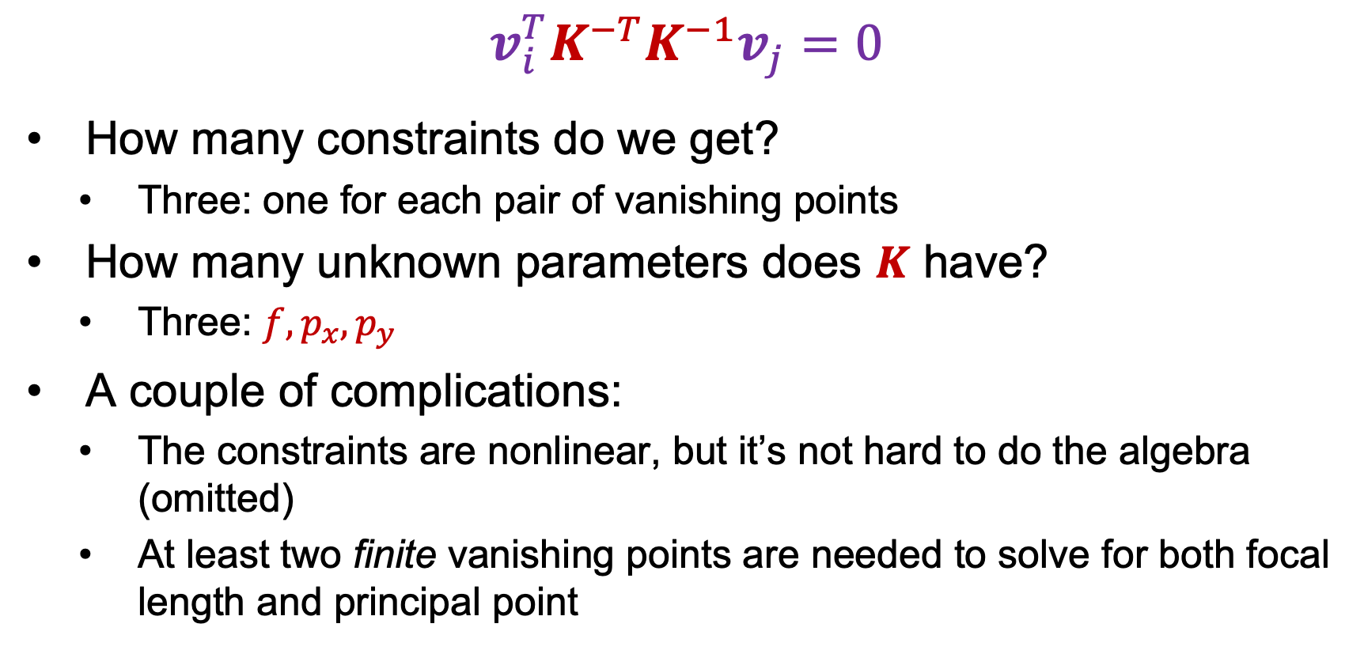
Calibration from vanishing points
$$v_{i}^{T}K^{−T}K^{−1}v_{j}=0$$
How many constraints do we get?
  Three: one for each pair of vanishing points
How many unknown parameters does $K$ have?
  Three: $f,p_{x},p_{y}$
A couple of complications:
  The constraints are nonlinear, but it’s not hard to do the algebra (omitted)
  At least two finite vanishing points are needed to solve for both focal length and principal point

Slide 22
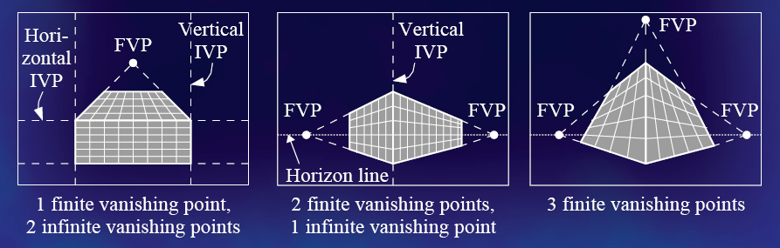
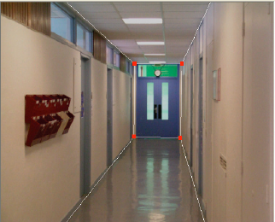
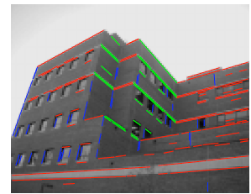
Calibration from vanishing points
Cannot recover focal length, principal point is the third vanishing point
Can solve for focal length, principal point

Slide 23

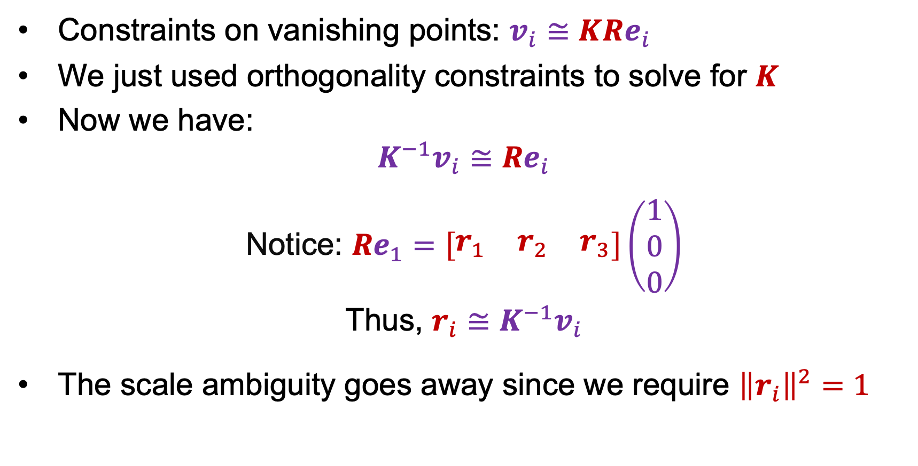
Rotation from vanishing points
Constraints on vanishing points: $v_{i}≅KRe_{i}$
We just used orthogonality constraints to solve for $K$
Now we have:
$$K^{−1}v_{i}≅Re_{i}$$
Notice: $Re_{1}=\left[\begin{matrix}r_{1} & r_{2} & r_{3}\end{matrix}\right]\left(\begin{aligned}1 \\ 0 \\ 0\end{aligned}\right)$
Thus, $r_{i}≅K^{−1}v_{i}$
The scale ambiguity goes away since we require ${\left\|r_{i}\right\|}^{2}=1$
$$=r_{1}$$

Slide 24
Calibration from vanishing points: Summary
Solve for intrinsic parameters (focal length, principal point) using three orthogonal vanishing points
Get extrinsic parameters (rotation) directly from vanishing points once calibration matrix is known
Advantages
  No need for calibration chart, 2D-3D correspondences
  Could be completely automatic
Disadvantages
  Only applies to certain kinds of scenes
  It is tricky to accurately localize vanishing points
  Need at least two finite vanishing points

Slide 25
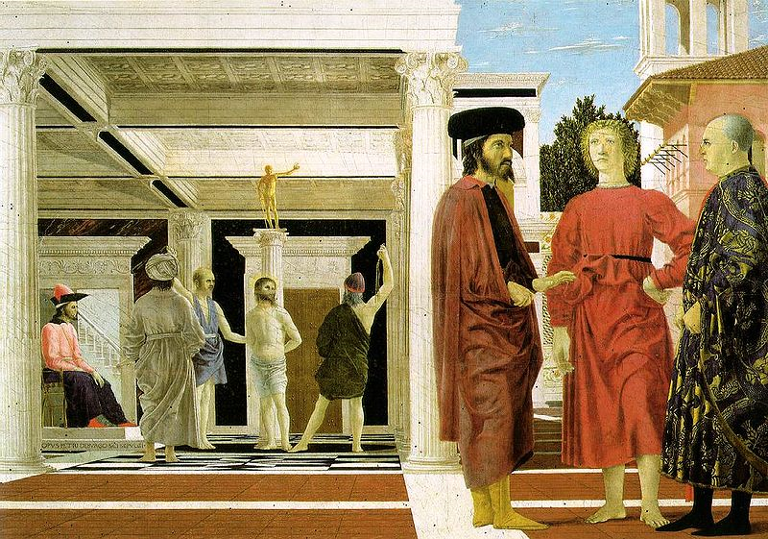
Outline
Camera calibration using vanishing points
Measurements from a single image
  Measuring height above the ground plane
  Measuring within planes

Slide 26

Comparing heights
Vanishing
Point
Slide by Steve Seitz

Slide 27
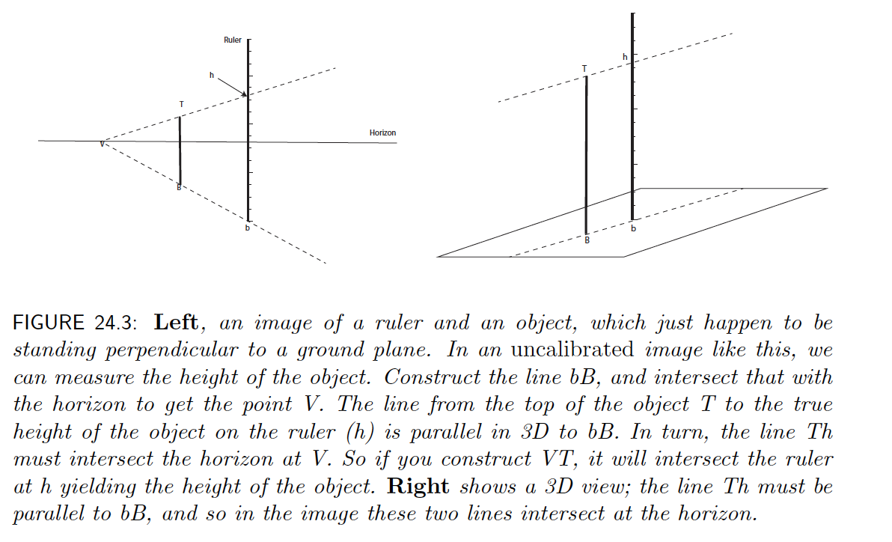
Using a ruler

Slide 28
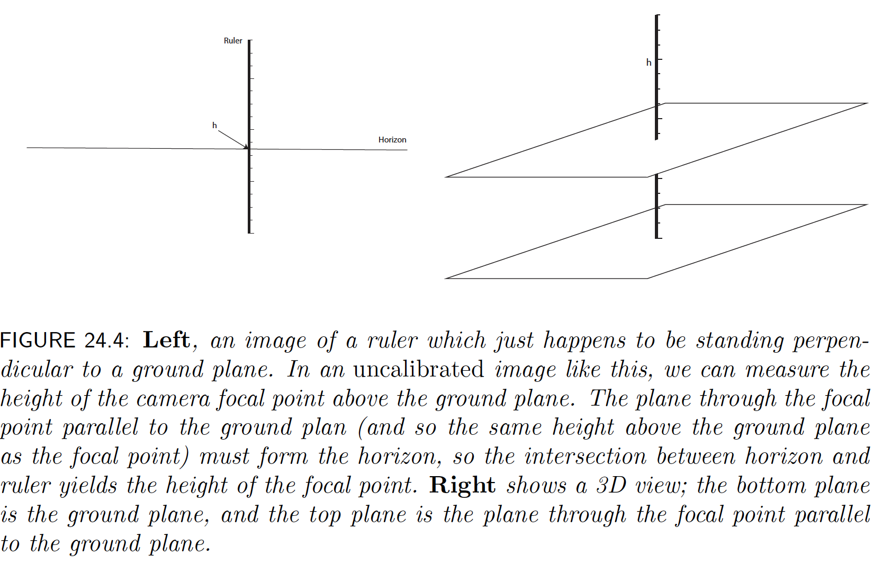
Using a ruler

Slide 29
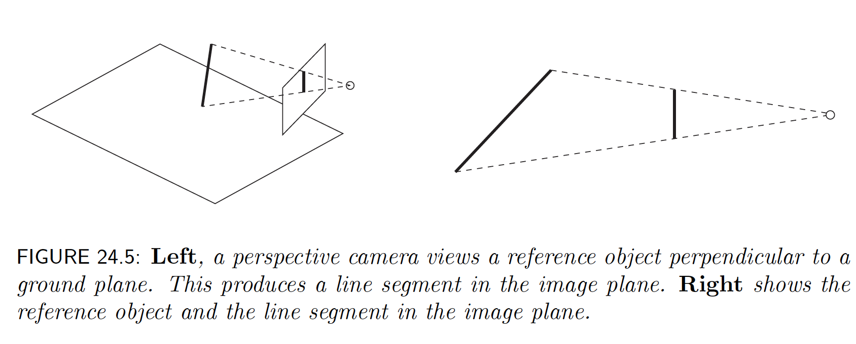
Working without a ruler is harder than might seem

Slide 30
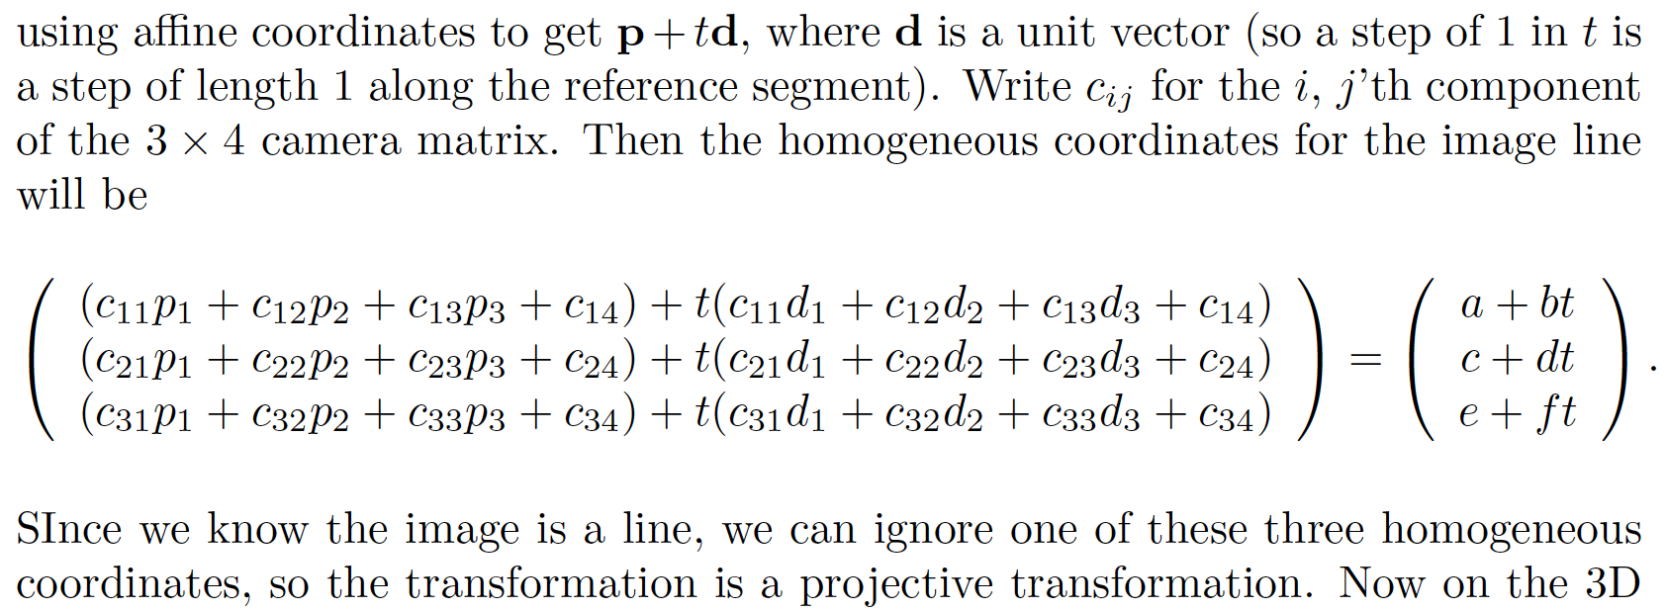
Working without a ruler is harder than might seem

Slide 31
Working without a ruler is harder than might seem

Slide 32
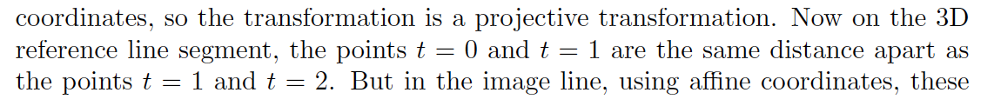
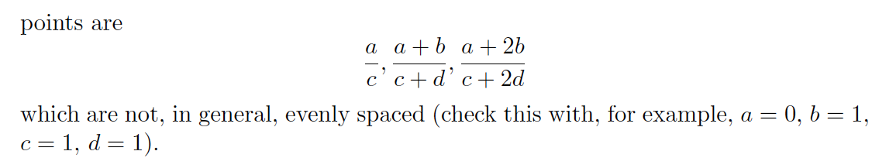
Working without a ruler is harder than might seem

Slide 33
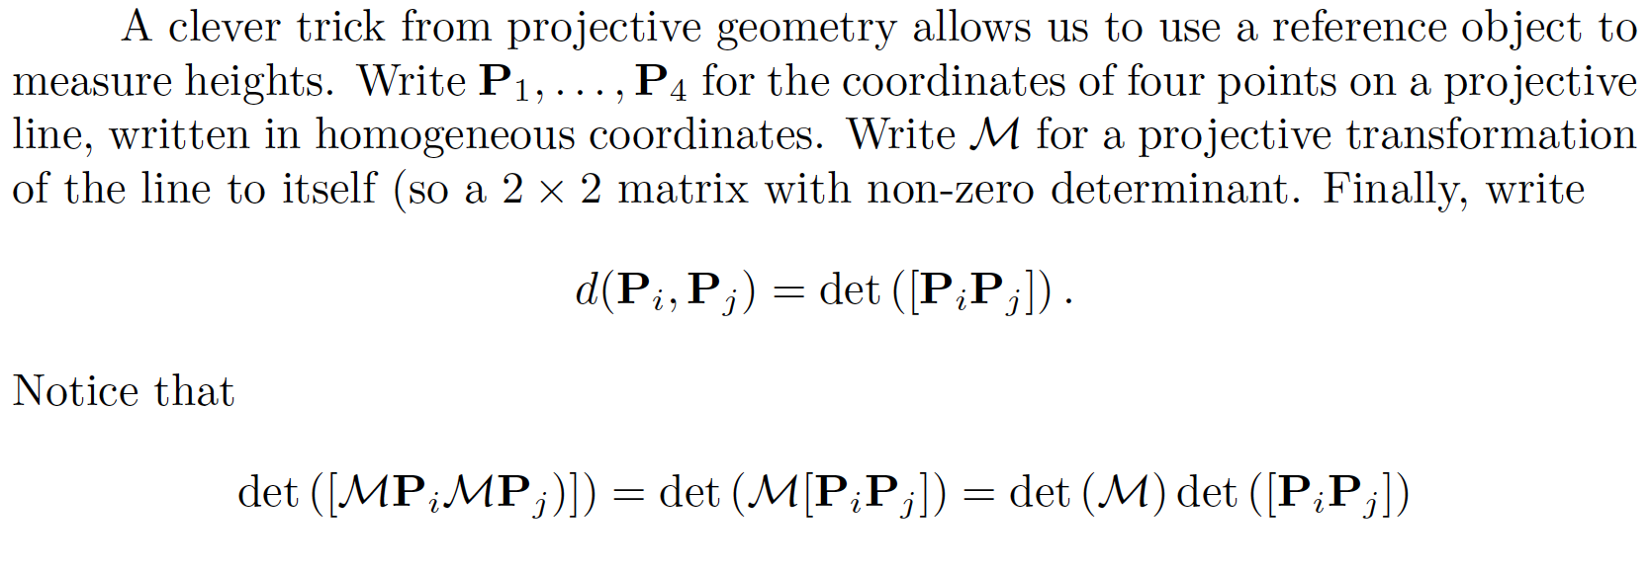
The Cross-ratio

Slide 34
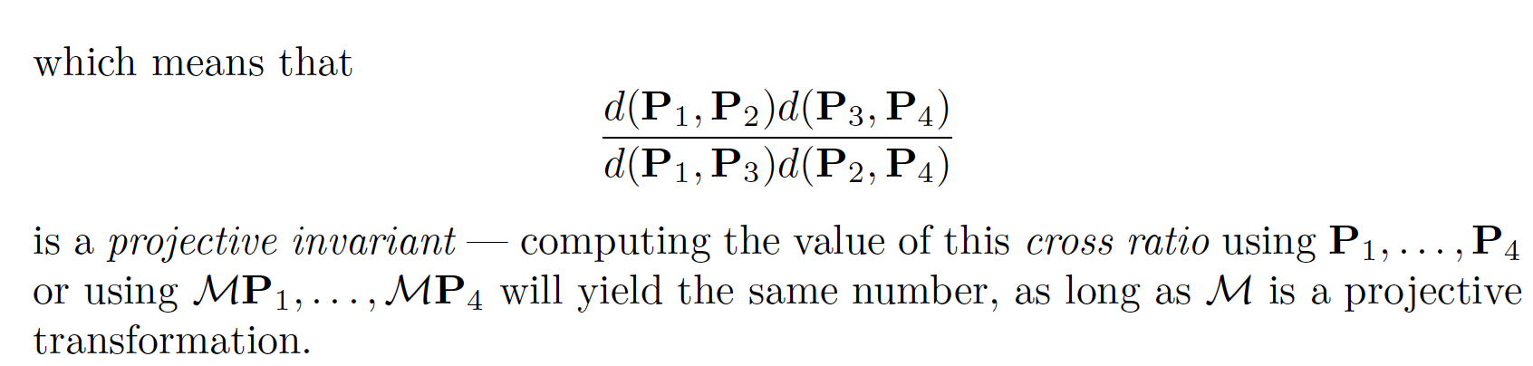
The Cross-ratio

Slide 35
The Cross-ratio

Slide 36
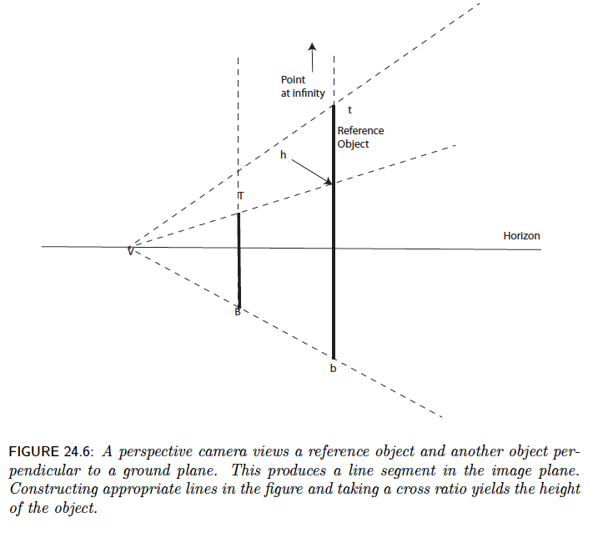
The Cross-ratio

Slide 37
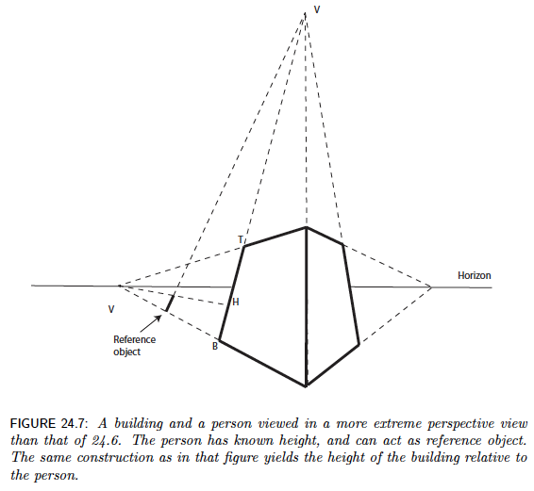
The Cross-ratio

Slide 38

Measuring height with a ruler
5.4
5
Camera height
4
3.3
3
2.8
2
1
What is the height of the camera?
Slide by Steve Seitz

Slide 39

Horizon: Vanishing line of the ground plane
What can the horizon tell us about the relative height of scene points and the camera?
camera
center
ground plane
What is higher: The camera or the parachutist?
Image source: S. Seitz
Notes:
Is this parachutist higher or lower than the person taking this picture?
Lower—he is below the horizon

Slide 40


Measuring height without a ruler
Goal: compute height $H$ from image measurements
Camera center
$$H$$
ground plane

Slide 41

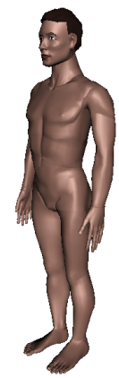
Measuring height without a ruler

Slide 42









Measuring height without a ruler
$$r$$
$$t$$
$$t0$$
$$v$$
$$H$$
$$R$$
$$H$$
$$b0$$
$$b$$
To find $\frac{H}{R}$, we need to do some extra work…

Slide 43







Measuring height
$T$: top of object
To make 3D measurements based on image observations, we need an invariant that does not change under perspective projection from 3D to 2D
$$t$$
$r$
$R$: reference point
$$C$$
H
$$b$$
R
$B$: bottom of object
ground plane

Slide 44





Cross-ratio
Defined for four collinear points, invariant to projective transformations, including perspective projection from 3D to 2D
  Also invariant to permutation of the points
$$\frac{\left\|P_{3}−P_{1}\right\|}{\left\|P_{3}−P_{2}\right\|}\frac{\left\|P_{4}−P_{2}\right\|}{\left\|P_{4}−P_{1}\right\|}$$
$$P4$$
$$P3$$
$$P2$$
$$P1$$

Slide 45





Measuring height
We need a fourth point to compute a cross-ratio – what could it be?
$T$: top of object
$$t$$
$r$
$R$: reference point
$$C$$
H
$$b$$
R
$B$: bottom of object
ground plane

Slide 46





Measuring height
We need a fourth point to compute a cross-ratio – what could it be?
∞: vertical vanishing point
Scene cross ratio:
$$\frac{\left\|T−B\right\|}{\left\|R−B\right\|}\frac{\left\|∞−R\right\|}{\left\|∞−T\right\|}$$
$$=\frac{H}{R}$$
$T$: top of object
$$t$$
$r$
$R$: reference point
$$C$$
H
Image cross ratio:
$$\frac{\left\|t−b\right\|}{\left\|r−b\right\|}\frac{\left\|v_{z}−r\right\|}{\left\|v_{z}−t\right\|}=\frac{H}{R}$$
$$b$$
R
$$vZ$$
$B$: bottom of object
ground plane

Slide 47








$$vz$$
$$r$$
How do we compute the coordinates of $v$ and $t$?
$$t0$$
$$t$$
$$v$$
$$H$$
$$R$$
$$b0$$
$$b$$
Image cross-ratio:
$$\frac{\left\|t−b\right\|}{\left\|r−b\right\|}\frac{\left\|v_{z}−r\right\|}{\left\|v_{z}−t\right\|}=\frac{H}{R}$$

Slide 48

2D lines in homogeneous coordinates
Line equation: $ax+by+c=0$
$l^{T}x=0$, where $l=\left(\begin{aligned}a \\ b \\ c\end{aligned}\right), x=\left(\begin{aligned}x \\ y \\ 1\end{aligned}\right)$
Line passing through two points: $l=x_{1}×x_{2}$
Intersection of two lines: $x=l_{1}×l_{2}$
  What is the intersection of two parallel lines?

Slide 49




$$vz$$
$$r$$
$$v≅\left(b×b_{0}\right)×\left(v_{x}×v_{y}\right)$$
$$t0$$
$$t≅\left(v×t_{0}\right)×\left(r×b\right)$$
$$t$$
$$vx$$
$$v$$
$$vy$$
$$H$$
$$R$$
$$b0$$
$$b$$
Image cross-ratio:
$$\frac{\left\|t−b\right\|}{\left\|r−b\right\|}\frac{\left\|v_{z}−r\right\|}{\left\|v_{z}−t\right\|}=\frac{H}{R}$$

Slide 50


Single-view measurement examples
That booth is still there! (Oxford, September 2022)
A. Criminisi, I. Reid, and A. Zisserman, Single View Metrology, IJCV 2000
Figure from UPenn CIS580 slides

Slide 51

Single-view measurement examples
A. Criminisi, I. Reid, and A. Zisserman, Single View Metrology, IJCV 2000
Figure from UPenn CIS580 slides

Slide 52

Another example
Are the heights of the two groups of people consistent with one another?
  Measure heights using Christ as reference
Piero della Francesca, Flagellation, ca. 1455
A. Criminisi, M. Kemp, and A. Zisserman,Bringing Pictorial Space to Life: computer techniques for the analysis of paintings,
Proc. Computers and the History of Art, 2002

Slide 53


Measurements within planes
4
3
2
1
1
2
3
4
Simplest approach: unwarp then measure
What kind of warp is this?
Notes:
homography!

Slide 54



Image rectification
$$x′$$
$$x$$
To unwarp (rectify) an image, solve for homography $H$ given four pairs of matches assumed to have a known configuration (e.g., square)

Slide 55

Image rectification: Example

Slide 56


Putting everything together: Single-view modeling
A. Criminisi et al. Bringing Pictorial Space to Life: computer techniques for the analysis of paintings,
Proc. Computers and the History of Art, 2002

Slide 57
Putting everything together: Single-view modeling
J. Vermeer, Music Lesson, 1662
A. Criminisi et al. Bringing Pictorial Space to Life: computer techniques for the analysis of paintings,
Proc. Computers and the History of Art, 2002

Slide 58
Outline
Camera calibration using vanishing points
Measurements from a single image
Applications of single-view metrology

Slide 59





Application: Fully automatic modeling
sky
vertical
ground
D. Hoiem, A.A. Efros, and M. Hebert, Automatic Photo Pop-up, SIGGRAPH 2005

Slide 60

Application: Object detection
D. Hoiem, A.A. Efros, and M. Hebert. Putting Objects in Perspective. CVPR 2006

Slide 61



Application: Object Detection
$$y_{object}≈\frac{h∙y_{camera}}{v_{0}−v}$$
“Reasonable” approximation:
Source: D. Hoiem, J. Johnson and D. Fouhey

Slide 62

Application: Object detection
D. Hoiem, A.A. Efros, and M. Hebert. Putting Objects in Perspective. CVPR 2006

Slide 63
Application: Image editing
Inserting synthetic objects into images
K. Karsch and V. Hedau and D. Forsyth and D. Hoiem. Rendering Synthetic Objects into Legacy Photographs. SIGGRAPH Asia 2011

Slide 64

Application: Image editing
Inserting synthetic objects into images:
K. Karsch and V. Hedau and D. Forsyth and D. Hoiem. Rendering Synthetic Objects into Legacy Photographs. SIGGRAPH Asia 2011

