Slide 1
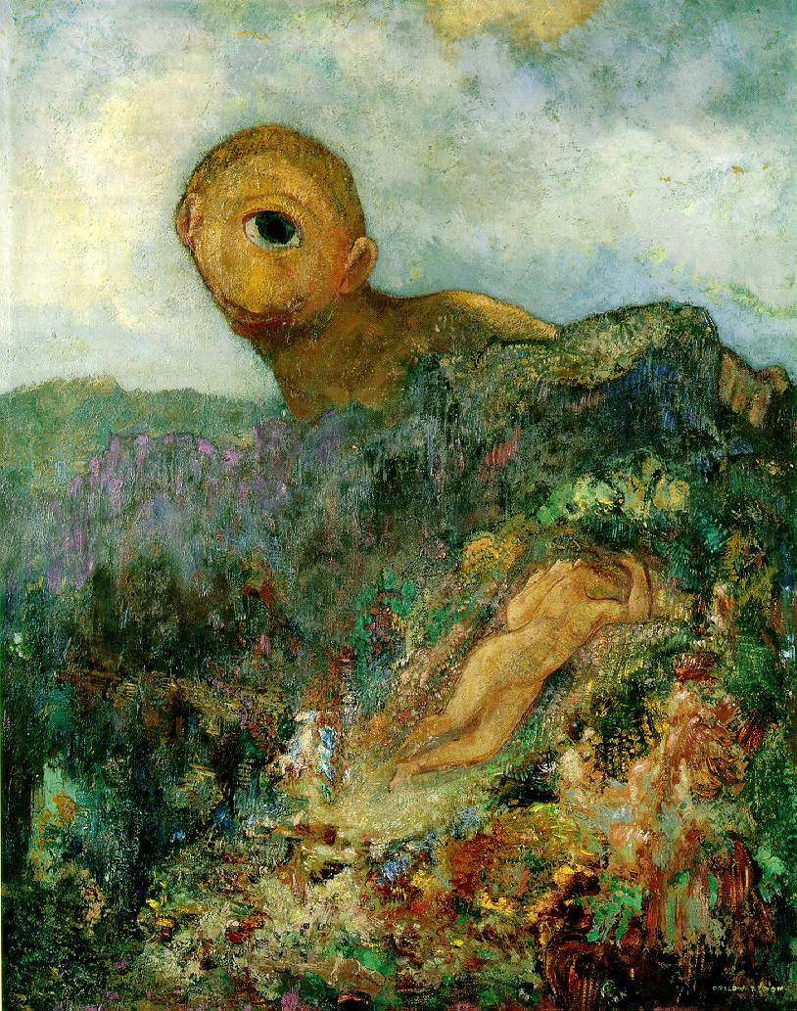
Camera calibration
Odilon Redon, Cyclops, 1914

Slide 2
Overview
Camera calibration
  Intrinsic camera parameters
  Extrinsic camera parameters
  Estimation
First taste of 3D reconstruction: triangulation

Slide 3
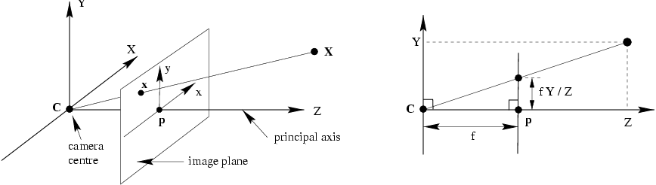
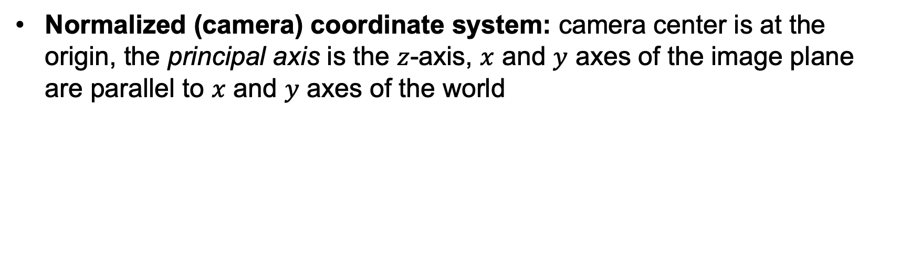
Perspective projection in normalized coordinates
Normalized (camera) coordinate system: camera center is at the origin, the principal axis is the $z$-axis, $x$ and $y$ axes of the image plane are parallel to $x$ and $y$ axes of the world

Slide 4





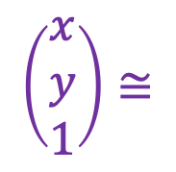
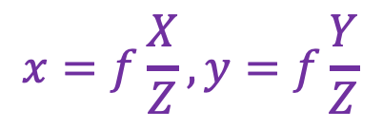
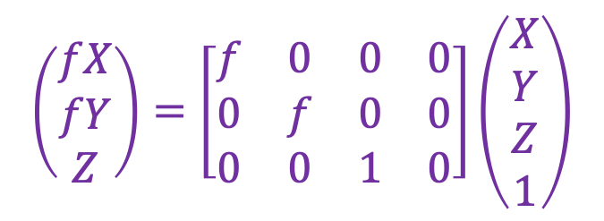

Perspective projection in normalized coordinates
$$(X,Y,Z)$$
$$(x,y)$$
$$x=f\frac{X}{Z}, y=f\frac{Y}{Z}$$
$$\left(\begin{aligned}fX \\ fY \\ Z\end{aligned}\right)=\left[\begin{matrix}f & 0 & 0 & 0 \\ 0 & f & 0 & 0 \\ 0 & 0 & 1 & 0\end{matrix}\right]\left(\begin{aligned}X \\ Y \\ Z \\ 1\end{aligned}\right)$$
$$\left(\begin{aligned}x \\ y \\ 1\end{aligned}\right)≅$$
$$x≅PX$$
$$x$$
$$P$$
$$X$$
Equality up to scale
Homogeneous coord. vec. of image point
Camera projection matrix
Homogeneous coord. vec. of 3D point

Slide 5
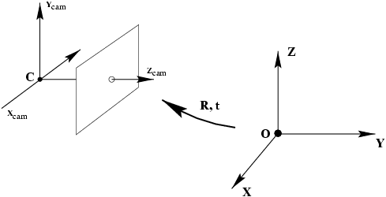


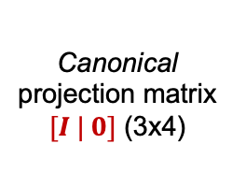



Camera calibration: Overview
world coordinate system
Camera calibration: figuring out transformation from world coordinate system to image coordinate system
World to
camera coord.
trans. matrix
$\left[\begin{matrix}R & t \\ 0^{T} & 1\end{matrix}\right]$ (4x4)
3D
point
(4x1)
2D
point
(3x1)
Camera to
pixel coord.
trans. matrix
$K$ (3x3)
Canonical
projection matrix
$[I | 0]$ (3x4)
$$≅$$
$$x$$
Intrinsic camera parameters: principal point, scaling factors
Extrinsic camera parameters: rotation, translation
$$X$$

Slide 6

Camera calibration: Overview
world coordinate system
Camera calibration: figuring out transformation from world coordinate system to image coordinate system
World to
camera coord.
trans. matrix
$\left[\begin{matrix}R & t \\ 0^{T} & 1\end{matrix}\right]$ (4x4)
3D
point
(4x1)
2D
point
(3x1)
Camera to
pixel coord.
trans. matrix
$K$ (3x3)
Canonical
projection matrix
$[I | 0]$ (3x4)
$$≅$$
$$x$$
$$X$$
$$P=K[R|t]$$
General camera projection matrix

Slide 7
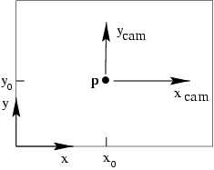
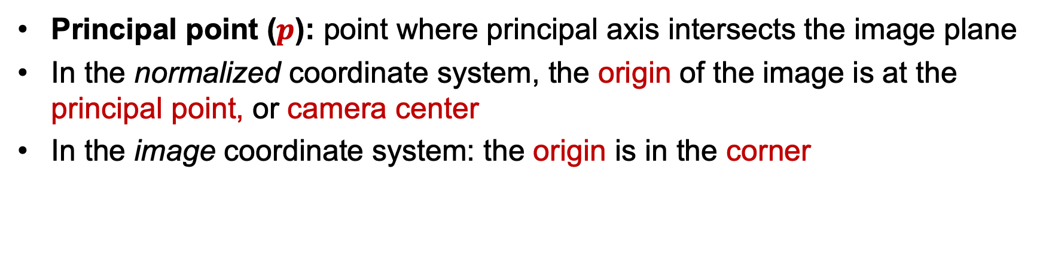
Intrinsic parameters: Principal point
Principal point ($p$): point where principal axis intersects the image plane
In the normalized coordinate system, the origin of the image is at the principal point, or camera center
In the image coordinate system: the origin is in the corner

Slide 8

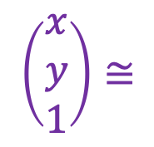
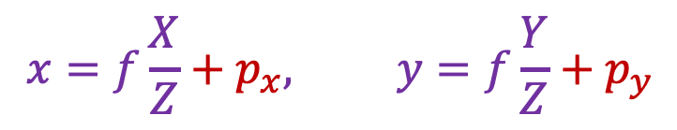
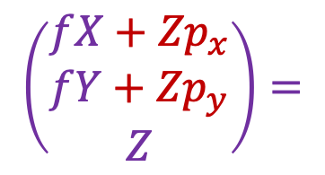
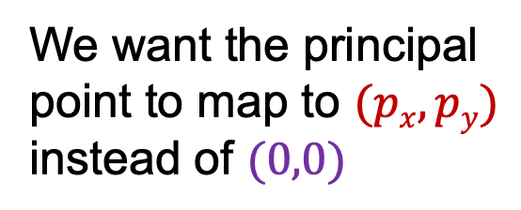
Intrinsic parameters: Principal point
We want the principal point to map to $(px, py)$ instead of $(0,0)$
p_{y}
p_{x}
$$x=f\frac{X}{Z}+p_{x}, y=f\frac{Y}{Z}+p_{y}$$
$$\left[\begin{matrix}f & 0 & p_{x} & 0 \\ 0 & f & p_{y} & 0 \\ 0 & 0 & 1 & 0\end{matrix}\right]\left(\begin{aligned}X \\ Y \\ Z \\ 1\end{aligned}\right)$$
$$\left(\begin{aligned}x \\ y \\ 1\end{aligned}\right)≅$$
$$\left(\begin{aligned}fX+{Zp}_{x} \\ fY+{Zp}_{y} \\ Z\end{aligned}\right)=$$

Slide 9

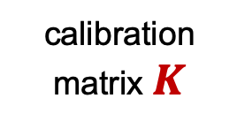
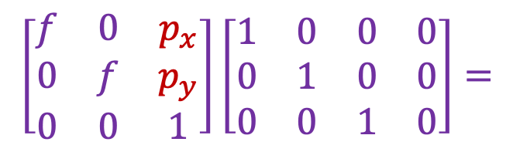
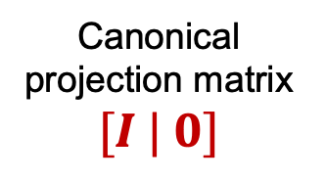

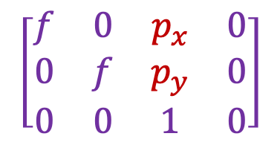
Intrinsic parameters: Principal point
p_{y}
Principal point: $(px, py)$
p_{x}
$$\left[\begin{matrix}f & 0 & p_{x} \\ 0 & f & p_{y} \\ 0 & 0 & 1\end{matrix}\right]\left[\begin{matrix}1 & 0 & 0 & 0 \\ 0 & 1 & 0 & 0 \\ 0 & 0 & 1 & 0\end{matrix}\right]=$$
$$\left[\begin{matrix}f & 0 & p_{x} & 0 \\ 0 & f & p_{y} & 0 \\ 0 & 0 & 1 & 0\end{matrix}\right]$$
calibration matrix $K$
Canonical projection matrix $[I | 0]$
$$P=K[I|0]$$

Slide 10
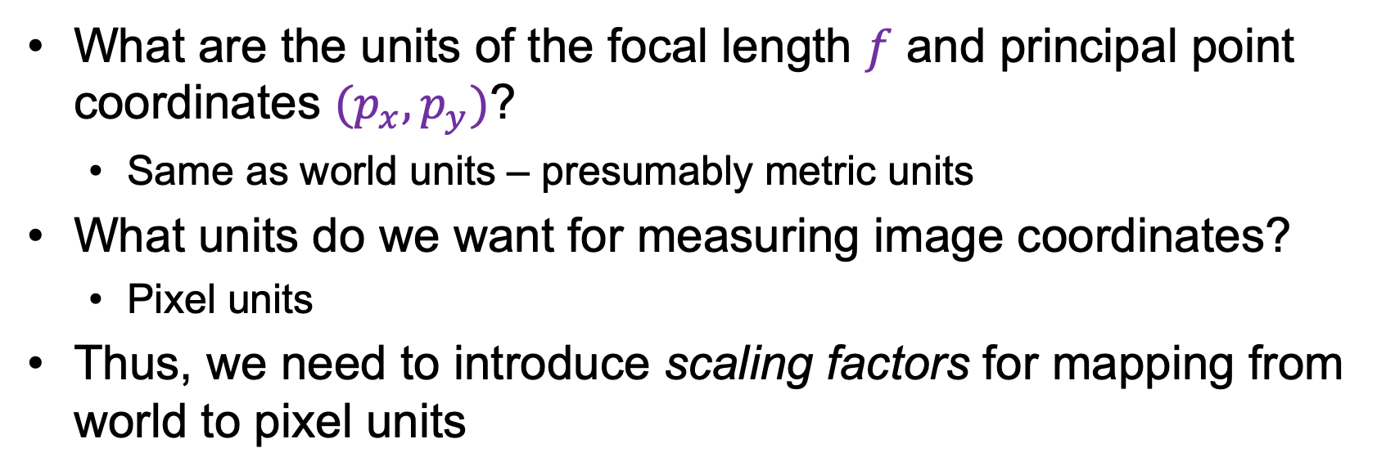
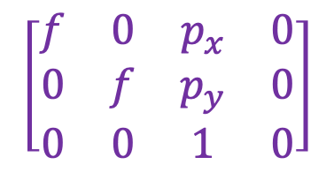
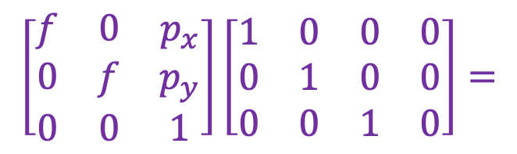
Intrinsic parameters: Principal point
What are the units of the focal length $f$ and principal point coordinates ${(p}_{x},p_{y})$?
  Same as world units – presumably metric units
What units do we want for measuring image coordinates?
  Pixel units
Thus, we need to introduce scaling factors for mapping from world to pixel units
$$\left[\begin{matrix}f & 0 & p_{x} \\ 0 & f & p_{y} \\ 0 & 0 & 1\end{matrix}\right]\left[\begin{matrix}1 & 0 & 0 & 0 \\ 0 & 1 & 0 & 0 \\ 0 & 0 & 1 & 0\end{matrix}\right]=$$
$$\left[\begin{matrix}f & 0 & p_{x} & 0 \\ 0 & f & p_{y} & 0 \\ 0 & 0 & 1 & 0\end{matrix}\right]$$
calibration matrix $K$
Canonical projection matrix $[I | 0]$
$$P=K[I|0]$$

Slide 11
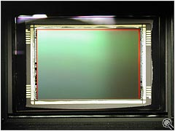
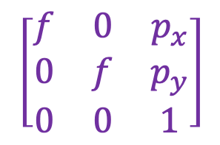
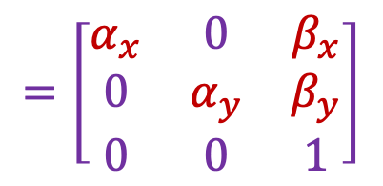
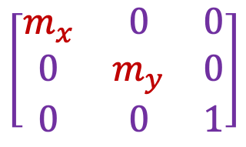
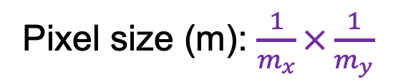
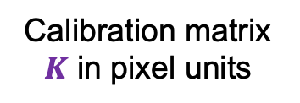
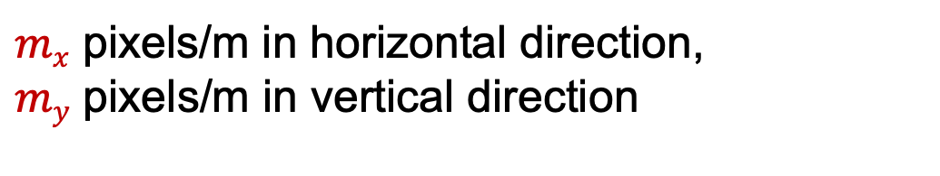
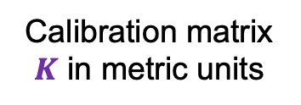
Intrinsic parameters: Scaling factors
Camera sensor
$mx$ pixels/m in horizontal direction,
$my$ pixels/m in vertical direction
Pixel size (m): $\frac{1}{m_{x}}×\frac{1}{m_{y}}$
Calibration matrix $K$ in metric units
Calibration matrix $K$ in pixel units
Scaling factors
$$\left[\begin{matrix}m_{x} & 0 & 0 \\ 0 & m_{y} & 0 \\ 0 & 0 & 1\end{matrix}\right]$$
$$\left[\begin{matrix}f & 0 & p_{x} \\ 0 & f & p_{y} \\ 0 & 0 & 1\end{matrix}\right]$$
$$=\left[\begin{matrix}α_{x} & 0 & β_{x} \\ 0 & α_{y} & β_{y} \\ 0 & 0 & 1\end{matrix}\right]$$
pixels/m
m
pixels
Notes:
To convert from metric image coordinates to pixel coordinates, we have to multiply the x, y coordinates by the x, y pixel magnification factors (pix/m)
Beta_x, beta_y is the principal point coordinates in pixels

Slide 12
Extrinsic parameters: Rotation and translation
In general, the camera coordinate frame will be related to the world coordinate frame by a rotation and a translation
camera coordinate system
world coordinate system

Slide 13


Extrinsic parameters: Rotation and translation
In general, the camera coordinate frame will be related to the world coordinate frame by a rotation and a translation
camera coordinate system
world coordinate system
In non-homogeneous coordinates, the transformation from world to normalized camera coordinate system is given by:
$${\tilde{X}}_{cam}=R\left(\tilde{X}−\tilde{C}\right)$$
$$=R\tilde{X}+t$$
coords. of point
in normalized camera frame
coords. of camera center
in world frame
3x3 rotation matrix
coords. of a point
in world frame

Slide 14
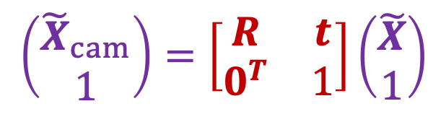

Extrinsic parameters: Rotation and translation
In non-homogeneous coordinates:
In homogeneous coordinates:
$$\left(\begin{aligned}{\tilde{X}}_{cam} \\ 1\end{aligned}\right)=\left[\begin{matrix}R & t \\ 0^{T} & 1\end{matrix}\right]\left(\begin{aligned}\tilde{X} \\ 1\end{aligned}\right)$$
$${\tilde{X}}_{cam}=R\tilde{X}+t$$
3D transformation matrix (4 x 4)

Slide 15

Extrinsic parameters: Rotation and translation
In non-homogeneous coordinates:
In homogeneous coordinates:
$${\tilde{X}}_{cam}=R\tilde{X}+t$$
$$X_{cam}=\left[\begin{matrix}R & t \\ 0^{T} & 1\end{matrix}\right]X$$
3D transformation matrix (4 x 4)

Slide 16
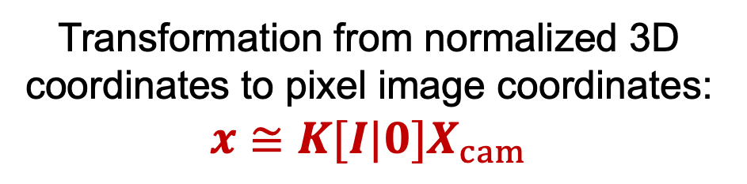
Extrinsic parameters: Rotation and translation
In non-homogeneous coordinates:
In homogeneous coordinates:
$${\tilde{X}}_{cam}=R\tilde{X}+t$$
$$X_{cam}=\left[\begin{matrix}R & t \\ 0^{T} & 1\end{matrix}\right]X$$
Transformation from normalized 3D coordinates to pixel image coordinates:
$$x≅K[I|0]X_{cam}$$

Slide 17

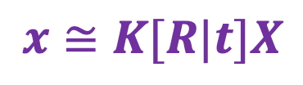
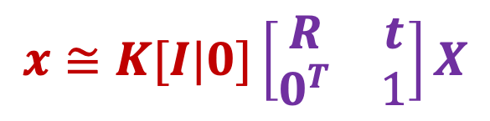
Extrinsic parameters: Rotation and translation
In homogeneous coordinates:
$$x≅K[I|0]\left[\begin{matrix}R & t \\ 0^{T} & 1\end{matrix}\right]X$$
Finally:
$$x≅K[R|t]X$$
$$t=−R\tilde{C}$$

Slide 18

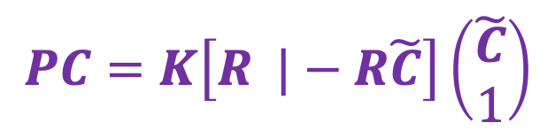

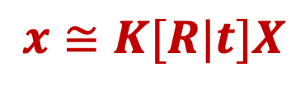
Extrinsic parameters: Rotation and translation
coords. of camera center
in world frame
$$x≅K[R|t]X$$
$$t=−R\tilde{C}$$
What is the projection of the focal point in world coordinates?
$$PC=K\left[R |−R\tilde{C}\right]\left(\begin{aligned}\tilde{C} \\ 1\end{aligned}\right)$$
$$=K\left(R\tilde{C}−R\tilde{C}\right)=0$$
The focal point is the null space of the projection matrix!

Slide 19
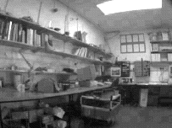
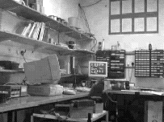
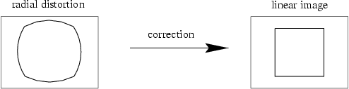
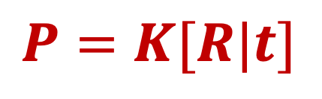
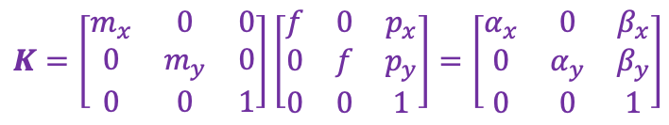
Camera parameters: Summary
$$P=K[R|t]$$
Intrinsic parameters
  Principal point coordinates
  Focal length
  Pixel magnification factors
  Skew (non-rectangular pixels) – tends to get ignored in practice
  Radial distortion – important in practice!
$$K=\left[\begin{matrix}m_{x} & 0 & 0 \\ 0 & m_{y} & 0 \\ 0 & 0 & 1\end{matrix}\right]\left[\begin{matrix}f & 0 & p_{x} \\ 0 & f & p_{y} \\ 0 & 0 & 1\end{matrix}\right]=\left[\begin{matrix}α_{x} & 0 & β_{x} \\ 0 & α_{y} & β_{y} \\ 0 & 0 & 1\end{matrix}\right]$$

Slide 20
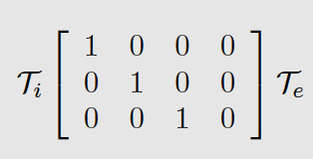
Camera extrinsics
Intrinsics
Extrinsics
Rotation matrix - orthornormal, det=1

Slide 21
Camera intrinsics
Intrinsics
Extrinsics

Slide 22
Overview
Camera calibration
  Intrinsic camera parameters
  Extrinsic camera parameters
  Estimation

Slide 23
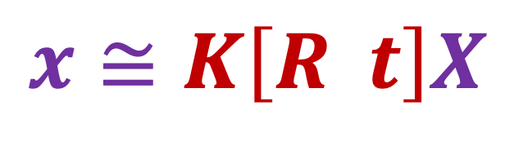
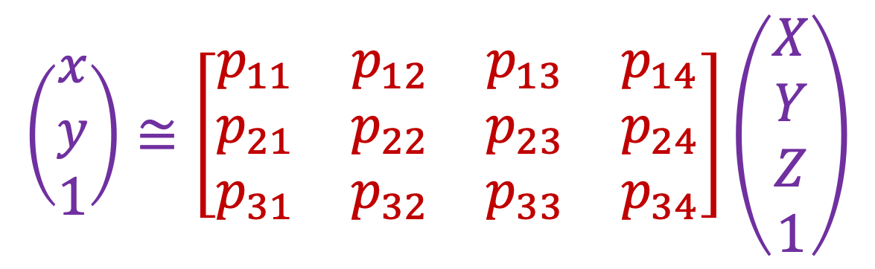
Camera calibration
$$x≅K\left[R t\right]X$$
$$\left(\begin{aligned}x \\ y \\ 1\end{aligned}\right)≅\left[\begin{matrix}p_{11} & p_{12} & p_{13} & p_{14} \\ p_{21} & p_{22} & p_{23} & p_{24} \\ p_{31} & p_{32} & p_{33} & p_{34}\end{matrix}\right]\left(\begin{aligned}X \\ Y \\ Z \\ 1\end{aligned}\right)$$

Slide 24
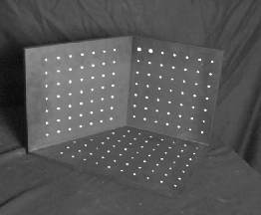




Camera calibration
Given $n$ points with known 3D coordinates $Xi$ and known image projections $xi$, estimate the camera parameters
$$Xi$$
$$xi$$
$$P$$

Slide 25
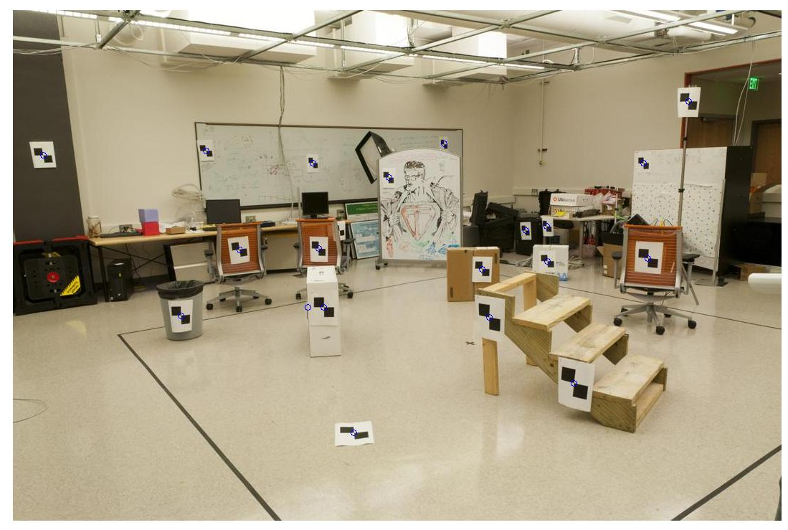
Camera calibration
Given $n$ points with known 3D coordinates $Xi$ and known image projections $xi$, estimate the camera parameters
Known 2D image coords
Known 3D locations
880 214
43 203
270 197
886 347
745 302
943 128
476 590
419 214
317 335
783 521
235 427
665 429
655 362
427 333
412 415
746 351
434 415
525 234
716 308
602 187
312.747 309.140 30.086
305.796 311.649 30.356
307.694 312.358 30.418
310.149 307.186 29.298
311.937 310.105 29.216
311.202 307.572 30.682
307.106 306.876 28.660
309.317 312.490 30.230
307.435 310.151 29.318
308.253 306.300 28.881
306.650 309.301 28.905
308.069 306.831 29.189
309.671 308.834 29.029
308.255 309.955 29.267
307.546 308.613 28.963
311.036 309.206 28.913
307.518 308.175 29.069
309.950 311.262 29.990
312.160 310.772 29.080
311.988 312.709 30.514
Image credit: J. Hays

Slide 26




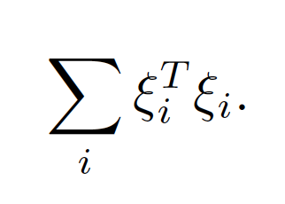
Camera calibration: non-linear method
N reference points with known position in 3D
Predict the locations of the known points in camera using
estimated camera parameters
Compare to observed locations
Minimize least-squares error

Slide 27
Camera calibration: non-linear method
Two issues:
write out equations for optimization problem
good start point for optimization

Slide 28
Camera extrinsics
Intrinsics
Extrinsics
Rotation matrix - orthornormal, det=1

Slide 29
Camera intrinsics
Intrinsics
Extrinsics

Slide 30



Camera calibration: non-linear, equations
The i’s are intrinsic parameters
(remember, this is upper triangular)
The e’s are extrinsic parameters
(they are constrained)

Slide 31
Camera calibration: non-linear
Strategy:
chuck it into a constrained optimizer and run
this fails – you need a good starting point
Start point:
neat linear construction

Slide 32

Camera calibration: Linear method
x component of location of i’th point in image
One match gives two linearly independent constraints on the camera matrix

Slide 33
Calibration: Linear method
N points gives 2N homogeneous equations
The camera matrix is 3 x 4 but scale doesn’t matter so there are
11 degrees of freedom – we can estimate it with 6 points

Slide 34




Camera calibration: Linear method
Recall homography fitting:
$$\left(\begin{matrix}x_{i} \\ y_{i} \\ 1\end{matrix}\right)×\left(\begin{matrix}P_{1}^{T}X_{i} \\ P_{2}^{T}X_{i} \\ P_{3}^{T}X_{i}\end{matrix}\right)=0$$
$$x_{i}≅PX_{i}$$
$$x_{i}×PX_{i}=0$$
$$\left[\begin{matrix}0^{T} & {−X}_{i}^{T} & {y_{i}X}_{i}^{T} \\ X_{i}^{T} & 0^{T} & −x_{i}X_{i}^{T} \\ −y_{i}X_{i}^{T} & x_{i}X_{i}^{T} & 0^{T}\end{matrix}\right]\left(\begin{matrix}P_{1} \\ P_{2} \\ P_{3}\end{matrix}\right)=0$$
One match gives two linearly independent constraints

Slide 35


Camera calibration: Linear method
Final linear system:
$$\left[\begin{matrix}0^{T} & X_{1}^{T} & −y_{1}X_{1}^{T} \\ X_{1}^{T} & 0^{T} & −x_{1}X_{1}^{T} \\ … & … & … \\ 0^{T} & X_{n}^{T} & −y_{n}X_{n}^{T} \\ X_{n}^{T} & 0^{T} & −x_{n}X_{n}^{T}\end{matrix}\right]\left(\begin{matrix}P_{1} \\ P_{2} \\ P_{3}\end{matrix}\right)=0$$
One 2D/3D correspondence gives two linearly independent equations
  The projection matrix has 11 degrees of freedom
  6 correspondences needed for a minimal solution
Homogeneous least squares: find $p$ minimizing ${\left\|Ap\right\|}^{2}$
  Solution is eigenvector of $ATA$ corresponding to smallest eigenvalue
$$Ap=0$$

Slide 36

Camera calibration: Linear method
Final linear system:
What if all the $n$ 3D points are coplanar, i.e., there exists a set of line parameters $Π^{T}={(a,b,c,d)}^{T}$ such that $ΠTX_{i}=0$ for all $i$?
  Then we will get degenerate solutions $(Π,0,0)$, $(0,Π,0)$, or $(0,0,Π)$

Slide 37

Camera parameters from camera matrix
Camera matrix is:

Slide 38

Camera parameters from camera matrix
Camera matrix is:

Slide 39

Parameters from camera matrix

Slide 40

Parameters from camera matrix

Slide 41
Camera calibration: nonlinear
non-linear methods are preferred
  Can include radial distortion and constraints such as known focal length, orthogonality, visibility of points

Slide 42

Camera calibration using vanishing points
If world coordinates of reference 3D points are not known,
in special cases, we may be able to use vanishing points
Source: A. Efros, A. Criminisi

Slide 43
Camera calibration using vanishing points
If world coordinates of reference 3D points are not known,
in special cases, we may be able to use vanishing points
Vertical vanishing
point
Vanishing
line
Vanishing
point
Vanishing
point
Source: A. Efros, A. Criminisi

Slide 44

Review: Vanishing points
image plane
vanishing point$v$
line in the scene
camera
center
All lines having the same direction share the same vanishing point

Slide 45






Computing vanishing points
$$v$$
$$X_{t}$$
$$X_{0}$$
Let’s parameterize the line using point $X_{0}={(X_{0},Y_{0},Z_{0},1)}^{T}$ and direction vector $D={(D_{1},D_{2},D_{3})}^{T}$:
$$X_{t}=\left(\begin{aligned}X_{0}+tD_{1} \\ Y_{0}+tD_{2} \\ Z_{0}+tD_{3} \\ 1\end{aligned}\right)$$
$$≅\left(\begin{aligned}X_{0}/t+D_{1} \\ Y_{0}/t+D_{2} \\ Z_{0}/t+D_{3} \\ 1/t\end{aligned}\right)$$
$$X_{∞}=\left(\begin{aligned}D_{1} \\ D_{2} \\ D_{3} \\ 0\end{aligned}\right)$$
$X∞$ is a point at infinity, $v$ is its projection: $v≅PX∞$

Slide 46





Calibration from vanishing points
Consider a scene with three orthogonal vanishing directions:
Note: $v1$, $v2$ are finite vanishing points and $v3$ is an infinite vanishing point
.
.
$$v1$$
$$v2$$
$$v3$$
Notes:
The third homogeneous coordinate of an infinite vanishing point is 0. Infinite vanishing points correspond to directions of lines that are parallel to the image plane.

Slide 47
Calibration from vanishing points
Consider a scene with three orthogonal vanishing directions:
We can align the world coordinate system with these directions
.
.
$$v1$$
$$v2$$
$$v3$$

Slide 48

Projection of the world coordinate system
$$P=\left[\begin{matrix}{ p}_{11} & p_{12} & p_{13} & p_{14} \\ { p}_{21} & p_{22} & p_{23} & p_{24} \\ { p}_{31} & p_{32} & p_{33} & p_{34} \end{matrix}\right]$$

Slide 49






Projection of the world coordinate system
$$\left[\begin{matrix}{ p}_{11} & p_{12} & p_{13} & p_{14} \\ { p}_{21} & p_{22} & p_{23} & p_{24} \\ { p}_{31} & p_{32} & p_{33} & p_{34} \end{matrix}\right]\left(\begin{aligned}1 \\ 0 \\ 0 \\ 0\end{aligned}\right)$$
$$=p_{1}$$
$$p_{1}$$
$$p_{2}$$
$$p_{3}$$
$$p_{4}$$

Slide 50


Projection of the world coordinate system
$$\left[\begin{matrix}{ p}_{11} & p_{12} & p_{13} & p_{14} \\ { p}_{21} & p_{22} & p_{23} & p_{24} \\ { p}_{31} & p_{32} & p_{33} & p_{34} \end{matrix}\right]\left(\begin{aligned}0 \\ 1 \\ 0 \\ 0\end{aligned}\right)$$
$$=p_{2}$$
$$p_{1}$$
$$p_{2}$$
$$p_{3}$$
$$p_{4}$$

Slide 51



Projection of the world coordinate system
$$\left[\begin{matrix}{ p}_{11} & p_{12} & p_{13} & p_{14} \\ { p}_{21} & p_{22} & p_{23} & p_{24} \\ { p}_{31} & p_{32} & p_{33} & p_{34} \end{matrix}\right]\left(\begin{aligned}0 \\ 0 \\ 1 \\ 0\end{aligned}\right)$$
$$=p_{3}$$
$$p_{1}$$
$$p_{2}$$
$$p_{3}$$
$$p_{4}$$
Vanishing points in
$x$, $y$, $z$ directions
(i.e., $v1$, $v2$, $v3$)

Slide 52


Projection of the world coordinate system
$$\left[\begin{matrix}{ p}_{11} & p_{12} & p_{13} & p_{14} \\ { p}_{21} & p_{22} & p_{23} & p_{24} \\ { p}_{31} & p_{32} & p_{33} & p_{34} \end{matrix}\right]\left(\begin{aligned}0 \\ 0 \\ 0 \\ 1\end{aligned}\right)$$
$$=p_{4}$$
$$p_{1}$$
$$p_{2}$$
$$p_{3}$$
$$p_{4}$$
Vanishing points in
$x$, $y$, $z$ directions
(i.e., $v1$, $v2$, $v3$)
Projection of world origin
Problem: this only gives us the four columns up to independent scale factors, additional constraints needed to solve for them

Slide 53


Calibration from vanishing points
Let us align the world coordinate system with three orthogonal vanishing directions in the scene:
$e_{1}=\left(\begin{aligned}1 \\ 0 \\ 0\end{aligned}\right),$ $e_{2}=\left(\begin{aligned}0 \\ 1 \\ 0\end{aligned}\right), e_{3}=\left(\begin{aligned}0 \\ 0 \\ 1\end{aligned}\right)$
$$v_{i}≅K\left[R|t\right]\left(\begin{aligned}e_{i} \\ 0\end{aligned}\right)$$

Slide 54





Calibration from vanishing points
Let us align the world coordinate system with three orthogonal vanishing directions in the scene:
$e_{1}=\left(\begin{aligned}1 \\ 0 \\ 0\end{aligned}\right),$ $e_{2}=\left(\begin{aligned}0 \\ 1 \\ 0\end{aligned}\right), e_{3}=\left(\begin{aligned}0 \\ 0 \\ 1\end{aligned}\right)$
Orthogonality constraint: $e_{i}^{T}e_{j}=0$
$$v_{i}^{T}K^{−T}RR^{T}K^{−1}v_{j}=0$$
$$v_{i}≅KRe_{i}$$
$$e_{i}≅R^{T}K^{−1}v_{i}$$
$$e_{i}^{T}$$
$$e_{j}$$

Slide 55

Calibration from vanishing points
Let us align the world coordinate system with three orthogonal vanishing directions in the scene:
$e_{1}=\left(\begin{aligned}1 \\ 0 \\ 0\end{aligned}\right),$ $e_{2}=\left(\begin{aligned}0 \\ 1 \\ 0\end{aligned}\right), e_{3}=\left(\begin{aligned}0 \\ 0 \\ 1\end{aligned}\right)$
Orthogonality constraint: $e_{i}^{T}e_{j}=0$
$$v_{i}^{T}K^{−T}K^{−1}v_{j}=0$$
Extrinsic parameter matrix ($R$) disappears and we are left with constraints on the calibration matrix!
$$v_{i}≅KRe_{i}$$
$$e_{i}≅R^{T}K^{−1}v_{i}$$

Slide 56

Calibration from vanishing points
$$v_{i}^{T}K^{−T}K^{−1}v_{j}=0$$
How many constraints do we get?
  Three: one for each pair of vanishing points
How many unknown parameters does $K$ have?
  Three: $f,p_{x},p_{y}$
A couple of complications:
  The constraints are nonlinear, but it’s not hard to do the algebra (omitted)
  At least two finite vanishing points are needed to solve for both focal length and principal point

Slide 57



Calibration from vanishing points
Cannot recover focal length, principal point is the third vanishing point
Can solve for focal length, principal point

Slide 58


Rotation from vanishing points
Constraints on vanishing points: $v_{i}≅KRe_{i}$
We just used orthogonality constraints to solve for $K$
Now we have:
$$K^{−1}v_{i}≅Re_{i}$$
Notice: $Re_{1}=\left[\begin{matrix}r_{1} & r_{2} & r_{3}\end{matrix}\right]\left(\begin{aligned}1 \\ 0 \\ 0\end{aligned}\right)$
Thus, $r_{i}≅K^{−1}v_{i}$
The scale ambiguity goes away since we require ${\left\|r_{i}\right\|}^{2}=1$
$$=r_{1}$$

Slide 59
Calibration from vanishing points: Summary
Solve for intrinsic parameters (focal length, principal point) using three orthogonal vanishing points
Get extrinsic parameters (rotation) directly from vanishing points once calibration matrix is known
Advantages
  No need for calibration chart, 2D-3D correspondences
  Could be completely automatic
Disadvantages
  Only applies to certain kinds of scenes
  It is tricky to accurately localize vanishing points
  Need at least two finite vanishing points

Slide 60
Overview
Camera calibration
  Intrinsic camera parameters
  Extrinsic camera parameters
  Estimation
First taste of 3D reconstruction: triangulation

Slide 61



Triangulation
Given projections of a 3D point in two or more images (with known camera matrices), find the coordinates of the point

Slide 62

Triangulation
Given projections of a 3D point in two or more images (with known camera matrices), find the coordinates of the point
$$X?$$

Slide 63





Triangulation
Given projections of a 3D point in two or more images (with known camera matrices), find the coordinates of the point
$$X?$$
$$x2$$
$$x1$$
$$O1$$
$$O2$$

Slide 64

Triangulation
We want to intersect the two visual rays corresponding to
$x1$ and $x2$, but because of noise and numerical errors, they don’t meet exactly
$$X?$$
$$x2$$
$$x1$$
$$O1$$
$$O2$$

Slide 65


Triangulation: Geometric approach
Find shortest segment connecting the two viewing rays and let $X$ be the midpoint of that segment
$$X$$
$$x2$$
$$x1$$
$$O1$$
$$O2$$

Slide 66




Triangulation: Nonlinear approach
Find $X$ that minimizes
$${\left\|{proj(P}_{1}X)−x_{1}\right\|}_{2}^{2}+{\left\|{proj(P}_{2}X)−x_{2}\right\|}_{2}^{2}$$
$$X?$$
$$P1X$$
$$x2$$
$$x1$$
$$P2X$$
$$O1$$
$$O2$$

Slide 67




Triangulation: Linear approach
$$x_{1}≅P_{1}X$$
$$x_{2}≅P_{2}X$$
$$x_{1}×P_{1}X=0$$
$$x_{2}×P_{2}X=0$$
$$[{x_{1}}_{×}]P_{1}X=0$$
$$[{x_{2}}_{×}]P_{2}X=0$$
Rewrite cross product as matrix multiplication:
$$a×b=\left[\begin{matrix}0 & −a_{3} & a_{2} \\ a_{3} & 0 & −a_{1} \\ {−a}_{2} & a_{1} & 0\end{matrix}\right]\left(\begin{aligned}b_{1} \\ b_{2} \\ b_{3}\end{aligned}\right)=[a_{×}]b$$

Slide 68

Triangulation: Linear approach
$$x_{1}≅P_{1}X$$
$$x_{2}≅P_{2}X$$
$$x_{1}×P_{1}X=0$$
$$x_{2}×P_{2}X=0$$
$$[{x_{1}}_{×}]P_{1}X=0$$
$$[{x_{2}}_{×}]P_{2}X=0$$
Two independent equations each in terms of
three unknown entries of $X$

Slide 69



Preview: Structure from motion
Figure credit: Noah Snavely
Camera 1
Camera 3
$$R1,t1$$
Camera 2
$$R2,t2$$
$$R3,t3$$
Given 2D point correspondences between multiple images, compute the camera parameters and the 3D points
Notes:
Structure from motion solves the following problem:
Given a set of images of a static scene with 2D points in correspondence, shown here as color-coded points, find…
a set of 3D points P and
a rotation R and position t of the cameras that explain the observed correspondences. In other words, when we project a point into any of the cameras, the reprojection error between the projected and observed 2D points is low.
This problem can be formulated as an optimization problem where we want to find the rotations R, positions t, and 3D point locations P that minimize sum of squared reprojection errors f. This is a non-linear least squares problem and can be solved with algorithms such as Levenberg-Marquart. However, because the problem is non-linear, it can be susceptible to local minima. Therefore, it’s important to initialize the parameters of the system carefully. In addition, we need to be able to deal with erroneous correspondences.

Slide 70
Preview: Structure from motion
?
Camera 1
Camera 3
$$R1,t1$$
Camera 2
$$R2,t2$$
$$R3,t3$$
Structure: Given known cameras and projections of the same 3D point in two or more images, compute the 3D coordinates of that point
  Triangulation!
Notes:
Structure from motion solves the following problem:
Given a set of images of a static scene with 2D points in correspondence, shown here as color-coded points, find…
a set of 3D points P and
a rotation R and position t of the cameras that explain the observed correspondences. In other words, when we project a point into any of the cameras, the reprojection error between the projected and observed 2D points is low.
This problem can be formulated as an optimization problem where we want to find the rotations R, positions t, and 3D point locations P that minimize sum of squared reprojection errors f. This is a non-linear least squares problem and can be solved with algorithms such as Levenberg-Marquart. However, because the problem is non-linear, it can be susceptible to local minima. Therefore, it’s important to initialize the parameters of the system carefully. In addition, we need to be able to deal with erroneous correspondences.

Slide 71
Preview: Structure from motion
Camera 1
?
Camera 3
$$R1,t1$$
Camera 2
?
?
$$R2,t2$$
$$R3,t3$$
Motion: Given a set of known 3D points seen by a camera, compute the camera parameters
  Calibration!
Notes:
Structure from motion solves the following problem:
Given a set of images of a static scene with 2D points in correspondence, shown here as color-coded points, find…
a set of 3D points P and
a rotation R and position t of the cameras that explain the observed correspondences. In other words, when we project a point into any of the cameras, the reprojection error between the projected and observed 2D points is low.
This problem can be formulated as an optimization problem where we want to find the rotations R, positions t, and 3D point locations P that minimize sum of squared reprojection errors f. This is a non-linear least squares problem and can be solved with algorithms such as Levenberg-Marquart. However, because the problem is non-linear, it can be susceptible to local minima. Therefore, it’s important to initialize the parameters of the system carefully. In addition, we need to be able to deal with erroneous correspondences.

Slide 72

Multi-view geometry “Bible”

