Slide 1
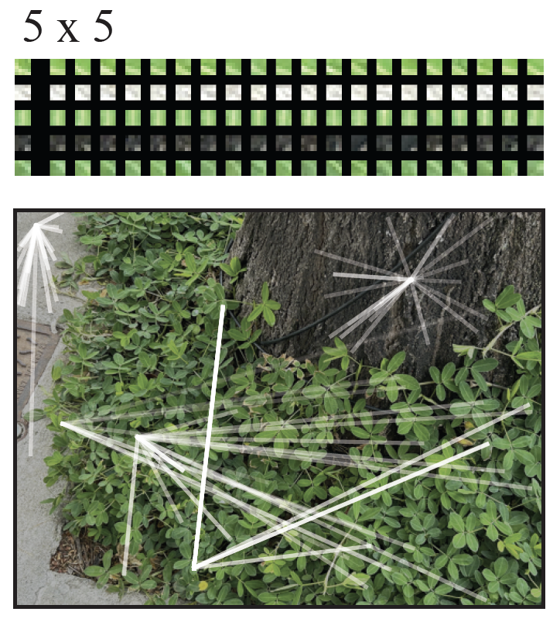
Denoising images using patches
Images tend to be made of repeating
patches

Slide 2
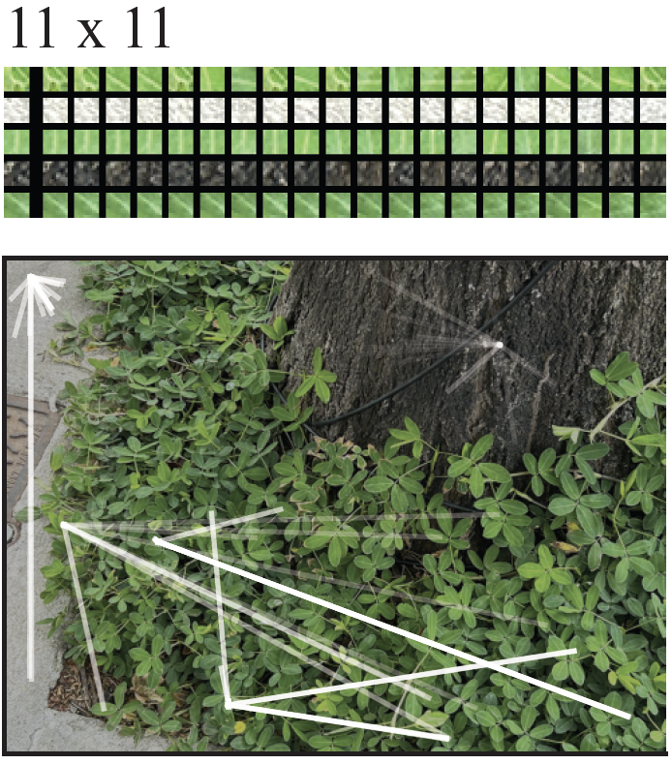
Denoising images using patches
Images tend to be made of repeating
patches
This is true even for quite big
(so quite distinctive)
patches

Slide 3
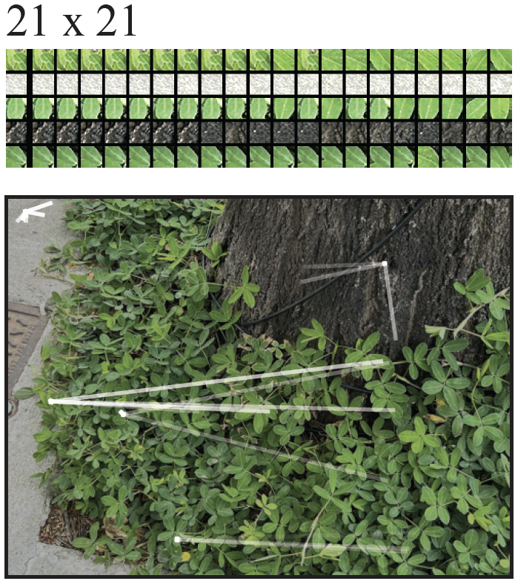
Denoising images using patches
Images tend to be made of repeating
patches
This is true even for quite big
(so quite distinctive)
patches

Slide 4
Denoising images using patches
Images tend to be made of repeating
patches
This is true even for quite big
(so quite distinctive)
patches

Slide 5
Inpainting
Simplest case:
- some fraction of pixels has been “knocked out” at random
(perhaps set to zero)
and you know which pixels
Fix:
- take window around knocked out pixel
- find closest match in the image
- take the center pixel from matching window

Slide 6
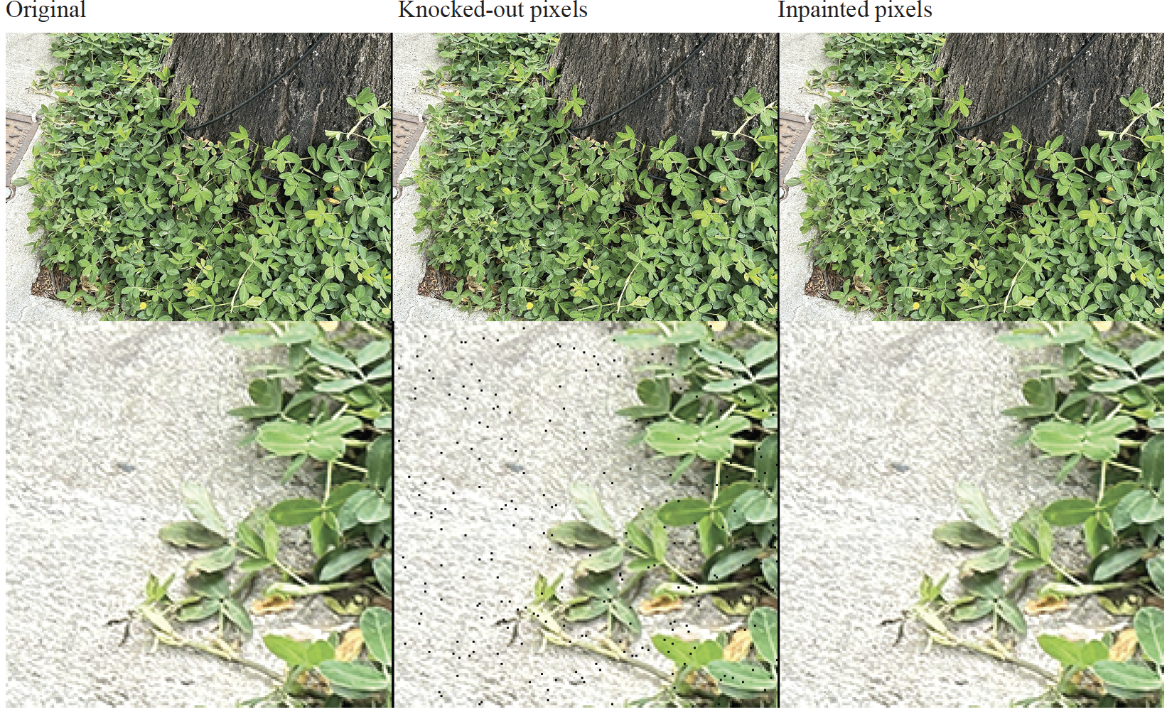

Slide 7
Inpainting for bigger knockouts
Assume a kxk window gets ”knocked out” (k small, but k>1)
Procedure works if you are careful about matching
- eg don’t match to windows that have knocked out pixels

Slide 8
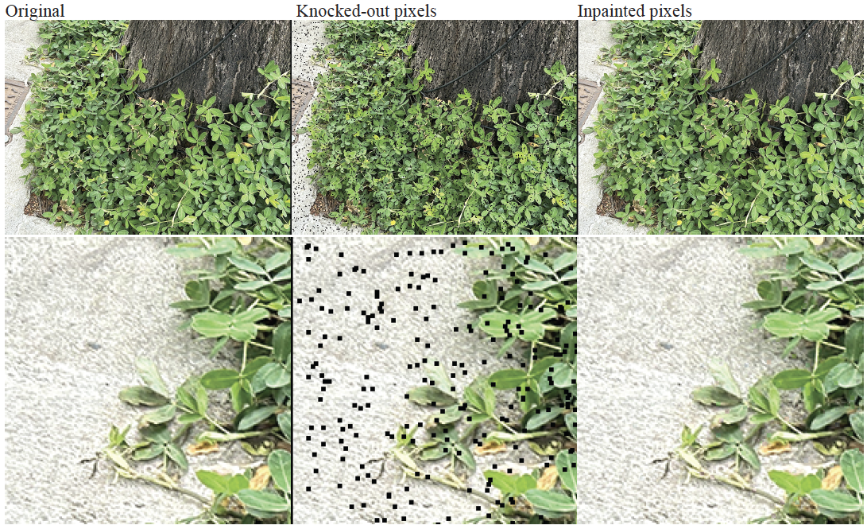

Slide 9
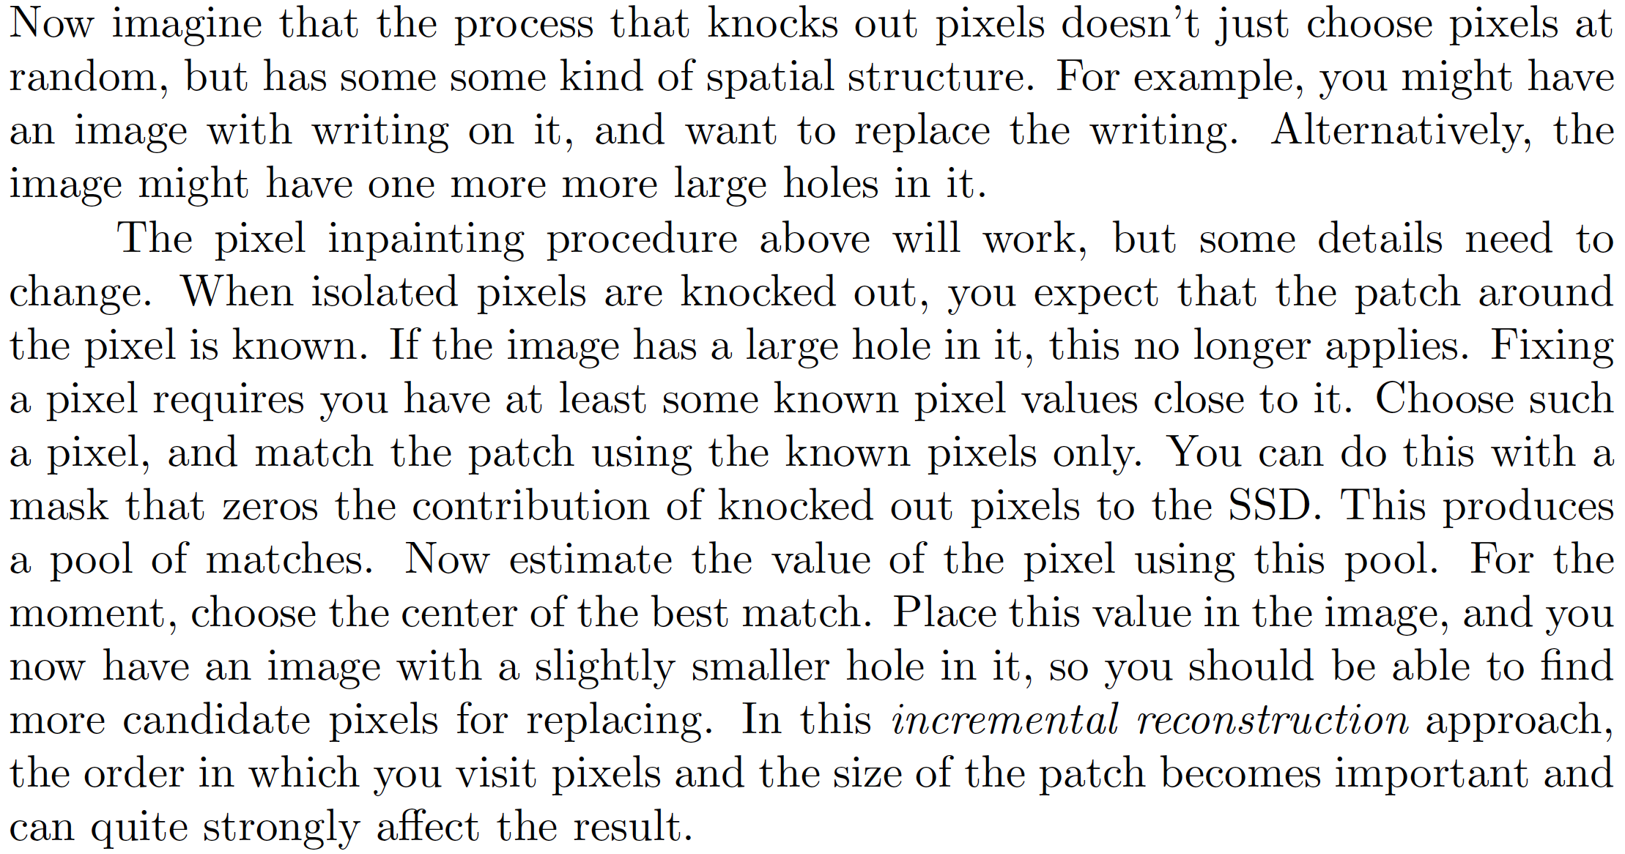
Incremental inpainting

Slide 10
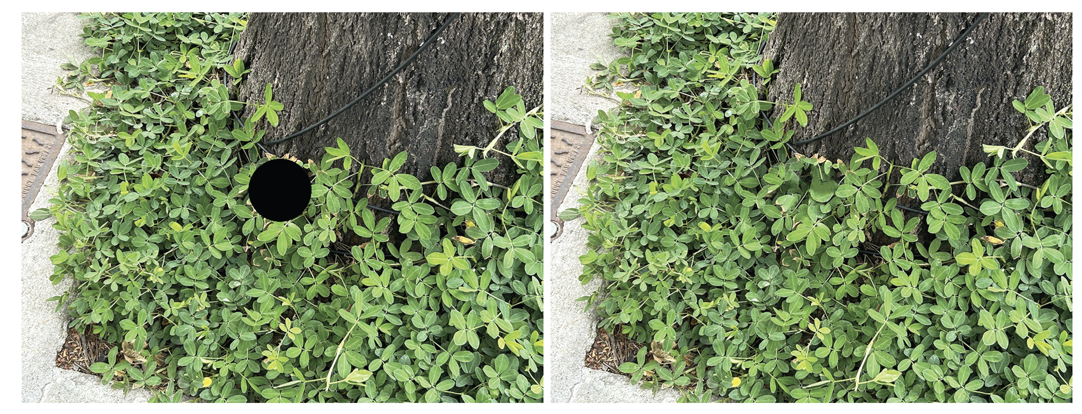

Slide 11
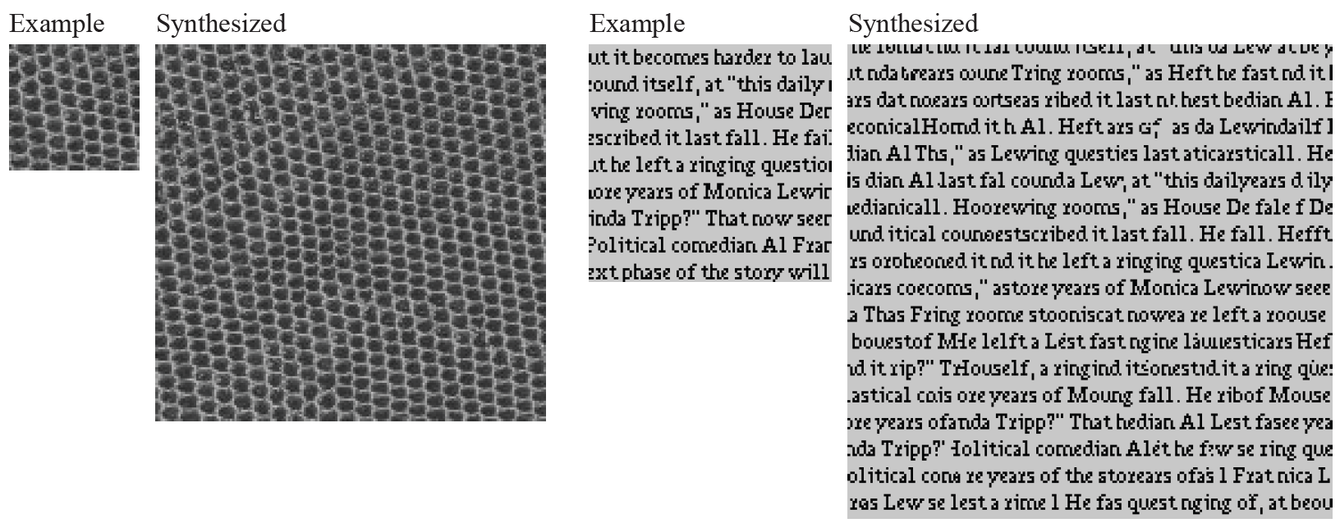
Incremental inpainting makes big images from small

Slide 12
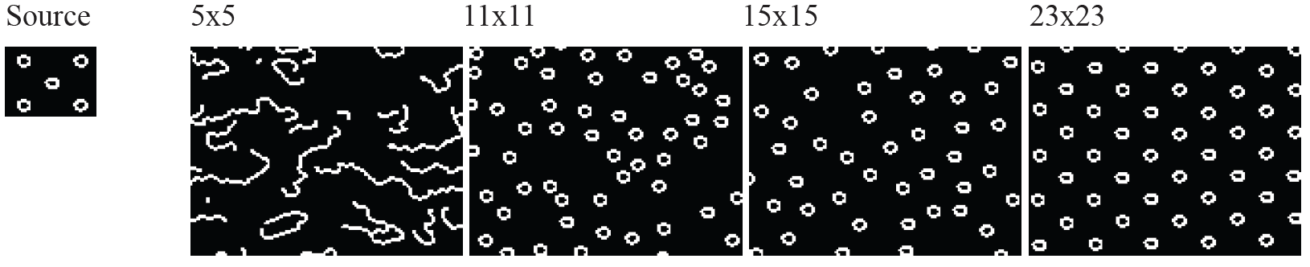
The size of the patch matters

Slide 13
But this is a weird noise model…
You *know* which pixels are wrong
What about additive gaussian noise?
The principle here is that there are other patches in the image that are “like” the patch you are interested in
Idea – estimate pixel value using
a weighted sum *over all patches* weighted by similarity
of patch to neighborhood around pixel

Slide 14
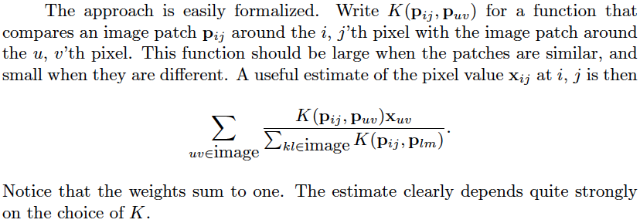
Non-local means

Slide 15
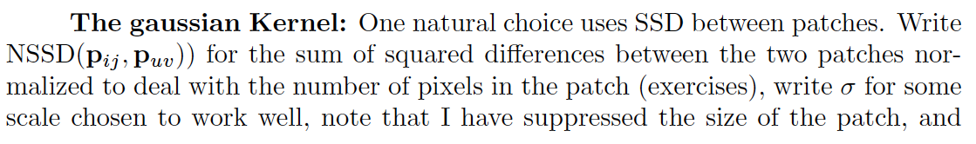
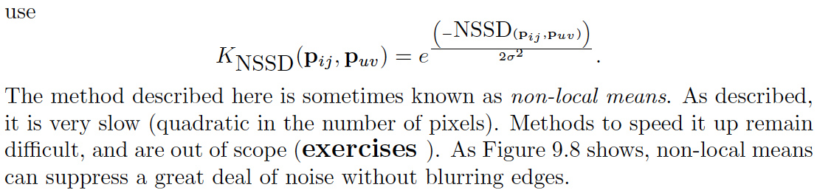

Slide 16
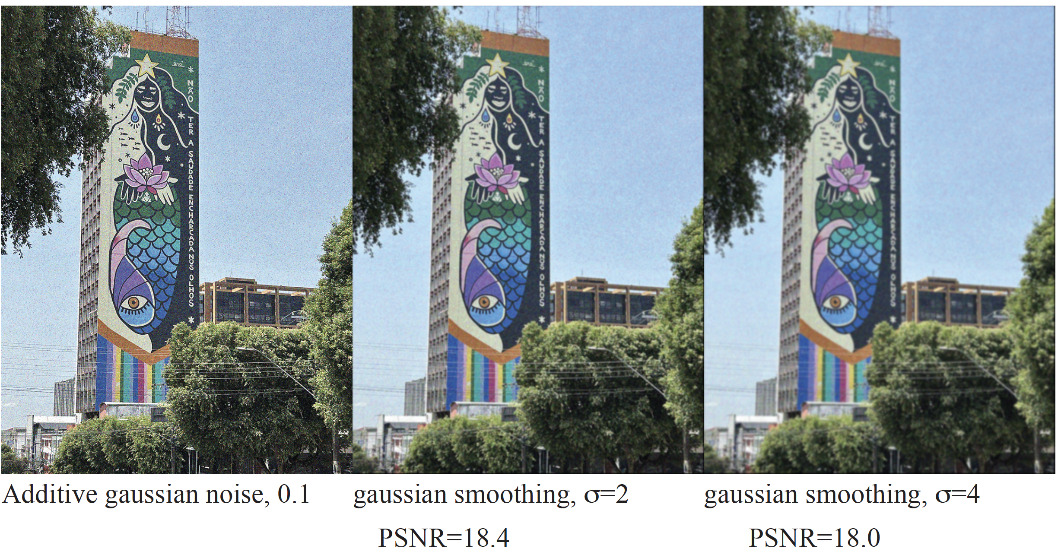

Slide 17
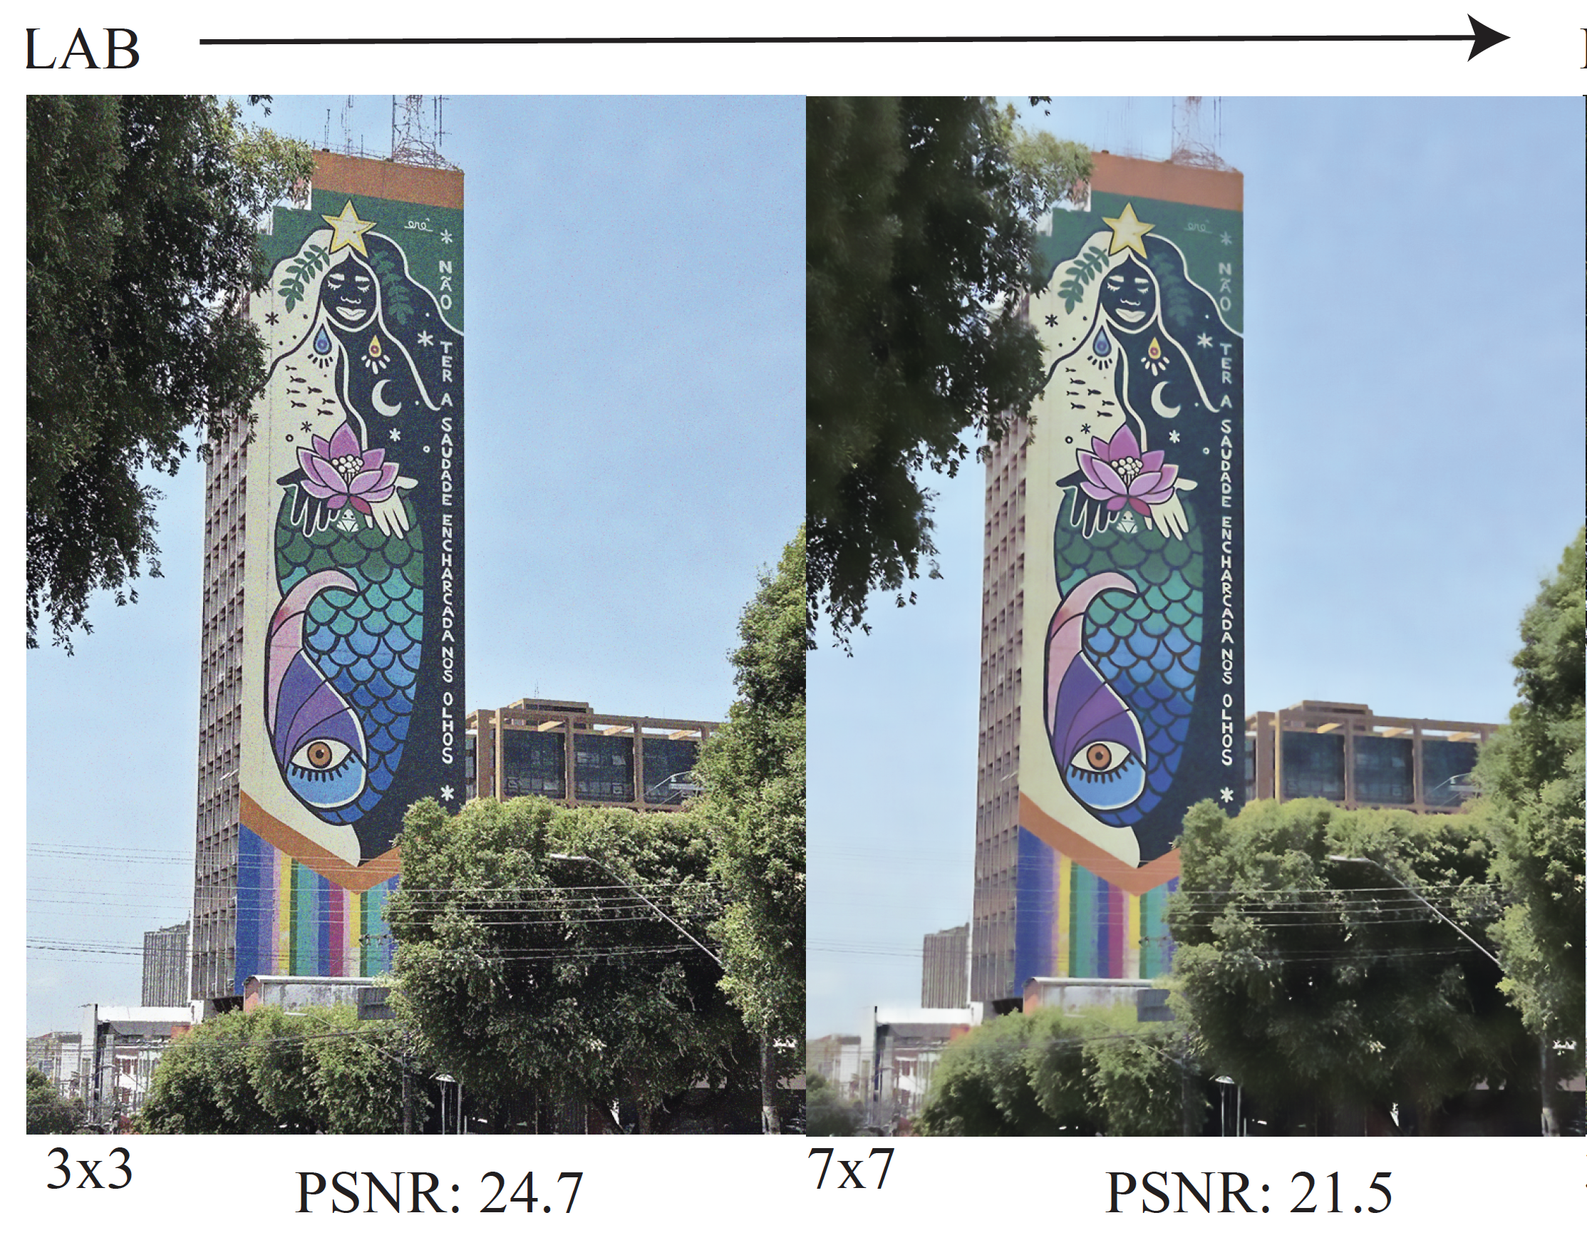

Slide 18
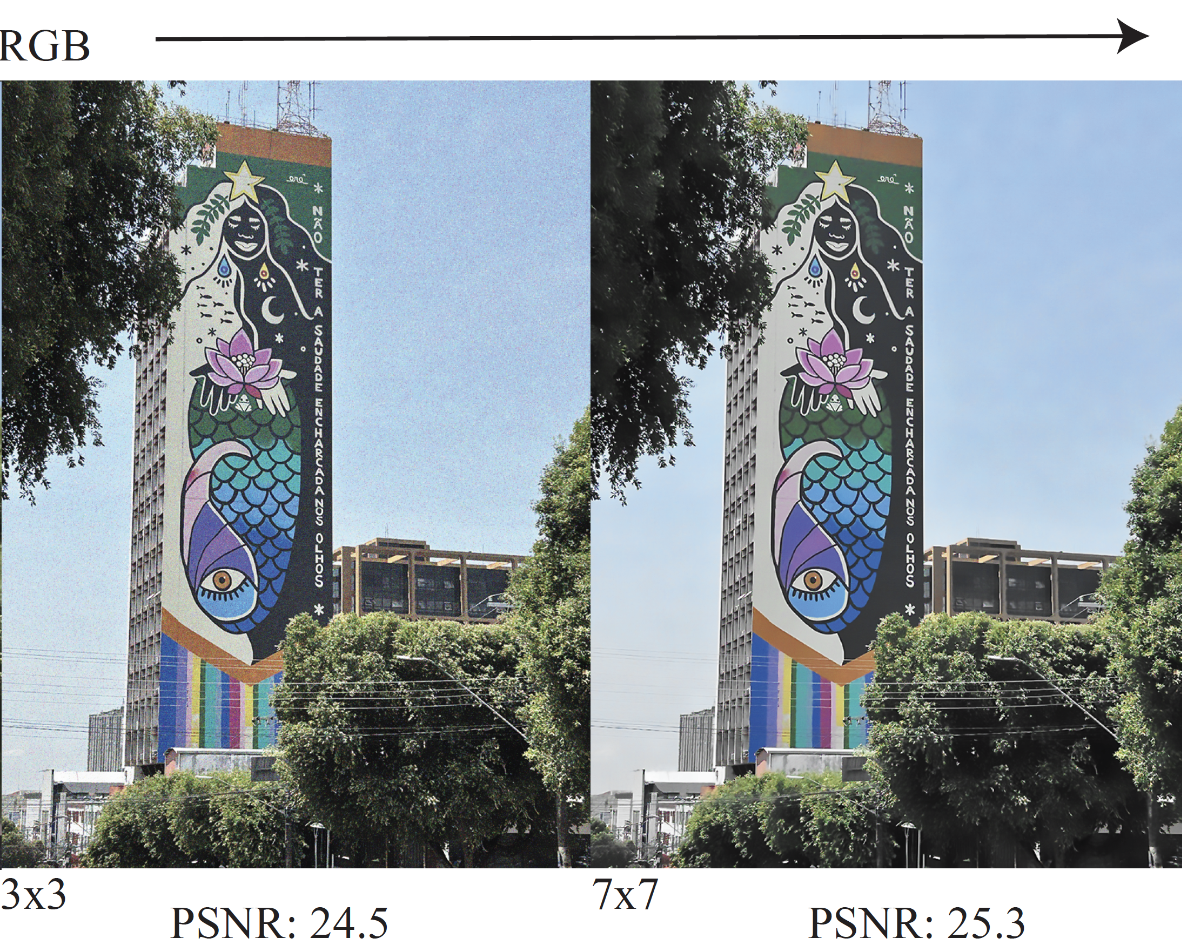

Slide 19
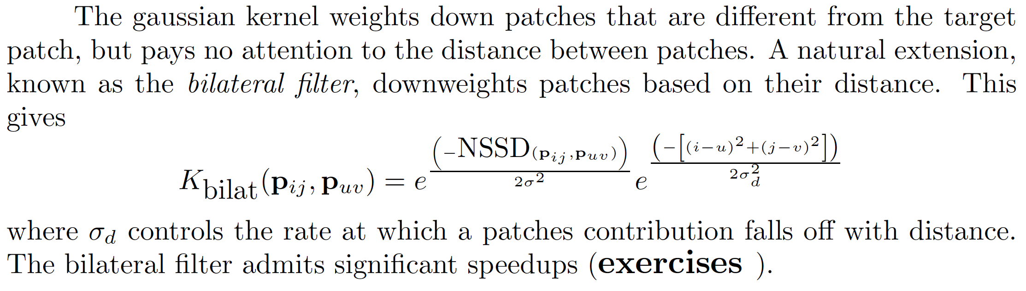
The Bilateral Filter

