Slide 1
Forming and using patch dictionaries
Idea:
other patches in an image are good for denoising
why not use other patches in other images?
Issues:
how to find the right patch in a very large number of patches?
redundancy
many patches are like one another, and so just make work

Slide 2
Desirable outcome
Procedure to
accept a patch
produce a patch/some patches that are similar
Built out of very large number of patches

Slide 3
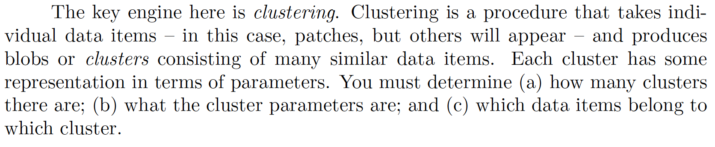
Clustering

Slide 4
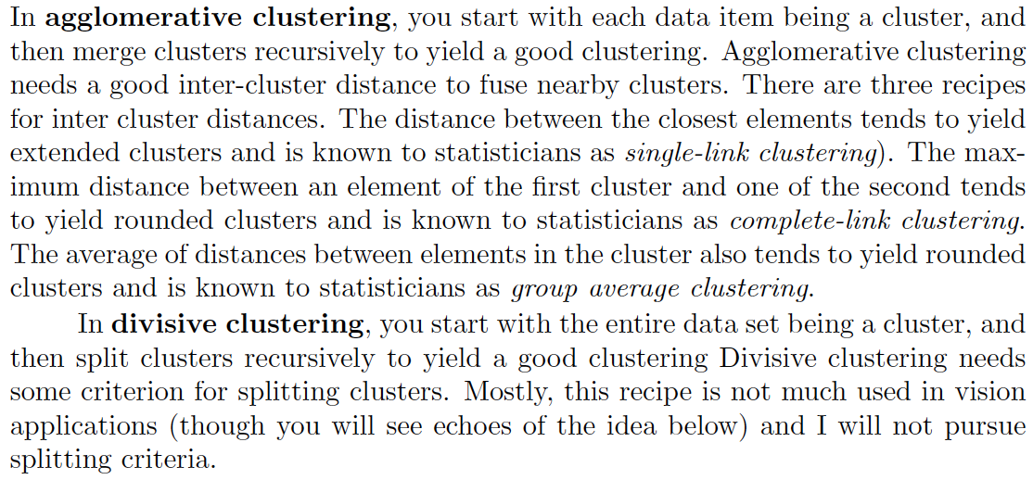
Clustering

Slide 5
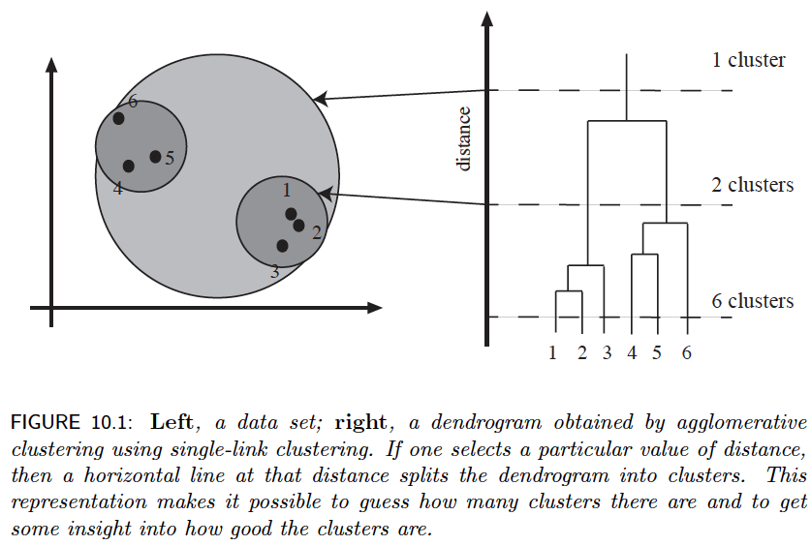
Dendrograms

Slide 6
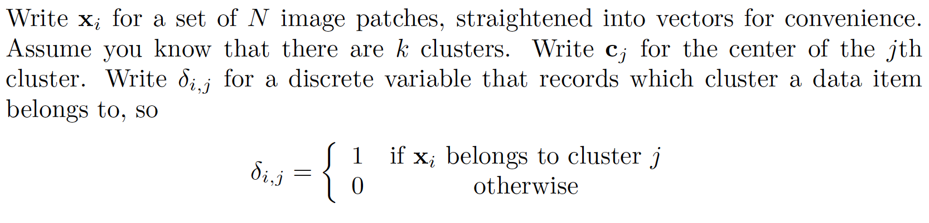
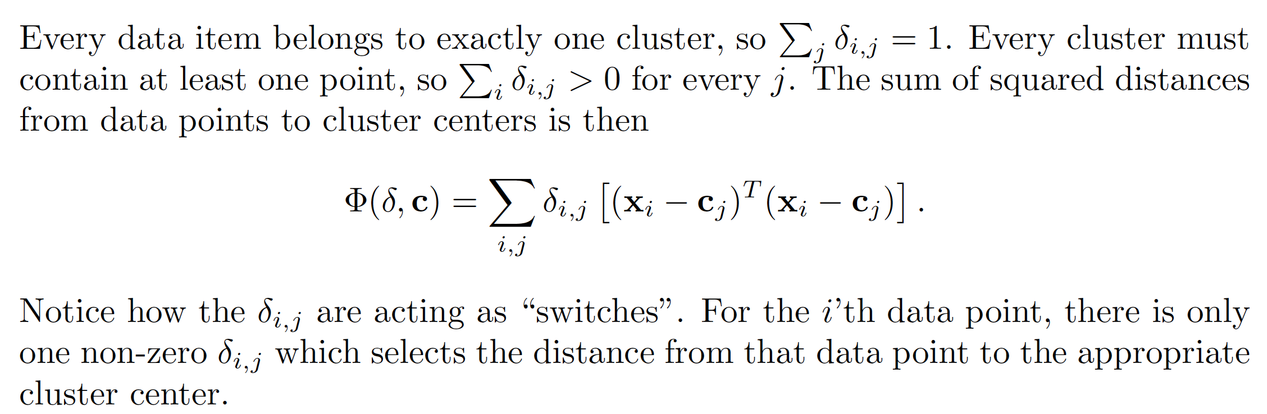
K-means clustering

Slide 7
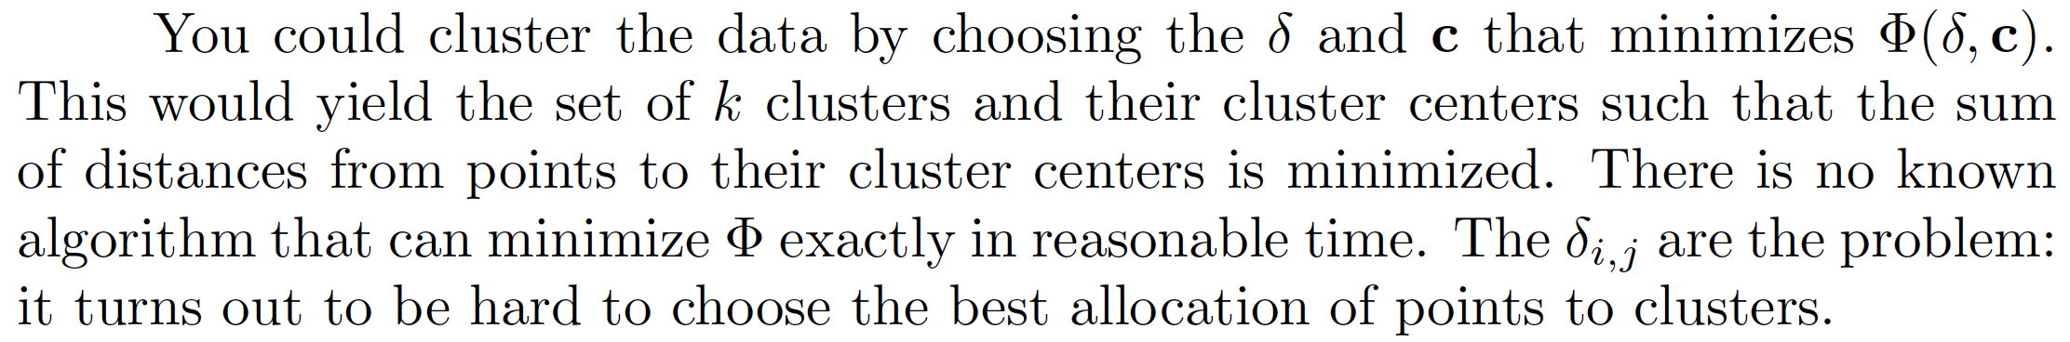
Minimize the objective function, but how?

Slide 8
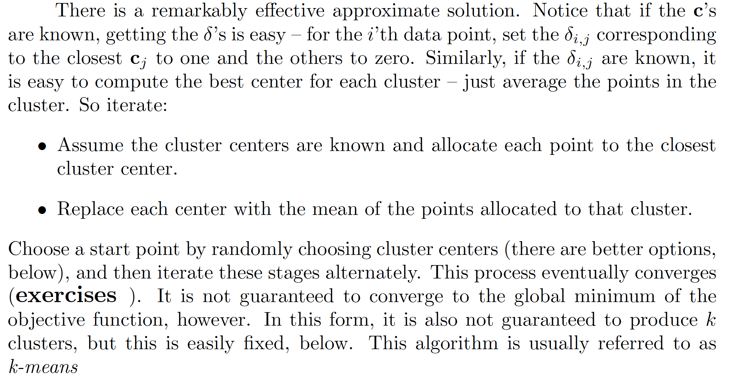
Approximate minimization

Slide 9
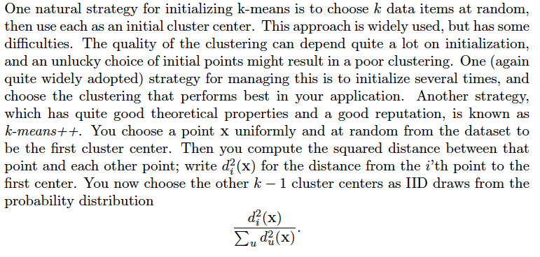
Fixes – efficient starting

Slide 10
Choosing K
Strategies:
Cost function for various values of K [DOESN’T WORK!!!]
Purity, etc. [Hardly ever relevant]
Choose some K’s, try application with different K’s,
choose the best

Slide 11
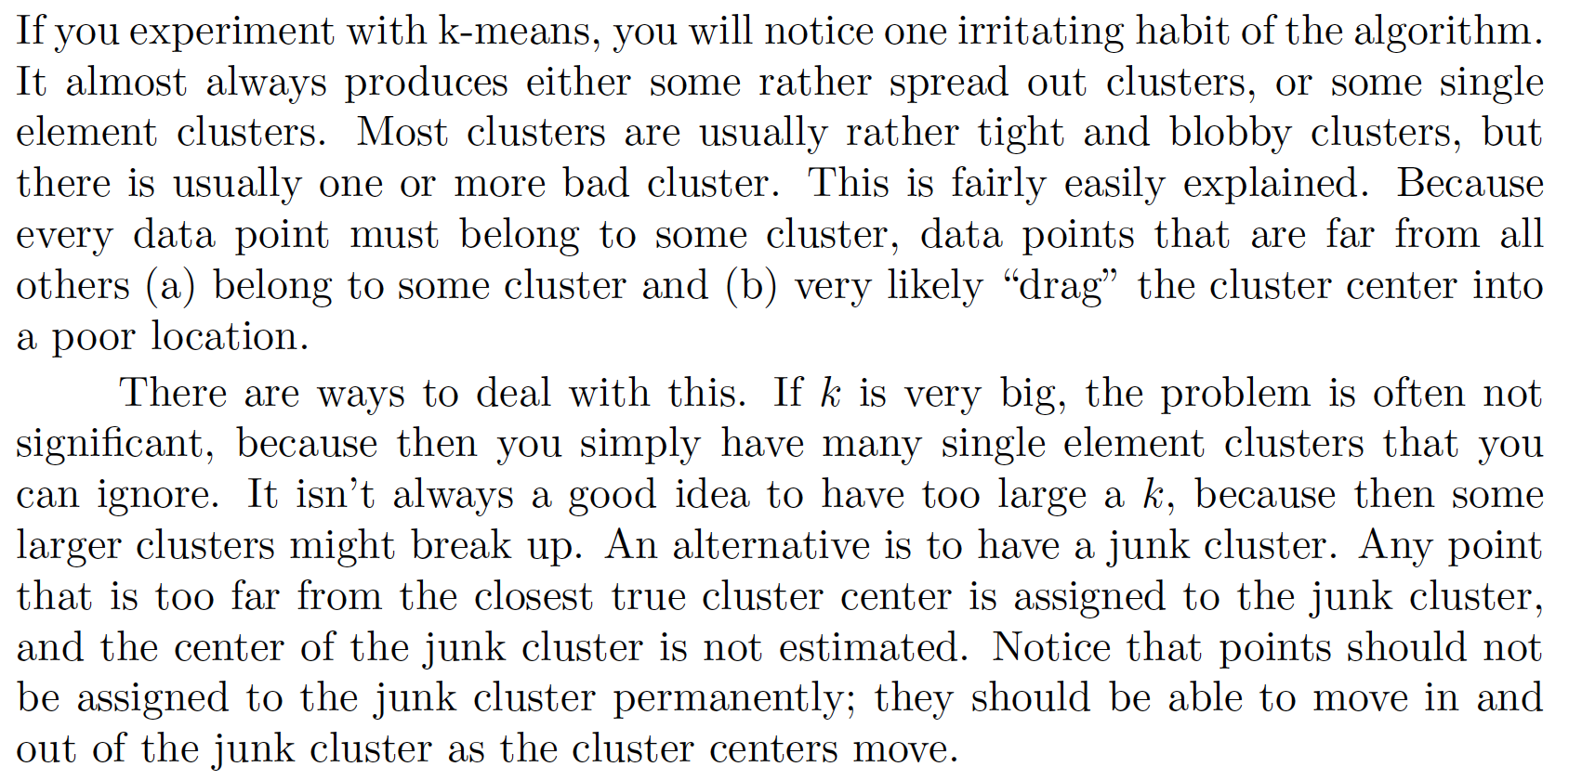
Fixes – Scattered Points and Junk Clusters

Slide 12
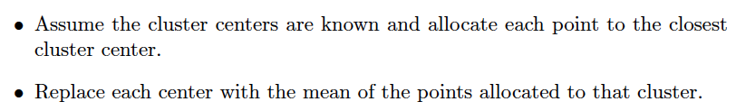
Fixes – Empty Clusters
So some clusters might be empty and mean fails
Cure:
for any empty cluster, randomly select a data point to serve as its center

Slide 13
Why K-means is useful
Take input patch
Find its cluster center
Use patches in the cluster or the cluster center itself to denoise the image

Slide 14
Hierarchical K means
But what if there are too many data points?
too many clusters, finding cluster center is hard
IDEA:
Cluster data using K means
Each cluster is now a dataset
Cluster each dataset using K means

Slide 15
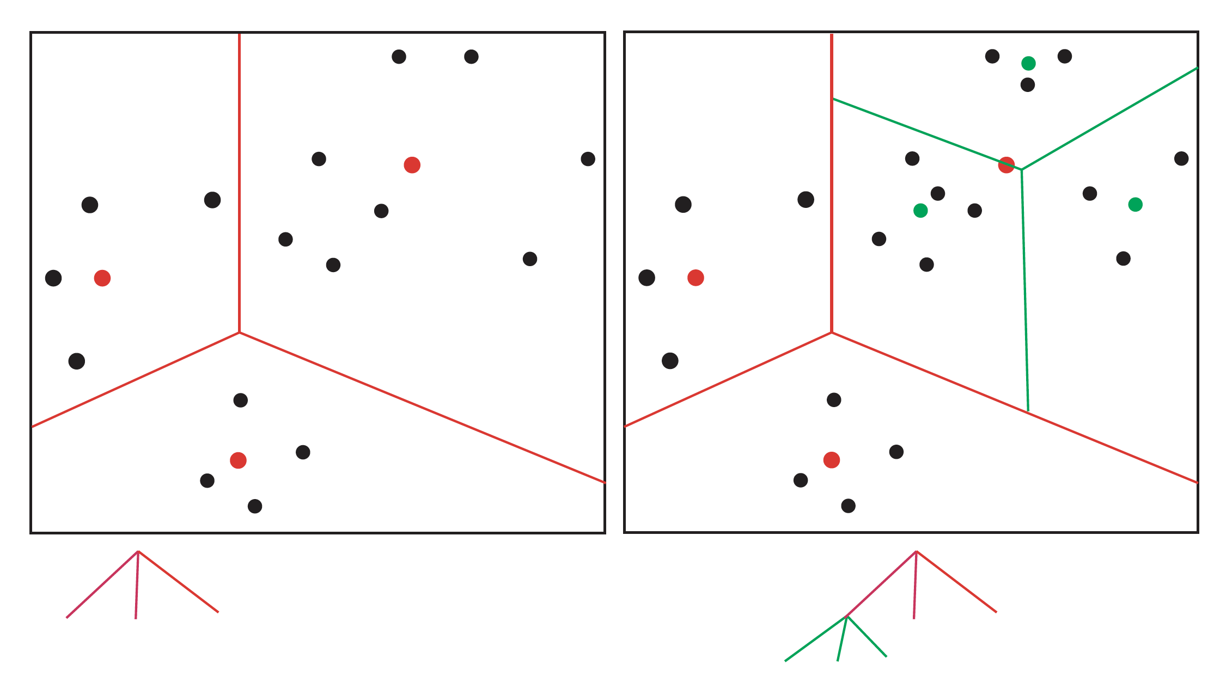

Slide 16
Hierarchical K means
But what if there are too many data points?
too many clusters, finding cluster center is hard
IDEA:
Cluster data using K means
Each cluster is now a dataset
Cluster each dataset using K means
Notice this is a simple tree; you could make it deeper.

Slide 17
Nearest neighbors
Idea:
Find the patch that is closest to query patch, denoise (etc) with that
Issue:
How to do this fast? (v. hard)

Slide 18
Approximate nearest neighbors and k-means
Idea:
“Walk” input patch down hierarchical k-means tree
Find closest patch from patches in the leaf cluster
Use that instead of nearest neighbor

Slide 19
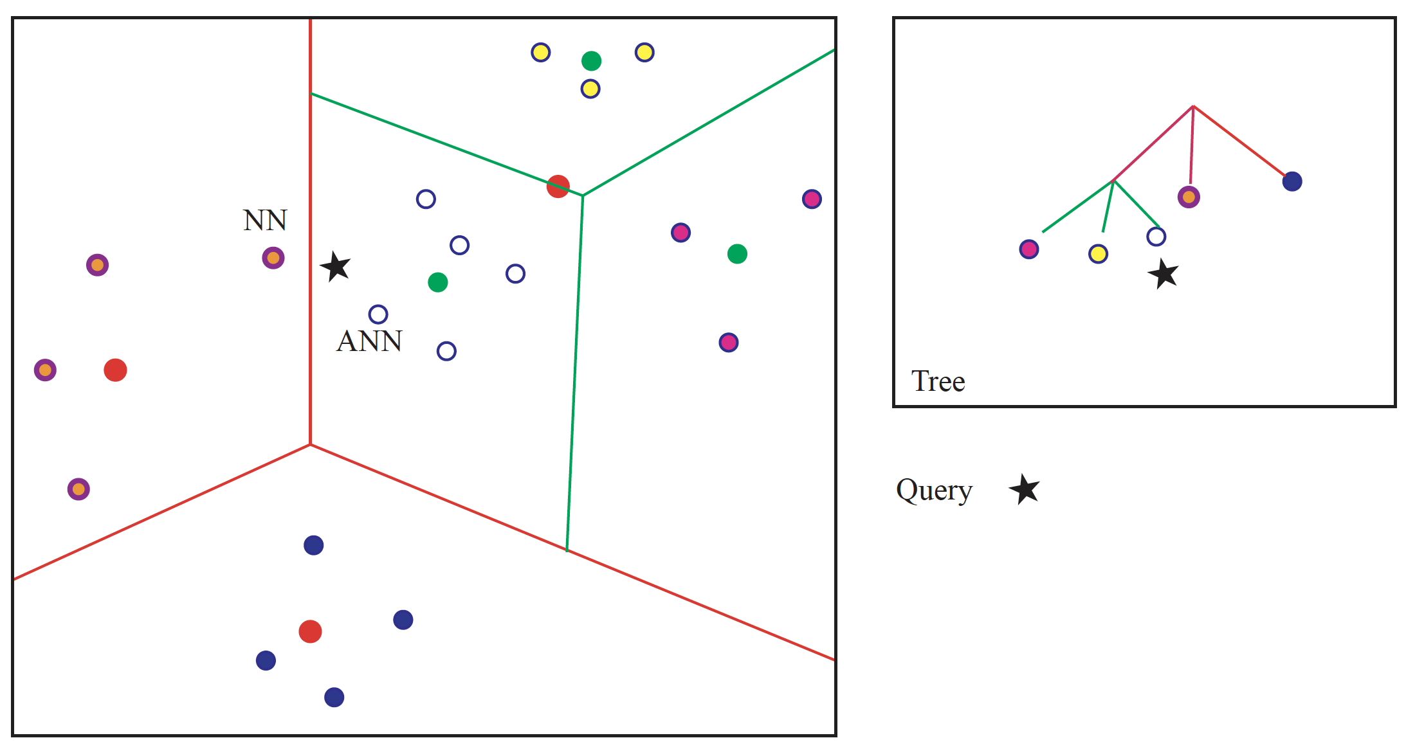
Approximate nearest neighbors and k-means

Slide 20
Approximate nearest neighbors and k-means
Idea:
“Walk” input patch down hierarchical k-means tree
Find closest patch from patches in the leaf cluster
Use that instead of nearest neighbor
Fact: not nearest neighbor; with high probability nearly as close
Fact: hard to find a closer neighbor by walking tree

Slide 21
Approximate nearest neighbors and k-means

Slide 22
Denoising with a patch dictionary
Procedure:
Divide noisy image into patches, which could overlap
Match each patch using a dictionary (ANN using HKM)
Reconstruct
if the patches don’t overlap, easy
if they do, average

Slide 23
Options when matching
Walk tree, find patch in leaf that is closest to query patch
Walk tree, use mean of all patches in leaf
- this should be better than you might think
cause all the patches should be quite similar

Slide 24
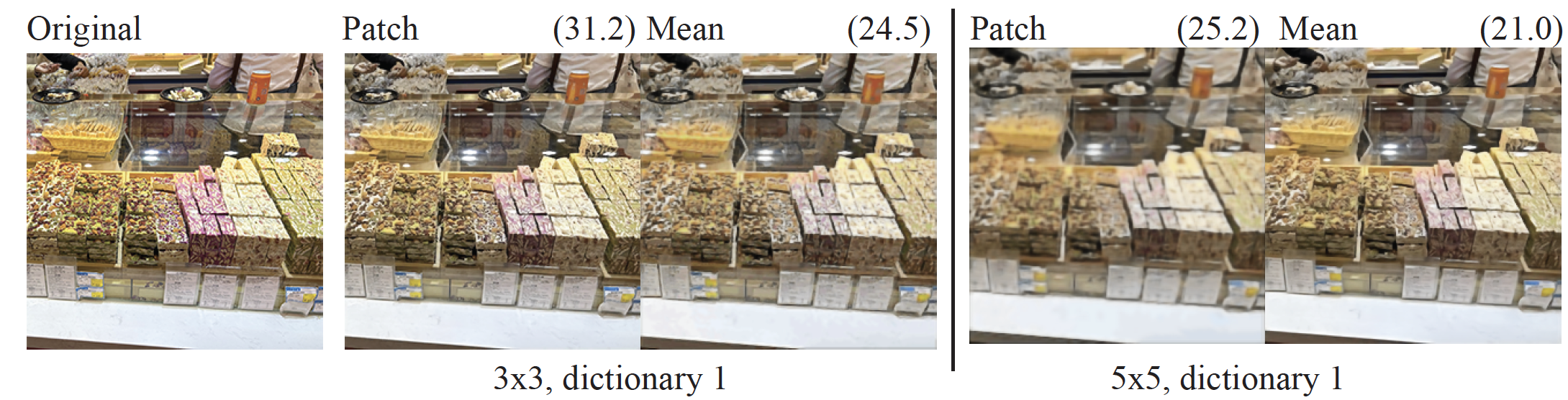
Denoising with a patch dictionary - overlapping

Slide 25
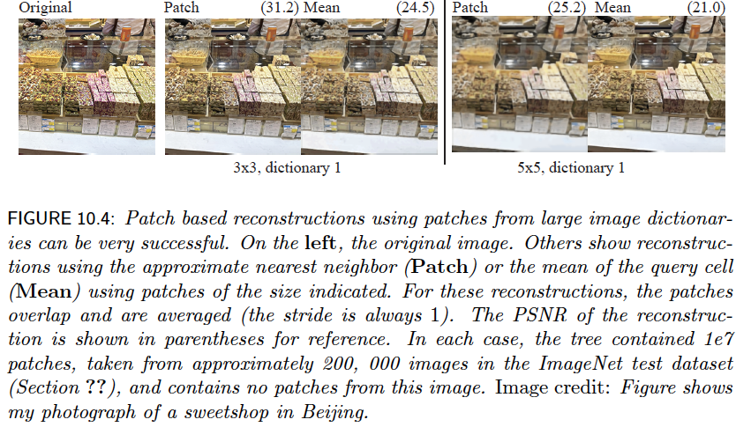

Slide 26
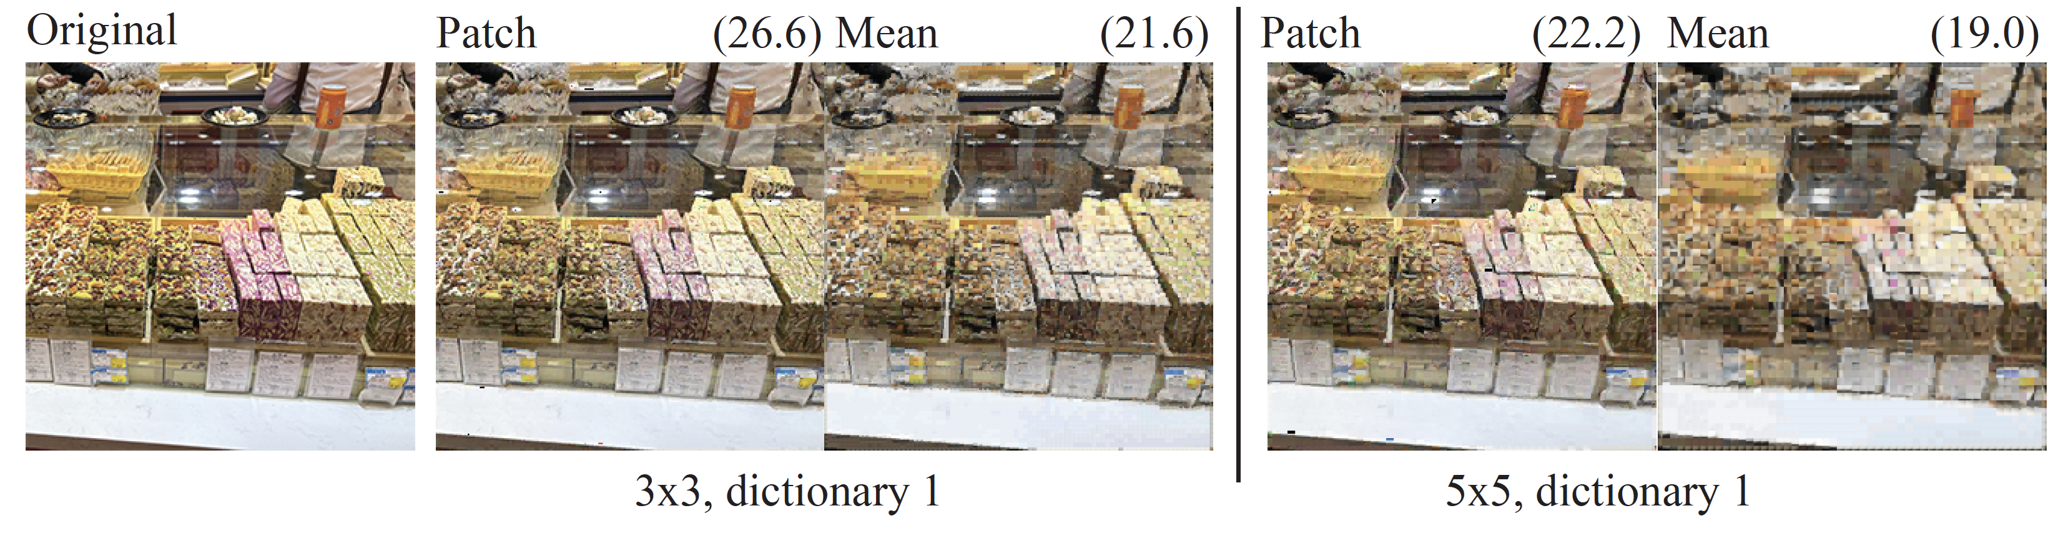
Denoising with a patch dictionary, no overlap

Slide 27
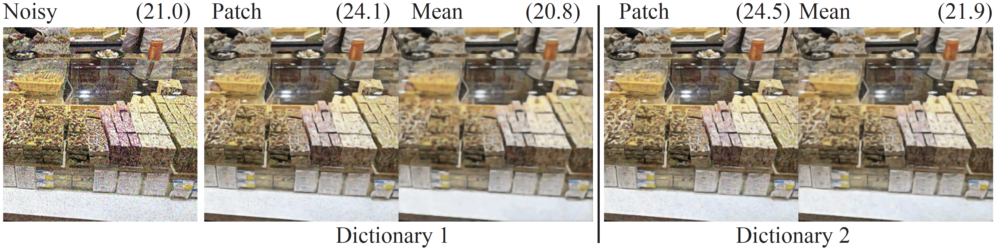
Dictionary size has a significant effect
Dictionary 1 – 1e7 patches, 200, 000 images, 2000 leaves
Dictionary 2 – 5 e 7 patches, 1e6 images

Slide 28
Vector quantization
Recall:
Walk tree, use mean of all patches in leaf
- this should be better than you might think
cause all the patches should be quite similar
Notice that you have built a mapping. You could replace the mean with the number of the leaf to get: patch-> leaf
This has a range of uses – compression, etc.

Slide 29
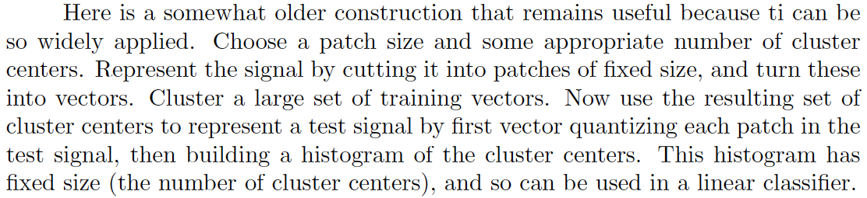
Building features with vector quantization
Image might have variable size
Histogram has fixed size

Slide 30
Idea: vector quantization and voting
Problem:
you want to classify an image
Strategy:
learning:
get many labelled images
cut into patches
build tree
for each leaf, record the most common label
classifying:
cut image into patches
pass patch down tree
vote for label
Now old-fashioned, but moderately
effective and very good in its time

