Slide 1
The Uses of Correspondence, or elementary 3D, tracking, etc
D.A. Forsyth, University of Illinois at Urbana Champaign
SOME APPLICATION SLIDES MISSING

Slide 2
Main points
Matching locations across images reveals
  how you have moved; the shape of things; what else is moving
Low compute matching for scattered points is very powerful
  Structure from motion or SLAM
You can fill in shape information
High compute matching yields very dense information
  but requires some thought about network structure

Slide 3
Calibration
Procedure
  View N known reference points in 3D
  Obtain locations in image plane
  Produce
    Camera intrinsics and extrinsics
Why
  recovering intrinsics for future use
  where is an object/camera in the camera/world frame?
How
  Optimization: minimize reprojection error

Slide 4
Strategies
Chuck it into an optimizer and run
  AAARGH!
Find a good start point
  all works out
Variants
  Different point locations; points on plane; etc., etc.

Slide 5
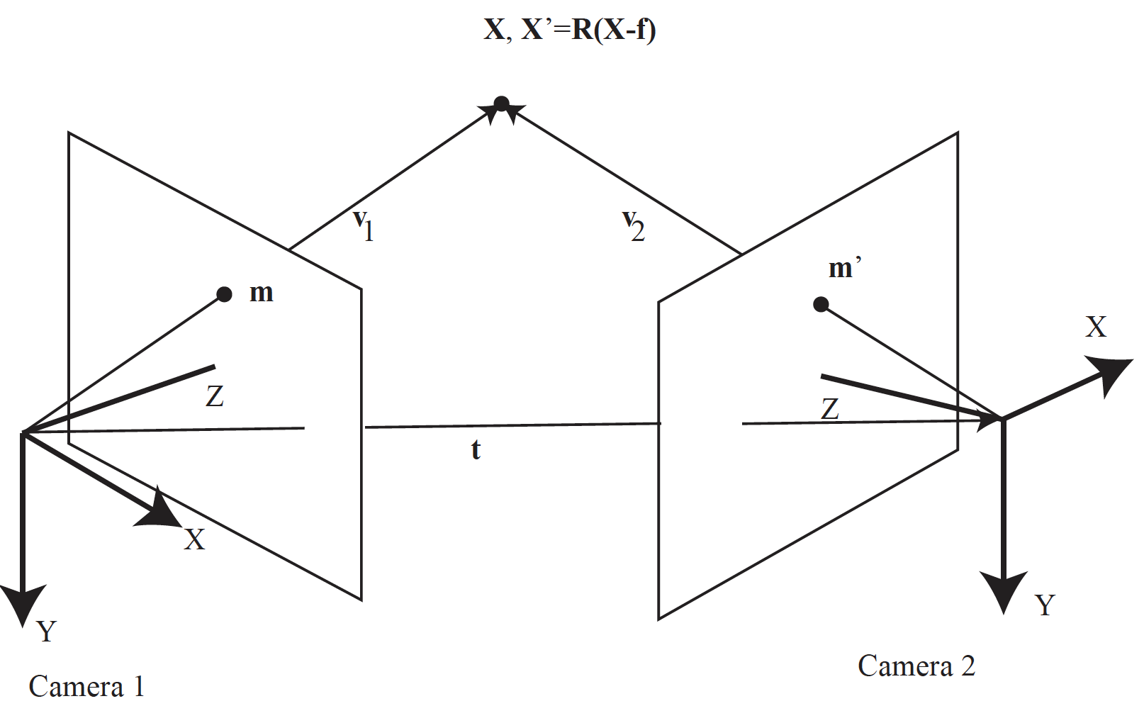
Reconstruct point from two views

Slide 6
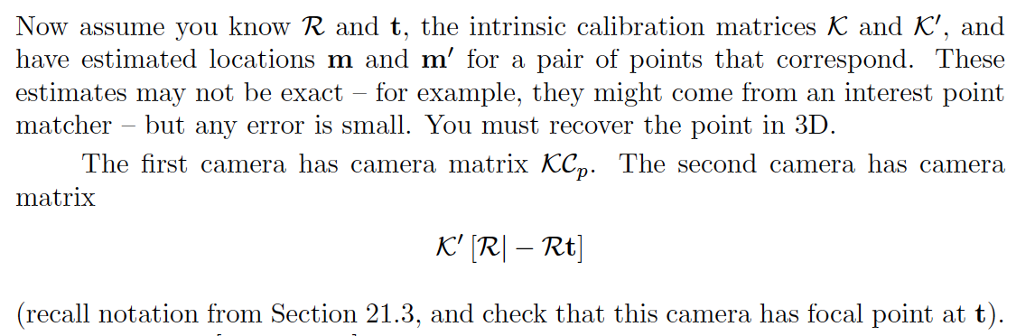
Triangulation
Have m, m’, R, t
Compute reprojection error
  sum:
    residual between X projected into 1 and m
    residual between X projected into 2 and m’
Choose X that minimizes

Slide 7
Stereo
Given two images of a static scene
  construct a depth map by:
    correspondence
    triangulation
Photometric consistency
  points that match will have same color (intensity)
  largely, but not wholly, true
    specular surfaces, glossy surfaces, etc.

Slide 8
Recall triangulation
IF you know m, m’ correspond
  you can get X

Slide 9
Stereo image rectification
If the image planes are not parallel, we can find homographies to project each view onto a common plane parallel to the baseline
C. Loop and Z. Zhang. Computing Rectifying Homographies for Stereo Vision. CVPR 1999

Slide 10
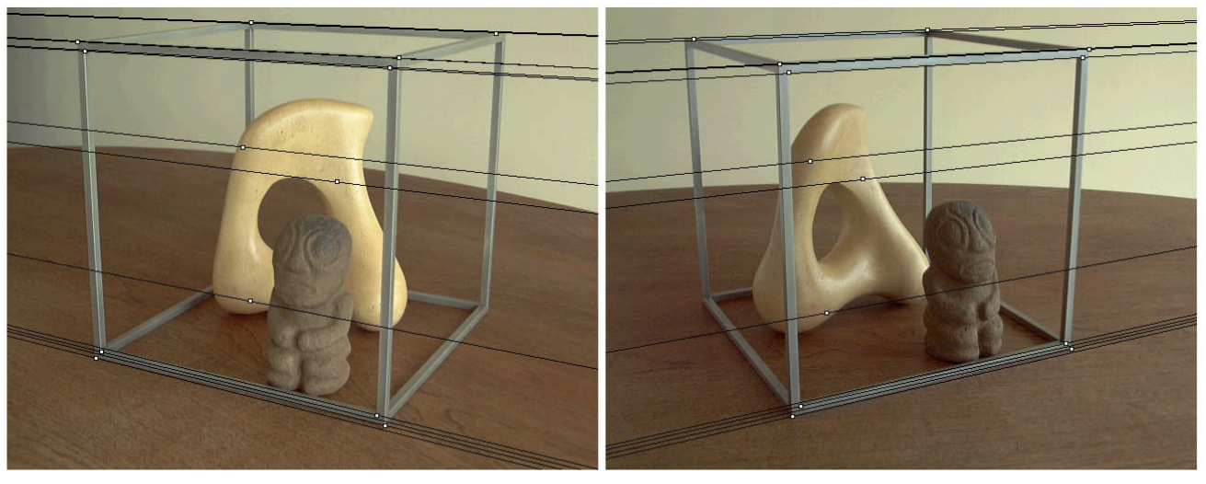
Stereo image rectification
Before rectification:
Image source

Slide 11
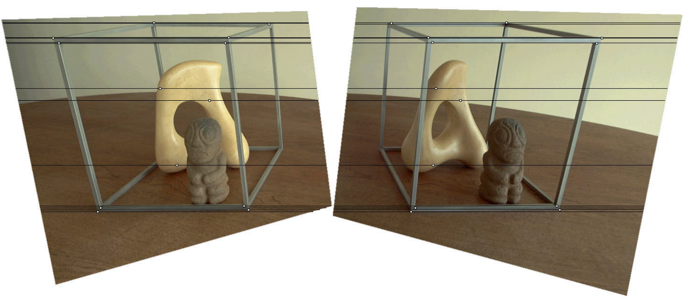
Stereo image rectification
After rectification:
Image source

Slide 12
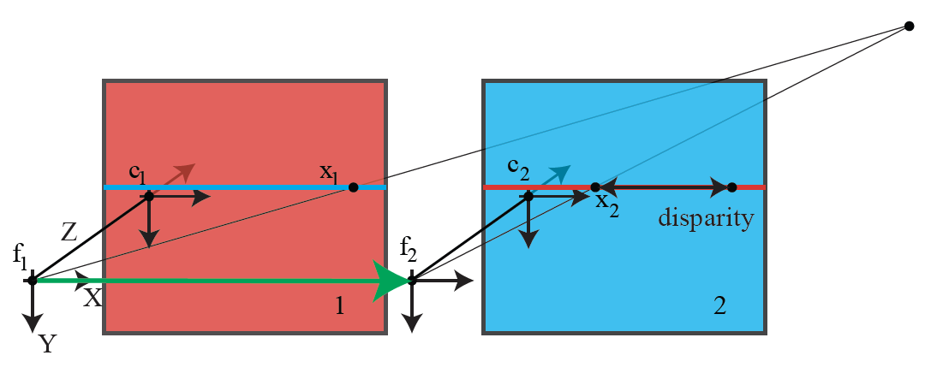

Disparity and baseline
$$B$$

Slide 13
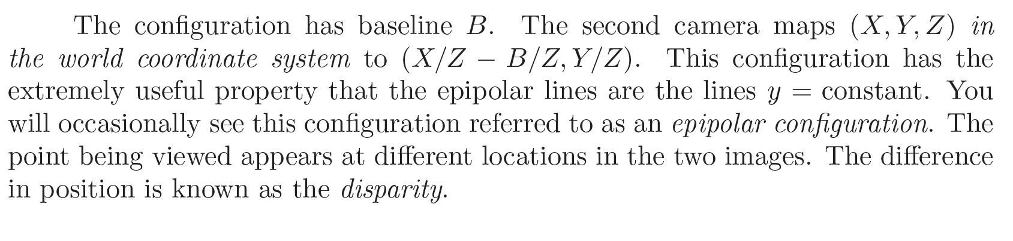

Disparity and baseline
$$B$$

Slide 14
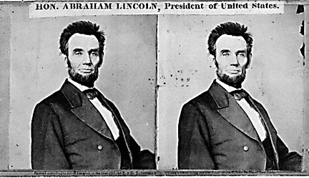
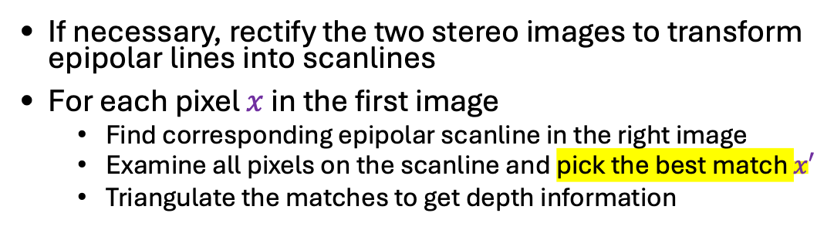
Basic stereo recipe
If necessary, rectify the two stereo images to transform epipolar lines into scanlines
For each pixel $x$ in the first image
  Find corresponding epipolar scanline in the right image
  Examine all pixels on the scanline and pick the best match $x′$
  Triangulate the matches to get depth information
Hard to pick the best match
--might be far away
– some points don’t have matches

Slide 15
Effect of baseline on stereo results
  Larger baseline
    Smaller triangulation error
    Matching is more difficult
  Smaller baseline
    Higher triangulation error
    Matching is easier

Slide 16
Some points don’t have matches
This is a depth cue, though not much used directly
Effect sometimes known as
Da Vinci stereopsis

Slide 17
Stereo as optimization
Depth => Disparity => Matches
Search for disparities such that
  Matches are good
  Disparities meet various constraints
  Depth map is “like” real depth map
Highly developed, effective theory

Slide 18
Optical flow
Given two images of any scene
  where stuff could move
Build a field of arrows
  tail at pixel
  head at new location of surface behind pixel
    in next frame
Uses
  inference about your motion (egomotion)
  inference about motion in the world
  inference about depth
  segmentation
  compression

Slide 19
Time to contact example

Slide 26
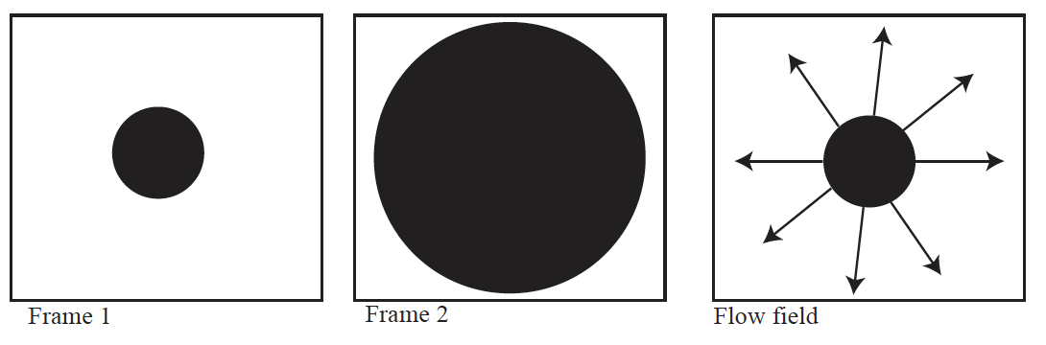
Flow fields reveal your motion

Slide 27
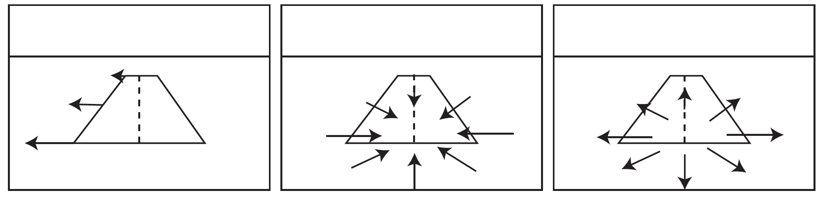
Flow fields reveal your motion

Slide 28
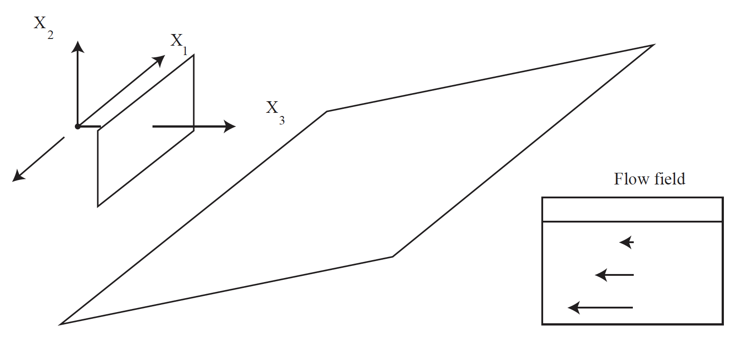
Flow fields reveal shape

Slide 29
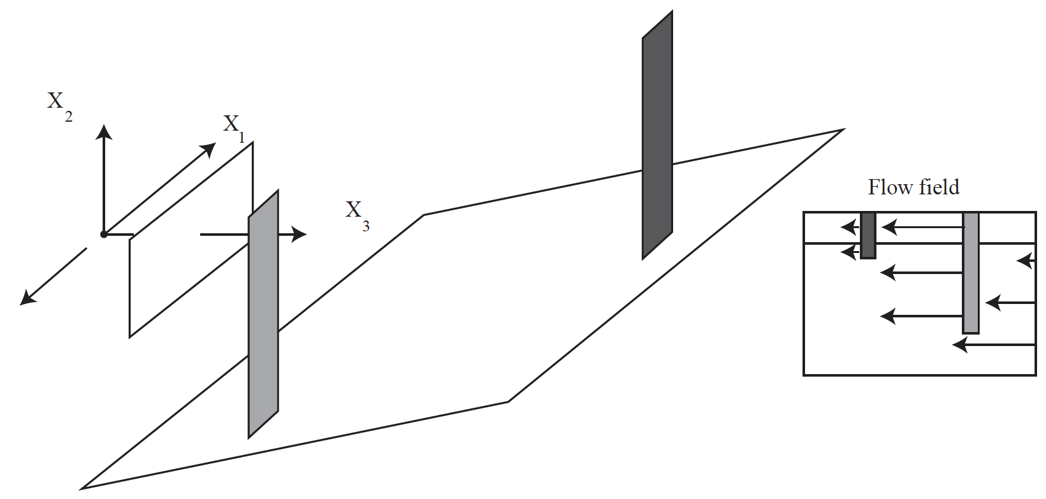
Flow fields reveal segmentation

Slide 30
Why estimating flow is hard
Flow is ambiguous at most points
  the aperture problem
You must interpolate
  but there are discontinuities
Flow is not defined everywhere
  some things are visible only in one frame
Some objects move by large amounts
Motion blurring complicates estimation

Slide 31
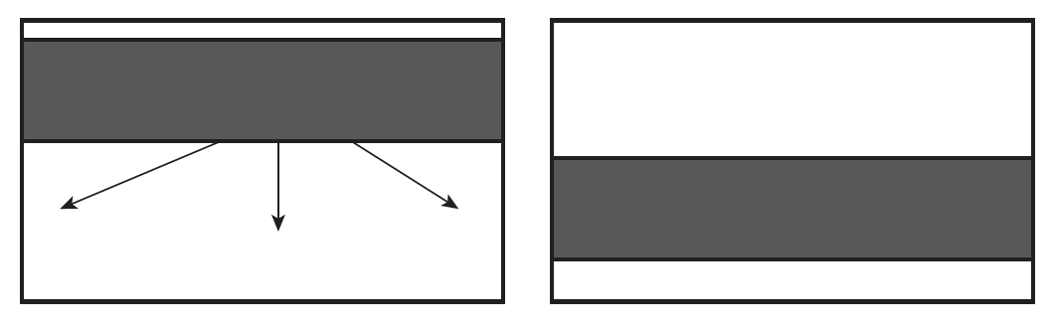
The aperture problem

Slide 32
Flow is often discontinuous

Slide 33
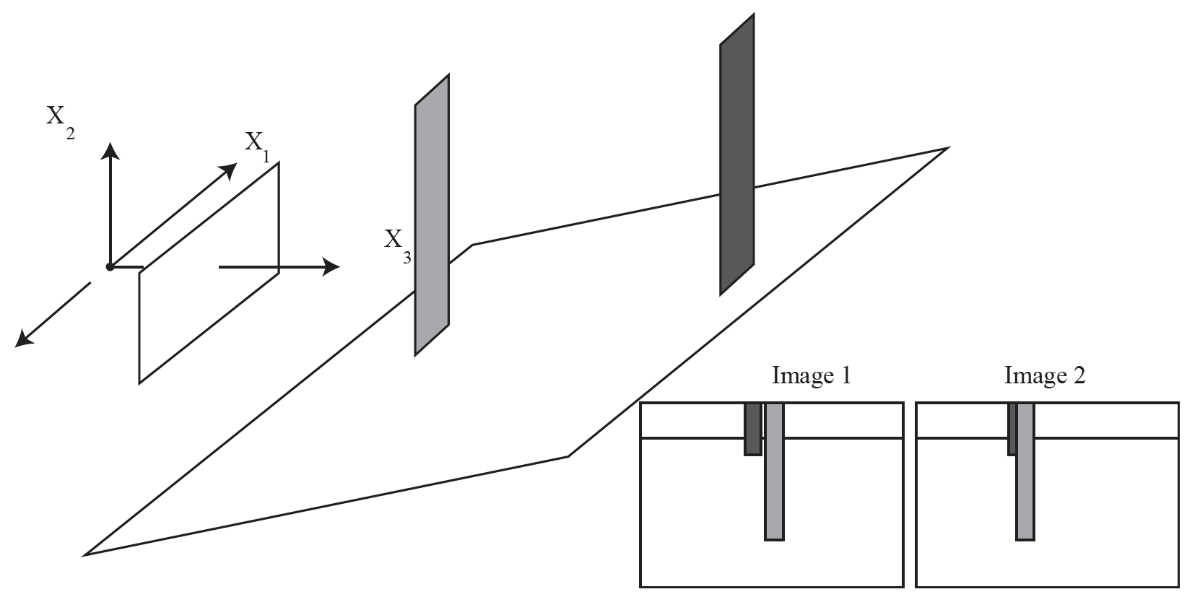
Flow is not defined everywhere

Slide 34
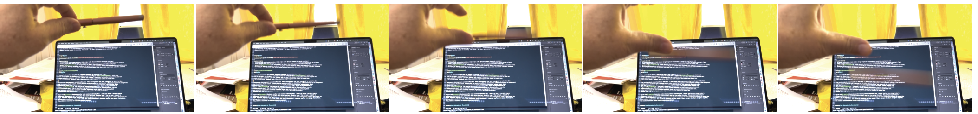
Large movements and motion blur

Slide 35
Learned flow and stereo estimates
You might
  pass two images into encoder/decoder network
  hope to get stereo/flow at the output
  This doesn’t work, because
    you need to compare possibly distant locations
      to identify correspondences
    and impose structure
      to avoid implausible flow/disparity fields
Cost volume
  a tensor that compares locations
You can fuse single image depth information with stereo/flow

Slide 36
Flow and stereo are related, but different
In each
  you must find what matches between images
  matches will have the same color (mostly)
  The core computation is matching from image to image
Stereo
  two views of a static scene
    epipolar geometry applies
    strong constraints on what can match
Optical flow
  things could move
    flow structure isn’t obliged to meet epipolar constraints

Slide 37
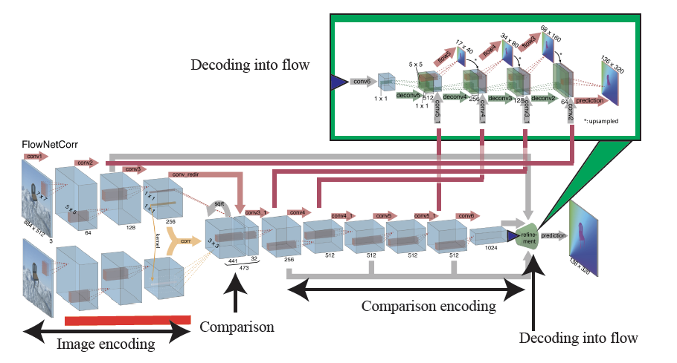
Flownet
Cost volume

Slide 38
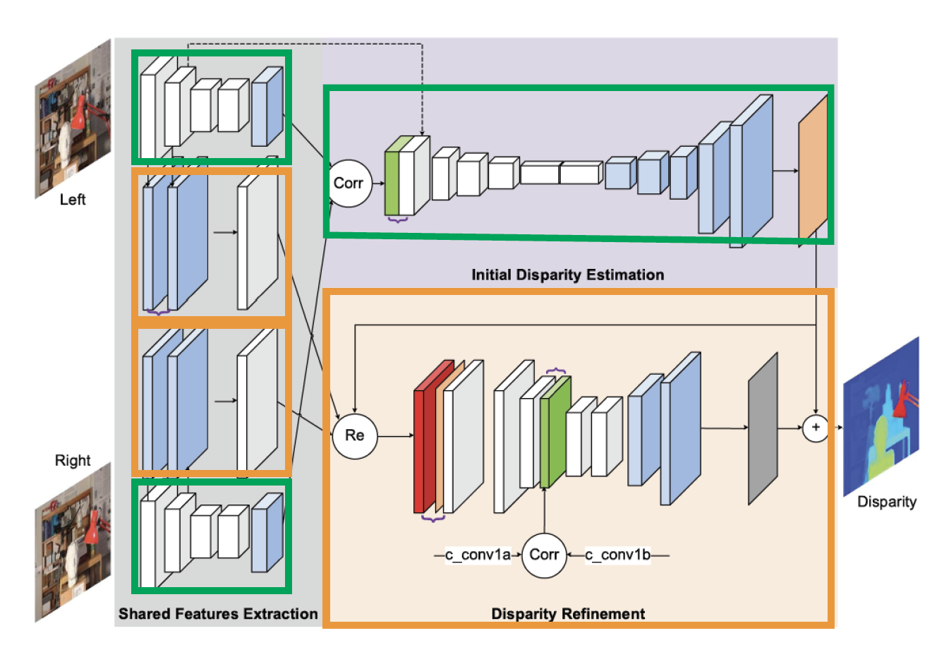
Stereo with cost volumes and residuals

Slide 39
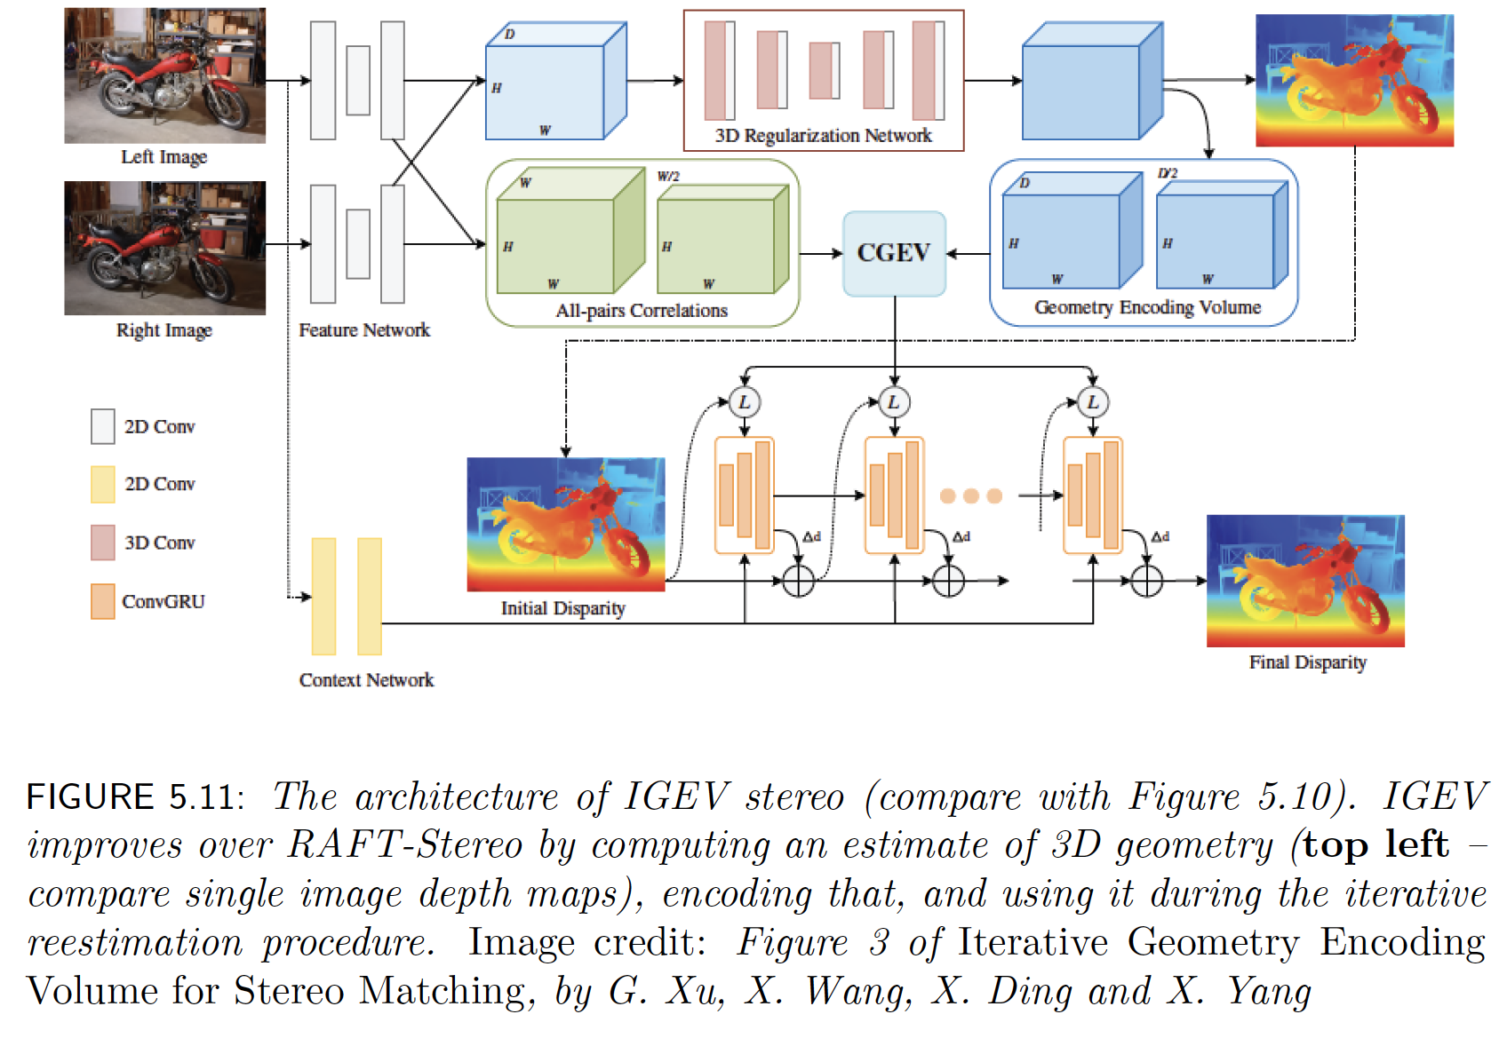

Slide 40
Estimating a fundamental matrix
If you know 8 (7) correspondences
  you can get fundamental matrix
  but you don’t know exactly
Strategy (RANSAC):
  use interest point descriptors to find matches (most, but not all, are right)
  iterate:
    choose 8 (7) at random
      fit FM using optimization problem
      check what others agree
  take the best
Care in formulating the optimization problem is rewarded!

Slide 41
Fundamental vs essential matrix
Fundamental matrix is a geometric concept
  true whatever the coordinate system
Essential matrix
  what happens in coordinates

Slide 42
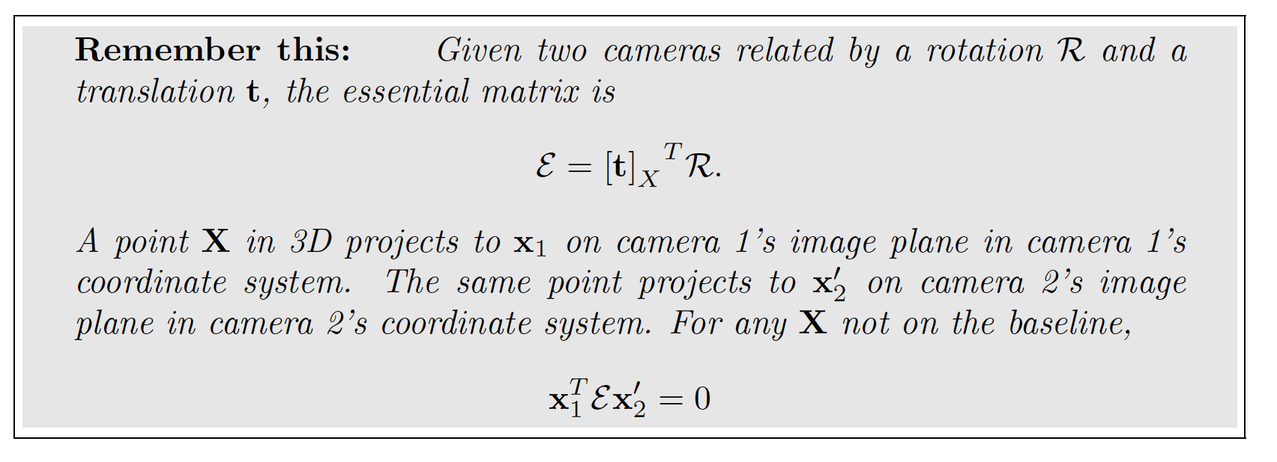
The essential matrix
it follows from fundamental matrix that something like this should be there; but here we have an expression relating it to camera transformation

Slide 43
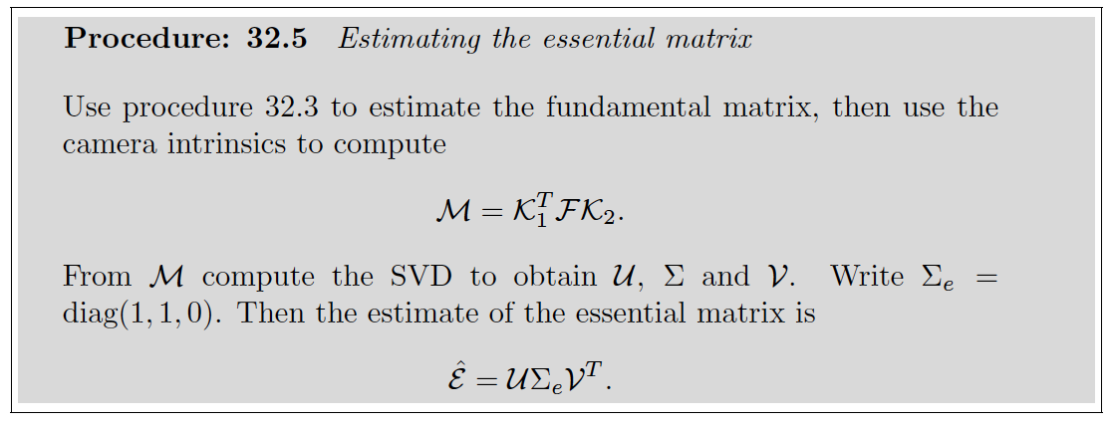
Estimating the essential matrix

Slide 44
Monocular visual odometry - I
A calibrated camera
  views a static scene,
  moves,
  views again
Q: how did it move?
  We care: this allows us to recover movement from single cameras
  We should be able to tell
    Recall epipoles etc are quite informative about movement

Slide 45
Monocular visual odometry - II
Recovering how it moved:
  Fit a fundamental matrix (above)
  From it, recover essential matrix (above; calibrated)
  From that, recover rotation, translation
    out of the form of the matrix
      details are delicate
    Fact:
      you can get direction but not scale of translation

Slide 46

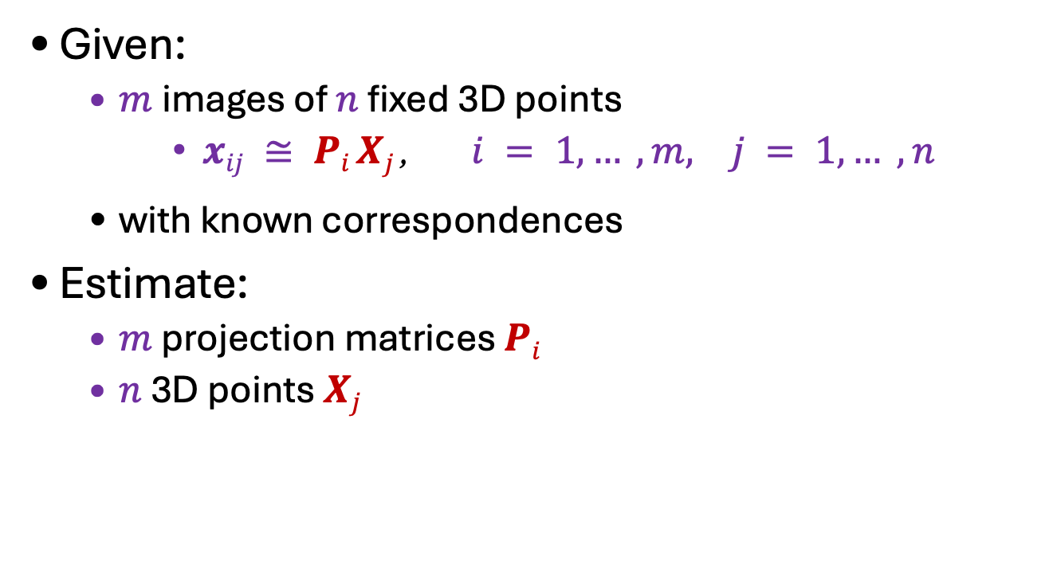






Core problem
Given:
  $m$images of $n$ fixed 3D points
  $xij ≅ Pi Xj$, $i = 1, … , m, j = 1, … , n$
  with known correspondences
Estimate:
  $m$ projection matrices $Pi$
  $n$ 3D points $Xj$
$$Xj$$
$$x1j$$
$$x3j$$
$$x2j$$
$$P1$$
$$P3$$
$$P2$$

Slide 47
Cases:
Offline
  work with all images
  structure from motion
    underlying Q:
      how to make best use of all information
    roughly familiar structure
      set up huge optimization problem by constructing start point
      efficiency is now a serious issue
Online
  build best estimate available up to time t
  SLAM
    simultaneous localization and mapping
    build a map at the same time as determining where you are
    new Q:
      how do you make best use of all information up to now
      efficiency often crucial
Hybrids are quite usual, and important

Slide 48
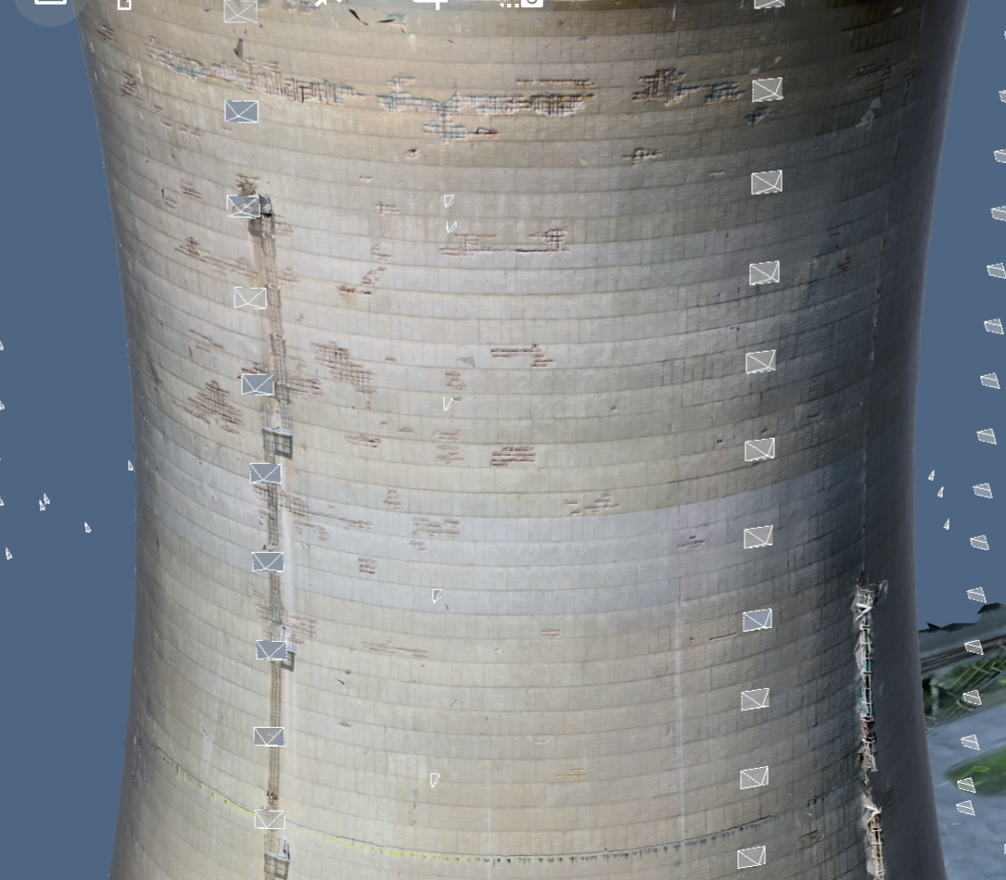
Applications
Enable inspection in hard to reach areas with drone photos and 3D reconstruction
Create 3D model from images
Provide tools to inspect on images and map interactions to 3D
Source: D. Hoiem

Slide 49
Applications: where is my drone?
Highly relevant
Taste prevents the use of news pictures...

Slide 50

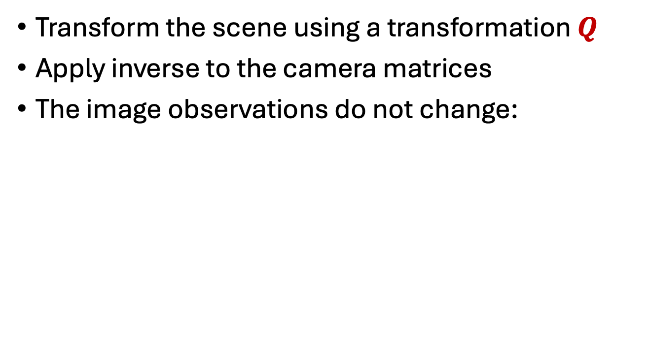
Structure from motion ambiguity
Transform the scene using a transformation $Q$
Apply inverse to the camera matrices
The image observations do not change:
  $$x≅PX=\left(PQ^{−1}\right)(QX)$$

Slide 51
Structure from motion ambiguity
Cases:
  nothing is known about cameras – Q is projective tx
  camera calibrations known – Q is scaled Euclidean

Slide 52
Recall: Two calibrated cameras
Obtain interest points and some matches
Obtain fundamental matrix
  as before, using matches
Obtain essential matrix
  as before, using calibration
Obtain rotation, translation up to scale
  as before, using odometry
Triangulate

Slide 53
Three calibrated cameras
Do two cameras for c1, c2
  reconstruct all points in both c1 and c2
Now figure out c3
  using reconstructions - calibration
  There is only one missing scale!
You can now insert more points into 3D!
  anything in c1 and c3 but not c2
  anything in c2 and c3 but not c1
  just more triangulation

Slide 54
Three calibrated cameras
You can now insert more points into 3D!
  anything in c1 and c3 but not c2
  anything in c2 and c3 but not c1
  just more triangulation

Slide 55
3 or more calibrated cameras
Issue:
  in what order should you insert cameras?
Online:
  no issue
    in the order you get them, BUT
      how do you get best estimate of points, cameras from data?
Offline
  major issue

Slide 56
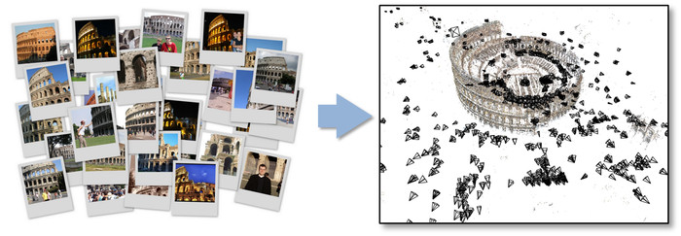
Representative SFM pipeline
N. Snavely, S. Seitz, and R. Szeliski. Photo tourism: Exploring photo collections in 3D. SIGGRAPH 2006
http://phototour.cs.washington.edu/
Notes:
Here’s how the same set of photos appear in our photo explorer. Our system takes the set of photos and automatically determines the relative positions and orientations from which each photo was taken. We can then load the photos into our immersive 3D browser where the user can visualize and explore the photos using spatial relationships.

Slide 57
SFM software
Bundler
OpenSfM
OpenMVG
VisualSFM
COLMAP
See also Wikipedia’s list of toolboxes

Slide 58
Core idea
Observe the world from a moving platform
Build:
  a map of the world
  an estimate of pose in that map
Online:
  notice that new observations update:
    estimate of pose
    estimate of map
Filtering problem

Slide 59
Some more details
With two cameras and some calibration:
  we can recover the position of 3D points
    in the vehicle’s coordinate system
      see triangulation movie, etc.
Together with an EKF, we can use this to recover
  points in world coordinates (a map)
  vehicle location
In fact, we can do all this with one camera
  with some minor care

Slide 60
Variants
More complex vehicle dynamics
Different measurement process
  one camera
  LIDAR
  SONAR (v. hard)
  photo-consistency constraints (direct methods)
Multiple processes at different timescales
  fast:
    estimate configuration, landmarks
  slow:
    refine estimates (something like bundle adjustment)
    take more local image data into account

Slide 61
SFM is about scattered points
Reconstruct a denser representation
  from many pix
    (or other stuff)
Q:
  in what form?
Here:
  Multiple depth maps, Point clouds
Notes:
  Voxel grids, Implicit functions, Density functions, Primitives
Others
  CSG rep’ns
  NURBS
  etc.

Slide 62
Options
Here:
  Multiple depth maps
  Point clouds
Notes:
  Voxel grids
  Implicit functions
  Density functions
  Primitives
Others
  CSG rep’ns
  NURBS
  etc.

Slide 63
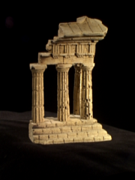
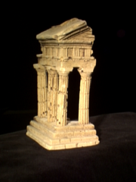
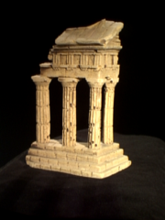
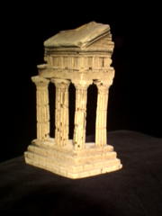
Multi-view stereo: Basic idea
Source: Y. Furukawa

Slide 64
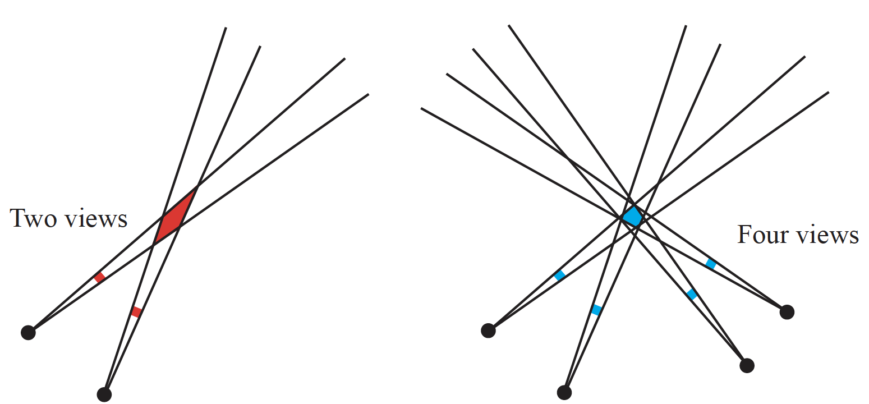
Improved error estimates

Slide 65
Rep’n: Multiple depth maps
One per image
  or per cluster of images
  consistent
Advantages
  straightforward to get
  known how to pass to a triangle mesh (if dense enough)
Disadvantages
  resolution issues (eg zooming camera)
  can be tricky to render cleanly
  some geometric calculations are hard
    volume

Slide 66
Plane sweep stereo: Key idea
✓
Image 1
Image 2
Reference image

Slide 67
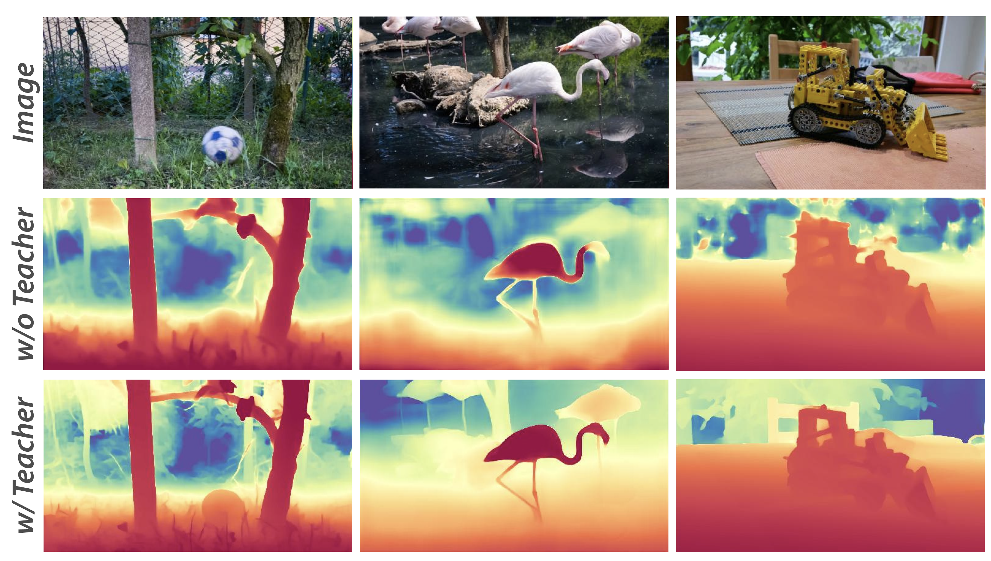
DepthAnything V3 depth maps
https://github.com/ByteDance-Seed/Depth-Anything-3

Slide 68
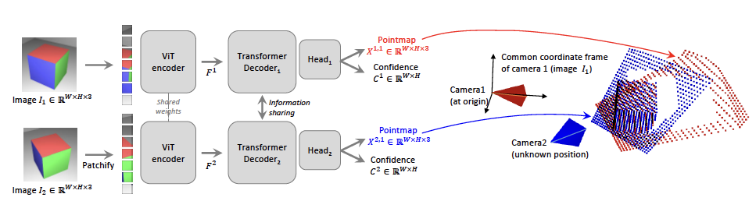
DUST3R – I
Accept two images, make a point map for each
DUSt3R: Geometric 3D Vision Made Easy, Wang et al, 2024

Slide 69
Point maps
one (3D) point per pixel
  so WxHx3
I1 is in canonical frame, both calibrated
  point map at (i, j) with depth z(i, j) contains
point map for I2 is in I1 frame

Slide 70
Now train
Simplest
  accept image pair
  produce pointmap
Train w/ ground truth
  recalling I2 pointmap is in I1’s frame
  lots of data of form (image pair, depthmap pair)
Loss:
  scaled L2 regression loss between prediction, g.t.
  weighted by confidence term

Slide 71
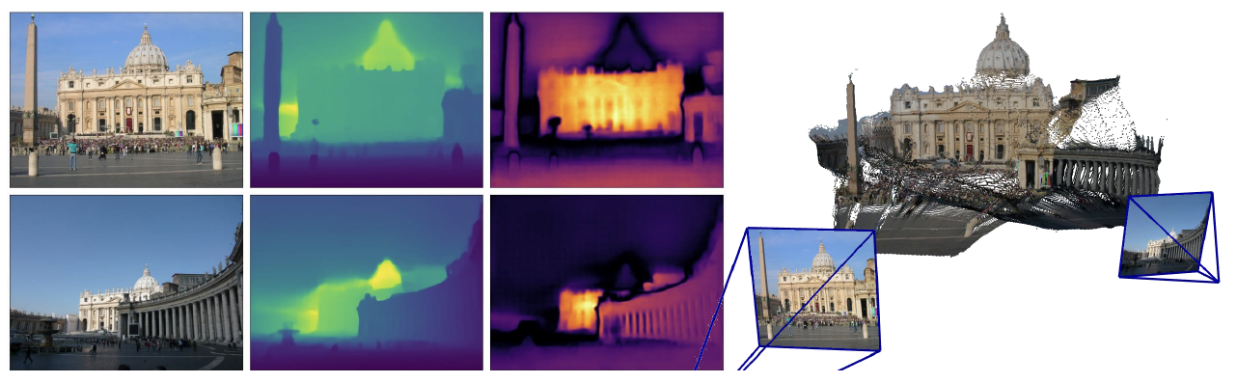
Image
Depth
Confidence
Point cloud
DUSt3R: Geometric 3D Vision Made Easy, Wang et al, 2024

Slide 72
Downstream
I1, I2 pixel correspondences
  find nearest neighbors in pointmaps
Camera intrinsics
  pointmap is in I1’s frame
    easy optimization
Relative camera pose
  predict twice using I1, I2 then I2, I1
  register the two predictions
    first in I1’s frame, second in I2’s frame
Absolute pose
  register

Slide 73
More than two frames
Like SFM pipeline:
  find pairs with many overlapping points
  reconstruct for every such pair
  register reconstructions

Slide 74
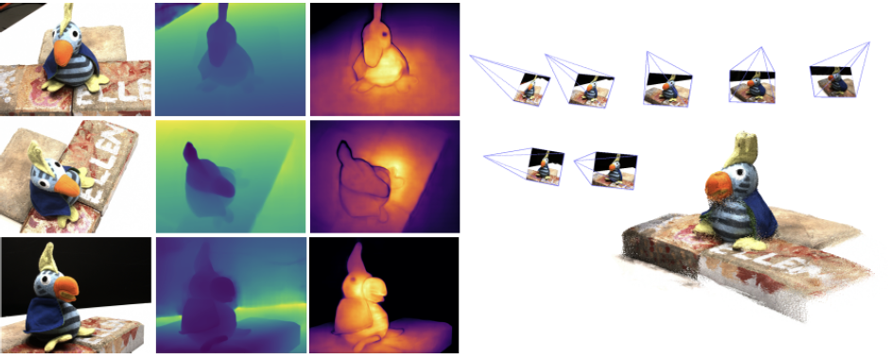
Image
Depth
Confidence
Point cloud
DUSt3R: Geometric 3D Vision Made Easy, Wang et al, 2024

Slide 75
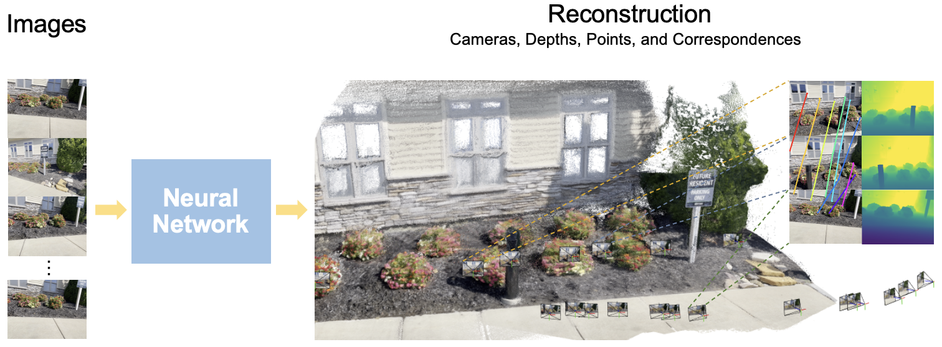
VGGT
https://vgg-t.github.io

Slide 76
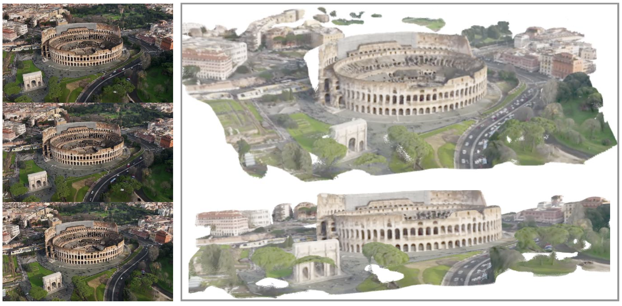
VGGT
https://vgg-t.github.io

Slide 77
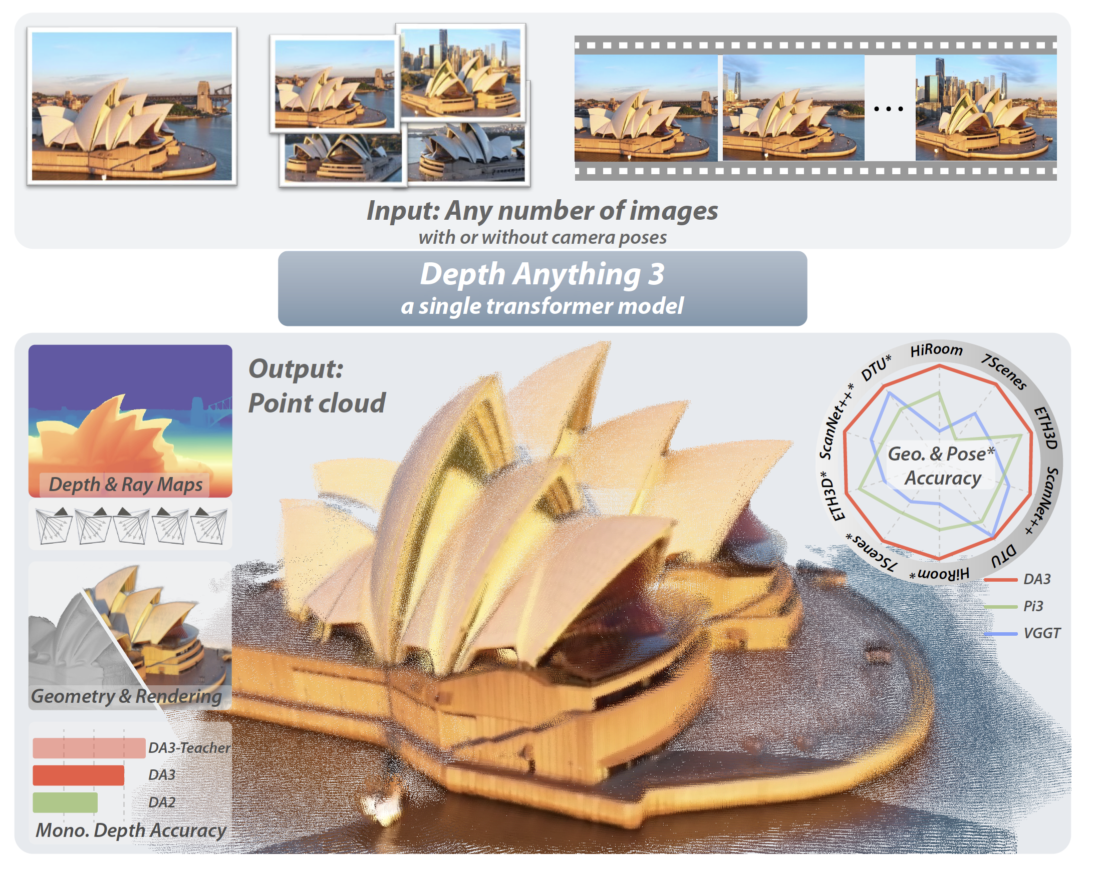
https://github.com/ByteDance-Seed/Depth-Anything-3

Slide 78
Tracking
Join up instances of objects over time for long sequences
  Despite various inconveniences
    objects getting occluded and reappearing
    objects deforming as they move
    etc
Applications:
  obvious security stuff
  what do people do?
    improved architectural design
  increasingly useful in grasp planning, etc.

Slide 79
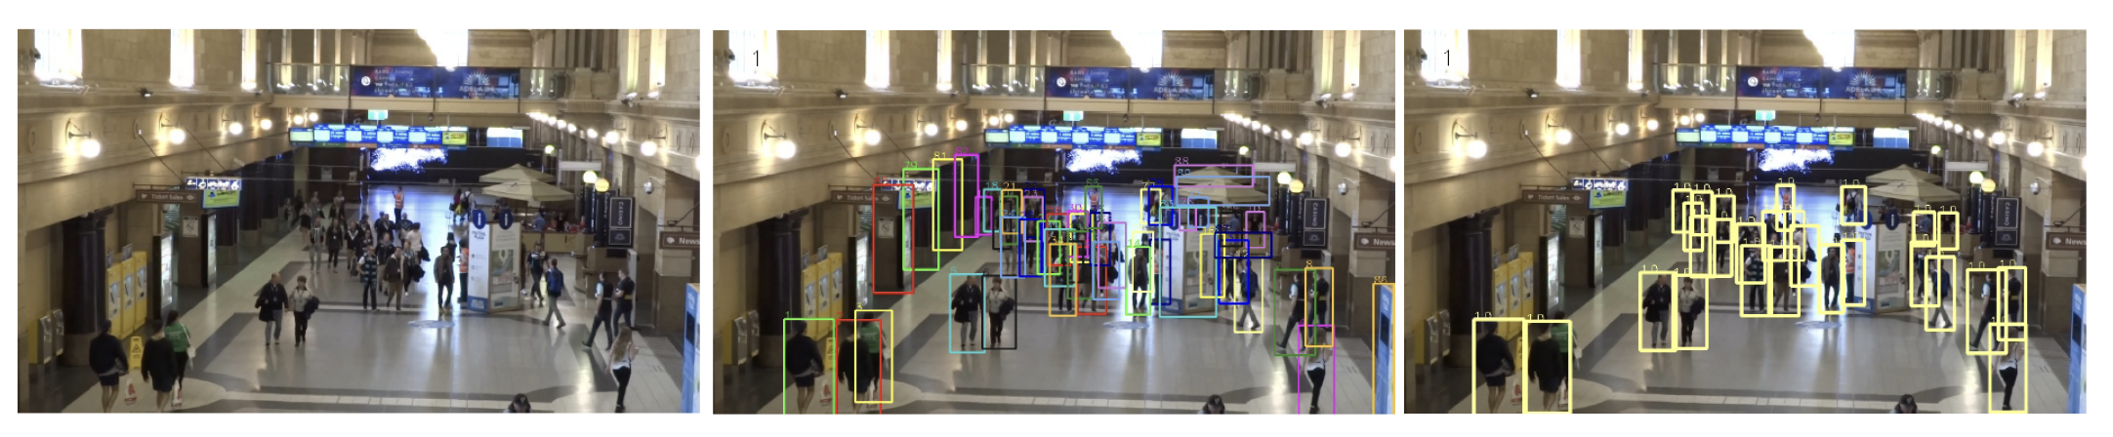
MOT-20 example

Slide 80
Tracking by detection
Assume
  a reliable detector
  Link detects across time

Slide 81
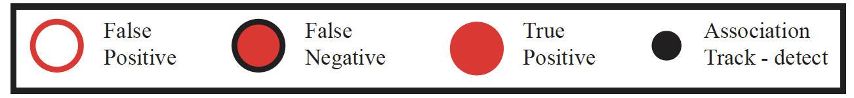
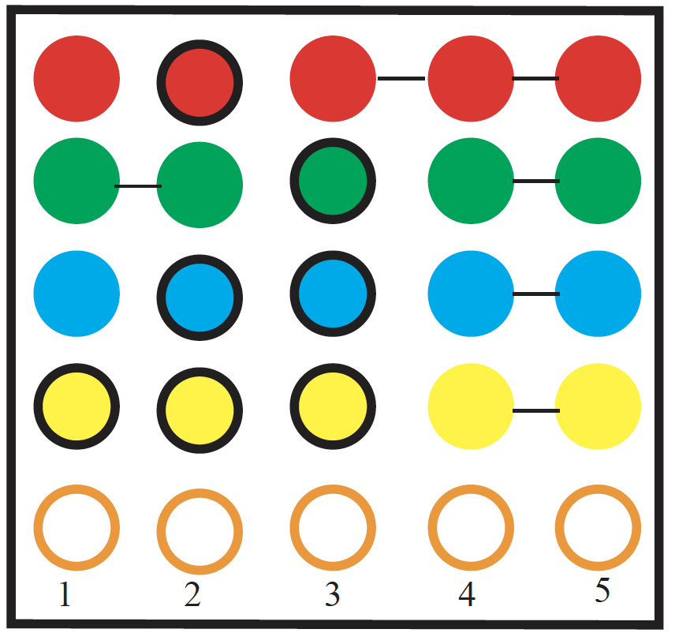
Simplest -> broken tracks

Slide 82
Point tracks reveal public behaviour
Yan+Forsyth, 04

Slide 83
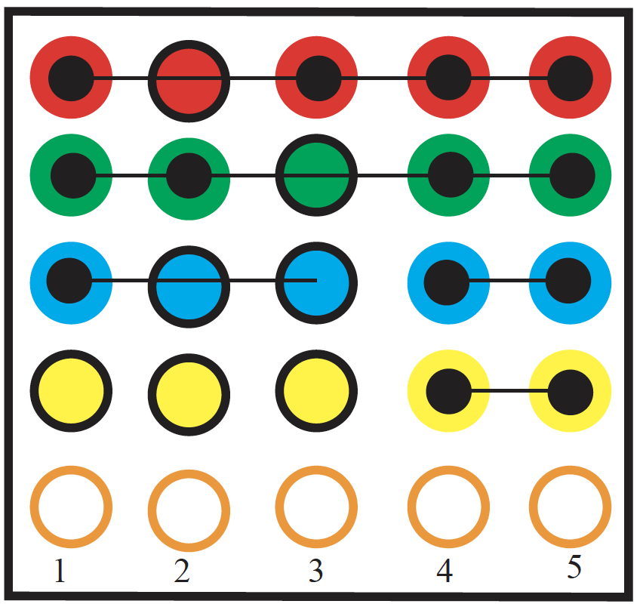
Abstract tracks

Slide 84
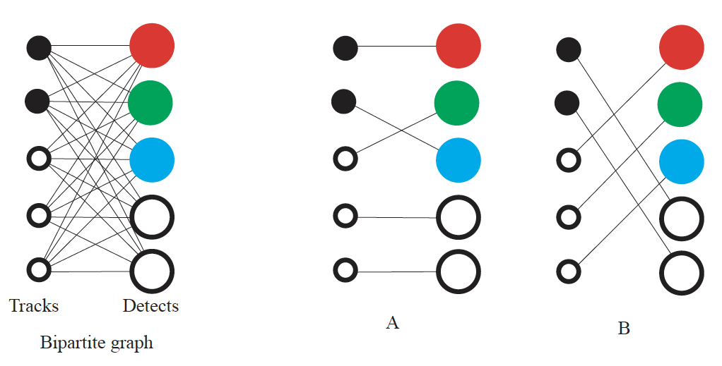
Correspondence
Use the Hungarian algorithm
Weights from appearance, dynamics

Slide 85
Appearance weights
Distance between feature vectors
  tracks could have multiple
    memory
Some test of distance
  between predicted pos’n and true pos’n
    1-IOU has a good record

Slide 86
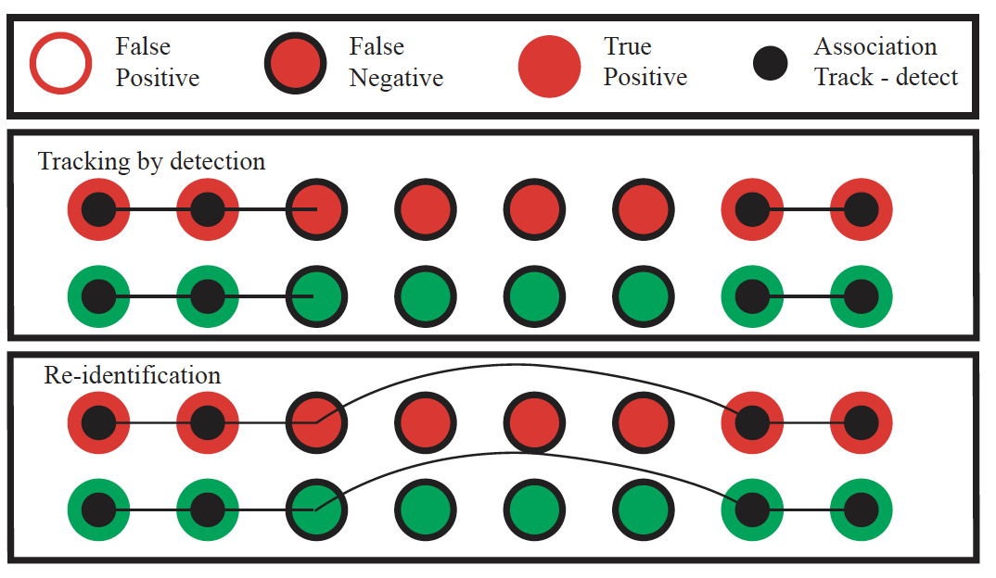
Reidentification

Slide 87
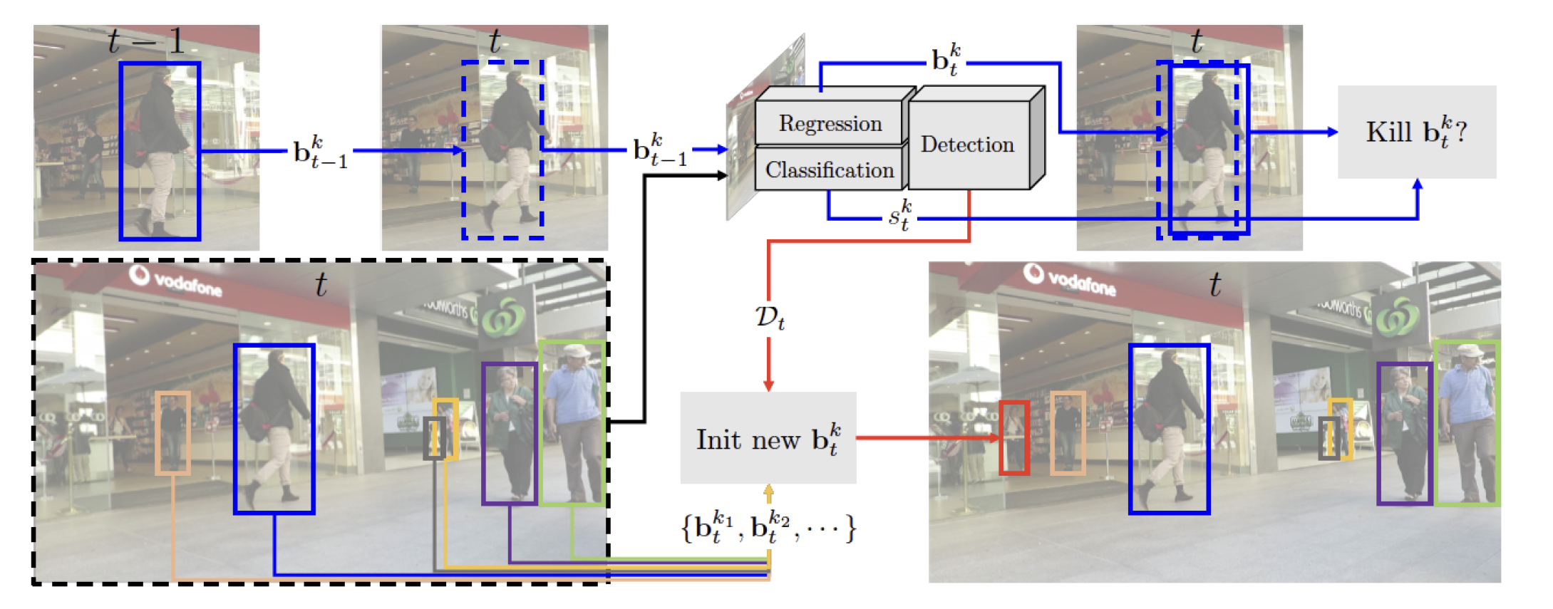
TbD variants- Exploit FasterRCNN

Slide 88
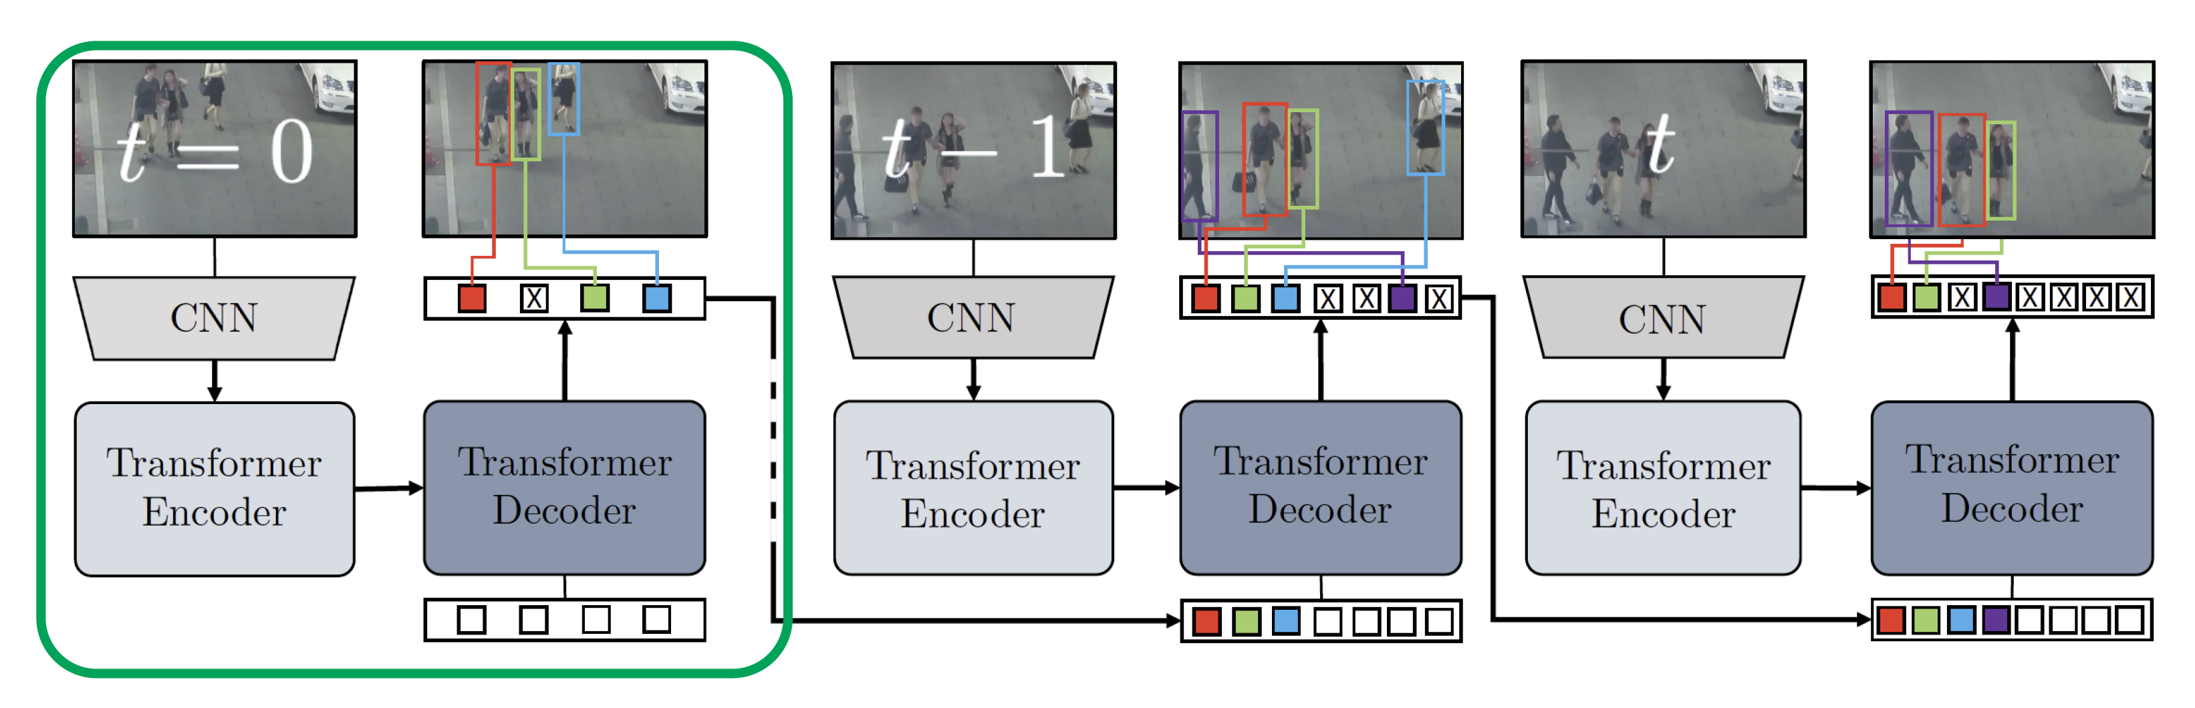
TbD variants- Exploit DetR

Slide 89
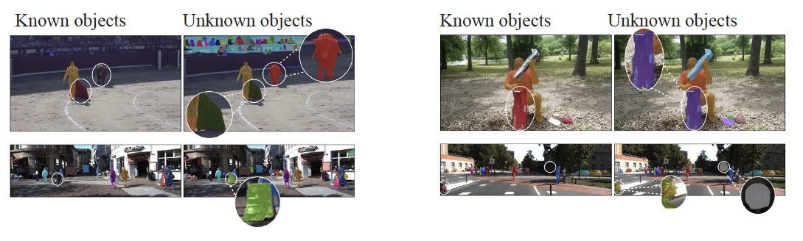
TbD variants – open world
Use RPN to detect objects
  adjust RPN score
Use appearance match for correspondence

Slide 90
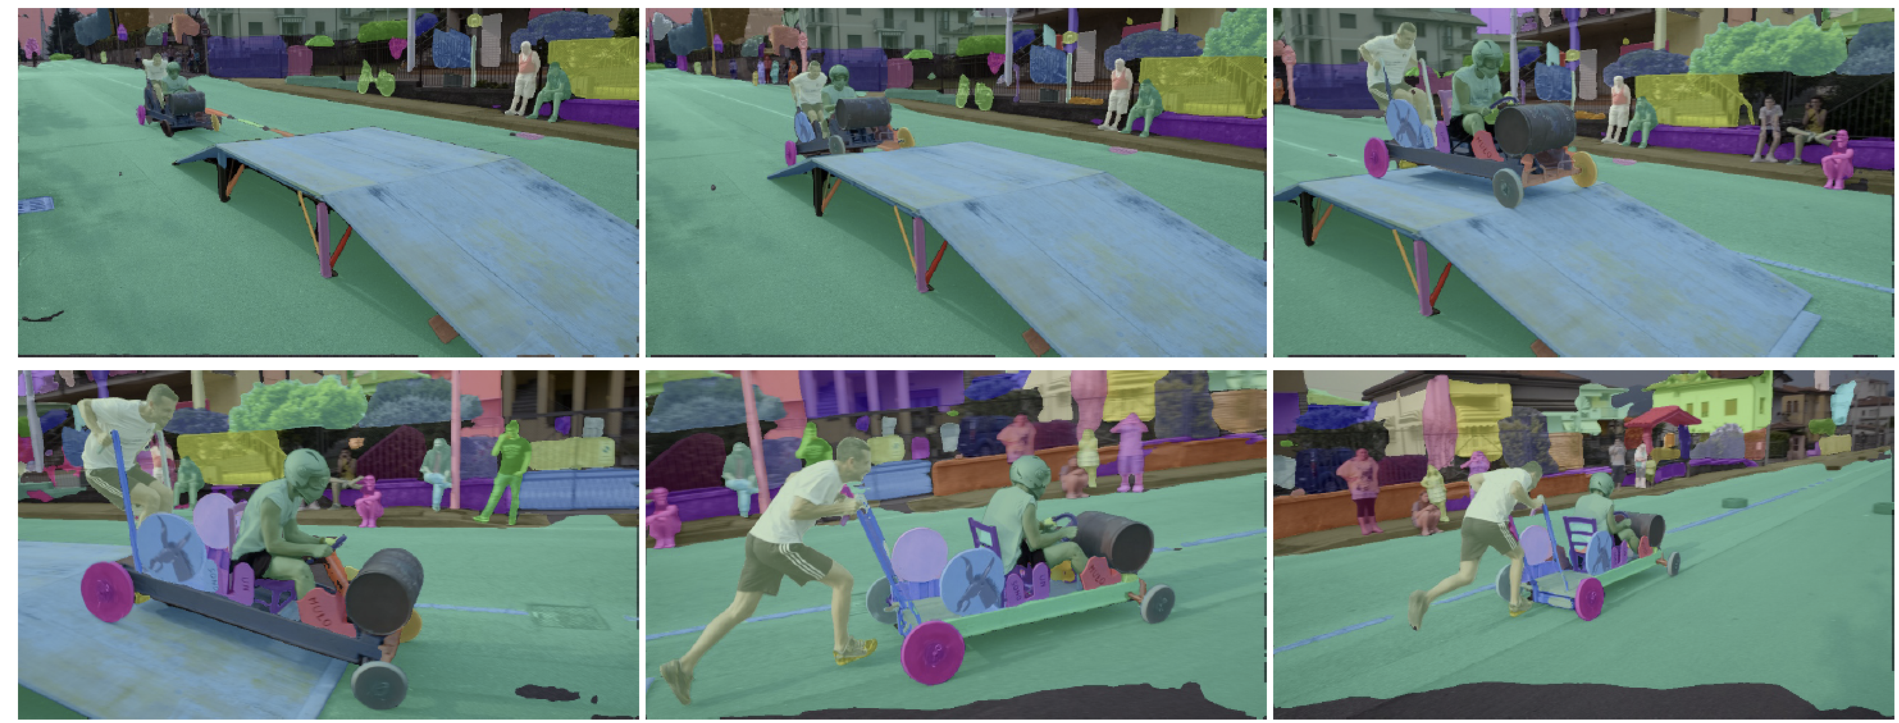
TbD variants – tracking segments

Slide 91
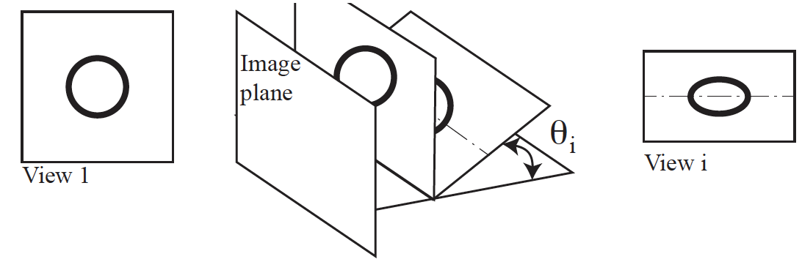
Why not points?
Idea
  apply TbD recipe to interest points
Obstacle
  appearance match using SIFT is a problem
  Foreshortening!

Slide 92
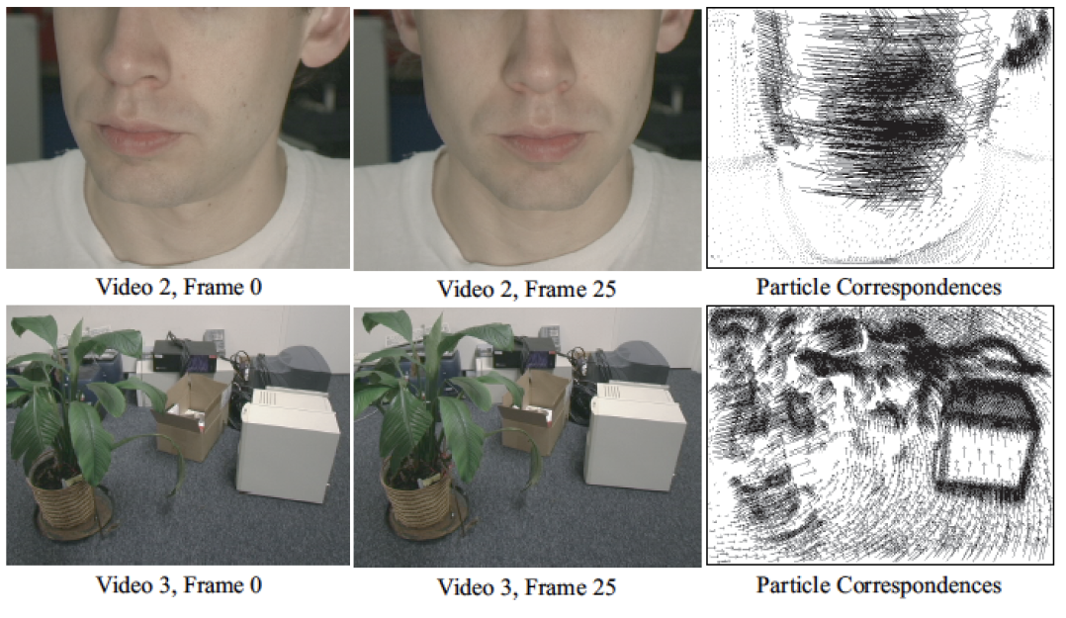
Particle video

Slide 93
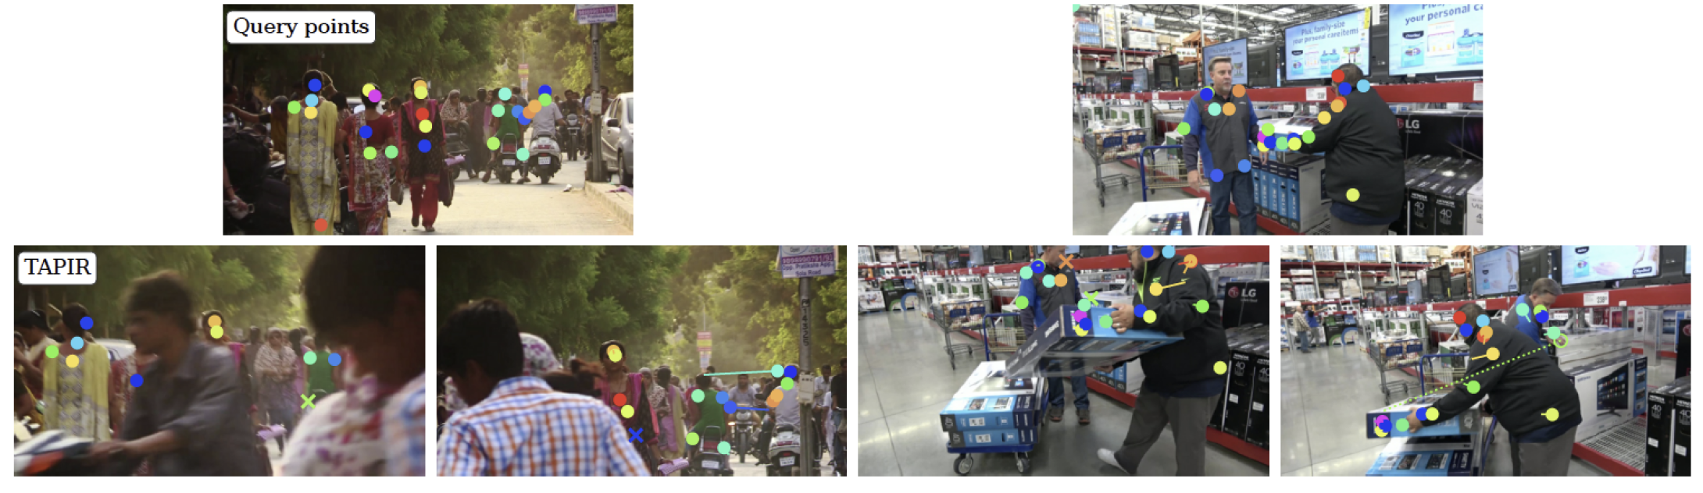
TAPIR
Make coarse point tracks
  refine across space/time
Predict visibility and confidence at each pt

Slide 94
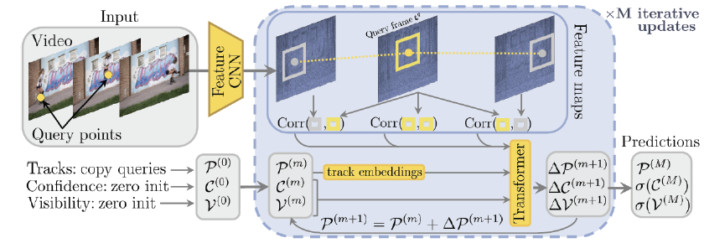
CoTracker3

Slide 95


