Slide 1
Obtaining Images
D.A. Forsyth,
University of Illinois at Urbana Champaign
Some slides adapted from
Svetlana Lazebnik, who adapted from Alyosha Efros, Derek Hoiem

Slide 2
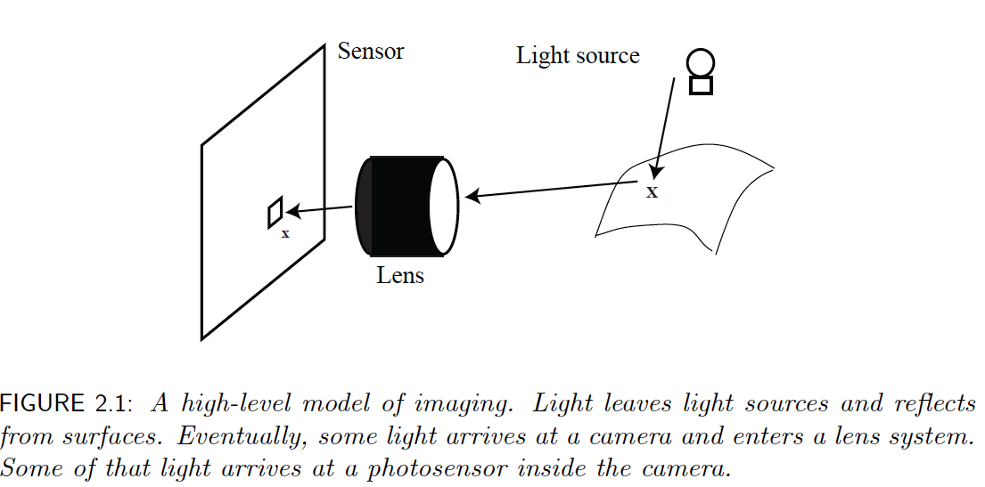
Model of imaging

Slide 3
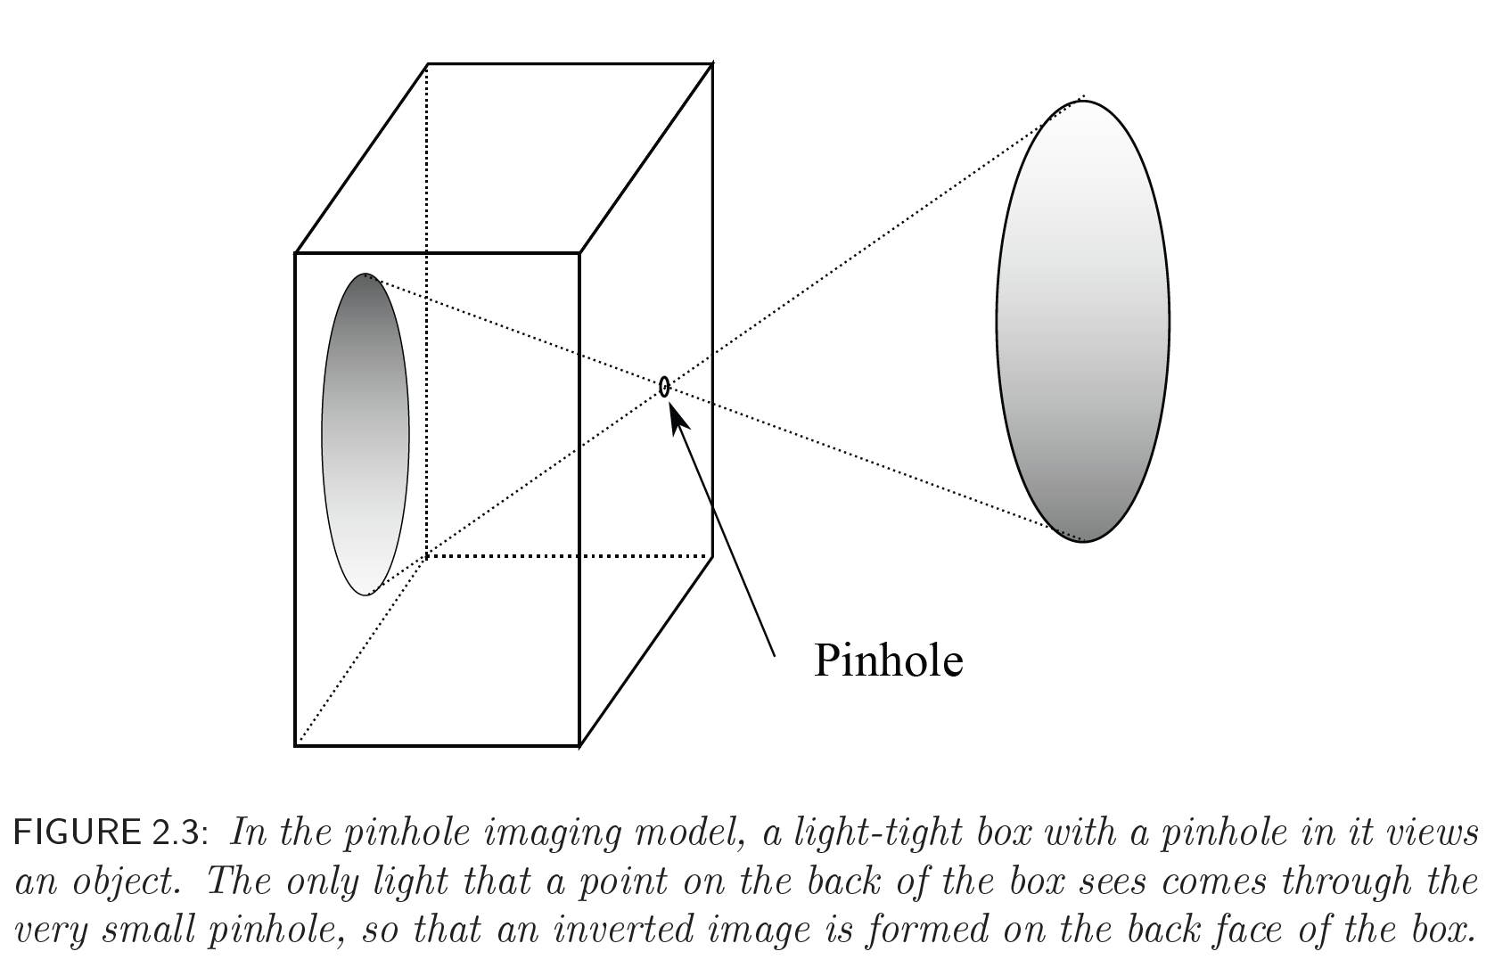
A Pinhole Camera

Slide 4
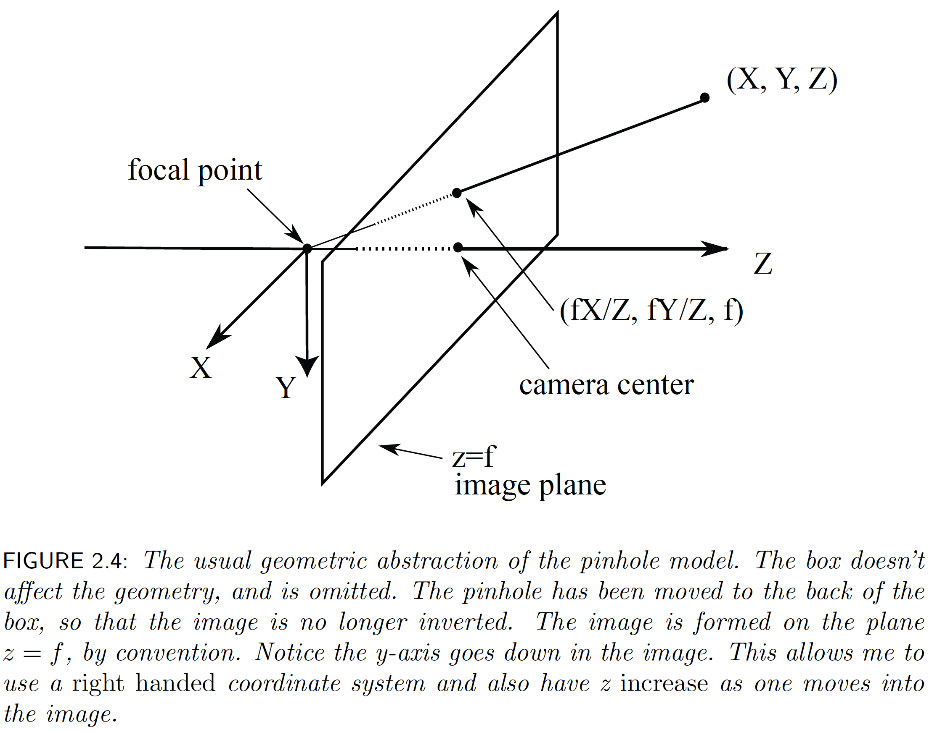
The Pinhole Camera

Slide 5
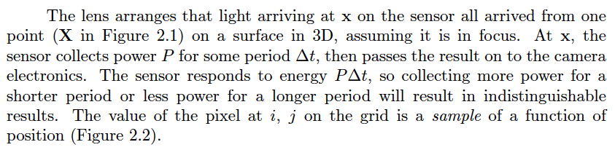

Slide 6
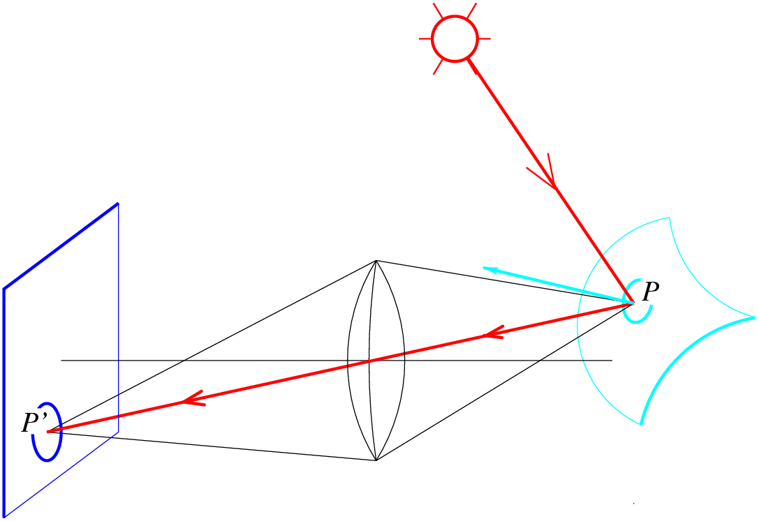
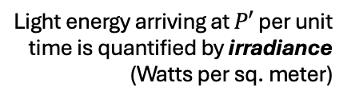
Image formation (preview)
What determines the brightness of an image pixel?
Light source(s)
Image plane
Scene surface
Light energy arriving at $P′$ per unit time is quantified by irradiance (Watts per sq. meter)
Strictly speaking, we need spectral irradiance to account for light across different wavelengths
Camera (lenses, shutter)
Notes:
Review slide (skip)

Slide 7
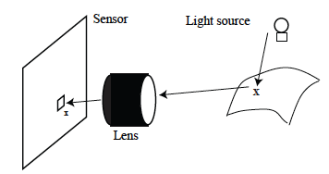
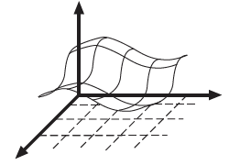


Slide 8
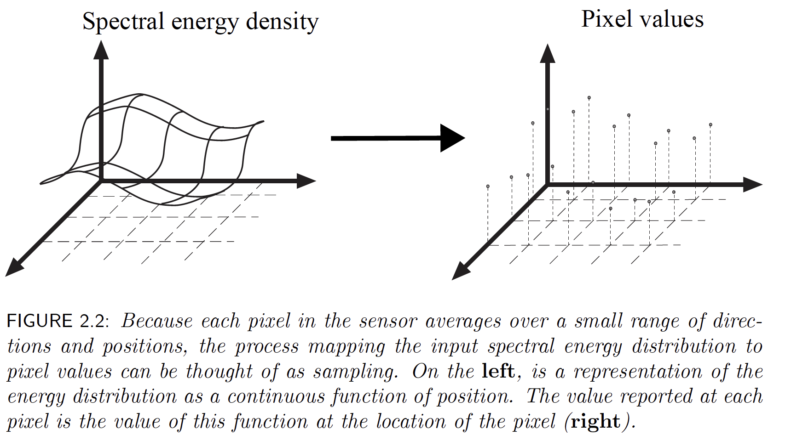

Slide 9
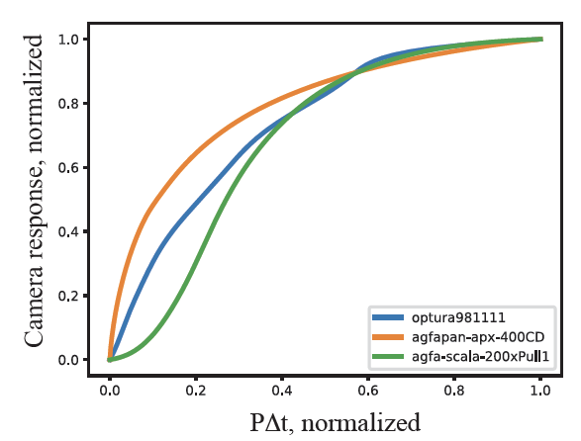
Cameras aren’t linear in input energy
This is deliberate, and usually a property of camera electronics.
  Helps imitate film
  Increases dynamic range
It’s not the sensor (which is usually linear)
  you can usually get linear pix from cameras with enough work
Different cameras have different nonlinearities

Slide 10
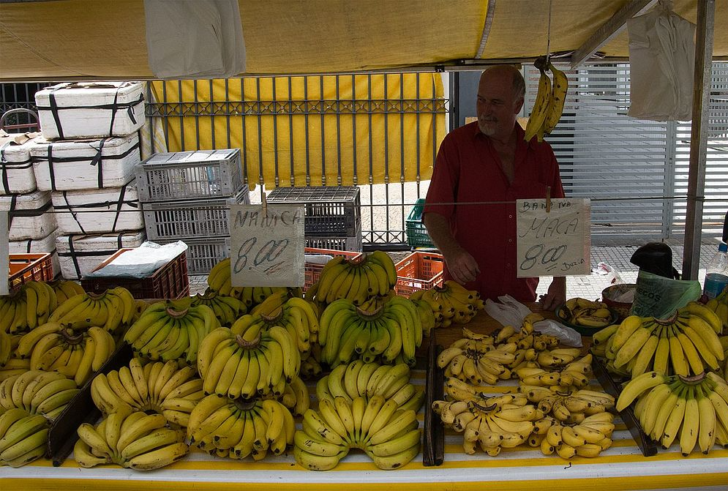
From wikipedia, https://commons.wikimedia.org/wiki/File:Raw_vs_jpg.jpg

Slide 11
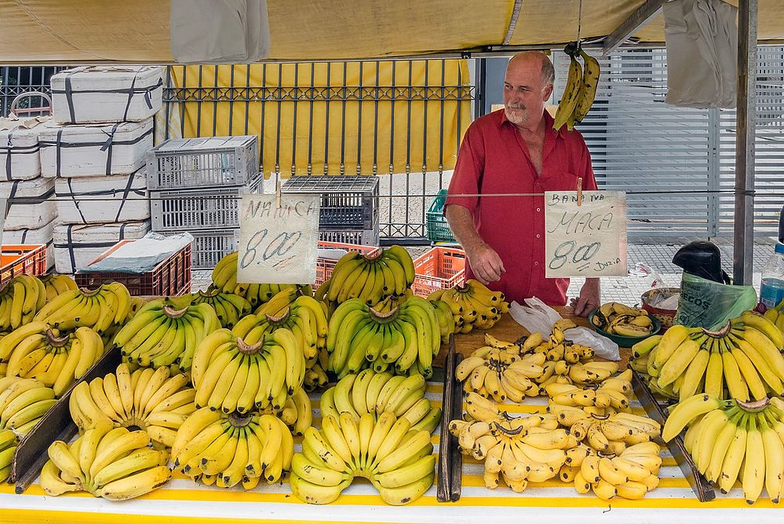
https://commons.wikimedia.org/wiki/File:Raw_vs_jpg.jpg

Slide 12
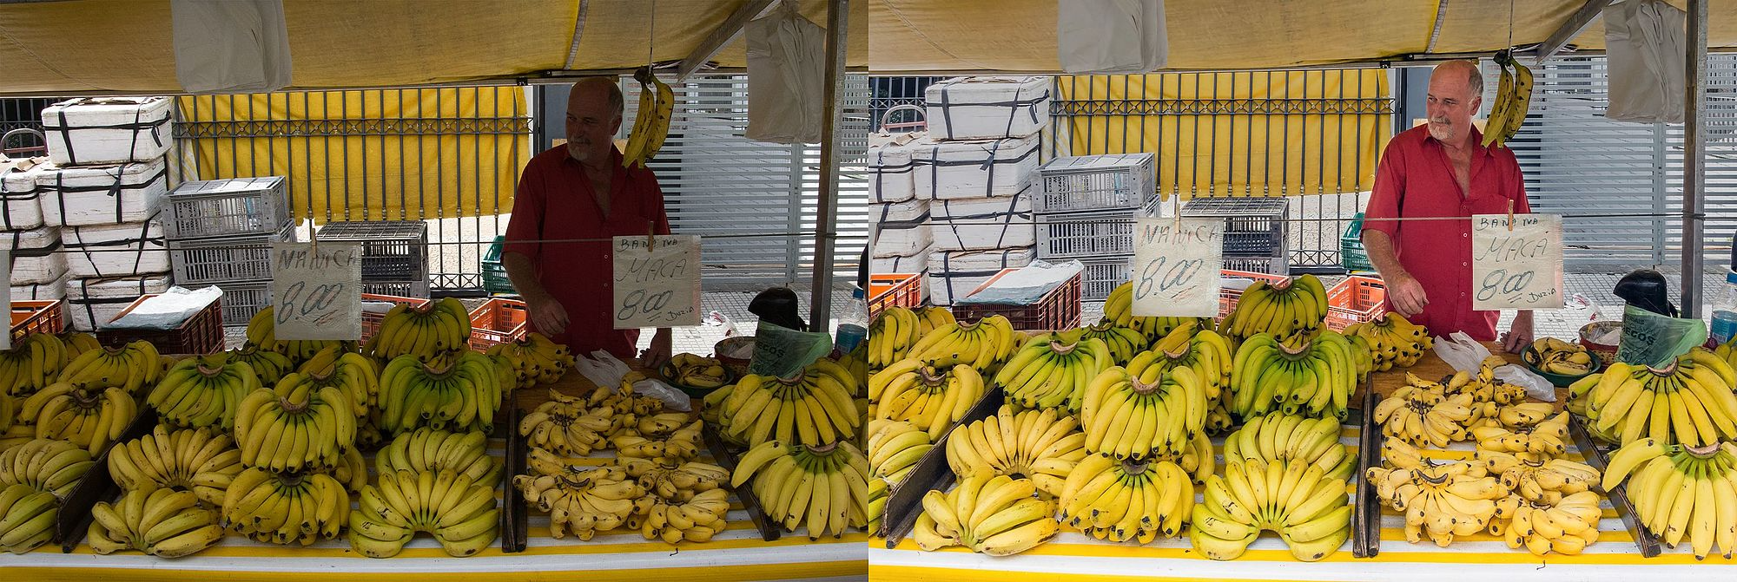
https://commons.wikimedia.org/wiki/File:Raw_vs_jpg.jpg

Slide 13
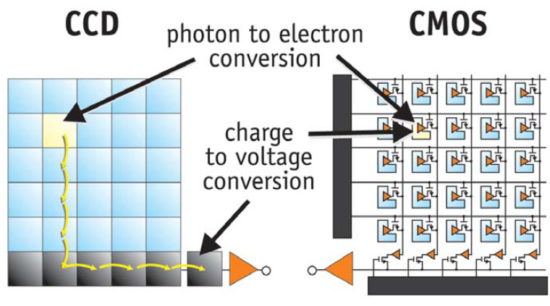
Images as sampled functions

Slide 14
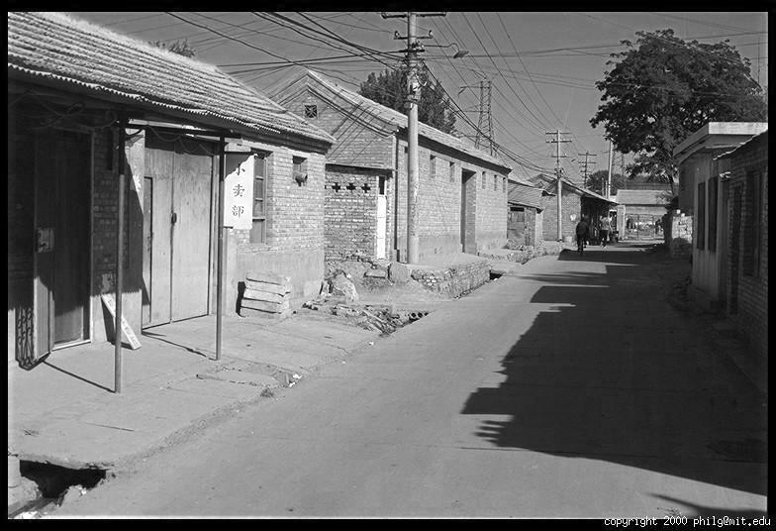
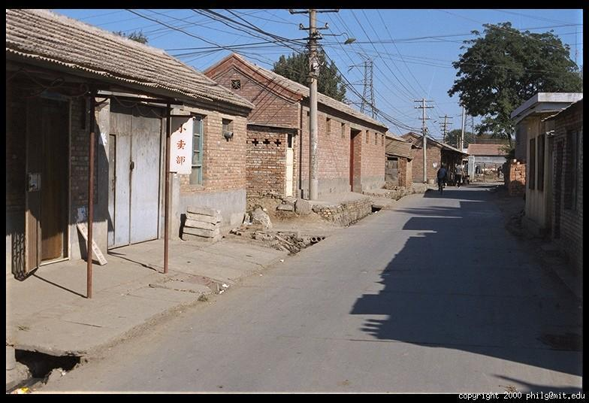
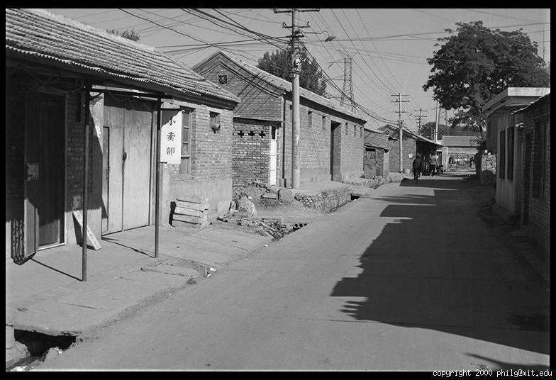
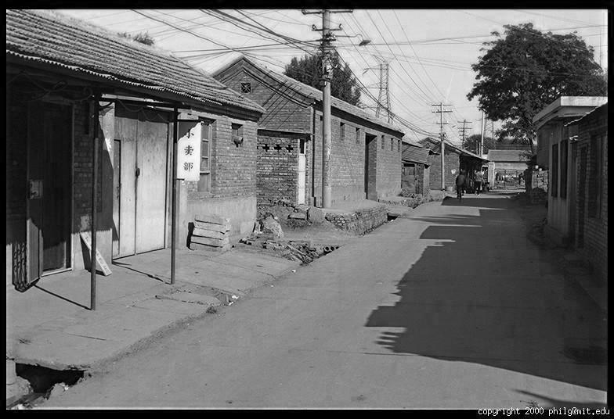
Digital color image
R
G
B

Slide 15
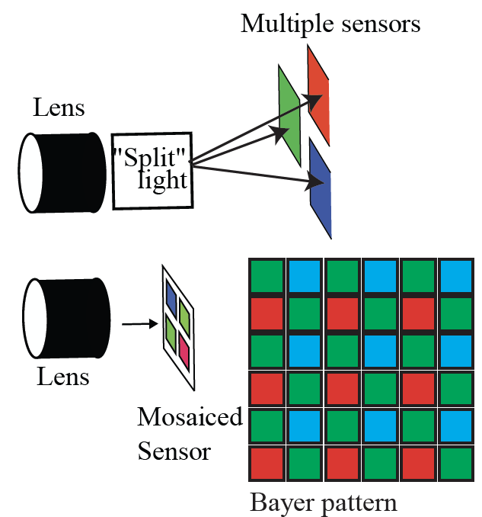
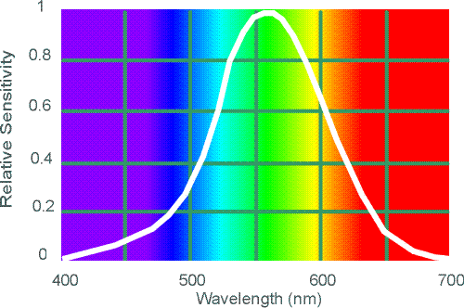
Why more green?
Human Luminance Sensitivity Function

Slide 16
Images in Python
im = cv2.imread(filename) # read image
im = cv2.cvtColor(im, cv2.COLOR_BGR2RGB) # order channels as RGB
im = im / 255 # values range from 0 to 1
RGB image im is a H x W x 3 matrix (numpy.ndarray)
im[0,0,0] is the top-left pixel value in R-channel
im[y, x, c] is the value y+1 pixels down, x+1 pixels to right in the c^{th} channel
im[H-1, W-1, 2] is the bottom-right pixel in B-channel
row
column
R
0.92 | 0.93 | 0.94 | 0.97 | 0.62 | 0.37 | 0.85 | 0.97 | 0.93 | 0.92 | 0.99
0.95 | 0.89 | 0.82 | 0.89 | 0.56 | 0.31 | 0.75 | 0.92 | 0.81 | 0.95 | 0.91
0.89 | 0.72 | 0.51 | 0.55 | 0.51 | 0.42 | 0.57 | 0.41 | 0.49 | 0.91 | 0.92
0.96 | 0.95 | 0.88 | 0.94 | 0.56 | 0.46 | 0.91 | 0.87 | 0.90 | 0.97 | 0.95
0.71 | 0.81 | 0.81 | 0.87 | 0.57 | 0.37 | 0.80 | 0.88 | 0.89 | 0.79 | 0.85
0.49 | 0.62 | 0.60 | 0.58 | 0.50 | 0.60 | 0.58 | 0.50 | 0.61 | 0.45 | 0.33
0.86 | 0.84 | 0.74 | 0.58 | 0.51 | 0.39 | 0.73 | 0.92 | 0.91 | 0.49 | 0.74
0.96 | 0.67 | 0.54 | 0.85 | 0.48 | 0.37 | 0.88 | 0.90 | 0.94 | 0.82 | 0.93
0.69 | 0.49 | 0.56 | 0.66 | 0.43 | 0.42 | 0.77 | 0.73 | 0.71 | 0.90 | 0.99
0.79 | 0.73 | 0.90 | 0.67 | 0.33 | 0.61 | 0.69 | 0.79 | 0.73 | 0.93 | 0.97
0.91 | 0.94 | 0.89 | 0.49 | 0.41 | 0.78 | 0.78 | 0.77 | 0.89 | 0.99 | 0.93
G
0.92 | 0.93 | 0.94 | 0.97 | 0.62 | 0.37 | 0.85 | 0.97 | 0.93 | 0.92 | 0.99
0.95 | 0.89 | 0.82 | 0.89 | 0.56 | 0.31 | 0.75 | 0.92 | 0.81 | 0.95 | 0.91
0.89 | 0.72 | 0.51 | 0.55 | 0.51 | 0.42 | 0.57 | 0.41 | 0.49 | 0.91 | 0.92
0.96 | 0.95 | 0.88 | 0.94 | 0.56 | 0.46 | 0.91 | 0.87 | 0.90 | 0.97 | 0.95
0.71 | 0.81 | 0.81 | 0.87 | 0.57 | 0.37 | 0.80 | 0.88 | 0.89 | 0.79 | 0.85
0.49 | 0.62 | 0.60 | 0.58 | 0.50 | 0.60 | 0.58 | 0.50 | 0.61 | 0.45 | 0.33
0.86 | 0.84 | 0.74 | 0.58 | 0.51 | 0.39 | 0.73 | 0.92 | 0.91 | 0.49 | 0.74
0.96 | 0.67 | 0.54 | 0.85 | 0.48 | 0.37 | 0.88 | 0.90 | 0.94 | 0.82 | 0.93
0.69 | 0.49 | 0.56 | 0.66 | 0.43 | 0.42 | 0.77 | 0.73 | 0.71 | 0.90 | 0.99
0.79 | 0.73 | 0.90 | 0.67 | 0.33 | 0.61 | 0.69 | 0.79 | 0.73 | 0.93 | 0.97
0.91 | 0.94 | 0.89 | 0.49 | 0.41 | 0.78 | 0.78 | 0.77 | 0.89 | 0.99 | 0.93
B
0.92 | 0.93 | 0.94 | 0.97 | 0.62 | 0.37 | 0.85 | 0.97 | 0.93 | 0.92 | 0.99
0.95 | 0.89 | 0.82 | 0.89 | 0.56 | 0.31 | 0.75 | 0.92 | 0.81 | 0.95 | 0.91
0.89 | 0.72 | 0.51 | 0.55 | 0.51 | 0.42 | 0.57 | 0.41 | 0.49 | 0.91 | 0.92
0.96 | 0.95 | 0.88 | 0.94 | 0.56 | 0.46 | 0.91 | 0.87 | 0.90 | 0.97 | 0.95
0.71 | 0.81 | 0.81 | 0.87 | 0.57 | 0.37 | 0.80 | 0.88 | 0.89 | 0.79 | 0.85
0.49 | 0.62 | 0.60 | 0.58 | 0.50 | 0.60 | 0.58 | 0.50 | 0.61 | 0.45 | 0.33
0.86 | 0.84 | 0.74 | 0.58 | 0.51 | 0.39 | 0.73 | 0.92 | 0.91 | 0.49 | 0.74
0.96 | 0.67 | 0.54 | 0.85 | 0.48 | 0.37 | 0.88 | 0.90 | 0.94 | 0.82 | 0.93
0.69 | 0.49 | 0.56 | 0.66 | 0.43 | 0.42 | 0.77 | 0.73 | 0.71 | 0.90 | 0.99
0.79 | 0.73 | 0.90 | 0.67 | 0.33 | 0.61 | 0.69 | 0.79 | 0.73 | 0.93 | 0.97
0.91 | 0.94 | 0.89 | 0.49 | 0.41 | 0.78 | 0.78 | 0.77 | 0.89 | 0.99 | 0.93

Slide 17
Pointwise image transformations
Apply the same function to each pixel value
  perhaps different for R, G, B
Simple applications
  remove camera non-linearity
  simulate different camera
  increase/reduce contrast

Slide 18
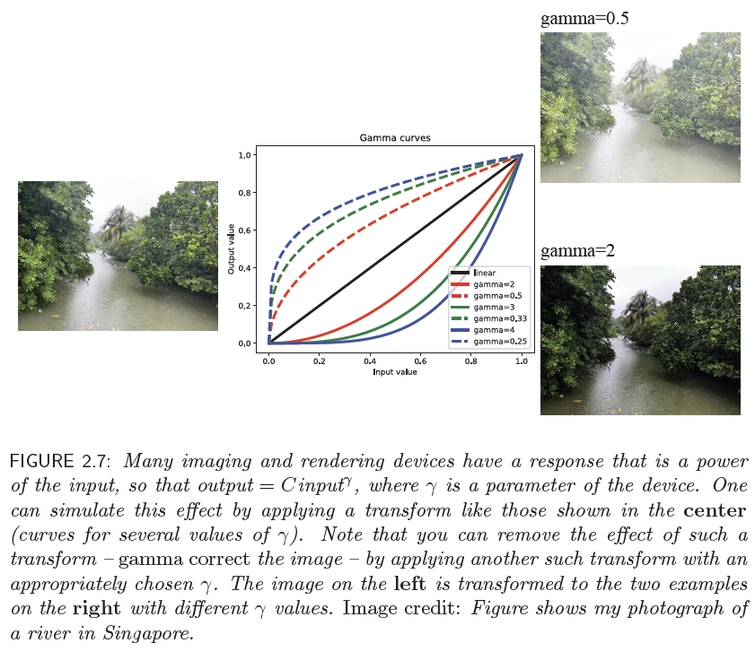

Slide 19
Other sensors...
Basically, light cameras with extra tricks
  IR cameras
    light cameras at different wavelengths
      but you might have to cool sensors
  Polarization cameras
    specialized sensors to measure intensity at particular polarizations
  Multispectral cameras
    various arrangements to image with more sensors than R, G, and B
Really different
  Depth cameras

Slide 20
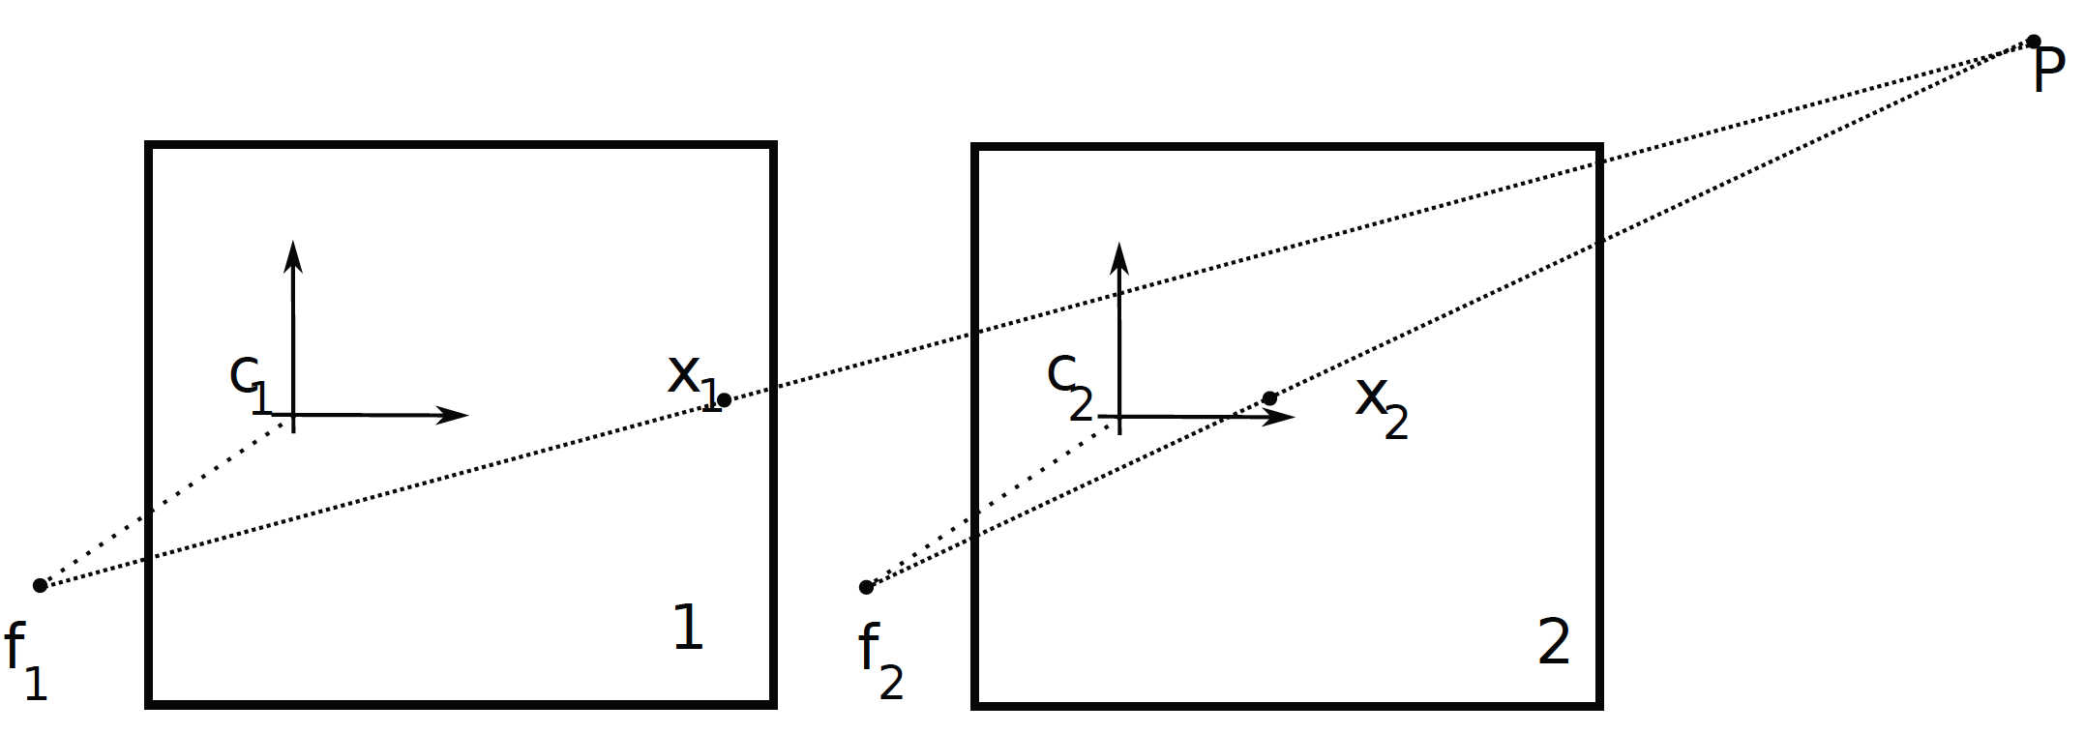
Two cameras yield depth

Slide 21
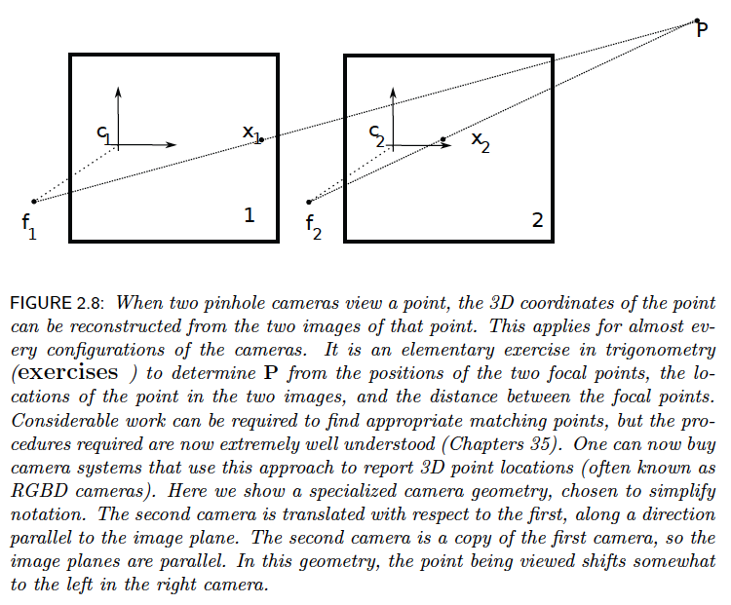

Slide 22
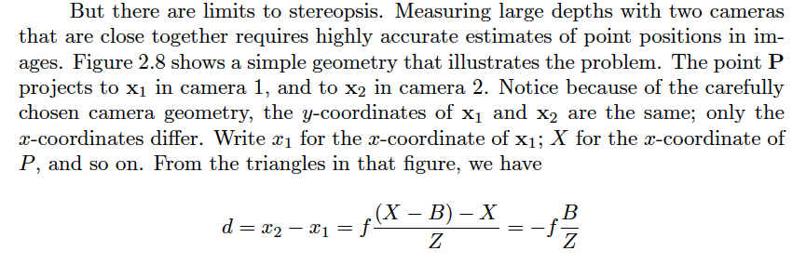
If’s, and’s and but’s...

Slide 23
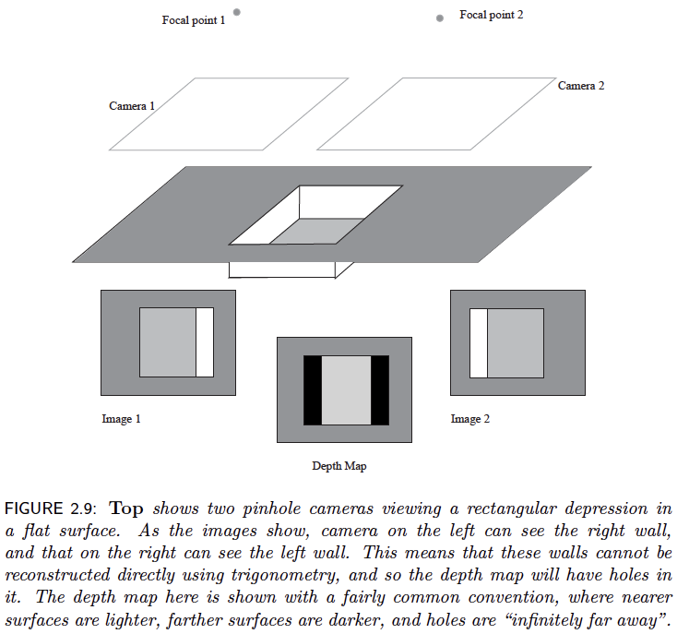

Slide 24
Camera – projector stereo

Slide 25
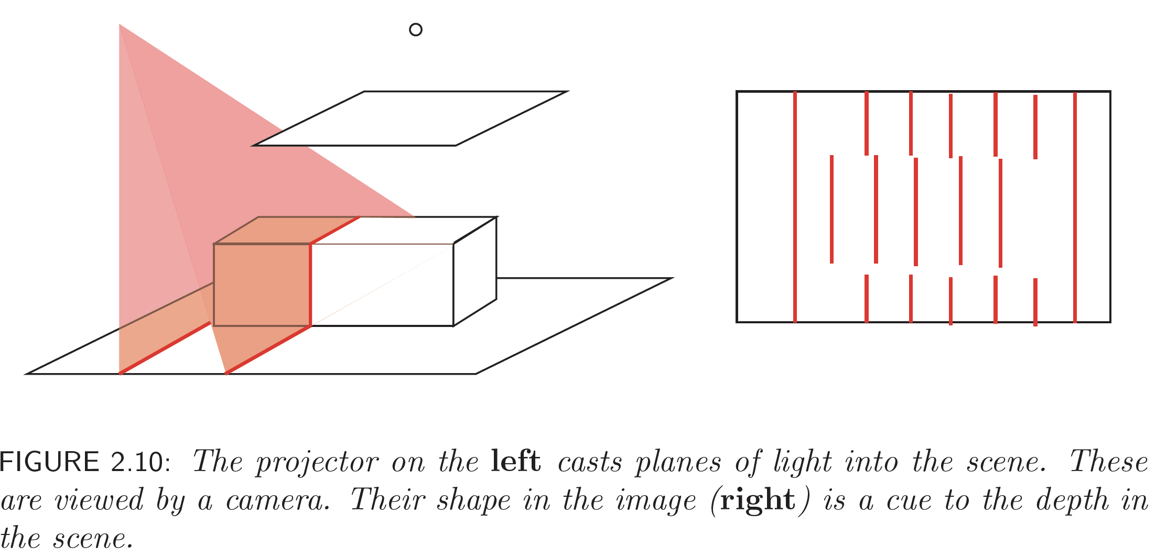
Structured light

Slide 26
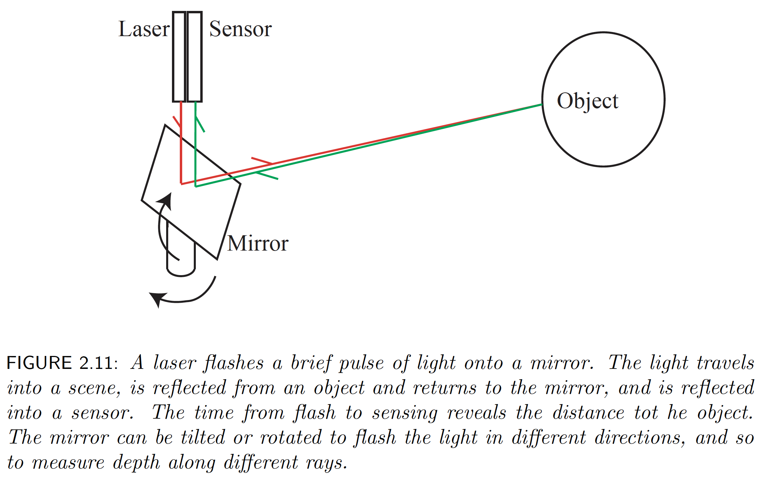
LIDAR

Slide 27
