Slide 1
Background Subtraction and Shot Boundary Detection
D.A. Forsyth
University of Illinois, Urbana Champaign

Slide 2
Key idea of segmentation
Break images/videos into large, useful pieces
internally coherent pieces
same color; same color and texture; etc
simplify
Identify key objects
Important simple applications
Background subtraction
Shot boundary detection

Slide 3
Background subtraction
Allocate pixels to
foreground
background
based on a model of background appearance
usually obtained by watching the background from stationary camera
Simple:
if d(frame(i, j)-background(i, j))>thresh
foreground
else
background

Slide 4
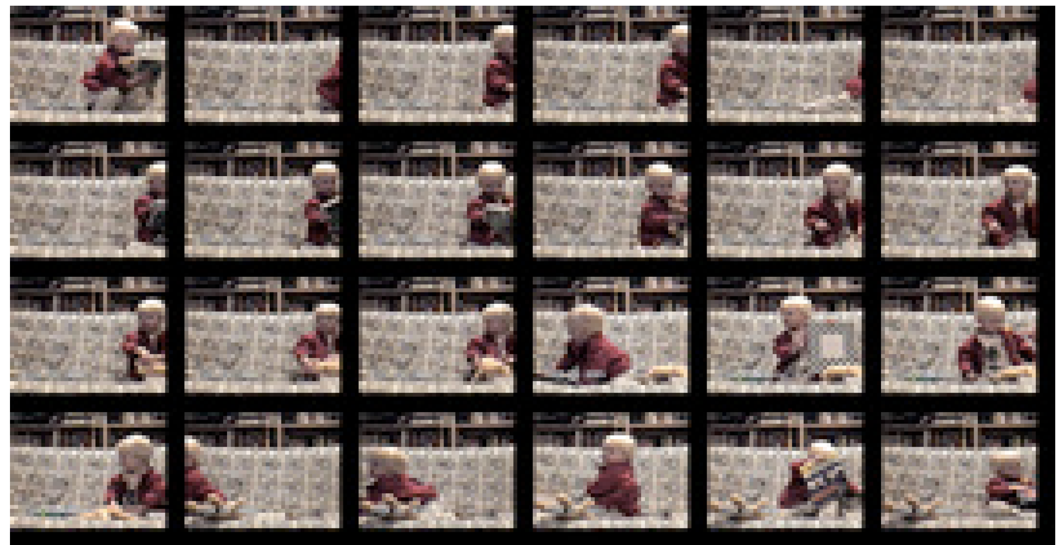

Slide 5
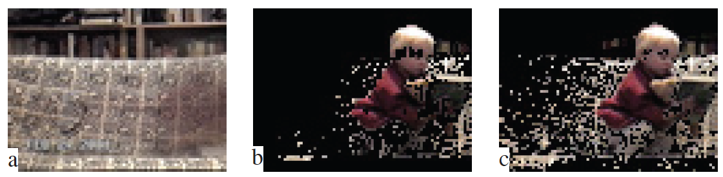

Slide 6
Shot boundary detection
Break longer video into smaller “shots”
coherent bits of video
boundaries are big breaks in appearance
Test some difference between frames i, i+1
SSD
difference in color histograms
difference between averaged boxes
Split where this is big
Not deep, but useful

