Slide 1
Image segmentation as clustering
D.A. Forsyth,
University of Illinois at Urbana Champaign

Slide 2
Key idea of segmentation
Break images/videos into large, useful pieces
  internally coherent pieces
    same color; same color and texture; etc
  simplify
  Identify key objects

Slide 3
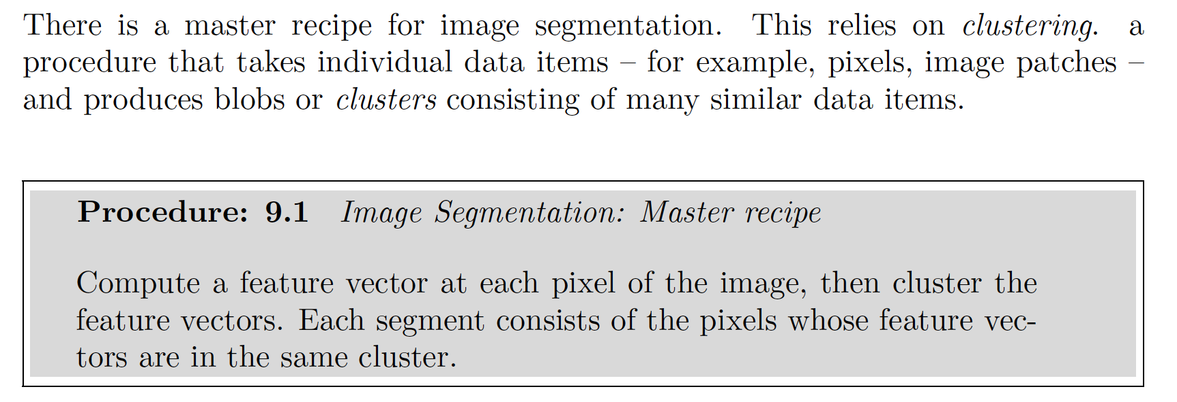
Segmentation – master recipe

Slide 4
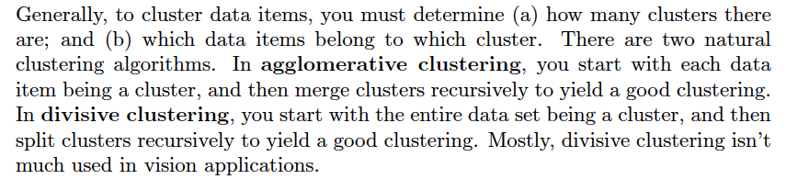
Agglomerative and divisive

Slide 5
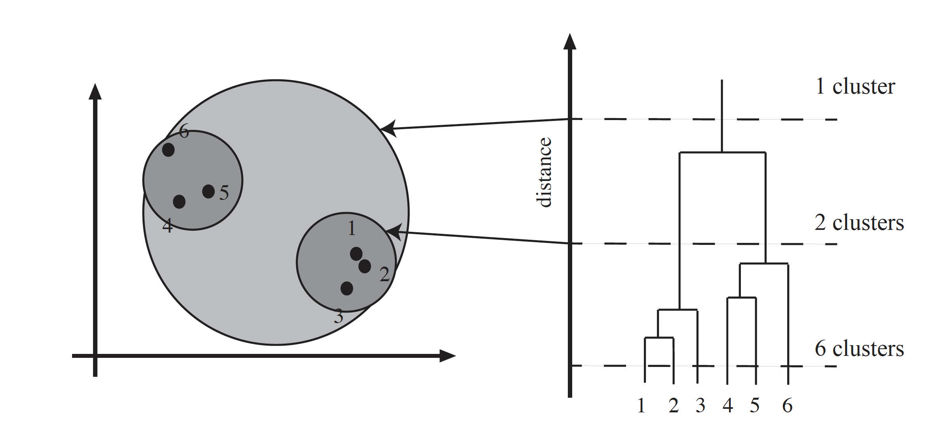
Simple clusters and dendrograms

Slide 6
Distances between clusters
Distances between points are easy
  but distances between clusters?
Three standard solutions
  Distance between the closest pair of points
    single link clustering
      can get long thin clusters in feature space
  Distance between furthest pair of points
    complete link clustering
      blobby clusters in feature space
  Average of distances in clusters
    average link clustering
      tends to blobby

Slide 7
Distances
Cluster on color – feature vector is (r, g, b)
  but clusters might not even be connected
Cluster on color and position – (r, g, b, x, y)
  “blobby” clusters
  BUT what if r, g, b are in range 0, 1
    and x, y is in range 0, 1024?
    scaling problem; fix with elementary fiddling
More interesting segmentation
  more complicated feature vectors
  more serious scaling problems

Slide 8
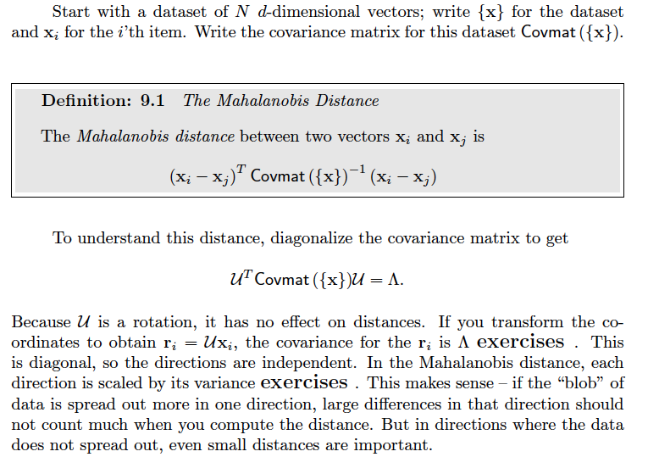
Mahalanobis

Slide 9
Dimension reduction
If you use high dimensional features
  many small eigenvalues in Covmat
    general experimental phenomenon
Issue with Mahalanobis distance
  divide by small number exaggerates effect
  generalization problems
Fix
  ignore variation in these directions
  equivalently
    project onto lower dimension
    compute Mahalanobis distance in that space

Slide 10
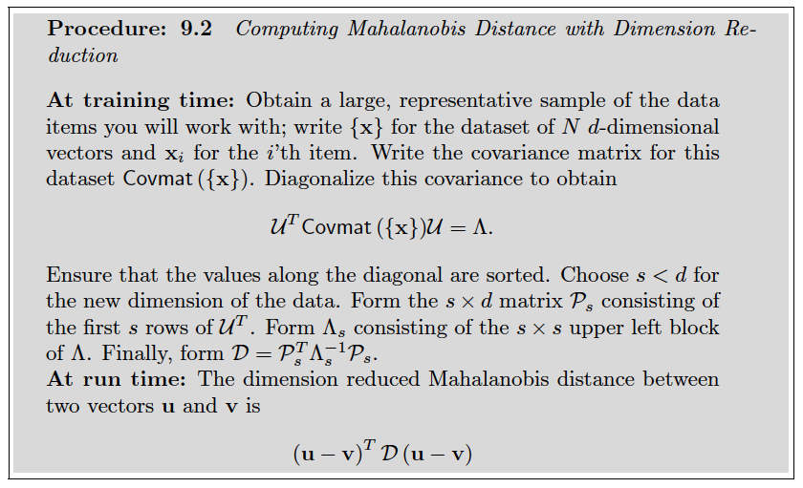

Slide 11
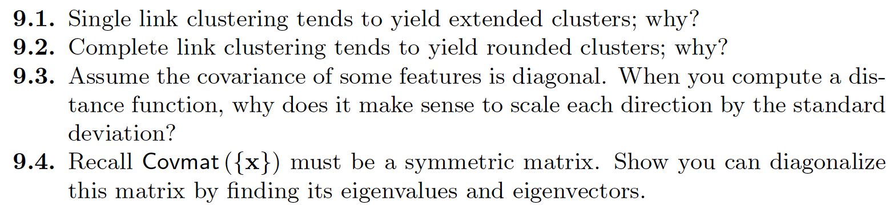
Things to think about

