Slide 1
Denoising considerations
D.A. Forsyth,
University of Illinois

Slide 2
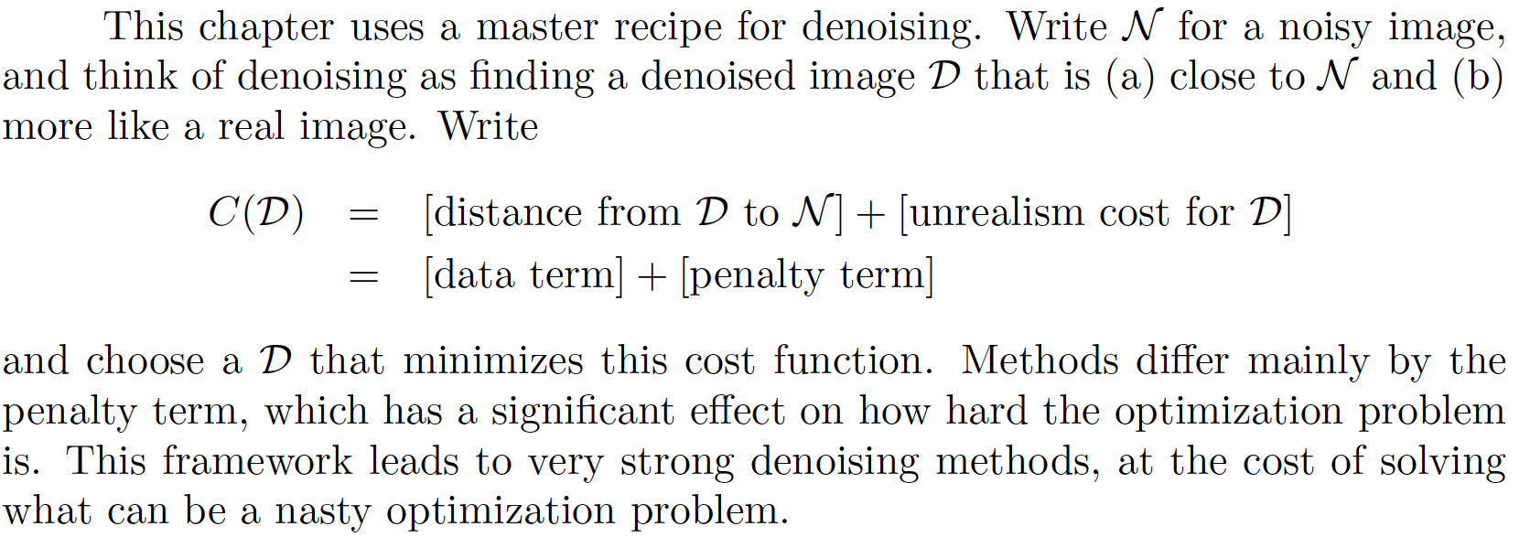
Denoising Images using Optimization

Slide 3
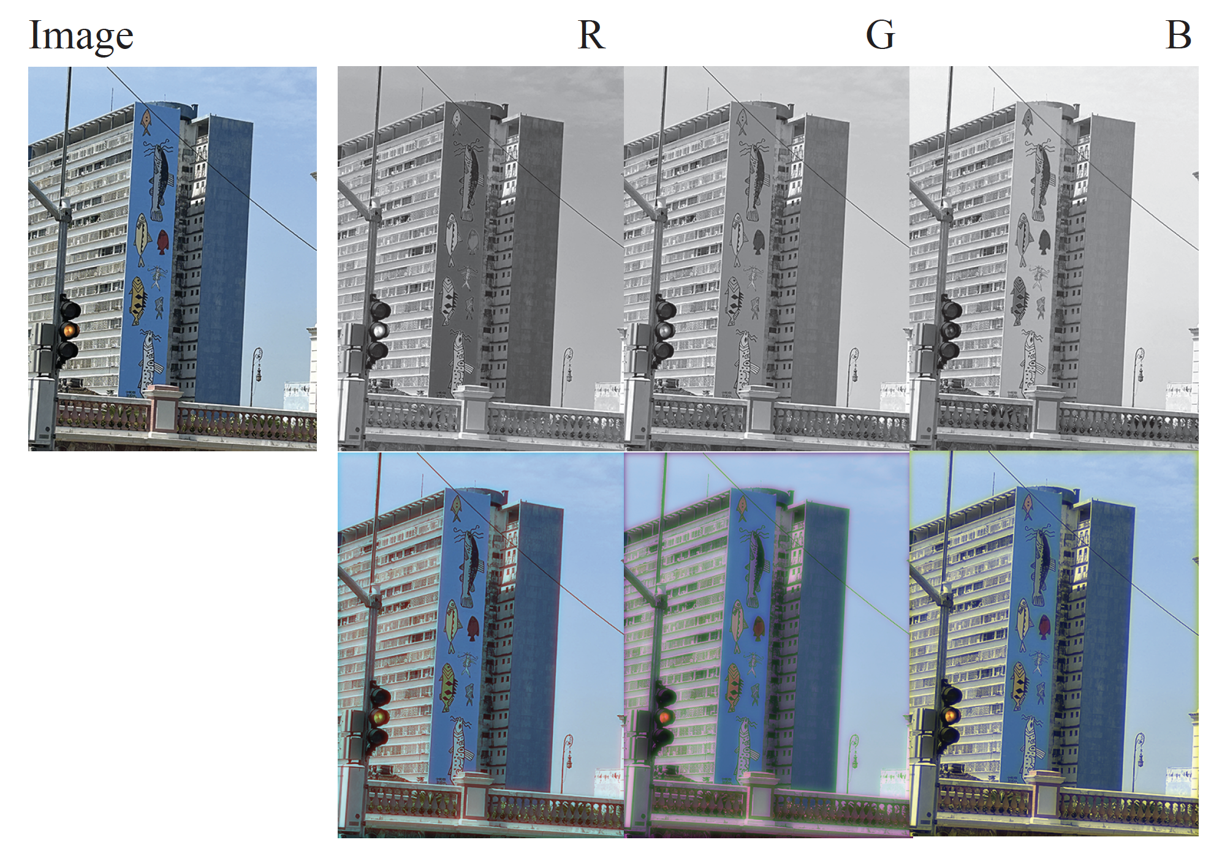
Color images – R, G, and B are strongly correlated

Slide 4
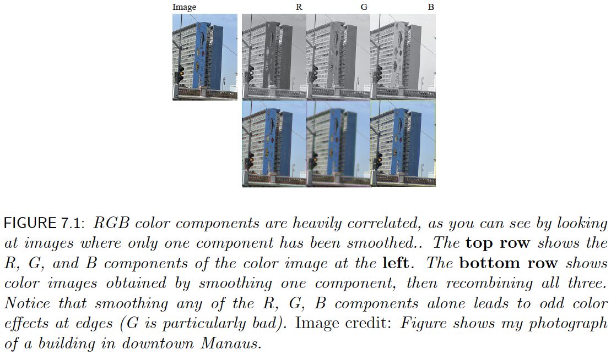
Color images – R, G, and B are strongly correlated

Slide 5
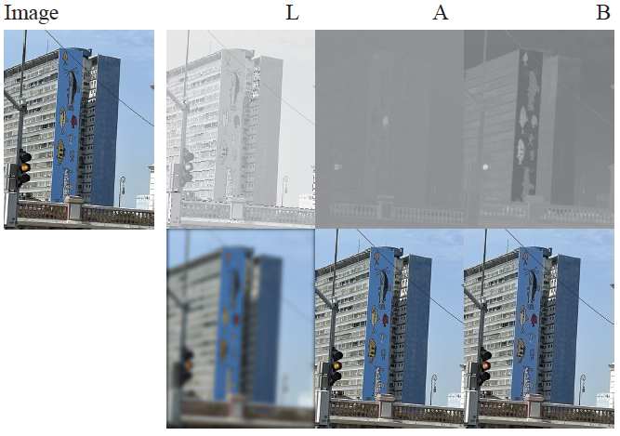
LAB and smoothing

Slide 6
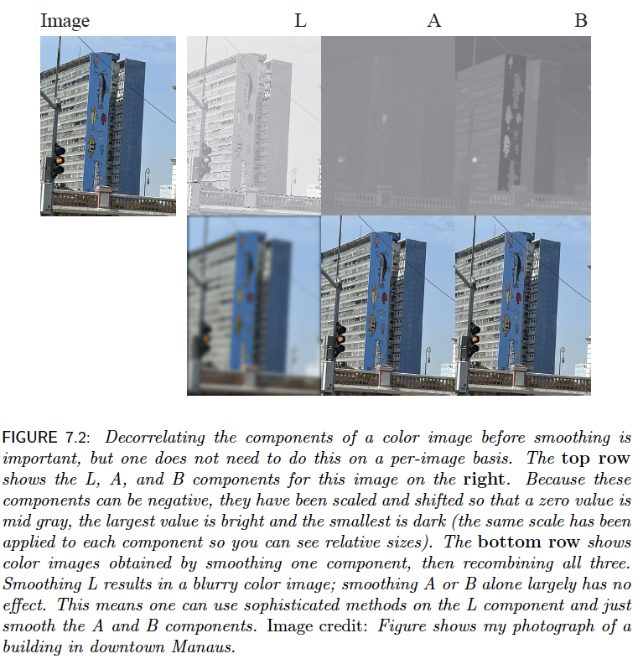

Slide 7
This means you can
Convert to LAB
Apply sophisticated denoising to L
Smooth A, B
Convert back

Slide 8
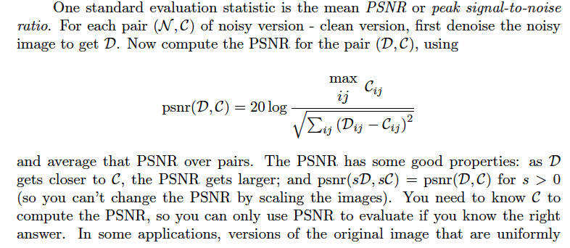
Evaluation: PSNR

Slide 9
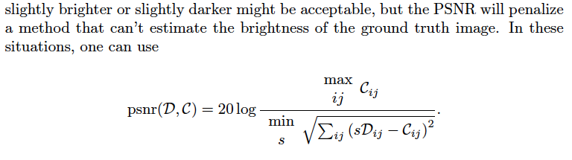
Scaled PSNR

Slide 10
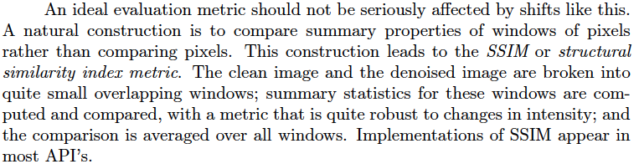
SSIM
PSNR doesn’t account for small shifts, etc

Slide 11
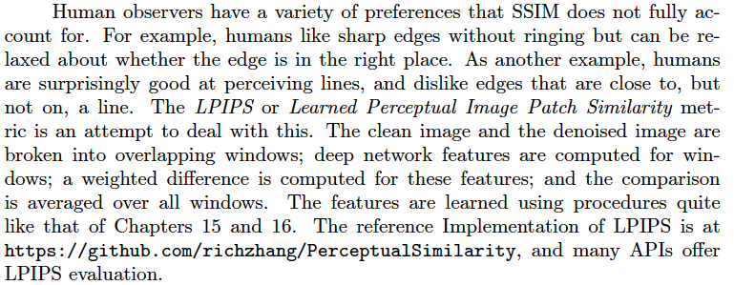
LPIPS

Slide 12
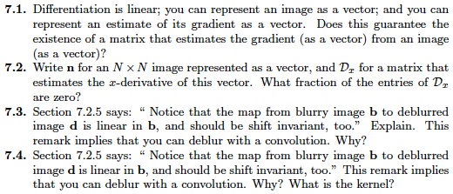
Think about this...

